Slide 1



Project Monitoring
Lecture 6
PMG 333
Scheduling Resources
And Costs
Prepared by
Dr. Mohammed Mustafa

Slide 2


Learning objectives
Constrained and resource-constrained schedules.
Identify different types of resource constraints.
Describe how the smoothing approach is used on time-constrained projects.
Describe how leveling approach is used for resource-constrained projects.
Understand how project management soft ware creates resource-constrained schedules.
Understand when and why splitting tasks should be avoided.
Identify general guidelines for assigning people to specific tasks.
Identify common problems with multi-project resource scheduling.

Slide 3
Lecture
Outlines
06
Overview of the Resource Scheduling Problem
Types of Resource Constraints
Classification of a Scheduling Problem
Resource Allocation Methods
Computer Demonstration of Resource-Constrained Scheduling
Splitting Activities
Benefits of Scheduling Resources
Assigning Project Work
Multi-project Resource Schedules
Using the Resource Schedule to Develop a Project Cost Baseline
www.midocean.ae

Slide 4

1. Overview of the Resource Scheduling Problem
Any project scheduling system should facilitate finding quick, easy answers to these questions.
The planned network and activity project duration times found in previous chapters fail to deal with resource usage and availability.
The time estimates for the work packages and network times were made independently with the implicit assumption that resources would be available.
www.midocean.ae

Slide 5
Overview of the Resource Scheduling Problem – Cont.
This may or may not be the case. If resources are adequate but the demand varies widely over the life of the project, it may be desirable to even out resource demand by delaying noncritical activities (using slack) to lower peak demand and, thus, increase resource utilization.
This process is called resource smoothing.
On the other hand, if resources are not adequate to meet peak demands, the late start of some activities must be delayed, and the duration of the project may be increased.
www.midocean.ae

Slide 6
Overview of the Resource Scheduling Problem – Cont.
This process is called resource-constrained scheduling.
One research study of more than 50 projects by Woodworth and Willie (1975) found that planned project network durations were increased 38 percent when resources were scheduled.
The consequences of failing to schedule limited resources are costly and project delays usually manifest themselves midway in the project when quick corrective action is difficult.
www.midocean.ae

Slide 7

Overview of the Resource Scheduling Problem – Cont.
An additional consequence of failing to schedule resources is ignoring the peaks and valleys of resource usage over the duration of the project.
Because project resources are usually overcommitted and because resources seldom line up by avail ability and need, procedures are needed to deal with these problems.
www.midocean.ae

Slide 8
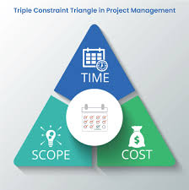
2. Types of Resource Constraints
Resources are people, equipment, and material that can be drawn on to accomplish something.
In projects the availability or unavailability of resources will often influence the way projects are managed.
1. People: This is the most obvious and important project resource. Human resources are usually classified by the skills they bring to the project—
for example, programmer, mechanical engineer, welder, inspector, marketing director, supervisor. In rare cases some skills are interchangeable,
but usually with a loss of productivity. The many differing skills of human resources add to the complexity of scheduling projects.
www.midocean.ae

Slide 9
Types of Resource Constraints – Cont.
2. Materials: Project materials cover a large spectrum:
For example, chemicals for a scientific project, concrete for a road project, survey data for a marketing project.
Material availability and shortages have been blamed for the delay of many projects. When it is known that a lack of availability of materials is important and probable, materials should be included in the project network plan and schedule.
For example, delivery and placement of an oil rig tower in a Siberian oil field has a very small time window during one summer month. Any delivery delay means a one-year, costly delay.
www.midocean.ae

Slide 10
Types of Resource Constraints – Cont.
3. Equipment: Equipment is usually presented by type, size, and quantity.
In some cases equipment can be interchanged to improve schedules, but this is not typical.
Equipment is often overlooked as a constraint. The most common oversight is to assume the resource pool is more than adequate for the project.
For example, if a project needs one earthmoving tractor six months from now and the organization owns four, it is common to assume the resource will not delay the pending project.
www.midocean.ae

Slide 11
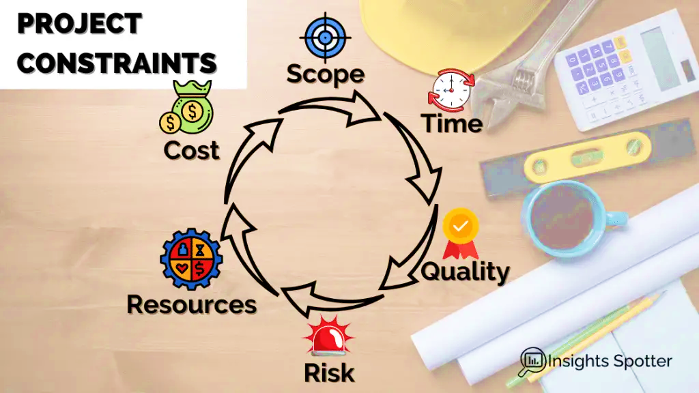
Types of Resource Constraints – Cont.
However, when the earthmoving tractor is due on-site in six months, all four machines in the pool might be occupied on other projects.
In multi-project environments it is prudent to use a common resource pool for all projects.
This approach forces a check of resource availability across all projects and reserves the equipment for specific project needs in the future.
Recognition of equipment constraints before the project begins can avoid high crashing or delay costs.
www.midocean.ae

Slide 12
3. Classification of a Scheduling Problem
Most of the scheduling methods available today require the project manager to classify the project as either time constrained or resource constrained.
Project managers need to consult their priority matrix to determine which case fits their project.
One simple test to determine if the project is time or resource constrained is to ask, “If the critical path is delayed, will resources be added to get back on schedule?” If the answer is yes, assume the project is time constrained; if no, assume the project is resource constrained.
www.midocean.ae

Slide 13
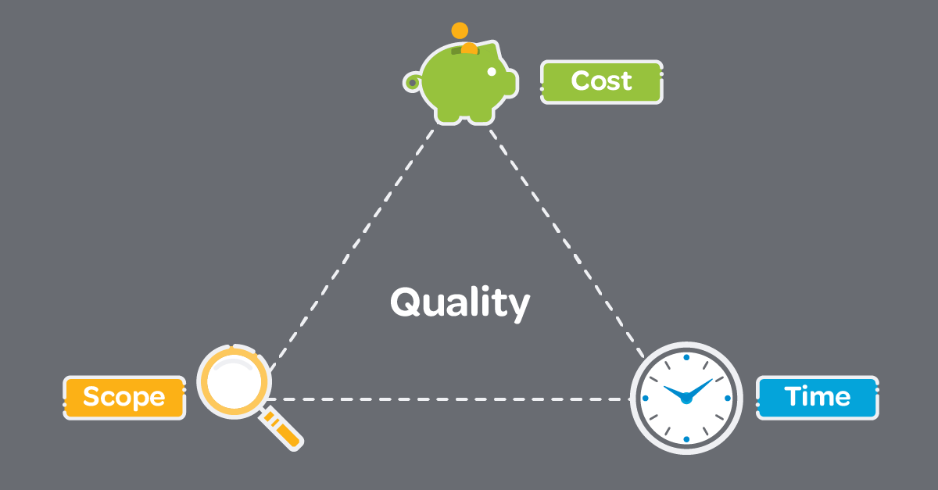
Classification of a Scheduling Problem – Cont.
A time-constrained project is one that must be completed by an imposed date.
If required, resources can be added to ensure the project is completed by a specific date.
Although time is the critical factor, resource usage should be no more than is necessary and sufficient.

Slide 14
Classification of a Scheduling Problem – Cont.
A resource-constrained project is one that assumes the level of resources avail able cannot be exceeded.
If the resources are inadequate, it will be acceptable to delay the project, but as little as possible.
In scheduling terms, time constrained means time (project duration) is fixed and resources are flexible, while resource constrained means resources are fixed and time is flexible.
Methods for scheduling these projects are presented in the next section.
www.midocean.ae

Slide 15

4. Resource Allocation Methods
Assumptions: Ease of demonstrating the allocation methods available requires some limiting assumptions to keep attention on the heart of the problem.
First, splitting activities will not be allowed.
This means once an activity is placed in the schedule, assume it will be worked on continuously until it is finished; hence, an activity cannot be started, stopped for a period of time, and then finished.
www.midocean.ae

Slide 16

4. Resource Allocation Methods – Cont.
Second, the level of resources used for an activity cannot be changed.
These limiting assumptions do not exist in practice, but simplify learning.
It is easy for new project managers to deal with the reality of splitting activities and changing the level of resources when they meet them on the job.

Slide 17
4. Resource Allocation Methods – Cont.
Time-Constrained Projects: Smoothing Resource Demand Scheduling time-constrained projects focuses on resource utilization.
When demand for a specific resource type is erratic, it is difficult to manage, and utilization may be very poor.
Practitioners have attacked the utilization problem using resource leveling techniques that balance demand for a resource.
Basically, all leveling techniques delay noncritical activities by using positive slack to reduce peak demand and fill in the valleys for the resources. An example will demonstrate the basic procedure for a time constrained project.

Slide 18
4. Resource Allocation Methods – Cont.
See Figure below. For the purpose of demonstration, the Botanical Garden project uses only one resource (backhoes); all backhoes are interchangeable.
The top bar chart shows the activities on a time scale. The dependencies are shown with the vertical connecting arrows.
The horizontal arrows following activities represent activity slack (for example, irrigation requires six days to complete and has six days slack).

Slide 19
4. Resource Allocation Methods – Cont.
The number of backhoes needed for each task is shown in the shaded activity duration block (rectangle).
After the land has been scarified and the plan laid out, work can begin on the walkways, irrigation, and fencing and retaining walls simultaneously.
The middle chart shows the resource profile for the backhoes. For periods 4 through 10, four backhoes are needed

Slide 20
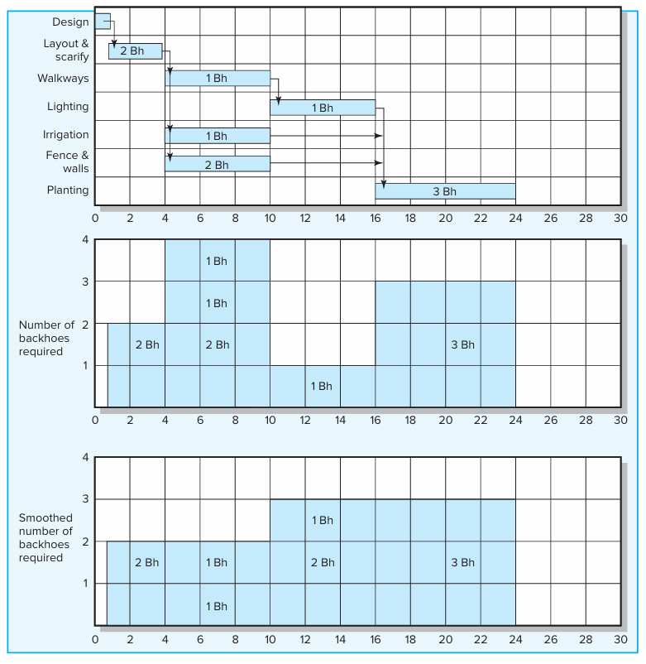
Botanical Garden

Slide 21
4. Resource Allocation Methods – Cont.
Resource-Constrained: Projects When the number of people and/or equipment is not adequate to meet peak demand requirements and it is impossible to obtain more, the project manager faces a resource constrained problem.
Something has to give. The trick is to prioritize and allocate resources to minimize project delay without exceeding the resource limit or altering the technical network relationships.

Slide 22
4. Resource Allocation Methods – Cont.
The resource scheduling problem is a large combinatorial one.
This means even a modest-size project network with only a few resource types might have several thou sand feasible solutions.
A few researchers have demonstrated optimum mathematical solutions to the resource allocation problem but only for small networks and very few resource types (Arrow and Hurowicz, 1977; Talbot and Patterson, 1979; Woodworth and Shanahan, 1988).

Slide 23
4. Resource Allocation Methods – Cont.
The massive data requirements for larger problems make pure mathematical solutions (e.g., linear programming) impractical.
An alternative approach to the problem has been the use of heuristics (rules of thumb) to solve large combinatorial problems.
These practical decision or priority rules have been in place for many years.

Slide 24
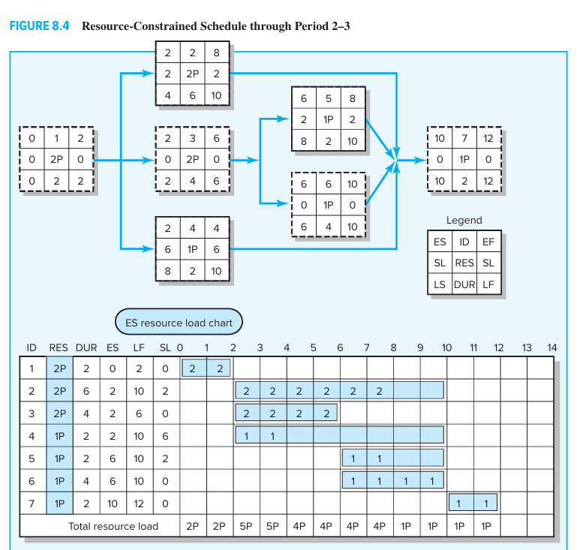
Figure: Resources – Constrained Schedule through Period 2 - 3

Slide 25
5. Computer Demonstration of Resource-Constrained Scheduling
Fortunately, project management software is capable of assessing and resolving complicated resource-constrained schedules using heuristics similar to what was described above.
We will use the EMR project to demonstrate how this is done using MS Project.
It is important to note that the software is not “managing” the project. The software is simply a tool the project manager uses to view the project from different perspectives and conditions

Slide 26
6. Splitting Activities
Splitting tasks is a scheduling technique used to get a better project schedule and/or to increase resource utilization.
A planner splits the continuous work included in an activity by interrupting the work and sending the resource to another activity for a period of time and then having the resource resume work on the original activity.
Splitting can be a useful tool if the work involved does not include large start-up or shutdown costs—for example, moving equipment from one activity location to another.

Slide 27
6. Splitting Activities – Cont.
The most common error is to interrupt “people work,” where there are high conceptual start-up and shutdown costs.
For example, having a bridge designer take time off to work on the design problem of another project may cause this individual to lose four days shifting conceptual gears in and out of two activities. The cost may be hidden, but it is real.

Slide 28
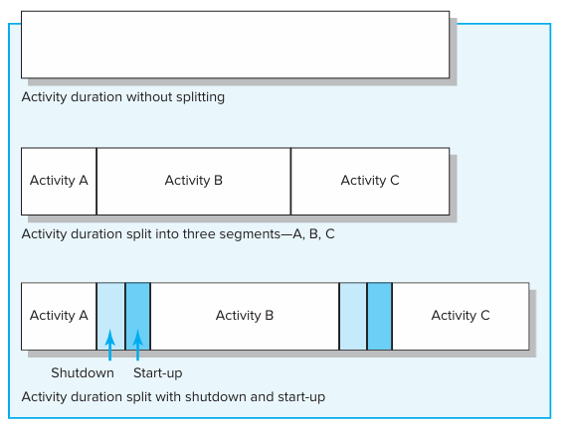
**Splitting Activities – Cont.

Slide 29
7. Benefits of Scheduling Resources
It is important to remember that, if resources are truly limited and activity time estimates are accurate, the resource-constrained schedule will materialize as the project is implemented—not the time-constrained schedule!
Therefore, failure to schedule limited resources can lead to serious problems for a project manager.
The benefit of creating this schedule before the project begins leaves time for considering reasonable alternatives.

Slide 30
Benefits of Scheduling Resources – Cont.
If the scheduled delay is unacceptable or the risk of being delayed too high, the assumption of being resource constrained can be reassessed.
Cost-time trade offs can be considered. In some cases priorities may be changed
Resource schedules provide the information needed to prepare time-phased work package budgets with dates.

Slide 31
Benefits of Scheduling Resources – Cont.
Once established, they provide a quick means for a project manager to gauge the impact of unforeseen events such as turnover, equipment breakdowns, or transfer of project personnel.
Resource schedules also allow project managers to assess how much flexibility they have over certain resources.
This is useful when they receive requests from other managers to borrow or share resources.
Honoring such requests creates goodwill and an “IOU” that can be cashed in during a time of need.

Slide 32
8. Assigning Project Work
When making individual assignments, project managers should match, as best they can, the demands and requirements of specific work with the qualifications and experience of available participants.
In doing so, there is a natural tendency to assign the best people the most difficult tasks.
Project managers need to be careful not to overdo this. Over time these people may grow to resent the fact that they are always given the toughest assignments.

Slide 33
Assigning Project Work – Cont.
At the same time, less experienced participants may resent the fact that they are never given the opportunity to expand their skill/knowledge base.
Project managers need to balance task performance with the need to develop the talents of people assigned to the project.
Project managers not only need to decide who does what but who works with whom.
A number of factors need to be considered in deciding who should work together.

Slide 34
Assigning Project Work – Cont.
First, to minimize unnecessary tension, managers should pick people with compatible work habits and personalities but who complement each other (i.e., one person’s weakness is the other person’s strength).
For example, one person may be brilliant at solving complex problems but sloppy at documenting his or her progress.
It would be wise to pair this person with an individual who is good at paying attention to details.

Slide 35
9. Multi-project Resource Schedules
For clarity we have discussed key resource allocation issues within the context of a single project.
In reality resource allocation generally occurs in a multi-project environment where the demands of one project have to be reconciled with the needs of other projects.
Organizations must develop and manage systems for efficiently allocating and scheduling resources across several projects with different priorities, resource requirements, sets of activities, and risks.

Slide 36
Multi-project Resource Schedules – Cont.
The system must be dynamic and capable of accommodating new projects as well as reallocating resources once project work is completed.
While the same resource issues and principles that apply to a single project also apply to this multi-project environment, application and solutions are more com plex, given the interdependency among projects.

Slide 37
Multi-project Resource Schedules – Cont.
The following lists three of the more common problems encountered in managing multi-project resource schedules.
Note that these are macro manifestations of single project problems that are now magnified in a multi-project environment:

Slide 38
Multi-project Resource Schedules – Cont.
1. Overall schedule slippage. Because projects often share resources, delays in one project can have a ripple effect and delay other projects.
For example, work on one software development project can grind to a halt because the coders scheduled for the next critical task are late in completing their work on another development project.
2. Inefficient resource utilization. Because projects have different schedules and requirements, there are peaks and valleys in overall resource demands.
For example, a firm may have a staff of 10 electricians to meet peak demands when, under normal conditions, only 5 electricians are required.

Slide 39
Multi-project Resource Schedules – Cont.
3. Resource bottlenecks. Delays and schedules are extended as a result of shortages of critical resources that are required by multiple projects.
For example, at one Lattice Semiconductor facility, project schedules were delayed because of competition over access to test equipment necessary to debug programs.
Likewise, several projects at a U.S. forest area were extended because there was only one silviculturist on the staff

Slide 40

10. Using the Resource Schedule to Develop a Project Cost Baseline
Once resource assignments have been finalized we are able to develop a baseline bud get schedule for the project.
Using your project schedule, you can time-phase work packages and assign them to their respective scheduled activities to develop a budget schedule over the life of your project.
Understanding the reason for time-phasing your budget is very important.
Without a time-phased budget good project schedule and cost control are impossible.

Slide 41



Thank You

