Slide 1

Risk Management
Prepared by Dr. Nael Zabel
Lecture 9
MGM 510
Risk Management

Slide 2

Lecture 9
Topics to Cover in Week 9
Application of a risk matrix
Inherent and current level of risk
as low as reasonably practicable (ALARP)
Risk Significance
Opportunity Assessment
Riskiness index
Upside in strategy
Upside in projects
Upside in operations

Slide 3
Lecture 9
Application of a risk matrix
The use of a risk matrix is a very simple way of demonstrating the level of risk that a particular event represents to an organization.
A risk matrix is normally used to represent the residual or current level of risk.
This can also be referred to as the net risk.

Slide 4
Lecture 9
Application of a risk matrix
When the risk matrix is used to illustrate the current level of risk, the vertical axis will normally be labelled as impact.
However, the risk matrix can also be used to represent gross or inherent level of risk, which is the level of risk before controls are applied.
When the risk matrix is used to illustrate the inherent level of risk, the vertical axis may sometimes be labelled magnitude.

Slide 5
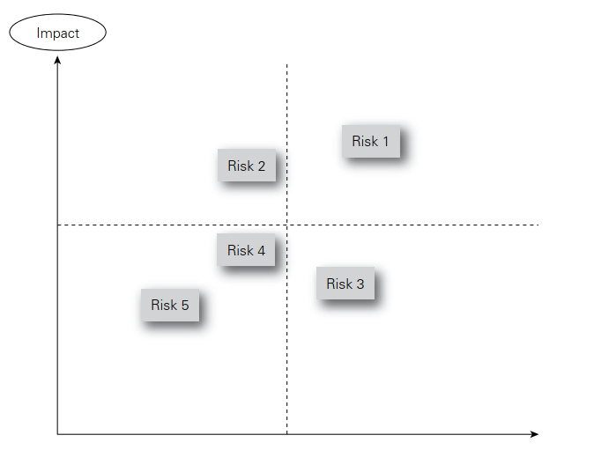
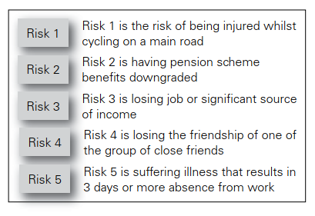

Lecture 9
Application of a risk matrix

Slide 6
Lecture 9
Inherent and current level of risk
Many risk management practitioners assess risk at its current (also referred to as residual) level.
However, internal auditors prefer to undertake an assessment of the risk at its inherent level.
There are advantages in considering the inherent level of a risk when undertaking a risk assessment.
Considering the inherent level will enable the effect of individual control measures to be identified.

Slide 7
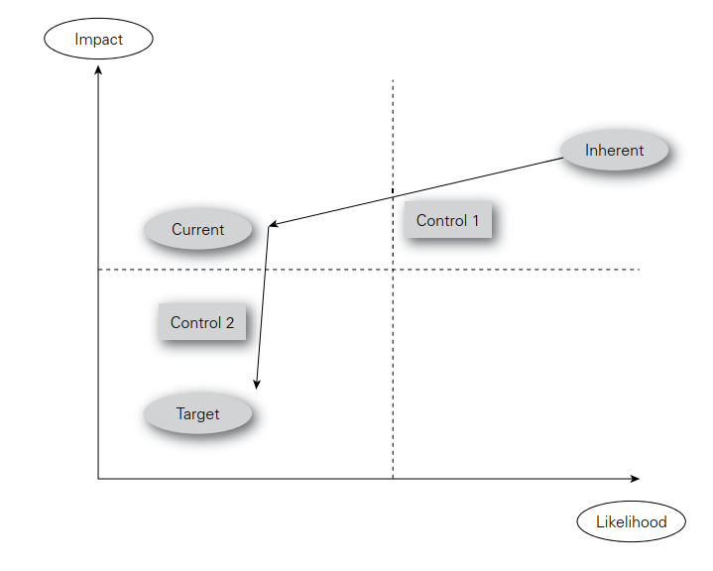
Lecture 9
Inherent and current level of risk

Slide 8
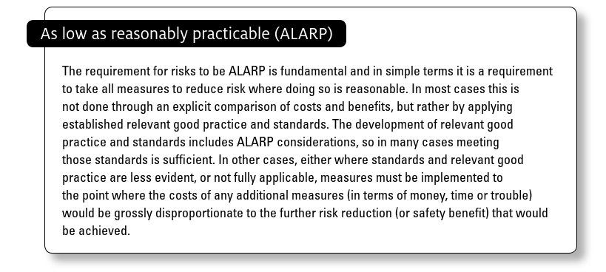
Lecture 9
as low as reasonably practicable (ALARP)

Slide 9
Lecture 9
Risk Significance
When undertaking a risk assessment, it is quite common to identify a hundred or more risks that could impact the objective, core process or key dependency that is being considered.

Slide 10
Lecture 9
Risk Significance
This is an unmanageable number of risks and so a method is required to reduce the number that will be considered to be priority issues for management.
In order for an organization to concentrate on significant risks, a test for risk significance is required.

Slide 11
Lecture 9
Risk Significance
For risks that will have a financial or commercial impact, the benchmark test is likely to be based on monetary value.
For risks that could disrupt the infrastructure or routine operations of the organization, a benchmark test based on the impact, cost and duration of disruption is appropriate.

Slide 12
Lecture 9
Risk Significance
For reputational risks, the most likely benchmark will be based on the adverse publicity that would result if the risk materializes.
This may vary according to the nature of the risk and whether it is a financial or non-financial one.

Slide 13
Lecture 9
Opportunity Assessment
Successfully embracing business opportunities is more likely to be achieved if the organization undertakes opportunity assessments.
Many consultancy firms undertake a detailed evaluation of each new business prospect.

Slide 14
Lecture 9
Opportunity Assessment
The organization will look at the new prospect and evaluate the scope for a profitable partnership, opportunities to earn extra income and the reputational benefits that might arise from having that potential client as a customer.

Slide 15
Lecture 9
Opportunity Assessment
Opportunity assessment can be undertaken in relation to new business ventures, as well as new clients.
This opportunity evaluation is designed to identify the additional business opportunities that could arise from winning that client business.

Slide 16
Lecture 9
Opportunity Assessment
The evaluation will also look at the potential disadvantages of successfully acquiring the client prospect.
When undertaking such an opportunity assessment, there has to be the possibility that the organization will advise the client prospect that they do not wish to tender for the business.

Slide 17
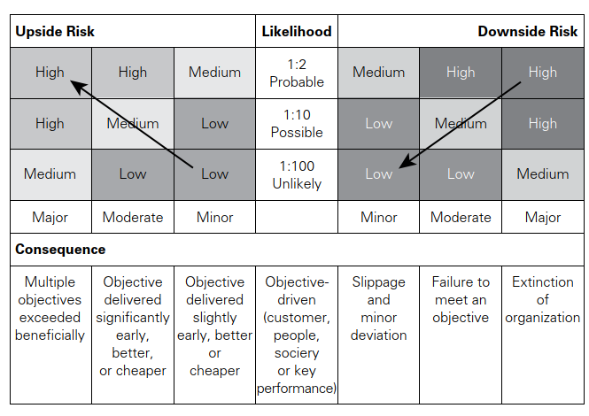
Lecture 9
Opportunity Assessment

Slide 18
Lecture 9
Riskiness index
The risk profile of an organization can be represented in many ways.
The most common method used is to prepare a risk register that contains details of the significant risks that it faces.

Slide 19
Lecture 9
Riskiness index
However, a disadvantage of the risk register is that it is usually a qualitative evaluation of individual risks.
Organizations need to develop a means of measuring, evaluating and quantifying the total risk exposure of the
organization.

Slide 20
Lecture 9
Riskiness index
One of the features of the enterprise risk management approach is to develop a consolidated view of the risk exposure of the organization.
The approach based on calculating the total risk exposure of an organization is similar to the approach taken to the measurement and quantification of risk in operational risk management.

Slide 21
Lecture 9
Riskiness index
This section introduces the idea of a ‘riskiness index’. The idea is to present a semi-quantitative approach that takes a snapshot of the overall level of risk embedded in the organization.
The overall level of risk will take account of the strategy currently being followed by the organization, the projects that are in progress, and the nature of the routine operations being undertaken.

Slide 22
Lecture 9
Riskiness index
This approach can offer an opportunity to benchmark risk management performance and track changes over time.
Table 14.2 presents a set of questions that can be used to develop a riskiness index for an organization.
The table uses the structure of the FIRM risk scorecard as a means of categorizing risks.

Slide 23
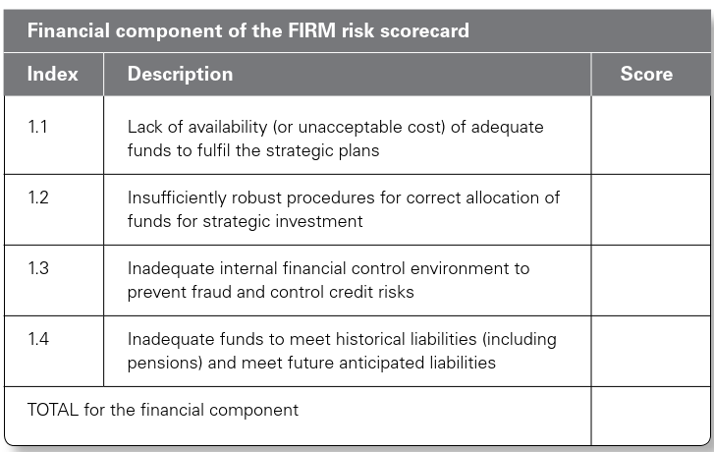
Lecture 9
Table 14.2 Riskiness index

Slide 24
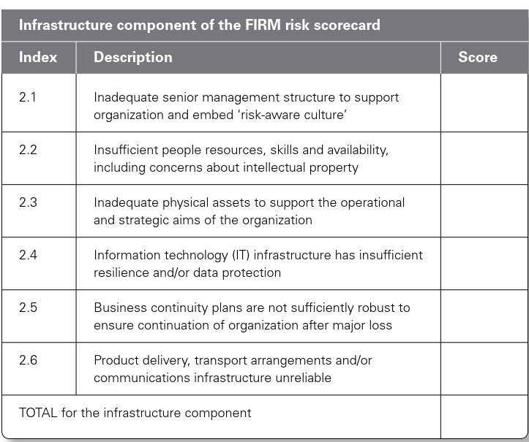
Lecture 9
Table 14.2 Riskiness index

Slide 25
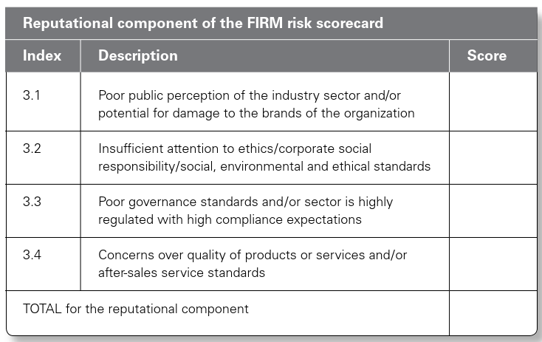
Lecture 9
Table 14.2 Riskiness index

Slide 26
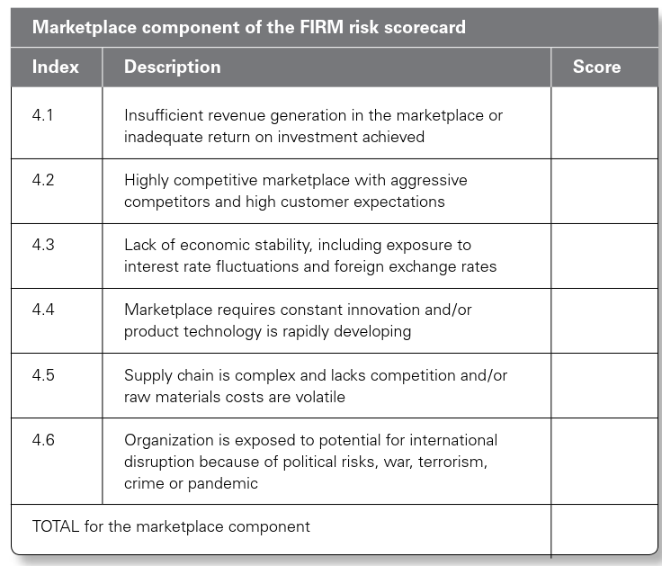
Lecture 9
Table 14.2 Riskiness index

Slide 27
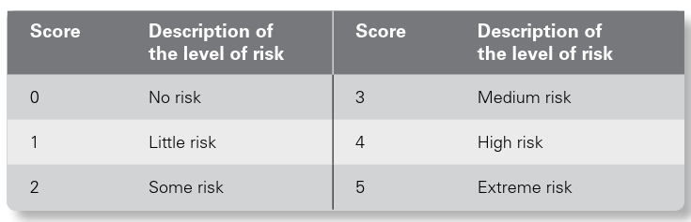
Lecture 9
Table 14.2 Riskiness index

Slide 28
Lecture 9
Upside in strategy
Organizations will have a mission statement, together with a set of corporate objectives and an understanding of the expectations of the different stakeholders in the organization.
The board of the organization then needs to develop an effective and efficient strategy that will deliver exactly what is expected in terms of the mission, objectives and expectations.

Slide 29
Lecture 9
Upside in strategy
In order to make correct strategic decisions, the board of the organization will need access to risk information.
A risk assessment of the proposed strategy, together with a risk assessment of any viable alternative strategies, should be undertaken.
The availability of this risk assessment information will ensure that the strategic decisions are more likely to be correct.

Slide 30
Lecture 9
Upside in projects
It is essential that every organization adopts the correct core processes.
A core process may be considered as the collection of activities that deliver a specific stakeholder expectation.
This is the meaning of core process that is allocated by business process re-engineering (BPR) practitioners.
There is a difference between a process being efficient and effective.

Slide 31
Lecture 9
Upside in projects
An efficient process means that there is no disruption and no excess cost.
However, the process may be the incorrect one for cost-effectively delivering the requirements.

Slide 32
Lecture 9
Upside in projects
Where processes need to be improved, a project will normally be undertaken and change achieved.
In circumstances where a series of projects are required, this is often referred to as a programme of work.
When a project, or programme of work, is implemented by an organization, the desire will normally be to improve the effectiveness and/or efficiency of core processes.

Slide 33
Lecture 9
Upside in operations
It is a fundamental requirement for organizations that they have effective and efficient operations.
Efficient operations should make best use of the resources of the organization and should operate without unplanned disruption.
Undertaking efficient operations that use minimum resources and produce maximum output will deliver the greatest benefit to the organization.

Slide 34
Lecture 9
Upside in operations
Operations also need to be effective in that they represent the best way of conducting the operations.
For example, it is possible to have an efficient journey by car or bus across a busy city.
However, the effective way to travel in many large cities is by means of the metro or underground system.

Slide 35
Lecture 9
Thank You

