Slide 1



Computer Organization and Architecture
Prepared by Dr. Eng. Gamal Selim
Lecture - Intro

Slide 2
Chapter
Course Overview
Intro
In this course, we will introduce Machine Architecture with coverage of digital logic, machine level data and instruction representation, ALU design, and organization of the processor data path and control. Examines performance analysis, memory system hierarchy, pipelining, and communication.
www.midocean.ae

Slide 3
Chapter
Course content summary
Intro
  Introduction
    Organization and Architecture, Structure and Function.
  Computer Evolution and Performance
    A Brief History of Computers, Designing for Performance, The Evolution of the Intel x86 Architecture.
  A Top-level View of Computer Function and Interconnection
    Computer Function.
    Interconnection Structures, Bus Interconnection, PCI.
www.midocean.ae

Slide 4
Chapter
Course content summary Cont.
Intro
  Cache Memory
    Computer Memory System Overview, Cache Memory Principles, Elements of Cache Design.
  Internal Memory
    Semiconductor Main Memory.
    Error Correction, Advanced DRAM Organization.
  External Memory
    Magnetic Disk, RAID, Optical Memory, Magnetic Tape.
www.midocean.ae

Slide 5
Chapter
Course content summary Cont.
Intro
  Input/output
    External Devices, I/O Modules, Programmed I/O, Interrupt-Driven I/O, Direct Memory Access, I/O Channels and Processors, The External Interface.
  Operating System Support
    Operating System Overview, Scheduling.
    Memory Management.
  Instruction Sets: Characteristics and Functions
    Machine Instruction Characteristics, Types of Operands, Intel x86 and ARM Data Types, Types of Operations
www.midocean.ae

Slide 6
Chapter
Learning Outcomes
Intro
Upon completion of this course, students should be able to:
  Explain digital logic and its use in digital systems.
  Understand machine level representation of data.
  Understand assembly level machine organization.
  Describe the functional organization of a processor data path and performance enhancements.
  Describe memory system organization and architecture.
  Describe interfacing and communication.
  Understand technical literature on computer systems.
  Analyze a computer system's expected performance.
www.midocean.ae

Slide 7

Course Staff
Dr. Eng. Gamal Eldin Ibrahim Selim
Position:
Lecturer at CSE Department, Faculty of Electronic Engineering, Menoufia University – Egypt
Lecturer at Artificial Intelligence Department, MIDOCEAN University
Education:
PhD, Computer Science and Engineering Department, Faculty of Electronic Engineering, Menoufia University – Egypt
MSc, Computer Science and Engineering Department, Faculty of Electronic Engineering, Menoufia University – Egypt
Diploma of UNIX/Linux Administration at Information Technology Institute (ITI)
Bachelor's degree, Computer Science and Engineering Department, Faculty of Electronic Engineering, Menoufia University – Egypt
Contacts:
E-mail: gamal.selim@midocean.ae
www.midocean.ae

Slide 8
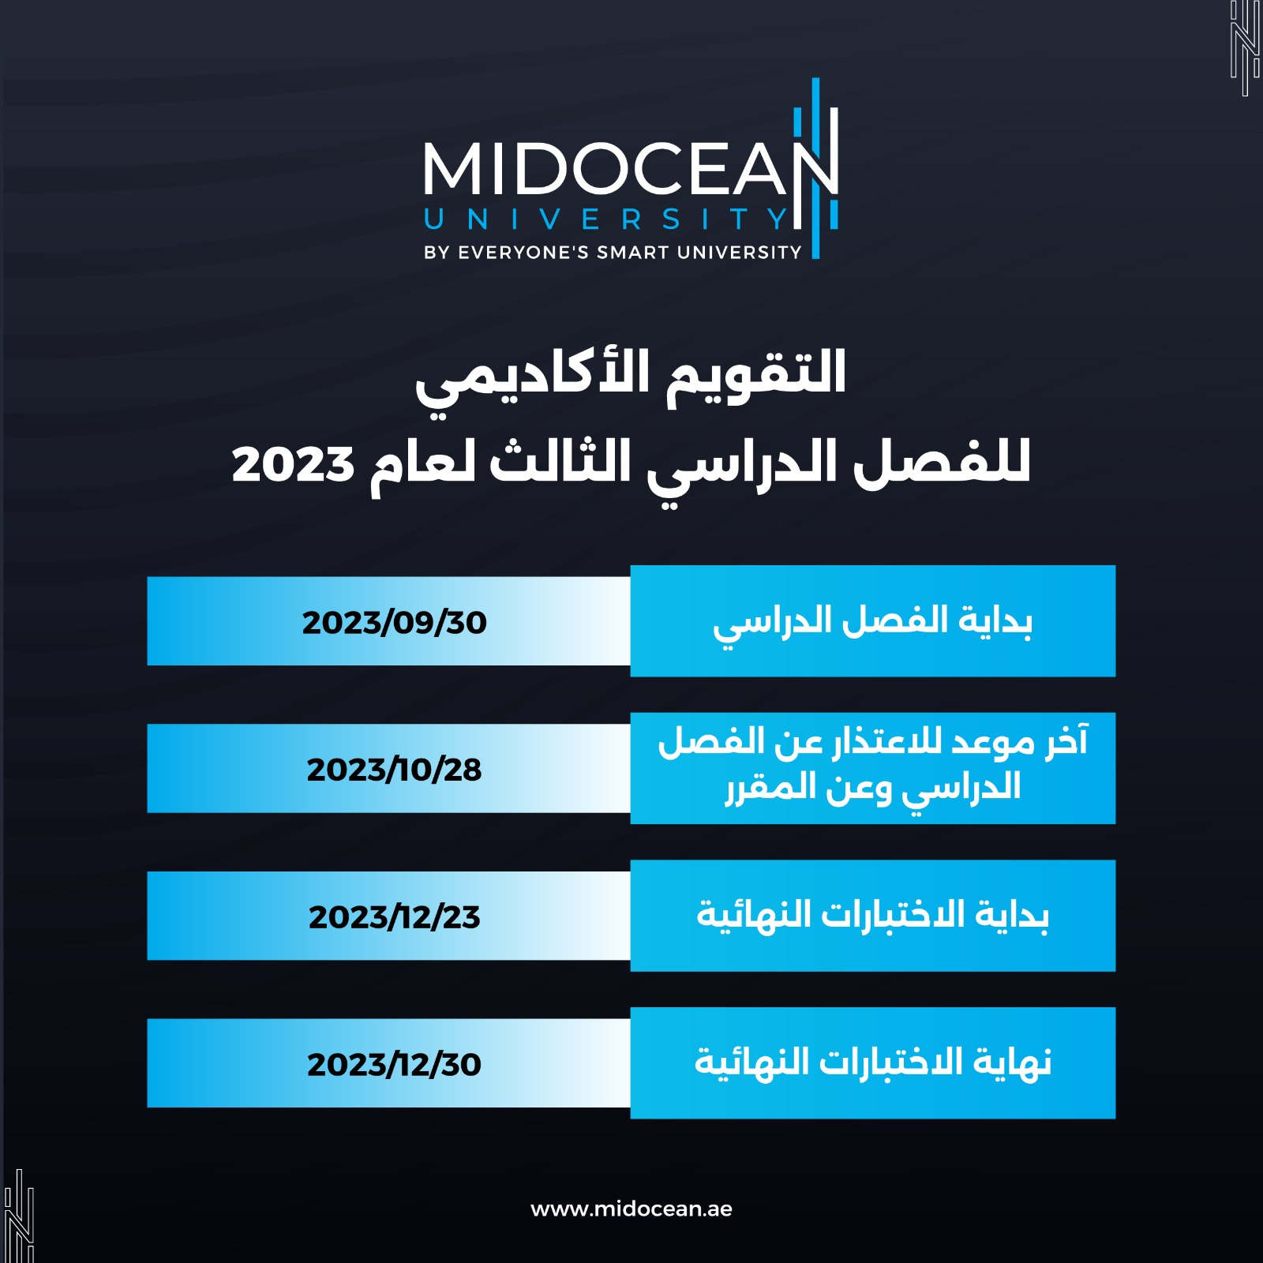

Slide 9
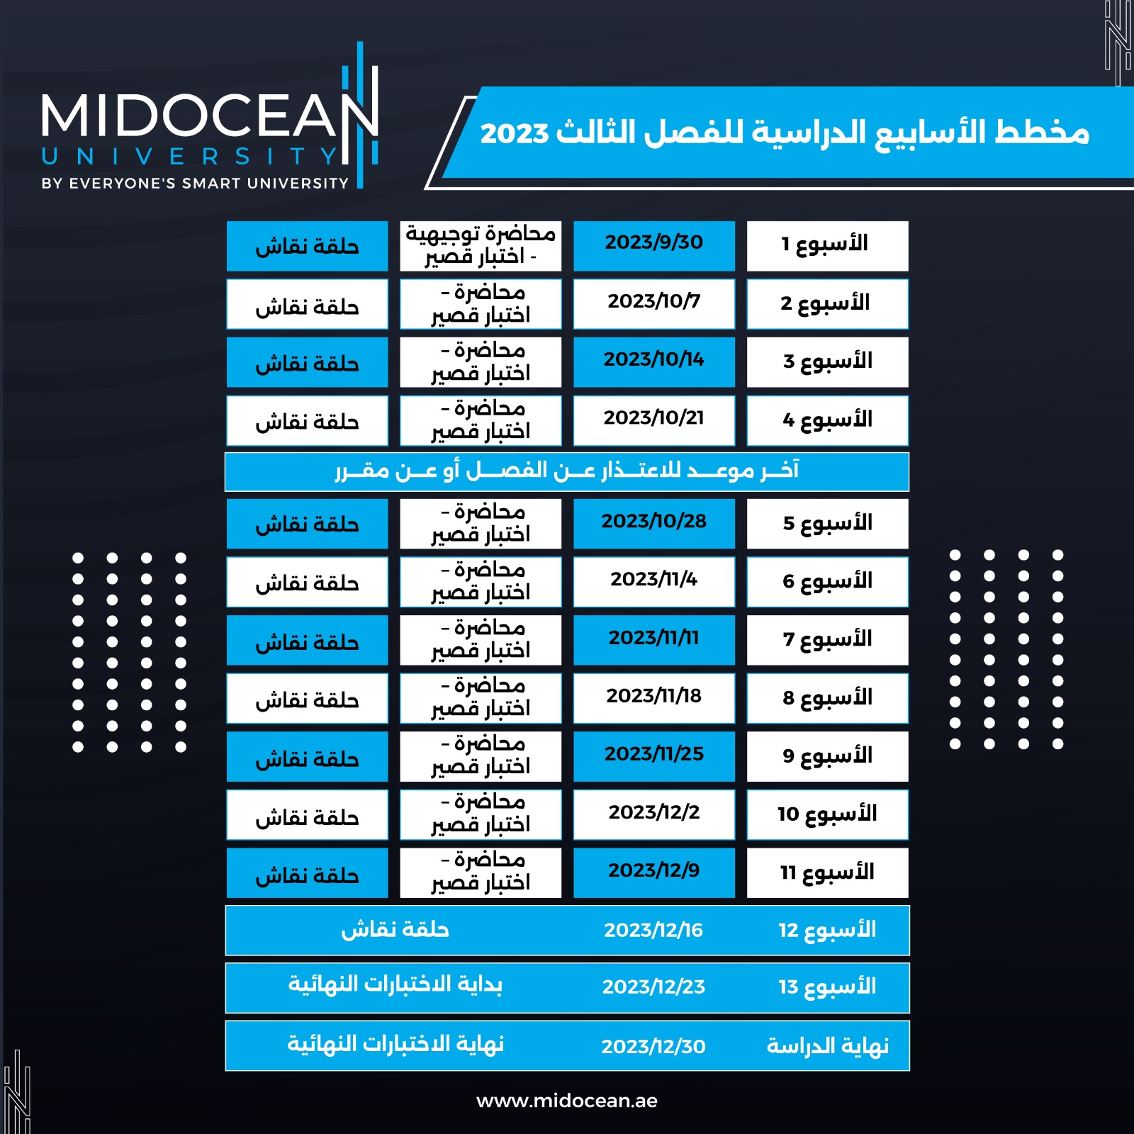

Slide 10
Chapter
References
Intro
Required Textbook:
Patterson, David A., Hennessy, John L., (2014), Computer Organization and Design: the Hardware /Software Interface, (5th Edition). Morgan Kaufmann Publishers, ISBN-13: 978-0124077263, ISBN-10: 0124077269.
www.midocean.ae

Slide 11



Thank You

