Slide 1
Optimized Hybrid Deep Learning and Machine Learning Approach for CKD Diagnosis Using Genetic Algorithms
Prepared By: Nasser Naim Qanabta
Supervised by: Dr. Wesam Ahmad

Slide 2
Agenda
1. Introduction
2. Objectives
3. Contributions
4. Edit Work
5. Proposed Framework
6. Dataset
7. Hardware & Software
8. Reference

Slide 3
Introduction
Chronic Kidney Disease (CKD) is a long-term condition in which the kidneys gradually lose their ability to perform essential functions, removing waste, balancing electrolytes, regulating fluids, and producing hormones that control blood pressure and red blood cell production.
CKD often advances silently, showing no symptoms until late stages, leading to delayed diagnosis and worse outcomes.
AI now enables earlier, more accurate CKD detection by analyzing complex patterns in patient data beyond traditional biomarkers In the case of Chronic Kidney Disease (CKD), AI can analyze structured clinical variables such as blood pressure, hemoglobin, serum creatinine, and comorbidities to identify patients at risk before symptoms appear

Slide 4
Objectives
We aim to develop a hybrid AI system that combines convolutional neural networks (CNNs) for automatic feature extraction with several optimized machine learning classifiers for early CKD detection. By leveraging genetic algorithms for hyperparameter tuning, our goal is to achieve higher prediction accuracy and practical clinical utility using real-world patient data.

Slide 5
Contributions
Hybrid CNN–ML Framework – Development of a hybrid approach that employs a Convolutional Neural Network (CNN) for automated feature extraction from structured clinical data, followed by multiple machine learning classifiers (e.g., SVM, Random Forest, XGBoost, LightGBM, k-NN, Artificial Neural Network) for classification.
Genetic Algorithm Optimization – Implementation of a Genetic Algorithm (GA) to optimize hyperparameters of the ML classifiers, ensuring maximum predictive accuracy, robustness, and generalization capability.
Comprehensive Performance Benchmarking – Comparative evaluation of the hybrid CNN–ML models against standalone ML classifiers using robust metrics such as Accuracy, Precision, Recall, F1-score, and AUC-ROC.
Explainable AI Integration – Incorporation of SHAP (SHapley Additive exPlanations) to identify the most influential clinical features (e.g., creatinine, hemoglobin, eGFR) and provide patient-specific explanations, enhancing trust and transparency in clinical decision-making.

Slide 6
Edit Work
Ref | Year | Dataset | Models | Results | Advantages | Limitations
Phuong et al. [32] | 2025 | UCI CKD dataset (400 samples, 24 features) | SVM, RF, KNN, LR, NB, DT | RF highest accuracy (~99%), SVM second (~98%), others 90–96% | - Comprehensive comparison of six popular ML algorithms on the same dataset. - Identified creatinine, hemoglobin, and specific gravity as top predictors. - Straightforward methodology for replication in similar datasets. | - Small dataset limits generalization. - No external validation performed. - Only binary classification; no CKD stage prediction
Metherall et al. [35] | 2025 | At-home monitoring dataset (short-term) | XGBoost, RF, SVM | XGBoost: ~96% accuracy; RF ~94%; SVM ~92% | - Incorporated at-home measurements (creatinine, BP) for early detection. - Compared multiple algorithms on identical features. - Useful in remote patient monitoring contexts. | - Short monitoring period limits ability to predict long-term progression. - Potential sensor inaccuracies in home data. - Limited demographic diversity in dataset.
Debal et al. [37] | 2022 | UCI CKD dataset | RF, SVM, LR | RF ~98%, SVM: 96%, LR: 92% | - Straightforward preprocessing steps for reproducibility. - RF performed consistently across folds. - Demonstrated stability with minimal parameter tuning. | - Limited dataset size and diversity. - Absence of advanced feature engineering. - No inclusion of temporal or longitudinal data.

Slide 7
Ref | Year | Dataset | Models | Results | Advantages | Limitations
Chowdhury et al. [41] | 2021 | Type 1 diabetes CKD dataset | RF, SVM, LR, KNN, NB | RF: ~95%, SVM: ~94%, LR: ~92%, KNN: ~91%, NB: ~90% | - Compared performance of multiple classic ML models. - Dataset focused on diabetic CKD detection. - Identified early markers in diabetic patients. | - Narrow patient population limits generalization. - No advanced ensemble or hybrid methods tested. - Limited to static data without time-series analysis.
Alsekait et al. [45] | 2023 | UCI CKD dataset (400 samples) | Stacked DNNs (CNN, RNN) + SVM meta-classifier | Accuracy: 99.69%, F1 = 0.997, AUC: 0.999 | - Leveraged multiple model strengths, - population based optimization, - improved learning via feature selection. | - Possible overfitting, - ensemble complexity hinders real-time use, - untested on real-world EHRs.
Tian et al. [46] | 2024 | Renal ultrasound (1,049 patients, 4,365 images) | ResNet-34 CNN + radiomic features + fusion ensemble | AUC: 0.918 overall, 0.867–0.931 (G4–G5 stages) | - Outperformed physicians in early detection, - Hybrid of CNN and expert texture features, - Highly relevant to clinical practice. | - Single-center training, - Low interpretability, - Lacked integration with clinical data.

Slide 8
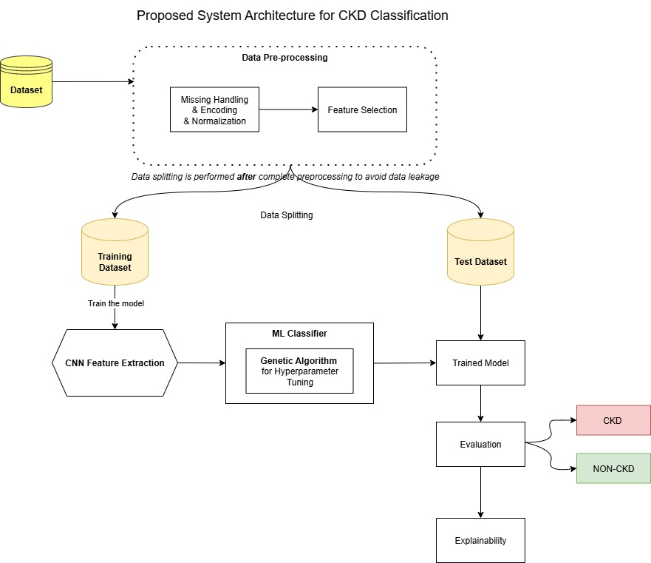
Proposed System Architecture for CKD Classification

Slide 9
Chronic kidney failure dataset reboot
Dataset contains clinical and laboratory data related to chronic kidney disease, a medical condition in which the kidneys progressively lose their ability to function properly. The goal of this dataset is to support analysis, early diagnosis, and prediction of this disease through data science and machine learning techniques.
This Dataset size: 15,051 rows
Number of features: 21 columns
Target label: Chronic Kidney Disease (yes or no)
Format: CSV
URL: https://www.kaggle.com/datasets/marcklugerhart/chronic-kidney-failure-dataset-reboot/data

Slide 10

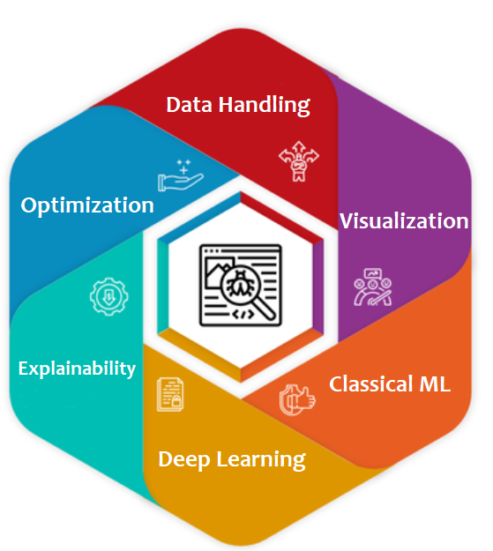
Hardware & Software
Hardware
CPU: Intel Core i7-6700HQ
RAM: 16GB DDR4 SDRAM
Storage: 1TB NVMe SSD
GPU: NVIDIA GeForce GTX 960M (4GB GDDR5)
Software
Data Handling : pandas, NumPy, OpenPyXL
Visualization: Matplotlib, Seaborn, Plotly
Classical ML: scikit-learn, XGBoost, LightGBM
Deep Learning: TensorFlow/Keras, PyTorch
Explainability: SHAP, LIME, Eli5
Optimization: Optuna, Hyperopt

Slide 11
Reference
Phuong, N. D., Tuyen, N. T., Linh, V. T. T., Nguyen, N. N., & Nguyen, T. Q. (2025). Machine learning techniques in chronic kidney diseases: A comparative study of classification model performance. Bioinformatics and Biology Insights, 19, 11779322251356563. https://doi.org/10.1177/11779322251356563
Metherall, B., Berryman, A. K., & Brennan, G. S. (2025). Machine learning for classifying chronic kidney disease and predicting creatinine levels using at-home measurements. Scientific Reports, 15, 4364. https://doi.org/10.1038/s41598-025-88631-y
Debal, D. A., & Sitote, T. M. (2022). Chronic kidney disease prediction using machine learning techniques. Journal of Big Data, 9, 1–19. https://doi.org/10.1186/s40537-022-00657-5
Chowdhury, N. H., Hossain, F., Rahman, K., et al. (2021). Performance analysis of conventional machine learning algorithms for identification of chronic kidney disease in type 1 diabetes mellitus patients. Diagnostics, 11(12), 2267. https://doi.org/10.3390/diagnostics11122267
Alsekait, D. M., Saleh, H., Gabralla, L. A., Alnowaiser, K., El-Sappagh, S., Sahal, R., & El-Rashidy, N. (2023). Toward Comprehensive Chronic Kidney Disease Prediction Based on Ensemble Deep Learning Models. Applied Sciences, 13(6), 3937. https://doi.org/10.3390/app13063937
Tian, S., Yu, Y., Shi, K., Jiang, Y., Song, H., Wang, Y., Yan, X., Zhong, Y., & Shao, G. (2024). Deep learning radiomics based on ultrasound images for the assisted diagnosis of chronic kidney disease. Nephrology (Carlton, Vic.), 29(11), 748–757. https://doi.org/10.1111/nep.14376

Slide 12
Thank you

