Slide 1


ICD-9-CM Coding
Prepared by Dr. Hayat Farag
MHA631
Health Insurance
Lecture 5

Slide 2

Objectives
Understand ICD-9-CM Coding and Mandatory Reporting.
Explore Medical Necessity.
Discuss Outpatient Coding Guidelines.
Examine ICD-9-CM Index to Procedures and Tabular List of Procedures.

Slide 3
Chapter
ICD-9-CM Coding
05
There are two related classifications of diseases with similar titles.
The International Classification of Diseases (ICD) is published by the World Health Organization (WHO) and is used to code and classify mortality (death) data from death certificates.
The International Classification of Diseases, Ninth Revision, Clinical Modification (ICD-9-CM) was developed in the United States and is used to code and classify morbidity (disease) data from inpatient and outpatient records, including physician office records.

Slide 4
Chapter
ICD-9-CM Coding
05
The health insurance specialist employed in a physician’s office assigns ICD-9-CM codes to diagnoses, signs, and symptoms documented by the healthcare provider.
Entering ICD-9-CM codes on insurance claims results in uniform reporting of medical reasons for healthcare services provided.

Slide 5
Chapter
Overview of ICD-9-CM
05
ICD-9-CM was sponsored in 1979 as the official system for assigning codes to diagnoses (inpatient and outpatient care, including physician offices) and procedures (inpatient care).
The ICD-9-CM is organized into three volumes:
● Volume 1 (Tabular List of Diseases).
● Volume 2 (Index to Diseases).
● Volume 3 (Index to Procedures and Tabular List of Procedures).

Slide 6
Chapter
Overview of ICD-9-CM
05
The National Center for Health Statistics (NCHS) and CMS are U.S. Department of Health and Human Services agencies responsible for overseeing all changes and modifications to the ICD-9-CM.
The NCHS works with the World Health Organization (WHO) to coordinate official disease classification activities for ICD-9-CM.

Slide 7
Chapter
Mandatory Reporting of ICD-9-CM Codes
05
Requiring diagnosis codes to be reported on submitted claims establishes the medical necessity of procedures and services rendered to patients (e.g., inpatient care, office visit, outpatient visit, or emergency department visit).
Medical necessity is defined by Medicare as “the determination that a service or procedure rendered is reasonable and necessary for the diagnosis or treatment of an illness or injury.”

Slide 8
Chapter
Mandatory Reporting of ICD-9-CM Codes
05
If it is possible that scheduled tests, services, or procedures may be found “medically unnecessary” by Medicare, the patient must sign an advance beneficiary notice (ABN), which acknowledges patient responsibility for payment if Medicare denies the claim.

Slide 9
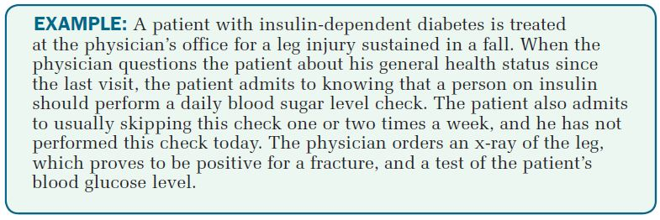
Chapter
Mandatory Reporting of ICD-9-CM Codes
05

Slide 10
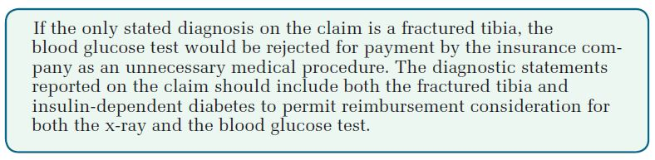
Chapter
Mandatory Reporting of ICD-9-CM Codes
05

Slide 11
Chapter
ICD-9-CM Annual Updates
05
CMS enforces regulations pursuant to the Medicare Prescription Drug, Improvement, and Modernization Act (MMA), which require that all code sets (e.g., ICD-9-CM) reported on claims be valid at the time services are provided.
To be compliant, this means that traditional mid-year (April 1) and end-of-year (October 1) coding updates must be immediately implemented so that accurate codes are reported on submitted claims.

Slide 12
Chapter
ICD-9-CM Annual Updates
05
It is crucial that updated coding manuals be purchased and/or billing systems be updated with coding changes so that billing delays (e.g., due to waiting for new coding manuals to arrive) and claims rejections are avoided.
If outdated codes are submitted on claims, providers and healthcare facilities will incur administrative costs associated with resubmitting corrected claims and delayed reimbursement for services provided.

Slide 13
Chapter
Medical Necessity
05
Medical necessity is the measure of whether a healthcare procedure or service is appropriate for the diagnosis and/or treatment of a condition. This decision-making process is based on the payer’s contractual language and the treating provider’s documentation.
Generally, the following criteria are used to determine medical necessity:
● Purpose: the procedure or service is performed to treat a medical condition.
● Scope: the most appropriate level of service is provided, taking into consideration potential benefit and harm to the patient.

Slide 14
Chapter
Medical Necessity
05
● Evidence: the treatment is known to be effective in improving health outcomes.
● Value: the treatment is cost-effective for this condition when compared to alternative treatments, including no treatment.
Note: Cost-effective does not necessarily mean least expensive.

Slide 15
Chapter
Overview of ICD-10-CM and ICD-10-PCS
05
The International Classification of Diseases, 10th Revision, Clinical Modification (ICD-10-CM) and the International Classification of Diseases, 10th Revision, Procedure Coding System (ICD-10-PCS), also abbreviated as ICD-10-CM/PCS, has replaced ICD-9-CM on October 1, 2015.
ICD-10-CM/PCS includes many more codes and applies to more users than ICD-9-CM because it is designed to collect data on every type of healthcare encounter (e.g., inpatient, outpatient, hospice, home health care, and long-term care). ICD-10-CM/PCS also enhances accurate payment for services rendered and facilitates evaluation of medical processes and outcomes.

Slide 16
Chapter
Overview of ICD-10-CM and ICD-10-PCS
05
ICD-10-CM is the United States’ clinical modification of the ICD-10, developed by the National Center for Health Statistics (NCHS).
ICD-10-PCS is an entirely new procedure classification system developed by the Centers for Medicare & Medicaid Services (CMS) for use in the United States for inpatient hospital settings only.
ICD-10-PCS uses a multiaxial 7-character alphanumeric code structure (e.g., 047K04Z) that provides a unique code for all substantially different procedures. It also allows new procedures to be easily incorporated as new codes. ICD-10-PCS contains more than 87,000 7-character alphanumeric procedure codes. (ICD-9-CM has about 4,000 3- to 4-digit numeric procedure codes.)

Slide 17
Chapter
Overview of ICD-10-CM and ICD-10-PCS
05
● Making clinical decisions.
● Tracking public health.
● Identifying fraud and abuse.
● Conducting research.
ICD-10-CM/PCS also includes updated medical terminology and classification of diseases, provides codes to allow comparison of mortality and morbidity data, and provides better data for:
● Measuring care furnished to patients.
● Designing payment systems.
● Processing claims.

Slide 18
Chapter
Outpatient Coding Guidelines
05
A. Selection of First-listed Condition
Because diagnoses are often not established at the time of the patient’s initial encounter or visit, two or more visits may be required before the diagnosis is confirmed. An outpatient is a person treated in one of four settings:
● Ambulatory surgery center (ASC) where the patient is released prior to a 24-hour stay (length of stay must be 23 hours, 59 minutes, and 59 seconds or less).
● Healthcare provider’s office (e.g., physician).

Slide 19
Chapter
Outpatient Coding Guidelines
05
● Hospital clinic, emergency department, outpatient department, same-day surgery unit (length of stay must be 23 hours, 59 minutes, and 59 seconds or less).
● Hospital observation where the patient’s length of stay is: ■ 23 hours, 59 minutes, and 59 seconds or less (commercial insurance) (unless documentation for additional observation is medically justified). ■ 24–48 hours (Medicare).

Slide 20
Chapter
Outpatient Coding Guidelines
05
An inpatient is a person admitted to a hospital or long-term care facility (LTCF) for treatment (or residential care, if LTCF) with the expectation that the patient will remain in the hospital for a period of 24 hours or more. The inpatient status is stipulated by the admitting physician.
You may see principal diagnosis referred to as first-listed diagnosis in medical literature. Remember! The outpatient setting’s first-listed diagnosis is not the principal diagnosis. (The outpatient first-listed diagnosis used to be called the primary diagnosis because it was the most significant condition for which services and/or procedures were provided.)

Slide 21
Chapter
Outpatient Coding Guidelines
05
The inpatient principal diagnosis is defined as “the condition determined after study which resulted in the patient’s admission to the hospital.”
Secondary diagnoses include comorbidities and complications.
A comorbidity is a concurrent condition that coexists with the first-listed diagnosis (outpatient care) or principal diagnosis (inpatient care), has the potential to affect treatment of the first-listed diagnosis (outpatient care) or principal diagnosis (inpatient care), and is an active condition for which the patient is treated and/or monitored. (Insulin dependent diabetes mellitus is an example of a comorbidity.)

Slide 22
Chapter
Outpatient Coding Guidelines
05
A complication is a condition that develops after outpatient care has been provided (e.g., ruptured sutures after office surgery) or during an inpatient admission (e.g., inpatient develops postoperative wound infection).

Slide 23
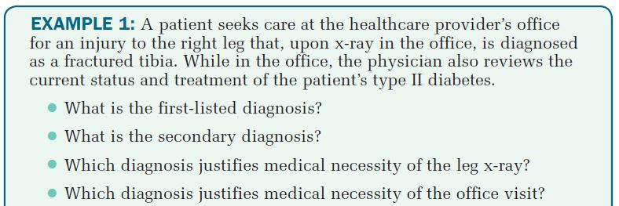
Chapter
Outpatient Coding Guidelines
05

Slide 24
Chapter
Outpatient Coding Guidelines
05

Slide 25
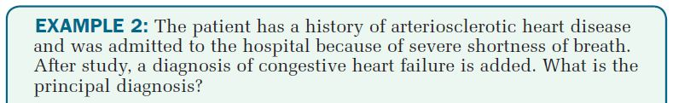
Chapter
Outpatient Coding Guidelines
05

Slide 26
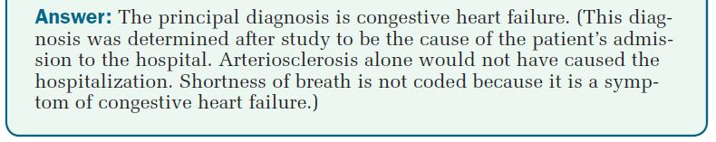
Chapter
Outpatient Coding Guidelines
05

Slide 27
Chapter
Outpatient Coding Guidelines
05
B. ICD-9-CM Tabular List of Diseases (Codes 001.0 through V89.09)
The appropriate code or codes from 001.0 through V89.09 must be used to identify diagnoses, symptoms, conditions, problems, complaints, or any other reason for the encounter/visit.
C. Accurate Reporting of ICD-9-CM Diagnosis Codes
For accurate reporting of ICD-9-CM diagnosis codes, the documentation should describe the patient’s condition using terminology that includes specific diagnoses as well as symptoms, problems, or reasons for the encounter. There are ICD-9-CM codes to describe all of these.

Slide 28
Chapter
Outpatient Coding Guidelines
05
D. ICD-9-CM Code for the Diagnosis, Condition, Problem, or Other Reason for Encounter/Visit
Report first the ICD-9-CM code for the diagnosis, condition, problem, or other reason for encounter/visit shown in the medical record to be chiefly responsible for the services provided. Then report additional codes that describe coexisting conditions that were treated or medically managed or that influenced the treatment of the patient during the encounter.
E. Uncertain Diagnoses
Do not code diagnoses documented as probable, suspected, questionable, rule out, or working diagnosis, because these are considered uncertain diagnoses. Instead, code condition(s) to the highest degree of certainty for that encounter/visit, such as symptoms, signs, abnormal test results, or other reasons for the visit.

Slide 29
Chapter
Outpatient Coding Guidelines
05
Another difference in coding inpatient hospitalizations versus outpatient and/or provider office encounters involves the assignment of codes for qualified diagnoses.
A qualified diagnosis is a working diagnosis that is not yet proven or established. Terms and phrases associated with qualified diagnoses include suspected, rule out, possible, probable, questionable, suspicious for, and ruled out. For office visits, do not assign an ICD-9-CM code to qualified diagnoses; instead, code the sign(s) and/or symptom(s) documented in the patient’s chart.

Slide 30
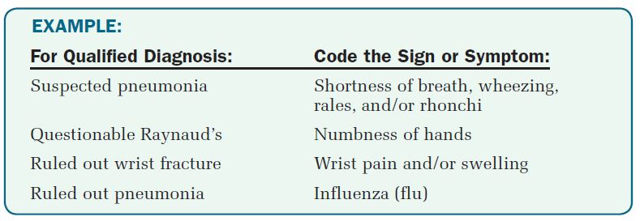
Chapter
Outpatient Coding Guidelines
05
Qualified diagnoses are a necessary part of the hospital and office chart until a specific diagnosis can be determined. CMS regulations permit the reporting of patients’ signs and/or symptoms instead of the qualified diagnoses.

Slide 31
Chapter
Outpatient Coding Guidelines
05
F. Chronic Diseases
Chronic diseases treated on an ongoing basis may be coded and reported as many times as the patient receives treatment and care for the condition(s).
G. Code All Documented Conditions That Coexist
Code all documented conditions that coexist at the time of the encounter/ visit and require or affect patient care treatment or management. Do not code conditions that were previously treated and no longer exist. However, history codes (V10–V19) may be reported as secondary codes if the historical condition or family history has an impact on current care or influences treatment.

Slide 32
ICD-9-CM Index to Procedures and Tabular List of Procedures
Chapter
05
Principal versus Secondary Procedures
Hospitals are required to rank all inpatient procedures according to specific criteria for selection of principal and secondary procedures and to code them using the ICD-9-CM procedure index and tabular list.
A principal procedure is a procedure performed for definitive treatment rather than diagnostic purposes; one performed to treat a complication; or one that is most closely related to the principal diagnosis. There may be cases in which procedures performed are not directly related to the principal diagnosis, but are related to secondary conditions. In such cases, the principal procedure is considered to be the major definitive treatment performed.

Slide 33
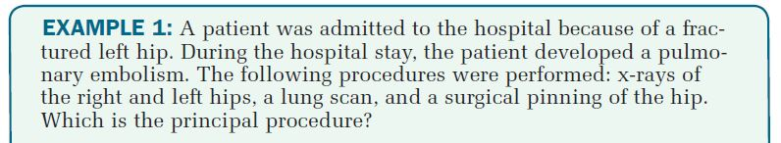
ICD-9-CM Index to Procedures and Tabular List of Procedures
Chapter
05
Secondary procedures are additional procedures performed during the same encounter as the principal procedure.

Slide 34
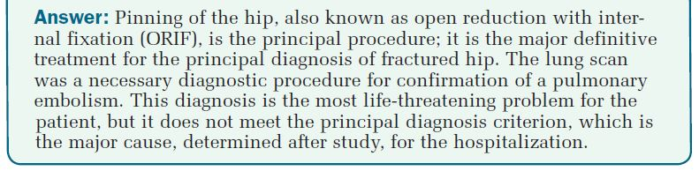
ICD-9-CM Index to Procedures and Tabular List of Procedures
Chapter
05

Slide 35
ICD-9-CM Index to Procedures and Tabular List of Procedures
Chapter
05
Morphology indicates the tissue type of a neoplasm. A basic knowledge of morphology coding can be helpful to a coder because the name of the neoplasm documented in the patient’s chart does not always indicate whether the neoplasm is benign (not cancerous) or malignant (cancerous).
In addition, coding should be delayed until the pathology report is available in the patient’s chart for review.
Neoplasms are new growths, or tumors, in which cell reproduction is out of control. For coding purposes, the provider should specify whether the tumor is benign (noncancerous, nonmalignant, noninvasive) or malignant (cancerous, invasive, capable of spreading to other parts of the body). It is highly advisable that neoplasms be coded directly from the pathology report.

Slide 36
ICD-9-CM Index to Procedures and Tabular List of Procedures
Chapter
05
Primary malignancy—The original tumor site. All malignant tumors are considered primary unless otherwise documented as metastatic or secondary.
Secondary malignancy—The tumor has metastasized (spread) to a secondary site, either adjacent to the primary site or to a remote region of the body.
Carcinoma (Ca) in situ—A malignant tumor that is localized, circumscribed, encapsulated, and noninvasive (has not spread to deeper or adjacent tissues or organs).
Benign—A noninvasive, non-spreading, nonmalignant tumor.

Slide 37
ICD-9-CM Index to Procedures and Tabular List of Procedures
Chapter
05
Primary Malignancies
A malignancy is coded as the primary site if the diagnostic statement documents:
● Metastatic from a site.
● Spread from a site.
● Primary neoplasm of a site.
● A malignancy for which no specific classification is documented.
● A recurrent tumor.

Slide 38
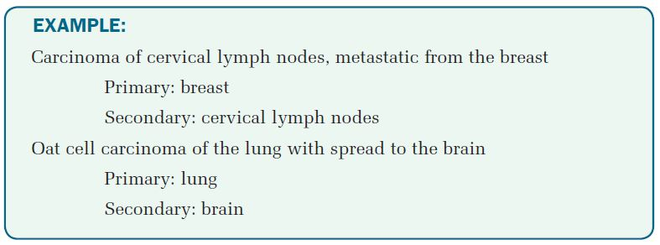
ICD-9-CM Index to Procedures and Tabular List of Procedures
Chapter
05

Slide 39
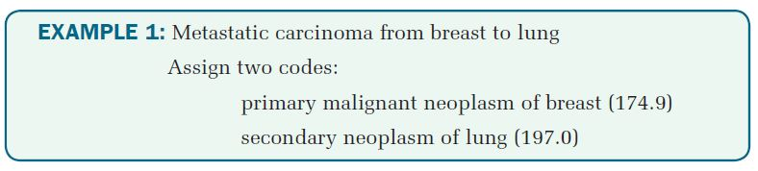
ICD-9-CM Index to Procedures and Tabular List of Procedures
Chapter
05

Slide 40
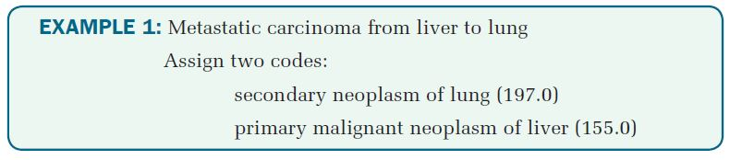
ICD-9-CM Index to Procedures and Tabular List of Procedures
Chapter
05

Slide 41

Key Takeaways
Chapter
05
The United States adopted the International Classification of Diseases, 9th Revision, Clinical Modification (ICD-9-CM) to facilitate the coding and classification of morbidity (disease) data from inpatient and outpatient records, and physician office records.
Medical necessity is the measure of whether a healthcare procedure or service is appropriate for the diagnosis and/or treatment of a condition.
Outpatient claims require reporting of the patient’s first-listed diagnosis, secondary diagnoses, procedures, and services.

Slide 42



Thank You

