Slide 1





A Novel Stacking Framework for Student Success Prediction Using Combined Machine Learning and Deep Learning Approaches
1

Slide 2
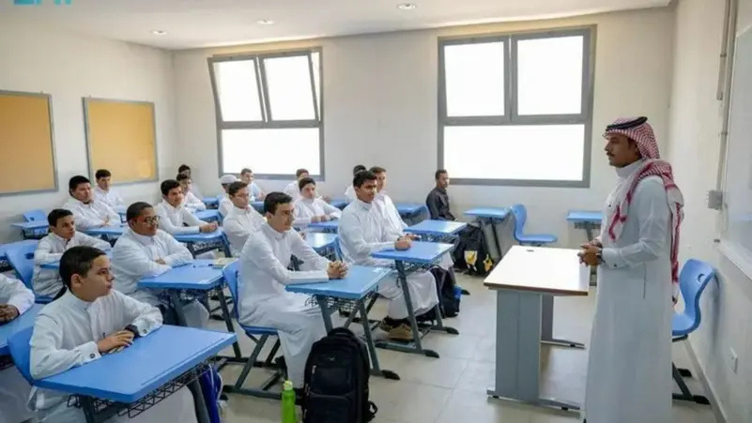

A Novel Stacking Framework for Student Success Prediction Using Combined Machine Learning and Deep Learning Approaches
Prepared By:
  Rami Mohammad AbuLaban (ID: 233000631)
  Khaled Ayman Alnbrees (ID: 241001469)
  Mohammed Nafeth Mansour (ID: 241000459)
  Khalid Jamal Al Zaqzouq (ID: 241001334)
Supervised By: Dr. Wesam Ahmed
College of Informatics, Midocean University, UAE
2

Slide 3
Agenda
Presentation Outline
  Introduction and Background
  Contributions
  Literature Review
  Methodology
  Results and Analysis
  Conclusion and Future Work
  References
3

Slide 4

INTRODUCTION AND BACKGROUND
Predicting student performance is critical in modern education to enable early interventions, reduce dropout rates, and personalize learning.
Machine Learning (ML) and Deep Learning (DL) excel at uncovering complex patterns in student data. Artificial Neural Networks (ANNs) capture non-linear relationships, achieving high accuracy in predicting academic outcomes.
4

Slide 5
Problem Statement: Predicting student success (e.g., graduation rates, academic performance) is crucial for educational institutions to provide timely interventions.
Challenges: Traditional methods often fail to capture complex patterns in student data due to heterogeneity (demographics, grades, attendance).
Objective: Develop a novel stacking ensemble framework that integrates machine learning (ML) and deep learning (DL) models for improved prediction accuracy.
Significance: Enhances personalized education, reduces dropout rates, and supports data-driven decision-making.
INTRODUCTION AND BACKGROUND
Problem Statement: Predicting student success (e.g., graduation rates, academic performance) is crucial for educational institutions to provide timely interventions.
Challenges: Traditional methods often fail to capture complex patterns in student data due to heterogeneity (demographics, grades, attendance).
Objective: Develop a novel stacking ensemble framework that integrates machine learning (ML) and deep learning (DL) models for improved prediction accuracy.
Significance: Enhances personalized education, reduces dropout rates, and supports data-driven decision-making.
5

Slide 6
CONTRIBUTIONS
KEY RESEARCH CONTRIBUTIONS
Main Contributions
  Hybrid Feature Selection Technique
    Combines filter methods (Pearson correlation, Chi-square, Mutual Information)
    Integrates wrapper methods (recursive feature elimination)
    Balances speed, interpretability, and predictive capability
  Comprehensive ML Base Learners
    Linear/Ridge/Lasso Regression for linear relationships
    Decision Tree/Random Forest for non-linear patterns
    K-Nearest Neighbors for similarity-based predictions
  Advanced Meta-Learning Architecture
    Multi-Layer Perceptron (MLP) meta-learner
    Captures complex non-linear relationships
    Optimizes ensemble predictions
7

Slide 7
CONTRIBUTIONS
ADDITIONAL CONTRIBUTIONS
Performance and Applications
  Superior Performance Achievement
    Stacking ensemble: R² = 0.8722, MSE = 17.3085
    Outperforms individual baseline models
    Robust prediction across diverse student profiles
  Practical Educational Applications
    Early identification of at-risk students
    Data-driven intervention strategies
    Support for personalized learning and dropout prevention
8

Slide 8
LITERATURE REVIEW
Table 1 .COMPARAtive Analysis of Related Work
Ref | Year | Datasets | Models | Results | Advantages | Limitations
Ahmed et al. (2025) | 2025 | Dataset 1: 10,000 samples (6 features) Dataset 2: 6,607 records (20 features) | KNN Regressor, Linear Regression, CatBoost, XGBoost, AdaBoost, + Voting Regression Ensemble | Dataset 1: RMSE=0.1050, MAE=0.0837, R²=0.9890 Dataset 2: R²=0.7716 | High predictive performance Robust across datasets Explainable (LIME & SHAP) | Model complexity & heavy data requirements
Ying & Ma (2024) | 2024 | Original small educational datasets (Mathematics and Portuguese); and augmented with synthetic data | Support Vector Regression (SVR), Neural Network (NN), Random Forest (RF) | Regression approach improved prediction accuracy by 21.9% (SVR), 15.6% (NN), 6.6% (RF) compared to classification; synthetic data added modest gains (~2.5%) | Regression approach more accurate than classification; effectively handles small datasets using synthetic data | Synthetic data generated by GANs might be noisy or limited by small original datasets; slight improvement only (~2.5%)
Tang, B. et al. | 2024 | College student data (unspecified size), captured via technology-enhanced learning platforms | Deep neural network ensemble with weighted voting and new feature-ranking mechanism | RMSE = 1.66 MAPE = 9.75% R² = 0.7430 Outperformed null model (RMSE=4.05, MAPE=24.89%, R²=0.2897) | Enhanced prediction accuracy via ensemble & optimized deep learning parameters Effective feature ranking | Dataset specifics (size, feature details) not provided, limiting reproducibility Computation intensive
Yang, K. (2024) | 2024 | Educational data mining dataset including academic records, homework scores, class participation, etc. (Journal Ases) | Yang, K. (2024) | 2024 | Educational data mining dataset including academic records, homework scores, class participation, etc. (Journal Ases) | Yang, K. (2024)
Wang et al. (2021) | 2021 | UCI Student Performance Dataset (two Portuguese schools: grades, demographic, social, school-related features) | Graph-based ensemble combining supervised models (e.g., Decision Tree, SVM) and unsupervised clustering (hierarchical, k-means, DBSCAN) with iterative propagation on a bipartite graph | Improves prediction accuracy by up to 14.8% compared to the best traditional ML method | Improves stability and accuracy via ensemble + clusteringEnhances feature selection & robust predictionsBalances supervised and unsupervised learning in one framework | Lack of detail on dataset size and distributionMethod complexity may hinder reproducibilityComputational requirements for iterative graph operations
Orji & Vassileva (2022) | 2022 | Data from 924 university dentistry students (Chile): attributes of intrinsic/extrinsic motivation, autonomy, relatedness, competence, self-esteem, study strategies, demographics | Five ML models: Decision Tree (DT), Random Forest (RF), K-Nearest Neighbors (KNN), Linear/Logistic Regression (LR), Support Vector Machine (SVM) used for both regression and classification tasks | Regression: MAE for academic performance — RF: 0.3913, LR: 0.4003, SVM: 0.4026, DT: 0.3777, KNN: 0.4242. Classification: Accuracy for study strategy — RF: 0.949, LR: 0.589, SVM: 0.599, DT: 0.880, KNN: 0.685; RF showed best F1, precision, recall ~0.949 | - High prediction accuracy for both performance and strategy using psychological motivators - Use of well-known motivational constructs supports model generalizability - Combines regression and classification tasks in one framework | - Dataset limited to dentistry students, which may reduce generalizability - Used self-reported measures, potentially biased - Did not explore deep learning or ensemble methods to further boost performance
10

Slide 9
LITERATURE REVIEW
Identified Gaps and Our Solutions
Gap Category | Current Limitations | Our Solution
Model Integration | Single model approaches or limited ensemble | Comprehensive stacking: 6 ML + 1 DL
Feature Selection | Basic statistical or single-method selection | Hybrid filter + wrapper approach
Dataset Scope | Limited to specific platforms/institutions | 80,000 student multi-dimensional dataset
Interpretability | Focus on accuracy without explanation | Integrated SHAP and LIME analysis
Performance Balance | High accuracy OR interpretability | Both high performance AND explainability
9

Slide 10
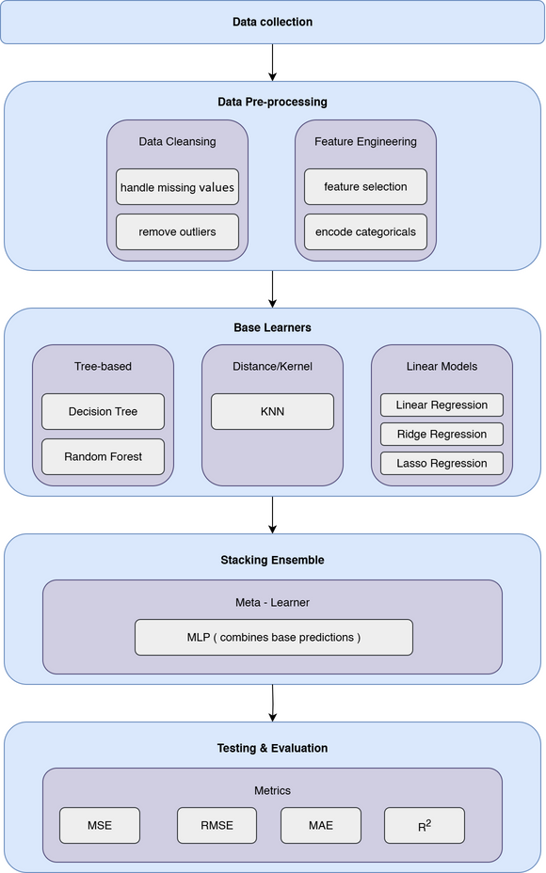
METHODOLOGY
PROPOSED FRAMEWORK ARCHITECTURE
12

Slide 11
METHODOLOGY
DATASET DESCRIPTION
Comprehensive Student Dataset (80,000 Records)
Five Main Feature Categories:
  Academic Information
    Student ID, Age (16-28), Gender, Major
    Study hours per day, Attendance percentage
    Previous GPA, Exam scores
  Digital Lifestyle Factors
    Social media hours, Netflix hours, Screen time
    Modern technology impact on learning
  Physical & Mental Health
    Sleep hours, Exercise frequency, Diet quality
    Mental health rating, Stress level, Exam anxiety (1-10 scale)
  Family & Support Systems
    Family income range, Parental support/education level
    Access to tutoring, Extracurricular participation
  Personal Management
    Motivation level, Time management score
    Learning style, Study environment preferences
11

Slide 12
RESULTS AND ANALYSIS
EXPERIMENTAL DESIGN
Training and Validation Strategy
  Data Configuration:
    Training Set: 80% (64,000 students)
    Testing Set: 20% (16,000 students)
  Process Workflow:
    Preprocessing Pipeline: Applied to training data
    Feature Selection: Conducted on training set
    Base Model Training: 6 ML algorithms independently
    Meta-Learner Training: MLP on base predictions
    Cross-Validation: 5-fold CV for robust estimation
  Optimization:
    Grid Search: Systematic parameter exploration
    Hyperparameter Tuning: Model-specific optimization
17

Slide 13
METHODOLOGY
FEATURE SELECTION PROCESS
Two-Phase Hybrid Selection Strategy
  Phase 1: Filter Methods
    Chi-Square Test: Categorical variables (major, gender, learning style)
    Pearson Correlation: Linear relationships with continuous variables
    Mutual Information: Non-linear dependencies and complex interactions
    Selection: Top 10 features from each method
  Phase 2: Wrapper Method
    Recursive Feature Elimination: Uses LinearRegression as estimator
    Performance-based evaluation: Direct contribution to accuracy
    Cross-validation: Unbiased performance estimates
  Integration:
    Union Operation: Combines all method selections
    Comprehensive Coverage: Academic, lifestyle, psychological factors
    Redundancy Analysis: Identifies overlapping features
13

Slide 14
METHODOLOGY
BASE MODELS ARCHITECTURE
Six Diverse ML Base Learners
Model Type | Algorithm | Strengths
Linear | Linear Regression | Interpretable, baseline
Regularized | Ridge Regression | Handles multicollinearity
Sparse | Lasso Regression | Feature selection
Non-linear | Decision Tree | Captures interactions
Ensemble | Random Forest | Robust predictions
Instance-based | K-Nearest Neighbors | Local patterns
Meta-Learner:
  Multi-Layer Perceptron (MLP)
14

Slide 15




METHODOLOGY
EVALUATION METRICS
Comprehensive Performance Assessment
Regression Metrics:
15

Slide 16
RESULTS AND ANALYSIS
INDIVIDUAL MODEL RESULTS
Base Model Performance Comparison
  Key Observations:
    Random Forest: Best individual performance
    Linear Models: Consistent baseline results
    KNN: Struggled with high-dimensional complexity
    Decision Tree: Good interpretability-performance balance
Model | MSE | RMSE | MAE | R² | Rank
Linear Regression | 17.5364 | 4.1877 | 3.1956 | 0.8705 | 4th
Ridge Regression | 17.5364 | 4.1877 | 3.1956 | 0.8705 | 4th
Lasso Regression | 17.5525 | 4.1896 | 3.2079 | 0.8704 | 6th
Decision Tree | 17.414 | 4.173 | 3.2288 | 0.8714 | 3rd
Random Forest | 17.3023 | 4.1596 | 3.2202 | 0.8722 | 1st
K-Nearest Neighbors | 24.4988 | 4.9496 | 3.8094 | 0.819 | 7th
18

Slide 17
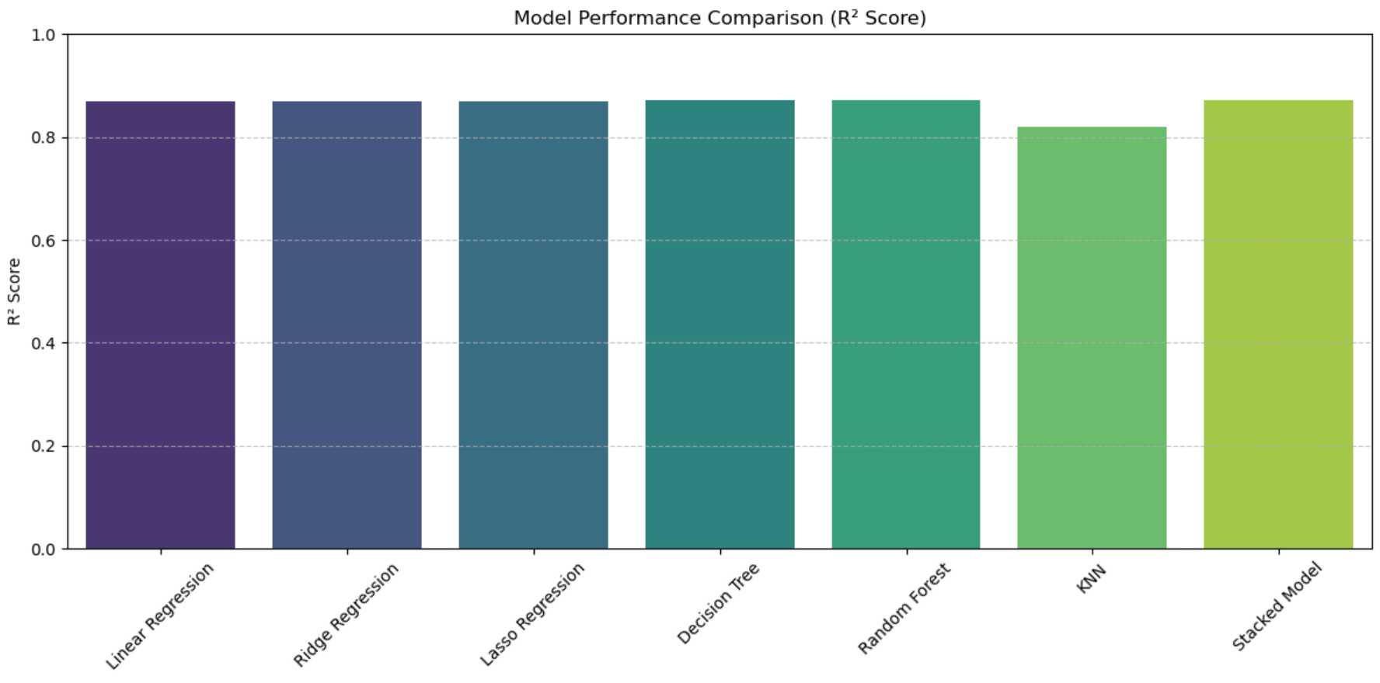
RESULTS AND ANALYSIS
STACKING FRAMEWORK RESULTS
SUPerior Ensemble Performance
  Stacked Model Achievement:
    MSE: 17.3085 (↓ improvement from best individual)
    RMSE: 4.1604 (↓ reduced error)
    MAE: 3.2145 (competitive accuracy)
    R²: 0.8722 (matches best individual)
  Performance Comparison:
19

Slide 18
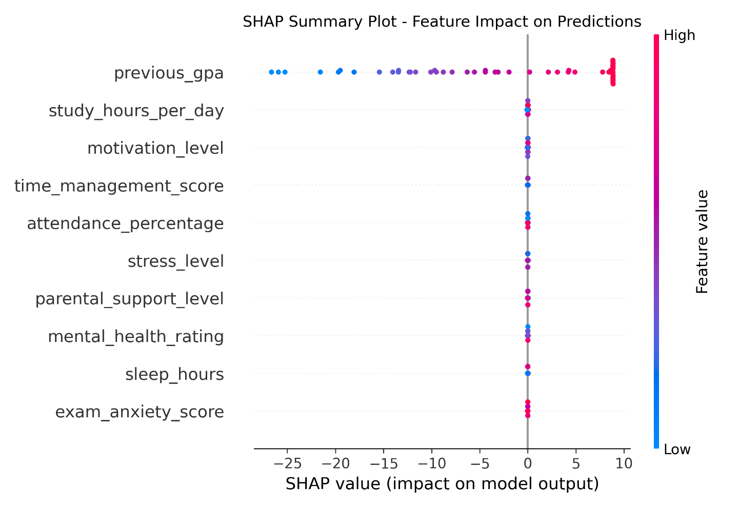
RESULTS AND ANALYSIS
FEATURE IMPORTANCE ANALYSIS
TOP Contributing Features: The SHAP summary of the stacking model
  Top Contributing Features:
20

Slide 19
RESULTS AND ANALYSIS
FEATURE IMPORTANCE ANALYSIS
TOP Contributing Features:
  Top Contributing Features:
Rank | Feature | Category | Impact | Educational Significance
1 | Previous GPA | Academic | High + | Strong historical predictor
2 | Study Hours/Day | Academic | High + | Direct effort correlation
3 | Attendance % | Academic | High + | Participation importance
4 | Mental Health Rating | Psychological | Moderate + | Well-being affects learning
5 | Stress Level | Psychological | Moderate - | High stress impairs performance
6 | Sleep Hours | Lifestyle | Moderate + | Rest quality impacts cognition
7 | Motivation Level | Personal | Moderate + | Drive for success
8 | Time Management | Personal | Moderate + | Organization skills
20

Slide 20
CONCLUSION AND FUTURE WORK
CONCLUSION
Combines hybrid feature selection, MLP meta-learner, and SHAP/LIME explainability for accurate and transparent predictions.
The proposed stacking framework integrates ML and DL, achieving superior student success prediction with MSE of 17.3085, RMSE of 4.1604, MAE of 3.2145, and R² of 0.8722.
Enables dropout prevention, personalized learning, and data-driven academic decisions, promoting equity and proactive educational strategies.
22

Slide 21
CONCLUSION AND FUTURE WORK
FUTURE WORK
Future research will seek to enhance the approach by:
Integrating multi-modal data, including text-based student feedback, behavioral patterns, and temporal data from learning management systems, to identify more subtle determinants of student performance.
Optimizing the framework for real-time prediction might make it possible to take prompt and flexible actions.
The meta-learner should improve performance on challenging datasets by investigating more sophisticated deep learning architectures, such as transformers or recurrent neural networks.
23

Slide 22
REFERENCES
REFERENCES (1/3)
FOundation Literature
  [1] Hernández-García, Á., et al. (2024). Exploring the relationship between LMS interactions and academic performance. Computers in Human Behavior, 155, 108183.
  [2] Guo, B., et al. (2015). Predicting students' performance in educational data mining. IEEE International Symposium on Educational Technology.
  [3] Isljamović, S., & Suknović, M. (2014). Predicting students' academic performance using artificial neural network. The Eurasia Proceedings of Educational and Social Sciences, 1, 68-72.
  [4] Alnasyan, B., et al. (2024). The power of deep learning techniques for predicting student performance in virtual learning environments. Computers and Education: Artificial Intelligence, 6, 100231.
  [5] Alshabandar, R., et al. (2022). A flexible feature selection approach for predicting students' academic performance in online learning. Computers and Electrical Engineering, 99, 107761.
  [6] Abid, M., et al. (2025). Explainable AI methods for predicting student grades and improving academic success. Journal of Information Systems and Education Management, 10(2), 45-59.
24

Slide 23
REFERENCES
REFERENCES (2/3)
RECEnt ML/DL Studies
  [14] Wang, J., & Yu, Y. (2025). Machine learning approach to student performance prediction of online learning. PLOS ONE, 20(1), e0299018.
  [15] Althaqafi, T., et al. (2025). Enhancing student performance prediction: The role of class imbalance handling in machine learning models. Discover Computing, 28(1), 79.
  [16] Sandeepa, A. G. R., & Mohottala, S. (2025). Evaluation of machine learning models in student academic performance prediction. IEEE ICARC Conference.
  [18] Yuan, J., et al. (2024). Integrating behavior analysis with machine learning to predict online learning performance. arXiv:2406.11847.
  [19] Arya, M., et al. (2024). A CNN-LSTM-based deep learning model for early prediction of students' performance. International Journal on Smart Sensing and Intelligent Systems.
  [20] Adefemi, K. O., et al. (2025). Hybrid deep learning models for predicting student academic performance. Mathematical and Computational Applications, 30(3), 59.
25

Slide 24
REFERENCES
REFERENCES (3/3)
ADVANCED AI And Educational Analytics
  [24] Neshaei, S. P., et al. (2024). Towards modeling learner performance with large language models. arXiv:2403.14661.
  [25] Zhang, L., et al. (2024). Predicting learning performance with large language models: A study in adult literacy. International Conference on Human-Computer Interaction, 333-353.
  [30] Yang, Y., et al. (2025). Student academic performance prediction via hypergraph and TabNet. Journal of Big Data, 12(1), 119.
  [31] Peng, T., et al. (2023). CLGT: A graph transformer for student performance prediction in collaborative learning. AAAI Conference on Artificial Intelligence, 15947-15954.
  [32] Yang, Y., et al. (2024). Framelet-based dual hypergraph neural networks for student performance prediction. International Journal of Machine Learning and Cybernetics, 15(9), 3863-3877.
26

Slide 25

Thank You
27

