Slide 1



HCIA-AI Huawei
Lecture 11
AI Important Modules with Practice
Prepared by
Eng. Eman Elgallad
www.midocean.ae

Slide 2

Lecture
Content:
11
Python important Modules
Pandas
Matplotlib
Seaborn
Deep Learning Practical Exercise
www.midocean.ae

Slide 3

Pandas

Slide 4
Pandas First Steps: install and import
Lecture
11
Pandas is an easy package to install. Open up your terminal program (shell or cmd) and install it using either of the following commands:
For jupyter notebook users, you can run this cell:
  The ! at the beginning runs cells as if they were in a terminal.
To import pandas we usually import it with a shorter name since it's used so much:
$ conda install pandas
OR
! pip install pandas
Installation: https://pandas.pydata.org/pandas-docs/stable/getting_started/install.html
!pip install pandas
import pandas as pd
www.midocean.ae

Slide 5
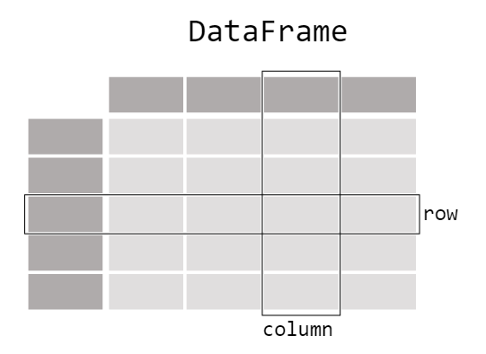
pandas: Data Table Representation
Lecture
11
www.midocean.ae

Slide 6
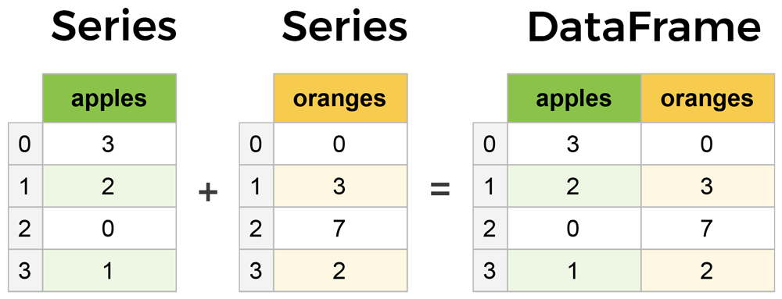
Core components of pandas: Series & DataFrames
Lecture
11
The primary two components of pandas are the Series and DataFrame.
  Series is essentially a column, and
  DataFrame is a multi-dimensional table made up of a collection of Series.
DataFrames and Series are quite similar in that many operations that you can do with one you can do with the other, such as filling in null values and calculating the mean.
  A Data frame is a two-dimensional data structure, i.e., data is aligned in a tabular fashion in rows and columns.
columns
Features of DataFrame
  Potentially columns are of different types
  Size – Mutable
  Labeled axes (rows and columns)
  Can Perform Arithmetic operations on rows and columns
rows
www.midocean.ae

Slide 7
Types of Data Structure in Pandas
Lecture
11
Data Structure | Dimensions | Description
Series | 1 | 1D labeled homogeneous array with immutable size
Data Frames | 2 | General 2D labeled, size mutable tabular structure with potentially heterogeneously typed columns.
Panel | 3 | General 3D labeled, size mutable array.
Series & Data Frame
  Series is a one-dimensional array (1D Array) like structure with homogeneous data.
  Data Frame is a two-dimensional array (2D Array) with heterogeneous data.
Panel
  Panel is a three-dimensional data structure (3D Array) with heterogeneous data.
  It is hard to represent the panel in graphical representation.
  But a panel can be illustrated as a container of Data Frame
www.midocean.ae

Slide 8
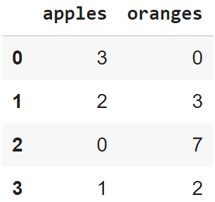
Creating a DataFrame from scratch
Lecture
11
There are many ways to create a DataFrame from scratch, but a great option is to just use a simple dict. But first you must import pandas.
Let's say we have a fruit stand that sells apples and oranges. We want to have a column for each fruit and a row for each customer purchase. To organize this as a dictionary for pandas we could do something like:
And then pass it to the pandas Data Frame constructor:
import pandas as pd
data = { 'apples':[3, 2, 0, 1] , 'oranges':[0, 3, 7, 2] }
df = pd.DataFrame(data)
www.midocean.ae

Slide 9
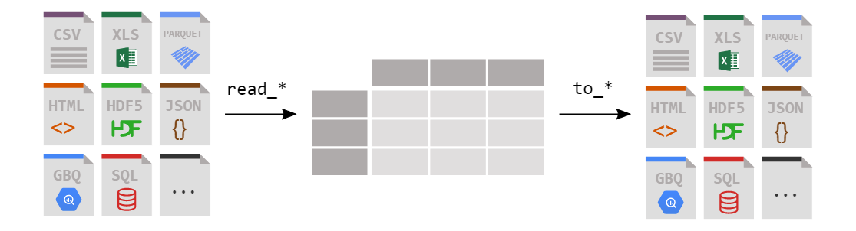
Loading a DataFrame from files
Lecture
11
www.midocean.ae

Slide 10
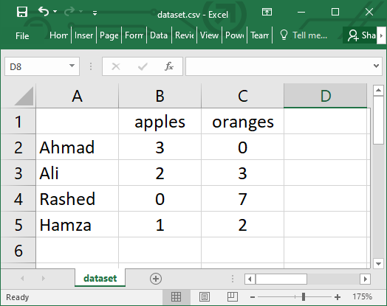
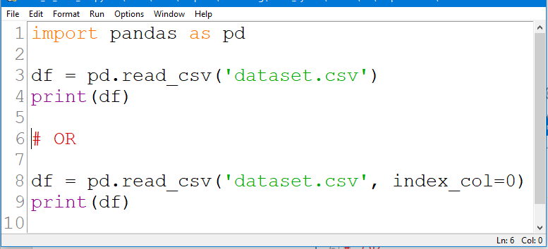
Reading data from a CSV file
Lecture
11
www.midocean.ae

Slide 11
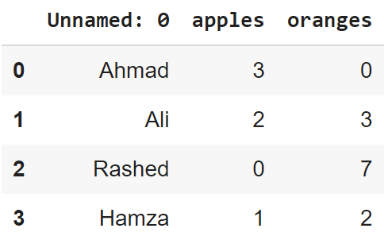
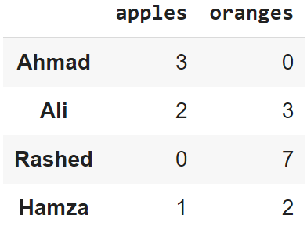
Reading data from CSVs
Lecture
11
With CSV files, all you need is a single line to load in the data:
df = pd.read_csv('dataset.csv')
CSVs don't have indexes like our DataFrames, so all we need to do is just designate the index_col when reading:
df = pd.read_csv('dataset.csv', index_col=0)
Note: here we're setting the index to be column zero.
www.midocean.ae

Slide 12
Reading data from JSON
Lecture
11
If you have a JSON file — which is essentially a stored Python dict — pandas can read this just as easily:
df = pd.read_json('dataset.json')
Notice this time our index came with us correctly since using JSON allowed indexes to work through nesting.
Pandas will try to figure out how to create a DataFrame by analyzing structure of your JSON, and sometimes it doesn't get it right.
Often you'll need to set the orient keyword argument depending on the structure
www.midocean.ae

Slide 13
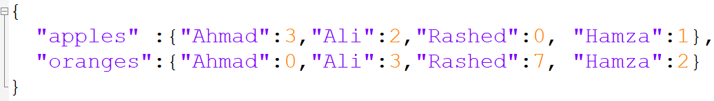
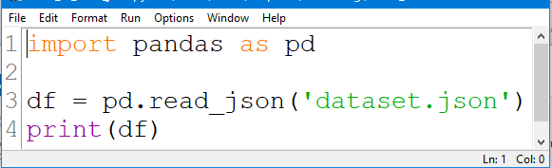
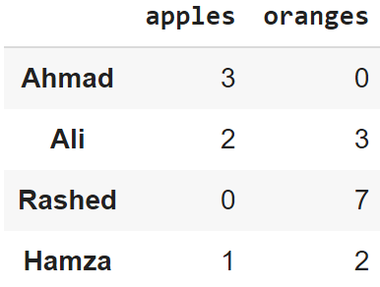
Example1: Reading data from JSON
Lecture
11
www.midocean.ae

Slide 14
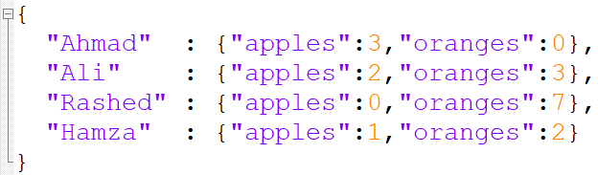
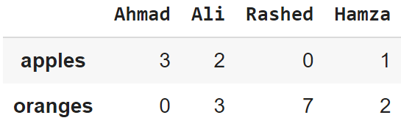
Example2: Reading data from JSON
Lecture
11
www.midocean.ae

Slide 15
Viewing your data
Lecture
11
The first thing to do when opening a new dataset is print out a few rows to keep as a visual reference. We accomplish this with .head():
.head() outputs the first five rows of your DataFrame by default, but we could also pass a number as well: movies_df.head(10) would output the top ten rows, for example.
To see the last five rows use .tail() that also accepts a number, and in this case we printing the bottom two rows.:
movies_df.head()
movies_df.tail(2)
www.midocean.ae

Slide 16
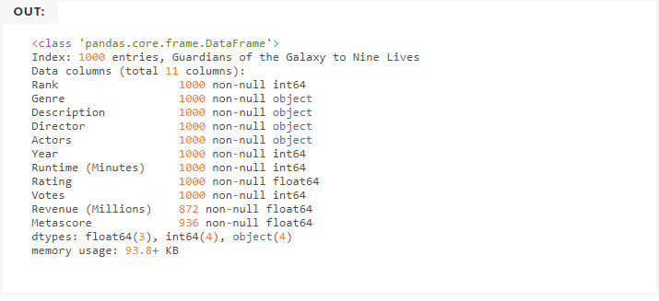

Getting info about your data
Lecture
11
.info() should be one of the very first commands you run after loading your data
.info() provides the essential details about your dataset, such as the number of rows and columns, the number of non-null values, what type of data is in each column, and how much memory your DataFrame is using.
movies_df.info()
movies_df.shape
www.midocean.ae

Slide 17
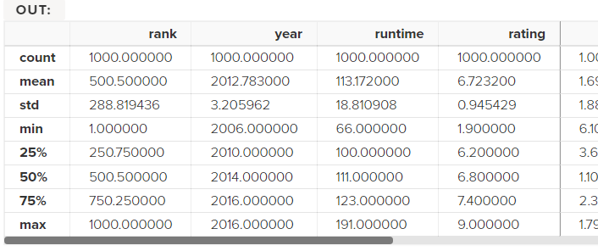
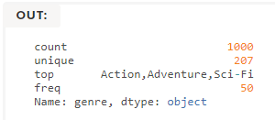
Understanding your variables
Lecture
11
Using .describe() on an entire DataFrame we can get a summary of the distribution of continuous variables:
.describe() can also be used on a categorical variable to get the count of rows, unique count of categories, top category, and freq of top category:
This tells us that the genre column has 207 unique values, the top value is Action/Adventure/Sci-Fi, which shows up 50 times (freq).
movies_df.describe()
movies_df['genre'].describe()
www.midocean.ae

Slide 18
Matplotlib and Seaborn

Slide 19
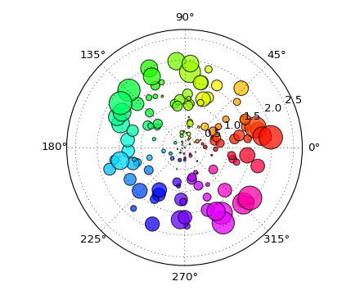
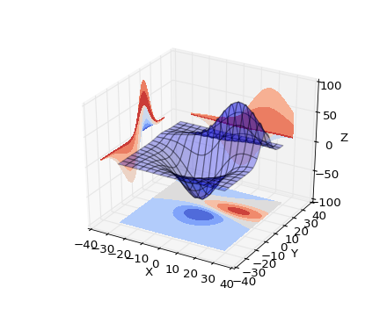
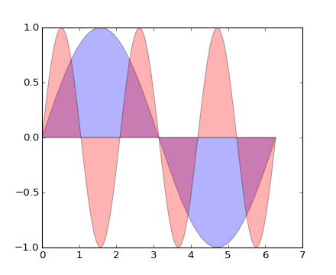
What is data visualization?
Lecture
11
Data visualization is the graphical representation of information and data.
  Can be achieved using visual elements like figures, charts, graphs, maps, and more.
Data visualization tools provide a way to present these figures and graphs.
Often, it is essential to analyze massive amounts of information and make data-driven decisions.
  converting complex data into an easy-to-understand representation.
www.midocean.ae

Slide 20
Matplotlib
Lecture
11
Matplotlib is one of the most powerful tools for data visualization in Python.
Matplotlib is an incredibly powerful (and beautiful!) 2-D plotting library.
  It is easy to use and provides a huge number of examples for tackling unique problems
In order to get matplotlib into your script,
  first you need to import it, for example:
  import matplotlib.pyplot as plt
However, if it is not installed, you may need to install it:
  Easiest way to install matplotlib is using pip.
  Type the following command in the command prompt (cmd) or your Linux shell;
    pip install matplotlib
    Note that you may need to run the above cmd as an administrator
www.midocean.ae

Slide 21
matplotlib
Lecture
11
Strives to emulate MATLAB
  matplotlib.pyplot is a collection of command style functions that make matplotlib work like MATLAB.
Each pyplot function makes some change to the figure:
  e.g.,
    creates a figure,
    creates a plotting area in the figure,
    plots some lines in the plotting area,
    decorates the plot with labels, etc.
Note that various states are preserved across function calls
Whenever you plot with matplotlib, the two main code lines should be considered:
  Type of graph
    this is where you define a bar chart, line chart, etc.
  Show the graph
    this is to display the graph
www.midocean.ae

Slide 22
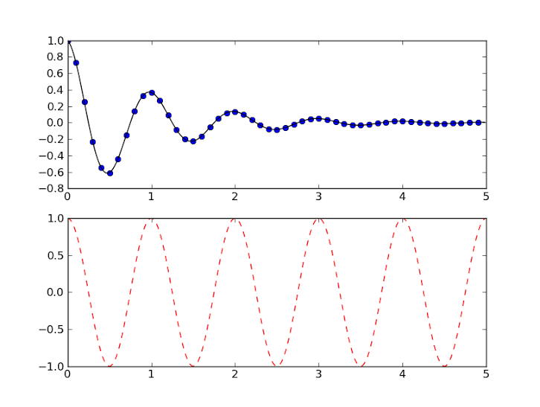
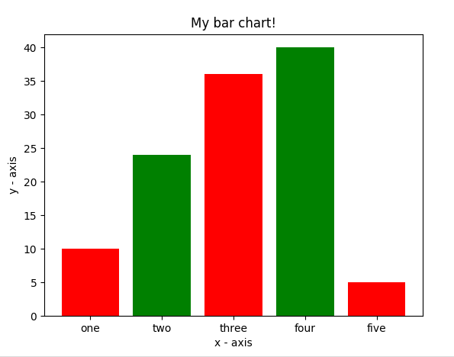
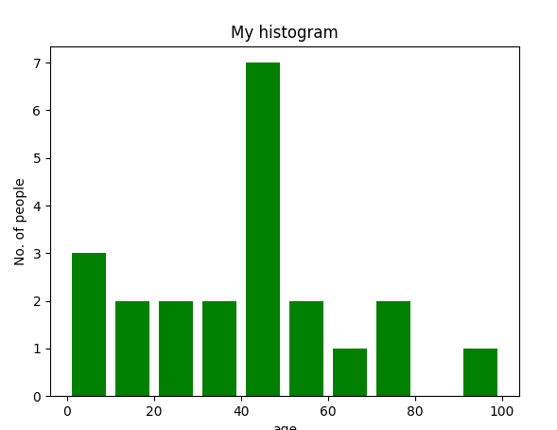
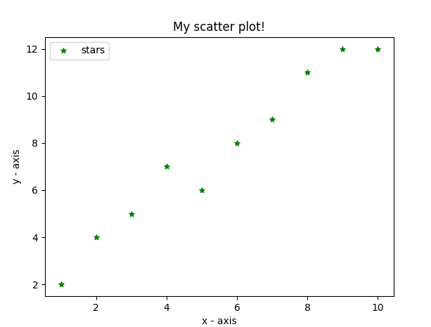
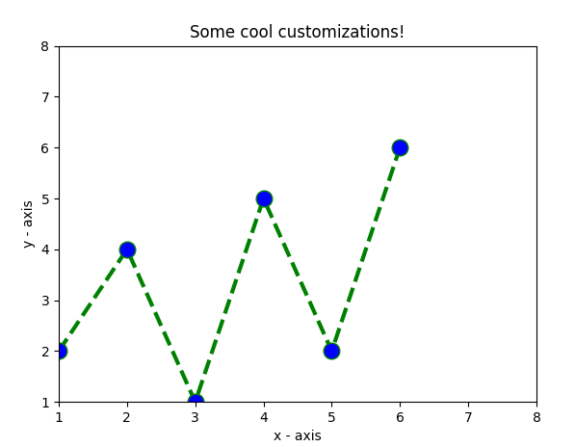
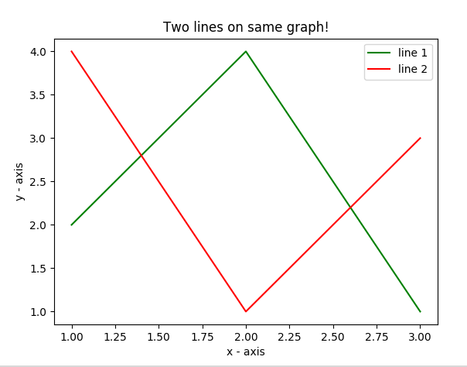
Lecture
11
Matplotlib allows you to make easy things
You can generate plots, histograms, power spectra, bar charts, errorcharts, scatterplots, etc., with just a few lines of code.

Slide 23
Seaborn :
It is also a Python library used for plotting graphs with the help of Matplotlib, Pandas, and Numpy. It is built on the roof of Matplotlib and is considered as a superset of the Matplotlib library. It helps in visualizing univariate and bivariate data. It uses beautiful themes for decorating Matplotlib graphics. It acts as an important tool in picturing Linear Regression Models. It serves in making graphs of statical Time-Series data. It eliminates the overlapping of graphs and also aids in their beautification.
www.midocean.ae

Slide 24
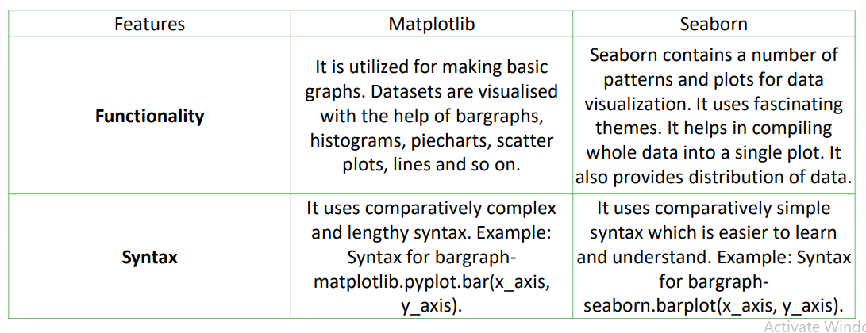
Lecture
11
Seaborn vs Matplotlib?
www.midocean.ae

Slide 25
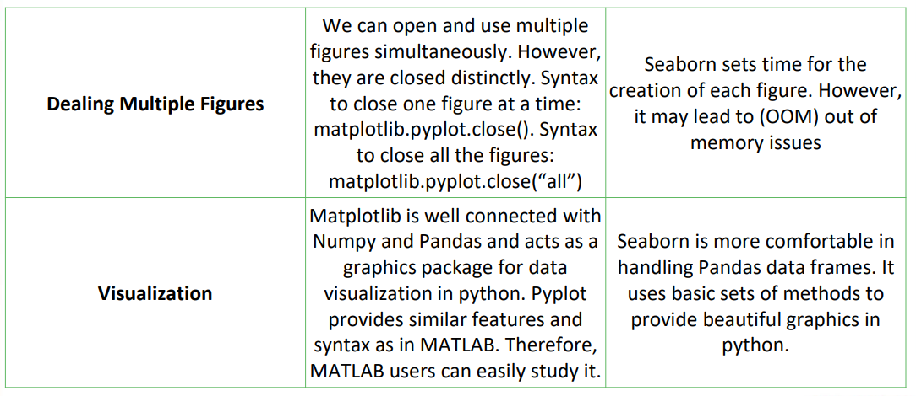
Lecture
11
Seaborn vs Matplotlib?
www.midocean.ae

Slide 26
Pandas, Matplotlib, and Seaborn Code
Lecture
11
https://drive.google.com/file/d/1a2F8SZU7n79VTCYfXL8hW9L2i7TXTwaG/view?usp=sharing
https://drive.google.com/file/d/1bpn5k-uw7nPPy3uDBchg9ez6aXmUEFXE/view?usp=sharing
https://drive.google.com/file/d/1i_Q0Gwmse4mgjtwh7RI6g1lZzTpbw5w3/view?usp=sharing
https://drive.google.com/file/d/11bG05RrQpjmd5BSL8XXvA3OTndPdb4nI/view?usp=sharing
www.midocean.ae
Notes:
Development history of neural networks (milestones of deep learning):
Budding neural network (1958–1969)
In 1958, Frank Rosenblatt invented the perceptron algorithm.
In 1969, Marvin Minsky, pioneer of artificial intelligence in the US, questioned that the perceptron could handle only linear classification problems and failed to classify even the simplest XOR problems. The research on the perceptron was doomed to failure.
Developing neural network (1986–1998)
The second-generation neural network: In 1986, G. E. Hinton, a deep learning expert, developed a BP algorithm suitable for multilayer perceptron (MLP) and used Sigmoid for non-linear mapping, which solved the problem of non-linear classification and learning.
Universal approximation theorem: In 1989, Robert Hecht-Nielsen proved that a continuous function f in any closed interval could be approximated by a BP network containing a hidden layer.
Emerging neural network (since 2006)
Year 2006 is the first year of deep learning. In 2006, Hinton proposed a solution to the vanishing gradient problem in the deep neural network training: weight initialization for unsupervised pre-training+weight adjustment for supervised training.
In 2012, CNN neural network of Hinton's team overwhelmed other methods and won the first prize in the top image recognition competition ImageNet, setting off an upsurge of deep learning.
In 2016, the deep learning AI program AlphaGo developed by Google beat the Go world champion Lee Sedol who is a player of 9 dan rank, further promoting the popularity of deep learning.

Slide 27
DL Practical Exercise

Slide 28
Implementation of CNN :
Creating the Sequential model
This initializes a Sequential model. In Keras, the Sequential model is appropriate for a plain stack of layers where each layer has exactly one input tensor and one output tensor.
model = Sequential([
Adding Convolutional Layers
These lines add two convolutional layers with 32 filters each, a filter size of (3,3), 'same' padding, and ReLU activation. The first layer also specifies the input shape as (32, 32, 3), indicating that the input images are 32x32 pixels with three color channels.
Conv2D(32, (3,3), padding='same', activation='relu', input_shape=(32, 32, 3)),
Conv2D(32, (3,3), padding='same', activation='relu’),
Adding MaxPooling and Dropout
MaxPooling2D((2,2)),
Dropout(0.25),
After each set of convolutional layers, there's a max-pooling layer to downsample the spatial dimensions, and a dropout layer to introduce regularization, preventing overfitting by randomly setting a fraction of input units to 0 at each update during training.
www.midocean.ae

Slide 29
Implementation of CNN Cont. :
Flatten Layer
This layer is used to flatten the input, transforming it into a one-dimensional array, before passing it to the dense layers.
Flatten()
Adding Dense (Fully Connected) Layers
Two fully connected layers (dense layers) are added with 256 and 10 units, respectively. ReLU activation is used for the first dense layer, and softmax activation for the output layer, which is common for multi-class classification problems.
Dense(256, activation='relu'),
Dropout(0.5),
Dense(10, activation='softmax')
Model Summary
This line prints a summary of the model architecture, including the number of parameters in each layer and the total number of parameters in the model.
model.summary()
www.midocean.ae

Slide 30
CNN Code
Lecture
11
https://drive.google.com/file/d/15M76gn5Lh-xdz1aBUAN_ZgYRLLQsTYc9/view?usp=sharing
www.midocean.ae
Notes:
Development history of neural networks (milestones of deep learning):
Budding neural network (1958–1969)
In 1958, Frank Rosenblatt invented the perceptron algorithm.
In 1969, Marvin Minsky, pioneer of artificial intelligence in the US, questioned that the perceptron could handle only linear classification problems and failed to classify even the simplest XOR problems. The research on the perceptron was doomed to failure.
Developing neural network (1986–1998)
The second-generation neural network: In 1986, G. E. Hinton, a deep learning expert, developed a BP algorithm suitable for multilayer perceptron (MLP) and used Sigmoid for non-linear mapping, which solved the problem of non-linear classification and learning.
Universal approximation theorem: In 1989, Robert Hecht-Nielsen proved that a continuous function f in any closed interval could be approximated by a BP network containing a hidden layer.
Emerging neural network (since 2006)
Year 2006 is the first year of deep learning. In 2006, Hinton proposed a solution to the vanishing gradient problem in the deep neural network training: weight initialization for unsupervised pre-training+weight adjustment for supervised training.
In 2012, CNN neural network of Hinton's team overwhelmed other methods and won the first prize in the top image recognition competition ImageNet, setting off an upsurge of deep learning.
In 2016, the deep learning AI program AlphaGo developed by Google beat the Go world champion Lee Sedol who is a player of 9 dan rank, further promoting the popularity of deep learning.

Slide 31

Thank You
www.midocean.ae

