Slide 1
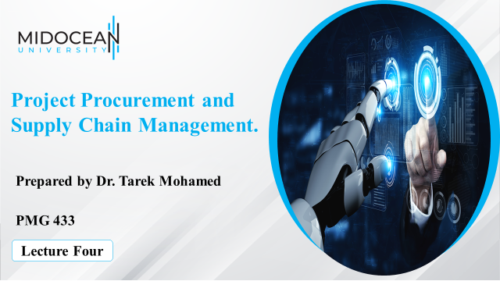

Slide 2
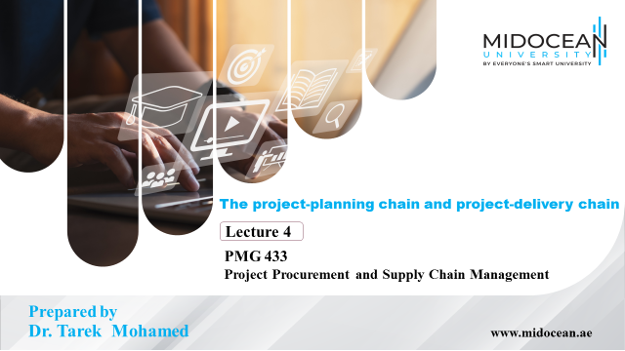

Slide 3


Learning Objectives
Define the requirements of initial planning, including the role that managing scope plays in this.
Identify characteristics of the planning process and approaches to planning
Understand the impact that the choice of structure will have on the achievement of project objectives.
Provide a framework for the project manager to guide understanding of some of the human resource issues that they will face.
Identify the elements of a control system appropriate to a particular project.
www.midocean.ae

Slide 4
The supply chain
The traditional purchasing department is concerned with the relationship with first-tier suppliers, those who supply the project organisation directly
Materials management is concerned with
  Physical goods and the logistic aspects of flow between first-tier suppliers through the project organisation to the first-tier customers
  The product breakdown structure provides the bill of materials
Supply chain management is concerned
  With project strategy and operations
  From primary industry to end-user
www.midocean.ae

Slide 5
The supply chain (Continued)
How important is the supply chain to the success of the project?
Depends on
  Value of bought-in products and services relative to the total value of the project
  The criticality of the items being purchased
  The timing of the work being purchased
  The impact of the quality of work purchased
If an organisation uses the same supplier over a period of time, suppliers usually rate highly on all four counts.
Considerable time must be invested in developing relationships
When a large organisation is being supplied by small ones, direct investment, knowledge sharing, training may be on offer
www.midocean.ae

Slide 6
Initial planning
‘Even the longest journey begins with a single step.’
A project may begin in different ways
  Inspiration
  Response to need
  Exploration of an issue
  A necessary part of a larger program
www.midocean.ae

Slide 7
Models of planning
From personal projects to new product development (NPD)
Dissertations – in the early stages there is chaos
  Many different ideas may be available
  These have to be filtered according to interest, feasibility and sufficient theoretical underpinning
  Rare to end up exactly as originally envisaged
Commercial NPDs are similar, it is rarely a linear activity
  Many different possibilities may be available
  These need to be screened with respect to the market, financial criteria, strategic and technical implications
www.midocean.ae

Slide 8
Models of planning (Continued)
The pipeline
  products at various stages of development
The creative processes of concept development
  Allow time and space for individuals to carry out exploration
  Protect ownership of ideas
  Encourage rapid prototyping
  Senior people to act as project champions
  Have rapid development processes ready to take ideas to fruition
  Clear criteria as to what will be supported and what will not
www.midocean.ae

Slide 9
The planning process (Continued)
Costs of the planning process
Labour (time)
Associated expenses
Planning tools
Cost of preparing formal written plan
Opportunity costs
Benefits of the planning process
Avoids costs of chaos of unplanned activity
Provides a basis for evaluation (or filtering)
Identifies problems in advance
Output of planning – a working tool or straitjacket?
Plans help decision making and guides future activities
Plans should change as circumstances change
Planning is a means to an end
Planning facilitates a beneficial insight into what may happen
www.midocean.ae

Slide 10
The planning process (Continued)
The approach and uncertainty
Product and/or process uncertainty
Planning needs to take into account such variables
Approaches
Claim we know everything
  Often repeated projects
  Beware optimism bias
Acknowledge we know nothing
  Wishful thinking
  Set up milestones and hope we meet them
Both, the nearer the point in time, the more we know
  Rolling wave planning
  High-level schedule of activities, detail added as project progresses
  The 50 per cent rule
www.midocean.ae

Slide 11
The planning process (Continued)
Do plans provide information or just data?
Data are the numbers on the page
Information is the part that can be usefully applied
Noise clutters the analysis process
The PM needs to collect data and add-value by creating information
The process of project planning – inputs, outputs and the process itself
‘What’ happens – the tactical plan
‘How’ it happens – the operational plan
Many cycles and reviews until ‘final’ plan produced
Verify overview before further effort committed
www.midocean.ae

Slide 12
The planning process (Continued)
Planning accuracy or precision?
‘Quick and dirty’ approach (accurate)
Months of painstaking planning approach (precise)
First assess the overview
  Has basic criteria (financial, technical) been satisfied?
  Are fundamental flaws revealed?
Followed by detailed planning
Managing the planning process
Traceability
Systematic approach
  Manageable chunk and logical sequence
  Estimate time and resources
  Provides logic for decisions, framework for assessment, shows effects on other systems, enables filtering of frivolous ideas and activities
  Essential for revision/refinement process
  Allows lessons to be learnt -Facilitates communication
www.midocean.ae

Slide 13
The planning process (Continued)
The PID (project initiation document)
The output of the planning process
The project brief
Project team management structure
Job descriptions
The project approach
The project quality plan
The project plan
The business case
A risk log
Project controls
A communication plan
www.midocean.ae

Slide 14
The planning process (Continued)
Formalisation
What level of formalisation is required?
Project complexity
Custom and practice
Who is the proposal for
  Internal/external customers
  The range of people
Why is the proposal required
  Competitive bid
  First examination
  Organisational policy
Opportunity to sell to potential customers
Executive summary, main body of report, appendices
www.midocean.ae

Slide 15
Basic project landscapes: stages and gates, activities and stages, and maps
Divide project into phases/stages
Determine the nature and objectives of each phase
Gates between phases give opportunity to review progress
Lay down criteria for passing to the next phase in advance
Failure at a gate
  Wind up activities
  Maximise potential benefit while minimising risk or expenditure
  Take on a joint partner
‘Fuzzy gates’
  Project allowed to continue until proper review can be conducted
  Gates don’t slow project down
  Can be confusion over which activities can continue/be stopped at the gate
www.midocean.ae

Slide 16
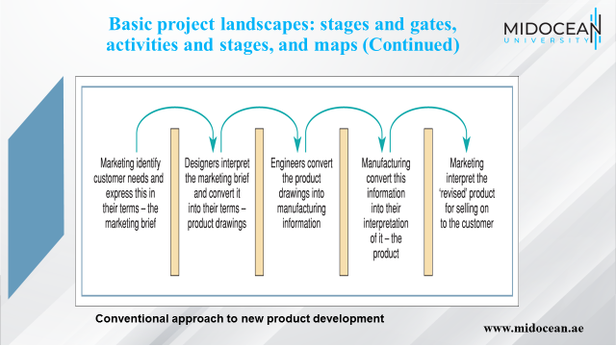

Slide 17
Basic project landscapes: stages and gates, activities and stages, and maps (Continued)
Concurrent engineering/fast track projects
Importance of time and reduced costs to market
Overlap activities/run activities in parallel
Requires co-operation in planning and high levels of communication
Benefits
  Reduced project time
  Reduced rework
  Reduced project costs
Disadvantages
  Increased overheads
  Costs of co-location
  Cultural resistance
  Inappropriate application at times
www.midocean.ae

Slide 18
Basic project landscapes: stages and gates, activities and stages, and maps (Continued)
Activity maps
An overview of what the project will look like
One graphical technique
  Four fields mapping (FFM)/Deployment flow chart (DFC)
  Relates four information fields
    The team members
    The logical phases of an activity
    Tasks to be performed including decisions made
    The standards that apply for each task
      Controls are specified
      Information is shared
  Entry and exit criteria specified
  No phase can be completed until all errors have been corrected and the cause identified
www.midocean.ae

Slide 19
Plan of a project
Planning – the production of plans add value
  it is not an end in itself
The planner has the opportunity of analysing the project system
  Revealing opportunities for improvement
  Revealing possible problem preventions
  Sets out the basis on how the project will proceed
Benefits are realised when they are communicated
www.midocean.ae

Slide 20
Constructing a time plan
How long will it take to complete the project?
How precise do you need to be?
How long did it take last time?
What could cause significant delay?
What other tasks might get in the way?
Estimates are guesses
Beware treating these numbers in a scientific way
Estimation continues through the project lifecycle
The nearer the completion, the more certainty about time, resources and costs
www.midocean.ae

Slide 21
Constructing a time plan
Gathering together individuals and making them a cohesive whole is a fundamental role of the project manager
  Possible problems….
The mix of personalities that will ensure the group dynamics are right is a project issue
How this project team fits in with the structure of the organisation is a strategic issue
Forming the team across multiple organisations (e.g. joint ventures) and/or multiple geographic locations (virtual teams) are extra challenges
www.midocean.ae

Slide 22
Teams
Large organisations are traditionally structured in functional disciplines or ‘silos’
  Grouping all specialisms together is efficient
  The function of the silos is focused and clear
  Career paths are defined
  Administration systems are geared to this way of working
  Can be detrimental
    To creativity of individuals
    To responsiveness to changing market needs
    Managers may build empires, creating work for themselves regardless of adding value
    Departmental head count appears to be the measure of status
Large organisation traditionally ordered in a hierarchical pyramid
www.midocean.ae

Slide 23
Teams (Continued)
De-layering attempts to minimise the number of layers in an organisation
  Simplifies decision making and communication
  Removes a considerable overhead
Alternative structures:
  Product group
  Customer type
  Geographical area
  Functions
  Mixture depending on nature of business and integration of supply chain
www.midocean.ae

Slide 24
Teams (Continued)
The role of teams
One single function will rarely provide the customer’s entire needs
  ‘Cross-functional’ activity is required
Where a project involves more than one function, the project manager should define organisational forms
The nature of the work organisation is important
  Defines responsibility and authority
  Outlines reporting arrangements
  Determines the management overhead
  Sets the structure behind the organisational culture
  Determines one group of stakeholders in project activities
www.midocean.ae

Slide 25
Teams (Continued)
The role of teams
Many organisations use ‘dotted-line’ responsibility
  The individual has responsibility to one functional manager with a dotted-line responsibility to a second, signalling a link to their goals.
  It encourages/enforces communication and integration between departments
  It allows specialists/specialist departments to be involved but does not allow them to hold responsibility, have power or empire-build
  To ensure integration
    Additional administrative procedures are needed
    There are often interminable meetings
    There are mountains of bureaucracy
www.midocean.ae

Slide 26
Teams (Continued)
Teams have various stages of development
Collection
Entrenchment
Resolution
Synergy
Decline
Break-up
The PM can identify the stage at which the team is operating
The PM can ensure the decline stage is held back for as long as possible
  Take development backwards by changing team composition
  Add a new challenge by expanding the range or scope of tasks
www.midocean.ae

Slide 27
Managing people
Personality and roles
The project manager can benefit from understanding the ways in which individuals behave in group situations
Designing the team
  Eligibility – qualifications and experience
  Suitability – how the individuals in the team fit together
  Balance – portfolio of characteristics relative to the task to be undertaken
www.midocean.ae

Slide 28
The concept of control
A project runs late, is over budget, does not deliver to requirements
  Question: How did this happen?
  Answer: Very gradually
Need system in place to
  detect occurrences
  offer opportunity to instigate corrective activities
Caveat
  If there has been poor planning, there may be considerable confusion
  Projects are rarely static
  Controlling by conformance to plan that may not be relevant is unlikely to be beneficial
www.midocean.ae

Slide 29
The concept of control (Continued)
Control activity predominately during execution phase
Needs careful consideration during planning phase
The control system:
Based on easy and simple measures that reflect the objectives of the project
Basic requirements are
  Defining system characteristics of importance
  Defining limits to their variation
  Measurement of those characteristics
  Making progress visible
  Feedback of performance to the team
  Instituting corrective action where required
www.midocean.ae

Slide 30
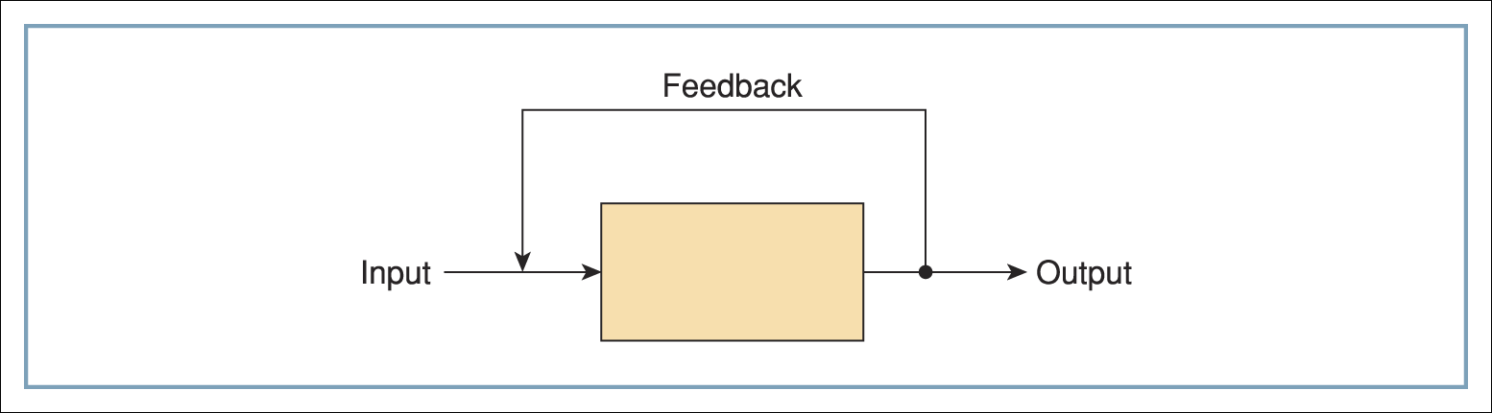
The concept of control (Continued)
The output of a process
  Monitor to determine characteristics of the output
  Interpret data
  Feed back to make changes to the process
  Acceptable deviations from desired performance defines corrective action
Basic model of control
www.midocean.ae

Slide 31
The concept of control (Continued)
Defining system characteristics of importance
  Typically: time, cost, quality
  Dependent on project strategy and available resources
  One constraint could be sacrificed rather than compromise the other two?
  Other issues of strategic importance Examples
    Legal, ethical, environmental, etc.
    Other concerns possible
www.midocean.ae

Slide 32
The concept of control (Continued)
Defining limits to their variation
  Performance will vary across people and activities When does a deviation become a problem?
  Examples
    Health and safety – zero tolerance
    For some organisations, 1% on cost acceptable whilst one day’s delay is unacceptable
  Always some variation expected
  Should expect positive and negative
  In theory: the positive’s benefits should cancel the negatives
  In reality: the former are difficult to harness, the latter accumulate
  Negatives should trigger further monitoring to ensure keeping on track
www.midocean.ae

Slide 33
The concept of control (Continued)
Measurement of characteristics
When to measure?
  Balance: too late to take action vs permanently harassing people to find out progress
  Need to satisfy control process vs project team’s work/report ratio
How often to measure?
  Continuously sense activity, assess feedback, take action
  Control failures
    time delay in receiving information
    time delay in implementing reaction
When do key characteristics take place?
  Input: designs, labour, materials
  In process: work methods, checks
  Output: number of defects, customer/user sign-off
www.midocean.ae

Slide 34
The concept of control (Continued)
Making progress visible and feedback of performance
The principle if visible signs
  lights on indicate a problem
  display of quantity of output relative to target
Instituting corrective action
What to do about the deviation?
‘You can only manage the future, what has happened is history’
‘Whilst knowing where you are is important, what you do next will make the difference’
www.midocean.ae

Slide 35
The concept of control (Continued)
Instituting corrective action
A single event is the product of many linked smaller events
  All smaller events should
    have progress monitored
    appropriate action taken to keep them on track
  The system for overall control can be viewed as a system of smaller systems of control
Feedforward
  Look for problems or situations that will/may be faced
  Make changes to protect the project outcomes
  Risk management should be performed at the start of the project
    and be on-going
www.midocean.ae

Slide 36
The concept of control (Continued)
Configuration control
Change happens…
  It costs
  Technology, requirements, markets, people change
Change control systems need to be established early
  Not to constrain change
  But to recognise it, accommodate it, plan for it
Need to ensure that everyone is working on the latest (current) version of the designs and specifications
  Fundamental even in smallest project
  Can be undertaken centrally by project office
www.midocean.ae

Slide 37
Summary of Learning Objectives
Define the requirements of initial planning, including the role that managing scope plays in this.
Identify characteristics of the planning process and approaches to planning
Understand the impact that the choice of structure will have on the achievement of project objectives;
Provide a framework for the project manager to guide understanding of some of the human resource issues that they will face.
Identify the elements of a control system appropriate to a particular project
www.midocean.ae

Slide 38
Essential Reference
Morris, P. W., & Pinto, J. K. (Eds.). (2007). The Wiley guide to project technology, supply chain, and procurement management (Vol. 4). John Wiley & Sons.
Ayers, J. B. (2003). Supply chain project management: a structured collaborative and measurable approach. CRC press.
Maylor and Wake (2011), Project Management, 4th Edition,
www.midocean.ae

Slide 39



Thank You

