Slide 1

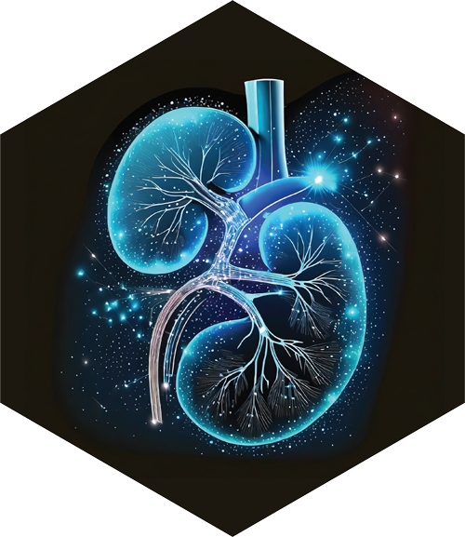

Optimized Hybrid Machine Learning Approach for CKD Diagnosis Using Genetic Algorithms

Slide 2


Optimized Hybrid Machine Learning Approach for CKD Diagnosis Using Genetic Algorithms
Author
Prepared By:
Nasser Naim Qanabta ID: 251003169
Supervisor Name: Wesam Ahmed
Collage of Informatics, Midocean University, UAE

Slide 3
Agenda
01.
Introduction and Background
02.
Contributions
03.
Literature Review
04.
Methodology
05.
Results and Analysis
06.
Conclusion and Future Work
07.
References

Slide 4

01
Introduction and Background
01
Introduction and Background

Slide 5



Chronic Kidney Disease (CKD) affects over
850 million people globally, a
prevalence that surpasses diabetes.
The "Silent™ Problem: Early stages (G1-G3) are
often asymptomatic, leading to late diagnosis at
advanced stages (G4-G5) when interventions
like dialysis or transplantation are costly and
less effective.
The Global Impact: CKD is projected to become
the 5th leading cause of death worldwide by
2040, with the most severe impact in low- and
middle-income countries.

Slide 6
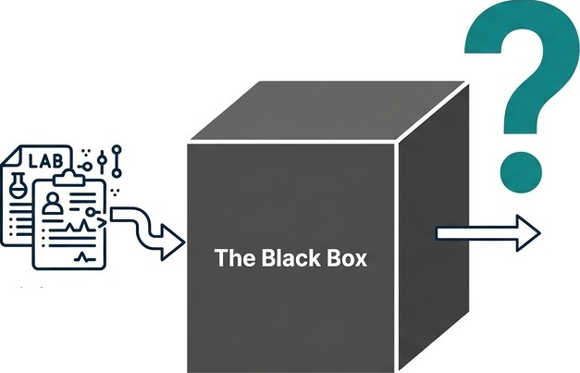
The AI Challenge: From Accuracy to Clinical Trust
The Accuracy–Interpretability Trade-off
Clinical Barrier and Research Need
In high-stakes healthcare settings, clinicians cannot rely on predictions that lack transparency and traceability.
Therefore, effective AI systems for CKD must achieve both high predictive accuracy and clinically meaningful explainability to support real-world clinical adoption.
Artificial Intelligence models have demonstrated high predictive accuracy in CKD risk prediction by learning complex, non-linear relationships from clinical data.
However, many high-performing models operate as “black boxes”, offering limited insight into how predictions are generated.
Prediction:
CKD
Clinical Data

Slide 7
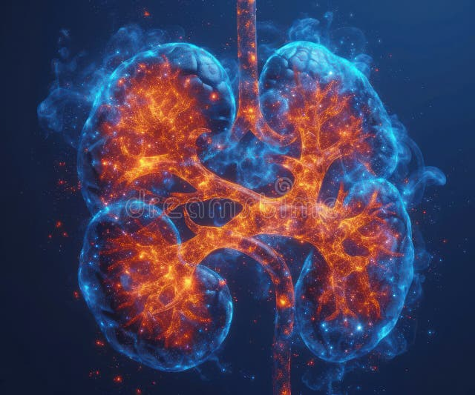
Problem Statement and Challenges
Problem Statement
Despite the high global burden of CKD, early-stage diagnosis remains challenging, as patients often present without clear clinical symptoms.
Current diagnostic approaches rely on limited and isolated biomarkers, leading to delayed detection and reduced opportunities for early intervention.
Challenges
Clinical assessment struggles to capture the complex interactions among multiple indicators (e.g., hemoglobin, blood pressure, albumin, comorbidities), reducing diagnostic sensitivity and generalizability.
Traditional statistical and rule-based methods are limited in modeling non-linear patterns in heterogeneous clinical data and often lack sufficient transparency for clinical adoption.

Slide 8

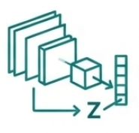


Research Objectives
Objective 1: Develop an Interpretable Hybrid Framework
Develop a hybrid framework that integrates deep learning and machine learning techniques to enable accurate and early prediction of Chronic Kidney Disease while maintaining interpretability.
Objective 2: Automate Feature Engineering
Employ a CNN-based encoder to automatically extract compact and informative latent feature representations from structured clinical data, reducing reliance on manual feature engineering.
Objective 3: Ensure Peak Performance
Apply a Genetic Algorithm (GA) to systematically optimize hyperparameters of machine learning classifiers, ensuring robust performance and fair model comparison.
Objective 4: Provide Clinical Traceability
Integrate Explainable AI (XAI) techniques to provide transparent and clinically meaningful explanations by linking model predictions to key clinical indicators.

Slide 9
02
Contributions
01
Introduction and Background

Slide 10




Research Contributions
Contribution 1: Hybrid and Interpretable AI Framework
Contribution 2: Automated Representation Learning
Contribution 3: Robust and Fair Model Optimization
Contribution 4: Clinically Meaningful Explainability
This research proposes a hybrid AI framework that integrates deep learning–based feature extraction with machine learning classifiers to achieve early and accurate CKD prediction while preserving interpretability.
A CNN-based encoder is introduced to automatically learn compact and informative latent representations from structured clinical data, reducing dependence on manual feature engineering.
A Genetic Algorithm (GA) is employed to systematically optimize model hyperparameters, enabling robust performance and fair comparison across multiple classifiers.
The framework incorporates Explainable AI (SHAP) to link model predictions to clinically relevant features, enhancing transparency and supporting clinical trust.

Slide 11
03
Literature Review
01
Introduction and Background

Slide 12
Table 1 Comparative Analysis of Related Work
Ref | Year | Dataset | Models | Results | Advantages | Limitations
Phuong et al. [1] | 2025 | UCI CKD dataset (400 samples, 24 features) | SVM, RF, KNN, LR, NB, DT | RF highest accuracy (~99%), SVM second (~98%), others 90–96% | - Comprehensive comparison of six popular ML algorithms on the same dataset. - Identified creatinine, hemoglobin, and specific gravity as top predictors. - Straightforward methodology for replication in similar datasets. | - Small dataset limits generalization. - No external validation performed. - Only binary classification; no CKD stage prediction
Metherall et al. [2] | 2025 | At-home monitoring dataset (short-term) | XGBoost, RF, SVM | XGBoost: ~96% accuracy; RF ~94%; SVM ~92% | - Incorporated at-home measurements (creatinine, BP) for early detection. - Compared multiple algorithms on identical features. - Useful in remote patient monitoring contexts. | - Short monitoring period limits ability to predict long-term progression. - Potential sensor inaccuracies in home data. - Limited demographic diversity in dataset.
Debal et al. [3] | 2022 | UCI CKD dataset | RF, SVM, LR | RF ~98%, SVM: 96%, LR: 92% | - Straightforward preprocessing steps for reproducibility. - RF performed consistently across folds. - Demonstrated stability with minimal parameter tuning. | - Limited dataset size and diversity. - Absence of advanced feature engineering. - No inclusion of temporal or longitudinal data.
Chowdhury et al. [4] | 2021 | Type 1 diabetes CKD dataset | RF, SVM, LR, KNN, NB | RF: ~95%, SVM: ~94%, LR: ~92%, KNN: ~91%, NB: ~90% | - Compared performance of multiple classic ML models. - Dataset focused on diabetic CKD detection. - Identified early markers in diabetic patients. | - Narrow patient population limits generalization. - No advanced ensemble or hybrid methods tested. - Limited to static data without time-series analysis.
Alsekait et al. [5] | 2023 | UCI CKD dataset (400 samples) | Stacked DNNs (CNN, RNN) + SVM meta-classifier | Accuracy: 99.69%, F1 = 0.997, AUC: 0.999 | - Leveraged multiple model strengths, - population based optimization, - improved learning via feature selection. | - Possible overfitting, - ensemble complexity hinders real-time use, - untested on real-world EHRs.
Tian et al. [6] | 2024 | Renal ultrasound (1,049 patients, 4,365 images) | ResNet-34 CNN + radiomic features + fusion ensemble | AUC: 0.918 overall, 0.867–0.931 (G4–G5 stages) | - Outperformed physicians in early detection, - Hybrid of CNN and expert texture features, - Highly relevant to clinical practice. | - Single-center training, - Low interpretability, - Lacked integration with clinical data.

Slide 13
04
Methodology
01
Introduction and Background

Slide 14
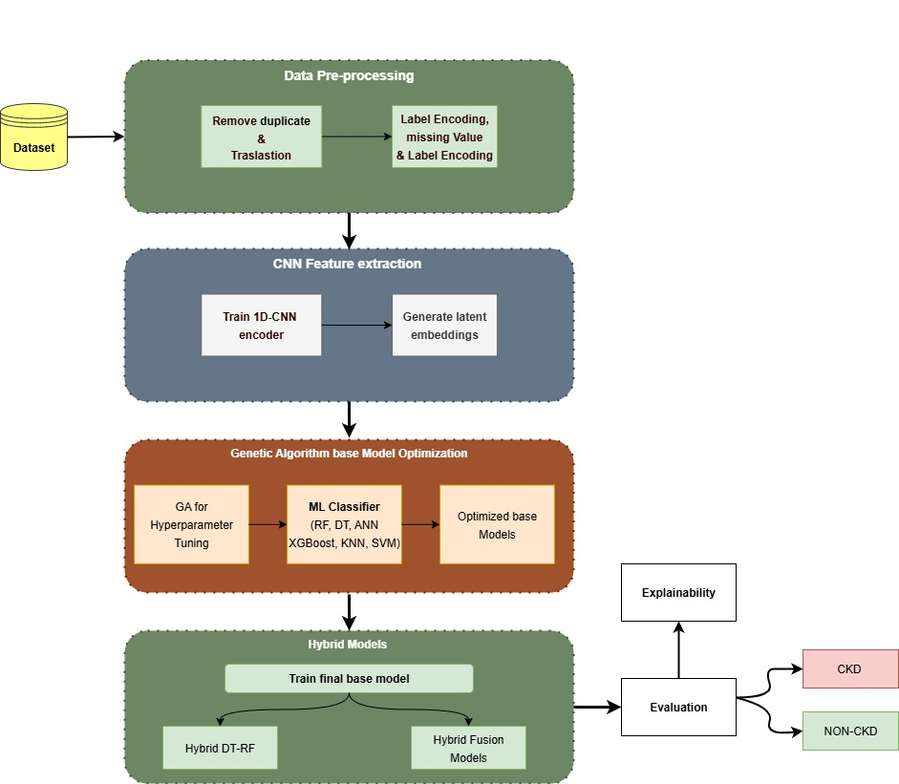
Proposed CKD Prediction Framework

Slide 15
Structured clinical dataset overview
Key numerical features
Categorical urine markers
Dataset Notes
Total records: 15,051
Urine specific
gravity
Target: binary CKD versus Non-CKD
Class distribution: approximately balanced (suitable for stratified sampling)
Vitals: blood pressure, pulse
Albumin
(categorical levels)
Hematology: hemoglobin, PCV
Sugar
(categorical levels)
Mixed data types support supervised classification experiments
Biochemistry: serum creatinine, blood urea, sodium, potassium
RBC presence
The experiments were conducted on a publicly available CKD dataset containing 15,051 patient records with 21 clinical features and a binary CKD label
Pus cells presence

Slide 16
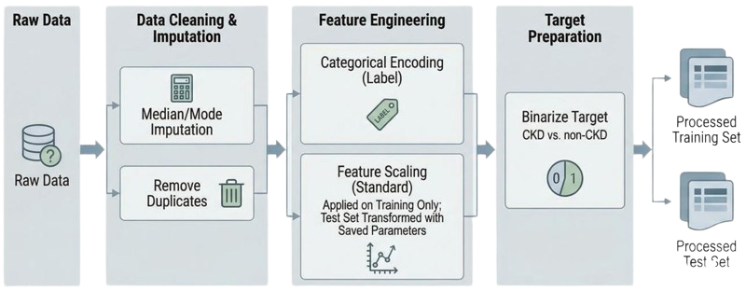
Data Preprocessing Methodology
Processed
Training Set
Processed
Test Set

Slide 17
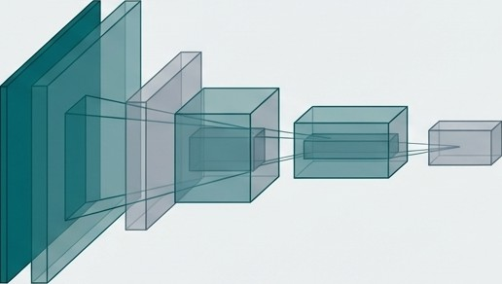




CNN Encoder
Instead of relying on manual feature engineering, we use a one-dimensional CNN to automatically learn the most informative patterns and non-linear interactions within the raw clinical data.
Input: 19 Preprocessed CNN Encoder
ClinicalVariables
Output: 32-dimensional Latent Feature Vector (Z)
e.g„ Serum Creatinine,
Hemoglobin, Pus Cells
This data-driven approach creates a feature representation that is fundamentally more powerful than the raw inputs alone.

Slide 18
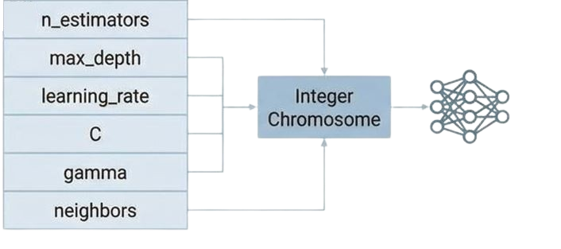
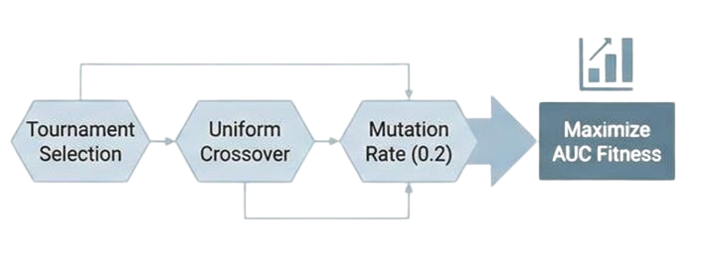
GA Optimization
Configuring Integer Chromosomes & Genetic Algorithm Steps for Model Enhancement
Hyper-Parameter Mapping
GA Process Configuration

Slide 19
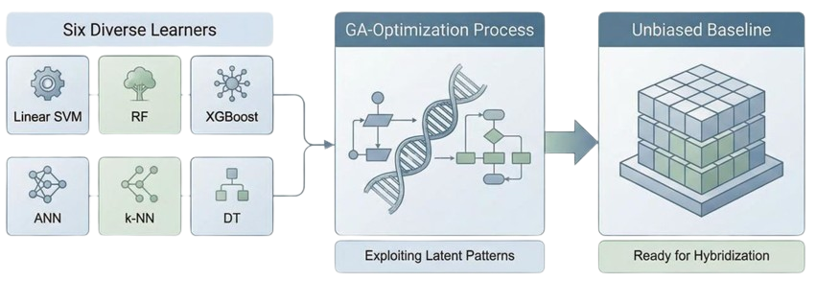
Baseline Model Development
Establishing an Unbiased Foundation for Hybridzation through GA Optimization

Slide 20





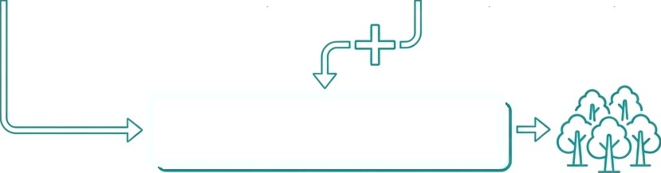
The Hybrid (DT-RF) Model for Traceability
Rationale: To engineer a model that embeds explicit, rule-based logic from a Decision Tree within the robust predictive power of a Random Forest.
Latent Features (Z)
One-Hot Encoded Rules
1. Rule Extraction
2. Logic Representation
Augmented Feature Set (Z + Rules)
3. Concatenation
4. Final Prediction

Slide 21
05
Results and Analysis
01
Introduction and Background

Slide 22
Experimental Design and Evaluation Protocol
Data Configuration
Training set: 70%
Testing set: 30%
Workflow
Preprocessing and feature encoding fitted on training data only
CNN-based feature extraction to learn latent representations
Independent training of multiple ML classifiers
Genetic Algorithm–based hyperparameter optimization
Construction of hybrid models using optimized components
Evaluation Strategy
Evaluation on unseen test data
Performance metrics: Accuracy, Precision, Recall, F1-score, AUC
Fair comparison across baseline and hybrid models

Slide 23
Performance of CNN–GA Optimized Base Models
Table 2: Performance of GA-Optimized Base Models on the Test Dataset
Model | Accuracy | Precision | Recall | F1-score | AUC
ANN_GA | 0.9971 | 0.9946 | 0.9995 | 0.9971 | 0.9998
XGB_GA | 0.9978 | 0.9968 | 0.9986 | 0.9977 | 0.9997
RF_GA | 0.9978 | 0.9964 | 0.9991 | 0.9977 | 0.9994
SVM_GA | 0.9980 | 0.9968 | 0.9991 | 0.9980 | 0.9989
DT_GA | 0.9978 | 0.9964 | 0.9991 | 0.9977 | 0.9984
KNN_GA | 0.9982 | 0.9968 | 0.9995 | 0.9982 | 0.9982
Key Insights:
All CNN–GA optimized models achieved consistently high performance across all evaluation metrics.
The results confirm the effectiveness of CNN-based feature extraction combined with GA optimization

Slide 24
Performance of the Proposed Hybrid Models
Model | Model Type | Accuracy | Precision | Recall | F1-score | AUC
Hybrid_DT_RF | Structural Hybrid | 0.9980 | 0.9968 | 0.9991 | 0.9980 | 0.9995
HybridB_Fusion (ANN_GA + XGB_GA) | Probability Fusion | 0.9973 | 0.9950 | 0.9995 | 0.9973 | 0.9998
HybridD_Fusion (ANN_GA + RF_GA) | Probability Fusion | 0.9973 | 0.9950 | 0.9995 | 0.9973 | 0.9998
HybridF_Fusion (DT_GA + XGB_GA) | Probability Fusion | 0.9980 | 0.9968 | 0.9991 | 0.9980 | 0.9995
HybridE_Fusion (RF_GA + DT_GA) | Probability Fusion | 0.9980 | 0.9968 | 0.9991 | 0.9980 | 0.9994
HybridC_Fusion (XGB_GA + SVM_GA) | Probability Fusion | 0.9980 | 0.9968 | 0.9991 | 0.9980 | 0.9992

Slide 25
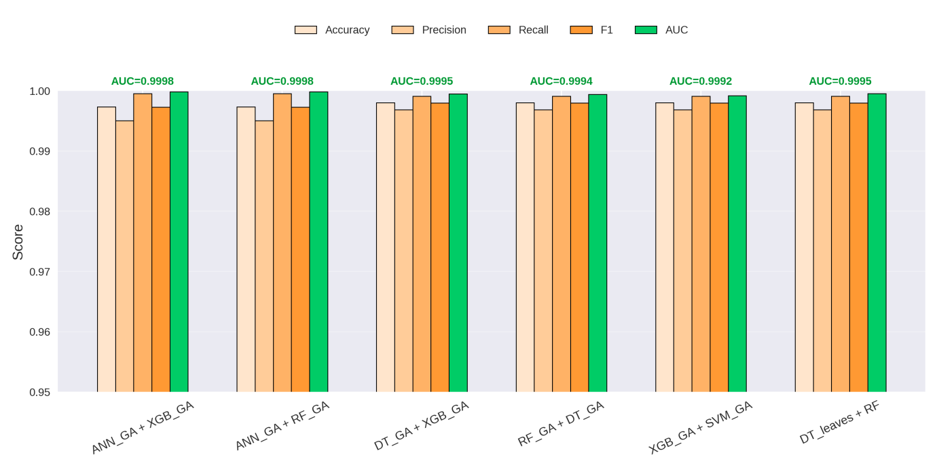
Comparative Performance Analysis

Slide 26
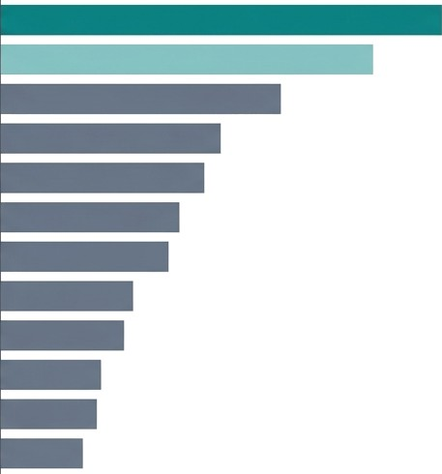
SHAP Explainability
Global Feature Importance (Mean Absolute SHAP Value)
CNN_Feature_13
DT RuIe_4
CNN_Feature 5
DT_RuIe_2
CNN Feature 21
DT Rule 1
CNN_Feature 9
DT_RuIe_3
CNN Feature 2
DT_RuIe 5
CNN Feature 17
DT Rule 0
Analysis Method: A SHAP (SHapley Additive exPlanations) analysis was applied to the Hybrid_DT RF model to quantify the impact of each featur's feature on its
predictions.
Key Insight: The model's predictive power comes from a combination of automatically learned latent representations and structurally integrated decision rules.

Slide 27
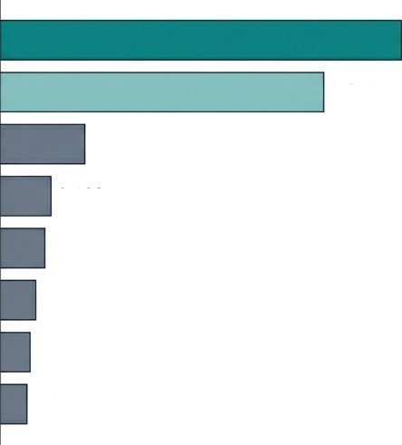
Reverse SHAP Mapping
The Key Contribution:
A Reverse SHAP Mapping strategy was employed to trace the contribution of the most influential latent features learned by the CNN (e.g., CNN_Feature_13) back to the original clinical variables.
Clinical Validation:
The analysis demonstrates that the model’s predictions are primarily driven by well-established clinical indicators of chronic kidney disease, including red blood cell count, pus cells, urine-specific gravity, hemoglobin, and blood pressure.
Clinical Significance:
These findings confirm that the proposed hybrid framework is not only highly accurate, but also clinically interpretable, as its decision-making process can be transparently linked to meaningful and medically relevant biomarkers.
Top Clinical Predictors (Normalized Reverse SHAP Impact)
Red Blood Cells
1.000
Pus_CeIIs
0.805
Urine_Soecific_Gravity
0.212
Urine_Sugar
0.174
Hemoglobin
0.144
WBC_Count
0.138
Appetite
0.131
Blood_Pressure
0.12

Slide 28
06
Conclusion and Future Work
01
Introduction and Background

Slide 29
Conclusion
A hybrid CNN–GA framework was proposed for early CKD prediction using structured clinical data.
The CNN encoder successfully learned compact latent representations, reducing reliance on manual feature engineering.
GA-based optimization ensured robust and fair performance across multiple ML classifiers.
Hybrid models, particularly the structural DT–RF hybrid, achieved near-perfect diagnostic performance.
SHAP and Reverse SHAP provided clinically meaningful explanations, bridging the gap between accuracy and trust.

Slide 30
A Foundation for the Future of Diagnostic Al
This study establishes a robust and interpretable framework for early CKD prediction, combining high diagnostic accuracy with clinical transparency.
Building on these findings, several promising research directions can be pursued:
Enhancing
Generalizabitity
To ensure robustness and real-world applicability, future studies will validate the framework on larger and more diverse multi-institutional datasets, improving generalization across different populations and healthcare environments.
Modeling Disease
Progression
Future work will focus on incorporating longitudinal (time-series) patient data to move beyond binary CKD classification toward stage-wise prediction and disease progression modeling, enabling earlier and more personalized clinical interventions.
The Path to Clinical Deployment
The ultimate objective is to translate the proposed framework into a real-time clinical decision support system. This requires addressing challenges related to data privacy, integration with Electronic Health Records (EHRs), and conducting prospective clinical validation studies.

Slide 31
07
References
01
Introduction and Background

Slide 32


Phuong, N. D., Tuyen, N. T., Linh, V. T. T., Nguyen, N. N., & Nguyen, T. Q. (2025). Machine learning techniques in chronic kidney diseases: A comparative study of classification model performance. Bioinformatics and Biology Insights, 19, 11779322251356563.
Metherall, B., Berryman, A. K., & Brennan, G. S. (2025). Machine learning for classifying chronic kidney disease and predicting creatinine levels using at-home measurements. Scientific Reports, 15, 4364.
Debal, D. A., & Sitote, T. M. (2022). Chronic kidney disease prediction using machine learning techniques. Journal of Big Data, 9, 1–19.
4. Chowdhury, N. H., Hossain, F., Rahman, K., et al. (2021). Performance analysis of conventional machine learning algorithms for identification of chronic kidney disease in type 1 diabetes mellitus patients. Diagnostics, 11(12),
5. Alsekait, D. M., Saleh, H., Gabralla, L. A., Alnowaiser, K., El-Sappagh, S., Sahal, R., & El-Rashidy, N. (2023). Toward Comprehensive Chronic Kidney Disease Prediction Based on Ensemble Deep Learning Models. Applied Sciences, 13(6), 3937.
6. Tian, S., Yu, Y., Shi, K., Jiang, Y., Song, H., Wang, Y., Yan, X., Zhong, Y., & Shao, G. (2024). Deep learning radiomics based on ultrasound images for the assisted diagnosis of chronic kidney disease. Nephrology (Carlton, Vic.), 29(11), 748–757.

Slide 33
Thank you

