Slide 1

PMG 506
Advanced Project Management
LECTURE 4
Feb 20, 2021
Everyone’s Smart
University
Managing conflicts and the art of communication

Slide 2

PMG506 Advanced Project Management (APM)
Introduction:
Lecture 1 Introduction to APM and Initial Project Strategy
Lecture 2 Project Quality Management
Project planning
Lecture 6 Initial project coordination and the project Charter
Lecture 7 Starting the project plan: The WBS
Lecture 8 Project risk management
Lecture 9 Budgeting, Estimating costs and risks
Project Initiation:
Lecture 3 Project Communication and team Management
Lecture 4 Managing conflicts and the art of communication
Lecture 5 Strategic Management and project selection
Project Execution
Lecture 10 Monitoring and information systems
Lecture 11 Project Control
Lecture 12 Project Auditing
Lecture 13 Project termination

Slide 3


Learning Outcomes
By the end of this lecture, you will be able to:
Understand what a conflict is.
Identify the types of conflicts that frequently occur in the project environment.
Discuss sources of conflict over the Project Life Cycle.
Understand the nature of negotiation.
Understand some requirements and principles of negotiation.

Slide 4
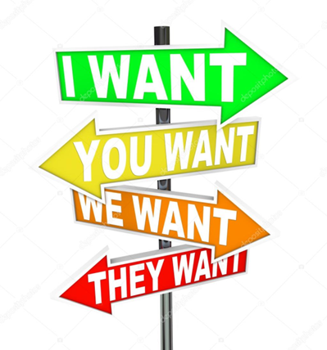
Why should there be so much conflict on projects?
conflict arises when people working on the same project have somewhat different ideas about how to achieve project objectives.

Slide 5
Why should such a disagreement occur?
Is there not “one best way?”
The process of planning a project usually requires inputs from many people. Even when the project is relatively small and simple, planning involves the interaction of almost every functional and staff operation in the organization. It is virtually impossible for these interactions to take place without conflict, and when a conflict arises, it is helpful if there are acceptable methods to reduce or resolve it.

Slide 6


What is conflict?

Slide 7
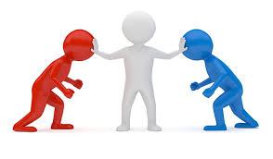
Conflict: an active disagreement between people with opposing opinions or principles.

Slide 8

Conflict
Conflict has sometimes been defined as “the process which begins when one party perceives that the other has frustrated, or is about to frustrate, some concern of his”.
A party to the conflict will be satisfied when the level of frustration has been lowered to the point where no action, present or future, against the other party is expected.
When all parties to the conflict are satisfied to this point, the conflict is said to be resolved.

Slide 9

The types of conflicts that frequently occur in the project environment.
Disagreements and conflicts naturally emerge within a project team during the life of the project.
Participants will disagree over priorities, allocation of resources, the quality of specific work, solutions to discovered problems, and so forth. Some conflicts support the goals of the group and improve project performance.
On the other hand, conflicts can also hinder group performance. Initial disagreements can escalate into heated arguments with both parties storming out of the room and refusing to work together.

Slide 10
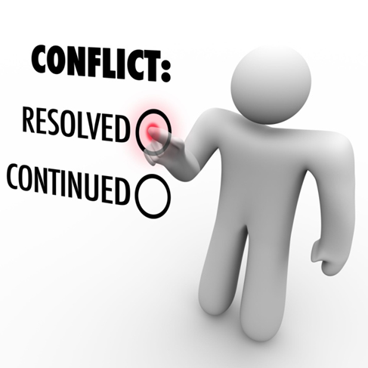
Example:
For example, two members may be locked in a debate over a design trade-off decision involving different features of a product. They argue that their preferred feature is what the primary customer truly wants.
This disagreement may force them to talk to or get more information from the customer, with the result that they realize neither feature is highly valued, but instead the customer wants something else.

Slide 11
The types of conflicts that frequently occur in the project environment.
Functional Conflict
Conflict that supports the goals of the group and improves its performance.
Dysfunctional Conflict
Conflict that hinders group performance.

Slide 12

Functional conflict
Encouraging Functional Conflict
The demarcation between functional and dysfunctional conflict is neither clear nor precise.
The distinguishing criterion is how the conflict affects project performance, not how individuals feel.
Members can be upset and dissatisfied with the interchange, but if the disagreement furthers the objectives of the project, then the conflict is functional.
Project managers should recognize that conflict is an inevitable and even a desirable part of project work; the key is to encourage functional conflict and manage dysfunctional conflict.

Slide 13

How to manage dysfunctional conflict?
There is often no easy solution to dysfunctional conflict. Project managers must decide among several different Strategies to manage it; the following are five possibilities:
Mediate the conflict.
1
Arbitrate the conflict.
2
Control the conflict.
3
Accept it.
4
Eliminate the conflict.
5

Slide 14

1. Mediate the conflict
- The manager tries to negotiate a resolution by using reasoning, persuasion, and suggesting alternatives.
- One of the keys is trying to find common ground.
- In some cases, the project manager can make the argument that the win/lose interchange has escalated to the point that it has become lose/lose for everyone and now is the time to make concessions.

Slide 15

2. Arbitrate the conflict
The manager imposes a solution to the conflict after listening to each party.
The goal is not to decide who wins but to have the project win.
- In doing so, it is important to seek a solution that allows each party to save face; otherwise, the decision may provide only momentary relief.

Slide 16
3. Control the conflict
Reducing the intensity of the conflict by smoothing over differences or interjecting humor is an effective strategy.
If feelings are escalating, the manager can adjourn the interaction and hope cooler heads prevail the next day.
- If the conflict continues to escalate, project assignments may need to be rearranged if possible so that two parties don’t have to work together.

Slide 17
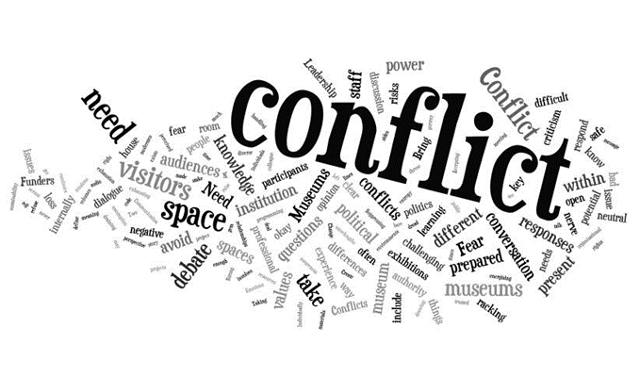
4. Accept it
In some cases, the conflict will outlive the life of the project and, though a distraction, it is one the manager must live with.

Slide 18

5. Eliminate the conflict.
- Sometimes the conflict has escalated to the point that it is no longer tolerable. If there is a clear villain then only, he or she should be removed.
- If, as is often the case, both parties are at fault, then it would be wise if possible, to eliminate both individuals.
- Their removal would give a clear signal to the others on the team that this kind of behavior is unacceptable.

Slide 19
Summary 1
In summary, project managers establish the foundation for functional conflict by establishing clear roles and responsibilities, developing common goals or a shared vision, and using group incentives that reward collaboration.
Project managers must be adroit at reading body language to identify unspoken disagreement. They also must stay connected with what is going on in a project to identify small problems that might escalate into big conflicts.
Well-timed humor and redirecting the focus to what is best for the project can alleviate the interpersonal tensions that are likely to flare up on a project team.

Slide 20

Learning Summary and Evaluation 1
The main idea I have learnt?
A new word I have learnt today is? It means……
How could I apply these ideas towards my course studies and career aspiration?

Slide 21


1. What is conflict?
Conflict: an active disagreement between people with opposing opinions or principles.
2. What are the types of conflicts that frequently occur in the project environment are?
Functional Conflict
Dysfunctional conflict

Slide 22
Sources of Conflict over the Project Life Cycle

Slide 23
1. During project definition
During project definition, the most significant sources of conflict are priorities, administrative procedures, and schedule.
Disputes occur over the relative importance of the project compared with other activities, which project management structure to use (especially how much control the project manager should have), the personnel to be assigned, and the scheduling of the project into existing workloads.

Slide 24
2. During the planning phase
During the planning phase, the chief source of conflict remains priorities, followed by schedules, procedures, and technical requirements.
This is the phase where the project moves from a general concept to a detailed set of plans. The relative importance of the project is still trying to be established as well as project priorities (time, cost, scope).
Disagreements often emerge over the final schedule, the assignment of resources, communication and decision-making procedures, and technical requirements for the project.

Slide 25
3. During the execution phase
During the execution phase, friction arises over schedule slippage, technical problems, and staff issues.
Milestones become more difficult to meet because of accumulating schedule slippages. This leads to tension within the team as delays prevent others from starting or completing their work.
Managing the trade-offs between time, cost, and performance becomes paramount. Project managers must decide between letting the schedule slip, investing additional funds to get back on track, or scaling back the scope of the project in order to save time.
Technical problems involve finding solutions to unexpected problems and integrating the contributions of different people. The strain of the project may be expressed in interpersonal conflicts as well as pressures to use resources more effectively.

Slide 26
4. During the delivery phase
During the delivery phase, the level of conflict tends to subside.
On troubled projects schedules continue to be the biggest source of conflict as schedule slippages make it more difficult to meet target completion dates.
Pressures to meet objectives coupled with growing anxiety over future assignments increase interpersonal tensions.
Technical problems are rare since most of them have been worked out during the earlier phases.

Slide 27

Learning Check
Can you work out sources of conflict over the Project Life Cycle. 1 minute GO!
Priorities
Defining
Technical
Planning
Workforce
Executing
Delivery
How many did you get right?

Slide 28

The Nature of negotiation
The favored technique for resolving conflict is negotiation.
What is negotiation?

Slide 29
Negotiation
Negotiation is a field of knowledge that focuses on gaining the favor of people from whom we want things.
Negotiation is a process for resolving conflict
Negotiation takes place when two or more people, with differing views, come together to attempt to reach agreement on an issue.

Slide 30

“Negotiation is about getting the best possible deal in the best possible way.”

Slide 31
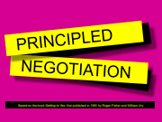
Based on the book Getting to Yes, first published in 1981 by Roger Fisher and William Ury

Slide 32
Principled negotiation is defined by four points:
1. Separate people from problem
2. Focus on interests, not positions
3. Invent options for mutual gain
4. Insist on using objective criteria

Slide 33
1. Separate people from problem
1. Remember that people are human.
2. Emotions can become entangled with the problem and can set ‘positions’.
3. Try to understand their perceptions.
4. Don’t assume you know how they feel.
5. Be able to see it from their side.
6. Openly discuss different perceptions.
7. Don’t blame people for problems.

Slide 34
2. Focus on interests, not positions
2. Interests can inform positions.
3. Look at interest from their perspective.
4. Sharing interests can show both sides not as opposed as initially thought.
5. Seek to understand their needs and wants.
6. Money is NOT the most important driver, sometimes there are human needs.
7. Openly discuss and understand interests.

Slide 35
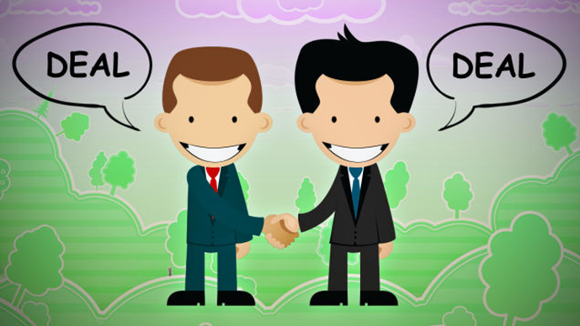
3. Invent options for mutual gain
1. When stuck, sit back and be creative in generating new ideas.
2. Encourage looking at the bigger picture.
3. Don’t think your offer or view is the only solution.
4. Step back from positions and refocus on interests.
5. Try and solve each others' problems.
6. Be prepared to lead and encourage brainstorming.

Slide 36
4. Insist on using objective criteria
1. Bring standards of fairness or scientific merit to problems.
2. Use recent comparisons or guides.
3. Be specific with facts.
4. Refer to original aims and ideal outcomes.
5. Review limitations, scope or authority and autonomy.
6. Develop specific criteria where needed.

Slide 37
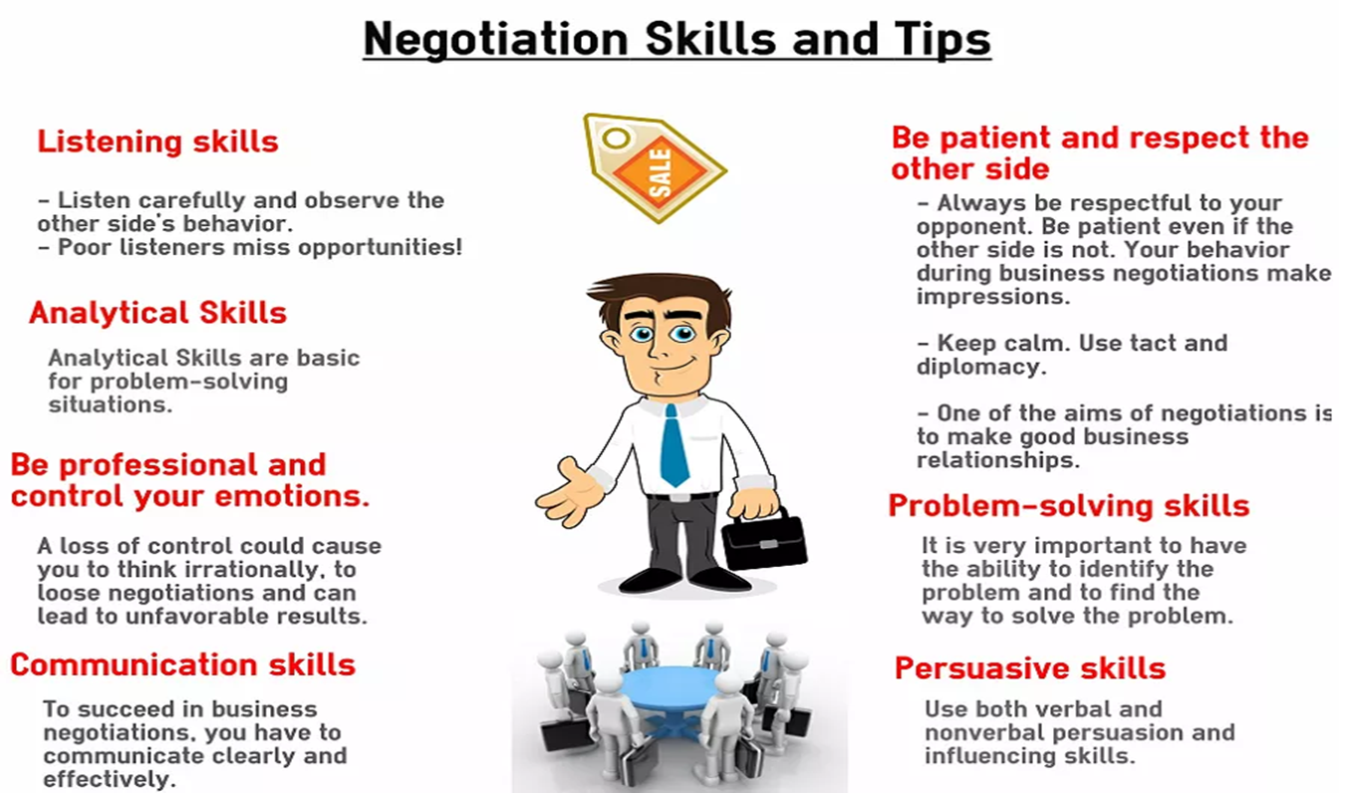

Slide 38
Learning Check
The favored technique for resolving conflict is:
A. Negotiating
B. Conciliation
C . Removal of participants
D. Not entertaining them
2. The fourth point of principled negotiation:
A. Separate people from problem
B. Insist on using objective criteria
C. Focus on interests, not positions
D. Invent options for mutual gain

Slide 39
Summary 2
This lecture addressed the need for negotiation as a tool to resolve project conflicts. We discussed the nature of negotiation and its purpose in the organization. We also described various categories of conflict and related them to the project life cycle. We followed this by identifying several requirements and principles of negotiation.
Specific points made in the lecture were these:
Negotiation within the firm should be directed at obtaining the best outcome for the organization, not winning.
The total level of conflict is highest during the project planning stage.
Project negotiation requirements are that conflicts must be settled without permanent damage, the methodology must foster honesty, and the solution must satisfy both individuals’ and the organization’s needs.
An approach to meeting the requirements of project negotiation is called “principled negotiation”.

Slide 40
What is next?
In the next lecture we move to the process of evaluating and selecting projects, as well as the information needed for project selection, and evaluation.

Slide 41

Glossary
Conflict: an active disagreement between people with opposing opinions or principles.
Functional Conflict : Conflict that supports the goals of the group and improves its performance.
Dysfunctional Conflict: Conflict that hinders group performance.
Negotiation: A field of knowledge that focuses on gaining the favor of people from whom we want things.
Positional Negotiation Stating immediate wants on the assumption that the environment is static.
Principled Negotiation A process of negotiation that aims to achieve a win-win result.
Parties-at-interest Those who have a vested interest in the outcome of the negotiations.
Win-win When both parties are better off in the outcome.

Slide 42
Discussion Questions
Identify the types of likely conflicts during the project.
Discuss sources of conflict over the Project Life Cycle.
Describe the four points of principled negotiation.

Slide 43
Resources

Slide 44


