Slide 1


Prepared by Dr. Weam Nasan Agha
REA619
Property and Facilities Management
Lecture 1

Slide 2



Real Estate Management
Lecture 1
REA619
Property and Facilities Management
Prepared by
Dr. Weam Nasan Agha

Slide 3

Contents
Introduction to Property Management
Ownership vs. Leasehold
License vs. Lease
The Tenancies in Real Estate
Landlord’s Right to Enter
Rules for Terminating a Tenancy
Recovering Possession of Property
Property Management Agreement (PMA)

Slide 4

Introduction to Property Management
Property Management is the day-to-day operation and oversight of a real estate asset on behalf of the owner. It involves collecting rent, overseeing maintenance, handling tenant relations, and ensuring the property complies with regulations.
Types of Property Managed:
Commercial:
offices, retail spaces
Industrial : warehouses, factories
Residential:
apartments, single-family homes
Others:
Mixed-use, HOA, vacation rentals
Notes:
Each property class requires unique management strategies, legal considerations, and communication styles.

Slide 5


Introduction to Property Management
Real estate vs. Property:
Real estate : sometimes legally called real property or realty, consists of:
• the land;
• the improvements and fixtures attached to the land; and
• all rights incidental or belonging to the property.
Property : Refers to the legal rights of ownership, use, and control over an asset.
It is broader, as it can include both tangible assets (like real estate) and intangible assets (like stocks or intellectual property).
In real estate, Property highlights the ownership and investment aspect of the asset.
Notes:
A building with land = Real Estate.Your right to own, lease, or sell that building = Property.

Slide 6
Introduction to Property Management
Objectives of Property Management:
Objectives of Property Management:
Maximize the investment return (ROI) through occupancy and rental income
Ensure tenant satisfaction and minimize vacancy
Maintain legal and regulatory compliance
Preserve physical and financial value of the property
Notes:
Maintaining property conditions
Communicating with tenants
Handling complaints and legal procedures
Preparing accurate reports for the owner
Ensuring contracts are followed
Lease renewals and marketing empty units

Slide 7
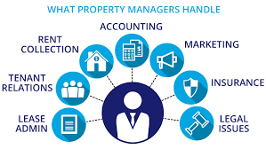
Introduction to Property Management
Responsibilities of Property Manager:
Property Manager serves as the essential link between the passive investor (Owner) and the active consumer (Tenant). Professional managers adhere to codes of conduct, mitigating risk for the owner.
Notes:
Maintaining property conditions
Communicating with tenants
Handling complaints and legal procedures
Preparing accurate reports for the owner
Ensuring contracts are followed
Lease renewals and marketing empty units

Slide 8
Introduction to Property Management
Role of Property Manager vs. Owner:
Why Owners Outsource?
Expertise (Legal/Finance),
Time (Operational Burden),
Detachment (Handling difficult evictions/disputes professionally).
Function | Property Manager | Owner
Main Role | Manages ongoing operations (leasing, rent, maintenance) | Owns the property , strategic investment decisions
Involvement | Daily / High involvement (tenants, maintenance, rent) | Strategic / Limited (long-term decisions)
Income | Fee/percent of rent | ROI, appreciation
Notes:
مكن للمالك أن "يُدير عقاره بنفسه" في حال كان صغيرًا (DIY Management)، لكن الأمر ليس عمليًا في العقارات الكبيرة أو متعددة الوحدات.
مدير الممتلكات هو عنصر أساسي لضمان الكفاءة التشغيلية والامتثال القانوني، وخاصة في الأسواق العقارية الحديثة والمنافسة.
بعض الملاك يتدخلون استراتيجيًا فقط (مثل تحديد سياسة التسعير، أو قرار البيع)، ويتركون التفاصيل اليومية للمدي

Slide 9
Introduction to Property Management
Role of Property Manager vs. Real Estate Agent:
Function | Property Manager | Real Estate Agent
Main Role | Manages ongoing operations | Helps buy/sell or lease Transactional
Involvement | Long-term, ongoing | Short-term, one-time
Paid by | Owner, monthly/percent fee | Commission on deal
Property Manager is Ongoing Management stays after the deal
Real Estate Agent is Transaction Facilitation leaves after sign-off
Notes:
Agents work on deals, managers ensure the deal runs successfully afterwards.

Slide 10
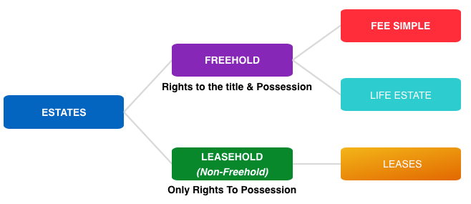
Ownership vs. Leasehold
Estates: The ownership interests a person may hold in real estate.
Estates at will
Notes:
Four types of estates exist in real estate:
Difference: Ownership endures; possession expires.
The Highest Right: Fee Simple Estate----The Highest Right: Fee Simple Estate The owner possesses the land and everything attached to it, virtually forever, with full rights to transfer or encumber the property. Ch. 1, p. 1
13 The Contractual Right: Leasehold Estate A temporary right derived from the Fee Simple owner. The tenant receives the right to possession, but the owner retains the reversionary interest.
Fee Example: landowner fully holding title
Lease Example: apartment tenant.

Slide 11
Ownership vs. Leasehold
Person who holds a fee estate interest in real estate is a fee owner (landlord).
Fee Simple
An indefinite, exclusive and absolute legal ownership interest in a parcel of real estate.
Life Estate
An interest in a parcel of real estate lasting the lifetime of the life tenant.

Slide 12
Ownership vs. Leasehold
Leases
sometimes called estates for years ,The right to possess a parcel of real estate, conveyed by a fee owner (landlord) to a tenant.
Estates at will
are considered part of the leasehold estates category. Leasehold estates are controlled by landlord/tenant law.

Slide 13
Ownership vs. Leasehold
Estate in Land | Right of Ownership | Right of Possession
Fee Simple | Fee simple owner | Fee simple owner
Life Estate | Remainderman | Life Tenant
Leasehold Estate | Landlord | Tenant
Notes:
leasehold is a time-bound right to use, not own.

Slide 14
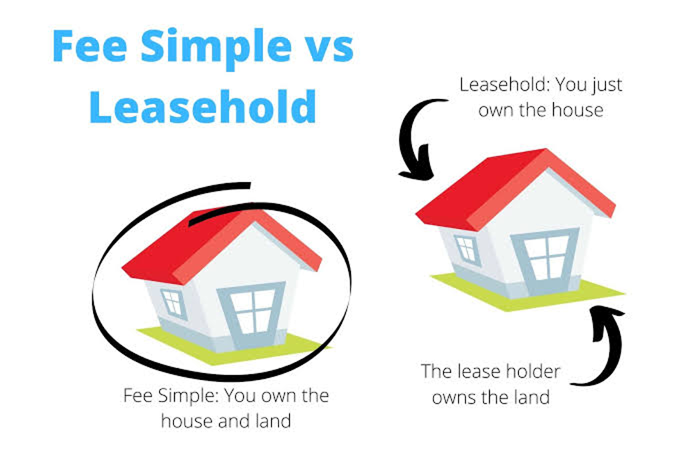
Ownership vs. Leasehold
Criteria | Fee Simple | Leasehold
Duration | Unlimited | Temporary
Rights | Ownership | Possession
Income | Owner gains ROI | Tenant obligated rent
Notes:
leasehold is a time-bound right to use, not own.

Slide 15
License vs Lease
License: The personal, unassignable right held by an individual to the non-exclusive use of property owned by another. A License is revocable at any time by the licensor; it provides no estate in land.
Lease :provides a tenant with an enforceable property interest.
License: | Lease :
Personal permission to use property | Legally binding contract
No exclusive possession | Grants exclusive possession
Revocable by owner at any time | Fixed term (months/years), enforceable
Minimal legal protection | Strong tenant protection under law
Example: kiosk, parking ticket, Coffee cart in a mall. | Example: apartment, office rental, store in a mall
Notes:
licencePermission only, can be terminated.
Not protected by “tenant rights
Lease :Exclusive area, contractual, legal protection.

Slide 16
License vs Lease
A license is not a property right but a personal permission to use property.
Unlike leases or easements, licenses do not run with the land and cannot bind future owners.
Rent is usually tied to lease agreements, not licenses. Licenses may involve small fees or contributions, but often it’s about access.
It’s possible for someone to be both a tenant (lease) and a licensee (license) simultaneously.
When conditions of a license become detailed (maintenance, rent-like payments), law may recharacterize it as a lease.
This distinction is crucial legally because of tenant rights (lease) vs. revocability (license).
Notes:
For example, a person who is a tenant with
exclusive occupancy to part of the space on the premises of a shopping
center also holds a license to use an adjacent portion of the premises as
well.

Slide 17
The Tenancies in Real Estate
Types of Tenancies
Fixed-term tenancies
(Lease /estate for years)
Periodic tenancies
(rental)
Tenancies-at-will (estate at will)
Tenancies-at-sufferance (holdover tenancy)
Notes:
such as
in a month-to-month tenancy, until terminated by notice by either the
landlord or the tenant

Slide 18
The Tenancies in Real Estate
A leasehold interest which lasts for the specific lease period set forth in a lease agreement. A fixed-term tenancy automatically terminates at the end of the lease period.
Fixed-term tenancies
(Lease /estate for years)
A leasehold interest which lasts for a specific length of time, such as month or year. the landlord and tenant agree to automatic equal, successive rental periods of time
Periodic tenancies
(rental)
Notes:
such as
in a month-to-month tenancy, until terminated by notice by either the
landlord or the tenant

Slide 19
The Tenancies in Real Estate
A leasehold interest granted to a tenant with the landlord’s knowledge and consent, with no fixed duration or rent owed. It can be terminated at any time by an advance notice from either party.
Tenancies-at-will (estate at will)
A leasehold interest held by a tenant who retains possession of the rented premises after the termination of the tenancy without any contractual right to do so.
Tenancies-at-sufferance (holdover tenancy)
Notes:
such as
in a month-to-month tenancy, until terminated by notice by either the
landlord or the tenant

Slide 20
The Tenancies in Real Estate
Aspect | Fixed-Term Tenancy (Estate for Years) | Periodic Tenancy | Tenancy at Will | Tenancy at Sufferance (Holdover)
Definition | Lease for a specific start & end date | Automatically renews each period (e.g., month-to-month) | Informal; no set term; ends anytime by either party | Tenant remains after lease expiration without landlord’s consent
Duration | Fixed (e.g., 1 year, 6 months) | Indefinite – continues until notice served | No defined duration | No legal term; unlawful occupation
Termination | Ends automatically at expiration date | Requires proper written notice (30–60 days typical) | Terminable anytime by landlord or tenant | Requires eviction notice & court action (UD)
Notes:
such as
in a month-to-month tenancy, until terminated by notice by either the
landlord or the tenant

Slide 21
The Tenancies in Real Estate
Aspect | Fixed-Term Tenancy (Estate for Years) | Periodic Tenancy | Tenancy at Will | Tenancy at Sufferance (Holdover)
Tenant Rights | Full rights for duration of lease | Full rights, but subject to notice | Minimal rights, fragile status | Very limited; tenant considered trespasser
Landlord’s Role | Bound until lease expiry, cannot evict early (except breach) | Must give proper notice to terminate | Can end at any time | Must use legal eviction process
Example | 1-year apartment lease | Month-to-month rental after initial lease | Friend allowed to stay without contract | Tenant overstaying after lease expiration
Notes:
such as
in a month-to-month tenancy, until terminated by notice by either the
landlord or the tenant

Slide 22
The Tenancies in Real Estate
Changing Tenancy Type:
Tenancy type is not fixed forever — it can shift depending on actions.
Tenancy can change due to three main reasons:
1) Proper notice by landlord
2) Expiration of a lease
3) Conduct of parties
Example:
A one‑year fixed lease expires → tenant stays and pays rent → landlord accepts → legally, this creates a new periodic tenancy, not another fixed term.
Notes:
وهذا يتجنب وصف المستأجر بأنه "متعدي" على الفور.يجب على المالك إصدار إشعار (بموجب القانون، عادةً 30 يومًا من شهر لآخر) للإنهاء.من المفيد مقارنة القانون العام (الولايات المتحدة/المملكة المتحدة) مع اللوائح المحلية (على سبيل المثال نظام الإيجار في السعودية / القانون المدني الإماراتي): بعض القوانين العربية تعتبر المستأجر المتأخر “متأخر بدون سند” إذا لم يدفع أو لم يتم تجديده، في حين أن الأنظمة الأخرى تصاحب مفهوم الامتداد الضمني.

Slide 23
The Tenancies in Real Estate
Proper Notice Periods
The type of notice required to terminate occupancy depends on three main factors:
1) Period of the tenancy or occupancy
2) Property Type
3) Location
Type of Tenancy / Property | Typical Notice Period
Residential (standard lease) | Usually 30 days (can be extended to 90 days in foreclosure cases)
Commercial / Industrial | Minimum 3 months (corporate procedures require longer time)
Mobile Home – Tenancy at Will | 60-day written notice required
Rent-Controlled Tenancy | Termination heavily restricted by local ordinances; simple notice not sufficient
Agreed Period (Clause in Lease) | Can be shorter/longer if agreed, but never less than 7 days

Slide 24
The Tenancies in Real Estate
Transient Occupancy
Transient occupancy is the occupancy of a vacation property, hotel, motel, inn, boarding house, lodging house, tourist home or similar sleeping accommodation for a period of 30 days or less.
This type of occupant is classified as a guest, also called a transient occupant. A transient occupant occupies property known as lodging, accommodation or unit, not space or premises.
The property is not called a rental. The term “rental” implies a landlord/tenant relationship exists.
Further, landlord/ tenant law does not control transient occupancy.
“Not every occupancy is a lease. Hotels, motels are not governed by landlord-tenant law; they’re transient accommodation governed by hospitality law.”
Notes:
س كل إشغال يُعَدُّ عقد إيجار. فالفنادق والموتيلات وشقق Airbnb لا تخضع لقانون المالك والمستأجر؛ بل هي أماكن إقامة مؤقتة تخضع لقانون الضيافة.الإشغال المؤقت هو إشغال عقار لقضاء العطلات، أو فندق، أو نُزُل، أو نُزُل، أو نُزُل، أو نُزُل، أو نُزُل إقامة، أو نُزُل سياحي، أو ما شابه ذلك من أماكن الإقامة لمدة 30 يومًا أو أقل. ويُصنَّف هذا النوع من الشاغلين كضيف، ويُسمى أيضًا شاغلًا مؤقتًا.يشغل الشاغل المؤقت عقارًا يُعرف باسم مكان الإقامة أو الوحدة السكنية، وليس مساحة أو عقارًا. ولا يُسمى العقار إيجارًا. ويشير مصطلح "إيجار" إلى وجود علاقة بين المالك والمستأجر. علاوة على ذلك، لا يُنظِّم قانون المالك والمستأجر الإشغال المؤقت.

Slide 25
The Tenancies in Real Estate
Tenant vs Guest (Lease vs Transient Occupancy):
Aspect | Tenant (Leasehold) | Guest (Transient Occupancy)
Legal Basis | Lease / Rental Agreement (creates legal estate & possession) | Reservation / Stay Agreement (no estate created)
Duration | Usually > 30 days (fixed-term or periodic) | ≤ 30 days (short-term: hotel, motel, Airbnb)
Payment | Rent paid weekly / monthly | Daily or nightly “rate”
Possession | Exclusive possession of premises (tenant has rights to stay) | Temporary stay – occupancy only, no permanent possession
Legal Protection | Covered under landlord–tenant law (eviction rules apply) | Covered by hospitality/contract law, not tenancy law
Manager’s Rights | Landlord must give notice before entry | Hotel manager may enter at checkout time, even if guest stays
Exit | Vacate the premises | Check-out (end of stay)

Slide 26
Landlord’s Right to Enter
The landlord must balance management needs against the tenant’s "Covenant of Quiet Enjoyment."
Entry must be reasonable and necessary.
Landlord may enter a rented premises:
In an emergency
To make repairs or improvements
To complete a pre-expiration inspection
To show the unit to prospective buyers, tenants, lenders, repairmen or contractors
When the tenant has vacated the premises and their right to occupy has been terminated by surrender or abandonment
Under a court order allowing entry

Slide 27
Landlord’s Right to Enter
Notice of Entry
A landlord (or any other person) who enters the property without
permission is guilty of unlawful forcible entry.
In most circumstances, Prior Notice of the entry is to be given to the tenant.
Generally, 24 or 48 hours written notice is required for non-emergency access (repairs, showing).
Emergencies (fire, flood) are the major exception.
Notice for Buyer Inspections
Any residential or commercial property occupied by a tenant is termed a rental.
Real estate brokers listing a rental property for sale must inform the owner (seller) about the legal rights and procedures for allowing prospective buyer inspections. There are Two Types of Notice Procedures .
24-hour written notice
120-day “For Sale” notice
Similar to repair/inspection notices)

Slide 28
Landlord’s Right to Enter
Notice for Buyer Inspections
Aspect | 24-hour Written Notice | 120-day “For Sale” Notice
Purpose | For repair or buyer inspection (single entry) | For repeated buyer inspections during sale period
Notice Method | Written notice delivered or mailed 24 hours in advance | Personal delivery or regular mail to tenant
Validity Period | Applies to a specific visit/date only | Creates 120-day window for multiple entries
Timing of Entry | Entry allowed after 24-hour period has passed | Entry allowed during normal business hours for 120 days
Tenant Rights | Must respect tenant privacy, limit to purpose of entry | Privacy still respected, but landlord/agent may show unit multiple times
Best Practice | Confirm appointment with tenant | Coordinate times, offer consideration for cooperation

Slide 29
Landlord’s Right to Enter
Tenant Rights & Best Practices
The tenant still retains privacy rights. Privacy still protected.
Landlord/agent cannot abuse access by excessive or disruptive entries.
Landlords and brokers must choose the proper notice procedure depending on whether inspections will be one-time or ongoing during a sales process. There are many practices should be taken into account such as :
Schedule showings in advance, not just “drop-in.”
Respect tenant’s work schedules, children, pets, etc.
Offer incentives for tenant cooperation (e.g., reduced rent during showing period).

Slide 30
Landlord’s Right to Enter
Potential Conflicts
Tenants sometimes resist showings regarding weekends/“normal business hours. (fearing sale = eviction).
Tie back to professional ethics:
balancing owner's right to sell vs tenant's right of quiet enjoyment.
Managers must handle communications sensitively and legally.

Slide 31
Rules for Terminating a Tenancy
Fixed-term expiry
A fixed-term lease ends automatically upon expiration.
A periodic tenancy can be terminated with a proper written notice as required by law )30 days typical; 60–90 days in special cases).
Acceptance of rent from a holdover tenant creates a new periodic tenancy, requiring a notice to terminate.
Lease may end earlier by mutual agreement (Voluntary Surrender).
For tenant’s breach, landlord must serve a legal notice (e.g., 3-day notice to pay or quit) before termination.
End of Periodic Tenancy by Notice
Voluntary Surrender
Breach & Forfeiture notices
If tenant remains after notice expires, they are in unlawful detainer status and landlord must file a UD action for eviction.
Notes:
وهذا يتجنب وصف المستأجر بأنه "متعدي" على الفور.يجب على المالك إصدار إشعار (بموجب القانون، عادةً 30 يومًا من شهر لآخر) للإنهاء.من المفيد مقارنة القانون العام (الولايات المتحدة/المملكة المتحدة) مع اللوائح المحلية (على سبيل المثال نظام الإيجار في السعودية / القانون المدني الإماراتي): بعض القوانين العربية تعتبر المستأجر المتأخر “متأخر بدون سند” إذا لم يدفع أو لم يتم تجديده، في حين أن الأنظمة الأخرى تصاحب مفهوم الامتداد الضمني.

Slide 32
Rules for Terminating a Tenancy
Aspect / Method | Termination by Notice | Termination by Court Action | Voluntary Surrender
How it happens | Written notice to tenant (e.g., 30–90 days) | Court judgment after filing Unlawful Detainer action (UD) | Agreement between landlord & tenant
When used | Periodic tenancies, holdover tenants | When tenant refuses to vacate after notice / serious breach | When both parties agree to end lease early
Tenant’s status | Lawful until notice expires | Unlawful Detainer once court rules | Ends tenancy instantly by mutual consent
Result | Lease obligations end after notice | Lease terminated + sheriff enforces eviction | Lease cancelled, tenant hands back keys
Advantages | Simple, low cost | Formal, enforceable, final resolution | Fast, amicable, less conflict
Risks/Limitations | Tenant may still refuse to leave | Time, cost, legal complexity | Requires tenant cooperation

Slide 33
Recovering Possession of Property
Tenant’s right of possession exists until terminated by proper legal process or voluntary surrender.
A landlord can recover possession by:
Lease expiration
Valid notice to quit
Court-ordered eviction (Unlawful Detainer action – UD)

Slide 34
Recovering Possession of Property
Self-help
A landlord’s own method of recovering possession from tenant outside the legal eviction process.
Entering while tenant is out & removing belongings.
Unlocking doors/windows without consent.
Pretending to “inspect” then retaking possession.
Using threats, violence, or intimidation.
Self-help (taking possession without court) is illegal.
Courts protect tenants: default/breach does not = immediate landlord possession.
Any forceful re-entry = Forcible Entry and Detainer → landlord liable for damages.

Slide 35
Recovering Possession of Property
“If the lease ended but tenant refuses to leave → Lease Terminated ✅ but Possession NOT Recovered ❌.”
Terminating lease ≠ Recovery of physical control.
Lease Expiration → Termination → Tenant Leaves → Recovery of Possession
Tenant’s right of possession continues until:
Proper notice expires + tenant vacates,
Voluntary Surrender
Court eviction judgment executed.
Legal Methods of Recovering Possession
Notes:
(خط سير التفكير: من انتهاء العقد → إلى الإشعار → إلى عدم الخروج → إلى استعادة الحيازة

Slide 36
Recovering Possession of Property
Termination vs Recovery of Possession
Aspect | Termination of Tenancy | Recovery of Possession
Meaning | Legal ending of the lease agreement | Landlord regains actual physical control of the property
Nature | Contractual – ends the legal relationship | Practical/Physical – deals with occupancy
How it Happens | - Expiration of fixed term - Proper notice served - Mutual agreement (surrender) - Forfeiture after breach notice | - Tenant vacates voluntarily - Court eviction (UD action, writ of possession) - Sheriff executes eviction order
Tenant’s Status | Tenant’s contractual rights/obligations end | Tenant may still occupy until legally removed
Key Point | Contract ends but possession might continue | Possession is returned only after tenant leaves or eviction enforced
Example | Lease ends Dec 31 – legally terminated | Tenant refuses to move until Jan 10 – landlord files UD to recover possession

Slide 37
Property Management Agreement (PMA)
Property Management Agreement (PMA) is An employment agreement setting the rights, responsibilities and expectations of both the property manager and the landlord.
The Property Management Agreement authorizes the Property Manager to:
Locate tenants;
Enter into rental and lease agreements, including leases for a term of over one year;
Deliver possession of units or space;
Collect rents;
Incur operating expenses; and
Disburse funds to pay expenses, mortgage payments and management fees.

Slide 38
Property Management Agreement (PMA)
Rules for Property Management Agreement
Agreements should be long-form, detailed, not short-form. Detailed agreements prevents conflicts & lawsuits and protect both landlord & manager.
Maintenance issues and rejected advice must be documented.
Trust funds must be strictly managed & reconciled monthly.
Accounting statements should be clarified as minimum quarterly, ideal monthly.
Written agreements are essential for fee collection & enforceability.
Compliance failures = legal liability & possible loss of license.

Slide 39
Property Management Agreement (PMA)
Structuring management fees:
Fees are negotiated and set between each individual property manager and landlord.
Property managers structure management fee schedules in several different ways:
1) A percentage of the rents collected.
2) Fixed fee
3) Fixed fee per unit
4) A percentage of the first month’s rent

Slide 40
Property Management Agreement (PMA)
Structuring management fees:
The property manager is entitled to charge a set percentage of the rents collected as a fee.
Customarily, the fee is typically 5% to 10% of the rents collected and is payable monthly. A percentage fee is a proper method for establishing the amount of fees.
1) A percentage of the rents collected
The property manager and landlord agree in advance to a set dollar amount – a fixed fee – to be charged monthly for management services.
The amount stays constant whether or not the units are rented. This method, while proper, lacks the motivational incentive to induce the property manager to generate maximum rental income.
2) Fixed fee

Slide 41
Property Management Agreement (PMA)
Structuring management fees:
Usually applied to large apartment complexes or condominium associations, a set dollar amount is charged for each unit the property manager manages.
In addition to the basic fee, property managers often charge a one-time fee each time a unit is re-rented.
3) Fixed fee per unit
4) A percentage of the first month’s rent
A front-end fee paid to the property manager is called a leasing or origination fee. If the landlord agrees, a fee can be charged when any tenant exercises an option to renew or extend, or when the premises is relet to an existing tenant.

Slide 42
Property Management Agreement (PMA)
Structuring management fees:
Fee Structure | Description | Typical Rate / Example | Typical Usage | Advantages | Motivational Impact | Limitations / Risks
% of Rent Collected | A set percentage applied only to the rent actually collected. | 5% to 10% of gross monthly rent. | Standard residential & commercial | Aligns manager’s pay with rent performance | High Incentive: Directly motivates the PM to maximize collection and minimize vacancy. | Income drops if vacancy/high delinquency
Fixed Fee (Flat monthly) | A predetermined, set dollar amount charged monthly, regardless of occupancy level. | E.g., $1,000 per month flat fee. | Single properties / small landlords | Predictable cost for landlord | Low Incentive: Manager earns the same whether the property is 100% or 50% occupied. | No incentive for maximizing rental income

Slide 43
Property Management Agreement (PMA)
Structuring management fees:
Fee Structure | Description | Typical Rate / Example | Typical Usage | Advantages | Motivational Impact | Limitations / Risks
Fixed Fee per Unit | Common in large multi-family or association management. A base fee applied per managed door. | E.g., $150 per unit, per month. | Large apartment complexes / HOAs | Scales well with large portfolios | Medium Incentive: Motivates unit filling, often paired with leasing fees. | May ignore differences in rent levels
% of First Month’s Rent | A one-time fee charged for securing a new tenant, renewing a lease, or re-letting to an existing tenant. | Typically, 50% to 100% of the first month's rent. | Leasing-heavy markets | Rewards effort in tenant sourcing/marketing | Transactional Incentive: Motivates securing occupancy quickly. | Risk of excessive tenant turnover (churn)

Slide 44



Thank You

