Slide 1

STATEMENT OF CASH FLOWS
Lecture8
MGM424 Financial Management
Prepared by
Dr. Mohamed Hamouda
www.midocean.ae

Slide 2

STATEMENT OF CASH FLOWS

Slide 3
Financial Management
Prepared by Dr. Mohamed Hamouda
Lecture 8
STATEMENT OF CASH FLOWS

Slide 4
Study Objectives
Indicate the usefulness of the statement of cash flows.
Distinguish among operating, investing, and financing activities.
Explain the impact of the product life cycle on a company’s cash flows.
Prepare a statement of cash flows using the indirect method.
Use the statement of cash flows to evaluate a company.

Slide 5
Statement of Cash Flows
The Statement of Cash Flows: Usefulness and Format
Preparing the Statement of Cash Flows—Indirect Method
Using Cash Flows to Evaluate a Company
Usefulness
Classifications
Significant noncash activities
Format
Corporate life cycle
Preparation
Indirect and direct methods
Step 1: Operating activities
Step 2: Investing and financing activities
Step 3: Net change in cash
Free cash flow
Assessing liquidity and solvency

Slide 6
Usefulness and Format
Usefulness of the Statement of Cash Flows
Provides information to help assess:
  Entity’s ability to generate future cash flows.
  Entity’s ability to pay dividends and obligations.
  Reasons for difference between net income and net cash provided (used) by operating activities.
  Cash investing and financing transactions during the period.
SO 1 Indicate the usefulness of the statement of cash flows.

Slide 7
Usefulness and Format
Classification of Cash Flows
Operating Activities
Investing Activities
Financing Activities
Income Statement Items
Changes in Investments and Long-Term Asset Items
Changes in Long-Term Liabilities and Stockholders’ Equity
SO 2 Distinguish among operating, investing, and financing activities.

Slide 8
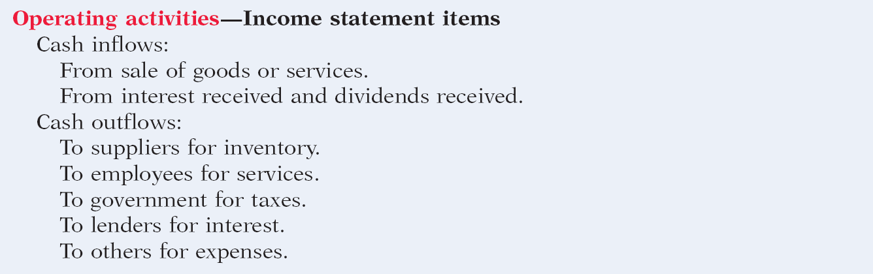
Usefulness and Format
Classification of Cash Flows
Illustration 12-1 Typical receipt and payment classifications
SO 2 Distinguish among operating, investing, and financing activities.

Slide 9
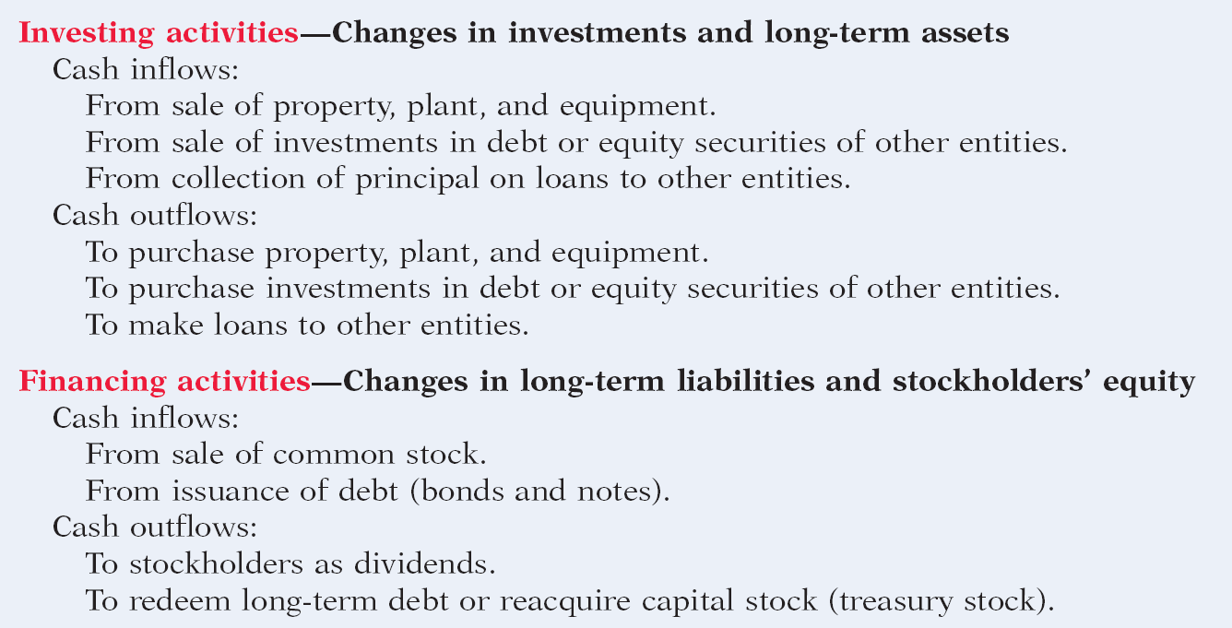
Usefulness and Format
Classification of Cash Flows
Illustration 12-1 Typical receipt and payment classifications
SO 2 Distinguish among operating, investing, and financing activities.

Slide 10
Usefulness and Format
Significant Noncash Activities
  Issuance of common stock to purchase assets.
  Conversion of bonds into common stock.
  Issuance of debt to purchase assets.
  Exchanges of plant assets.
Companies report noncash activities in either a
  separate schedule (bottom of the statement) or
  separate note to the financial statements.
SO 2 Distinguish among operating, investing, and financing activities.

Slide 11
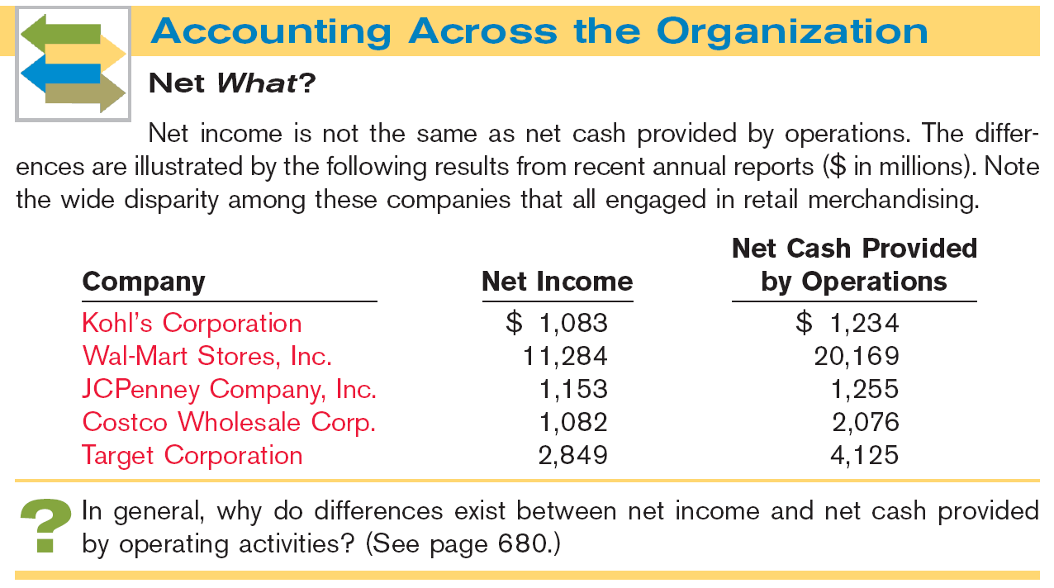

Slide 12
Usefulness and Format
Format of the Statement of Cash Flows
Order of Presentation:
  Operating activities.
  Investing activities.
  Financing activities.
Direct Method
Indirect Method
SO 2 Distinguish among operating, investing, and financing activities.

Slide 13
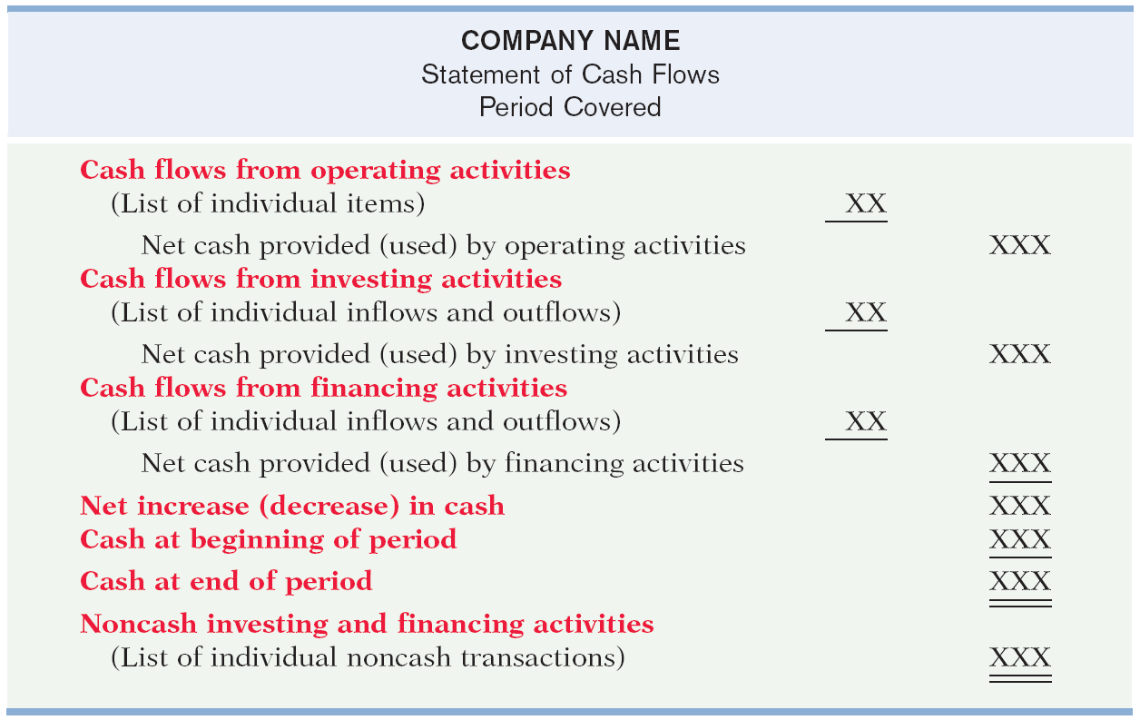
Format of the Statement of Cash Flows
Illustration 12-2
SO 2 Distinguish among operating, investing, and financing activities.

Slide 14

Format of the Statement of Cash Flows
Illustration: Classify each of these transactions by type of cash flow activity.
1. Issued 100,000 shares of $5 par value common stock for $800,000 cash.
2. Borrowed $200,000, signing a 5-year note bearing 8% interest.
3. Purchased two semi-trailer trucks for $170,000 cash.
4. Paid employees $12,000 for salaries and wages.
5. Collected $20,000 cash for services provided.
Financing
Financing
Investing
Operating
Operating
SO 2 Distinguish among operating, investing, and financing activities.

Slide 15
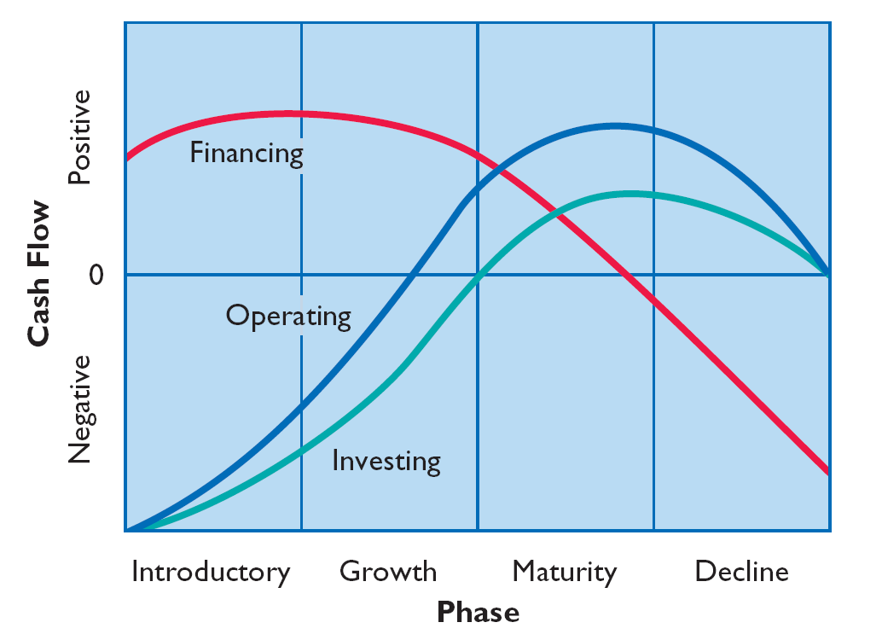
Usefulness and Format
The Corporate Life Cycle
Illustration 12-3
Impact
of product life cycle on
cash flows.
SO 3 Explain the impact of the product life cycle on a company’s cash flows.

Slide 16
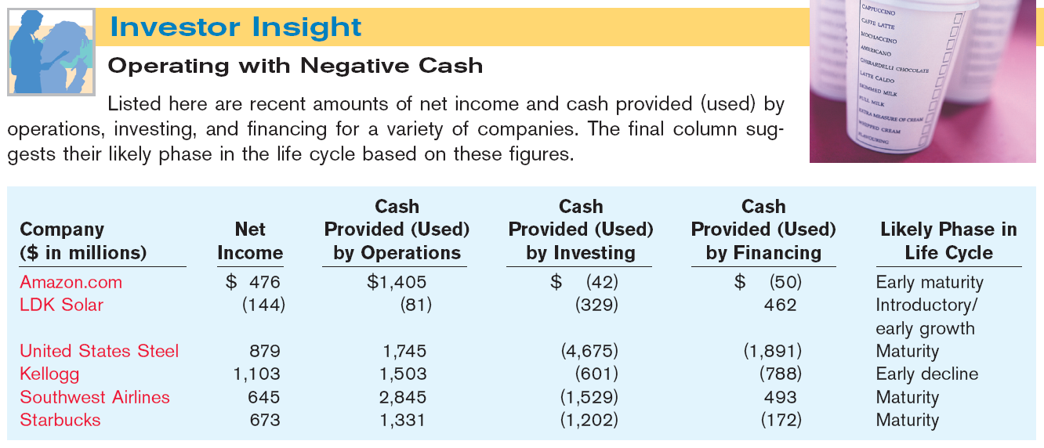

Slide 17
Usefulness and Format
Preparing the Statement of Cash Flows
Three Sources of Information:
  Comparative balance sheets
  Current income statement
  Additional information
SO 3 Explain the impact of the product life cycle on a company’s cash flows.

Slide 18
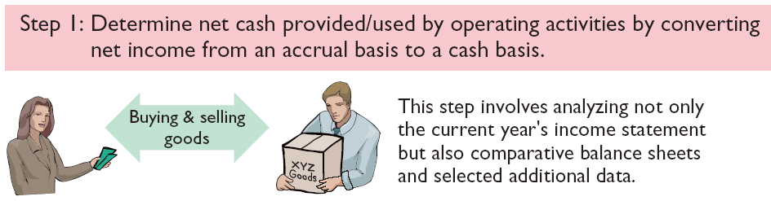
Usefulness and Format
Preparing the Statement of Cash Flows
Three Major Steps:
Illustration 12-4
SO 3 Explain the impact of the product life cycle on a company’s cash flows.

Slide 19
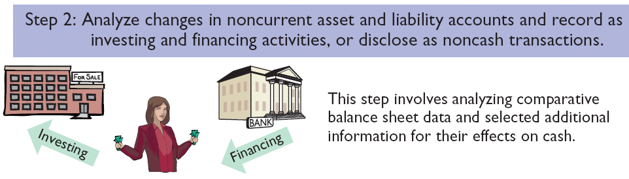
Usefulness and Format
Preparing the Statement of Cash Flows
Three Major Steps:
Illustration 12-4
SO 3 Explain the impact of the product life cycle on a company’s cash flows.

Slide 20
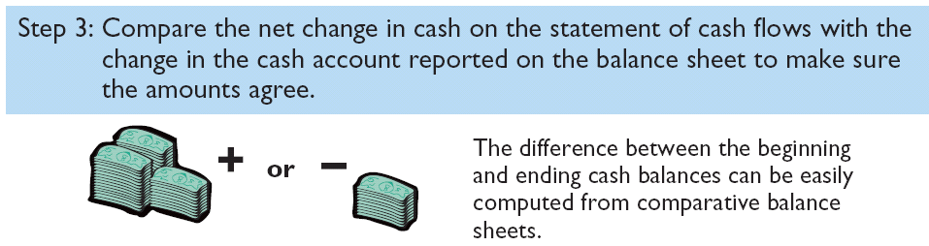
Usefulness and Format
Preparing the Statement of Cash Flows
Three Major Steps:
Illustration 12-4
SO 3 Explain the impact of the product life cycle on a company’s cash flows.

Slide 21
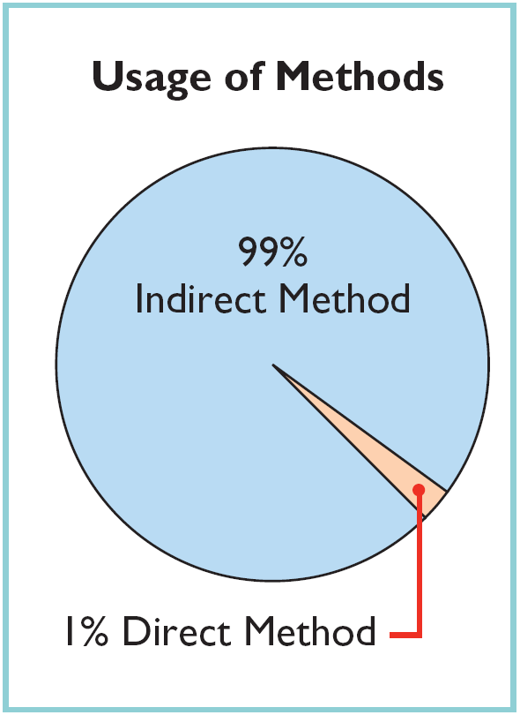
Usefulness and Format
Indirect and Direct Methods
Companies favor the indirect method for two reasons:
  Easier and less costly to prepare.
  Focuses on differences between net income and net cash flow from operating activities.
SO 3 Explain the impact of the product life cycle on a company’s cash flows.

Slide 22
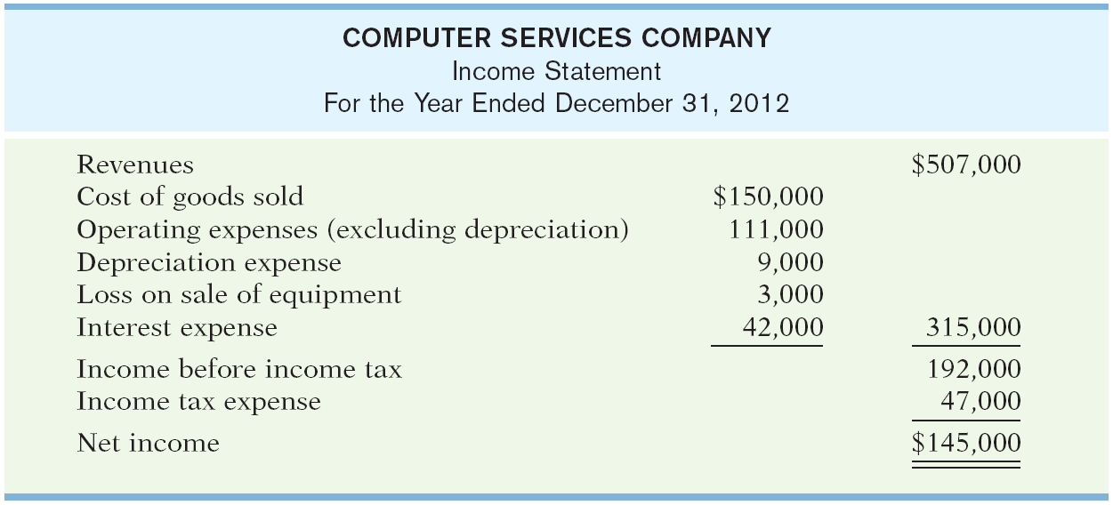
Preparing the Statement of Cash Flows
Illustration – Indirect Method
Illustration 12-5
SO 4 Prepare a statement of cash flows using the indirect method.

Slide 23
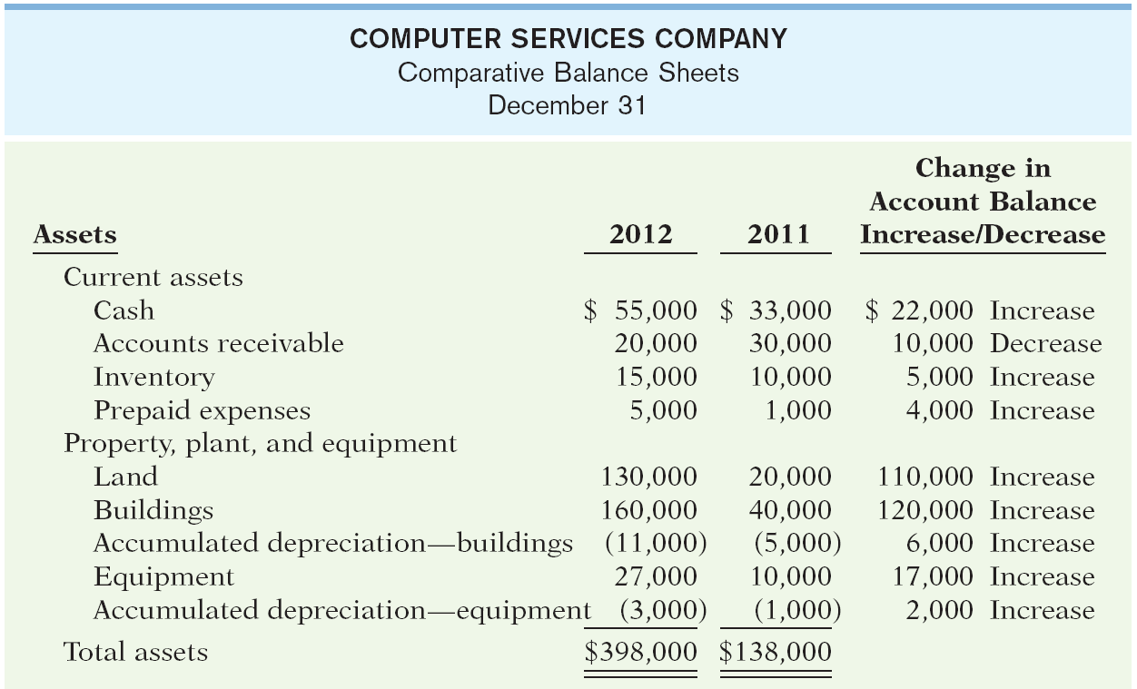
Preparing the Statement of Cash Flows
Illustration 12-5
SO 4 Prepare a statement of cash flows using the indirect method.

Slide 24
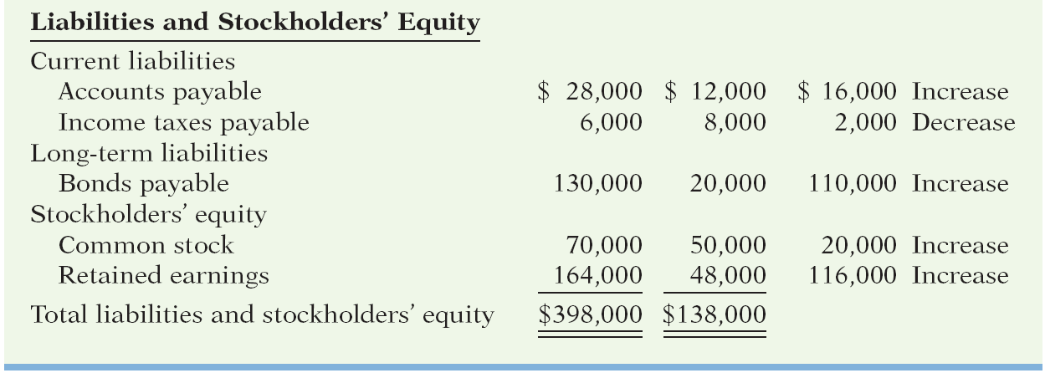
Preparing the Statement of Cash Flows
Additional information for 2012:
Depreciation expense was comprised of $6,000 for building and $3,000 for equipment.
The company sold equipment with a book value of $7,000 (cost $8,000, less accumulated depreciation $1,000) for $4,000 cash.
Issued $110,000 of long-term bonds in direct exchange for land.
A building costing $120,000 was purchased for cash. Equipment costing $25,000 was also purchased for cash.
Issued common stock for $20,000 cash.
The company declared and paid a $29,000 cash dividend.
SO 4.

Slide 25
Preparation of the Statement of Cash Flows – Indirect Method
Step 1: Operating Activities
Determine net cash provided/used by operating activities by converting net income from accrual basis to cash basis.
Common adjustments to Net Income (Loss):
  Add back non-cash expenses (depreciation, amortization, or depletion expense).
  Deduct gains and add losses.
  Changes in noncash current assets and current liabilities.
SO 4 Prepare a statement of cash flows using the indirect method.

Slide 26
Step 1: Operating Activities
Question
Which is an example of a cash flow from an operating activity?
  Payment of cash to lenders for interest.
  Receipt of cash from the sale of capital stock.
  Payment of cash dividends to the company’s stockholders.
  None of the above.
SO 4 Prepare a statement of cash flows using the indirect method.

Slide 27
Step 1: Operating Activities
Depreciation Expense
Although depreciation expense reduces net income, it does not reduce cash. The company must add it back to net income.
Illustration 12-7
SO 4 Prepare a statement of cash flows using the indirect method.

Slide 28
Operating Activities
Loss on Sale of Equipment
Companies report as a source of cash in the investing activities section the actual amount of cash received from the sale.
  Any loss on sale is added to net income in the operating section.
  Any gain on sale is deducted from net income in the operating section.
SO 4 Prepare a statement of cash flows using the indirect method.

Slide 29
Operating Activities
Loss on Sale of Equipment
Illustration 12-8
SO 4 Prepare a statement of cash flows using the indirect method.

Slide 30
Operating Activities
Changes to Noncash Current Asset Accounts
When the Accounts Receivable balance decreases, cash receipts are higher than revenue earned under the accrual basis.
Illustration 12-9
Accounts Receivable
1/1/012 Balance 30,000
Receipts from customers 517,000
Revenues 507,000
12/31/12 Balance 20,000
Company adds to net income the amount of the decrease in accounts receivable.
SO 4 Prepare a statement of cash flows using the indirect method.

Slide 31
Operating Activities
Changes to Noncash Current Asset Accounts
Illustration 12-10
SO 4 Prepare a statement of cash flows using the indirect method.

Slide 32
Operating Activities
Changes to Noncash Current Asset Accounts
When the Inventory balance increases, the cost of merchandise purchased exceeds the cost of goods sold.
Inventory
1/1/12 Balance 10,000
Cost of goods sold 150,000
Purchases 155,000
12/31/12 Balance 15,000
Cost of goods sold does not reflect cash payments made for merchandise. The company deducts from net income this inventory increase.
SO 4 Prepare a statement of cash flows using the indirect method.

Slide 33
Operating Activities
Changes to Noncash Current Asset Accounts
Illustration 12-10
SO 4 Prepare a statement of cash flows using the indirect method.

Slide 34
Operating Activities
Changes to Noncash Current Asset Accounts
When the Prepaid Expense balance increases, cash paid for expenses is higher than expenses reported on an accrual basis. The company deducts the decrease from net income to arrive at net cash provided by operating activities.
If prepaid expenses decrease, reported expenses are higher than the expenses paid.
SO 4 Prepare a statement of cash flows using the indirect method.

Slide 35
Operating Activities
Changes to Noncash Current Asset Accounts
Illustration 12-10
SO 4 Prepare a statement of cash flows using the indirect method.

Slide 36
Operating Activities
Changes to Noncash Current Liability Accounts
When Accounts Payable increases, the company received more in goods than it actually paid for. The increase is added to net income to determine net cash provided by operating activities.
When Income Tax Payable decreases, the income tax expense reported on the income statement was less than the amount of taxes paid during the period. The decrease is subtracted from net income to determine net cash provided by operating activities.
SO 4 Prepare a statement of cash flows using the indirect method.

Slide 37
Operating Activities
Changes to Noncash Current Liability Accounts
Illustration 12-11
SO 4

Slide 38
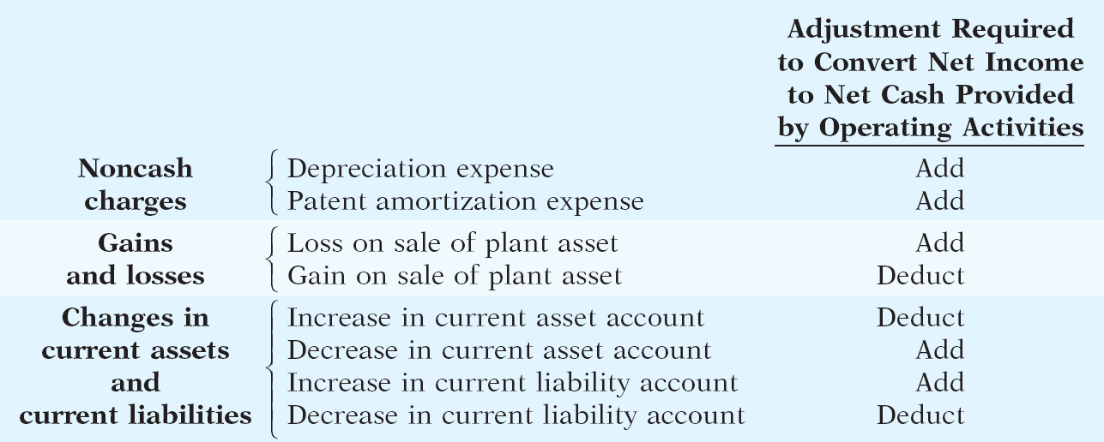
Operating Activities
Summary of Conversion to Net Cash Provided by Operating Activities—Indirect Method
Illustration 12-12
SO 4 Prepare a statement of cash flows using the indirect method.

Slide 39
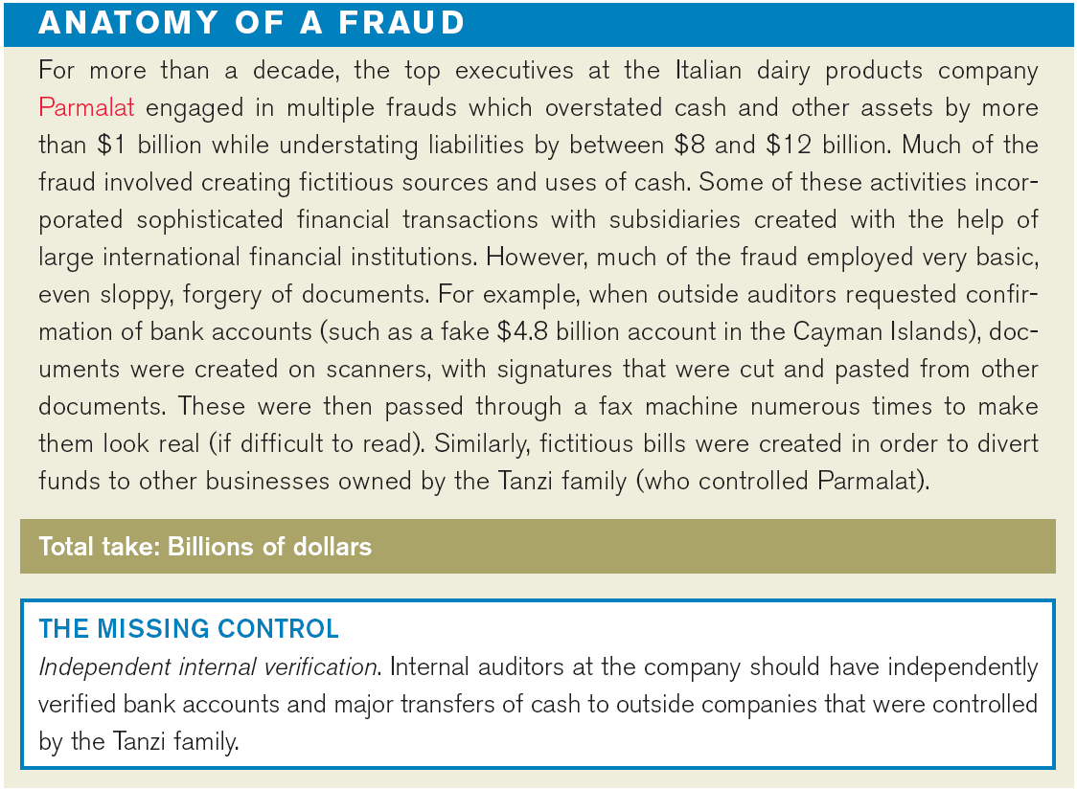

Slide 40
Step 2: Investing and Financing Activities
Company purchased land of $110,000 by issuing long-term bonds. This is a significant noncash investing and financing activity that merits disclosure in a separate schedule.
Land
1/1/12 Balance 20,000
Issued bonds 110,000
12/31/12 Balance 130,000
Bonds Payable
1/1/12 Balance 20,000
For land 110,000
12/31/12 Balance 130,000
SO 4 Prepare a statement of cash flows using the indirect method.

Slide 41
Investing and Financing Activities
Partial statement
SO 4

Slide 42
Investing and Financing Activities
From the additional information, the company acquired an office building for $120,000 cash. This is a cash outflow reported in the investing section.
Building
1/1/12 Balance 40,000
Office building 120,000
12/31/12 Balance 160,000
SO 4 Prepare a statement of cash flows using the indirect method.

Slide 43
Investing and Financing Activities
Illustration 12-14
Partial statement
SO 4

Slide 44
Investing and Financing Activities
The additional information explains that the equipment increase resulted from two transactions: (1) a purchase of equipment of $25,000, and (2) the sale for $4,000 of equipment costing $8,000.
Equipment
1/1/12 Balance 10,000
Equipment sold 8,000
Purchase 25,000
12/31/12 Balance 27,000
Cash 4,000
Accumulated depreciation 1,000
Loss on sale of equipment 3,000
Equipment 8,000
Journal Entry
SO 4 Prepare a statement of cash flows using the indirect method.

Slide 45
Statement of Cash Flows
Illustration 12-14
Indirect Method
SO 4

Slide 46
Investing and Financing Activities
The increase in common stock resulted from the issuance of new shares.
Common Stock
1/1/12 Balance 50,000
Shares sold 20,000
12/31/12 Balance 70,000
SO 4 Prepare a statement of cash flows using the indirect method.

Slide 47
Investing and Financing Activities
Partial statement
Illustration 12-14
SO 4

Slide 48
Investing and Financing Activities
Retained earnings increased $116,000 during the year. This increase can be explained by two factors: (1) Net income of $145,000 increased retained earnings, and (2) Dividends of $29,000 decreased retained earnings.
Retained Earnings
1/1/12 Balance 48,000
Dividends 29,000
Net income 145,000
12/31/12 Balance 164,000
SO 4 Prepare a statement of cash flows using the indirect method.

Slide 49
Statement of Cash Flows
Illustration 12-14
Indirect Method
SO 4

Slide 50
Step 3: Net Change in Cash
Compare the net change in cash on the Statement of Cash Flows with the change in the cash account reported on the Balance Sheet to make sure the amounts agree.
SO 4 Prepare a statement of cash flows using the indirect method.

Slide 51
Investing and Financing Activities
Review Question
Which is an example of a cash flow from an investing activity?
  Receipt of cash from the issuance of bonds payable.
  Payment of cash to repurchase outstanding capital stock.
  Receipt of cash from the sale of equipment.
  Payment of cash to suppliers for inventory.
SO 4 Prepare a statement of cash flows using the indirect method.

Slide 52
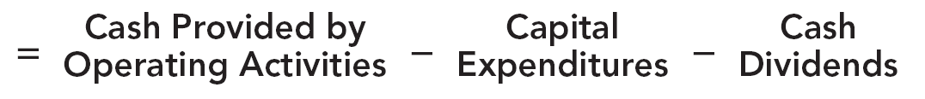
Using Cash Flows to Evaluate a Company
Free Cash Flow
Illustration 12-15
Free cash flow describes the cash remaining from operations after adjustment for capital expenditures and dividends.
SO 5 Use the statement of cash flows to evaluate a company.

Slide 53
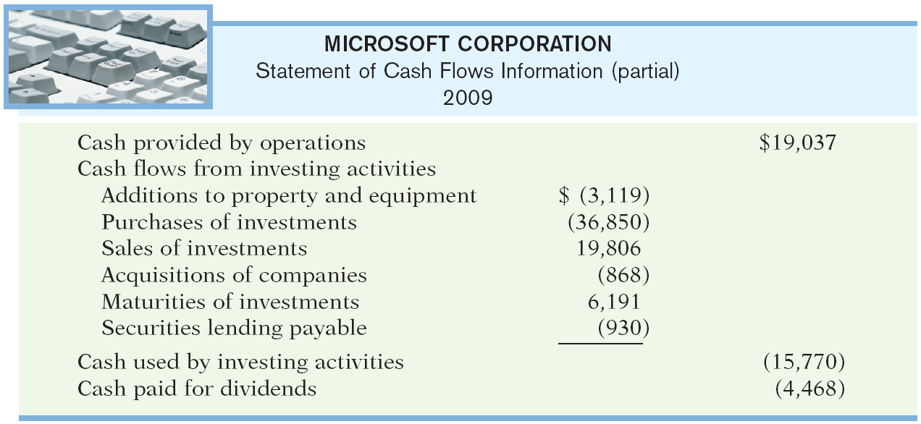
Using Cash Flows to Evaluate a Company
Required: Calculate Microsoft’s free cash flow.
Cash provided by operating activities $19,037
Less: Expenditures on property, plant, and equipment 3,119
Dividends paid 4,468
Free cash flow $11,450
SO 5 Use the statement of cash flows to evaluate a company.

Slide 54
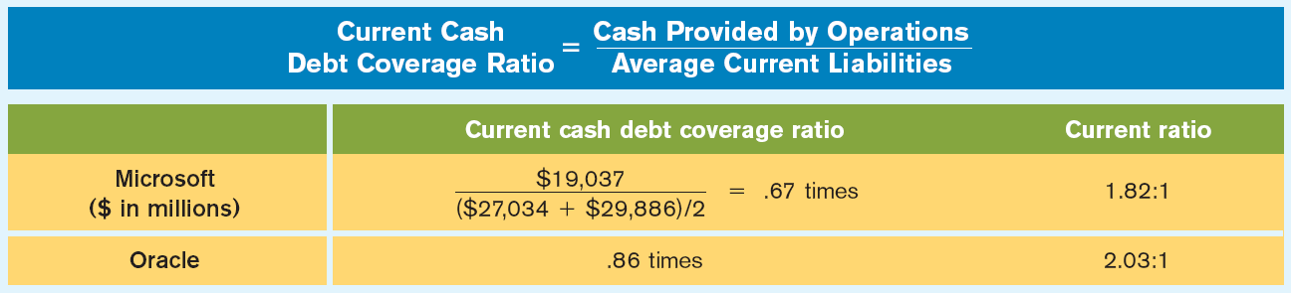
Using Cash Flows to Evaluate a Company
Assessing Liquidity and Solvency
Liquidity is the ability to pay obligations expected to become due within the next year.
Illustration 12-18
A value below .40 times is cause for additional investigation.
SO 5 Use the statement of cash flows to evaluate a company.

Slide 55
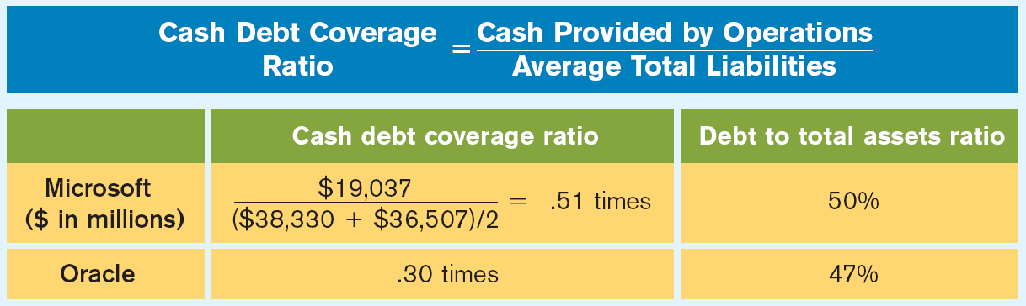
Using Cash Flows to Evaluate a Company
Assessing Liquidity and Solvency
Solvency is the ability of a company to survive over the long term.
Illustration 12-19
A ratio below .20 times is cause for additional investigation.
SO 5 Use the statement of cash flows to evaluate a company.

