Slide 1


Computer Organization and Architecture
Prepared by Dr. Eng. Gamal Selim
Lecture 03

Slide 2
Revision on Instruction set

Slide 3
Instruction Set
The collection of instructions of a computer
Different computers have different instruction sets
But with many aspects in common
Early computers had very simple instruction sets
Simplified implementation
Many modern computers also have simple instruction sets

Slide 4
Instruction Set Architecture
Anything programmers need to know to make a binary machine language program work correctly, including:
Registers
Organization of programmable storage
Data types and data structures: encoding and representations
Instruction set
Instruction formats
Modes of addressing: accessing data items and instructions
Exceptional conditions

Slide 5
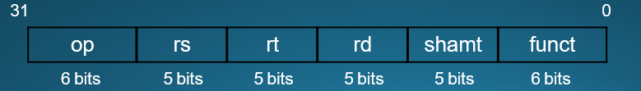
Arithmetic Operations
Add and subtract, three operands
Two sources and one destination
add a, b, c # a gets b + c
Operation, operator, operand
All arithmetic operations have this form
Design Principle 1: Simplicity favors regularity
Regularity makes implementation simpler
Simplicity enables higher performance at lower cost

Slide 6
Arithmetic Example
C code:
f = (g + h) - (i + j);
Compiled MIPS code:
add t0, g, h # temp t0 = g + h
add t1, i, j # temp t1 = i + j
sub f, t0, t1 # f = t0 - t1

Slide 7
Register Operands
Arithmetic instructions use operands from registers
The size of a register in MIPS architecture is 32 bits, which is a word
The word is the natural unit of access in a computer, usually a group of 32 bits; corresponds to the size of a register

Slide 8
Register Operands
MIPS has a 32 × 32-bit register file
Use for frequently accessed data
Cache of cache?
Numbered 0 to 31
Assembler names
$t0, $t1, …, $t9 for temporary values
$s0, $s1, …, $s7 for saved variables
$zero
Design Principle 2: Smaller is faster Cf. main memory: millions of locations

Slide 9
Register Operand Example
C code:
f = (g + h) - (i + j);
f, …, j in $s0, …, $s4
Compiled MIPS code:
add | $t0, | $s1, | $s2
add | $t1, | $s3, | $s4
sub | $s0, | $t0, | $t1

Slide 10
Memory Operands
Data transfer instruction: before arithmetic operations can be done
Load values from memory into registers
Store result from register to memory
RISC (Reduced instruction set computing) vs. CISC
Only load and store instructions access memory
Memory is byte addressed
Each address identifies an 8-bit byte
Alignment restriction: words are aligned in memory
For lw/sw, the address must be a multiple of 4
If either of the two least-significant bits of the address are non-zero, an Address Error exception occurs

Slide 11
Addressing Alignment Constraints
MIPS uses byte addressing for halfword, word, and doubleword accesses with the following alignment constraints:
Halfword accesses must be aligned on an even byte boundary (0, 2, 4...).
Word accesses must be aligned on a byte boundary divisible by four (0, 4, 8...).
Doubleword accesses must be aligned on a byte boundary divisible by eight (0, 8, 16...).

Slide 12
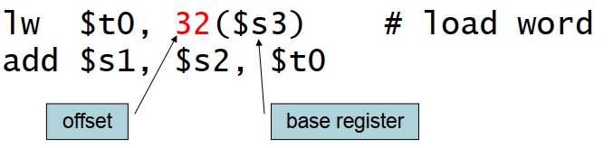
Memory Operand Example 1
C code:
g = h + A[8];
g in $s1, h in $s2, base address of A in $s3
Compiled MIPS code:
Index 8 requires offset of 32
4 bytes per word

Slide 13
Memory Operand Example 2
C code:
A[12] = h + A[8];
h in $s2, base address of A in $s3
Compiled MIPS code:
Index 8 requires offset of 32
lw | $t0, | 32($s3) | # | load | word
add sw | $t0, $t0, | $s2, $t0 48($s3) | # | store | word

Slide 14

Immediate Operands
Constant data specified in an instruction
addi $s3, $s3, 4
No subtract immediate instruction
Just use a negative constant
addi $s2, $s1, -1
Design Principle 3: Make the common case fast
Small constants are common
Immediate operand avoids a load instruction

Slide 15

Unsigned Binary Integers
Given an n-bit number
Range: 0 to +2^{n} – 1
Example
0000 0000 0000 0000 0000 0000 0000 1011₂
= 0 + … + 1×2³ + 0×2² +1×2¹ +1×2⁰
= 0 + … + 8 + 0 + 2 + 1 = 11₁₀
Using 32 bits
0 to +4,294,967,295

Slide 16
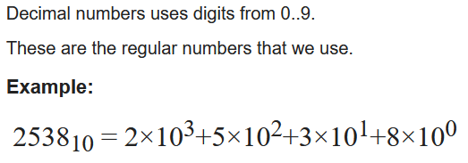
Decimal Numeral System - Base-10

Slide 17
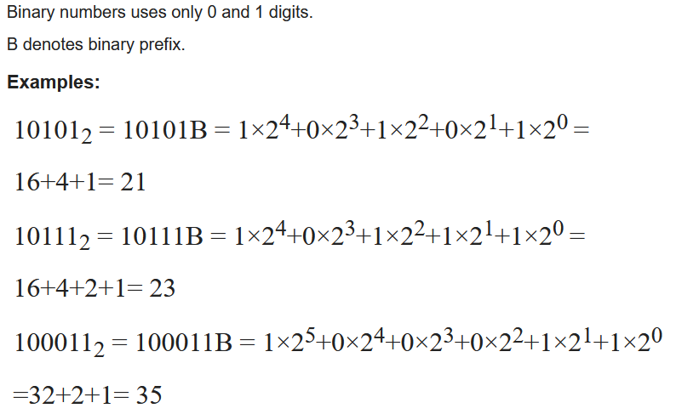
Binary Numeral System - Base-2

Slide 18
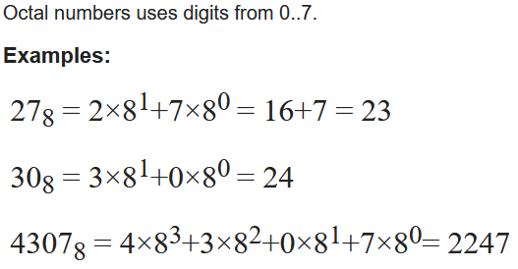
Octal Numeral System - Base-8

Slide 19
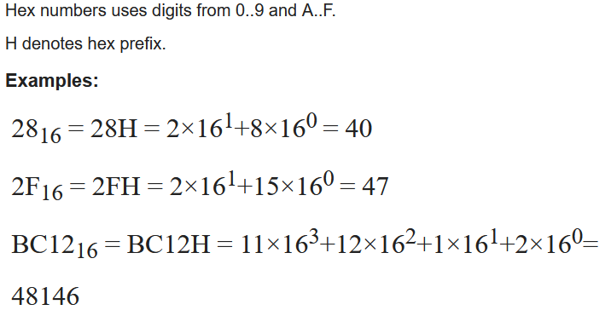
Hexadecimal Numeral System - Base-16

Slide 20

2s-Complement Signed Integers
Given an n-bit number
Range: –2^{n – 1} to +2^{n – 1} – 1
Example
1111 1111 1111 1111 1111 1111 1111 1100₂
= –1×2³¹ + 1×2³⁰ + … + 1×2² +0×2¹ +0×2⁰
= –2,147,483,648 + 2,147,483,644 = –4₁₀
Using 32 bits
–2,147,483,648 to +2,147,483,647

Slide 21
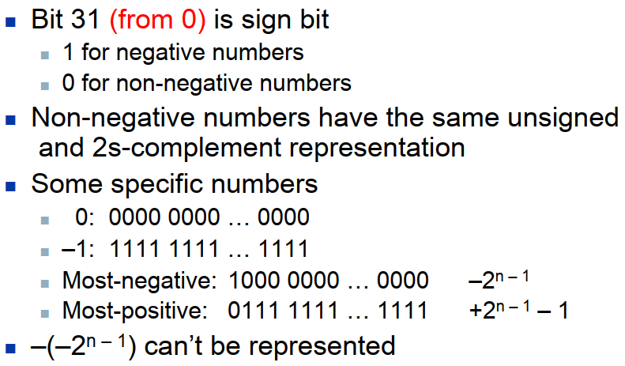
2s-Complement Signed Integers

Slide 22
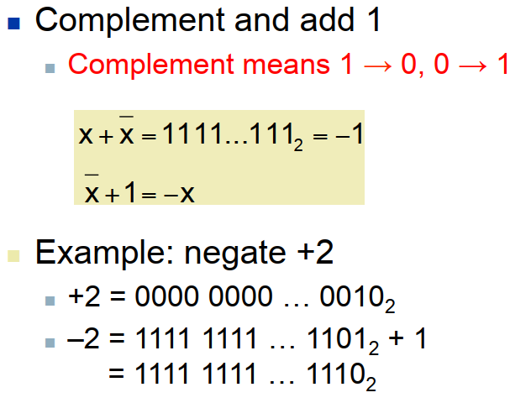
Signed Negation

Slide 23
Sign Extension
Representing a number using more bits
Preserve the numeric value
In MIPS instruction set
addi: extend immediate value
lb, lh: extend loaded byte/halfword
beq, bne: extend the displacement
Sign Extension: replicate the sign bit to the left
Cf. unsigned values: extend with 0s
Examples: 8-bit to 16-bit
+2: 0000 0010 => 0000 0000 0000 0010
–2: 1111 1110 => 1111 1111 1111 1110

Slide 24
MIPS R-format Instructions
op | rs | rt | rd | shamt | funct
6 bits 5 bits 5 bits 5 bits 5 bits 6 bits
Instruction format
The layout of the instruction
Instruction fields
op: operation code (opcode)
rs: first source register number
rt: second source register number
rd: destination register number
shamt: shift amount (00000, useless for R-format)
funct: function code (extends opcode)

Slide 25
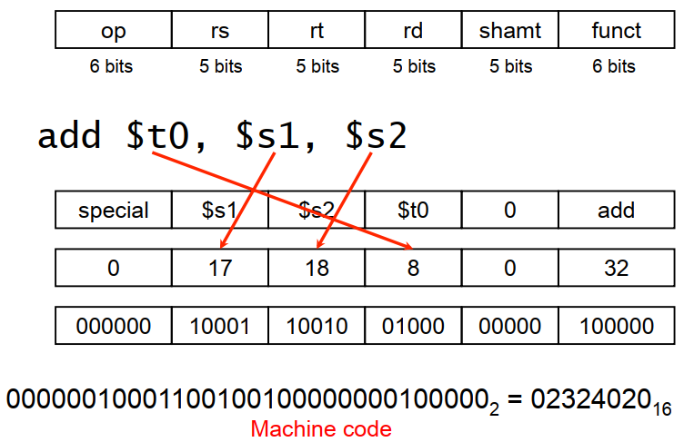
R-format Example

Slide 26
Hexadecimal
Base 16
Compact representation of bit strings
4 bits per hex digit
0 | 0000 | 4 | 0100 | 8 | 1000 | c | 1100
1 | 0001 | 5 | 0101 | 9 | 1001 | d | 1101
2 | 0010 | 6 | 0110 | a | 1010 | e | 1110
3 | 0011 | 7 | 0111 | b | 1011 | f | 1111
Example: eca8 6420
1110 1100 1010 1000 0110 0100 0010 0000

Slide 27

Logical Operations
Instructions for bitwise manipulation
Operation | C | Java | MIPS
Bitwise AND | & | & | and, andi
Bitwise OR | | | | | or, ori
Bitwise NOT | ~ | ~ | nor

Slide 28
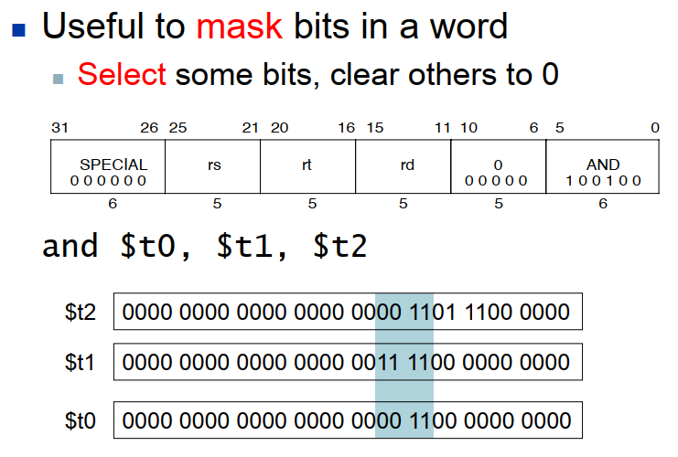
AND Operations

Slide 29
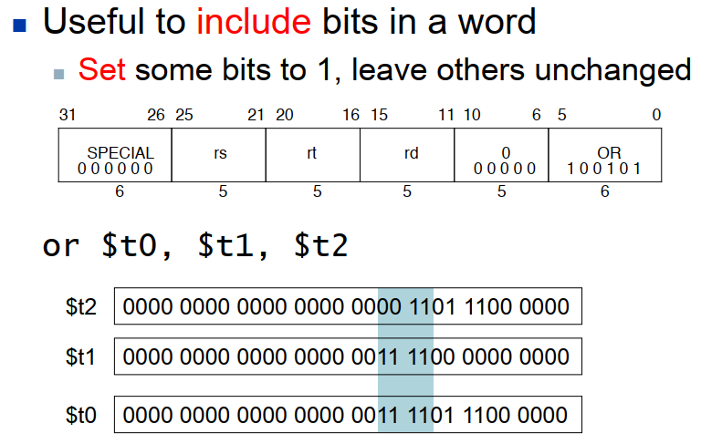
OR Operations

Slide 30
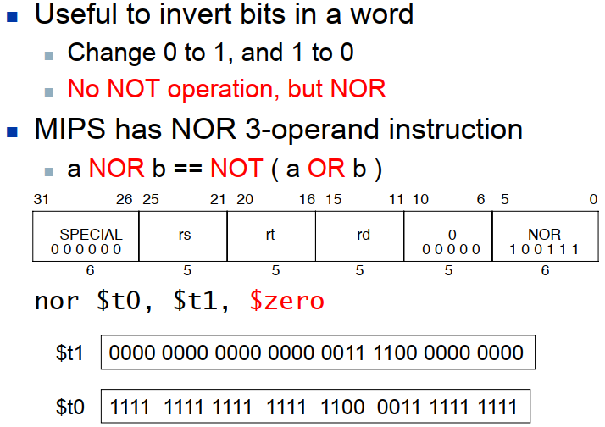
NOT Operations

Slide 31
Conditional Operations
The difference between a computer and a calculator is the ability to make decisions
In high level language
if statement
go to statement
Branch to a labeled instruction if a condition is true; Otherwise, continue sequentially
Conditional and unconditional branches
PC-relative and absolute/register indirect branch

Slide 32
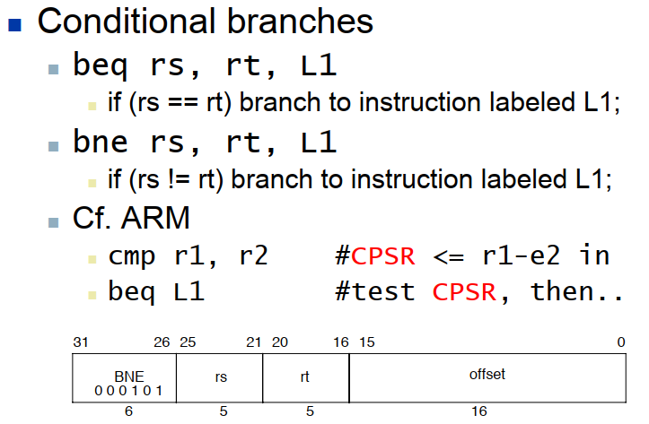
Conditional Operations

Slide 33
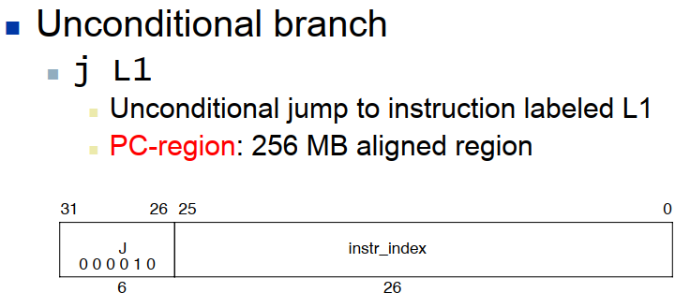
Conditional Operations

Slide 34
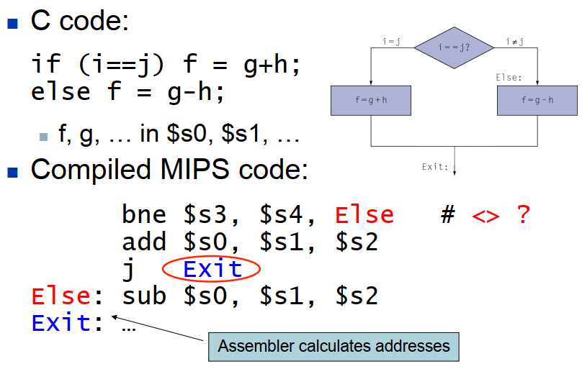
Compiling If Statements

Slide 35
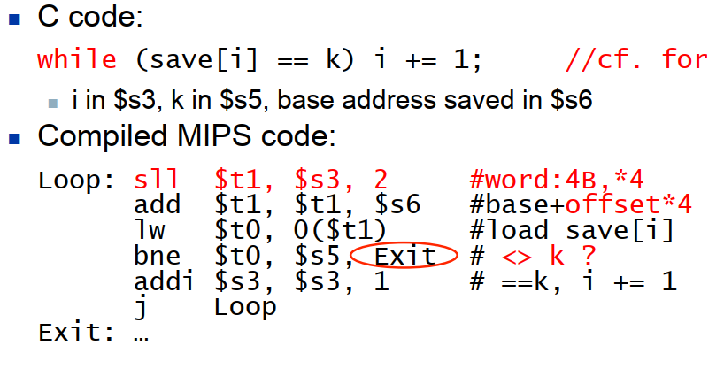
Compiling Loop Statements

Slide 36
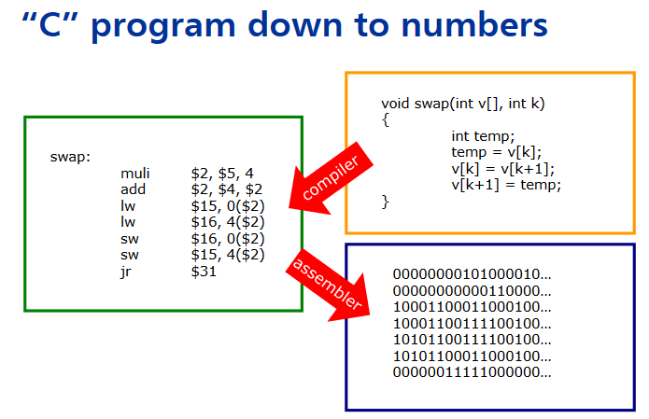

Slide 37
Arithmetic for Computers

Slide 38
Arithmetic for Computers
Operations on integers
  Addition and subtraction
  Multiplication and division
ALU: Arithmetic Logic Unit
  HW performs addition, subtraction, and usually logical operations such as AND and OR

Slide 39




  Thank You

