Slide 1


Software Engineering
Prepared by Dr. Yasser Abdelhamid
IT 382
Software Engineering
Lecture 6

Slide 2

Lecture Outline
Testing in XP
XP testing difficulties
Pair programming
Agile project management
Scrum
midocean.edu.km

Slide 3
Testing in XP

Slide 4
XP testing features
Test-first development.
Incremental test development from scenarios.
User involvement in test development and validation.
Automated test harnesses are used to run all component tests each time that a new release is built.

Slide 5
Test-first development
Writing tests before code clarifies the requirements to be implemented.

Slide 6
Test-first development
Tests are written as programs rather than data so that they can be executed automatically.
The test includes a check that it has executed correctly.
  Usually relies on a testing framework such as Junit.

Slide 7
Test-first development
All previous and new tests are run automatically when new functionality is added.
Checking that the new functionality has not introduced errors.

Slide 8
Customer involvement
The role of the customer in the testing process is to help develop acceptance tests for the stories that are to be implemented in the next release of the system.

Slide 9
Customer involvement
The customer who is part of the team writes tests as development proceeds.
All new code is therefore validated to ensure that it is what the customer needs.

Slide 10
Customer involvement
However, people adopting the customer role have limited time available and so cannot work full-time with the development team.
They may feel that providing the requirements was enough of a contribution and so may be reluctant to get involved in the testing process.

Slide 11
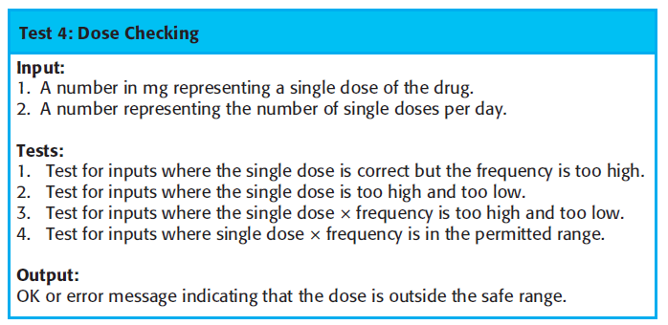
Test case description for dose checking

Slide 12
Test automation
Test automation means that tests are written as executable components before the task is implemented
  These testing components should be stand-alone,
  should simulate the submission of input to be tested and
  should check that the result meets the output specification.
  An automated test framework (e.g. Junit) is a system that makes it easy to write executable tests and submit a set of tests for execution.

Slide 13
Test automation
As testing is automated, there is always a set of tests that can be quickly and easily executed
  Whenever any functionality is added to the system, the tests can be run and problems that the new code has introduced can be caught immediately.

Slide 14
XP testing difficulties

Slide 15
Programmers prefer programming to testing
Sometimes programmers take short cuts when writing tests.
For example, they may write incomplete tests that do not check for all possible exceptions that may occur.

Slide 16
Some tests can be very difficult to write incrementally
For example, in a complex user interface, it is often difficult to write unit tests for the code that implements the ‘display logic’ and workflow between screens.

Slide 17
It is difficult to judge the completeness of a set of tests
Although you may have a lot of system tests, your test set may not provide complete coverage.

Slide 18
Pair programming

Slide 19
Pair programming
In XP, programmers work in pairs, sitting together to develop code.
This helps develop common ownership of code and spreads knowledge across the team.
It serves as an informal review process as each line of code is looked at by more than 1 person.
It encourages refactoring as the whole team can benefit from this.
Measurements suggest that development productivity with pair programming is similar to that of two people working independently.

Slide 20
Pair programming
In pair programming, programmers sit together at the same workstation to develop the software.
Pairs are created dynamically so that all team members work with each other during the development process.
The sharing of knowledge that happens during pair programming is very important as it reduces the overall risks to a project when team members leave.
Pair programming is not necessarily inefficient and there is evidence that a pair working together is more efficient than 2 programmers working separately.

Slide 21
Advantages of pair programming
It supports the idea of collective ownership and responsibility for the system.
  Individuals are not held responsible for problems with the code. Instead, the team has collective responsibility for resolving these problems.

Slide 22
Advantages of pair programming
It acts as an informal review process because each line of code is looked at by at least two people.

Slide 23
Advantages of pair programming
It helps support refactoring, which is a process of software improvement.
  Where pair programming and collective ownership are used, others benefit immediately from the refactoring so they are likely to support the process.

Slide 24
Agile project management

Slide 25
Agile project management
The principal responsibility of software project managers is to manage the project so that the software is delivered on time and within the planned budget for the project.

Slide 26
Agile project management
The standard approach to project management is plan-driven.
Managers draw up a plan for the project showing what should be delivered, when it should be delivered and who will work on the development of the project deliverables.

Slide 27
Agile project management
Agile project management requires a different approach, which is adapted to incremental development and the particular strengths of agile methods.

Slide 28
scrum
The Scrum approach is a general agile method, but its focus is on managing iterative development rather than specific agile practices.

Slide 29
Phases of scrum
  The initial phase is an outline planning phase where you establish the general objectives for the project and design the software architecture.
  This is followed by a series of sprint cycles, where each cycle develops an increment of the system.
  The project closure phase wraps up the project, completes required documentation such as system help frames and user manuals and assesses the lessons learned from the project.

Slide 30
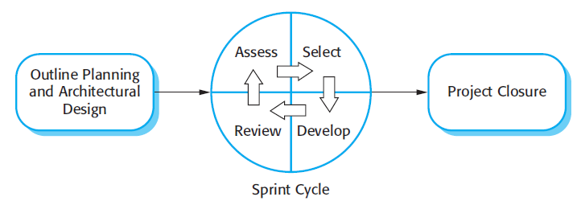
The Scrum process

Slide 31
The Sprint cycle
Sprints are fixed length, normally 2–4 weeks. They correspond to the development of a release of the system in XP.
The starting point for planning is the product backlog, which is the list of work to be done on the project.
The selection phase involves all of the project team who work with the customer to select the features and functionality to be developed during the sprint.

Slide 32
The Sprint cycle
Once these are agreed, the team organize themselves to develop the software. During this stage, the team is isolated from the customer and the organization, with all communications channelled through the so-called ‘Scrum master’.
The role of the Scrum master is to protect the development team from external distractions.
At the end of the sprint, the work done is reviewed and presented to stakeholders. The next sprint cycle then begins.

Slide 33
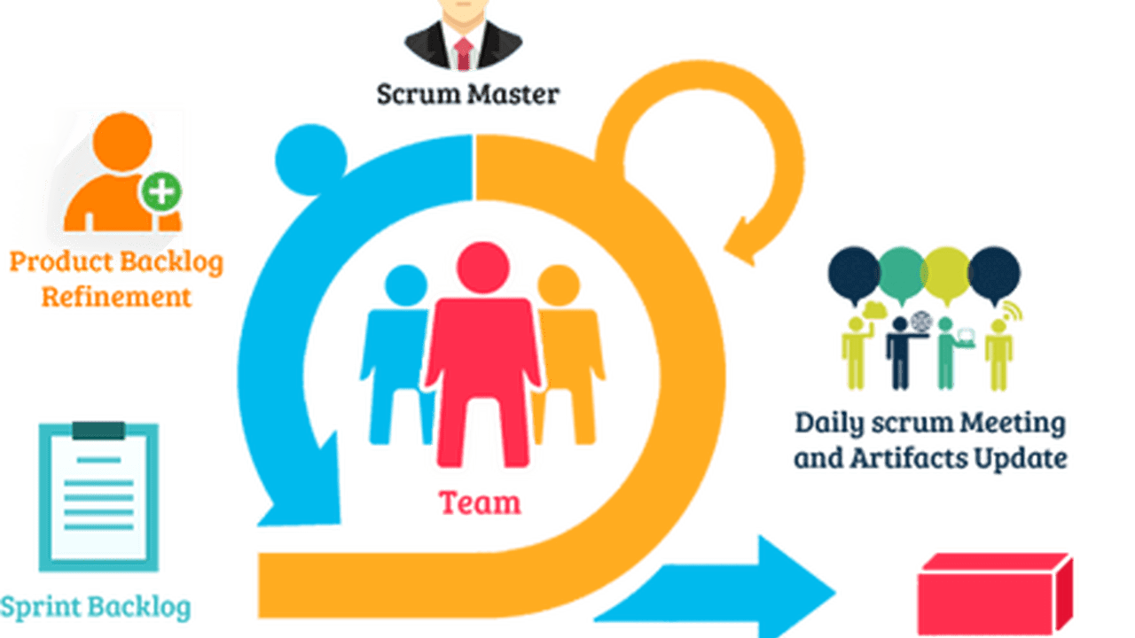
Scrum

Slide 34
Scrum master
The ‘Scrum master’ is a facilitator who arranges daily meetings, tracks the backlog of work to be done, records decisions, measures progress against the backlog and communicates with customers and management outside of the team.

Slide 35
Teamwork in Scrum
The whole team attends short daily meetings where all team members share information, describe their progress since the last meeting, problems that have arisen and what is planned for the following day.
  This means that everyone on the team knows what is going on and, if problems arise, can re-plan short-term work to cope with them.

Slide 36
Scrum benefits
The product is broken down into a set of manageable and understandable chunks.
Unstable requirements do not hold up progress.

Slide 37
Scrum benefits
The whole team have visibility of everything and consequently team communication is improved.
Customers see on-time delivery of increments and gain feedback on how the product works.

Slide 38
Scrum benefits
Trust between customers and developers is established and a positive culture is created in which everyone expects the project to succeed.

Slide 39
Summary
A particular strength of extreme programming is the development of automated tests before a program feature is created. All tests must successfully execute when an increment is integrated into a system.
The Scrum method is an agile method that provides a project management framework. It is centred round a set of sprints, which are fixed time periods when a system increment is developed.
Scaling agile methods for large systems is difficult. Large systems need up-front design and some documentation.
midocean.edu.km

Slide 40


Thank You

