Slide 1


Slide 2


Slide 3


Learning Objectives
Identify the decisions that are best solved by aggregate planning.
Understand the importance of aggregate planning as a supply chain activity.
Describe the information needed to produce an aggregate plan.
Explain the basic trade-offs to consider when creating an aggregate plan.
www.midocean.ae

Slide 4
Role of Aggregate Planning in a Supply Chain
Aggregate planning is a process by which a company determines planned levels of capacity, production, subcontracting, inventory, stockouts, and even pricing over a specified time horizon.
The goal of aggregate planning is to build a plan that satisfies demand while maximizing profit.
www.midocean.ae

Slide 5
Role of Aggregate Planning in a Supply Chain
Aggregate planning, as the name suggests, solves problems involving aggregate decisions rather than stock-keeping unit (SKU)-level decisions.
For example, aggregate planning determines the total production level in a plant for a given month, but it does so without determining the quantity of each individual SKU that will be produced
www.midocean.ae

Slide 6
Role of Aggregate Planning in a Supply Chain
This level of detail makes aggregate planning a useful tool for thinking about decisions with an intermediate time frame of between roughly 3 and 18 months.
In this time frame, it is too early to determine production levels by SKU, but it is also generally too late to arrange for additional capacity.
Therefore, aggregate planning answers the question: How should a firm best utilize the facilities that it currently has?
To be effective, aggregate planning requires inputs from all stages of the supply chain, and its results have a tremendous impact on supply chain performance.
www.midocean.ae

Slide 7
Role of Aggregate Planning in a Supply Chain
Collaborative forecasts are created by multiple supply chain enterprises and are an important input for aggregate planning.
In addition, many constraints that are key inputs to aggregate planning come from supply chain partners outside the enterprise.
Without these inputs from both up and down the supply chain, aggregate planning cannot realize its full potential to create value.
The output from aggregate planning is also of value to both upstream and downstream partners.
Production plans for a firm define demand for suppliers and establish supply constraints for customers.

Slide 8
Role of Aggregate Planning in a Supply Chain
As an example,
Consider how a premium paper supply chain uses aggregate planning to maximize profit.
Many types of paper mills face seasonal demand that ripples up from customers to printers to distributors and, finally, to the manufacturers.
Many types of premium paper have demand peaks in the spring, when annual reports are printed, and in the fall, when new-car brochures are released.
Building a mill with capacity to meet demand in the spring and fall on an as-needed basis is too costly, because of the high cost of mill capacity.
www.midocean.ae

Slide 9
Role of Aggregate Planning in a Supply Chain
On the other side of the supply chain, premium papers often require special additives and coatings that may be in short supply.
The paper manufacturer must deal with these constraints and maximize profit around them.
The mills use aggregate planning to determine production levels and inventory levels that they should build up in the slower months for sale in the spring and fall, when demand is greater than the mill’s capacity.
By taking into account the inputs from throughout the supply chain, aggregate planning allows the mill and the supply chain to maximize profit.
www.midocean.ae

Slide 10
Role of Aggregate Planning in a Supply Chain
Capacity has a cost and lead times are often long
Aggregate planning:
Process by which a company determines levels of capacity, production, subcontracting, inventory, stockouts, and pricing over a specified time horizon
Goal is to maximize profit decisions made at a product family (not SKU) level time frame of 3 to 18 months how can a firm best use the facilities it has?
www.midocean.ae

Slide 11
Role of Aggregate Planning in a Supply Chain
Specify operational parameters over the time horizon
  Production rate – Subcontracting
  Workforce – Backlog
  Overtime – Inventory on hand
  Machine capacity level
All supply chain stages should work together on an aggregate plan that will optimize supply chain performance
www.midocean.ae

Slide 12
The aggregate planner’s main objective
The aggregate planner’s main objective is to identify the following operational parameters over the specified time horizon:
Production rate: the number of units to be completed per unit time (such as per week or per month)
Workforce: the number of workers or units of labor capacity required
Overtime: the amount of overtime production planned
www.midocean.ae

Slide 13
The aggregate planner’s main objective
Machine capacity level: the number of units of machine capacity needed for production
Subcontracting: the subcontracted capacity required over the planning horizon
Backlog: demand not satisfied in the period in which it arises, but is carried over to future periods
Inventory on hand: the planned inventory carried over the various periods in the planning horizon
www.midocean.ae

Slide 14
Information Needed for an Aggregate Plan
Aggregate demand forecast F_{t} for each Period t over T periods
Production costs
  Labor costs, regular time ($/hr) and overtime ($/hr)
  Subcontracting costs ($/hr or $/unit)
  Cost of changing capacity – hiring or layoff ($/worker), adding or reducing machine capacity ($/machine)
Labor/machine hours required per unit
Inventory holding cost ($/unit/period)
Stockout or backlog cost ($/unit/period)
Constraints – overtime, layoffs, capital available, stockouts, backlogs, from suppliers
www.midocean.ae

Slide 15
Outputs of Aggregate Plan
Production quantity from regular time, overtime, and subcontracted time
Inventory held
Backlog/stockout quantity
Machine capacity increase/decrease
A poor aggregate plan can result in lost sales, lost profits, excess inventory, or excess capacity
www.midocean.ae

Slide 16
Identifying Aggregate Units of Production
An important first step in aggregate planning is the identification of a suitable aggregate unit of production.
When planning is done at the aggregate level, it is important that the aggregate unit be identified in a way that when the final production schedule is built (this has to be at the disaggregate product level), the results of the aggregate plan reflect approximately what can be accomplished in practice.
www.midocean.ae

Slide 17
Identifying Aggregate Units of Production
Given that the bottleneck is likely to be the most constraining area in any manufacturing facility, it is important to focus on the bottleneck when selecting the aggregate unit and identifying capacity as well as production times.
When evaluating production times, it is also important to account for activities—such as setups and maintenance—that use up capacity but do not result in any production.
www.midocean.ae

Slide 18
Identifying Aggregate Units of Production
Aggregate unit should be identified in a way that the resulting production schedule can be accomplished in practice
Focus on the bottlenecks when selecting the aggregate unit and identifying capacity and production times
Account for activities such as setups and maintenance
www.midocean.ae

Slide 19
Identifying Aggregate Units of Production
Consider, for example,
Red Tomato Tools, a small manufacturer of gardening equipment with manufacturing facilities in Mexico.
The company makes six product families at its manufacturing plant.
The costs, revenues, production times, setup times, and historical batch sizes of production for each family
www.midocean.ae

Slide 20
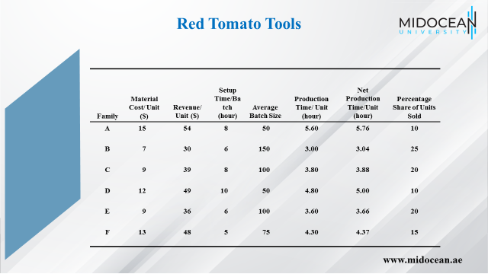

Slide 21
Red Tomato Tools
Weighted average approach
Material cost per aggregate unit
= 15 x 0.10 + 7 x 0.25 + 9 x 0.20
+ 12 x 0.10 + 9 x 0.20 + 13 x 0.15 = $10
Similarly
Revenue per aggregate unit = $40
Net production time per aggregate unit = 4.00 hours
www.midocean.ae

Slide 22
Aggregate Planning Strategies
The aggregate planner must make trade-offs among capacity, inventory, and backlog costs.
An aggregate plan that increases one of these costs typically results in reduction of the other two.
In this sense, the costs represent a trade-off: To lower inventory cost, a planner must increase capacity cost or delay delivery to the customer. Thus, the planner trades inventory cost for capacity or backlog cost.
Arriving at the most profitable combination of trade-offs is the goal of aggregate planning.
www.midocean.ae

Slide 23
Aggregate Planning Strategies
Given that demand varies over time, the relative level of the three costs leads to one of them being the key lever the planner uses to maximize profits.
If the cost of varying capacity is low, a company may not need to build inventory or carry backlogs.
If the cost of varying capacity is high, a company may compensate by building some inventory and carrying some backlogs from peak demand periods to off-peak demand periods.
www.midocean.ae

Slide 24
Aggregate Planning Strategies
Trade-off between capacity, inventory, backlog/lost sales
Chase strategy – using capacity as the lever
Time flexibility from workforce or capacity strategy – using utilization as the lever
Level strategy – using inventory as the lever
Tailored or hybrid strategy – a combination of strategies
www.midocean.ae

Slide 25
Chase Strategy
Vary machine capacity or hire and lay off workers as demand varies
Often difficult to vary capacity and workforce on short notice
Expensive if cost of varying capacity is high
Negative effect on workforce morale
Results in low levels of inventory
Used when inventory holding costs are high and costs of changing capacity are low
www.midocean.ae

Slide 26
Time Flexibility Strategy
Use excess machine capacity
Workforce stable, number of hours worked varies
Use overtime or a flexible work schedule
Flexible workforce, avoids morale problems
Low levels of inventory, lower utilization
Used when inventory holding costs are high and capacity is relatively inexpensive
www.midocean.ae

Slide 27
Level Strategy
Stable machine capacity and workforce levels, constant output rate
Inventory levels fluctuate over time
Inventories carried over from high to low demand periods
Better for worker morale
Large inventories and backlogs may accumulate
Used when inventory holding and backlog costs are relatively low
www.midocean.ae

Slide 28
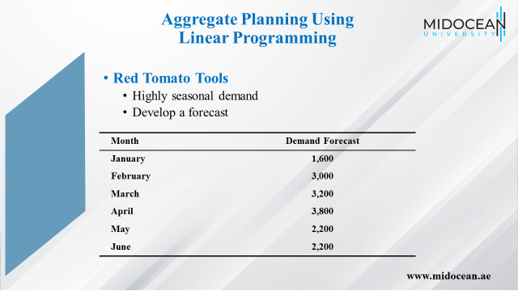

Slide 29
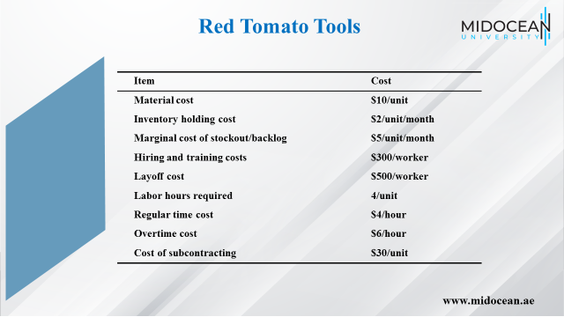

Slide 30
Forecast Error in Aggregate Plans
Forecast errors must be considered
Safety inventory
Safety capacity
  Use overtime as a form of safety capacity
  Carry extra workforce permanently as a form of safety capacity
  Use subcontractors as a form of safety capacity
  Build and carry extra inventories as a form of safety inventory
  Purchase capacity or product from an open or spot market as a form of safety capacity
www.midocean.ae

Slide 31
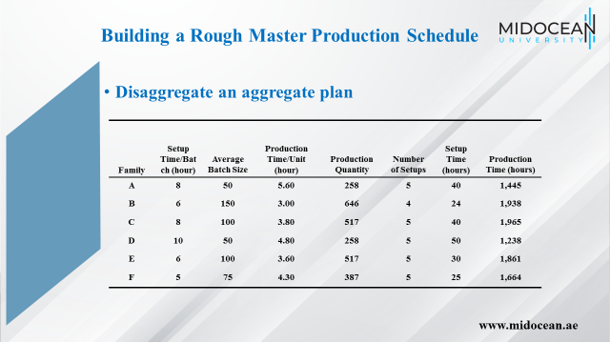

Slide 32
The Role of IT in
Aggregate Planning
The ability to handle large problems
The ability to handle complex problems (through either nonlinear optimization or linear approximations)
The ability to interact with other core IT systems such as inventory management and sourcing
www.midocean.ae

Slide 33
Implementing Aggregate Planning in Practice
Think beyond the enterprise to the entire supply chain
Most aggregate planning today takes only the enterprise as its breadth of scope. However, many factors outside the enterprise and throughout the supply chain can affect the optimal aggregate plan dramatically.
Therefore, avoid the trap of thinking only about your own enterprise when planning.
Work with downstream partners to produce forecasts, with upstream partners to determine constraints, and with any other supply chain entities that can improve the quality of the inputs into the aggregate plan.
www.midocean.ae

Slide 34
Implementing Aggregate Planning in Practice
Make plans flexible because forecasts are always inaccurate
Aggregate plans are based on forecasts of future demand. Given that these forecasts are always inaccurate to some degree, the aggregate plan needs to have some flexibility built into it if it is to be useful.
By building flexibility into the plan, when future demand changes or other changes occur, such as increases in costs, the plan can adjust appropriately to handle the new situation.
www.midocean.ae

Slide 35
Implementing Aggregate Planning in Practice
Rerun the aggregate plan as new data emerge
Aggregate plans provide a map for the next 3 to 18 months.
This does not mean that a firm should run aggregate plans only once every 3 to 18 months.
As inputs such as demand forecasts change, managers should use the latest values of these inputs and rerun the aggregate plan.
Be careful, however, to modify plans in a way that limits volatility.
www.midocean.ae

Slide 36
Implementing Aggregate Planning in Practice
Use aggregate planning as capacity utilization increases
Many companies do not create aggregate plans and instead rely solely on orders from their distributors or warehouses to determine their production schedules.
These orders are driven either by actual demand or through inventory management algorithms.
If a company has no trouble meeting demand efficiently this way, then the lack of aggregate planning may not harm the company significantly.
www.midocean.ae

Slide 37
Implementing Aggregate Planning in Practice
Use aggregate planning as capacity utilization increases
However, when utilization becomes high and capacity is an issue, relying on orders to set the production schedule can lead to shortages and delays.
When utilization is high, aggregate planning helps the firm effectively meet the forecasted demand.
www.midocean.ae

Slide 38
Summary of Learning Objectives
Identify the decisions that are best solved by aggregate planning.
Understand the importance of aggregate planning as a supply chain activity.
Describe the information needed to produce an aggregate plan.
Explain the basic trade-offs to consider when creating an aggregate plan.
www.midocean.ae

Slide 39
Essential Reference
Chopra, S., & Meindl, P. (2016). Global Edition. Pearson Education Limited
Chapter 8.
www.midocean.ae

Slide 40



Thank You

