Slide 1


Health Law and Ethics
Prepared by Dr. Aya Mohamed
MHA 633
A practical approach to ethics
Lecture 2

Slide 2

Chapter
In the previous Lecture: A practical approach to ethics
01
Think about the concept of Ethics
Levels of moral response
What is Ethics?
The Fact-Value Distinction
Ethical reasoning
Ethics Dilemmas
Basic principles of medical ethics
Why Ethics Become Important?
Ethics and Morality ……What are they?
Ethics Vs Law
Ethical Codes

Slide 3
Chapter
A practical approach to ethics
01
Key concepts in medical ethics
Medical Ethics Vs Bioethics
What Are Ethical Principles?
The Principle of Non-Maleficence
The Principle of Beneficence
The Principle of Autonomy
The Principle of Veracity
The Principle of Confidentiality
The Principle of Justice
The Principle of Privacy

Slide 4
Chapter
Key concepts in medical ethics
01
Professional ethics are standards of conduct that apply to people who occupy a professional occupation or role.
A person who enters a profession acquires ethical obligations because society trusts them to provide valuable goods and services that cannot be provided unless their conduct conforms to certain standards.
Professionals who fail to live up to their ethical obligations betray this trust.
Professional ethics studied by ethicists include medical ethics.

Slide 5
Chapter
Key concepts in medical ethics
01
Medical ethics
Concerns issues related to practice of medicine
Explores and promotes principles guiding conduct of health care professionals
Involves the consideration of others in deciding how to act
It is applied ethics. It consists of the same moral principles and rules that we would appeal to ,and argue for, in ordinary circumstances.

Slide 6
Chapter
Key concepts in medical ethics
01
Bioethics (Biomedical ethics)
Bioethics could be defined as the study of ethical issues and decision-making associated with the use of living organisms
Bioethics includes medical ethics. Bioethics is learning how to balance different benefits, risks and duties.
Bioethics: “a field of study concerned with the ethics and philosophical implications of certain biological and medical procedures, technologies, and treatments, such as organ transplants, genetic engineering, and care of the terminally ill”

Slide 7
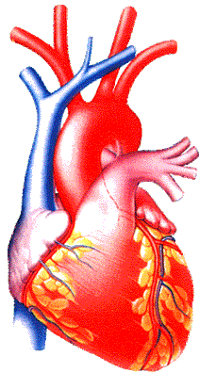

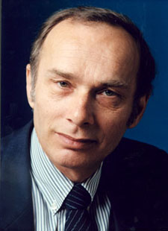
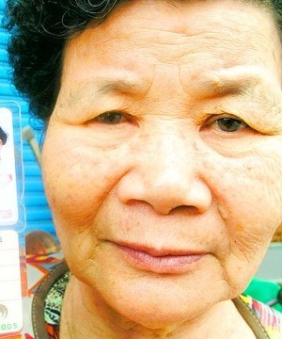
A classic bioethical decision
One heart available → who should get it?
  40-year-old school principal
  70-year-old woman
  17-year-old girl

Slide 8
Questions answered by Bioethics
    Deciding what we should do
    (what decisions are morally right or acceptable);
    Explaining why we should do it
    (how do we justify our decision in moral terms); and
    Describing how we should do it
    (the method or manner of our response when we act on our decision).

Slide 9
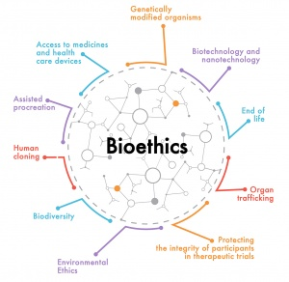
Medical Ethics Vs Bioethics
Whereas medical ethics focuses primarily on issues arising out of the practice of medicine, bioethics is a very broad subject that is concerned with the moral issues raised by developments in the biological sciences more generally.

Slide 10
Chapter
Key concepts in medical ethics
01
Clinical medical ethics is a practical and applied discipline that aims to improve patient care and patient outcomes by focusing on reaching a right and good decision in individual cases.
It focuses on the doctor-patient relationship and takes account of the ethical and legal issues that patients, doctors, and hospitals must address to reach good decisions for individual patients.

Slide 11

Key concepts in medical ethics
Medical Etiquettes:
The conventional laws, customs of courtesy and the code of conduct governing the relationship of the physician with his professional colleagues.

Slide 12
What is an “ethical issue” or a “moral problem”?
There is an ethical issue when:
  …we encounter conflicting values, beliefs, goals, or responsibilities
  …we are concerned that persons or their rights are not being respected
  …we are concerned about fairness and justice
  …we are unsure what we should do or why we should do it, morally speaking

Slide 13
What else could it be?
Miscommunication stands for 70-80% of problems in healthcare
  E.g. Doctors don’t know to tell medical info
Management issue
  “when shall I get promoted? All my colleagues did. This is not ethical!”
Financial issue
  “I am underpaid for my workload. This is not ethical!”

Slide 14
Chapter
The content of clinical ethics includes
01
Specific issues such as
1.truth-telling,
2.informed consent,
3.end of life care,
4. palliative care,
5.allocation of clinical resources,
6. the ethics of medical research.
The study of the doctor-patient relationship, including such issues as
1. honesty,
2.competence, integrity,
3.respect for persons.

Slide 15

Components of Medical Ethics
Chapter
01
The Physician -- Patient Relationship
The Physician -- Physician Relationship
The relationship of the Physician to the System of Healthcare
The Relationship of the Physician to Society

Slide 16
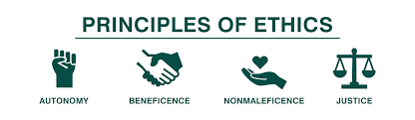
What Are Ethical Principles?
Chapter
01
The Principle of Non-Maleficence
The Principle of Beneficence
The Principle of Autonomy
The Principle of Veracity
The Principle of Confidentiality(or Fidelity)
The Principle of Social Responsibility and Justice

Slide 17
What Are Ethical Principles?
Chapter
01
The Principle of Non-Maleficence
Requires that a procedure does not harm the patient involved or others in society.
Concern about:
first do no harm
sanctity of life
be aware of the doctrine of double effect, where a treatment intended for good unintentionally causes harm.

Slide 18
Chapter
The Principle of Non-Maleficence
01
“Above all, do no harm,“ – Make sure that the procedure does not harm the patient or others in society
When interventions undertaken by physicians create a positive outcome while also potentially doing harm it is known as the "double effect."
Eg,. the use of morphine in the dying patient. eases pain and suffering while hastening the demise through suppression of the respiratory drive

Slide 19

Chapter
The Principle of Non-Maleficence
01
Physicians are obligated not prescribe medications they know to be harmful.
Some interpret this value to exclude the practice of euthanasia
Violation of non-maleficence is the subject of medical malpractice litigation

Slide 20
Chapter
The Principle of Beneficence
01
Requires that the procedure be provided with the intent of doing good for the patient involved.
Demands that health care providers develop and maintain skills and knowledge, continually update training, consider individual circumstances of all patients, and strive for net benefit.
patient’s welfare as the first consideration
All healthcare providers must strive to improve their patient’s health, to do the best for the patient in every situation.
what is good for one patient may not be good for another, so each situation should be considered individually.

Slide 21
Chapter
The Principle of Beneficence
01
The practitioner should act in “the best interest” of the patient - the procedure be provided with the intent of doing good to the patient
Patient’s welfare is the first consideration.
This needs health care provider to,
- develop and maintain skills and knowledge by continually updating training
- consider individual circumstances of all patients

Slide 22
Chapter
The Principle of Autonomy
01
People have the right to control what happens to their bodies.
This principle simply means that an informed, competent adult patient can refuse or accept treatments, drugs, and surgeries according to their wishes.
People have the right to control what happens to their bodies because they are free and rational.
These decisions must be respected by everyone, even if those decisions aren’t in the best interest of the patient.

Slide 23
Chapter
The Principle of Autonomy
01
Patient has freedom of thought, intention and action when making decisions regarding health care procedures
For a patient to make a fully informed decision, she/he must understand all risks and benefits of the procedure and the likelihood of success.
Always respect the autonomy of the patient - then the particular patient is free to choose
Such respect is not simply a matter of attitude, but a way of acting so as to recognize and even promote the autonomous actions of the patient.
The autonomous person may freely choose loyalties or systems of religious belief that may adversely affect him

Slide 24
Chapter
The Principle of Autonomy
01
The patient must be informed clearly the consequences of his action that may affect him adversely.
Desiring to "benefit" the patient, the physician may strongly want to intervene believing it to be a clear "medical benefit." The physician has a duty to respect the autonomous choice of the patient, as well as a duty to avoid harm and to provide a medical benefit.

Slide 25
Chapter
The Principle of Autonomy
01
But the physician should give greater priority to the respect for patient autonomy than to the other duties.
However, at times this can be difficult because it can conflict with the paternalistic attitude of many health care professionals.
In the case of a child, the principle of avoiding the harm of death, and the principle of providing a medical benefit that can restore the child to health and life, would be given precedence over the autonomy of the child's parents as surrogate decision makers.

Slide 26

The Principle of Autonomy
Autonomy
Patient has freedom of thought, intention and action when making decisions regarding health care procedures.
For a patient to make a fully informed decision, she/he must understand all risks and benefits of the procedure and the likelihood of success.
This includes the need to tell the truth (veracity) and to be faithful to one’s commitments (fidelity).

Slide 27

The Principle of Veracity
It refers to telling the truth. Loss of truth results in loose of relation with the patient as well as loss of credibility and respect from other professionals and patients alike.
e.g.: If the patient ask any question, the physician
must give him the correct information and not to liar

Slide 28
Chapter
The Principle of Veracity
01
Truth telling
Obligation to full and honest disclosure
An act or omission by a health care provider that deviates from accepted standards of practice in the medical community which causes injury to the patient.
Medical malpractice

Slide 29
Chapter
The Principle of Confidentiality
01
Based on loyalty and trust
Maintain the confidentiality of all personal, medical and treatment information
Information to be revealed with consent and for the benefit of the patient
Except when ethically and legally required
Disclosure should not be beyond what is required

Slide 30
Confidentiality…
Breaking it legally!
(a) The notification of births and deaths under the National Health Service Act 1977 Section 124 and regulation (1982 SI. No. 286).
(b) Notification of communicable disease covered by the Public Health (Control of Disease) Act 1984 and Public Health (Infectious Diseases) Regulations 1988.
(c) Notification of abortion — Abortion Regulations 1991, regulations 4—5 (duty of medical practitioner to notify of abortions carried out and circumstances in which further disclosure of that information may be required or requested).
(d) Serious accidents covered under the Health and Safety at Work etc. Act 1974. Regulations on the Reporting of Injuries Diseases and Dangerous Occurrence (1985 and 1989) and Road Traffic Acts.

Slide 31
Confidentiality….
Breaking it legally!
(e) Acts of Treason and Intention to cause explosion to Her Majesty’s Dockyards.
(f) There are certain obligations to pass on information under the Mental Health Act 1983; Mental Health Patients in the Community Act 1995;
Mental Health Act (Scotland) 1984; Mental Health NI Order 1986; and the Mental Treatments Acts (Ireland) 1945—61.
(g) Section 1 — AIDS Control Act 1987 (duty of health authority and others to make reports of number, but not the identity of, persons with AIDS or known to be HIV antibody positive).
(h) Section 18 — Prevention of Terrorism Act 1989 (power to require the production of information from any person, making it an offence to fail to volunteer that information).
(i) Road Traffic Act 1988 (S.172), which may require an attending doctor to provide the identity of patients he/she has treated following a road traffic
accident.

Slide 32
Chapter
The Principle of Justice
01
Justice is a complex ethical principle, with meanings that range from the fair treatment of individuals to the equitable allocation of healthcare dollars and resources.
Justice is concerned with the equitable distribution of benefits and burdens to individuals in social institutions, and how the rights of various individuals are realized.
Allocating scarce medical resources.
Be able to justify your actions in every medical situation.

Slide 33
Chapter
The Principle of Justice
01
The distribution of scarce health resources, and the decision of who gets what treatment “fairness and equality”
The burdens and benefits of new or experimental treatments must be distributed equally among all groups in society
The four main areas that Health care provider must consider when evaluating justice
1. Fair distribution of scarce resources
2. Competing needs
3. Rights and obligations
4. Potential conflicts with established legislations

Slide 34
The Principle of Justice
Equity or Justice
Fair and equal distribution of scarce health resources, and the decision of who gets what treatment.
The burdens and benefits of new or experimental treatments must be distributed equally among all groups in society.

Slide 35
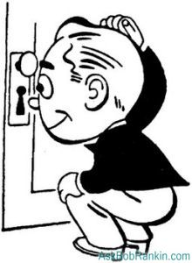
The Principle of Privacy
It is the right to respect one’s human being for his/her personal life and also consider privacy during examination and treatment.

Slide 36
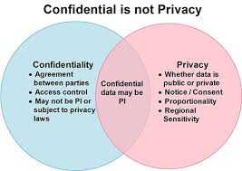
Confidentiality
Privacy
Concerning with the body of the patient
Concerning with the information about the patient

Slide 37

Autonomy (‘self-rule’)
  Help patients to make their own decisions and respect these decisions even if you disagree
Beneficence (Do Good)
  Doing what is best for the patient – but what is the best? May conflict with autonomy
Non-maleficence (Do no Harm)
Justice/Equity
  time and resources
Ethics Principles

Slide 38
Conclusion
MEDICINE means Mercy - Empathy - Dare - Integrity - Care - Ingenuity - Nobility - and Ethics.
Sick are not those who possess a sickness, but those who are possessed by sickness.
“For a patient to be fully treated by a doctor, the patient must be willing to put all psychological guards down and be vulnerable. And this can only happen if the patient can trust the doctor, and this trust can only be induced through the release of oxytocin, which can only be triggered in the patient's brain by the will of a doctor with a genuine act of kindness on the doctor's part.”
― Abhijit Naskar, Time to Save Medicine

Slide 39
Chapter
A practical approach to ethics
01
Key concepts in medical ethics
Medical Ethics Vs Bioethics
What Are Ethical Principles?
The Principle of Non-Maleficence
The Principle of Beneficence
The Principle of Autonomy
The Principle of Veracity
The Principle of Confidentiality
The Principle of Justice
The Principle of Privacy

Slide 40



Thank You

