Slide 1


Reinforcement Learning
(AI644)
Prepared by Dr. Ashraf Elsayed
Lecture 1

Slide 2


Reinforcement Learning
Lecture 1
Prepared by
Dr. Ashraf Elsayed
www.midocean.ae

Slide 3
Introduction to
Reinforcement Learning
www.midocean.ae

Slide 4
The objectives of the lecture is to:
Understand Reinforcement Learning Fundamentals
Define and explain the basic concepts of reinforcement learning, including agents, environments, actions, states, rewards, and policies.
Understand the difference between supervised learning, unsupervised learning, and reinforcement learning.
www.midocean.ae

Slide 5
What is Reinforcement Learning?
RL is a type of machine learning paradigm where an agent learns to make decisions by interacting with an environment. The agent takes actions in the environment, and based on these actions, it receives feedback in the form of rewards or penalties. The goal of the agent is to learn a policy, which is a mapping from states to actions, that maximizes the cumulative reward over time.
www.midocean.ae

Slide 6
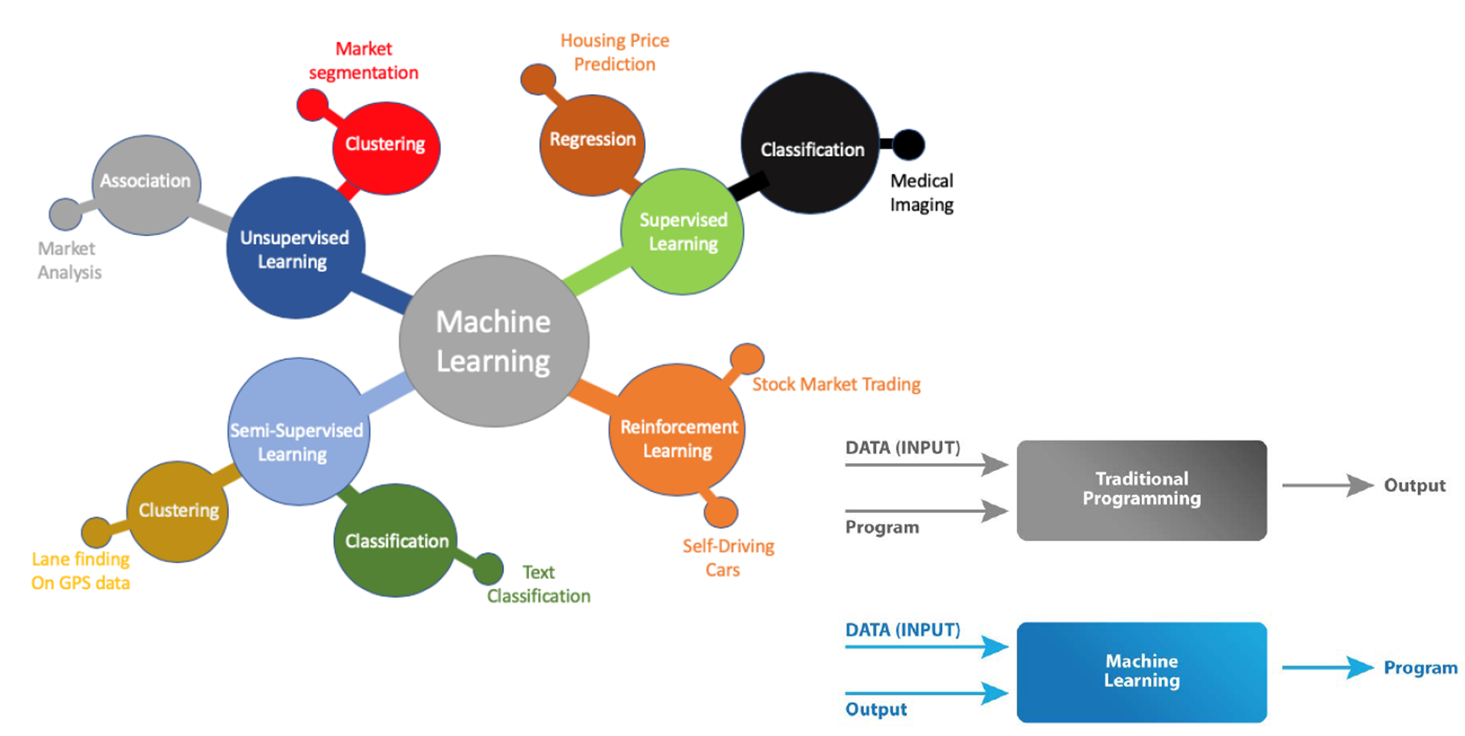
Machine Learning
www.midocean.ae

Slide 7
Machine Learning Areas
Supervised Learning: Data and corresponding labels are given
Unsupervised Learning: Only data is given, no labels provided
Semi-supervised Learning: Some (if not all) labels are present
Reinforcement Learning: An agent interacting with the world makes observations, takes actions, and is rewarded or punished; it should learn to choose actions in such a way as to obtain a lot of reward
www.midocean.ae

Slide 8
Supervised Learning
Learning a discrete function: Classification
  Boolean classification:
    Each example is classified as true(positive) or false(negative).
Learning a continuous function: Regression
www.midocean.ae

Slide 9
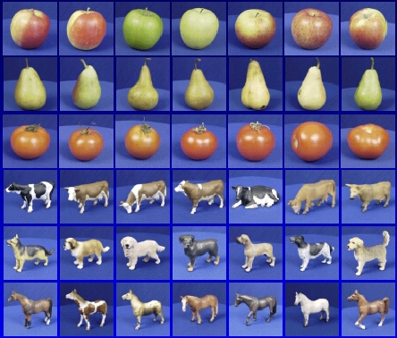

Steps
Training
Training Labels
Training Images
Image Features
Training
Learned model
Testing
Image Features
Learned model
Prediction
Test Image
www.midocean.ae

Slide 10


















Unsupervised Learning
Given x₁, x₂, ..., x_{n} (without labels)
Output hidden structure behind the x’s
– E.g., clustering
www.midocean.ae

Slide 11









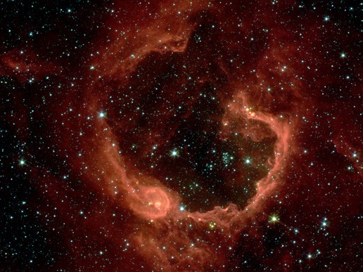
Unsupervised Learning
Social network analysis
Market segmentation
Image credit: NASA/JPL-Caltech/E. Churchwell (Univ. of Wisconsin, Madison)
Astronomical data analysis
www.midocean.ae

Slide 12
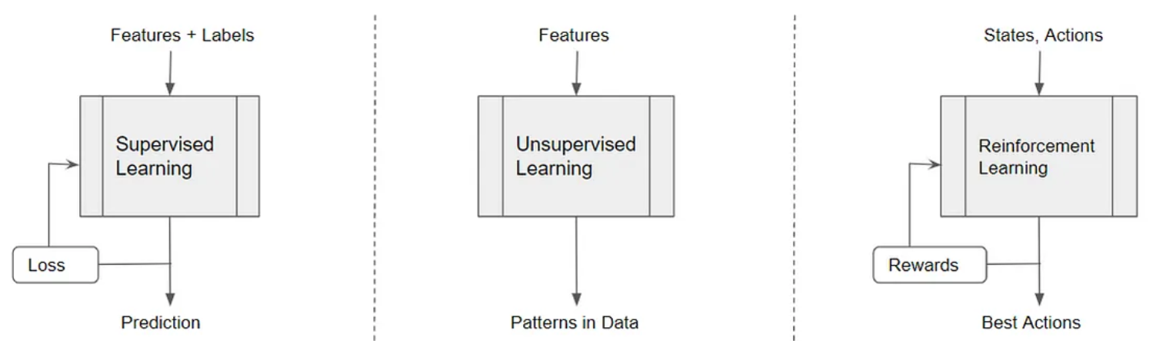
Reinforcement Learning
www.midocean.ae

Slide 13
What is reinforcement learning?
People and animals learn by interacting with our environment
This differs from certain other types of learning
  It is active rather than passive
  Interactions are often sequential — future interactions can depend on earlier ones
We are goal-directed
We can learn without examples of optimal behaviour
Instead, we optimize some reward signal
Framework of learning to make decisions from interaction
www.midocean.ae

Slide 14
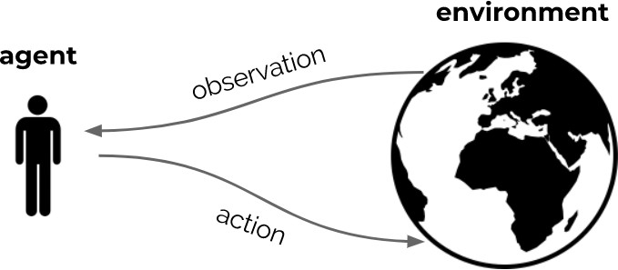
The interaction loop
Goal: optimize sum of rewards, through repeated interaction
www.midocean.ae

Slide 15
The reward hypothesis
Reinforcement learning is based on the reward hypothesis:
Any goal can be formalized as the outcome of maximizing a cumulative reward
www.midocean.ae

Slide 16
Examples of RL problems
Fly a helicopter
Manage an investment portfolio
Control a power station
Make a robot walk
Play video or board games
→ Reward: air time, inverse distance, ...
→ Reward: gains, gains minus risk, ...
→ Reward: efficiency, ...
→ Reward: distance, speed, ...
→ Reward: win, maximize score, ...
If the goal is to learn via interaction, these are all reinforcement learning problems (Irrespective of which solution you use)
www.midocean.ae

Slide 17
What is reinforcement learning?
There are distinct reasons to learn:
Find solutions
  A program that plays chess really well
  A manufacturing robot with a specific purpose
Adapt online, deal with unforeseen circumstances
  A chess program that can learn to adapt to you
  A robot that can learn to navigate unknown terrains
Reinforcement learning can provide algorithms for both cases
Note that the second point is not (just) about generalization — it is about continuing to learn efficiently online, during operation
www.midocean.ae

Slide 18
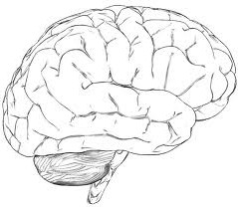
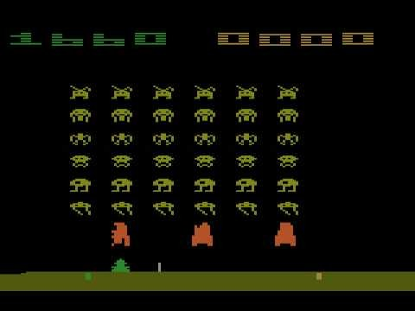


Atari Example: Reinforcement Learning
observation
action
o_{t}
a_{t}
Rules of the game are unknown
Learn directly from interactive game-play
Pick actions on joystick, see pixels and scores
reward
r_{t}
www.midocean.ae

Slide 19
Agent and Environment
At each step t the agent:
  Receives observation O_{t} (and reward R_{t} )
  Executes action A_{t}
The environment:
  Receives action A_{t}
  Emits observation O_{t+1} (and reward R_{t+1})
www.midocean.ae

Slide 20
Rewards
A reward R_{t} is a scalar feedback signal
Indicates how well agent is doing at step t — defines the goal
The agent’s job is to maximize cumulative reward
G_{t} = R_{t+1} + R_{t+2} + R_{t+3} + ...
We call this the return
Reinforcement learning is based on the reward hypothesis:
Any goal can be formalized as the outcome of maximizing a cumulative reward
www.midocean.ae

Slide 21
Values
We call the expected cumulative reward, from a state s, the value
v (s) = E [G_{t} | S_{t} = s]
= E [R_{t+1} + R_{t+2} + R_{t+3} + ... | S_{t} = s]
Expected future rewards given that
the agent is at State s
The value depends on the actions the agent takes
Goal is to maximize value, by picking suitable actions
Returns and values can be defined recursively
G_{t} = R_{t+1} + G_{t+1}
v (s) = E [R_{t+1} + v (S_{t+1}) | S_{t} = s]
www.midocean.ae

Slide 22
Maximizing value by taking actions
Goal: select actions to maximize value
Actions may have long term consequences
Reward may be delayed
It may be better to sacrifice immediate reward to gain more long-term reward
Examples:
  Refueling a helicopter (might prevent a crash in several hours)
  Defensive moves in a game (may help chances of winning later)
  Learning a new skill (can be costly & time-consuming at first)
A mapping from states to actions is called a policy
www.midocean.ae

Slide 23
Action values
It is also possible to condition the value on actions:
Expected reward given that
the agent take the action a
We will talk in depth about state and action values later
www.midocean.ae

Slide 24
Core concepts
The reinforcement learning formalism includes
Environment (dynamics of the problem)
Reward signal (specifies the goal)
Agent, containing:
  Agent state
  Policy
  Value function estimate?
  Model?
We will now go into the agent
www.midocean.ae

Slide 25
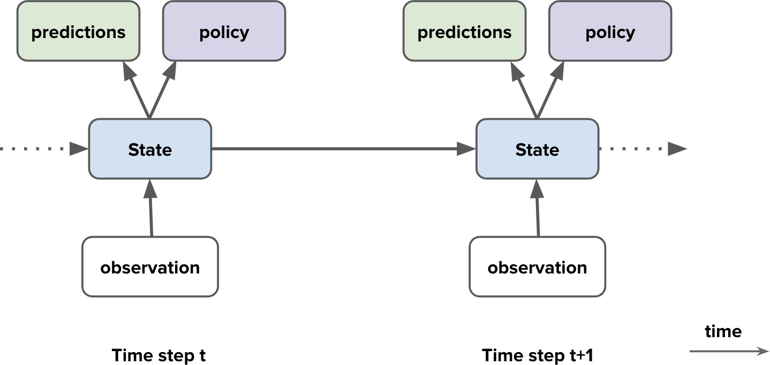
Agent components
Agent components
Agent state
Policy
Value functions
Model
www.midocean.ae

Slide 26
Environment State
The environment state is the environment’s internal state
It is usually invisible to the agent
Even if it is visible, it may contain lots of irrelevant information
www.midocean.ae

Slide 27
Agent State
The history is the full sequence of observations, actions, rewards
H_{t} = O₀, A₀, R₁, O₁, ..., O_{t−1}, A_{t−1}, R_{t} , O_{t}
For instance, the sensorimotor stream of a robot
This history is used to construct the agent state S_{t}
www.midocean.ae

Slide 28
Fully Observable Environments
Full observability
Suppose the agent sees the full environment state
observation = environment state
The agent state could just be this observation:
S_{t} = O_{t} = environment state
www.midocean.ae

Slide 29
Markov decision processes
Markov decision processes (MDPs) are a useful mathematical framework
Definition
A decision process is Markov if
p (r , s | S_{t} , A_{t} ) = p (r , s | H_{t} , A_{t} )
Probability of reward r and state s given that all history of states and action A_{t}
This means that the state contains all we need to know from the history
Doesn’t mean it contains everything, just that adding more history doesn’t help
Once the state is known, the history may be thrown away
  The full environment + agent state is Markov (but large)
  The full history H_{t} is Markov (but keeps growing)
Typically, the agent state S_{t} is some compression of H_{t}
Note: we use S_{t} to denote the agent state, not the environment state
www.midocean.ae

Slide 30
Partially Observable Environments
Partial observability: The observations are not Markovian
  A robot with camera vision isn’t told its absolute location
  A poker playing agent only observes public cards
Now using the observation as state would not be Markovian
This is called a partially observable Markov decision process (POMDP)
The environment state can still be Markov, but the agent does not know it
We might still be able to construct a Markov agent state
www.midocean.ae

Slide 31
Agent State
The agent’s actions depend on its state
The agent state is a function of the history
For instance, S_{t} = O_{t}
More generally:
S_{t+1} = u(S_{t} , A_{t} , R_{t+1}, O_{t+1})
where u is a ‘state update function‘
The agent state is often much smaller than the environment state
www.midocean.ae

Slide 32

Agent State
The full environment state of a maze
www.midocean.ae

Slide 33

Agent State
A potential observation
www.midocean.ae

Slide 34

Agent State
An observation in a different location
www.midocean.ae

Slide 35

Agent State
The two observations are indistinguishable
www.midocean.ae

Slide 36

Agent State
These two states are not Markov
How could you construct a Markov agent state in this maze (for any reward signal)?
www.midocean.ae

Slide 37
Partially Observable Environments
To deal with partial observability, agent can construct suitable state representations
Examples of agent states:
  Last observation: S_{t} = O_{t} (might not be enough)
  Complete history: S_{t} = H_{t} (might be too large)
  A generic update: S_{t} = u(S_{t−1}, A_{t−1}, R_{t} , O_{t} ) (but how to pick/learn u?)
Constructing a fully Markovian agent state is often not feasible
More importantly, the state should allow good policies and value predictions
www.midocean.ae

Slide 38
Agent components
Agent components
Agent state
Policy
Value function
Model
www.midocean.ae

Slide 39
Policy
A policy defines the agent’s behavior
It is a map from agent state to action
Deterministic policy: A = π (S)
Stochastic policy: π (A|S) = p (A|S)
www.midocean.ae

Slide 40
Agent components
Agent components
Agent state
Policy
Value function
Model
www.midocean.ae

Slide 41
Value Function
The actual value function is the expected return
v (s) = E [G | S = s, π ]
π t t
= E [R_{t+1} + γ R_{t+2} + γ ²R_{t+3} + ... | S_{t} = s, π ]
We introduced a discount factor γ ∈ [0, 1]
  Trades off importance of immediate vs long-term rewards
The value depends on a policy
Can be used to evaluate the desirability of states
Can be used to select between actions
www.midocean.ae

Slide 42
Value Function
The return has a recursive form G_{t} = R_{t+1} + γ G_{t+1}
Therefore, the value has as well
v_{π} (s) = E [R_{t+1} + γ G_{t+1} | S_{t} = s, A_{t} ∼ π (s)]
= E [R_{t+1} + γv_{π} (S_{t+1}) | S_{t} = s, A_{t} ∼ π (s)]
Here a ∼ π (s) means a is chosen by policy π in state s
This is known as a Bellman equation (Bellman 1957)
A similar equation holds for the optimal (=highest possible) value:
v (s) = max E [R
+ γ v ∗(S
) | S = s, A = a]
∗ t+1
t+1 t t
a
This does not depend on a policy
www.midocean.ae

Slide 43
Agent components
Agent components
Agent state
Policy
Value function
Model
www.midocean.ae

Slide 44
Model
A model predicts what the environment will do next
E.g., predicts the next state
E.g., predicts the next (immediate) reward
≈ E [R_{t+1} | S_{t} = s, A_{t} = a]
A model does not immediately give us a good policy - we would still need to plan
We could also consider stochastic (generative) models
www.midocean.ae

Slide 45

Maze Example
Start
Rewards: -1 per time-step
Actions: N, E, S, W
States: Agent’s location
Goal
www.midocean.ae

Slide 46
Maze Example: Policy
Start
Goal
Arrows represent policy π (s) for each state s
www.midocean.ae

Slide 47
Maze Example: Value Function
Numbers represent value v_{π} (s) of each state s
www.midocean.ae

Slide 48
Maze Example: Model
www.midocean.ae

Slide 49
Agent Categories
Value Based
  No Policy (Implicit)
  Value Function
Policy Based
  Policy
  No Value Function
Actor Critic
  Policy
  Value Function
www.midocean.ae

Slide 50
Agent Categories
Model Free
  Policy and/or Value Function
  No Model
Model Based
  Optionally Policy and/or Value Function
  Model
www.midocean.ae

Slide 51
Learning Agent Components
All components are functions
  Policies: π : S → A (or to probabilities over A)
  Value functions: v : S → R
  Models: m : S → S and/or r : S → R
  State update: u : S × O → S
E.g., we can use neural networks, and use deep learning techniques to learn
Take care: we do often violate assumptions from supervised learning (iid, stationarity)
Deep learning is an important tool
Deep reinforcement learning is a rich and active research field
www.midocean.ae

Slide 52


Thank You

