Slide 1


Network Security
Master of Science in Cybersecurity
Orientation show
عرض توجيهي
Dr. Mohammed Anbar
Everyone Smart University
Faculty of IT
2023

Slide 2
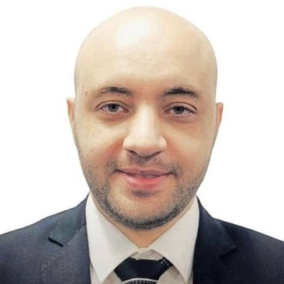

Who Am I?
Dr. Mohammed F.R Anbar
Senior lecturer at National Advanced IPv6 Centre of Excellence (NAv6), Universiti Sains Malaysia (USM)
2013 | PhD in Advanced Internet Security and Monitoring. National Advanced IPv6 Centre of Excellence (NAv6) , Universiti Sains Malaysia (USM), Malaysia
2009 | Master of Information Technology Universiti Utara Malaysia (UUM), Malaysia.
2007 | Bachelor of Computer System Engineering AL-Azhar University, Gaza, Palestine .
Network Security, Dr. Mohammed Anbar

Slide 3



Who Am I? (cont.)
  How to reach me
    By email at mohamedfawzy@esu.ac.ae
    ( please include “Network Security” in the subject line)
  Office hours
  Discussion Time (every Sunday at 6:00 PM)
https://scholar.google.com.my/citations?user=_0mXw6oAAAAJ&hl=en
https://www.scopus.com/authid/detail.uri?authorId=34976191000
https://orcid.org/0000-0002-7026-6408
Network Security, Dr. Mohammed Anbar

Slide 4

The course that will be taught
Network Security (CYB630)
3 credit hours
Network Security, Dr. Mohammed Anbar
Notes:
Network Security , Dr. Mohammed Anbar , Autumn 2022

Slide 5
What This Course is About
  This course provides the fundamental knowledge needed to analyze risks to the system and implement a workable security policy that protects information assets from potential intrusion or damage. Students will learn about a variety of network security attacks such as attacks on the web and email. Also, students will learn which countermeasures to deploy to thwart potential attacks.
Network Security, Dr. Mohammed Anbar

Slide 6
Course outcomes
1
Understand network infrastructure security,
2
To be familiar with attacks detection mechanisms (firewall, IDS, and IPS) and a clear understanding of their importance,
3
To master fundamentals of secret and public cryptography,
4
provide students with a high‐level understanding of web and email security
Network Security, Dr. Mohammed Anbar

Slide 7
Roadmap
Symmetric encryption algorithms
Asymmetric encryption algorithms
HASH function
Public Key Infrastructure
Web security
Email Security
Year 5
04
Introduction to web and email security
03
Introduction to cryptograph
02
01
Network infrastructure security
Introduction to detection mechanisms
Firewall
Intrusion Detection System (IDS)
Intrusion Preinvasion System (IPS)
Honeypot and honeynets
Introduction to infrastructure security
Infrastructure security vs Information Security
Switching, DHCP, and DNS security
IPv6 Security
Network Security, Dr. Mohammed Anbar

Slide 8
Learning Resources:
  Essential References:
  Vincent Nestler, Gregory White, wm. Arthur Conklin, Principles of Computer Security: CompTIA Security+ and Beyond – Lab Manual, ISBN: 978-0-07-174856-8, MHID: 0-07-174856-3, McGraw Hill, 2011.
  Aumasson, J. P. (2017). Serious cryptography: a practical introduction to modern encryption. No Starch Press.
  Stallings, W. (2006). Cryptography and network security principles and practices 4th edition
  Wong, A., & Yeung, A. (2009). Network infrastructure security. Springer Science & Business Media.
Network Security, Dr. Mohammed Anbar

Slide 9
Units of Course Contents
  Lecture Structure:
Module | Course Unit | Week #
1 | Lecture 1: Introduction to Networks infrastructure security (part 1) | 1
2 | Lecture 2: Introduction to Networks infrastructure security (part2) | 2
3 | Lecture 3: IPv6 security | 3
4 | Lecture 4: Firewall | 4
5 | Lecture 5: Intrusion Detection Systems and Intrusion Prevention Systems | 5
6 | Lecture 6: Cryptography | 6
7 | Lecture 7: Public Key Infrastructure | 7
8 | Lecture 8: Web security (part 1) | 8
9 | Lecture 9: Web security (part 2) | 9
10 | Lecture 10: Email Security | 10
Network Security, Dr. Mohammed Anbar

Slide 10

Course Assessment
  Assessment Method:
Quiz ( 80% marks)
    Number of Quizzes (Weekly)
    8 Marks for each Quiz.
  Final Exam (20% )
Network Security, Dr. Mohammed Anbar

Slide 11
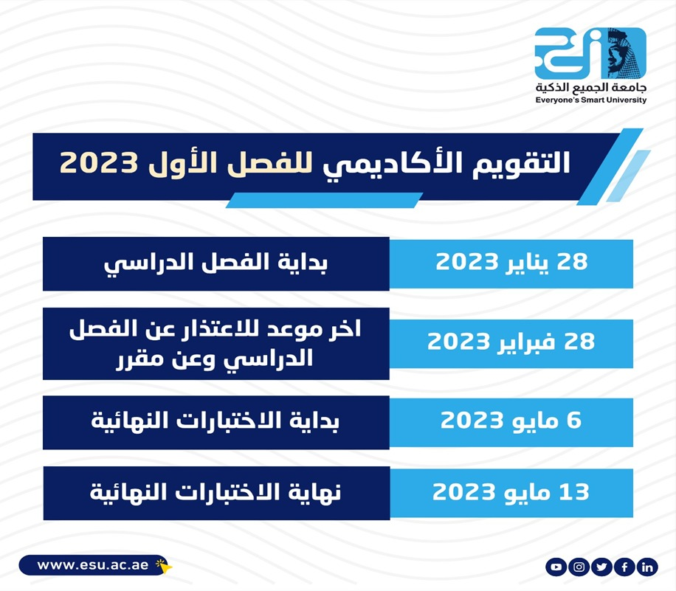
Academic Calendar
Network Security, Dr. Mohammed Anbar

Slide 12
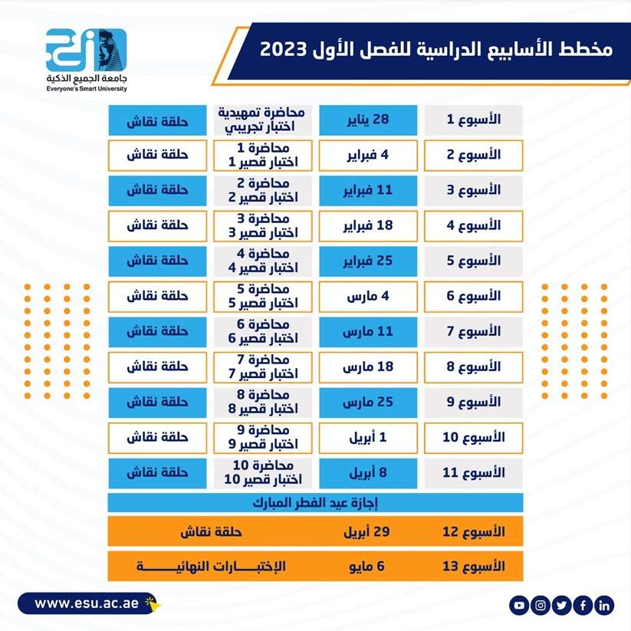
Academic Calendar
Network Security, Dr. Mohammed Anbar

Slide 13
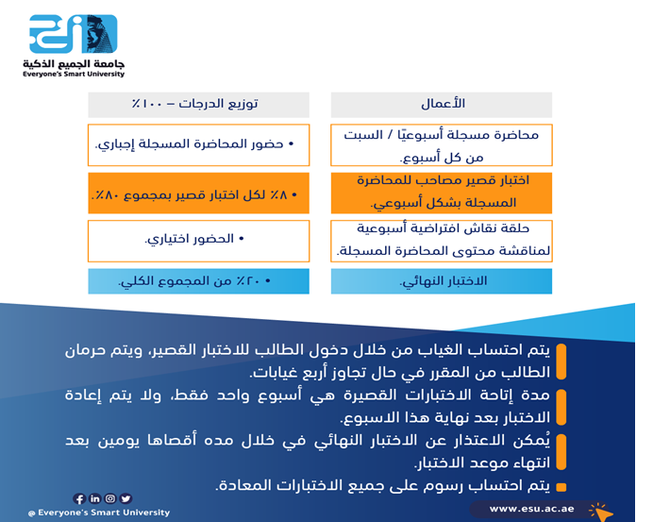
Academic Calendar
الأعمال وتوزيع درجات الفصل الدراسي
-- اللغة الأساسية في المحاضرات هي:
اللغة الإنجليزية
-- الاختبارات باللغة الإنجليزية مع وجود
ترجمة للسؤال.
Network Security, Dr. Mohammed Anbar

Slide 14


