Slide 1



Programming
Foundations in
Python
Prepared by Dr. Hamada I. AbdulWakel
Lecture 8

Slide 2



Object-Oriented
Programming
Lecture 8
Prepared by
Dr. Hamada I. AbdulWakel
www.midocean.ae

Slide 3
Lecture
RECAP: LECTURE 7
08
The function default arguments.
The inner and high-order functions.
The anonymous functions
The use of modules.
www.midocean.ae

Slide 4
Lecture
LECTURE MAIN POINTS
08
Understanding the Procedural-Oriented Programming.
The meaning of Object-Oriented Programming.
The building blocks and principles of OOP.
Difference between a constructor, instance variables, and methods for a class of objects.
www.midocean.ae

Slide 5
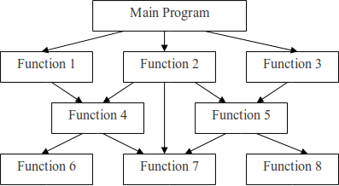
PROCEDURAL-ORIENTED PROGRAMMING (POP)
Lecture
08
www.midocean.ae

Slide 6
Lecture
08
POP: FEATURES
The main concern in POP is doing things.
Depend on the built-in and user-defined functions.
Based on local and global variables in parameter passing.
Modularity: means splitting the program into parts where the top-down design can be applied.
www.midocean.ae

Slide 7
Lecture
08
POP: ADVANTAGES AND DISADVANTAGES
Advantages:
  Excellent for general-purpose programming.
  The coded simplicity along with ease of implementation of compilers and interpreters
  The program flow can be tracked easily.
Disadvantages:
  Poor modeling to real world problems.
  It is not easy to maintain program if it is too complex.
  Provide poor data security.
  Not extensible programming paradigm.
www.midocean.ae

Slide 8
Lecture
08
PRIMITIVE DATA TYPES
Primitive data types, a.k.a. basic or fundamental data types, are the simplest and most basic building blocks in a programming language. It store single simple value.
The primitive data types vary between programming languages, but some common ones include:
  Integer, Short, and Long.
  Floating-point, Double.
  Character.
  Boolean.
  String.
www.midocean.ae

Slide 9
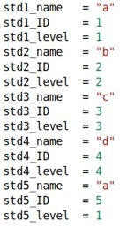
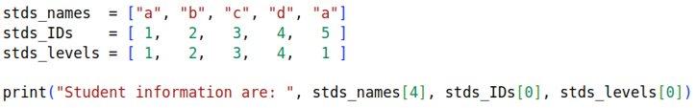
Lecture
08
PRIMITIVE DATA TYPES PROBLEMS
Student Management System Case Study
  Suppose you want to store data for 5 students for an academic institution.
  Each student has name, ID, and level information.
  How to use primitive data types to solve this?
www.midocean.ae

Slide 10
Lecture
08
PRIMITIVE DATA TYPES PROBLEMS
Cont'd
Student Management System Case Study
  Now, the academic institution has 100 registered students.
  Each student has name, ID, address, email, level, and registered courses information.
  Each course has course name, course ID, course time, and course level information.
  Primitive data types were not a problem for simple programs. But, for large scale and complex program it is not suitable at all.
www.midocean.ae

Slide 11
Lecture
08
COMPLEX/CUSTOME DATA TYPES
Custom data types, a.k.a. user-defined data types, allow developers to create structures that suitable for the specific needs of their applications.
They offer several advantages in terms of organization, abstraction, and functionality.
Complex data types help in representing real world things/objects.
www.midocean.ae

Slide 12
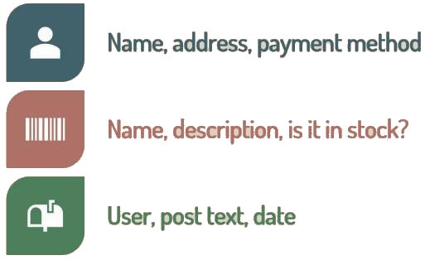

Lecture
08
COMPLEX/CUSTOME DATA TYPES
Cont'd
www.midocean.ae

Slide 13

Lecture
08
OBJECT-ORIENTED PROGRAMMING
Object-Oriented Programming (OOP) is a programming paradigm that organizes code into objects, which can encapsulate data and behavior.
  Program is divided into classes and objects.
  The main concern on data.
  Strong modeling to real world problems.
  It is easy to maintain program even if it is too complex.
  Provide strong data security.
  It is highly extensible programming paradigm.
  Unit of programming is class.
  Ex: Python, Java, C#.
www.midocean.ae

Slide 14
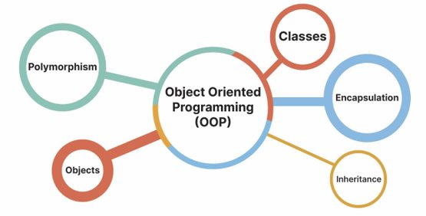
Lecture
08
OOP: KEY CONCEPTS
www.midocean.ae

Slide 15
Lecture
08
OOP: CLASS
Classes: the user-defined data types that act as the blueprint for individual objects, attributes and methods.
  Attributes: are defined in the class template and represent the state of an object. Class attributes belong to the class itself.
  Methods: are functions that are defined inside a class that describe the behaviors of an object.
www.midocean.ae

Slide 16
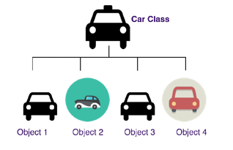
Lecture
08
OOP: OBJECT
Objects: are instances of classes and represent real-world entities. They encapsulate data (attributes) and behavior (methods) related to those entities.
www.midocean.ae

Slide 17
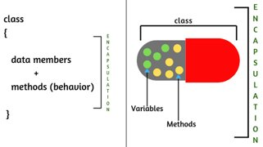
Lecture
08
OOP: ENCAPSULATION
Encapsulation is the bundling of data (attributes) and the methods (functions) that operate on that data into a single unit (class). It restricts access to the internal details of an object, providing a protective barrier around the object's state.
www.midocean.ae

Slide 18
OOP: INHERITANCE AND POLYMORPHISM
Lecture
08
Inheritance:
Allows a class to inherit the properties and behaviors of another class.
This promotes code reuse and the creation of a hierarchy of classes.
Polymorphism: Objects are designed to share behaviors (methods) and they can take on more than one form.
www.midocean.ae

Slide 19
Lecture
08
CLASS DEFINITION
All class definitions start with the class keyword, which is followed by the name of the class and a colon.
Any code that is indented below the class definition is considered part of the class’s body.
class className :
#class body
www.midocean.ae

Slide 20
Lecture
08
CLASS DEFINITION
Cont'd
Example: empty class
class Student:
pass #indicating where code will eventually go
print(Student)
www.midocean.ae

Slide 21
Lecture
08
INSTANCE ATTRIBUTES
Instance attributes are the properties that all objects must have and defined inside the method called __init__().
When a new object is created, __init__() sets the initial state of the object by assigning the values of the object’s properties.
If you change the attributes of an instance, it won’t affect other instances.
The __init__() can take any number of parameters, but the first parameter will always be a variable called self.
www.midocean.ae

Slide 22
Lecture
08
INSTANCE ATTRIBUTES
Cont'd
Example:
class Student:
def __init__(self, name, age):
self.name = name
self.age = age
Both name and age are called instance attributes.
www.midocean.ae

Slide 23
Lecture
08
CLASS ATTRIBUTES
The class attributes are properties that have the same value for all class instances.
Class attributes are defined directly under the line of the class name, outside the __init__() function.
You can access the class attribute via instances of the class or via the class name.
www.midocean.ae

Slide 24
Lecture
08
CLASS ATTRIBUTES
Cont'd
Example:
class Student:
course = "OOP in Python"
def __init__(self, name, age):
self.name = name
self.age = age
The course property is called class attribute and has the "OOP in Python" value for every student object.
www.midocean.ae

Slide 25
DEALING WITH INSTANCE AND CLASS ATTRIBUTES
Lecture
08
When you access an attribute via an instance of the class, Python searches for the attribute in the instance attribute list.
If the instance attribute list doesn’t have that attribute, Python continues looking up the attribute in the class attribute list.
However, if you access an attribute via the class name, Python directly searches for the attribute in the class attribute list.
www.midocean.ae

Slide 26
DEALING WITH INSTANCE AND CLASS ATTRIBUTES
Lecture
08
Cont'd
Example:
class Student:
age = 10
def __init__(self):
self.age = 20
test = Test()
print(test.age) # 20
print(Test.age) # 10
www.midocean.ae

Slide 27
Lecture
08
INSTANTIATING OBJECTS
You can instantiate a new object by typing the name of the class, followed by opening and closing parentheses.
ObjectName = ClassName( [arguments if exist] )
After you create the instances, you can access their instance attributes using dot notation.
The custom objects are mutable by default.
You can delete the instance or its attribute using the keyword del.
www.midocean.ae

Slide 28
Lecture
08
INSTANTIATING OBJECTS
Cont'd
Example:
class Student:
def __init__(self, name, age):
self.name = name
self.age = age
std1 = Student("Ahmed", 20) The object std1 is automatically
passed where self is referring to the
object std1
www.midocean.ae

Slide 29
Lecture
08
INSTANTIATING OBJECTS
Cont'd
Example:
std1 = Student("Ahmed", 20)
std2 = Student("Mohamed", 15)
print(std1 is std2)
print(std1.name)
std1.age = 25
print(std1.age)
del std1.age
print(std1.age)
del std1
www.midocean.ae

Slide 30
Lecture
08
INSTANCE METHODS
Methods are functions defined inside a class and can only be called/accessed from an instance of that class.
Like __init__(), an instance method’s first parameter is always the self argument.
When there are two instance methods with the same name and different implementation, the second version of the method overridden the first one when calling it.
www.midocean.ae

Slide 31
Lecture
08
INSTANCE METHODS
Cont'd
Example:
class Student:
def __init__(self, name, age):
self.name = name
self.age = age
def displayStudentInfo(self):
return f"{self.name} is {self.age} years old"
s1 = Student("Ahmed", 15)
print(s1.displayStudentInfo())
www.midocean.ae

Slide 32
Lecture
08
INSTANCE METHODS
Cont'd
Example:
class Student:
def display(self):
print(self.name)
def display(self):
return f" The student's name is {self.name}"
s1 = Student("Ahmed", 15)
print(s1.display())
www.midocean.ae

Slide 33
Lecture
08
SPECIAL INSTANCE METHODS
This kind of methods overriding the functionality implementation of a built-in functions in Python to be suitable for custom classes.
Like __init()__ method, a special instance method is always beginning and ending with double underscores _ _.
The __str__() method is used to change what printed when passing an instance to the print() method.
The __len__() method which is called when the built-in function len() is called, with the object being the argument.
www.midocean.ae

Slide 34
Lecture
08
SPECIAL INSTANCE METHODS
Cont'd
Example:
class Student:
def __init__(self, name):
self.name = name
def __str__(self):
return f"The student name is {self.name}"
def __len__(self):
return len(self.name)
s1 = Student("Ahmed")
print(s1); print( len(s1) )
www.midocean.ae

Slide 35
Lecture
08
EXAMPLE
Create a class called "Distance" that has two instance attributes called "feet" and "inches" and has the following methods:
  __init__(): that initializes the distance objects using the default arguments.
  getDistance(): that takes the distance information from the user.
  addDistances(): that adds two different distance and return the sum of their feets and inches.
www.midocean.ae

Slide 36
Lecture
08
EXAMPLE
Cont'd
Code:
class Distance:
def __init__(self, feet = 0, inch = 0.0):
self.feet = feet
self.inch = inch
def getDistance(self):
f = int(input("Enter the distnace feet value: "))
self.feet = f
inc = float(input("Enter the distnace feet value: "))
self.inch = inc
www.midocean.ae

Slide 37
Lecture
08
EXAMPLE
Cont'd
Code:
class Distance:
def addDistances(self, otherObj):
temp = self.__class__()
temp.feet = self.feet + otherObj.feet
temp.inch = self.inch + otherObj.inch
if temp.inch >= 12.0:
temp.feet += 1
temp.inch -= 12.0
return temp
www.midocean.ae

Slide 38
Lecture
08
EXAMPLE
Cont'd
Code:
d1 = Distance()
print(d1.feet)
d1.getDistance()
print(d1.feet)
d2 = Distance(2, 1.5)
d3 = d1.addDistances(d2)
print(d3.feet, d3.inch)
www.midocean.ae

Slide 39
Lecture
08
QUESTIONS FOR ONLINE DISCUSSION
Write a class, Student, which has three properties, including a 6-digit student ID, a name, and a list of exam scores. The constructor takes the student name as the first argument, followed by an optional number of additional arguments representing the examination scores. The Student class provide two methods, including average, which takes no argument and returns the average score of the student, and __str__, which formats the student information as ‘[ID\t name\t scores]’, where scores is a tab-seperated list of floating-point numbers, accurate to two digits after the decimal point.
www.midocean.ae

Slide 40


Thank You

