Slide 1


Slide 2


Slide 3
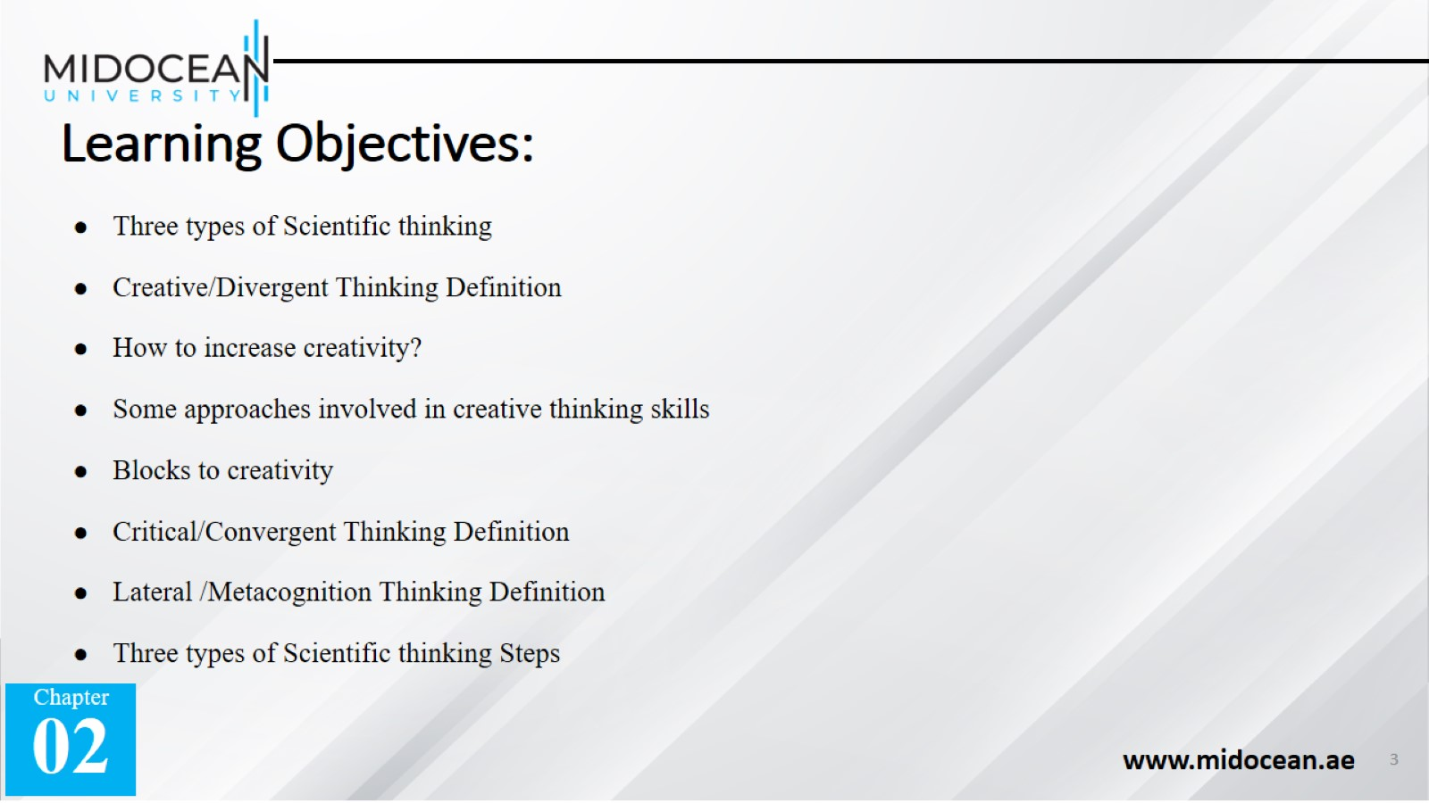
Learning Objectives:

Slide 4
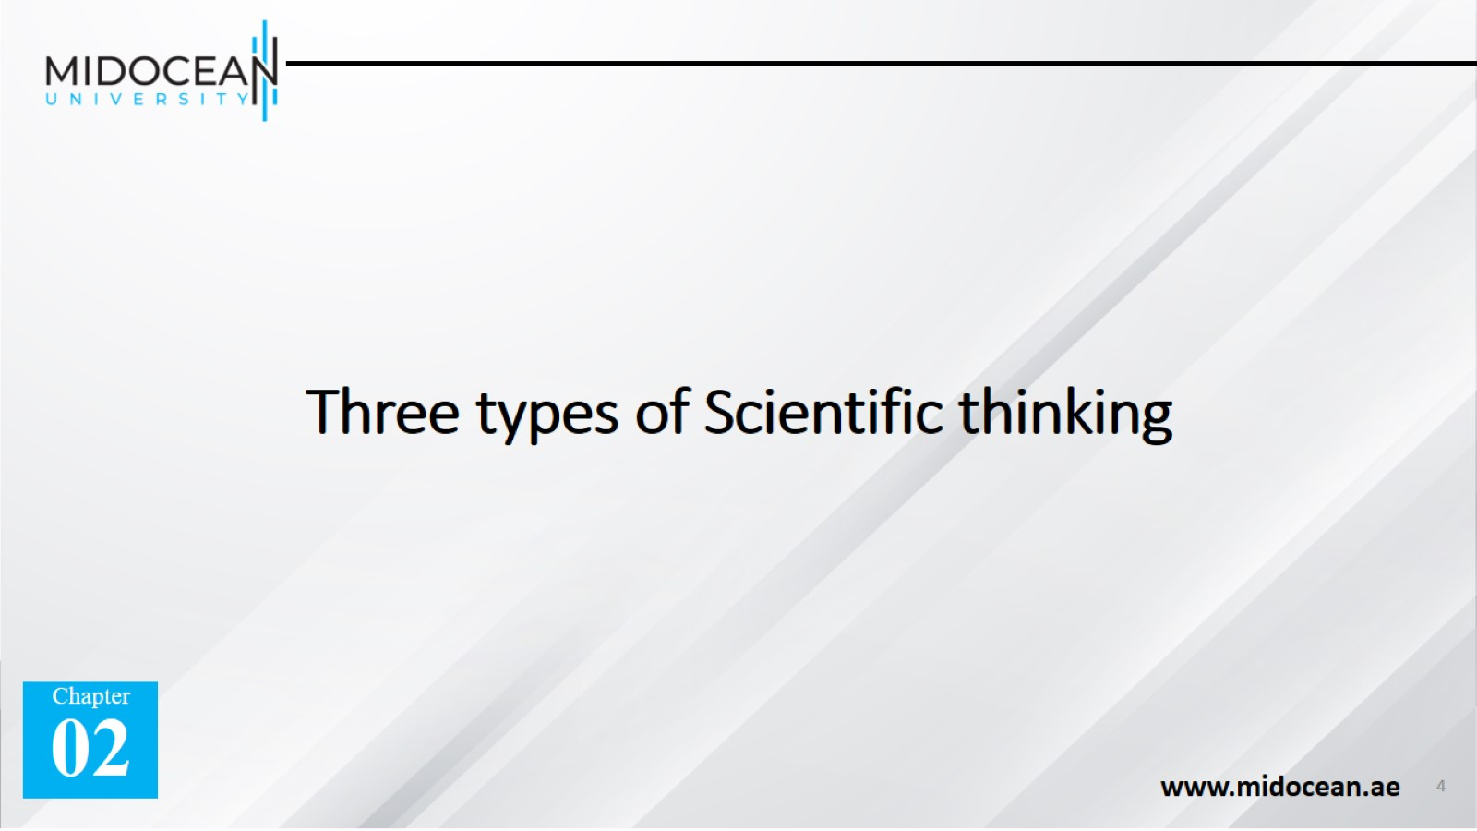
Three types of Scientific thinking

Slide 5
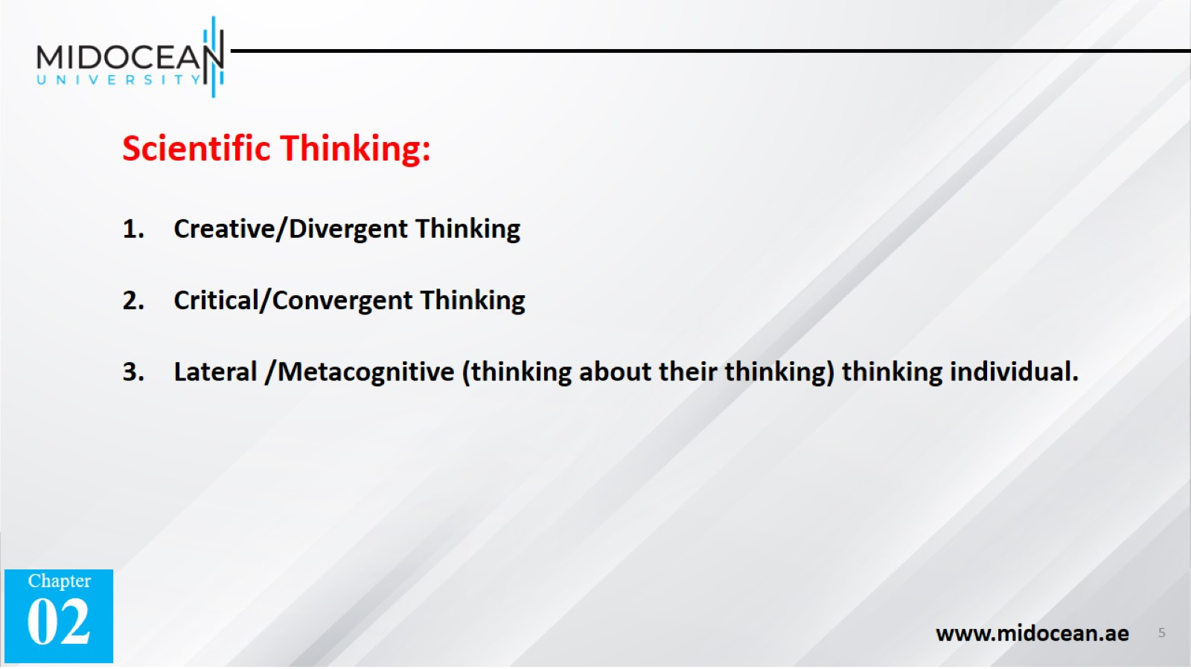

Slide 6


Slide 7
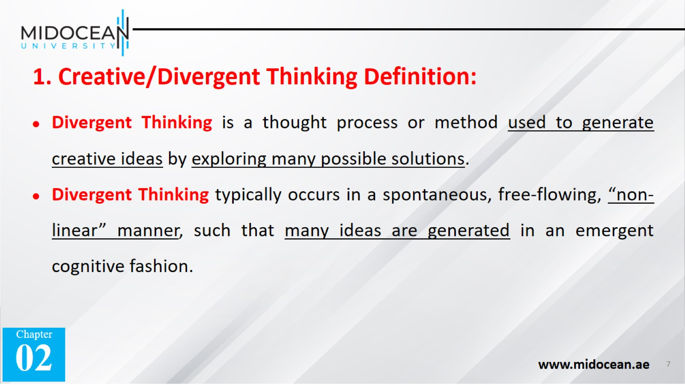

Slide 8
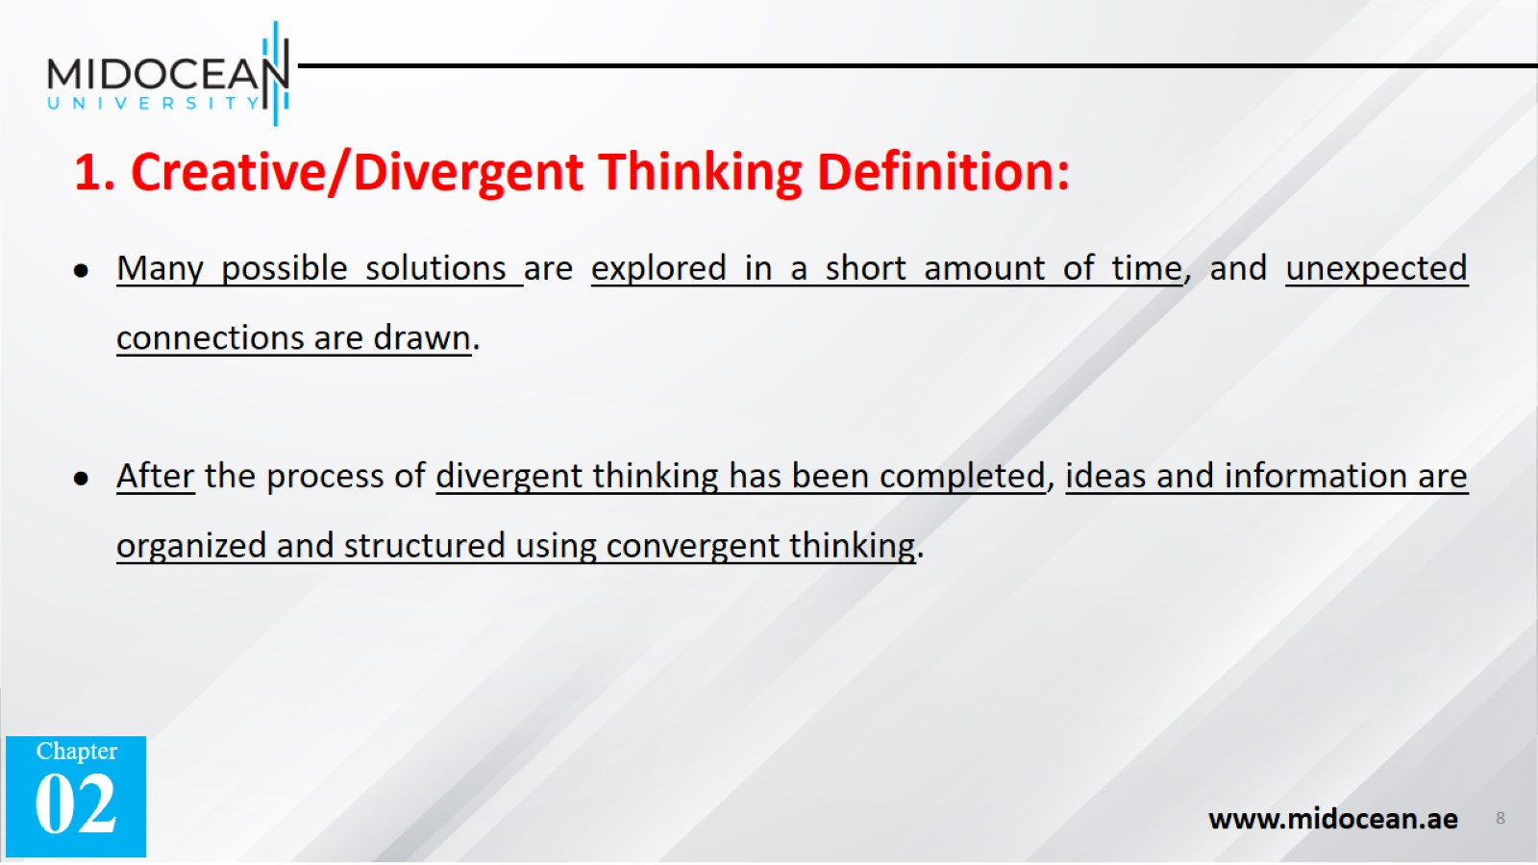

Slide 9
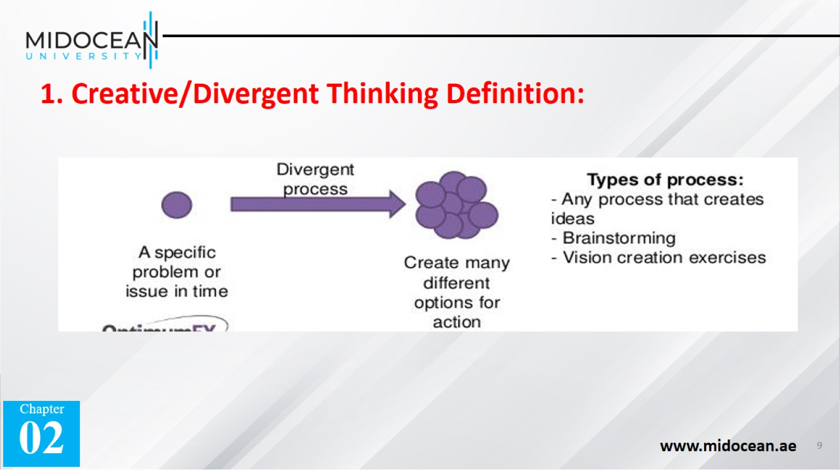

Slide 10
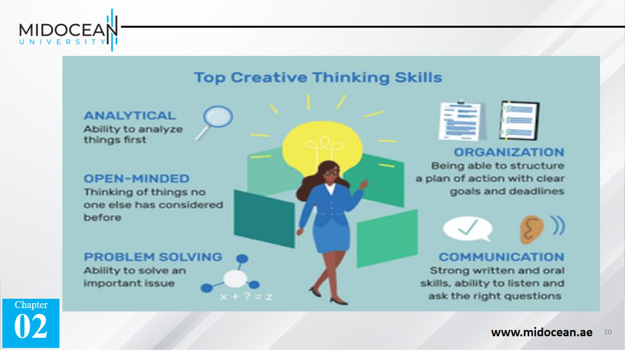

Slide 11
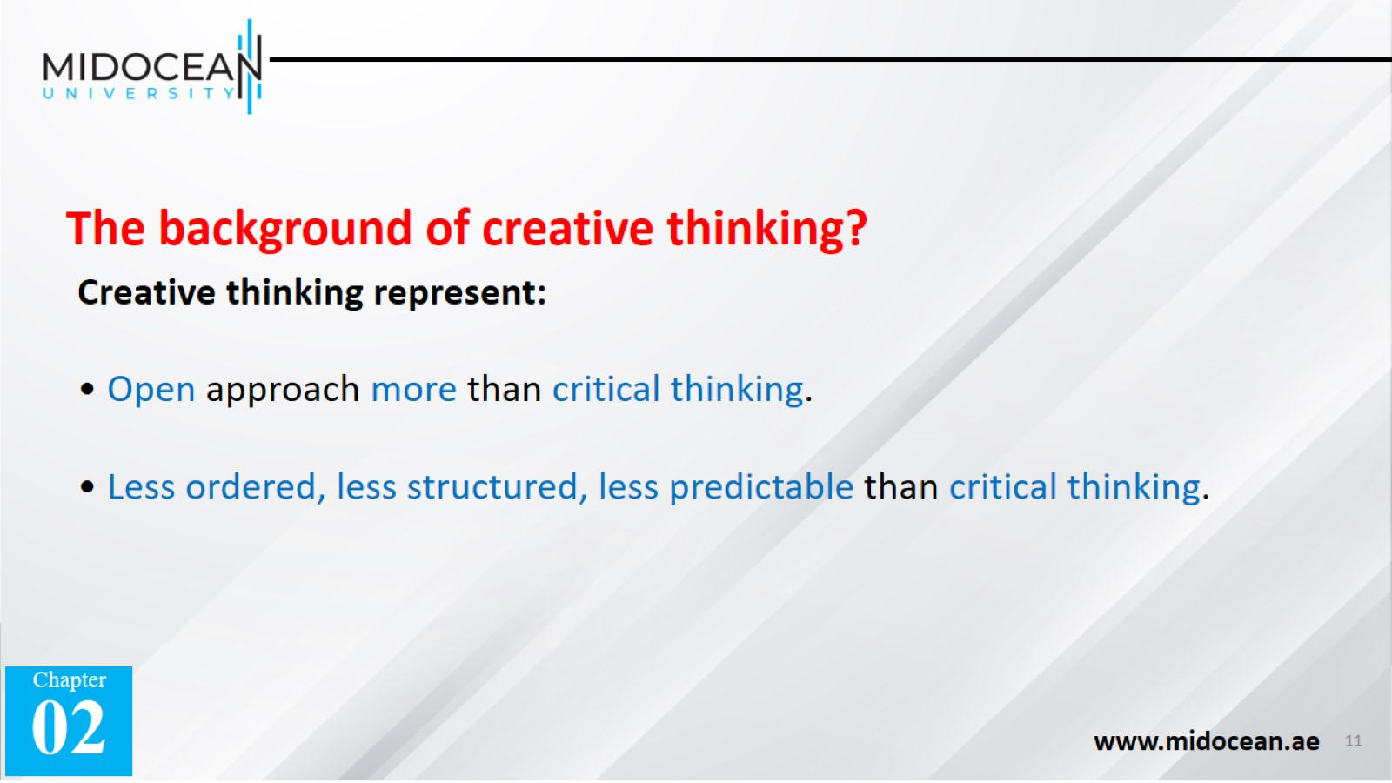

Slide 12


Slide 13
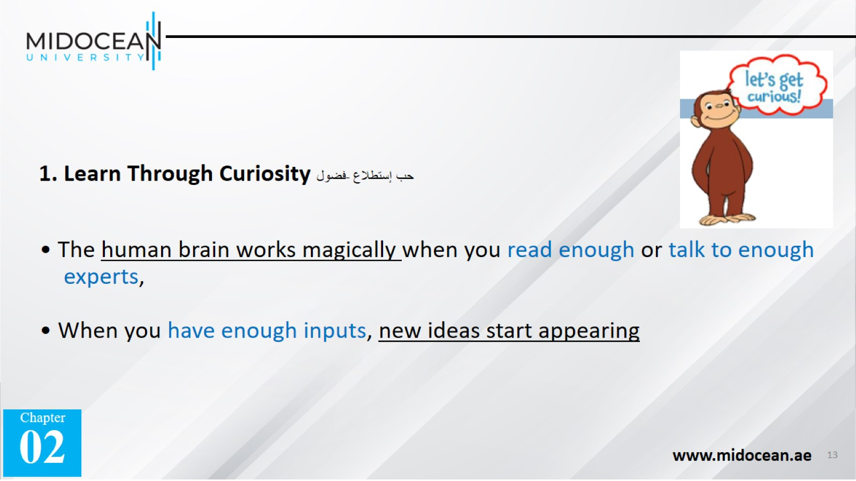

Slide 14
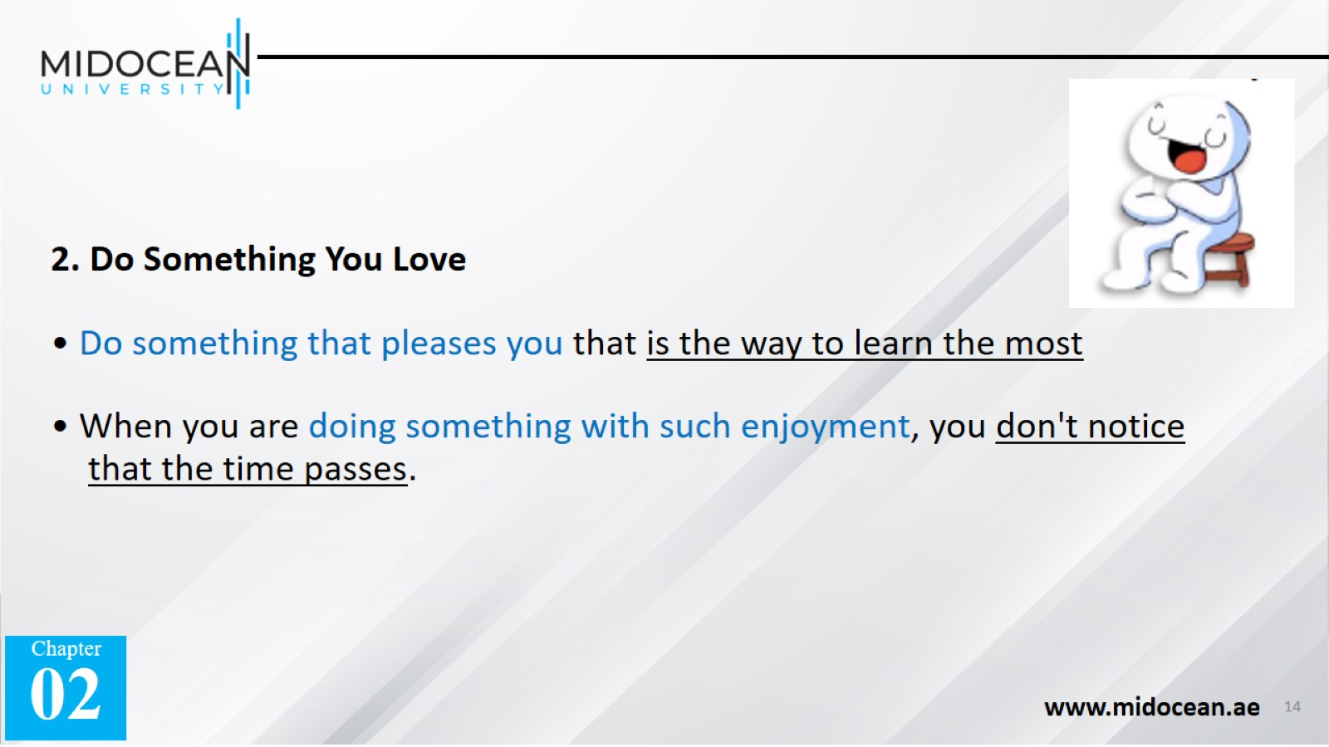

Slide 15
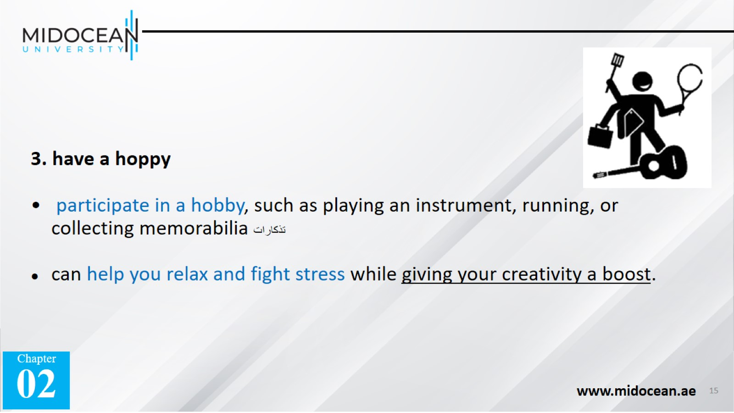

Slide 16
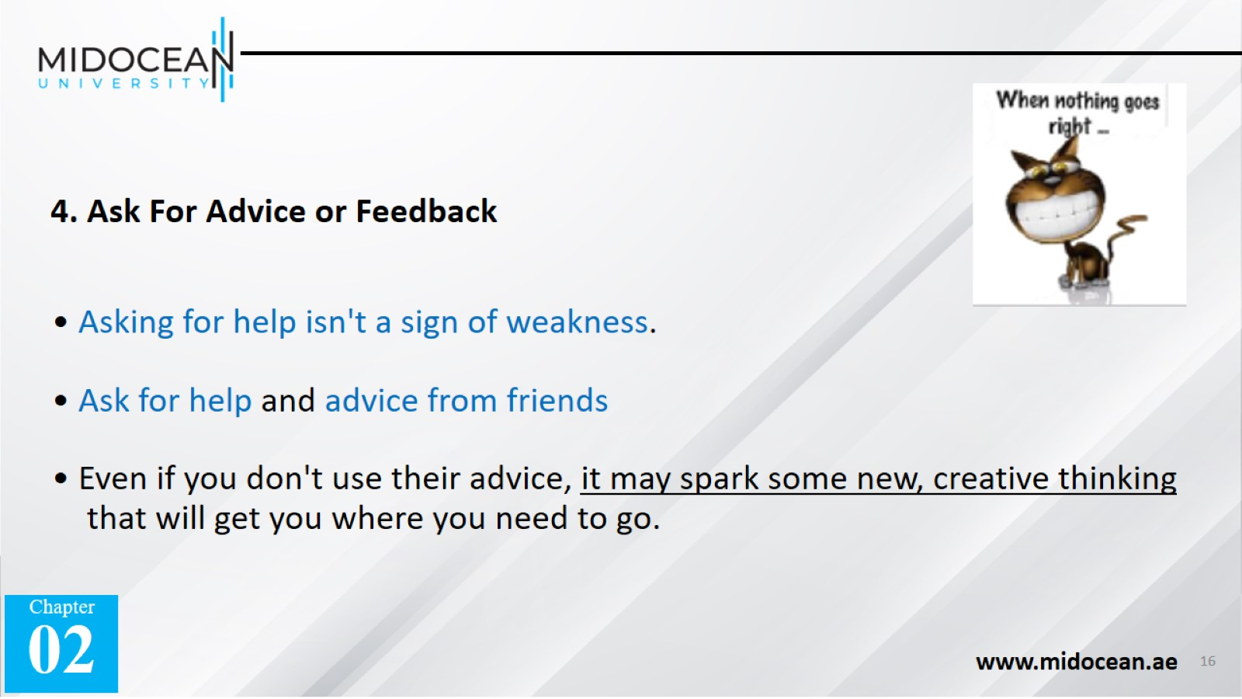

Slide 17
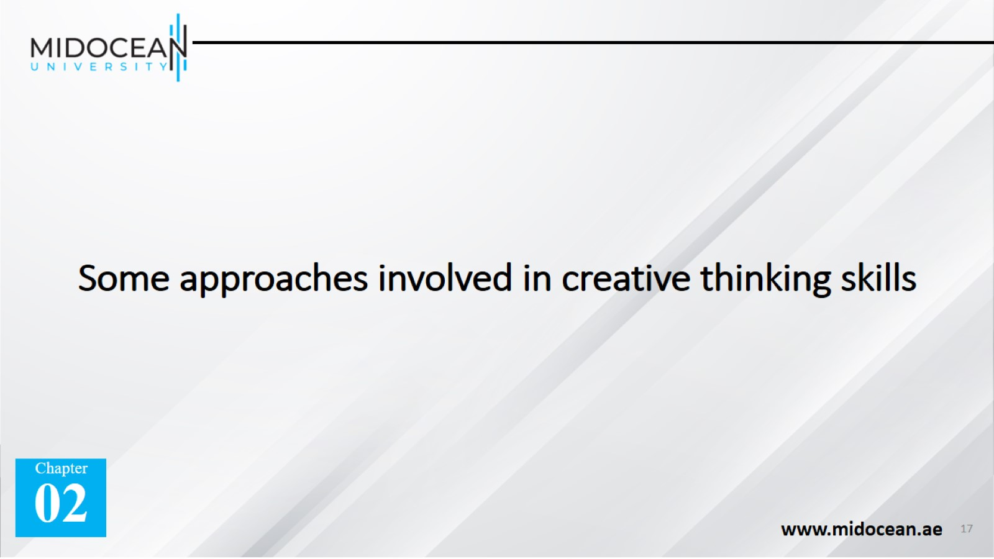
Some approaches involved in creative thinking skills

Slide 18
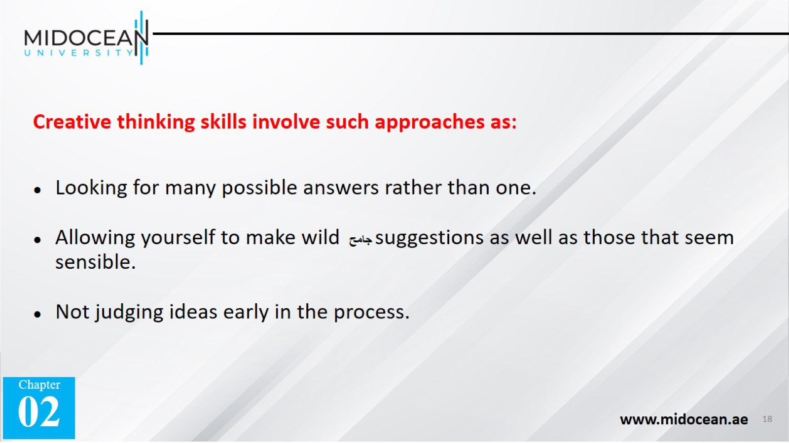

Slide 19
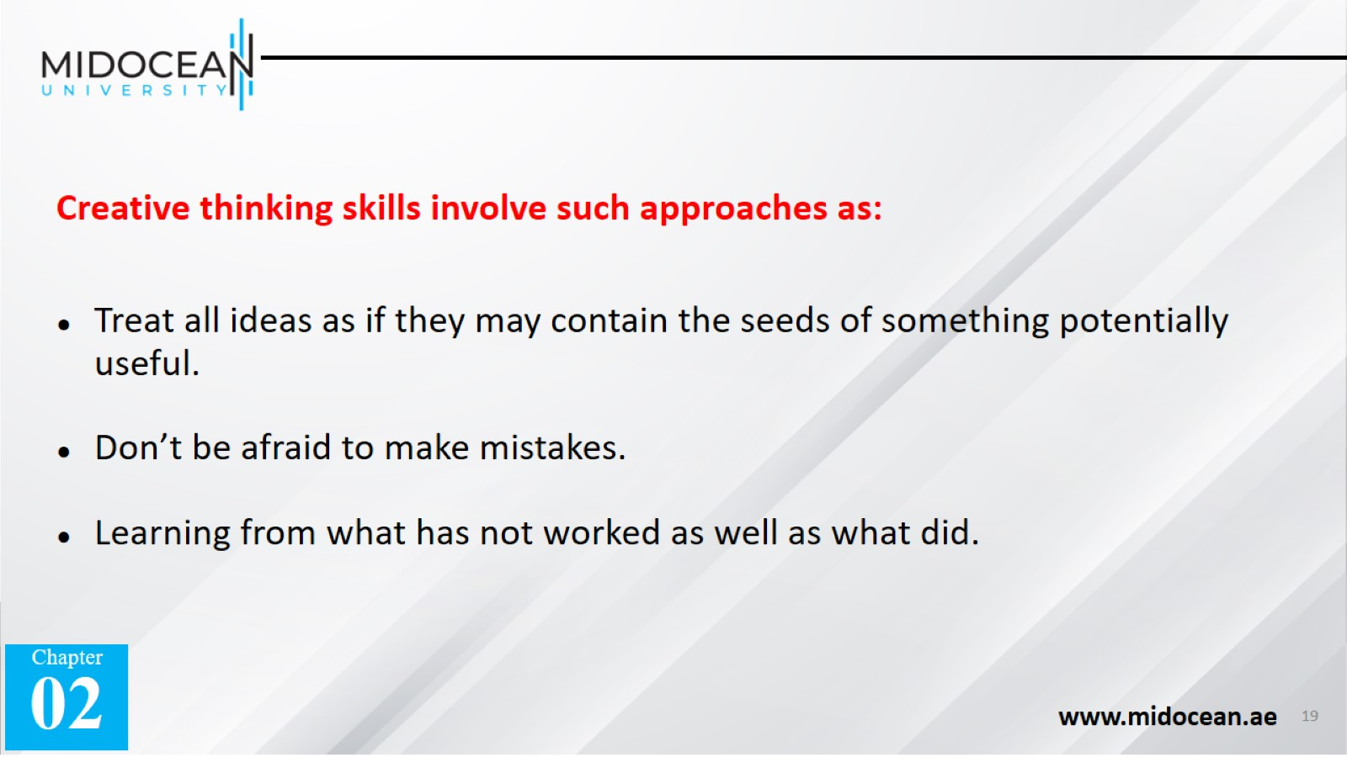

Slide 20
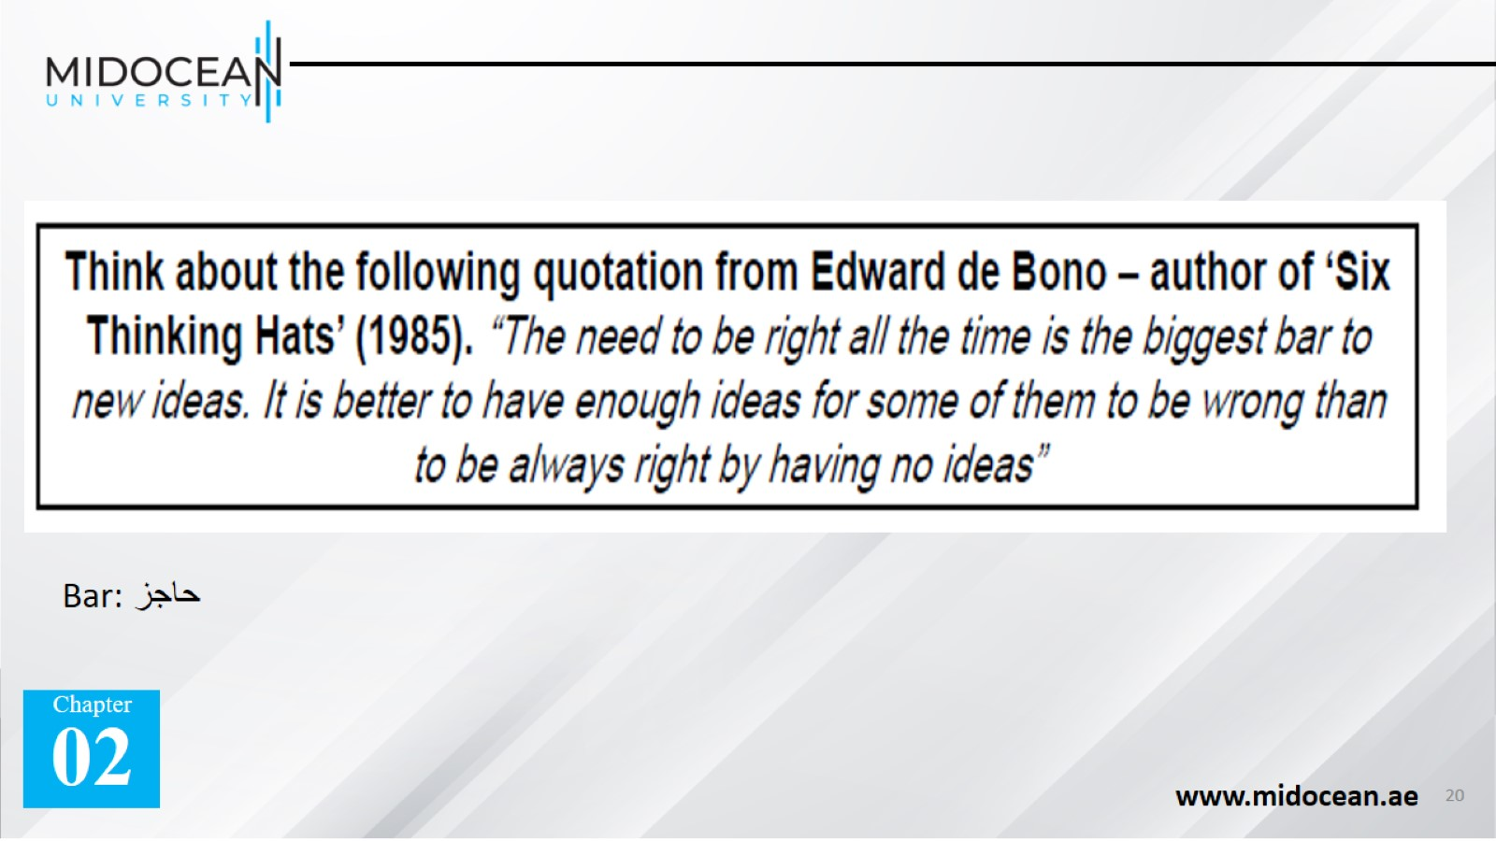

Slide 21


Slide 22
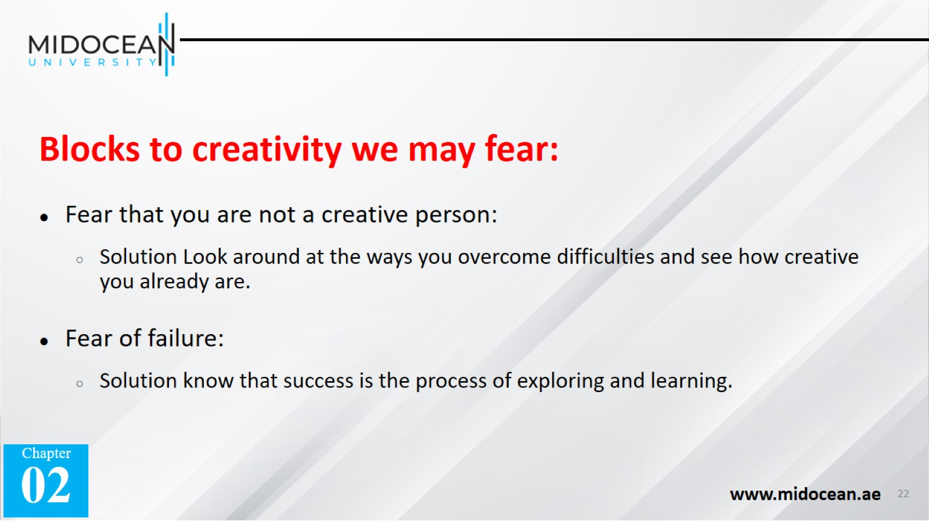

Slide 23
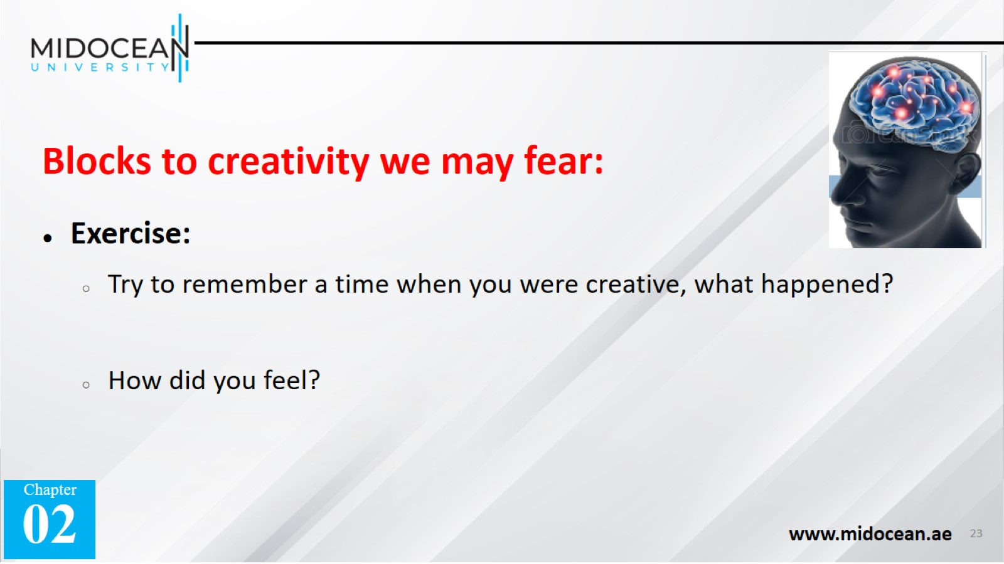

Slide 24


Slide 25
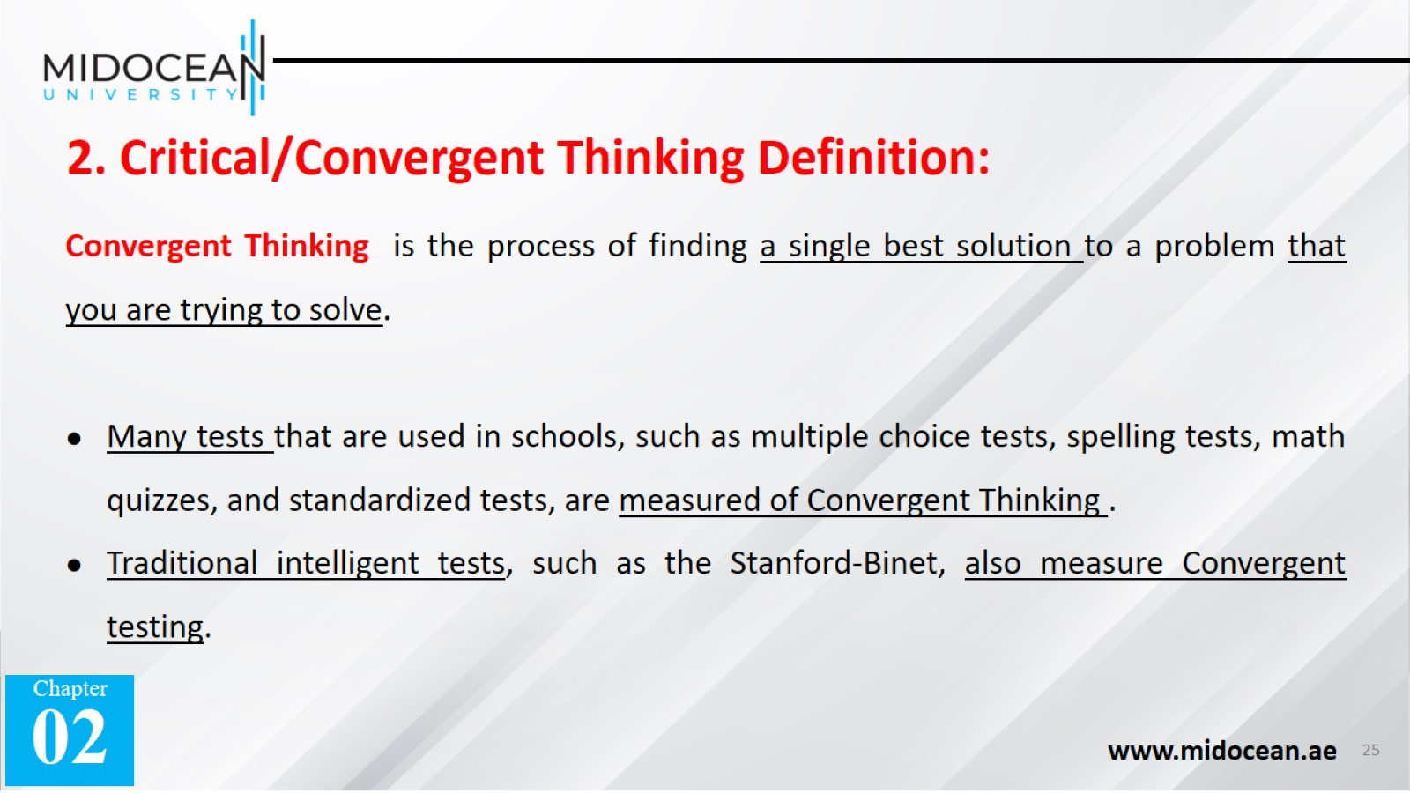

Slide 26
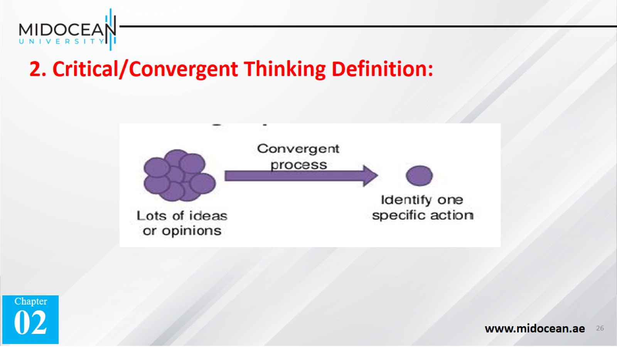

Slide 27
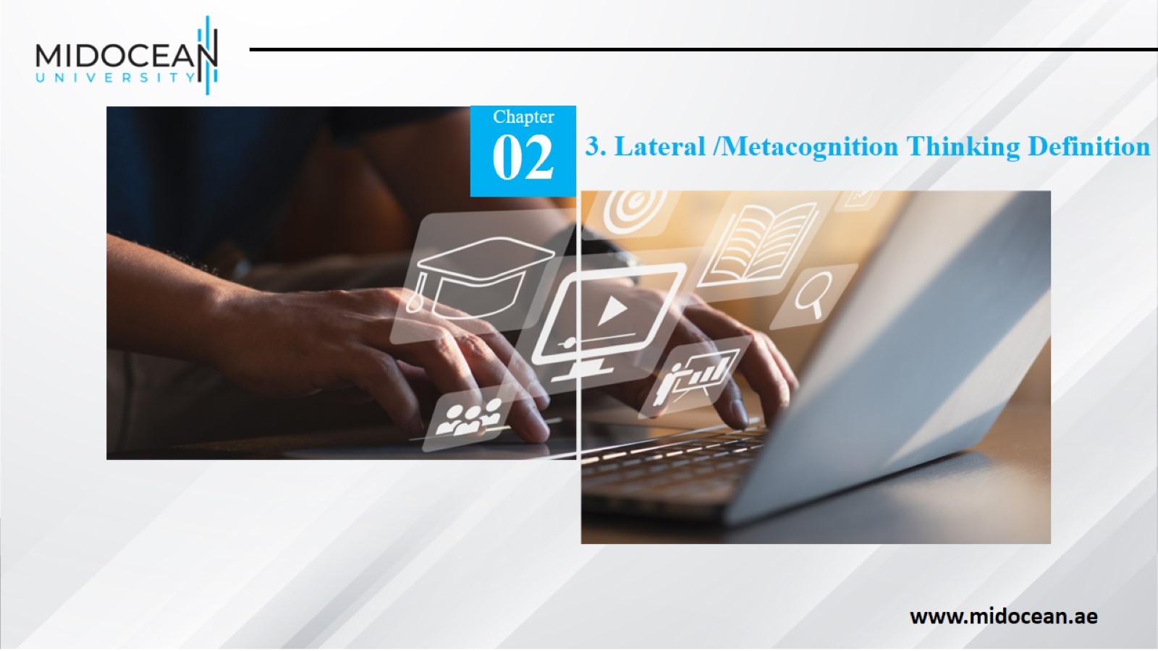

Slide 28
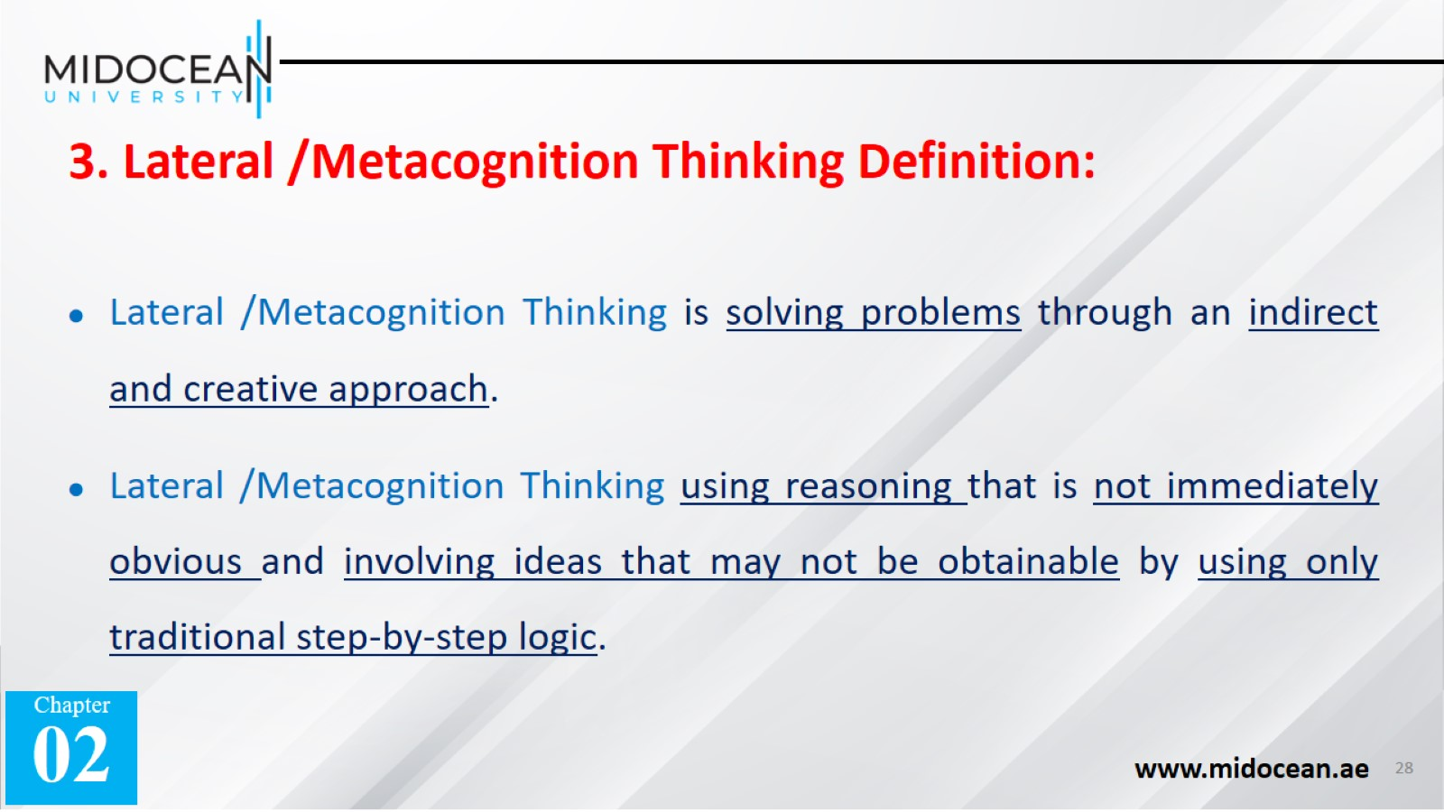

Slide 29


Slide 30
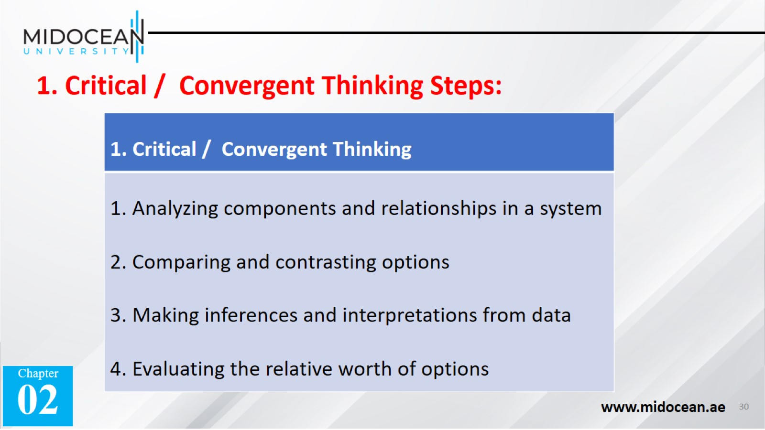

Slide 31


Slide 32
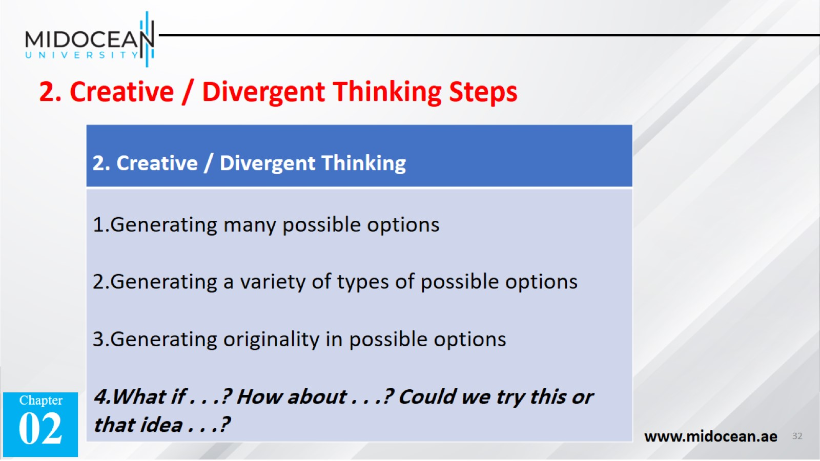

Slide 33


Slide 34
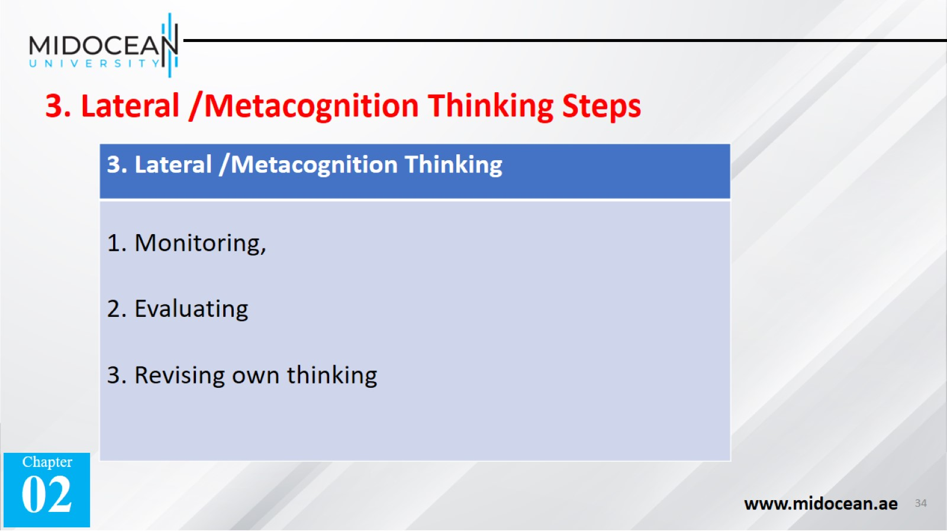

Slide 35
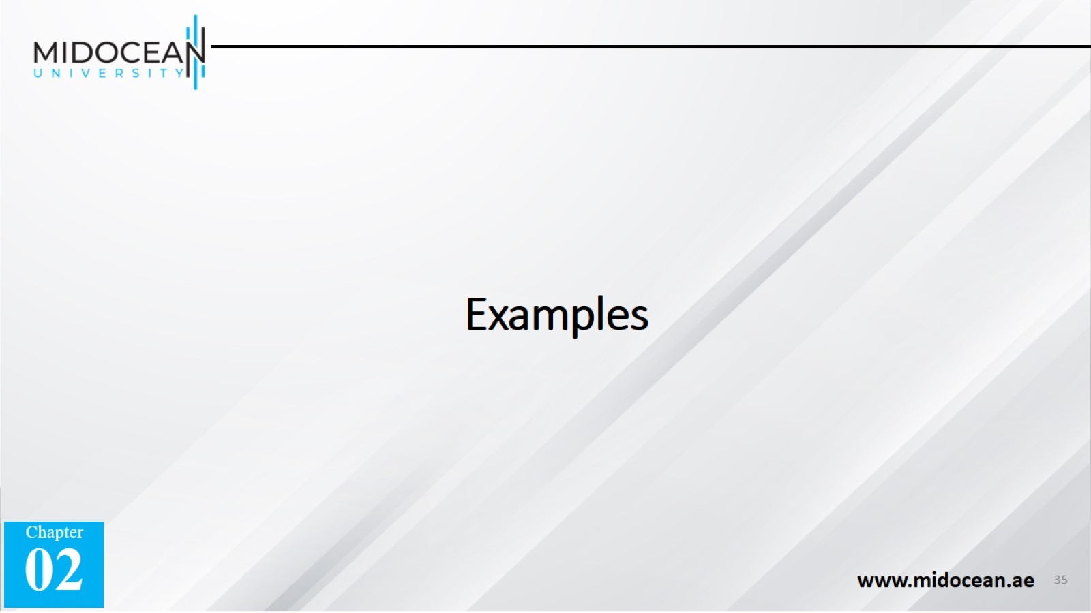
Examples

Slide 36
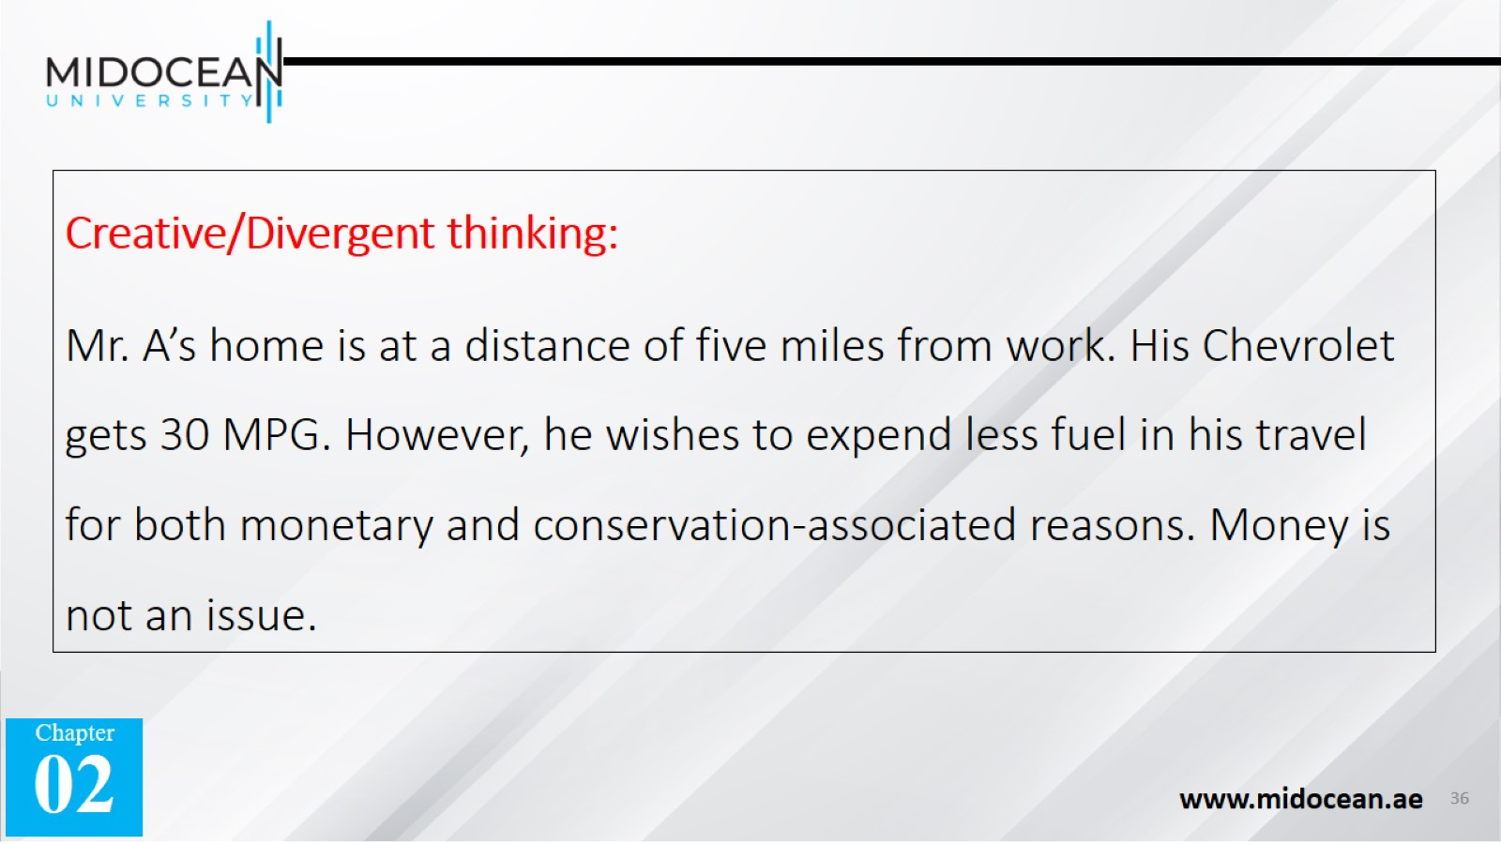
Creative/Divergent thinking:
Mr. A’s home is at a distance of five miles from work. His Chevrolet gets 30 MPG. However, he wishes to expend less fuel in his travel for both monetary and conservation-associated reasons. Money is not an issue.

Slide 37
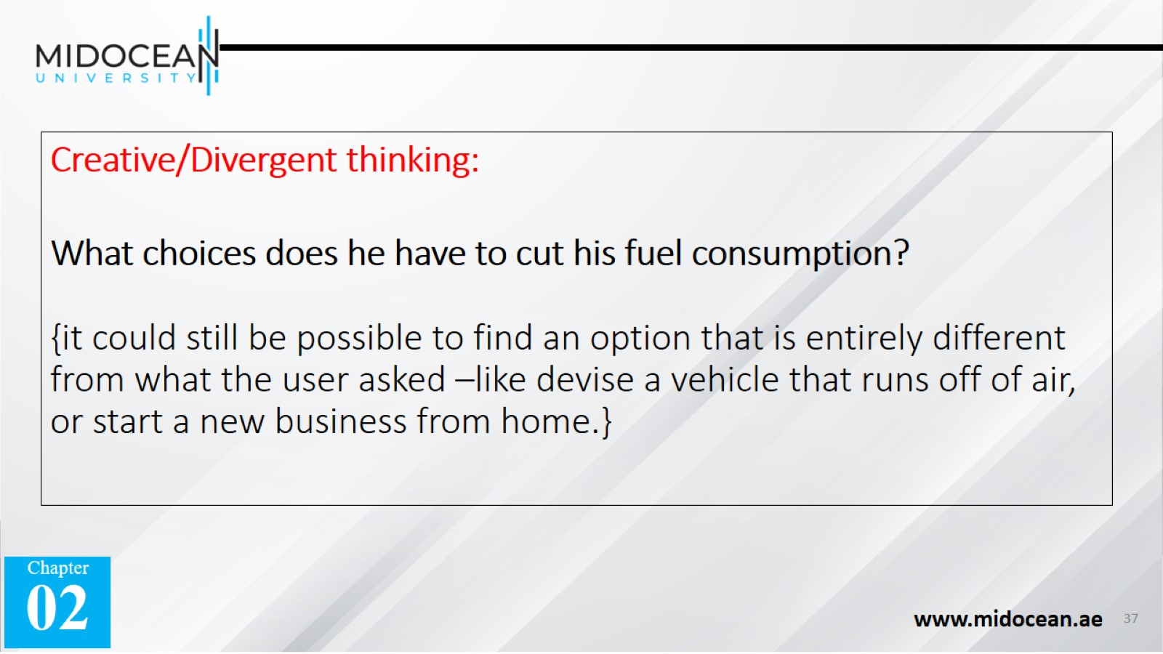
Creative/Divergent thinking:
What choices does he have to cut his fuel consumption?
{it could still be possible to find an option that is entirely different from what the user asked –like devise a vehicle that runs off of air, or start a new business from home.}

Slide 38

Critical/Convergent thinking:
Mr. A’s home is at a distance of five miles from work. His Chevrolet gets 30 MPG. However, he wishes to expend less fuel in his travel for both monetary and conservation-associated reasons. Money is not an issue.

Slide 39
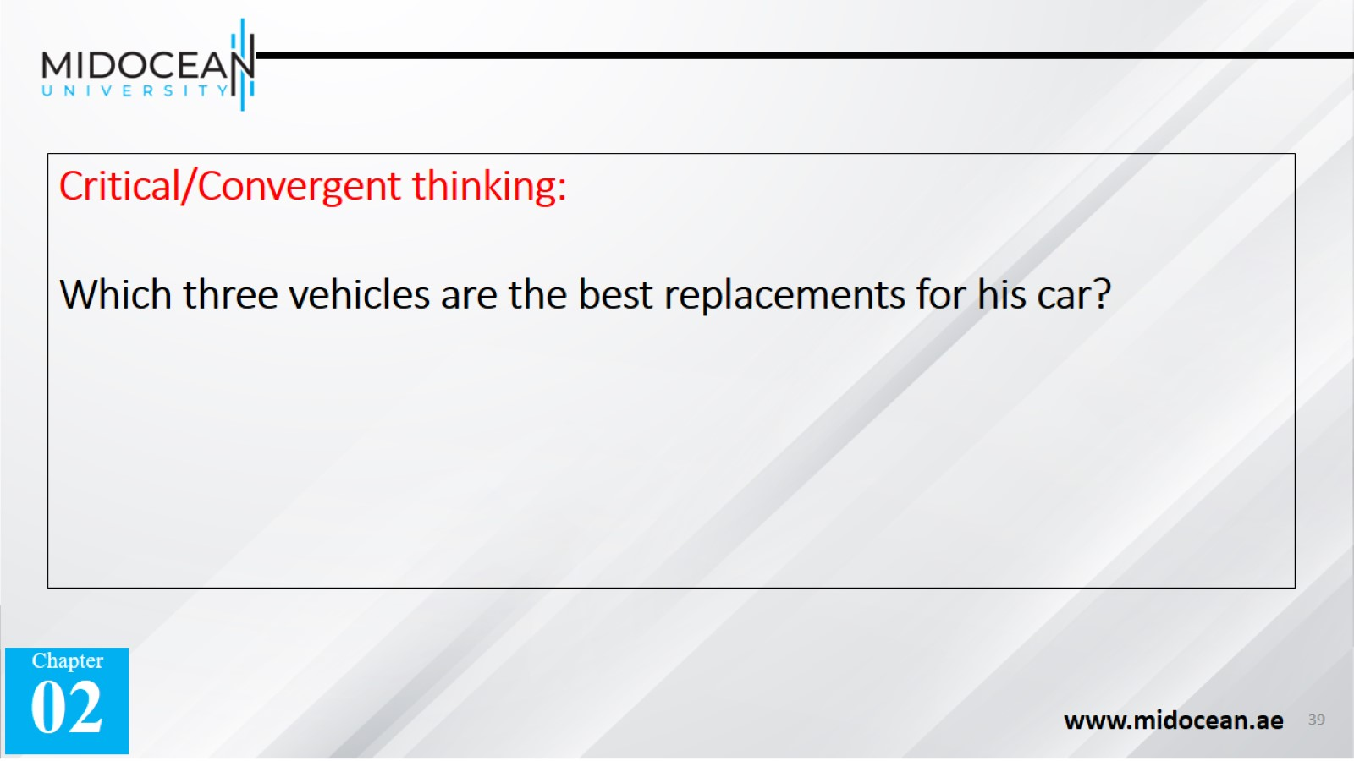
Critical/Convergent thinking:
Which three vehicles are the best replacements for his car?

Slide 40


