Slide 1



Prepared by
Eng. Mohamed Saied Hassan
Web Development (part one)
Introductory session

Slide 2


Introduction to Web Development
Lecture 00
Prepared by
Eng. Mohamed Saied Hassan

Slide 3
From the Web to Modern Web Applications
Why Web Applications?
What is the Web?
What is a Website?
What is Web Development?
Frontend vs Backend
Course Roadmap

Slide 4
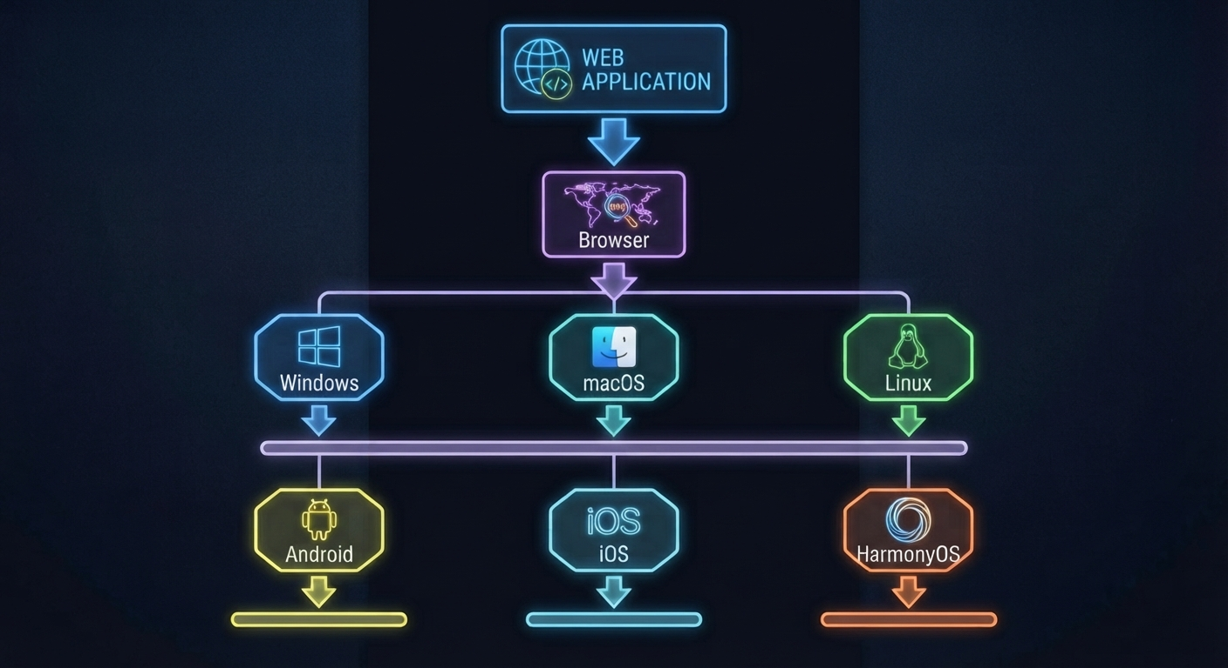
Why Web Applications?
Build Once, Reach Everywhere
One web application can serve
users across many operating systems.
Users usually don't need to install
a dedicated application.
Users can access it through common
browsers such as Chrome, Edge, Safari
Updates can be deployed to the server
without requiring every user to
download a new version.
Easier to share — send a URL.
The same application can potentially reach desktop, tablet, and mobile users.

Slide 5
What is the Internet?
The Internet = A global network of connected devices
      Computers
      Servers
      Smartphones
      Routers
The Internet is the infrastructure that allows devices to communicate.

Slide 6
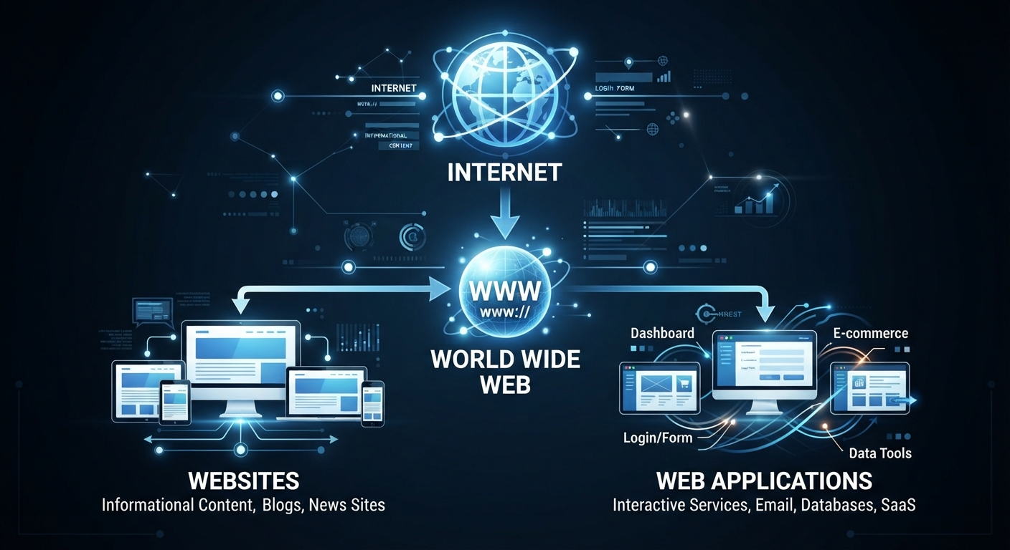
What is the World Wide Web?
The Web (WWW) is a system of linked documents and resources invented by Tim Berners‑Lee in 1989 and opened to the public in 1991.
Resources Examples
    Websites
    Web pages
    Web applications
    Online services
Internet ≠ Web
The Web is one service that runs on the Internet.

Slide 7
What is a Website?
website is a collection of related web pages available through the Web.
Examples:
      University website
      Company website
      Portfolio
      News website
      Restaurant website
A website can contain:
      Text
      Images
      Videos
      Links
      Forms
      Interactive elements

Slide 8
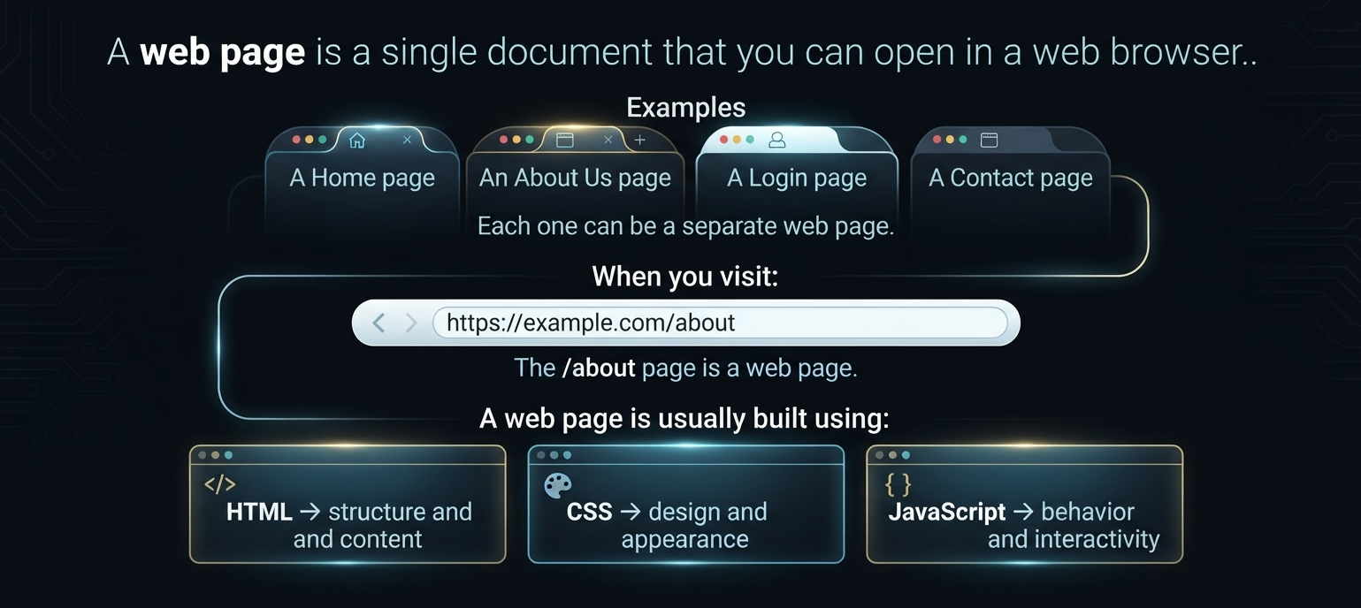
What is a Web Page?

Slide 9
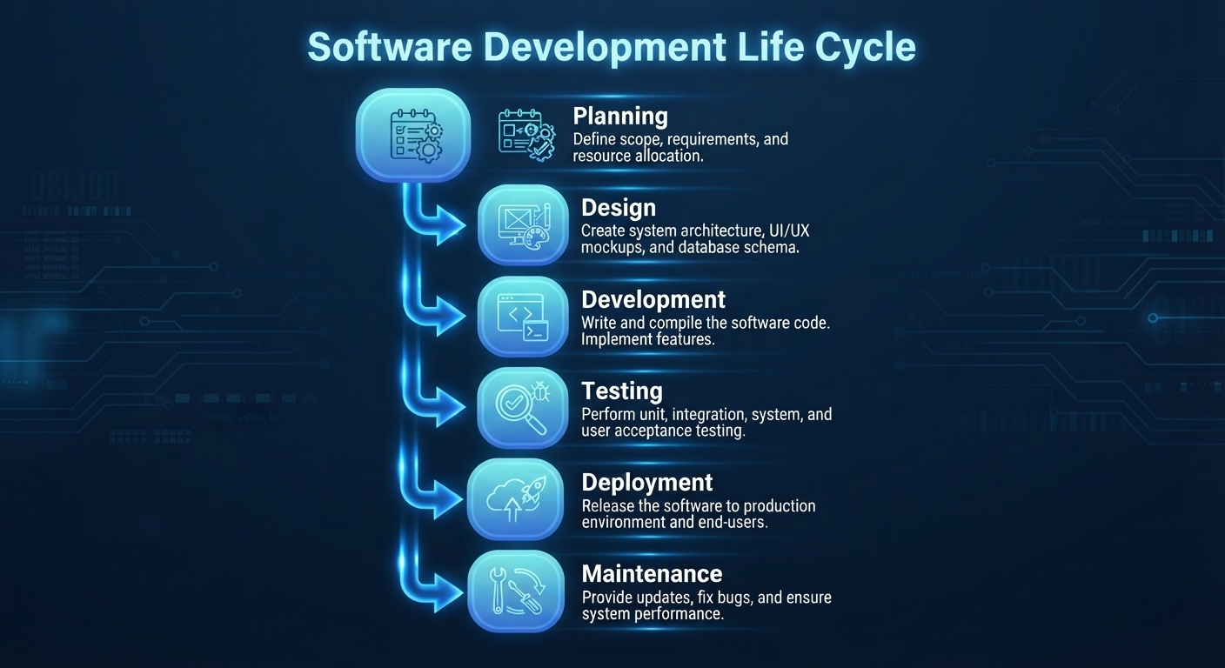
What is Web Development?
Web Development is the process of designing, building, testing, deploying, and maintaining websites

Slide 10
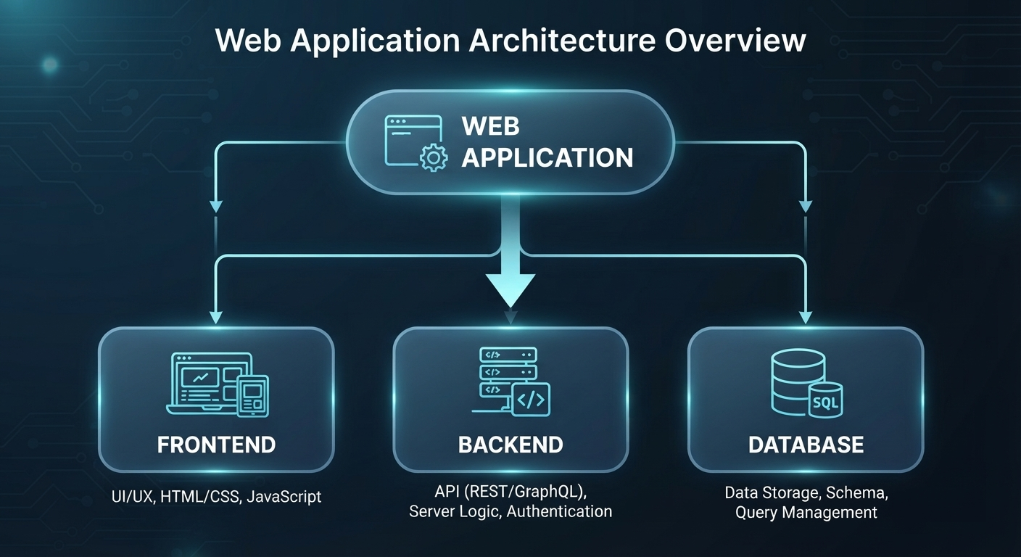
The Three Main Parts
A typical web application consists of

Slide 11
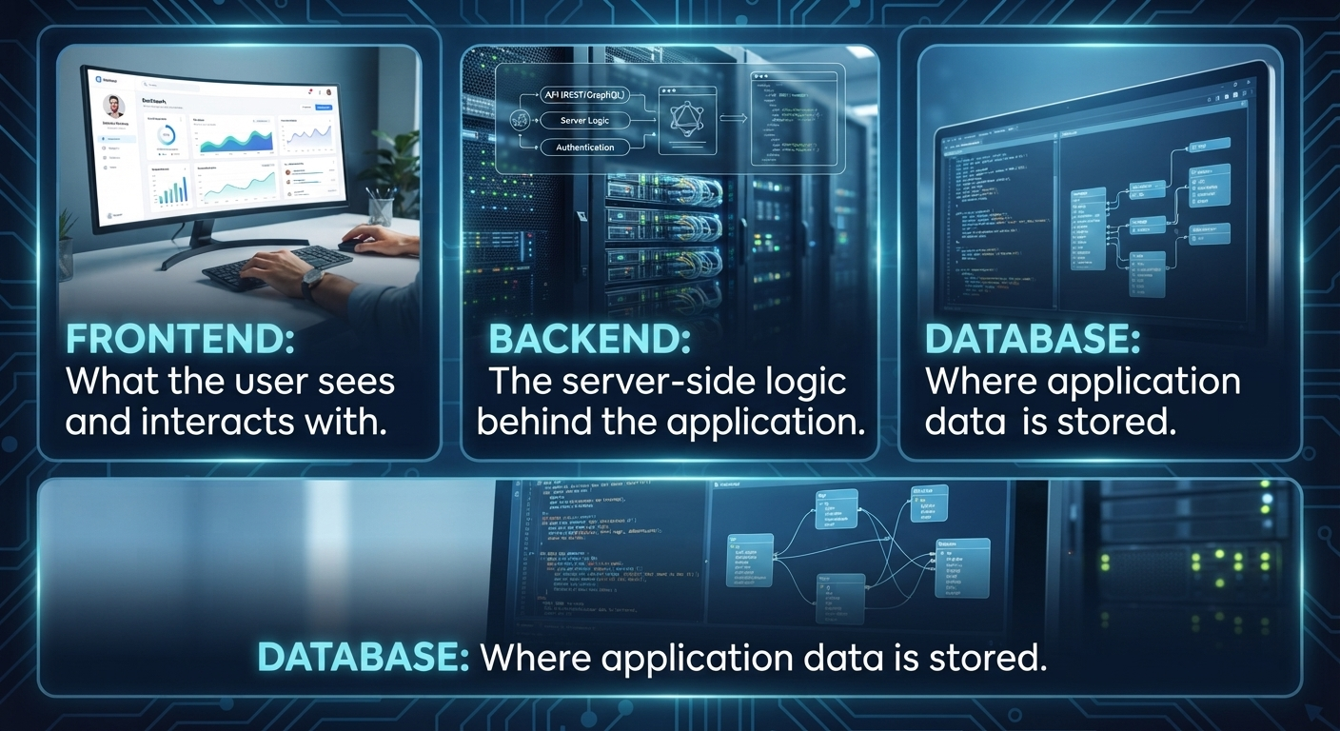
The Three Main Parts

Slide 12
Frontend Development
Frontend = User Interface + User Interaction
It runs primarily in the user's browser.
        Buttons
        Menus
        Forms
        Cards
        Tables
        Animations
        Pages
Main technologies:
        HTML
        CSS
        JavaScript
        Modern tools:
                Bootstrap
                React
                Angular
                Vue

Slide 13
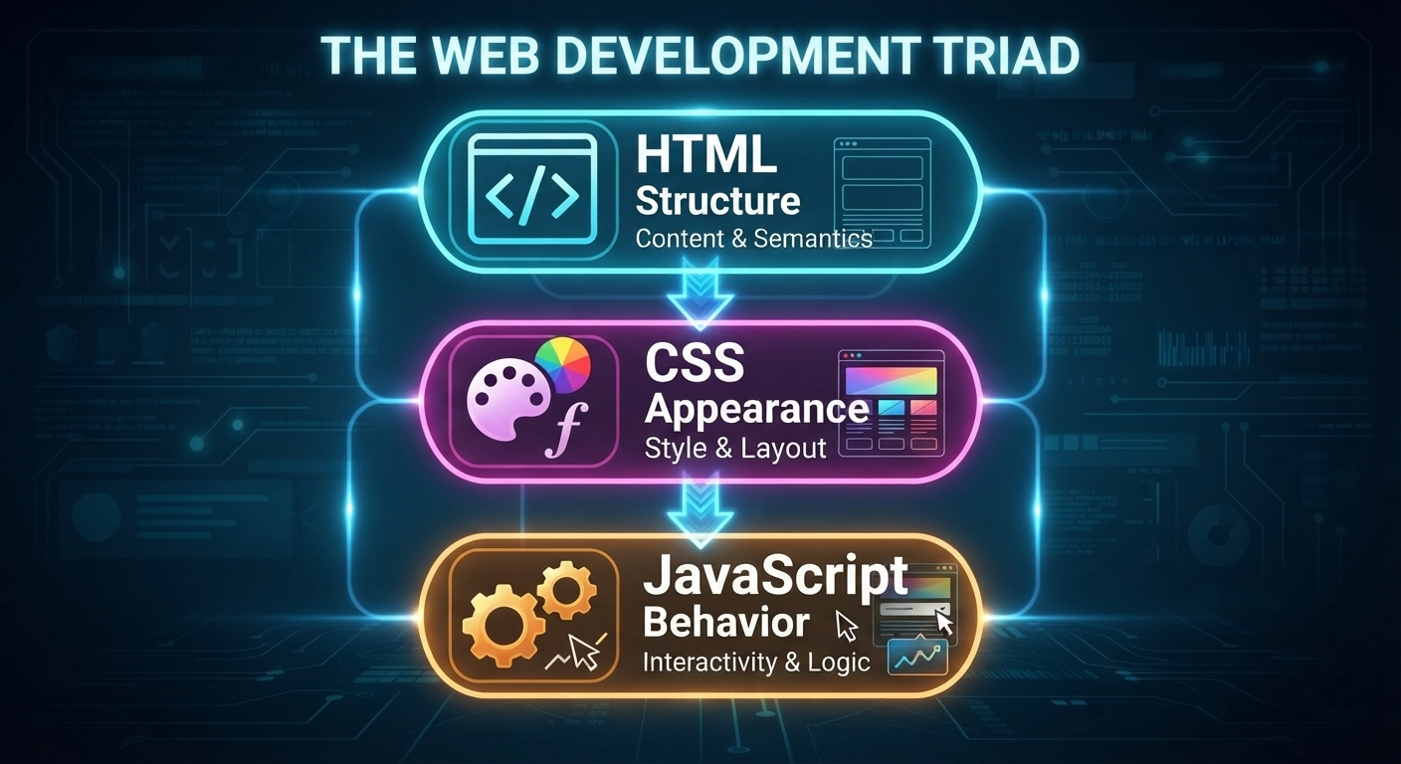
HTML, CSS & JavaScript
Think of a web page as a building:
HTML:
What is on the page?
CSS:
How does it look?
JavaScript:
How does it behave?

Slide 14
Backend Development
Backend = Server-side logic
The backend can handle:
    Business logic
    Authentication
    Authorization
    Data processing
    APIs
    Database communication
    File processing
    Notifications
    Popular technologies:
        ASP.NET Core
        Node.js
        Django
        Spring Boot
        Laravel

Slide 15
Database
The database stores application data
Examples:
  Users
  Products
  Orders
  Courses
  Students
  Messages
  Payments
    Popular databases:
      SQL Server
      PostgreSQL
      MySQL
      MongoDB
      Oracle

Slide 16
Lecture 1 — Web & HTML Foundations
• How the web works (client/server, browsers, VS Code, Live Server, Dev Tools basics)
• HTML document structure, semantic tags (header, nav, main, section, footer)
• Text elements, links, images, lists
• Forms and form inputs (intro)
• Mini project: static personal profile page “pure un styled HTML”

Slide 17
Lecture 2 — HTML + CSS
• Recap
• Tables, forms in depth (validation attributes, input types) • Accessibility basics (alt text, labels, semantic structure)
• CSS syntax, selectors, specificity
• Box model (margin, border, padding, content)
• Flexbox
• Live demo (nav, cards, basic responsive )
• Task “fully style their project pages”

Slide 18
Lecture 3 — HTML + CSS + Bootstrap
• Positioning (static, relative, absolute, fixed, sticky)
• Animation
• Bootstrap setup ,grid system
• Utility classes
• Core components
• Wrap-up
• Task rebuild their own project with Bootstrap

Slide 19
Lecture 4 — JavaScript Fundamentals I
Variables
Data types
Operators
Conditions
Loops
Functions
Scope

Slide 20
Lecture 5 — JavaScript + DOM
  DOM
  Selecting elements
  Manipulation
  Events

Slide 21
Lecture 6 — JavaScript + OOP + BOM
  Objects
  Classes
  OOP
  BOM
  localStorage
  sessionStorage
  Project

Slide 22
Lecture 7 — Modern JavaScript (ES6+) + API
    • Recap
    • Arrow functions, template literals, destructuring, spread/rest
    • Array methods (map, filter, reduce, forEach)
    • Modules, promises/async-await, fetch API
    • Live build — small app using fetch + storage
    • Wrap-up + Project Task

Slide 23
Lecture 8 — React I — Foundations
    Components
    JSX
    Props
    Composition
    Vite

Slide 24
Lecture 9 — React II — State & Effects
    useState
    useEffect
    useContext
    API integration

Slide 25
  Lecture 10 — React III — Routing
      React Router
      Routes
      Navigation
      Parameters
      Final Project

Slide 26
What We Will Build?
  Final Project:
small real-world web application containing:
      Multiple pages
      Responsive UI
      Reusable React components
      Forms
      User interaction
      API communication
      State management
      Routing

Slide 27
  By the end of the course
  You will understand how the pieces fit together rather than learning each technology independently.

Slide 28
  In the next lecture, we start building the frontend from the ground up — beginning with HTML

Slide 29
  Thank YOU

