Slide 1



Network
Programming
in Python
Prepared by Dr. Hamada I. AbdulWakel
Lecture 6

Slide 2



Sockets Security in
Python
Lecture 6
Prepared by
Dr. Hamada I. AbdulWakel
www.midocean.ae

Slide 3
Lecture
RECAP: LECTURE 5
06
The threading programming.
Programming the multiple client/server model.
The casting/communication types.
www.midocean.ae

Slide 4
Lecture
LECTURE MAIN POINTS
06
A broadcasting client/server example.
Securing Sockets.
The SSL Module.
www.midocean.ae

Slide 5
BROADCASTINGCLIENT/SERVER UDP EXAMPLE
Lecture
06
Code: 1- the server
import socket, threading, queue
messages = queue.Queue(); clients = []
server = socket.socket(socket.AF_INET, socket.SOCK_DGRAM)
port = 9999
server.bind( ( "localhost", port) )
def receive():
while True:
message, addr = server.recvfrom(1024)
messages.put((message, addr))
www.midocean.ae

Slide 6
BROADCASTINGCLIENT/SERVER UDP EXAMPLE
Lecture
06
Cont'd
Code: 1- the server
def broadcast():
while True:
while not messages.empty():
message, addr = messages.get()
print(message.decode())
if addr not in clients:
clients.append(addr)
www.midocean.ae

Slide 7
BROADCASTINGCLIENT/SERVER UDP EXAMPLE
Lecture
06
Cont'd
Code: 1- the server
def broadcast():
for client in clients: #inside second while after if statement
try:
if message.decode().startswith("SIGNUP_TAG:"):
name = message.decode()[message.decode().index(":")+1 : ]
server.sendto(f"{name} joined!".encode(), client)
else:
server.sendto(message, client)
except: clients.remove(client)
www.midocean.ae

Slide 8
BROADCASTINGCLIENT/SERVER UDP EXAMPLE
Lecture
06
Cont'd
Code: 1- the server
t1 = threading.Thread(target=receive)
t2 = threading.Thread(target=broadcast)
t1.start()
t2.start()
www.midocean.ae

Slide 9
BROADCASTINGCLIENT/SERVER UDP EXAMPLE
Lecture
06
Cont'd
Code: 2- the client
import socket, threading, random
client = socket.socket(socket.AF_INET, socket.SOCK_DGRAM)
client.bind( ("localhost", random.randint(8000, 9000)) )
name = input("Your name: ")
flag = False
def receive():
while True:
if flag == True: break
message, _ = client.recvfrom(1024); print(message.decode())
www.midocean.ae

Slide 10
BROADCASTINGCLIENT/SERVER UDP EXAMPLE
Lecture
06
Cont'd
Code: 2- the client
t = threading.Thread(target=receive) #no indentation
t.start()
client.sendto(f"SIGNUP_TAG:{name}".encode() , ("localhost", 9999))
while True:
message = input()
if message == "Q":
client.close(); flag = True; break
else:
client.sendto(f"{name}: {message}".encode() , ("localhost", 9999))
www.midocean.ae

Slide 11
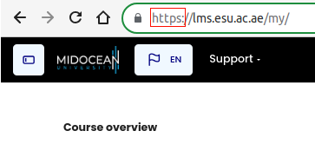
Lecture
06
SECURING CONNECTIONS
A website URL starts with http:// or https://.
The "s" in https:// signifies users are visiting a secure website, and the connection is encrypted and protected.
HTTPS combines HTTP (Hyper Transfer Protocol Secure) and SSL (Secure Socket Layer).
www.midocean.ae

Slide 12
Lecture
06
SECURING CONNECTIONS
Cont'd
Network security is important for office, home, and business networks.
Network Attacker completely owns the network:
  Control Wi-Fi, DNS, routers, his own websites.
  Listen to any packet, modify packets in transit.
  Inject his own packets into the network.
www.midocean.ae

Slide 13
Lecture
06
SECURITY TERMINOLOGIES
Encryption: the process of converting human-readable plain text to incomprehensible text, also known as ciphertext.
Decryption: the process of converting cipher text to a human-readable plain text.
www.midocean.ae

Slide 14

Lecture
06
SECURITY TERMINOLOGIES
Cont'd
Types of encryption:
  Symmetric-key encryption: the message is encrypted and decrypted by using the same key.
www.midocean.ae

Slide 15
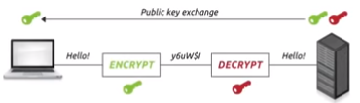
Lecture
06
SECURITY TERMINOLOGIES
Cont'd
Types of encryption:
  Asymmetric-key encryption: it based on public and private keys.
www.midocean.ae

Slide 16
Lecture
06
SSL: SECURE SOCKEY LAYER
A protocol used by SSL certificates to initiate secure sessions with a browser.
Widely deployed security protocol that supported by almost all browsers and web servers.
SSL certificates are small data files that use a public key infrastructure to make internet transactions secure when using HTTPs protocol.
Goals:
  Bank account details and credit card transactions.
  Medical records.
  E-commerce transactions encryption.
www.midocean.ae

Slide 17
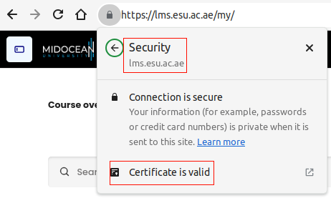
Lecture
06
SSL: SECURE SOCKEY LAYER
Cont'd
www.midocean.ae

Slide 18
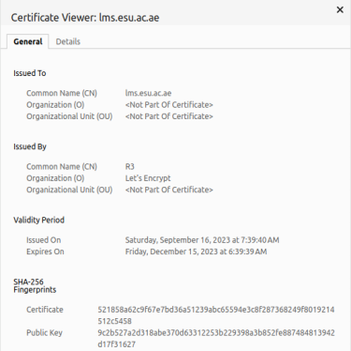
Lecture
06
SSL: SECURE SOCKEY LAYER
Cont'd
www.midocean.ae

Slide 19
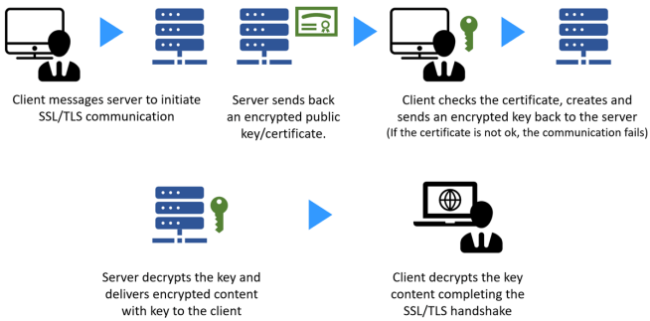
Lecture
06
SSL CLIENT/SERVER STEPS
www.midocean.ae

Slide 20
Lecture
06
SSL CLIENT/SERVER STEPS
Cont'd
When a client connects to a server secured with SSL, the secured server will send back an encrypted public key and a certificate.
The client will then check the certificate and if it is trusted, the client will create an encrypted key using the server's public key and send the new key to the server.
Lastly, the server will decrypt the new key using the server's private key and then send an acknowledgment to the client that is encrypted with the new key created by the client.
Now, the server and the client can encrypt all transmissions with the new key.
www.midocean.ae

Slide 21
Lecture
06
SSL CLIENT/SERVER STEPS
Cont'd
Handshake: A and B use their certificates, private keys to authenticate each other and exchange shared secret.
Key derivation: A and B use shared secret to derive set of keys.
  Considered bad to use same key for more than one cryptographic operation.
Data transfer: data to be transferred is broken up into series of records.
Connection closure: special messages to securely close connection.
www.midocean.ae

Slide 22
Lecture
06
GETTING AN SSL CERTIFICATE
To get an SSL certificate, you need to go through the following steps:
  Start by verifying your website information and ensuring it is the same as the information you are submitting to the CA.
    Certificate Authority (CA): a trusted entity that issues digital certificates which certifies the owner of a public key.
  Then, generate the certificate signing request (CSR) through an online generator or with the help of a hosting company.
  Submit the CSR to the certificate authority to validate the domain.
  Once the process is complete, install and use the SSL certificate on your website.
www.midocean.ae

Slide 23
Lecture
06
OPENSSL TOOLKIT
Install the OpenSSL toolkit.
Create the Private Key and Certificate Signing Request (CSR) files.
Submit CSR to your certificate authority (CA) of choice.
Retrieve your certificate from the certificate authority.
Download the “root certificate” from the same certificate authority.
www.midocean.ae

Slide 24
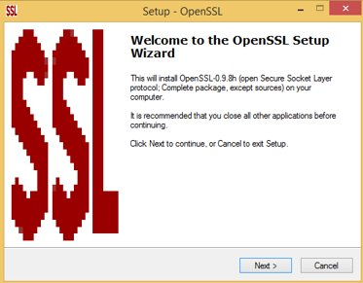

Lecture
06
OPENSSL TOOLKIT
Cont'd
www.midocean.ae

Slide 25

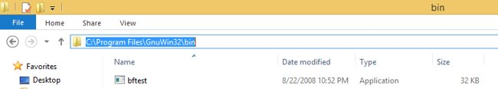
Lecture
06
OPENSSL TOOLKIT
Cont'd
www.midocean.ae

Slide 26
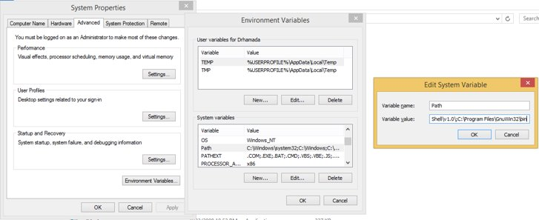

Lecture
06
OPENSSL TOOLKIT
Cont'd
www.midocean.ae

Slide 27
Lecture
06
SSL SELF-SIGNED CERTIFICATION
Create a CA folder.
openssl genrsa -aes256 -out caKey.pem 4096
openssl req -new -x509 -sha256 -days 365 -key caKey.pem -out caCert.pem
openssl genrsa -out certKey.pem 4096
openssl req -new -sha256 -subj "/CN=<NAME>" -key certKey.pem -out certQuery.csr
echo subjectAltName=IP:127.0.0.1 > extfile.cnf
openssl x509 -req -sha256 -days 365 -in certQuery.csr -CA /path/to/caCert.pem -CAkey /path/to/caKey.pem -out certServer.pem -extfile extfile.cnf -CAcreateserial
www.midocean.ae

Slide 28
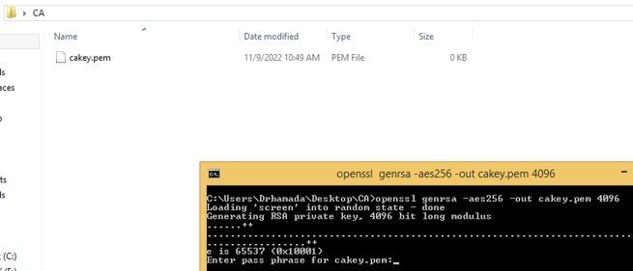
Lecture
06
SSL SELF-SIGNED CERTIFICATION
www.midocean.ae

Slide 29
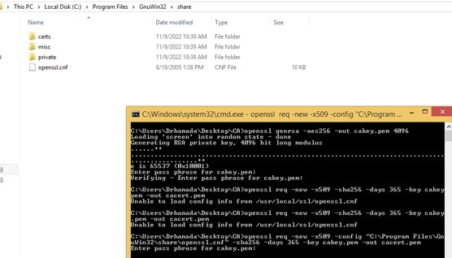
Lecture
06
SSL SELF-SIGNED CERTIFICATION
www.midocean.ae

Slide 30
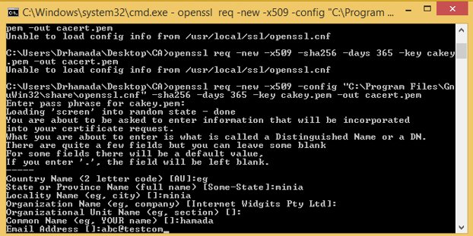
Lecture
06
SSL SELF-SIGNED CERTIFICATION
www.midocean.ae

Slide 31
Lecture
06
TCP-SSL CLIENT/SERVER EXAMPLE
Code: 1- the server
import socket, ssl
host = "127.0.0.1"
port = 10500
sock = socket.socket(socket.AF_INET, socket.SOCK_STREAM)
#context creation
ctxt = ssl.SSLContext(ssl.PROTOCOL_TLS_SERVER)
ctxt.load_cert_chain("/path/to/certServer.pem", "/path/to/certKey.pem")
sock.bind((host, port))
www.midocean.ae

Slide 32
Lecture
06
TCP-SSL CLIENT/SERVER EXAMPLE
Cont'd
Code: 1- the server
#start server
sock.listen()
print("Server start")
#secure the server
sslServer = ctxt.wrap_socket(sock, server_side=True)
#accept connection
client, ip = sslServer.accept()
print("The IP", ip, " is connected")
print("Client: ", client.recv(1024).decode() )
www.midocean.ae

Slide 33
Lecture
06
TCP-SSL CLIENT/SERVER EXAMPLE
Cont'd
Code: 2- the client
import socket, ssl
host = "127.0.0.1"
port = 10500
sock = socket.socket(socket.AF_INET, socket.SOCK_STREAM)
#context creation
ctxt = ssl.SSLContext(ssl.PROTOCOL_TLS_CLIENT)
ctxt.load_verify_locations("/path/to/caCert.pem")
www.midocean.ae

Slide 34
Lecture
06
TCP-SSL CLIENT/SERVER EXAMPLE
Cont'd
Code: 2- the client
#secure the client
sslClient = ctxt.wrap_socket(sock, server_hostname=host)
sslClient.connect((host, port))
#exchange message
msg = input(":> ").encode()
sslClient.send(msg)
www.midocean.ae

Slide 35
Lecture
06
QUESTIONS FOR ONLINE DISCUSSION
Try to modify the SSL client/server program to allow the server to accept multiple clients and secure connections with them.
www.midocean.ae

Slide 36


Thank You

