Slide 1










PROJECT FEASIBILITY STUDY
PMG201
Prepared by
Dr. Manal Elsayed
Lecture No.5

Slide 2









Lecture 5
THE MANAGER, THE ORGANIZATION, AND THE TEAM

Slide 3

THE MANAGER, THE ORGANIZATION, AND THE TEAM
The PM’s Roles
The PM’s Responsibilities to the Project
Selection of a Project Manager
Project Management as a Profession
Fitting Projects Into the Parent Organization
The Project Team
Effective Team Management

Slide 4




1- THE PM ’ S ROLES
Once a project has been selected, the next step is for senior management to choose a project manager (PM). It is the PM ’ s job to make sure that the project is properly planned, implemented, and completed

Slide 5

THE PM ’ S ROLES
The PM is a facilitator, unlike the traditional manager who is a supervisor.
The PM must adopt the systems approach to making decisions and managing projects.
Multiple communication paths exist in any project, and some paths bypass the PM, causing problems.
Much project communication takes place in meetings that may be run effectively if some simple rules are followed.
-
In
virtual projects
much communication is via
high technology channels.
- Above all, the PM must keep senior management informed about the current state
of the project.

Slide 6
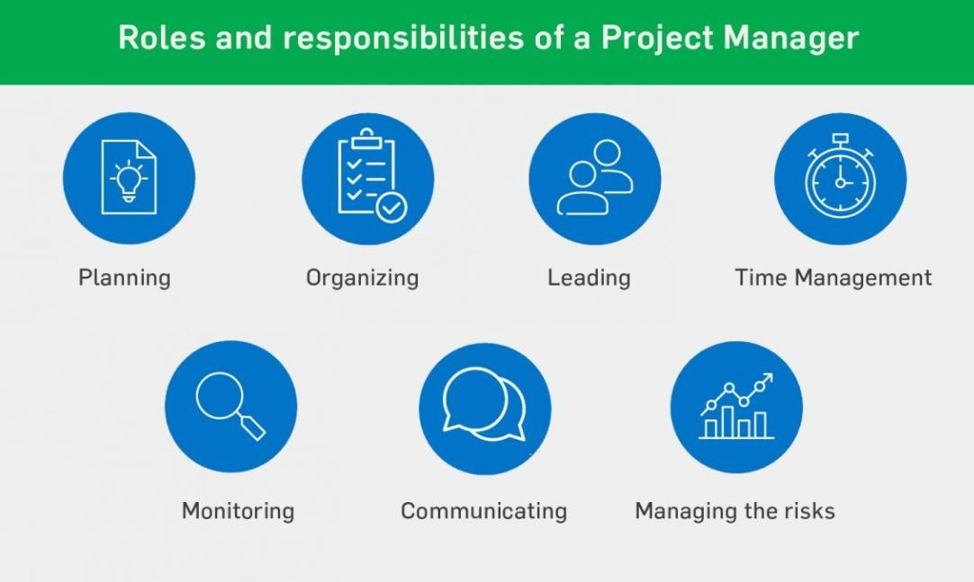
THE PM ’ S ROLES
Facilitator.
Communicator.
Virtual Project Manager.
• Meetings, Convener and Chair. تاعامتجلاا مظنم
سيئرلاو

Slide 7

PM’s Role in
Procurement
Know the procurement process; seek support early from specialists in contracting, purchasing, law, and technical disciplines.
Involvement should begin
the procurement process.
at the start of
•
Understand
contract
terms and
conditions
Ensure the contract contains all project management requirements and scope for the product or services being procured.

Slide 8
PM’s Role in Procurement
Identify
risks and incorporate ways
to
avoid, mitigate, transfer
to seller, or
share
the potential risk within the contract.
•
Fit the schedule
for completion of the
procurement process into the schedule for the project.
Be to
engaged during contract negotiation
establish a relationships with the seller.
Manage the entire project, not just the
contract statement of work.
Work with the contract or procurement
manager to
manage contract change
control.

Slide 9

2- THE PM ’ S RESPONSIBILITIES TO THE PROJECT
The PM has three overriding responsibilities to the project.
First is the acquisition of resources
and personnel. ةيرشبلا دراوملا باطقتسا ةيلاملاو
Second is dealing with the obstacles that arise during the course of the project.
Third is exercising the leadership
needed to bring the project to a successful conclusion and making
the trade – offs ةضيااقملا necessary to do so.

Slide 10
The PM is responsible for acquiring the human and material resources needed by the project.
The PM is also responsible for exercising leadership, fire fighting, and dealing with obstacles that impede the project ’ s progress.
Finally, the PM is responsible for making the trade - offs between budget, schedule, and scope that are needed to ensure project success.
To be successful at meeting this responsibilities, the PM must be skilled at negotiation, conflict resolution, and
persuasion.

Slide 11



The most important criterion, in the
3- SELECTION OF A PROJECT MANAGER
language of sales people, is a “
closer.
” Find individuals who
complete the tasks
they are given.
As any senior manager knows, hard workers are easy to find. What is rare is an individual who is driven to finish the job.

Slide 12
SELECTION OF A PROJECT MANAGER
Select those who meet the following criteria at reasonably high levels:
Credibility.
Sensitivity.
Leadership, Style, Ethics.

Slide 13








Successful PMs have some common characteristics.
They are “ closers. ”
They also have high administrative and technical credibility.
In addition, the PM should be a leader, and adopt a participatory
management style that may have to be modified depending on the level of
technological sophistication يجولونكتلا روطتلا and uncertainty involved in the project.
Another critical project management skill is the ability to direct the project
in an ethical manner.

Slide 14

4- PROJECT MANAGEMENT AS A PROFESSION
It should be obvious to the reader
that
project management is a
demanding job.
Planning and controlling the complexities of a project ’ s activities, schedule, and budget would be difficult.
If the PM had to
full authority
take any action, he is required to keep the project on course for successful completion.

Slide 15









5 - FITTING PROJECTS INTO THE PARENT
ORGANIZATION
The rapid growth in the use of projects has made the traditional ways of creating an interface between projects and the parent organization ملأا ةمظنملا inadequate in many cases.
Pure project organizations, are too costly and lack technological depth.
Linking the two forms into matrix organized projects combines the strengths of the traditional forms and avoids most of their weaknesses.
Pure project organizations , An organization in which the project is separated from the rest of the parent system. It becomes a self- contained unit with its own technical staff, its administration, tied to the parent firm by the tenuous strands of periodic progress reports and oversight. .ةباقرلاو ةيرودلا ةيلحرملا ريراقتلل ةشهلا طويخلا

Slide 16

FITTING PROJECTS INTO THE PARENT ORGANIZATION
Some organizations operate all three types of projects (Strategic, Operational, Compliance). Project management offices may be set up to achieve consistent project administration when the firm is operating a number of differently organized projects.
Project maturity measurement models have been developed to measure the degree to which individual organizations have mastered state - of- the- art project management practices.

Slide 17




6- THE PROJECT TEAM
Effective team members have some characteristics in common.
1- They must be technically competent
اينف نيصتخم.
2. Senior members of the project team must be politically sensitive .
It is rarely possible to complete a project of
reasonable size and complexity without incurring problems that require aid from the upper executive row;
To ensure cooperation and assistance, there is a delicate balance قيقد نزاوت of power that must be maintained between the project
and the functional departments, and between one project and others.
Members of the project team need a strong
problem orientation.

Slide 18
5- Team members need a strong goal orientation . Projects are uncomfortable
environments. In particular,
neither project
teams nor PMs can succeed if their focus is
on activity rather than results.
6- Project workers need high self - esteem . Project members who hide mistakes and failure are disasters waiting to happen. They can immediately acknowledge their own errors هئاطخأب فرتعي and point out problems caused by the errors of others.

Slide 19
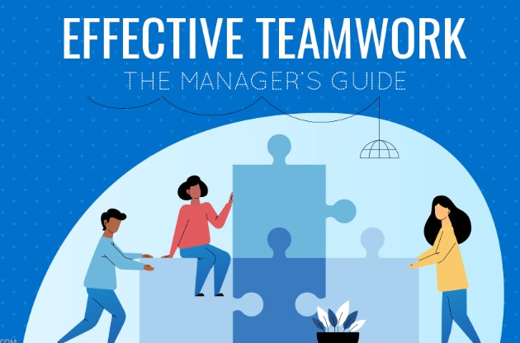
Effective Team Management

Slide 20
Groups, Teams and Organizational Effectiveness
Group | Team
A collection of individuals who work together in completing a task. | A group of persons having collective identity joined together, to accomplish a goal.
Individual Goals | Shared Goals
Individual Accountability | Individual and Mutual accountability
Individual success or failure | Collective success or failure

Slide 21
Groups, Teams and Organizational Effectiveness
Groups and teams can help an organization gain a competitive advantage because they can:
Enhance its performance.
Increase its responsiveness to customers.
Increase innovation.
Increase employees’ motivation and satisfaction.

Slide 22

Groups and Teams as Performance Enhancers
Synergy | Performance Enhancement
Performance gains that result when individuals and departments coordinate their actions. | Making use of the synergy from employees in a group producing more or better output than employees working separately.

Slide 23

Groups and Teams as Performance Enhancers
Factors that contribute to synergy
Ability to bounce ideas off one
another. راكفلاا دراوت
Correct each other’s errors
Bring more new ideas to bear on problems.
Accomplish projects beyond
the scope of individuals.

Slide 24
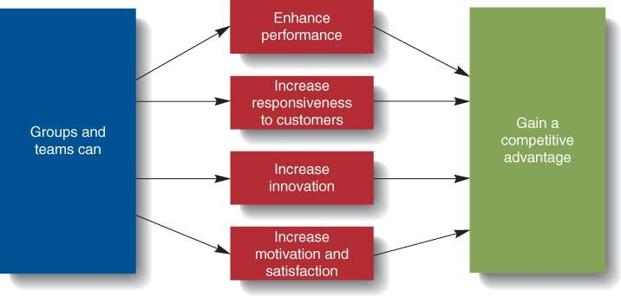
Groups’ and Teams’ Contributions to Organizational Effectiveness

Slide 25

Teams and Innovation
Innovation
The implementation of creative ideas for new products, new technologies, new services, or even new organizational structures essential for gaining and maintaining a competitive advantage

Slide 26

Groups and Teams as Motivators
Team members are more motivated and satisfied than if they were working alone.
Team members can see the effect of their contribution to
achieving
team and
organizational goals.
•
Teams provide
needed social
interaction
and
help employees
cope with work-related
stressors.

Slide 27
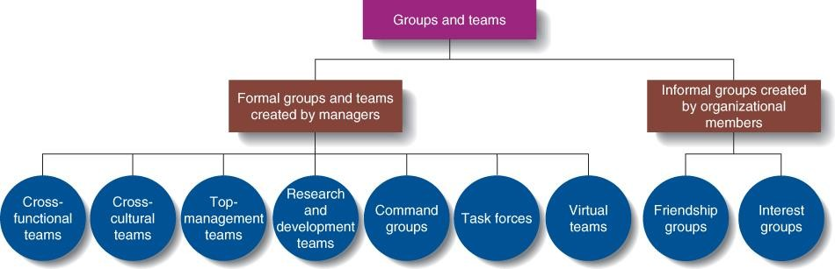
Types of Groups and Teams

Slide 28
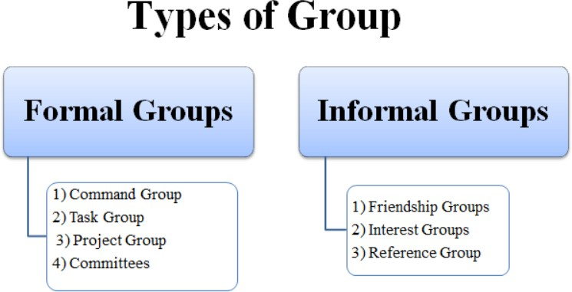
Types of Groups and Teams
Formal Group
A group that managers establish to achieve organization goals.
Informal Group
A group that managers or non managerial employees form to help achieve their own goals or to meet their own needs.

Slide 29

Types of Groups and Teams
Top-management team
A group composed of the CEO, the president, and the heads of the most important departments
Research and Development team
A team whose members have the expertise and experience needed to develop new products
•Command Groups رماولأا تاعومجم
A group composed of subordinates who report to
the same supervisor, also called a department or
unit
Task Forces
A committee of managers or non-managerial employees from various departments or divisions who meet to solve a specific, mutual problem; also
called an “ad hoc” committee ةصصخملا ةنجللا

Slide 30

Self-Managed Work Team
A group of employees who supervise their own activities and monitor the quality of the goods and services they provide
Virtual Team
A team whose members rarely meet face-to-face.
Interact by using various forms of
information technology.
Email, computer networks, telephone, fax, and videoconferences.

Slide 31

Types of Informal Groups and Teams
Interest Groups
- An informal group of employees seeking to achieve a common goal related to their organization.
Friendship Groups
- An informal group composed of employees who enjoy one another’s company and socialize with one another.

Slide 32

Group Dynamics
Group Dynamics
•
The characteristics and processes that affect how a group or team functions.
Group size affects how a group performs.
Normally, small groups (2 to 9 members) interact better and tend to be more motivated
Larger groups can be used when more resources are needed and division of labor is possible.
Division of labor
splitting the work to be performed into particular tasks and assigning tasks to individual workers.

Slide 33


