Slide 1



Project Cost
Management
Lecture 7
PMG 213
Prepared by
Dr. Hoda Metwally
www.midocean.ae

Slide 2
Financial Management Basis
www.midocean.ae

Slide 3
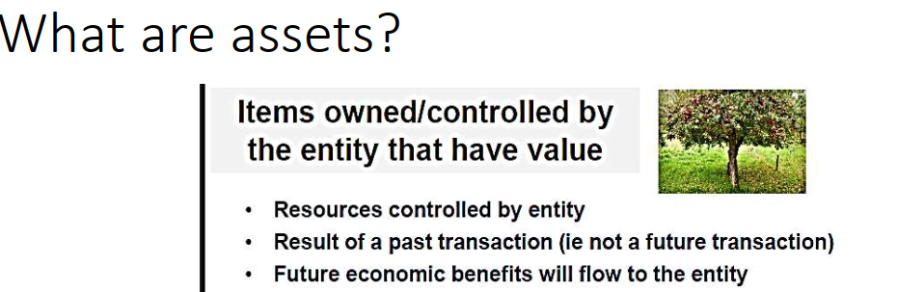
www.midocean.ae

Slide 4
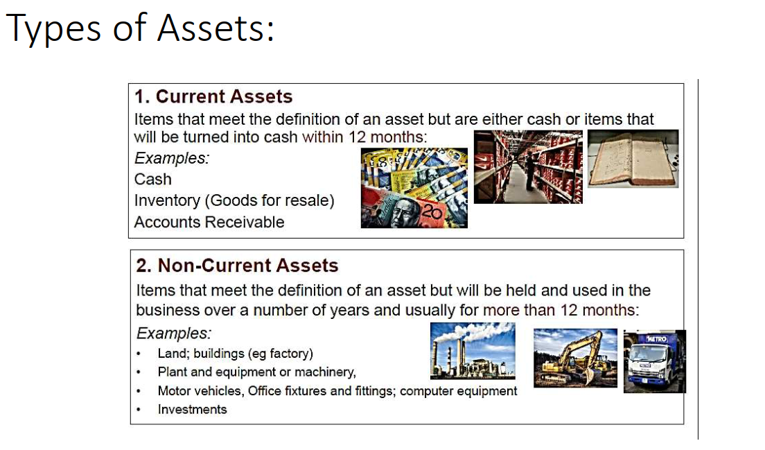
www.midocean.ae

Slide 5
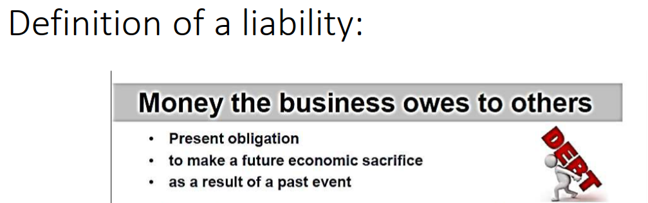
www.midocean.ae

Slide 6
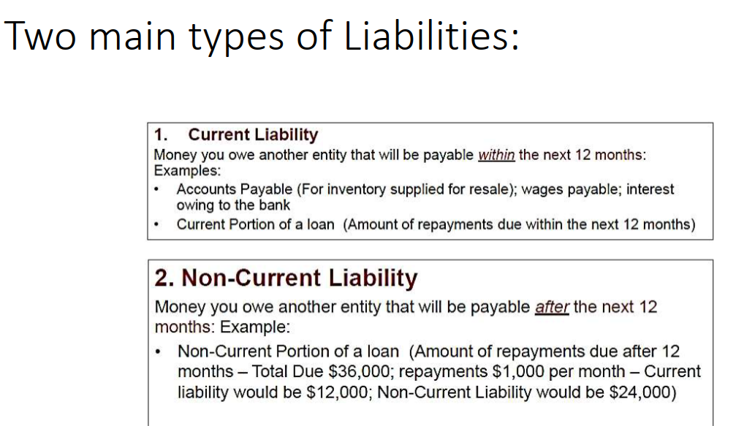
www.midocean.ae

Slide 7
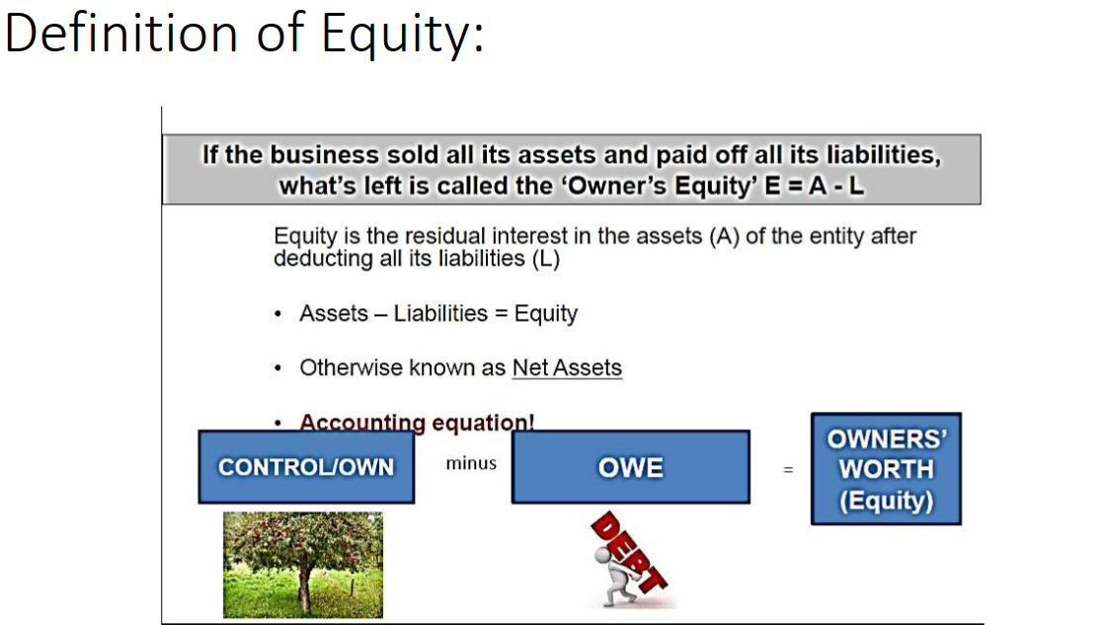
www.midocean.ae

Slide 8
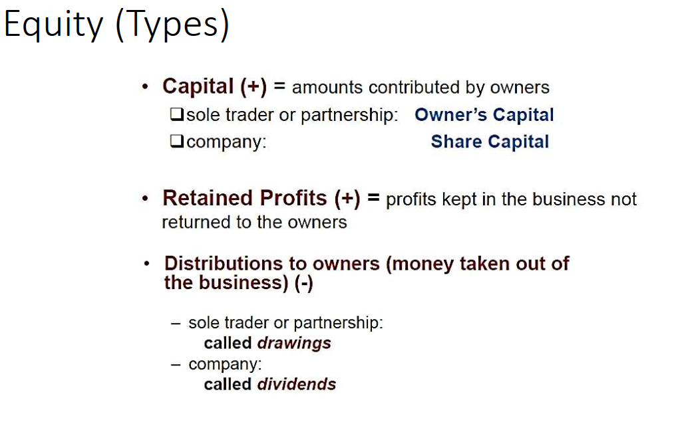
www.midocean.ae

Slide 9
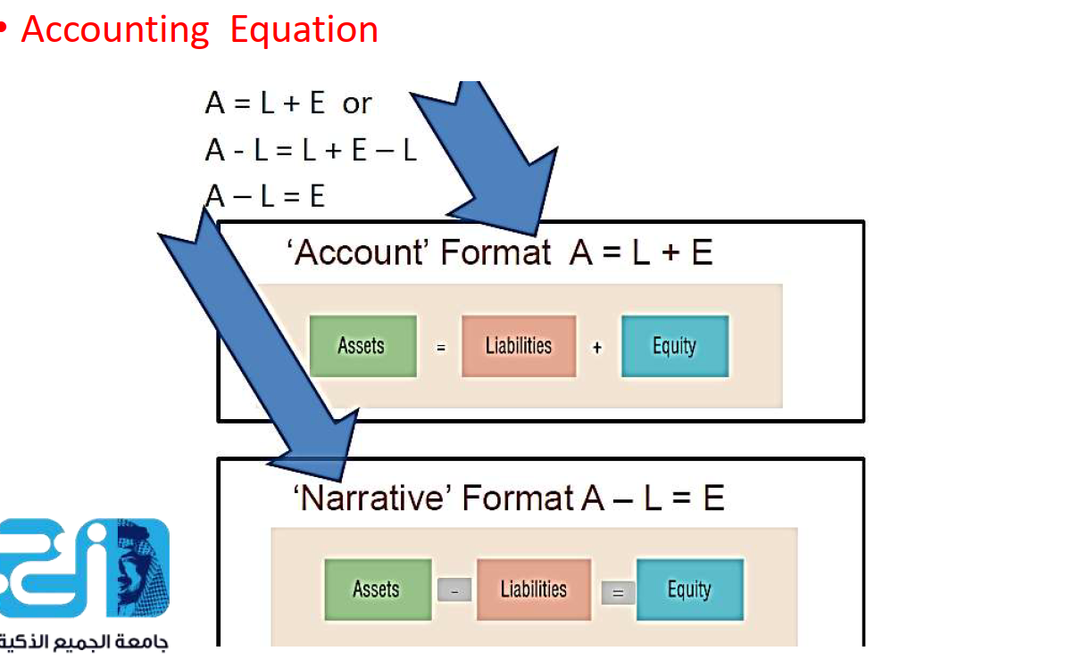
www.midocean.ae

Slide 10
Basic financial statements:
Balance Sheet
Income Statement
Statement of Retained Earnings
Statement of Cash Flows
Primary financial statements answer basic questions including:
  What is the company’s current financial status?
  What was the company’s operating results for the period?
  How did the company obtain and use cash during the period?
www.midocean.ae

Slide 11
Balance sheet:
Summary of the financial position of a company at a particular date
Assets: cash, accounts receivable, inventory, land, buildings, equipment and intangible items
Liabilities: accounts payable, notes payable and mortgages payable
Owners’ Equity: net assets after all obligations have been satisfied
www.midocean.ae

Slide 12
Balance Sheet answers these questions:
What are the resources of the company?
What are the company’s existing obligations?
What are the company’s net assets?
www.midocean.ae

Slide 13
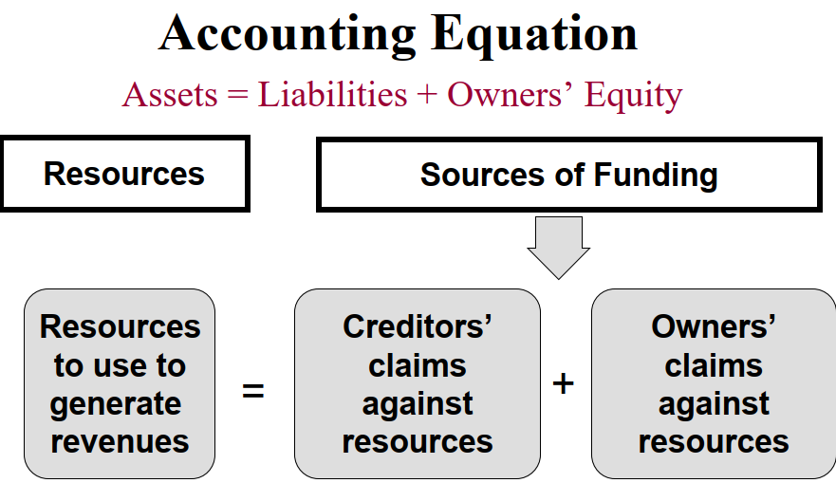
www.midocean.ae

Slide 14
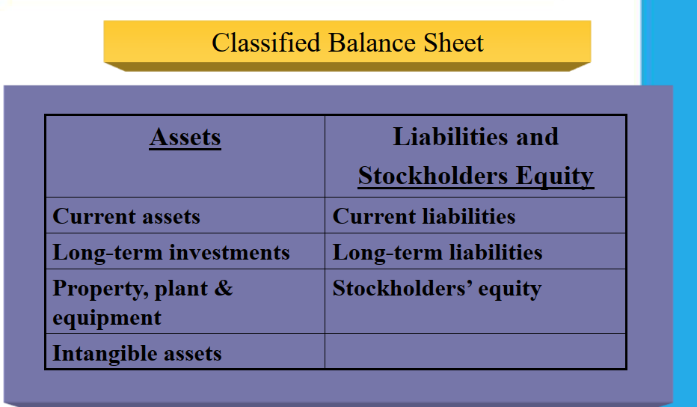
www.midocean.ae

Slide 15
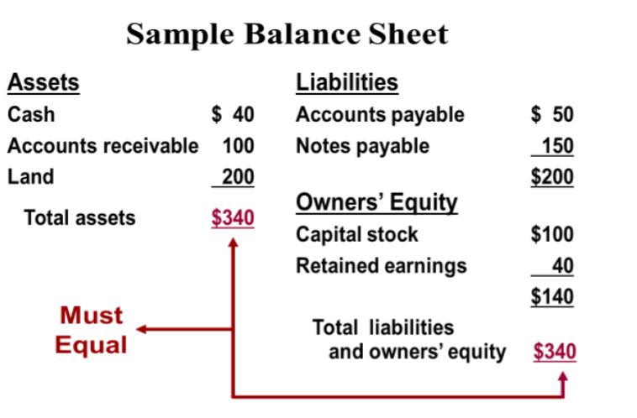
www.midocean.ae

Slide 16
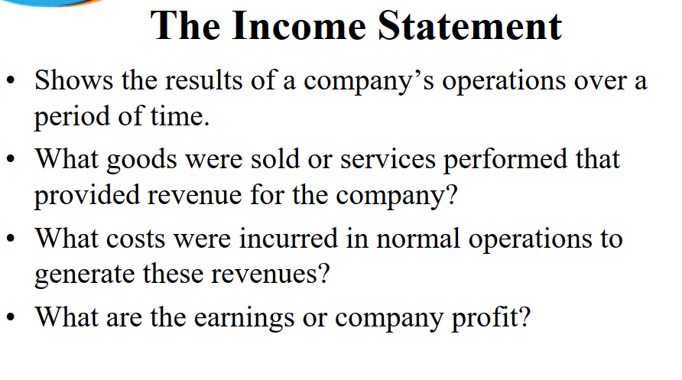
www.midocean.ae

Slide 17
Income Statement:
Revenues
Assets (cash or AR) created through business operations
Expenses
Assets (cash or AP) consumed through business operations
Net Income or (Net Loss)
Revenues - Expenses
www.midocean.ae

Slide 18
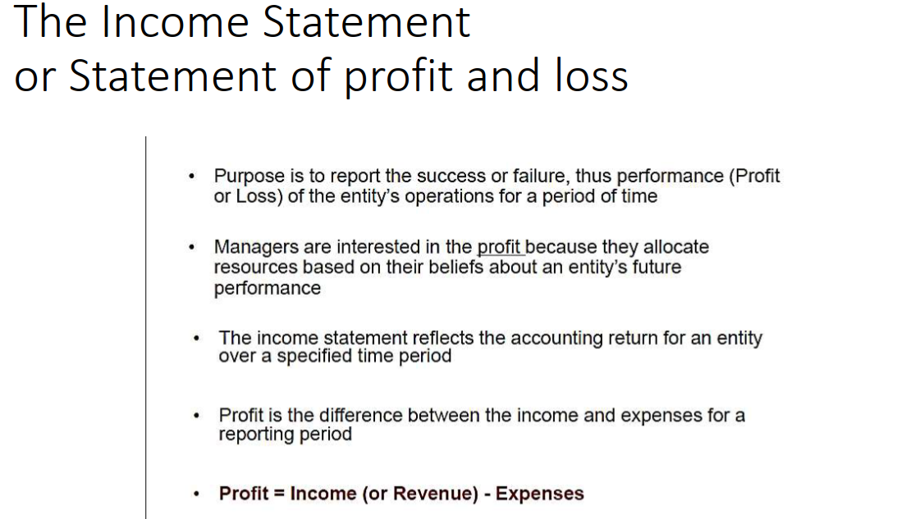
www.midocean.ae

Slide 19
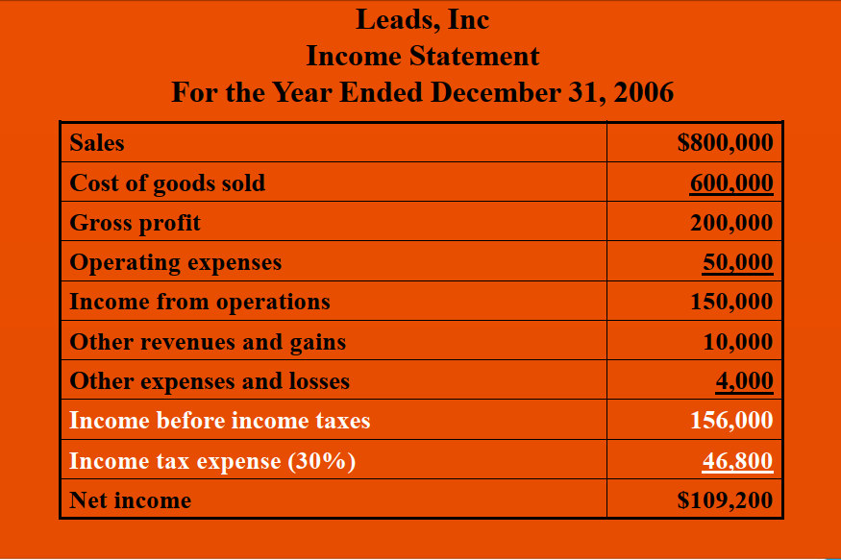
www.midocean.ae

Slide 20
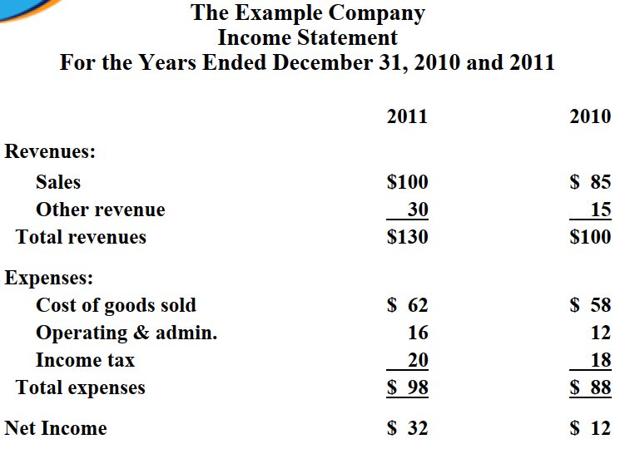
www.midocean.ae

Slide 21
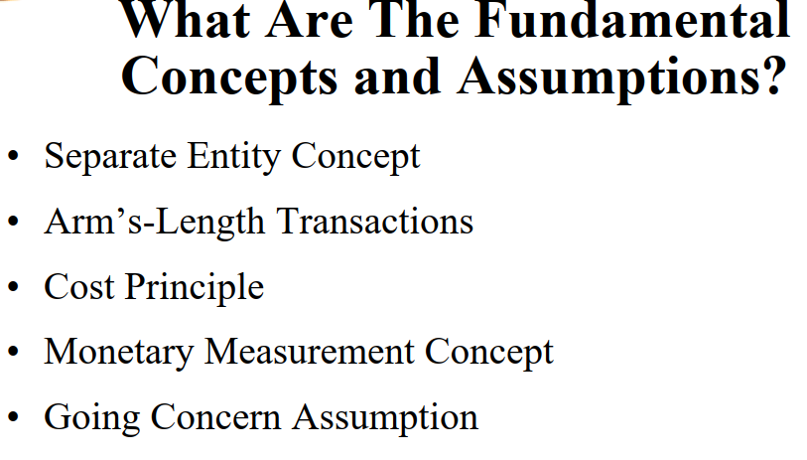
www.midocean.ae

Slide 22
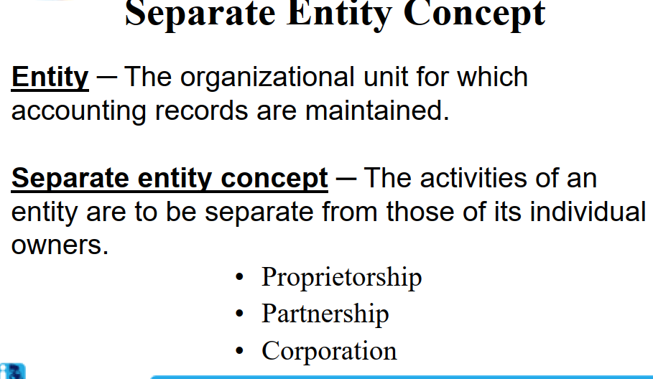
www.midocean.ae

Slide 23
The Cost Principle
All transactions are recorded at historical cost.
Historical cost is assumed to represent the fair market value of the item at the date of the transaction because it reflects the actual use of resources by independent parties.
www.midocean.ae

Slide 24
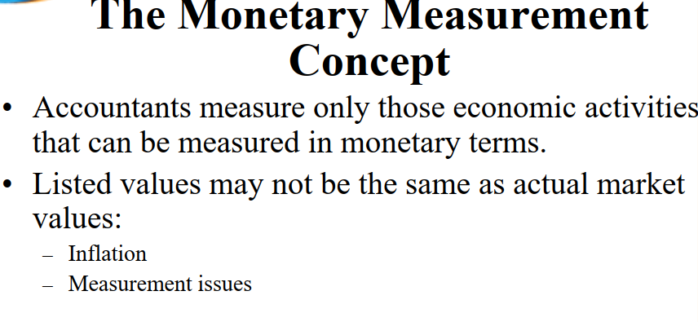
www.midocean.ae

Slide 25
The Going Concern Assumption
www.midocean.ae

Slide 26
The Time Period Concept
The life of a business is divided into distinct and relatively short time periods so the accounting information can be timely, generally 12 months or less.
www.midocean.ae

Slide 27
Define Accrual Accounting
A system of accounting in which revenues and expenses are recorded as they are earned and incurred, not necessarily when cash is received
or paid.
Provides a more accurate picture of a
company’s profitability.
Statement users can make more informed judgments concerning the company’s earnings
potential.
www.midocean.ae

Slide 28
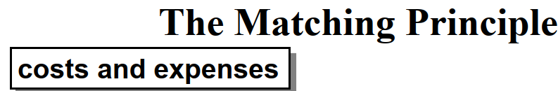

All costs and expenses incurred in generating revenues must be recognized in the same reporting period as the related revenues.
This process of matching expenses with recognized revenues determines the amount of net income reported on the income statement.
www.midocean.ae

Slide 29
Cash-Basis Accounting
Revenues and expenses are recognized only when cash is received or payments are made.
Mainly used by small businesses.
Not an accurate picture of true profitability.
www.midocean.ae

Slide 30
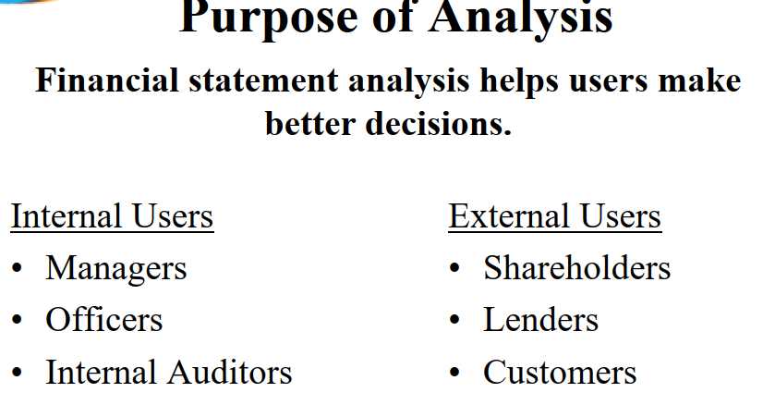
www.midocean.ae

Slide 31
Standards for Comparison
Intra-company
Competitor
Industry
Guidelines
www.midocean.ae

Slide 32
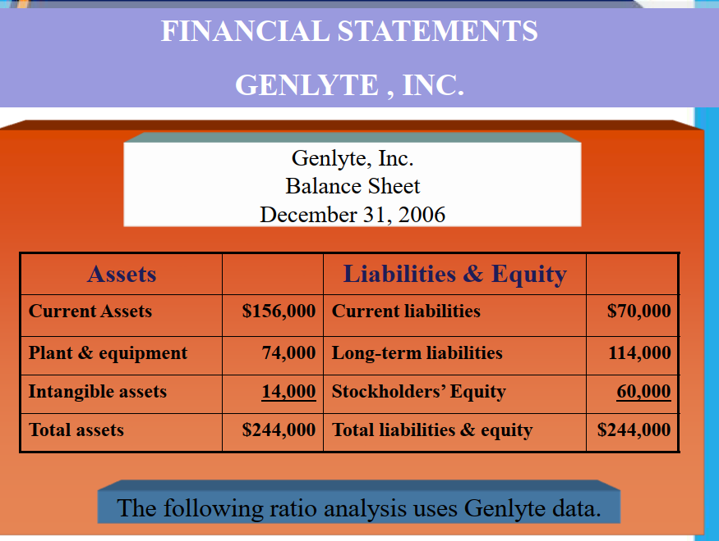
www.midocean.ae

Slide 33
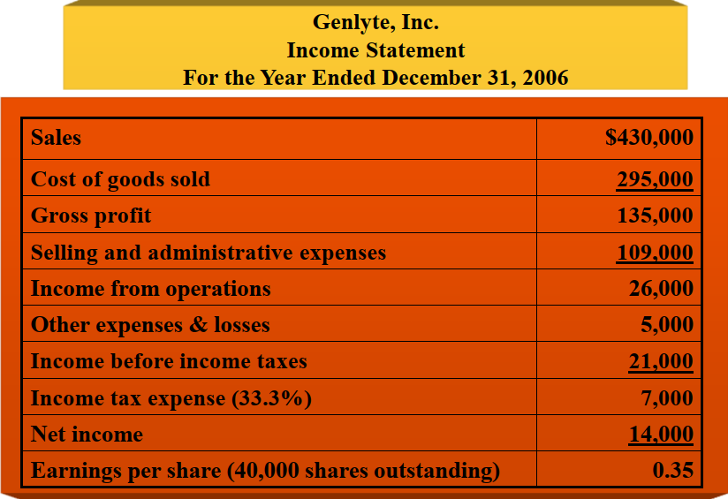
www.midocean.ae

Slide 34
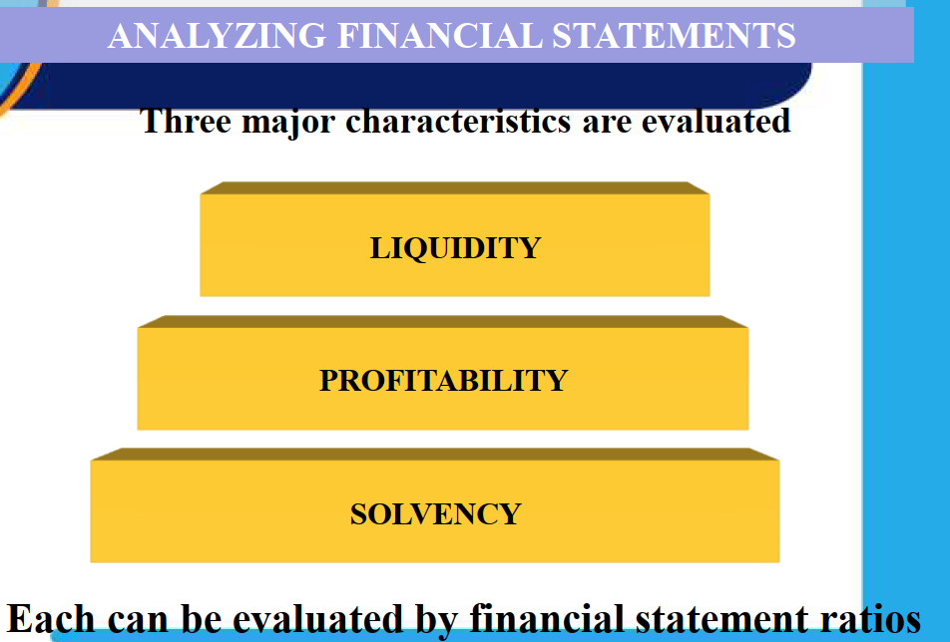
www.midocean.ae

Slide 35
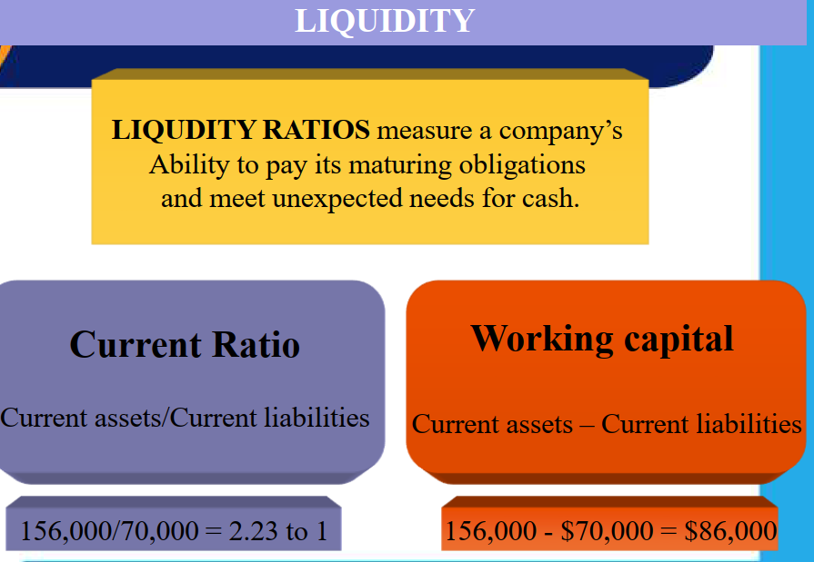
www.midocean.ae

Slide 36
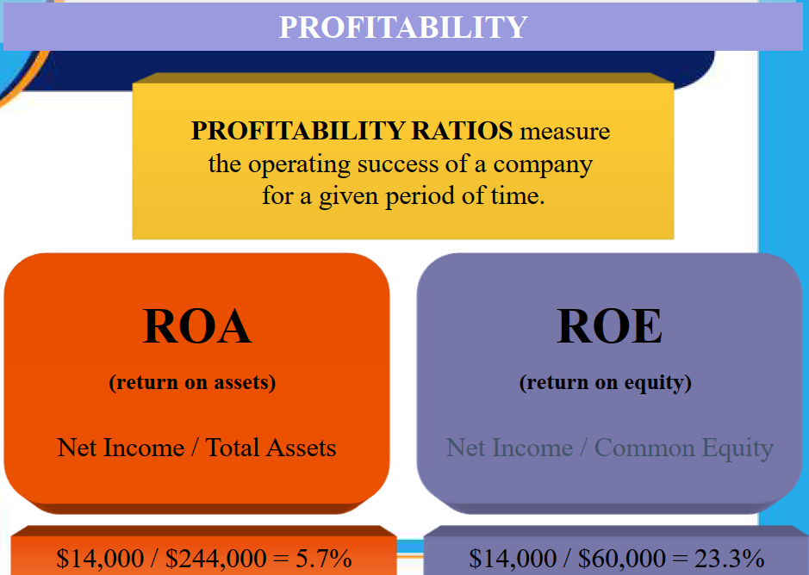
www.midocean.ae

Slide 37
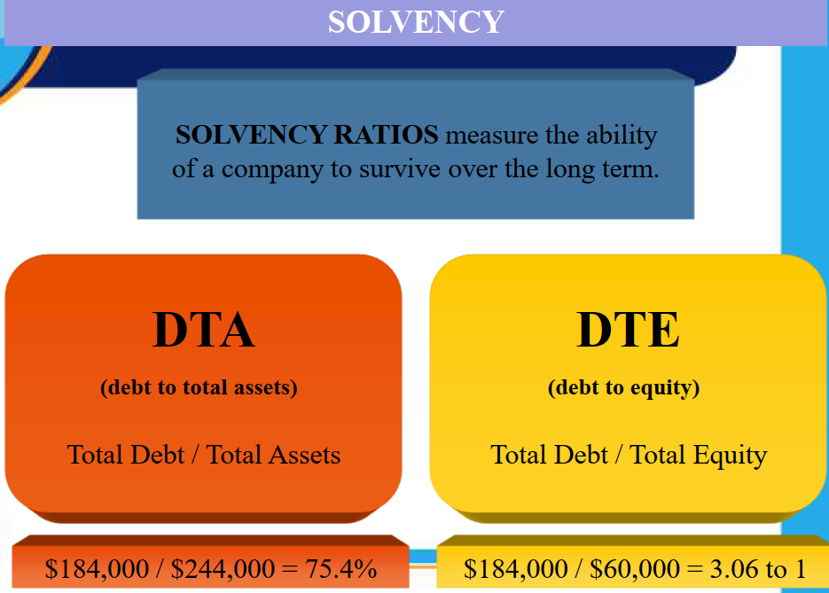
www.midocean.ae

Slide 38
Thank You
www.midocean.ae

