Slide 1


Computer Vision,
and Digital Image
Processing
Prepared by Dr. Mohamed Mostafa
AI 612
Lecture 4

Slide 2



Spatial Filtering
Lecture 4
AI 612
Prepared by
Dr. Mohamed Mostafa
www.midocean.ae

Slide 3

Spatial Filtering
Chapter
03
Resources for this lecture
Chapter 3:
Gonzalez, Rafael C. Digital image processing. Pearson education, India, 2009.
www.midocean.ae

Slide 4
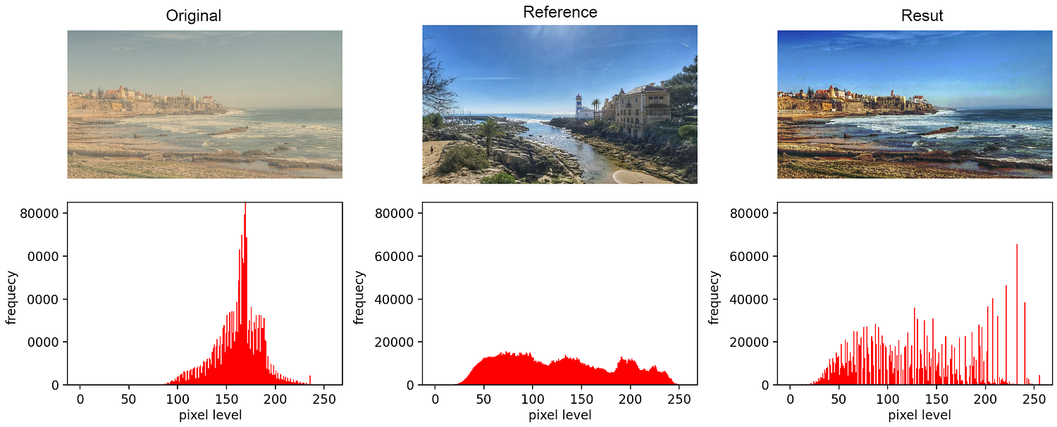
Histogram Matching (Specification)
Histogram matching, also known as histogram specification or histogram equalization matching, is a technique used to transform an image's histogram to match a specified or target histogram.
This process can be useful for various purposes, such as adjusting the contrast of an image to make it similar to a reference image's contrast.
Source:
medium

Slide 5
Histogram Matching (Specification)
The steps for histogram matching are as follows:
Compute the Histograms:
Source Image: Calculate the histogram of the source image for which you want to adjust the contrast.
Target Histogram: Obtain the histogram of the reference or target image to which you want to match the source image's histogram.
Compute the Cumulative Distribution Function (CDF):
Calculate the cumulative distribution function (CDF) for both the source image's histogram and the target histogram. The CDF represents the cumulative sum of the probabilities of each intensity value.
Normalize the CDFs:
Normalize both CDFs to ensure that they span the full intensity range (usually 0 to 1).

Slide 6
Histogram Matching (Specification)
The steps for histogram matching are as follows:
Create a Mapping Function:
Create a mapping function that relates the source image's normalized CDF to the target image's normalized CDF.
This mapping function helps transform the intensity values of the source image to match the target histogram.
mapping_function(source_intensity) = target_intensity
The mapping function assigns a new intensity value for each possible source intensity value.
Apply the Mapping Function:
For each pixel in the source image, apply the mapping function to transform its intensity value. Replace the original intensity with the corresponding target intensity according to the mapping function.
Create the Matched Image:
The result is a new image with the histogram matched to the target histogram. This image should have a similar contrast and distribution of intensity values as the target image.

Slide 7
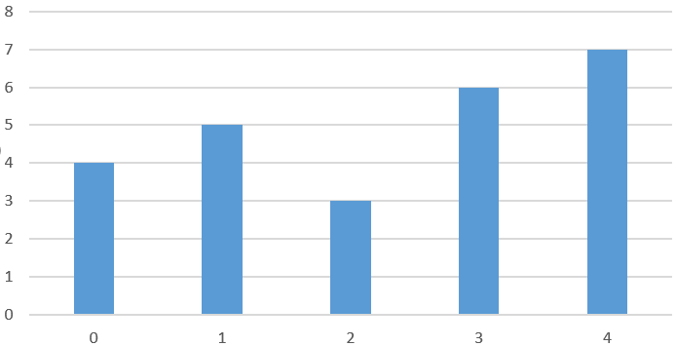
Histogram Matching Example
0 | 2 | 1 | 3 | 4
1 | 3 | 4 | 3 | 3
0 | 1 | 3 | 1 | 4
3 | 1 | 4 | 2 | 0
0 | 4 | 2 | 4 | 4
Intensity | # of Occurrence
0 | 4
1 | 5
2 | 3
3 | 6
4 | 7

Slide 8
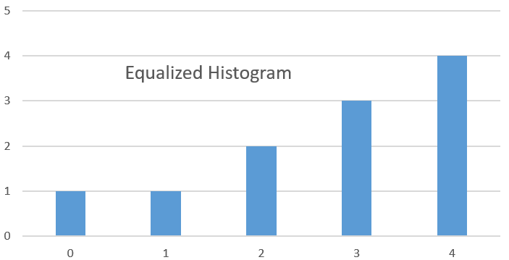
Histogram Matching Example
Intensity | # of Occurance | PDF | CDF | CDF*16 | Equalized Histogram
0 | 4 | 0.16 | 0.16 | 2.4 | 2
1 | 5 | 0.2 | 0.36 | 5.4 | 5
2 | 3 | 0.12 | 0.48 | 7.2 | 7
3 | 6 | 0.24 | 0.72 | 10.8 | 11
4 | 7 | 0.28 | 1 | 15 | 15

Slide 9
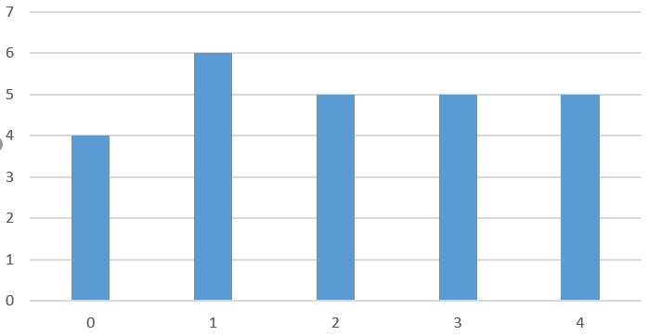
Histogram Matching Example
2 | 1 | 2 | 1 | 0
3 | 3 | 2 | 4 | 4
1 | 3 | 2 | 4 | 4
0 | 0 | 3 | 2 | 1
1 | 3 | 1 | 4 | 0
Intensity | # of Occurrence
0 | 4
1 | 6
2 | 5
3 | 5
4 | 5

Slide 10
Histogram Matching Example
Intensity | # of Occurance | PDF | CDF | CDF*16 | Equalized Histogram
0 | 4 | 0.16 | 0.16 | 2.4 | 2
1 | 6 | 0.24 | 0.4 | 6 | 6
2 | 5 | 0.2 | 0.6 | 9 | 9
3 | 5 | 0.2 | 0.8 | 12 | 12
4 | 5 | 0.2 | 1 | 15 | 15

Slide 11
Histogram Matching Example
Intensity | Referenc Image Equalized Histogram
0 | 2
1 | 6
2 | 9
3 | 12
4 | 15
Original Image Equalized Histogram | New Intensity
2 | 0
5 | 0
7 | 1
11 | 2
15 | 4

Slide 12
Local Histogram Processing
There are cases in which it is necessary to enhance details over small areas in the image.
The numbers of areas may have negligible influence on the computation of global transformation.
The solution is to advise transformation function based on the intensity distribution in a neighborhood of every pixel in the image.
Define transformation functions based on the intensity distribution in a neighborhood of every pixel in the image!
The procedure is to define a neighborhood and move its center from pixel to pixel.

Slide 13
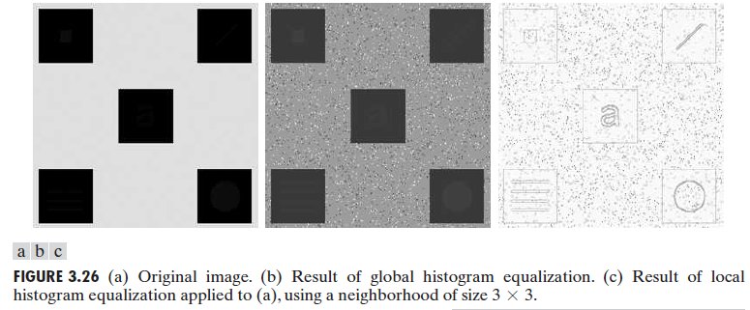
Local Histogram Processing

Slide 14
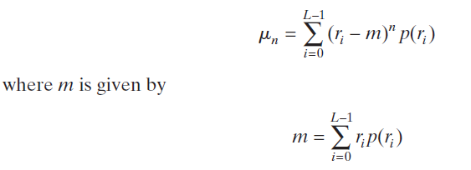



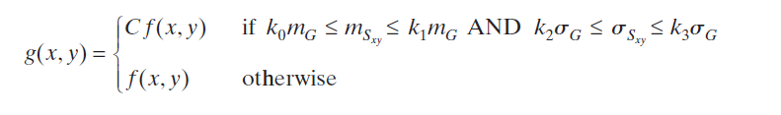
USING HISTOGRAM STATISTICS FOR IMAGE ENHANCEMENT
Statistics obtained directly from an image histogram can be used for image enhancement.
Let r denote a discrete random variable representing intensity values in the range [0,L − 1], and let p(r_{i}) denote the normalized histogram component corresponding to intensity value r_{i} .
Local mean, and standard deviation
Global mean, and standard deviation

Slide 15
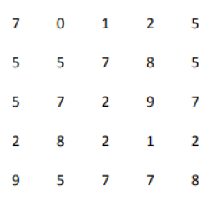
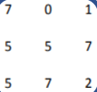
USING HISTOGRAM STATISTICS FOR IMAGE ENHANCEMENT
Local mean, and standard deviation
Global mean, and standard deviation

Slide 16
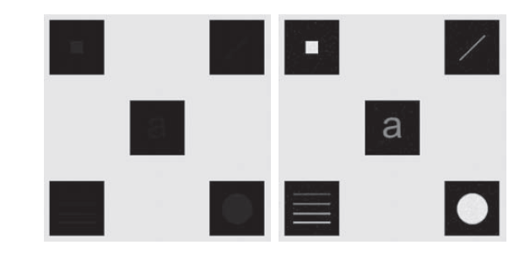
USING HISTOGRAM STATISTICS FOR IMAGE ENHANCEMENT

Slide 17
FUNDAMENTALS OF SPATIAL FILTERING
The name filter is borrowed from frequency domain processing, where “filtering” refers to passing, modifying, or rejecting specified frequency components of an image.
Spatial filtering modifies an image by replacing the value of each pixel by a function of the values of the pixel and its neighbors.
Spatial Filtering:
  Linear spatial filtering.
  Nonlinear spatial filtering.

Slide 18
The Mechanics of Spatial Filtering
The spatial filter consists of:
  Neighborhood, (typically a small rectangle).
  Predefined operation that is performed on the image pixels by the neighborhood.
  Use mask more than 1 x 1.
  It should be odd size mask (3 x 3, 5 x 5, 1 x 5 …)

Slide 19
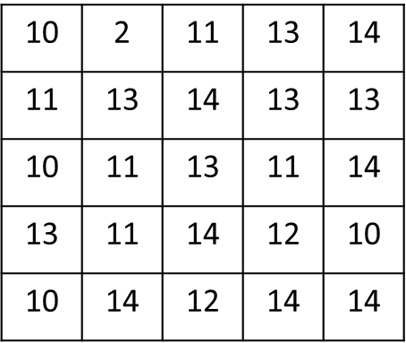
The Mechanics of Spatial Filtering

Slide 20
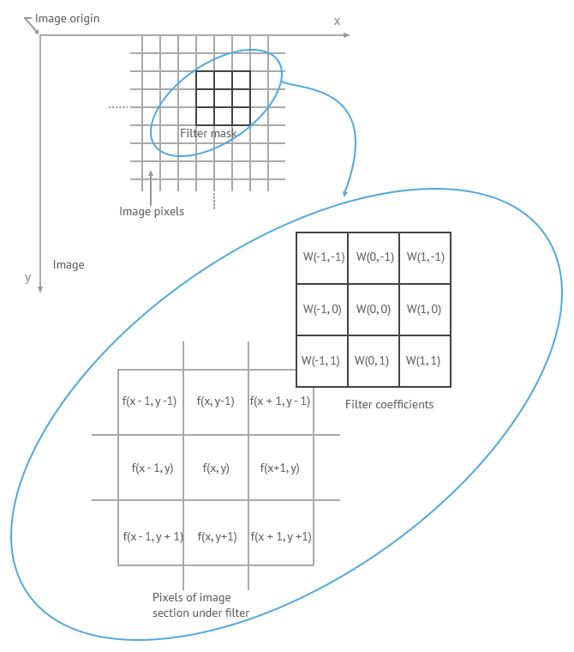
The Mechanics of Spatial Filtering
R = w(-1, -1) * f (x-1, y-1) + w(-1, 0) * f (x-1, y) + …+ w( 0, 0) * f (x, y) +…+ w(1, 0) * f (x+1, y) + w (1, 1) * f( x+1, y+1)

Slide 21
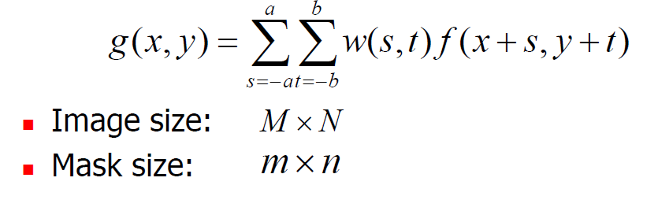
Linear Spatial Filters
The linear spatial filter for image of M x N, with a filter mask of size m*n is given by the expression:
Where x and y are varied so that each pixel in w visits every pixels in f, a = (m-1)/2 and b = (n-1)/2.
The spatial filter should be odd size and the smallest being of size 3 x 3.

Slide 22
Linear Spatial Filters
The mask falls outside the edge
Solutions?
  Ignore the edges
    The resulting image is smaller than the original
  Pad with zeros
    Introducing unwanted artifacts

Slide 23
Spatial Correlation and Convolution
Correlation is the process of moving a filter mask over the image and computing the sum of products at each location.
The mechanics of Convolution are the same except the filter first rotate by 180º
Where the minus signs on the right flip f(i.e. rotate it by 180)

Slide 24
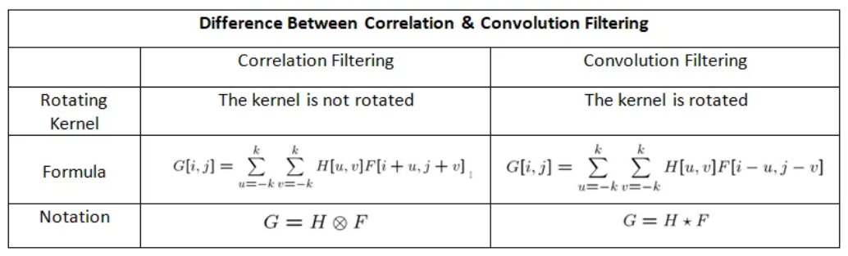
Spatial Correlation and Convolution

Slide 25
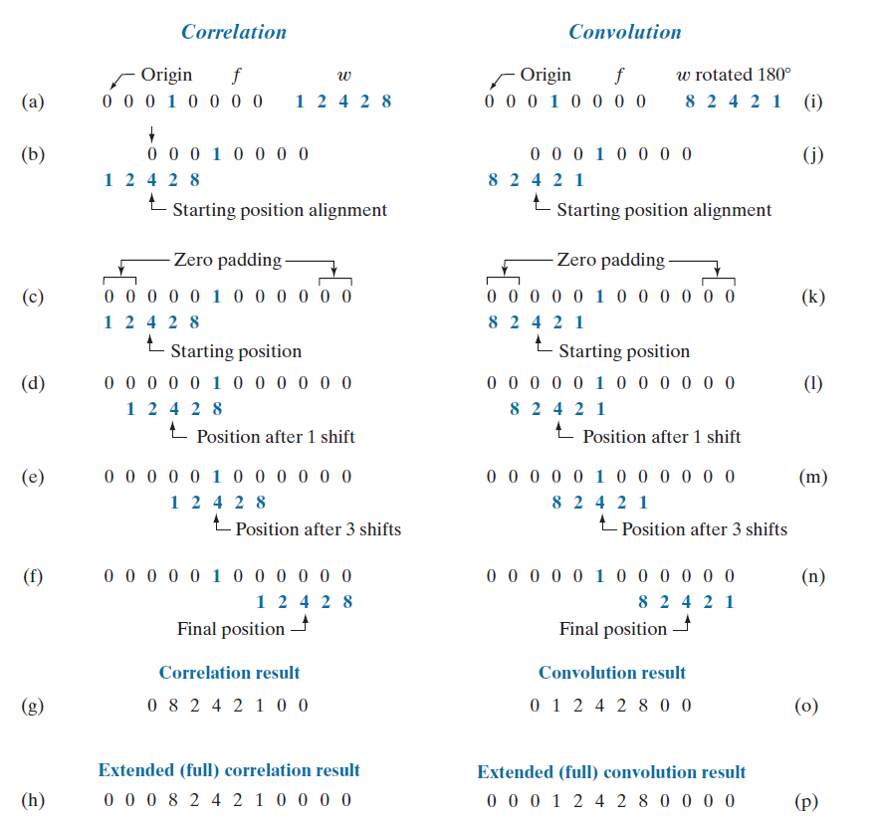
Spatial Correlation and Convolution

Slide 26
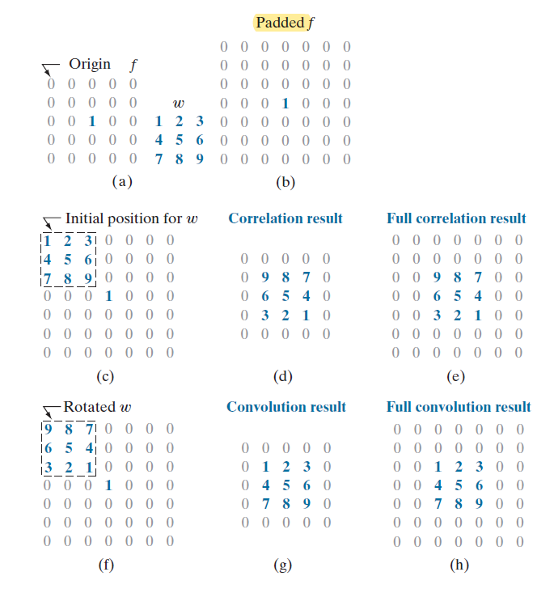
Spatial Correlation and Convolution

Slide 27
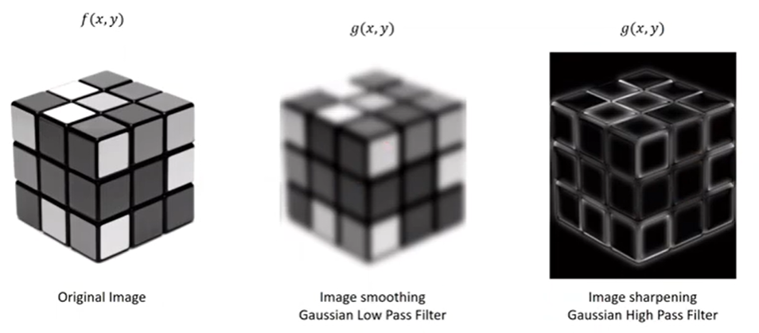
Spatial Filters
Smoothing Filters – low pass
Sharpening Filters – high pass
Source: Gaussian Filter in Python

Slide 28
Smoothing Spatial Filters
Smoothing filters are used for blurring and for noise reduction.
Blurring is used in preprocessing tasks such as removal of small details from an image.
Smoothing (i.e., low-pass filters)
  Reduce noise and small details.
  The elements of the mask must be positive.
  Sum of mask elements is 1
Noise reduction can be accomplished by:
  Smoothing linear filter.
  Smoothing nonlinear filter.

Slide 29
Smoothing Spatial Filters
A Low - Pass filter allows low spatial frequencies to pass unchanged , but suppress high frequencies. The low lass filet smoothes or blurs the image.
This tends to reduce noise, but also obscures fine detail.
How it works: the value of each pixel is replaced by the average of the gray levels in the neighborhood.
A spatial averaging filters in which all coefficients are equal sometimes is called a box filter (standard average).
A spatial averaging filters in which the coefficients are different sometimes is called a Weighted Average.
Median filter: order statistics, the center pixel of a M × M neighborhood is replaced by the median value of the corresponding window. .

Slide 30
Smoothing Spatial Filters
1 | 1 | 1
1 | 1 | 1
1 | 1 | 1
1 | 2 | 1
2 | 4 | 3
3 | 1 | 1
1/9 x
1/18 x
box filter (standard average).
Weighted Average.

Slide 31
Smoothing Spatial Filters
1 | 1 | 1
1 | 1 | 1
1 | 1 | 1
1/9 x
box filter (standard average).
Box filter for r=13
= (1*13 + 1*14 + 1*13 + 1*11 + 1* 13 + 1*11 + 1*11 + 1 *14 + 1*12 )/9 = 12.44

Slide 32
Smoothing Spatial Filters
1 | 1 | 1
1 | 1 | 1
1 | 1 | 1
1/9 x
box filter (standard average).
1 | 2 | 1
2 | 4 | 3
3 | 1 | 1
1/18 x
Box filter for r=13
= (1*13 + 1*14 + 1*13 + 1*11 + 1* 13 + 1*11 + 1*11 + 1 *14 + 1*12 )/9 = 12.44
Weighted filter for r=13
= (1*13 + 2*14 + 1*13 + 2*11 + 4* 13 + 3*11 + 3*11 + 1 *14 + 1*12 )/18 = 12.22
Weighted Average.

Slide 33
Smoothing Spatial Filters
2.4 | 24.7 | 45.7 | 44.4
3.5 | 36.9 | 46.2 | 66.7
6 | 6 | 100 | 100
5 | 5 | 100 | 100
5 | 5 | 100 | 100
6 | 6 | 100 | 100
1 | 1 | 1
1 | 1 | 1
1 | 1 | 1
1/9 x
box filter (standard average).

Slide 34
Smoothing Spatial Filters
2.9 | 25.3 | 51.5 | 55.5
3.5 | 31.5 | 68.5 | 72.2
6 | 6 | 100 | 100
5 | 5 | 100 | 100
5 | 5 | 100 | 100
6 | 6 | 100 | 100
1 | 2 | 1
2 | 4 | 3
3 | 1 | 1
1/18 x
Weighted Average.

Slide 35
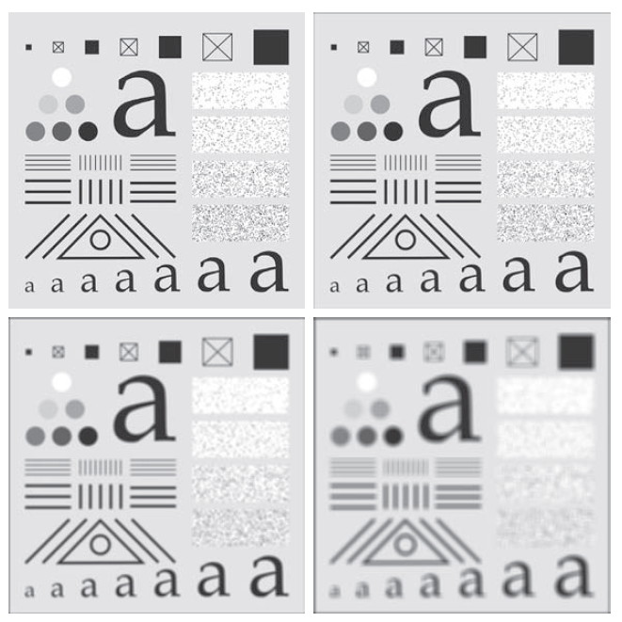
Smoothing Spatial Filters
Original Image
Box filter 3x3
Box filter 11x11
Box filter 21x21

Slide 36
Order-Statistic (Nonlinear)Filters
Order-statistic filters are nonlinear spatial filters whose response is based on ranking the pixels contained in the image area encompassed by the filter and then replacing the value of center pixel with the value determined by the ranking result.
The best-known filter in this category is the median, min and max filters.
Median filters are effective in the presence of impulse(salt and pepper) noise because of its appearance as white and black dots superimposed on an image.
67 | 66 | 55 | 0
57 | 255 | 56 | 70
57 | 50 | 60 | 70
67 | 60 | 75 | 80
pepper
salt

Slide 37
Median Filters
67 | 66 | 55 | 0
57 | 255 | 56 | 70
57 | 50 | 60 | 70
67 | 60 | 75 | 80

Slide 38
Median Filters
67 | 67 | 66
67
57
67 | 66 | 55 | 0
57 | 255 | 56 | 70
57 | 50 | 60 | 70
67 | 60 | 75 | 80
67
Pixels near 67 without ordering: { 67, 67, 66, 67, 67, 66, 57, 57, 255}
Ordered pixels: {57, 57 , 66, 67, 67, 67, 67, 255}

Slide 39
Median Filters
67 | 66 | 55
67 | 66 | 55 | 0
57 | 255 | 56 | 70
57 | 50 | 60 | 70
67 | 60 | 75 | 80
67 | 66
Pixels near 66 without ordering: { 67, 66, 55, 67, 66, 55, 57, 255, 56}
Ordered pixels: { 55 , 55 , 56, 57, 66, 66, 67, 67, 255}

Slide 40
Median Filters
66 | 55 | 0
67 | 66 | 55 | 0
57 | 255 | 56 | 70
57 | 50 | 60 | 70
67 | 60 | 75 | 80
67 | 66 | 56
Pixels near 66 without ordering: { 66, 55, 0, 66, 55, 0, 255, 56, 70}
Ordered pixels: {0, 0, 55, 55, 56, 66, 66, 70, 255}

Slide 41
Median Filters
55 | 0 | 0
 |  | 0
 |  | 70
67 | 66 | 55 | 0
57 | 255 | 56 | 70
57 | 50 | 60 | 70
67 | 60 | 75 | 80
67 | 66 | 56 | 55
Pixels near 66 without ordering: {55, 0, 0, 55, 0, 0, 56, 70, 70}
Ordered pixels: {0, 0, 0, 0, 55, 55, 56, 70, 70}

Slide 42
Median Filters
67 | 66 | 55 | 0
57 | 255 | 56 | 70
57 | 50 | 60 | 70
67 | 60 | 75 | 80
67 | 66 | 56 | 55
57
67
57
57
Pixels near 66 without ordering: {67, 67, 66, 57, 57, 255, 57, 57, 50 }
Ordered pixels: {50, 57, 57, 57, 57, 66, 67, 67, 255 }

Slide 43
Median Filters
67 | 66 | 55 | 0
57 | 255 | 56 | 70
57 | 50 | 60 | 70
67 | 60 | 75 | 80
67 | 66 | 56 | 55
57 | 57
Pixels near 66 without ordering: {67, 66, 55, 57, 255, 56, 57, 50, 60 }
Ordered pixels: {50, 55, 56, 57, 57, 60 , 66, 67, 255}

Slide 44
Median Filters
67 | 66 | 55 | 0
57 | 255 | 56 | 70
57 | 50 | 60 | 70
67 | 60 | 75 | 80
67 | 66 | 56 | 55
57 | 57
 |  | 70
Pixels near 66 without ordering: {255, 56, 70, 50, 60, 70, 60, 75, 80 }
Ordered pixels: {50, 56, 60, 60, 70, 70, 75, 80, 255}

Slide 45
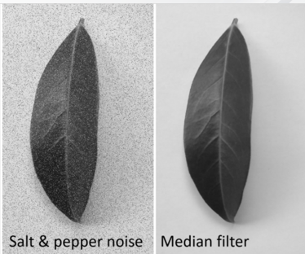
Median Filters

Slide 46



Order-Statistic (Nonlinear)Filters
Assignment:
  Explain how the following filters are working?
    Max filter
    Min filter

Slide 47


Thank You

