Slide 1


Real Estate
Finance & Investment
Prepared by Dr. Emad Zaher
Assistant Professor of Accounting
REA 631
Introductory Lecture

Slide 2



Real Estate Finance & Investment
Lecture 0 Orientation
REA631
Prepared by
Dr. Emad Zaher

Slide 3
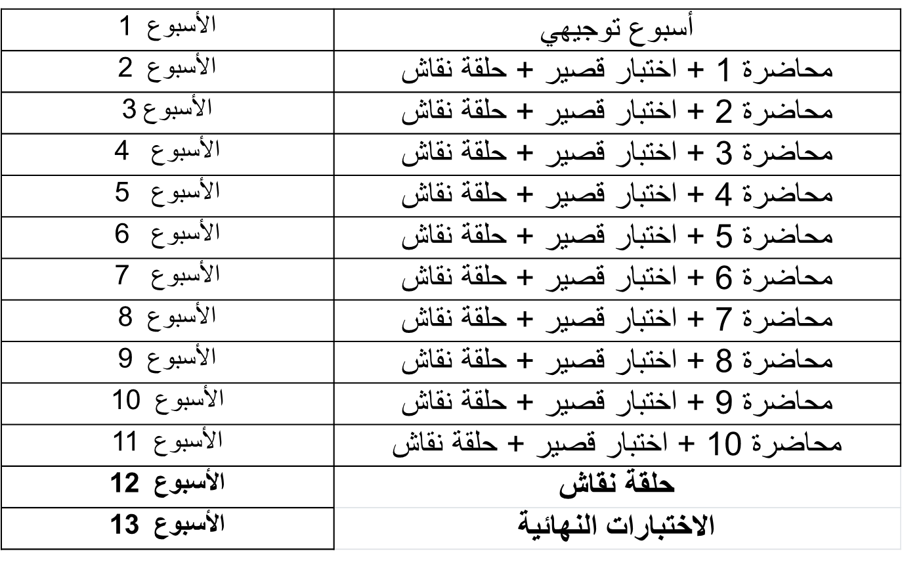

Slide 4
Quizzes & Exams
أسئلة الاختبار الفصلي / True-False / MCQ / أسئلة صوتية
تعد الإجابة على الاختبار بمثابة الحضور للطلاب
درجة الاختبار القصير 8 درجات/8 أسئلة (اجمالي 80 درجة)
فترة عقد الاختبار القصير /30 دقيقة/

Slide 5
Quizzes & Exams
الاختبار النهائي سيكون من خلال المودل
أسئلة الاختبار النهائي / True-False / MCQ / أسئلة صوتية
درجة الاختبار النهائي 20 درجة/20 سؤال
فترة عقد الاختبار النهائي /60 دقيقة/

Slide 6
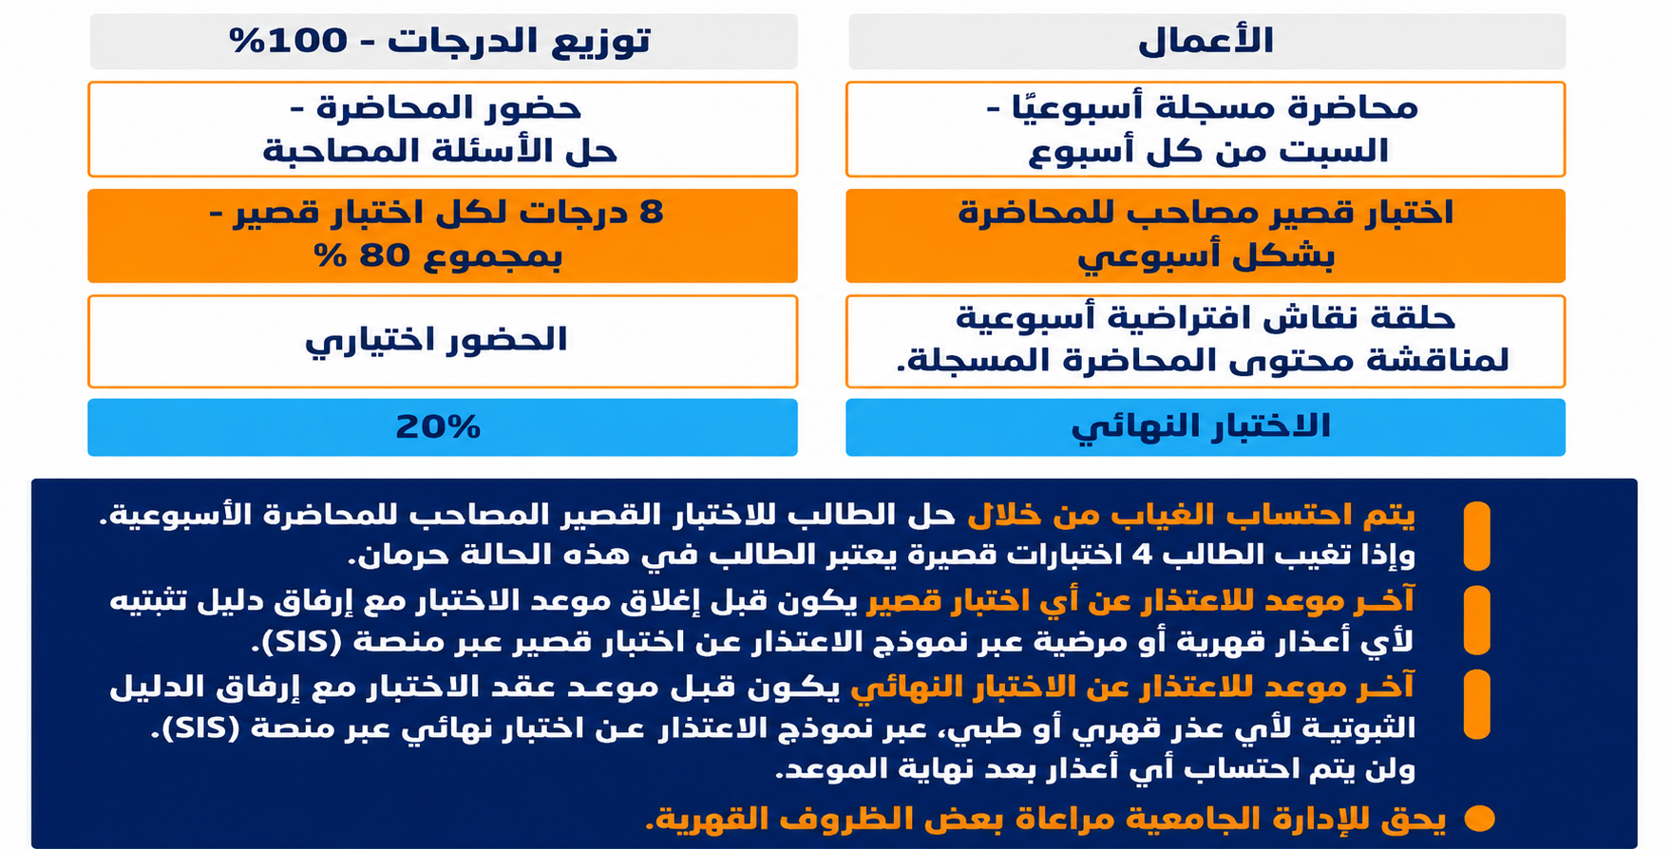

Slide 7





COURSE ROADMAP
What You Will Learn in This Course
01
02
03
04
FOUNDATIONS
ANALYSIS
FINANCE
PRACTICE
Valuation methods
NPV, IRR, payback
Sensitivity & risk
Mortgages & mezzanine
Capital structure
REITs & securitization
Development feasibility
Project financing
Live case studies
Real estate markets
Investment principles
Time value of money
Prepared by Dr. Emad Zaher
6 / 20

Slide 8
MODULE 1
Real Estate Markets & Investment Principles
Real estate is a unique asset class — illiquid, locally driven, and shaped by both space markets (rent, vacancy) and capital markets (yields, financing). Understanding how these two markets interact is the foundation of every investment decision you will make.
THE FOUR QUADRANTS
Private Equity
Public Equity
Direct ownership, partnerships
REITs, listed real estate
KEY CONCEPTS
The Four Quadrants: private vs. public × debt vs. equity
Property cycles: recovery, expansion, hyper-supply, recession
Location theory, demand drivers, supply elasticity
Risk–return profile across core, value-add, opportunistic
Private Debt
Public Debt
Whole loans, mezzanine
CMBS, mortgage bonds
Prepared by Dr. Emad Zaher
7 / 20

Slide 9
MODULE 2
Time Value of Money & Financial Mathematics
A dollar today is worth more than a dollar tomorrow. Every valuation, every investment decision, and every loan calculation in this course rests on this single idea.
Future Value
Present Value
FV = PV × (1 + r)ⁿ
PV = FV / (1 + r)ⁿ
Compounding: today's money grown forward
Discounting: tomorrow's money valued today
Annuity (PV)
Effective Rate
PV = PMT × [1 − (1+r)⁻ⁿ] / r
EAR = (1 + r/m)ᵐ − 1
Mortgage payments, lease streams
Compounding frequency adjustment
Prepared by Dr. Emad Zaher
8 / 20

Slide 10



MODULE 3
Real Estate Valuation — Three Approaches
Sales Comparison
Income Capitalization
Cost Approach
What did similar properties sell for?
What income will it generate?
What would it cost to replace?
Adjusts recent comparable transactions for differences in location, size, condition, and timing. Most reliable in active markets.
Value = NOI ÷ Cap Rate. The DCF refinement projects future cash flows and discounts them at the required return.
Land value + replacement cost − depreciation. Useful for new, special-purpose, or insurance-related valuations.
Prepared by Dr. Emad Zaher
9 / 20

Slide 11
MODULE 4
Investment Analysis & Decision Criteria
Which deal should we do? You will learn to defend an answer using four complementary tools — each one revealing a different facet of the same cash flow.
NPV
IRR
PB
SA
Net Present Value
Internal Rate of Return
Payback Period
Sensitivity Analysis
Dollar value created. Accept if NPV > 0.
The return implied by the deal's own cash flows. Accept if IRR > hurdle.
How quickly the initial equity is recovered. A liquidity and risk lens.
How the answer changes when rents, vacancy, or rates move against you.
Prepared by Dr. Emad Zaher
10 / 20

Slide 12
MODULE 5
Financing Instruments — The Capital Stack
THE CAPITAL STACK
HIGHER RISK
& RETURN
Who gets paid first, who takes the risk.
Common Equity
15–25%+ target IRR
Senior debt is paid first and bears the least risk , but takes the lowest return.
Mezzanine and preferred equity fill the gap between cheap debt and expensive common equity.
Common equity takes the residual risk , and the upside. The whole structure is the lever that transforms asset-level returns into equity-level returns.
Preferred Equity
10–14%
Mezzanine Debt
9–13%
Senior Mortgage
5–7%
LOWER RISK
& RETURN
Prepared by Dr. Emad Zaher
11 / 20

Slide 13
MODULE 6
Capital Markets & REITs
REITs democratised real estate — turning illiquid buildings into liquid shares. They now trade in 40+ countries and own over $4.5 trillion of gross real estate assets globally.
Liquid exposure to large, diversified property portfolios
Tax-advantaged structure: 90%+ of income distributed as dividends
Low correlation to stocks/bonds → portfolio diversifier
Securitization: CMBS, MBS, and tokenised real estate
WHY REITs MATTER
Prepared by Dr. Emad Zaher
12 / 20

Slide 14
MODULE 7
Risk Analysis & Portfolio Diversification
THE RISKS WE PRICE
DIVERSIFICATION
Market risk — rents, vacancy, cap-rate movement
Credit risk — tenant default, refinancing
Liquidity risk — exit timing in a frozen market
Operational risk — management, capex, insurance
Political & legal risk — regulation, expropriation, tax
Currency & inflation risk — cross-border exposure
Don't put all your buildings in one city.
Diversify across:
Property types
(office, industrial, residential, hospitality, data centres)
Geographies
(cities, countries, currencies)
Time vintages
(deploy capital through cycles, not at peaks)
Prepared by Dr. Emad Zaher
14 / 20

Slide 15
MODULE 8
Leverage, Capital Structure & Cost of Capital
Leverage amplifies returns — in both directions. The art is choosing the level of debt that maximises risk-adjusted equity returns without exposing you to refinancing or rate shocks.
THE WACC EQUATION
WACC = (E/V)·rₑ + (D/V)·r_d·(1−T)
Your hurdle rate.
Every deal you underwrite must clear it.
We will compute it, stress-test it, and use it to judge whether a project creates or destroys value.
15 / 20

Slide 16
MODULE 9
Development Feasibility & Project Financing
Site & Concept
Capital Raise
Stabilise / Exit
Location, zoning, market study
Construction loan + JV equity
Refinance, hold, or sell
01
02
03
04
05
Pro Forma
Build & Lease
Costs, revenues, timeline, returns
Manage cost overruns, pre-leasing
Prepared by Dr. Emad Zaher
16 / 20

Slide 17
MODULE 10
REITs & Real Estate Securitization
1,021
$2.04 T
40+
$4.5 T
Listed REITs worldwide (Nareit, 2024)
Combined REIT equity market cap
Countries with active REIT regimes
Gross real estate assets owned
FROM BUILDINGS TO BONDS
Securitization turns illiquid property cash flows into tradeable securities.
We will study how loans become CMBS, how REIT shares price properties daily, and how emerging tokenisation platforms (e.g. fractional ownership and on-chain real estate) are extending this logic further. Liquidity changes risk — and risk drives price.
Prepared by Dr. Emad Zaher
17 / 20

Slide 18
COURSE CONTENTS
Topics to Be Covered
01
Overview of Real Estate Markets and Investment Principles
07
Tax Implications and Legal Considerations in Real Estate Investment
02
Time Value of Money and Financial Mathematics
08
Risk Analysis and Portfolio Diversification
03
Real Estate Valuation Techniques (Sales Comparison, Income Capitalization, Cost Approach)
09
Leverage, Capital Structure, and Cost of Capital
04
Investment Analysis and Decision Criteria (NPV, IRR, Payback, Sensitivity Analysis)
10
Development Feasibility and Project Financing
05
Real Estate Financing Instruments (Mortgages, Mezzanine Debt, Equity)
11
Real Estate Investment Trusts (REITs) and Securitization
06
Real Estate Capital Markets and REITs
12
Case Studies in Property Acquisition and Development Financing
Prepared by Dr. Emad Zaher
19 / 20

Slide 19

Prepared by Dr. Emad Zaher

Slide 20



Thank You

