Slide 2
Contents
Sequential circuits
Flip-flops
Analysis of clocked sequential circuits
Design procedure

Slide 3
Design procedure
The procedure for designing synchronous sequential circuit is:
  Translate the design specifications to the state diagram for the circuit
  Assign binary values to the states
  Obtain the binary coded state table
  Choose the type of flip-flops to be used
  Derive the simplified flip-flop input equations and output equations
  Draw the logic diagram

Slide 4
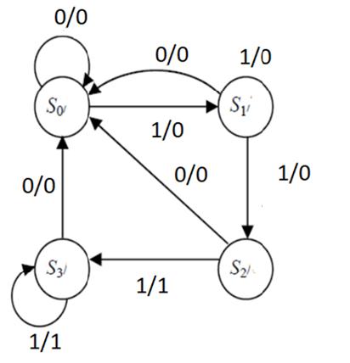
Sequence detector
Example: Design a circuit that detects three or more consecutive 1’s in a string of bits coming through an input line
The state diagram for the circuit is shown:

Slide 5
Sequence detector (Contd.)
It is derived by starting with state S₀
If input is 0, the circuit states in same state
If the input is 1, it goes to state S₁ to indicate that a 1 was detected
If the next input is 1, it changes to state S₂ to indicate the arrival of two consecutive 1’s

Slide 6
Sequence detector (Contd.)
But, if the input is 0, we go back to state S₀
Third consecutive 1 sends the circuit to S₃
If more 1’s are detected, circuit stays at S₃
Any 0 input sends the circuit back to S₀
Circuit stays at S₃, for three or more 1’s

Slide 7
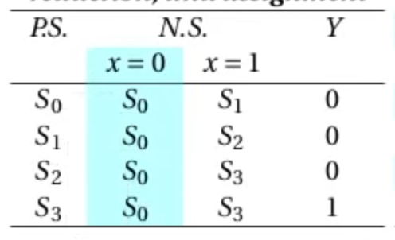
Sequence detector (Contd.)
  Assign binary values to the states
  00 →
  01 →
  10 →
  11 →

Slide 8
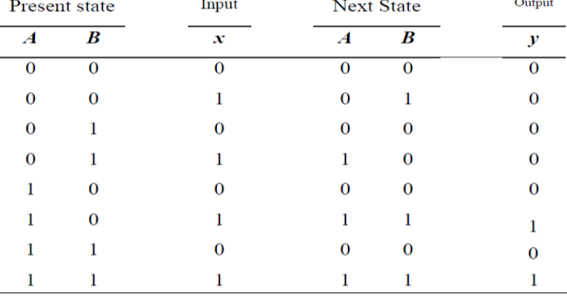
Synthesizing using D flip-flops
To design the circuit, we need to assign binary codes to the states and list the table
The state table is derived from the diagram

Slide 9
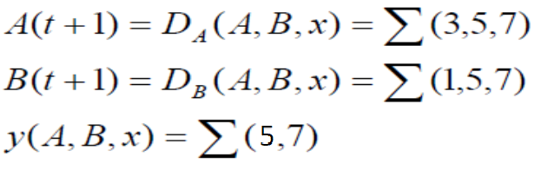
Using D flip-flops (Contd.)
We choose two D flip-flops to represent four states and label their outputs A and B
There is one input x and one output y
The characteristic equation of D flip-flop is
Q(t+1) = D_{Q}
D flip-flop equations are

Slide 10
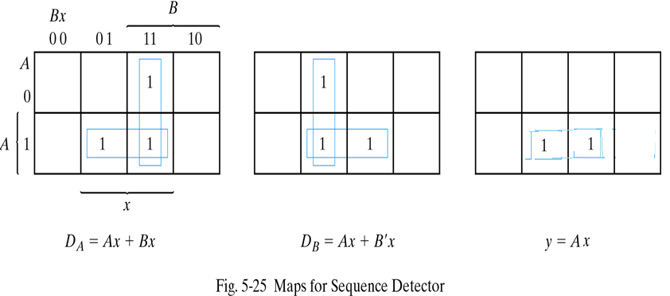
Using D flip-flops (Contd.)
Simplifying the above equations by K-map

Slide 11
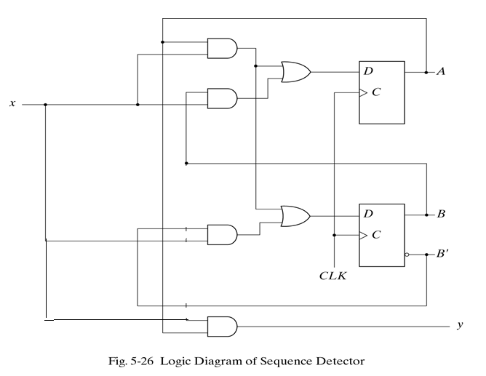
Using D flip-flops (Contd.)
The logic diagram for the circuit

Slide 12
Excitation table
Design with other types of flip-flops is not straightforward as the next state cannot directly be related to the input equations
In such cases we should use excitation tables, which list the required input for a given change of state
Next slide shows excitation tables for JK & T Flip-Flops
The symbol X represents a don’t care condition

Slide 13
Excitation table (Contd.)

Slide 14
Synthesizing using JK flip-flops
Example: Consider the sequential circuit given by the following table:

Slide 15
Using JK flip-flops (Contd.)
Assume that it is desired to design this sequential circuit using JK flip-flops
Using excitation table of JK FF, we have:

Slide 16
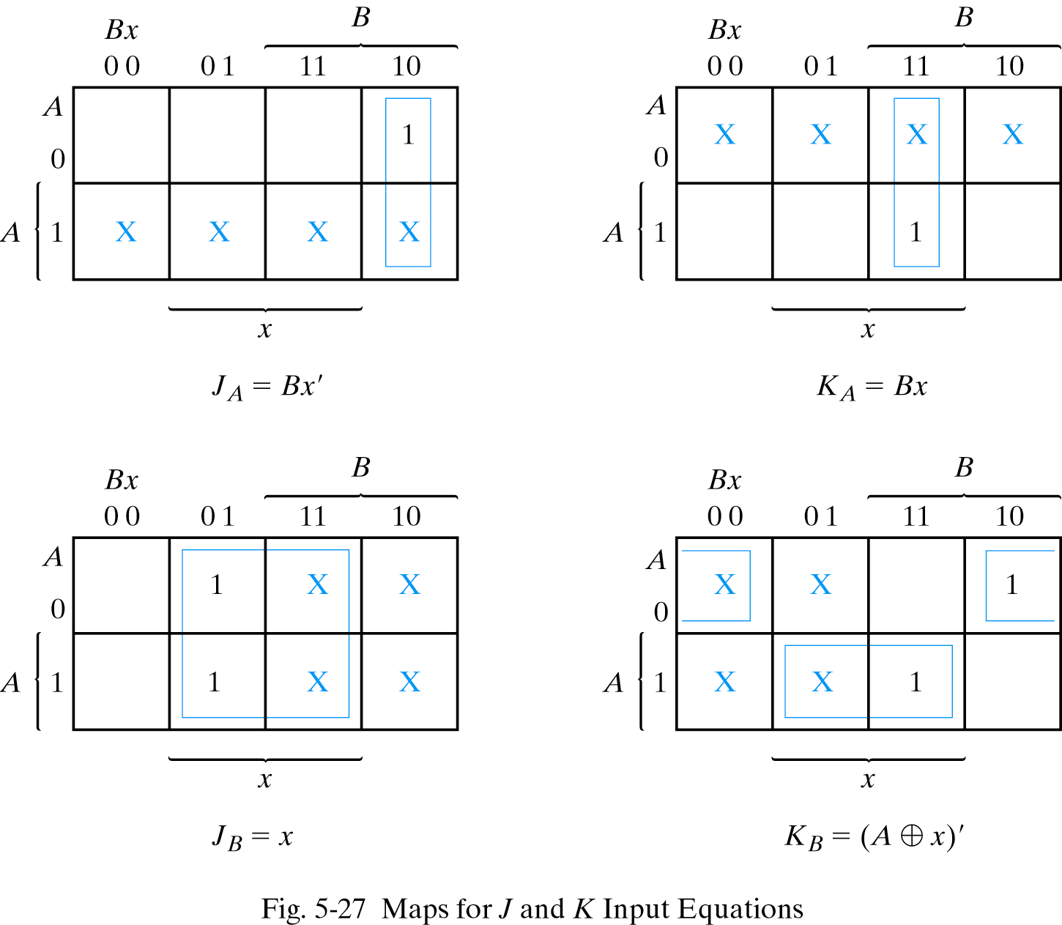
Using JK flip-flops (Contd.)

Slide 17
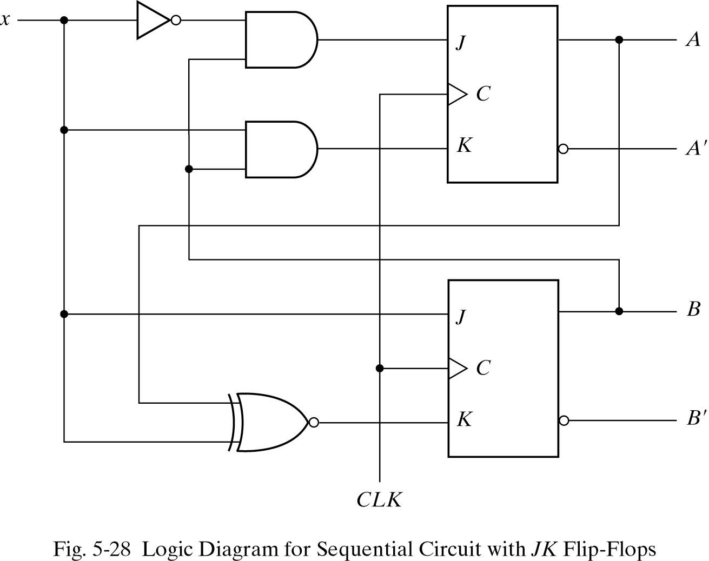
Using JK flip-flops (Contd.)
The logic diagram can be obtained from the input equations given above

Slide 18
Synthesizing using T flip-flops
Example: Consider a 3-bit binary counter shown in the diagram:
In fact the only input to the circuit is the clock and the output is the present state of the flip-flops.

Slide 19
Using T flip-flops (Contd.)
The state table for this example is as follows:

Slide 20
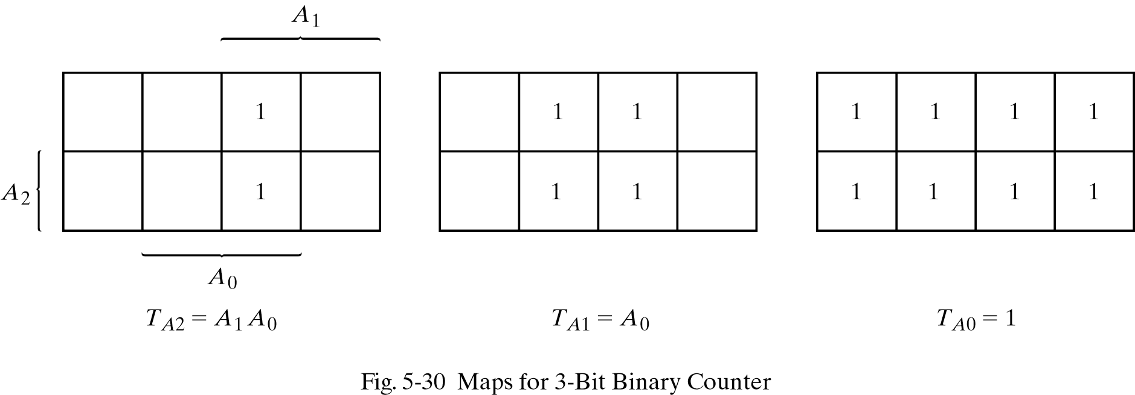
Using T flip-flops (Contd.)
The most efficient way to construct a binary counter is by using T flip-flops, because of their complement property.

Slide 21
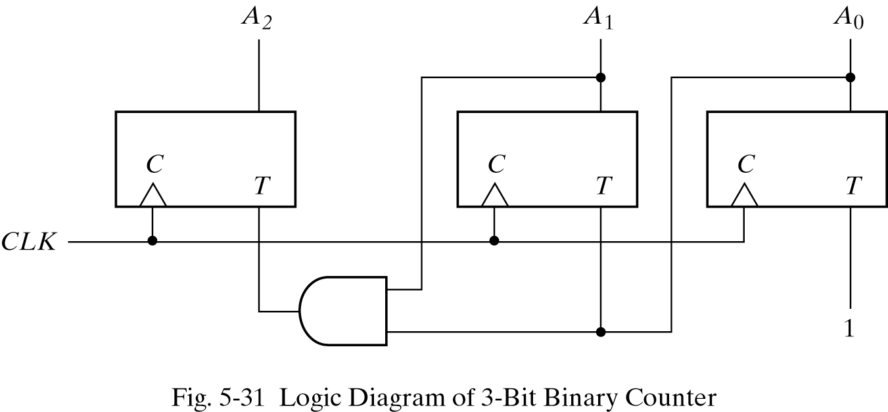
Using T flip-flops (Contd.)
Logic diagram of the counter:

Slide 22
Registers
A register is a memory device that can be used to store more than one bit of information.
A register is a circuit capable of storing data. In general, an n-bit register consists of n FFs, together with some other logic that allows simple processing of the stored data.
A register is a generalization of a flip-flop. Where a flip-flop stores one bit, a register stores several bits

Slide 23
Registers
The main operations on a register are the same as for any storage devices, namely:
  Load or Store: Put new data into the register
  Read: Retrieve the data stored in the register (usually without changing the stored data).

Slide 24
Registers
Types of transfer(load):
  Parallel transfer : When all bits of the register are loaded in the same time.
  Serial transfer: information is transferred one bit at a time.

Slide 25
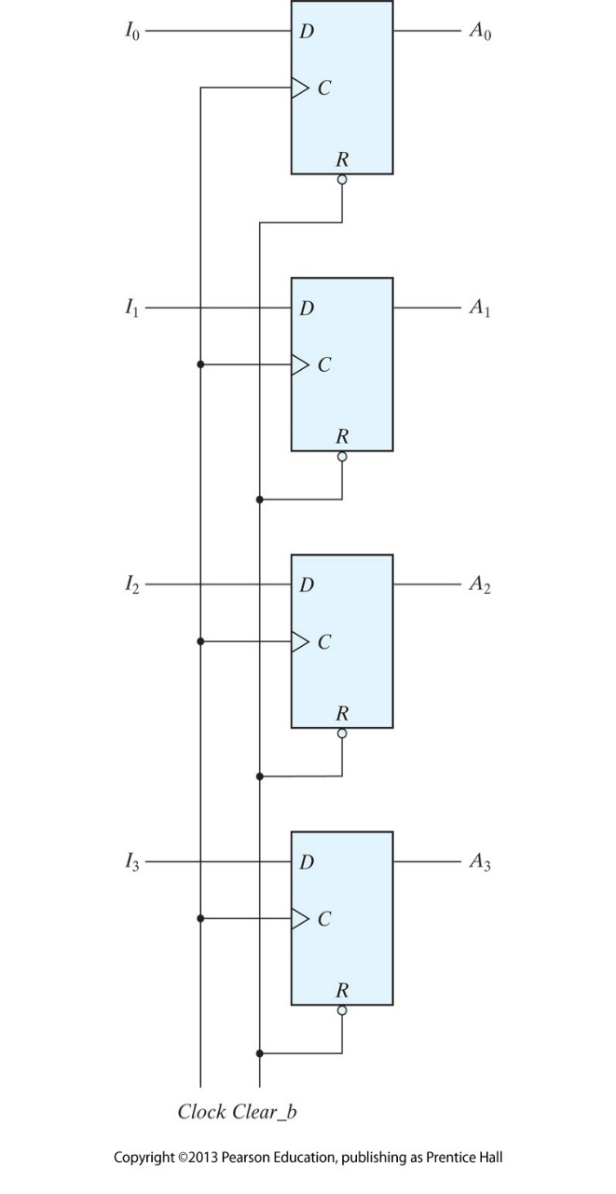
Registers
Figure shows one of the simplest register
  The clock input triggers FFs on positive edge.
  Four inputs are transferred into registers.
  The four outputs are to obtain the stored information.
  Clear_b is direct input to reset FFs.

Slide 26
Shift Registers
It is a register that can shift information in each cell to its neighboring cell.
It has chain of FF in cascade
  The output of one FF is connected to the input of the next FF.
Can be unidirectional(one direction) or bidirectional.

Slide 27
Shift Registers
This shift register is unidirectional (left‐to‐right). Each clock pulse shifts the contents of the register one bit position to the right. The configuration does not support a left shift
Serial input: determines what will go into the leftmost FF.
Serial output is taken from the output of the rightmost flip‐flop

Slide 28
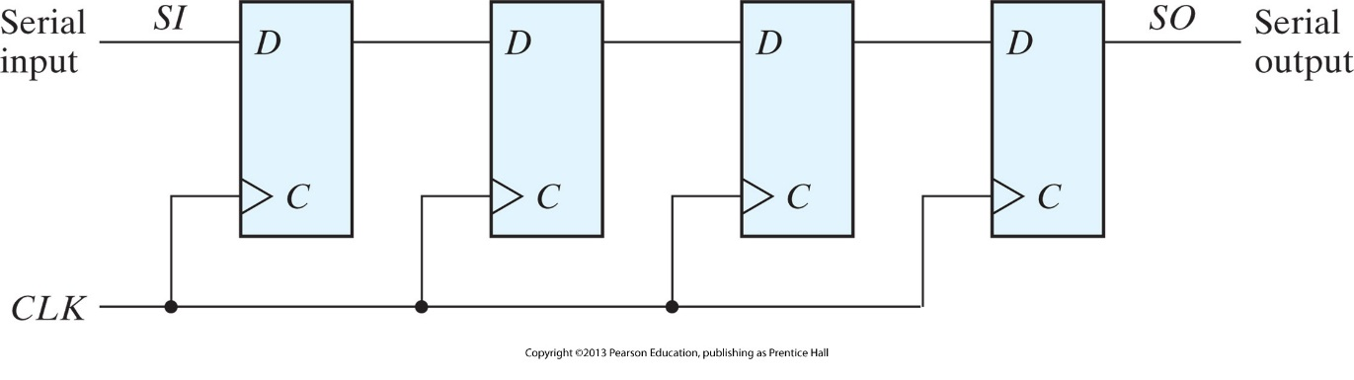
Shift Registers

Slide 29
Counters
It is a sequential circuit capable of incrementing and/or decrementing its contents
  Q ← Q plus n
  Q ← Q minus n
The definition of "plus" and "minus" depends on the way the register contents encode the integers
Binary Counters: Encode the integers with the binary number code
It is a register that goes through a predetermined sequence of binary states.

Slide 30
Counter
Counters
Counters categories:
  Ripple (Asynchronous) counters
    A FF output transition is a source for triggering other FFs.
  Synchronous counters:
    All FFs receives a common clock.

Slide 31
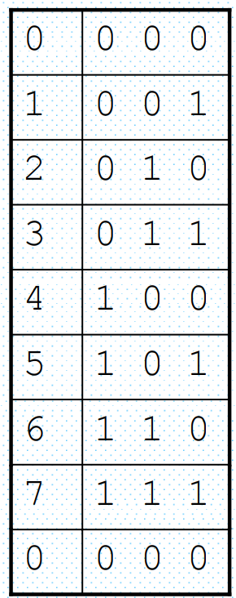
3-bit Binary Ripple Counter
Idea:
  to connect the output of one flip-flop to the C input of the next high-order flip-flop
We need “complementing” flip-flops
  We can use T flip-flops to obtain complementing flip-flops or
  JK flip-flops with its inputs are tied together or
  D flip-flops with complement output connected to the D input.

Slide 32
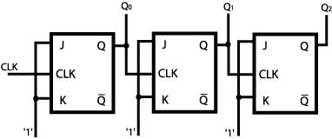
Asynchronous Counters 3-bit binary up counter

Slide 33
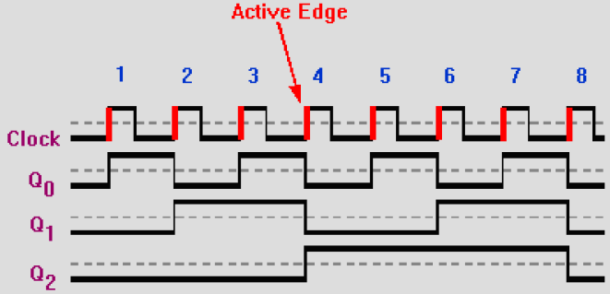

Slide 34
Synchronous Counters
A2 A1 A0
There is a common clock
  that triggers all flip-flops simultaneously
  If T = 0 or J = K = 0 the flip-flop does not change state.
  If T = 1 or J = K = 1 the flip-flop does change state.
Design procedure is so simple
  no need for going through sequential logic design process
  A0 is always complemented
  A1 is complemented when A0 = 1
  A 2 is complemented when A0 = 1 and A1 = 1
  so on

Slide 35
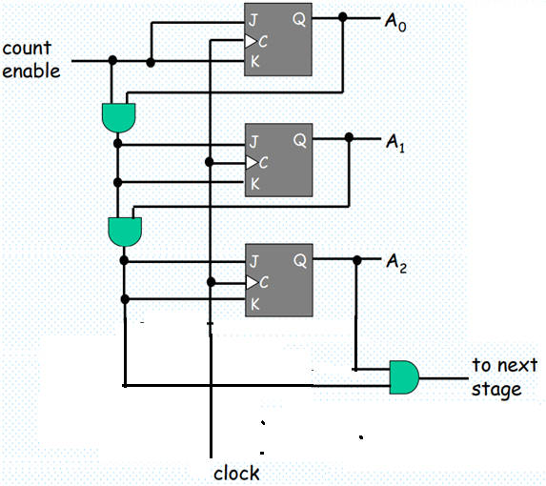
Synchronous Counters 3-bit binary up counter

Slide 36
End of lecture 10

