Slide 1


Integrated Marketing Communications
Prepared by Dr. Perihan Salah
MKT728
An Introduction to Integrated Marketing Communications
Lecture 2

Slide 2



Integrated Marketing Communications
Lecture 2
MKT728
The Role of IMC Planning Process
Prepared by
Dr. Perihan Salah

Slide 3

Chapter
02
LEARNING OBJECTIVES
Describe the role of advertising and promotion in an organization’s integrated marketing program.
Define target marketing.
Discuss the role of market segmentation in an IMC program.
Describe positioning and repositioning strategies.
Identify the marketing-mix decisions that influence advertising and promotional strategy.

Slide 4
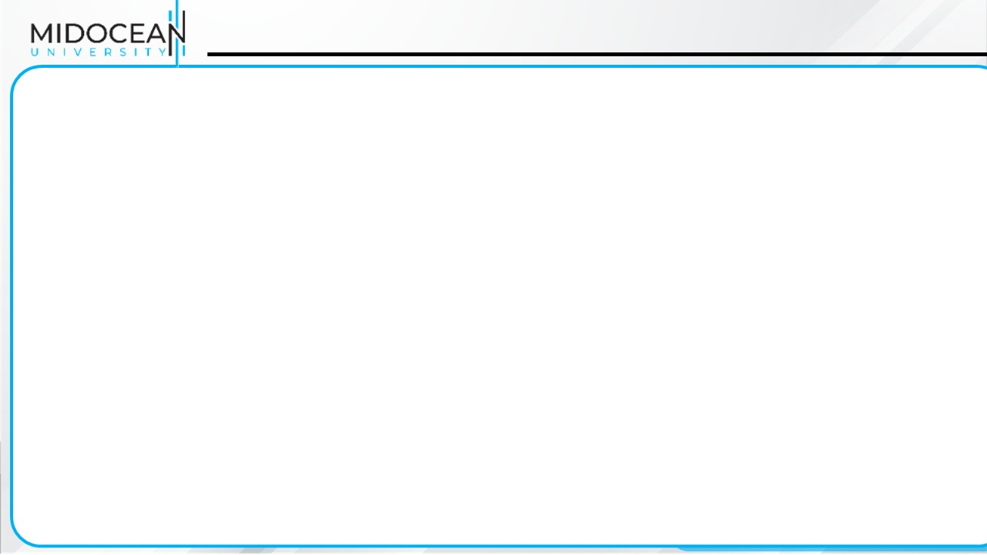
IMC Planning Model
Review of marketing plan
Analysis of promotional program situation and the communication process
Budget determination
Develop integrated marketing communications programs
Advertising
Direct
marketing
Digital/Internet
marketing
Sales
promotion
PR/publicity
Personal selling
Advertising
objectives
Direct-
marketing
objectives
Internet
marketing
objectives
Sales
promotion
objectives
PR/publicity
objectives
Personal-selling
objectives
Advertising
strategy
Direct-
marketing
strategy
Internet
marketing
strategy
Sales
promotion
strategy
PR/publicity
strategy
Personal-selling
strategy
Advertising
message &
media strategy
& tactics
Direct-
marketing
message &
media strategy
& tactics
Internet
message &
media strategy
& tactics
Sales promotion
message &
media strategy
& tactics
PR/publicity
message &
media strategy
& tactics
Sales message
strategy and
sales tactics
Integrate and implement marketing communications strategies
Monitor, evaluate, and control IMC Program
Notes:
Relation to Text:
This slide relates to page 31 of the text and Figure 1-7.
Summary Overview:
This slide presents the four major processes required of an IMC program for it to effectively communicate with target audiences.
Use of this Slide:
This slide can be used to explain to students that the Integrated Marketing Communications Plan provides the framework for developing, implementing, and controlling the IMC program. Those involved with the program must:
Decide on the role and function of the specific elements of the promotional mix
Develop strategies for each element
Determine how they will be integrated
Plan their implementation
Consider how to evaluate the results achieves, and
Make any necessary adjustments

Slide 5
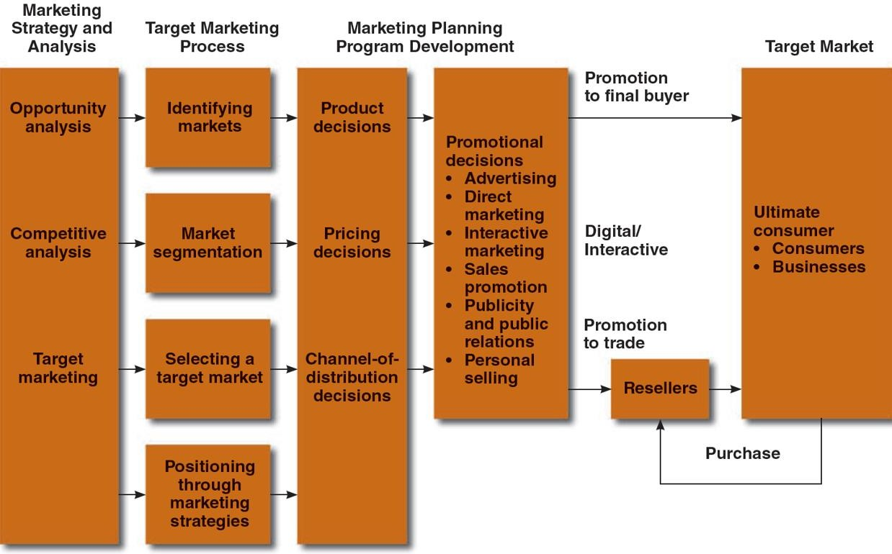
Marketing and Promotions Process Model

Slide 6
Marketing Strategy and Analysis
Strategic marketing plan:
  Guides allocation of organization’s resources
  Guides specific marketing programs and policies
  Evolves from an organization’s overall corporate strategy
  Allows for an understanding of market opportunities, competition, and market segments
    Market segments: distinct consumer groups within a market who have common needs

Slide 7
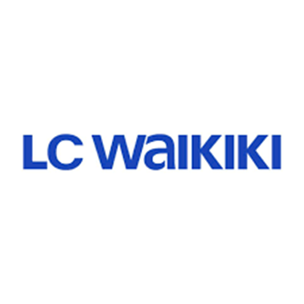
Opportunity Analysis
Market opportunities: Areas where:
  There are favorable demand trends
  Customers’ needs and opportunities are not being satisfied
  Firm can compete effectively
Steps to identify market opportunities
  Examine the marketplace
  Observe demand trends and competition in various market segments

Slide 8

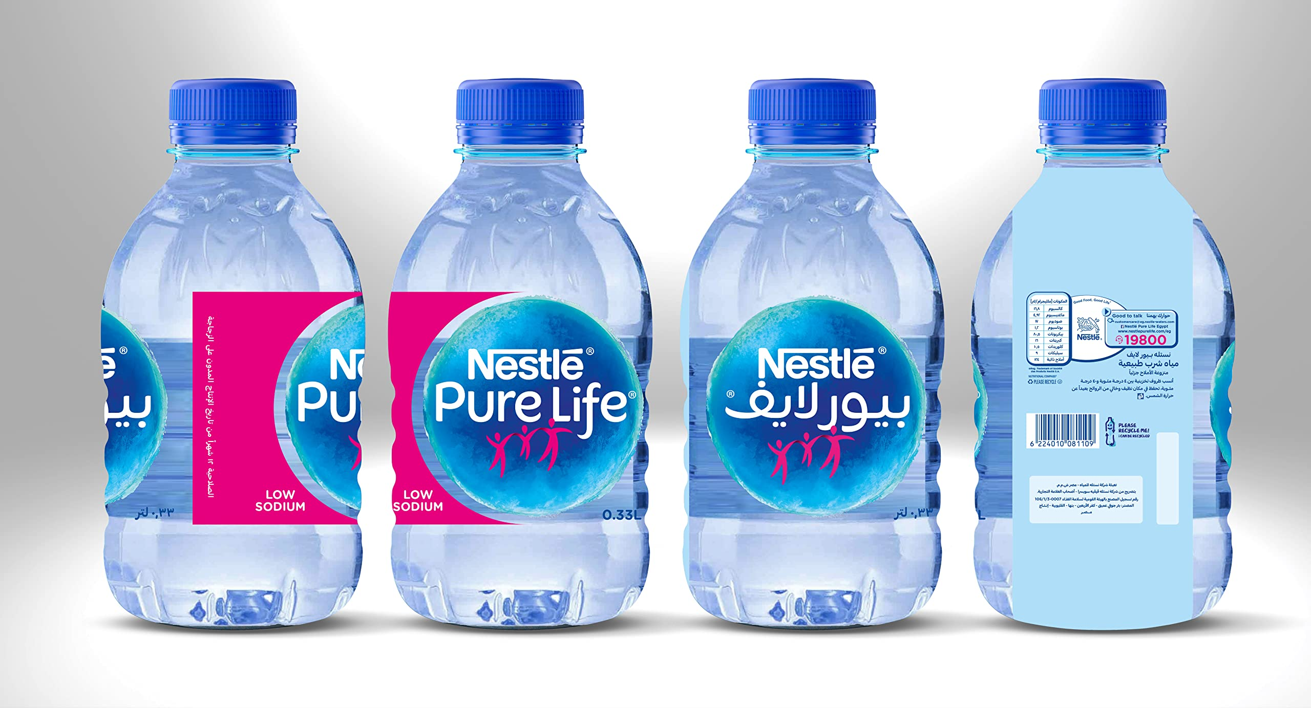
Competitive Analysis
Analyzing the competition in the marketplace and searching for a competitive advantage
  Competitive advantage: Attributes that give a firm an edge over competitors
    Better quality products
    Superior customer service
    Low production costs and lower prices
    Dominating channels of distribution
    Advertising

Slide 9
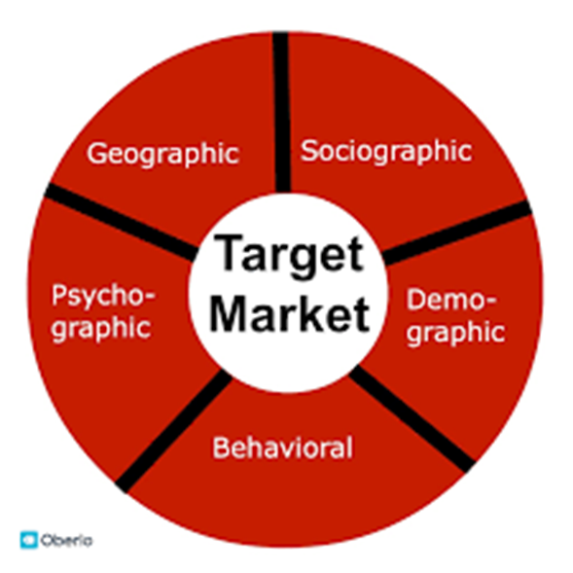
Target Market Selection
Done after evaluating market opportunities and doing a competitive analysis
Has direct implications on a firm’s advertising and promotional efforts

Slide 10
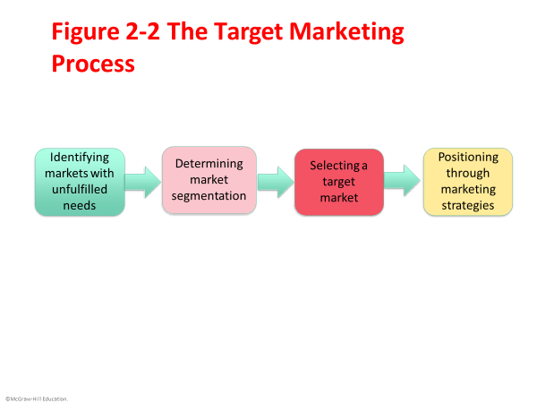
The Target Marketing Process

Slide 11
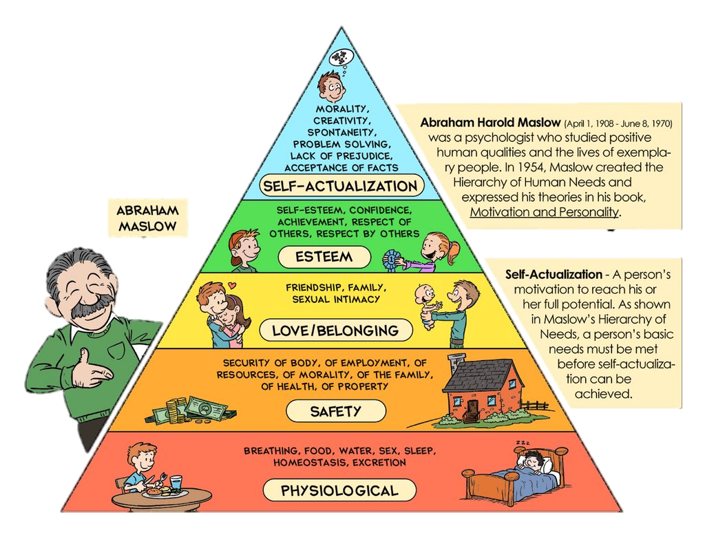
Maslow’s Hierarchy of Needs

Slide 12
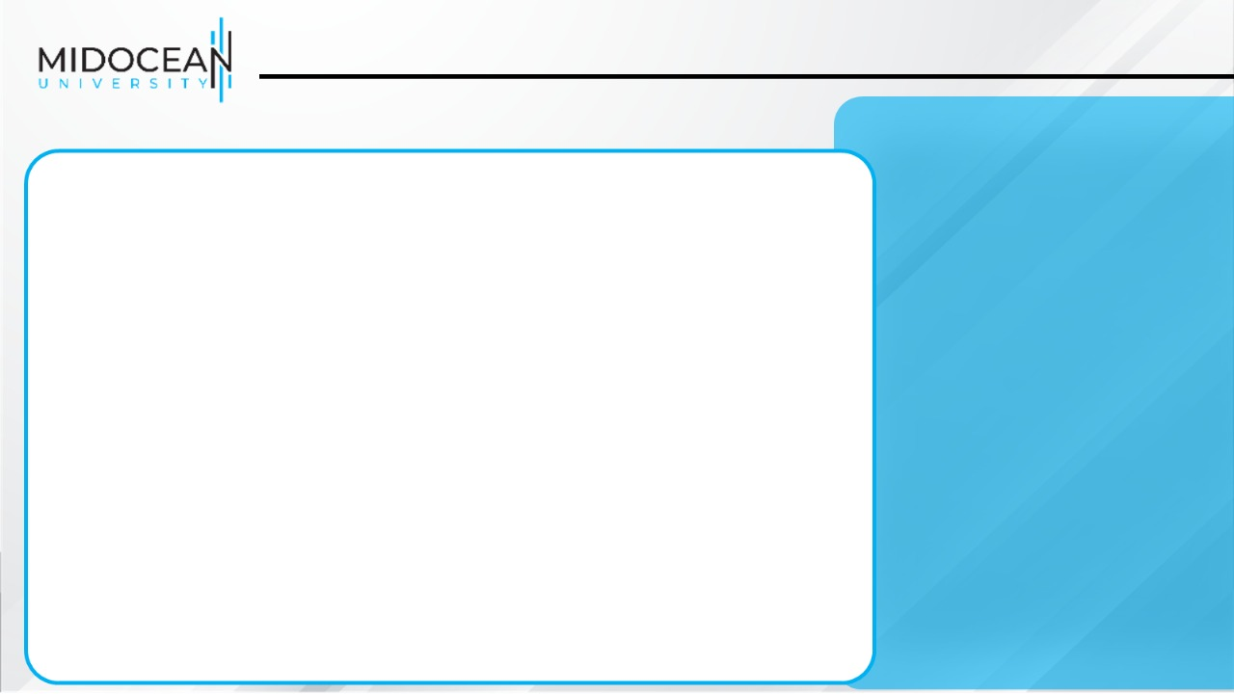
Identifying Markets
Marketer identifies the specific needs of groups of people (or segments)
Selects one or more of these segments as a target
Isolates consumers with similar lifestyles, needs, and the like
Increased marketer’s knowledge of consumers’ specific requirements

Slide 13

Market Segmentation
Dividing a market into distinct groups with common needs, who respond similarly to a marketing situation
Customer characteristics segmentation criteria
Geographic: Dividing the market on the basis of region, city size, metropolitan area, and/or density into different geographic units.
Demographic: Dividing the market on the basis of age, sex, family size, marital status, etc.

Slide 14
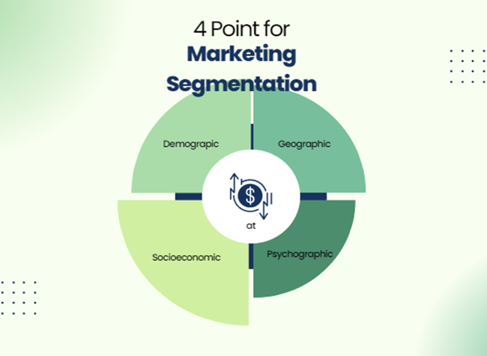
Market Segmentation
  Socioeconomic: Dividing the market on the basis of income, education, or occupation
  Psychographic: Dividing the market on the basis of personality, lifecycles, and/or lifestyles

Slide 15
Market Segmentation
Buying Situations
Markets can also be divided by customer buying situations
Buying situations segmentation criteria
  Outlet type
  Benefits sought
  Usage
  Awareness and intentions
  Behavior

Slide 16
Market Segmentation
Behavioristic segmentation
  Dividing consumers into groups according to their usage, loyalties, or buying responses to a product
  80-20 rule: 20 percent of buyers account for 80 percent of sales volume
Benefit segmentation
  Grouping of consumers on the basis of attributes sought in a product

Slide 17
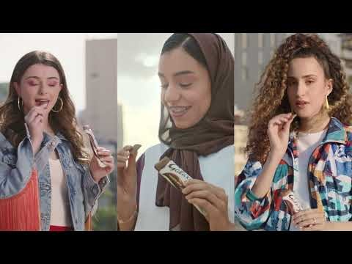

Slide 18
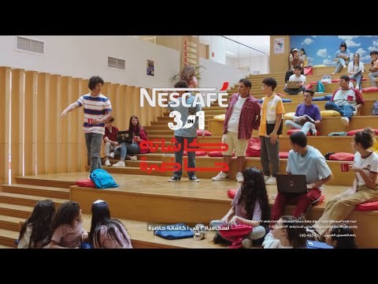

Slide 19


Slide 20
Selecting Target Market
Determine how many segments to enter
  Utilizing market coverage alternatives
Determine which segments offer the most potential
  Selecting the most attractive segment

Slide 21
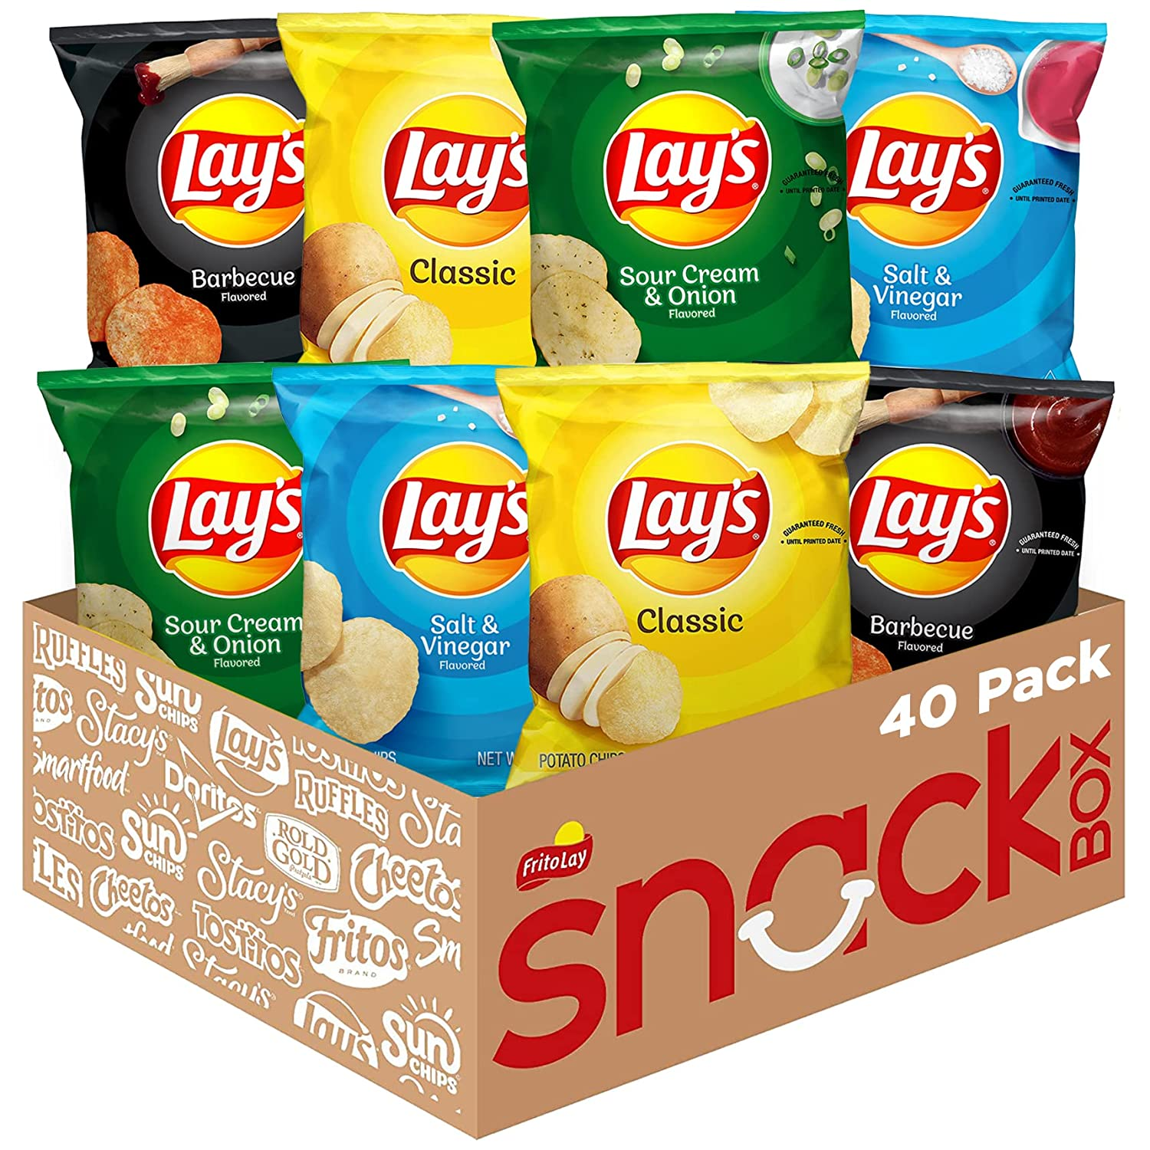
Market Coverage Alternatives
Undifferentiated marketing
  Ignoring segment differences and offering just one product or service to the entire market.
  (convenience products)

Slide 22
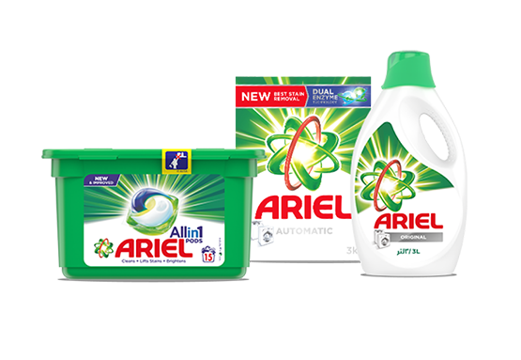
Market Coverage Alternatives
Differentiated marketing
  Involves marketing in a number of segments, developing separate marketing strategies for each

Slide 23

Market Coverage Alternatives
Concentrated marketing
  Selecting a segment and attempting to capture a large share of this market. (Niche market)

Slide 24


Slide 25

Selecting the Most Attractive Segment
Sales potential of segment
Opportunities for growth
Competition analysis
Ability to compete
Ability to market to this group

Slide 26
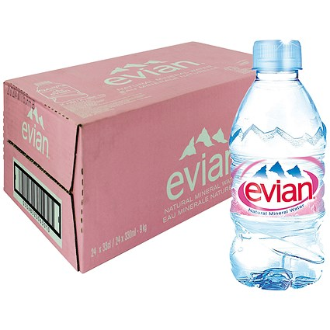
Market Positioning
Positioning: Fitting a product or service to one or more segments of the broad market to make it unique within the marketplace
Approaches
  Focusing on the consumer—
  Linking the product with the
  benefits the consumer will derive

Slide 27
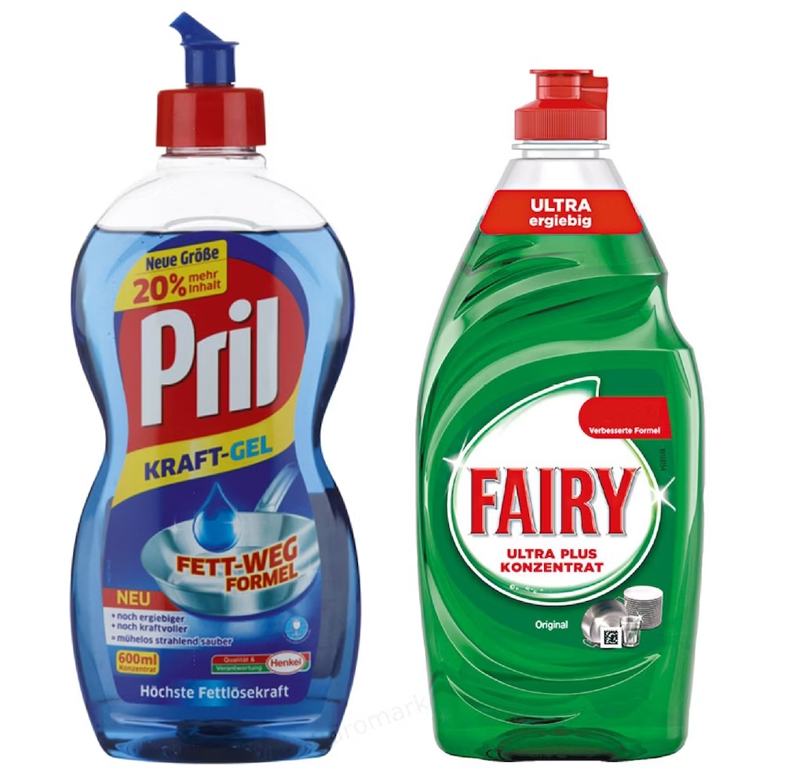
Market Positioning
  Focusing on competition—Positions the product by comparing the benefit it offers versus the competition

Slide 28
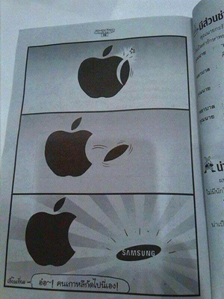
Positioning Strategies
Positioning by product attributes and benefits
  Sets the brand apart from competitors on the basis of specific characteristics or benefits offered
  Salient attributes: Important to consumers and are the basis for making a purchase decision

Slide 29





Slide 30
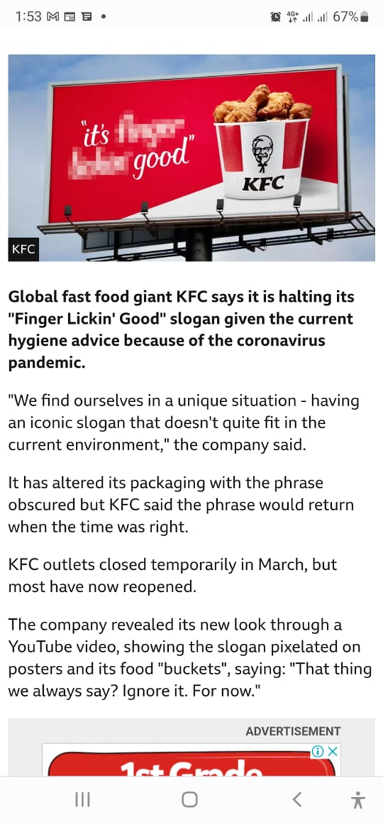



Market Positioning

Slide 31
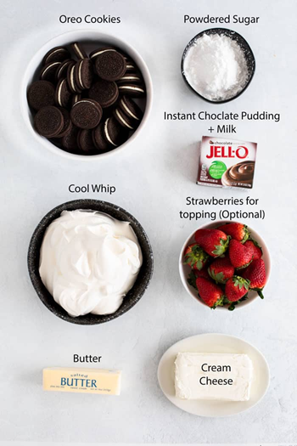


Positioning Strategies
Positioning by price/quality
  Done where cost comes secondary to quality
Positioning by use or application
  Used to enter a market on the basis
  of a particular use or application

Slide 32
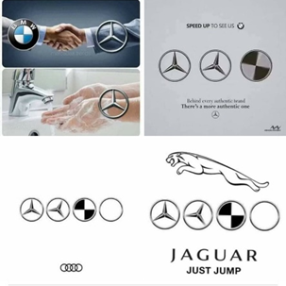

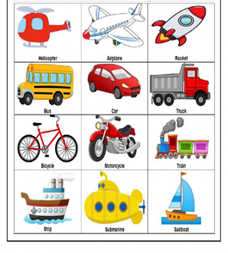


Positioning Strategies
Positioning by product class
Positioning by product user
Positioning by competitor
Positioning by cultural symbols
Makes the brand easily identifiable and differentiated from others

Slide 33
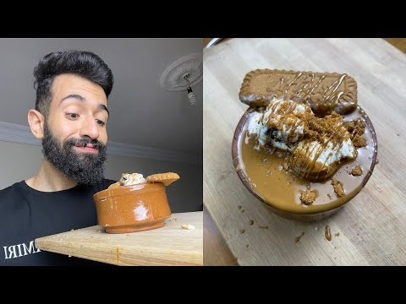

Slide 34


Slide 35
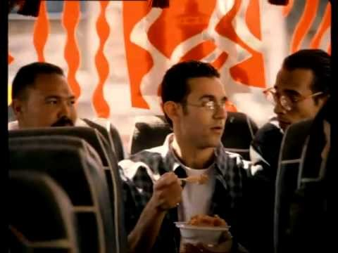
Positioning by usage occasion
Positioning by usage occasion

Slide 36

Positioning by cultural symbols

Slide 37


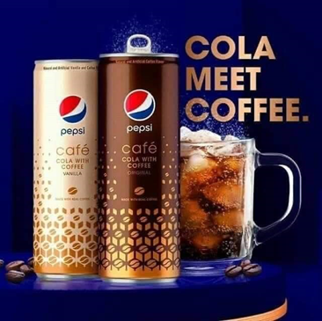
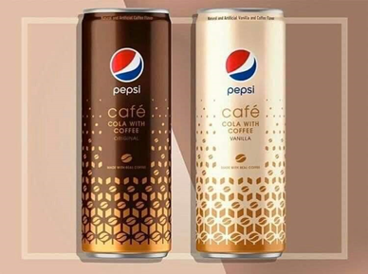
Repositioning
Altering a product’s or brand’s position due to:
  Declining or stagnant sales
  Anticipated opportunities in other market positions
Difficult to accomplish because of entrenched perceptions and attitudes toward the product or brand

Slide 38
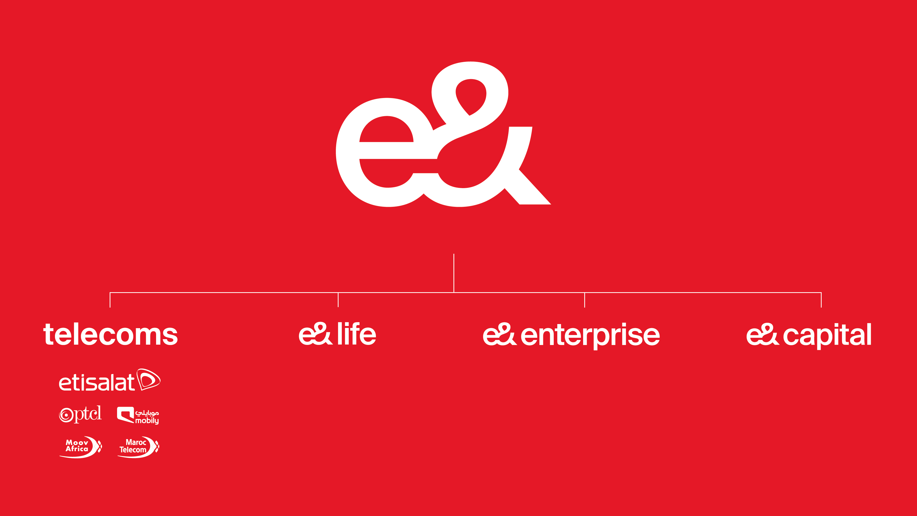

Repositioning

Slide 39
Product Decisions
Product symbolism: Refers to:
  What a product or brand means to consumers
  What consumers experience in purchasing and using a product
Branding
  Building and maintaining a favorable identity of the company and its products

Slide 40
Product Decisions
Packaging
  Provides functional benefits such as economy, protection, and storage
Builds and maintains brand awareness and interest
Develops and enhances attitudes toward the company or product
Builds relationships between the consumer and the brand

Slide 41
Branding
Brand identity
  Combination of name, logo, symbols, design, packaging, image, and associations held by consumers
Brand equity
  Intangible asset of added value

Slide 42
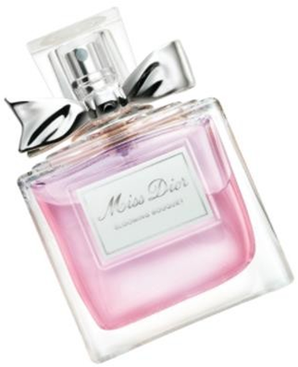
Packaging
Traditionally, the package provided functional benefits:
economy, protection, and storage
Role and function have changed due to:
  Self-service emphases of many stores
  More buying decisions at point of purchase
First impressions matter
  Often first exposure to product

Slide 43

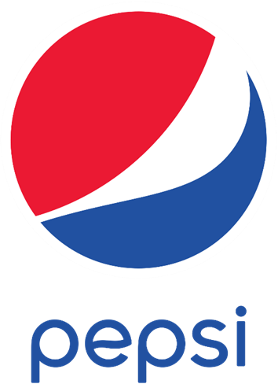

Price Decisions
Price variable—Refers to what the consumer
has to give in exchange for a purchase
Factors that determine price
  Costs
  Demand factors
  Competition
  Perceived value
  Product quality
  Advertising

Slide 44
Marketing Channels
Interdependent organizations involved in making a product or service available for use
Direct channels: Directly deal with customers
  Driven by direct-response ads, telemarketing, the Internet
  Used when selling expensive and complex products
Indirect channels: Network of wholesalers and/or retailers

Slide 45
Promotional Push Strategies
Programs designed to persuade the trade to stock, merchandise and promote a manufacturer’s products
Goal
– Push the product through the channels of distribution by selling and promoting it
Trade advertising: Used to motivate wholesalers and retailers to purchase products for resale

Slide 46
Promotional Pull Strategies
Spending money on advertising and sales promotion efforts directed toward the ultimate consumer
Goals
  Create demand among consumers
  Encourage consumers to request the product from the retailer

Slide 47

We described the role of advertising and promotion in an organization’s integrated marketing program.
We defined target marketing.
We discussed the role of market segmentation in an IMC program.
We described positioning and repositioning strategies.
We identified the marketing-mix decisions that influence advertising and promotional strategy.
To Sum Up…
Chapter
02

Slide 48

Thank You
Dr. Perihan Salah

