Slide 1


Data Preparation I (Cleaning & Preprocessing)
Prepared by Dr. Sumaya Alkubaisi
FNT633
Machine Learning in Finance
Lecture 2

Slide 2
Learning Goals
By the end of this lecture, students will be able to:
Understand data cleaning & preprocessing concepts
Retrieve data from CSV, JSON, SQL databases, APIs
Handle missing values, outliers, and inconsistent data
Implement cleaning techniques in Python Jupyter

Slide 3
Why Data Preparation Matters
1. Garbage in → Garbage out
Machine learning models can only be as good as the data they learn from.
If the data is messy, incomplete, or wrong, the model will make poor predictions.
Think of it like cooking: if you use spoiled ingredients, the dish will not taste good no matter how skilled the chef is.
2. Most of the work is in preparing the data
Around 80% of the effort in a machine learning project goes into cleaning and organizing data.
This includes removing errors, filling missing values, standardizing formats, and making sure the data is consistent.
Skipping this step can make all the time spent on modeling useless.

Slide 4
Why Data Preparation Matters
Example: Loan dataset
Suppose we have a dataset of loan applicants, but many entries are missing the income field.
If we train a model on this incomplete data, it might misclassify applicants:
Someone with a high income might be flagged as risky.
Someone with low income might be approved incorrectly.
Cleaning the data by filling missing income values or removing incomplete records improves the model’s predictions.
Summary
Good data preparation ensures accuracy, reliability, and fairness in machine learning.
Skipping this step can lead to wrong decisions and lost trust in your models.

Slide 5
Data Science Life Cycle Context
Collect → Prepare → Analyze → Evaluate → Deploy
For today: Prepare = Preprocessing + Cleaning
1.Preprocessing
Transforming the data into a format that a machine learning model can understand.
Example: Converting text labels (“Yes”/“No”) into numbers (1/0), scaling values, or encoding categories.
2.Cleaning (subset of preprocessing)
Fixing problems in the data, such as missing values, duplicates, or errors.
Example: If a dataset has missing income values, we might fill them in or remove those rows.

Slide 6
Data Cleaning: Key Steps
Identify missing values.
Detect and handle outliers.
Correct inconsistent data formats.
Remove duplicates.
Normalize data ranges.

Slide 7
Definition of Data Cleaning
Data cleaning is the process of finding and fixing problems in your dataset so it is correct and usable.
Dirty or messy data can confuse machine learning models, leading to wrong results.
Tasks include:
Missing values – some data points are empty or not reported.
Outliers – values that are unusually high or low compared to the rest.
Duplicates – repeated rows or records in the dataset.
Wrong formats – inconsistent ways of writing dates, numbers, or categories.

Slide 8
Why Cleaning is Important
Accuracy: Clean data ensures the model predicts correctly.
Efficiency: Models train faster when there’s no noise or errors.
Trust: Stakeholders and decision-makers can rely on the results.
Ethics: Reduces bias and error, and prevents unfair decisions, especially in finance (e.g., loan approvals).
Saves time and resources in later analysis.

Slide 9
Common Errors in Financial Data
Duplicates: Same transaction recorded more than once → could inflate totals.
Inconsistencies: Different ways of writing currency (USD, $, US$) → causes confusion in calculations.
Missing values: Some fields like income or credit history might be empty → affects predictions.
Wrong formats: Dates written differently (“2025/18/09” vs “2025-09-18”) → model may fail to read them.

Slide 10
Real Finance Example
Dataset: Loan applications from a bank.
Problems:
30% of applicants missing income information.
Some entries show negative age values (impossible).
Solution:
Clean the data – detect missing and wrong entries.
Impute missing values – fill in missing income with an average or estimated value.
Remove invalid entries – delete impossible values like negative age.
Result: The dataset becomes reliable for predicting loan approvals.

Slide 11
Consequences of Poor Cleaning
Wrong risk predictions: Bank might approve high-risk applicants or reject safe ones.
Example: A bank’s loan dataset has missing income data. A model predicts a high-income applicant as low-income due to missing values. The bank wrongly rejects a reliable borrower or approves someone who might default.
Fraud detection failures: Duplicate or inconsistent data can hide suspicious activity.
Example: A dataset has duplicate transactions from a credit card. Fraud detection software ignores them as normal activity. A fraudster can charge the same amount multiple times without being flagged.
Incorrect investment signals: Poor data may mislead analysts into making bad financial decisions.
Example: A stock trading dataset records prices in different formats (USD, $). An algorithm misreads them, seeing a stock price as $1000 instead of $10. Analysts get false signals and may make bad investment decisions, like buying or selling at the wrong time.

Slide 12
Retrieving & Inspecting Data
Sources of Financial Data
CSV and JSON files – e.g., stock prices, transactions.
Databases – e.g., customer bank records.
APIs – e.g., stock market API, financial services.
Cloud sources – scalable and secure storage.

Slide 13
Python setup
For lab activity, we will be using the following libraries:
pandas for managing the data.
numpy for mathematical operations.
seaborn for visualizing the data.
matplotlib for visualizing the data.
sklearn for machine learning and machine-learning-pipeline related functions.
scipy for statistical computations.

Slide 14
Demo Lab1: Reading CSV in Python
import pandas as pd
# Reading a CSV file
loans = pd.read_csv("loan_data.csv")
print(loans.head())
# Reading a JSON file
transactions = pd.read_json("transactions.json")
print(transactions.head())

Slide 15
Demo Lab2: Reading CSV in Python
import pandas as pd
# Example: Loan dataset
data = {
"age": [25, 40, None, 35, -5],
"salary": [50000, 60000, 55000, None, 45000],
"loan_amount": [20000, 25000, 22000, 18000, 30000],
"default": ["No", "Yes", "No", "No", "Yes"]
}
loans = pd.DataFrame(data)
print(loans)

Slide 16
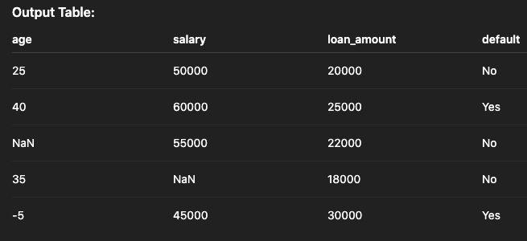
Understanding Data Issues
From the example dataset, notice:
Missing Values: age (row 3), salary (row 4).
Outlier/Wrong Value: age = -5 (not realistic).
Target Variable: default (Yes/No).
These issues must be fixed before analysis or ML modeling.

Slide 17
Reading & understanding our dataset : (Inspecting the Dataset)
# Basic info
loans.info()
# Summary statistics
loans.describe()
info() → column types, non-null counts
describe() → mean, std, min, max, quartiles
Helps identify missing values and suspicious entries (e.g., negative age)

Slide 18
Reading & understanding our dataset : (Checking for Duplicates and Unique Index)
# Check duplicates
print(loans.duplicated())
# Drop duplicates if any
loans = loans.drop_duplicates()
# Check if index is unique
print(loans.index.is_unique)
Ensures dataset is clean and unique before ML
Important for financial datasets to avoid double counting loans

Slide 19
Demo Lab: Checking Missing Values
# Check for missing values
print(loans.isnull().sum())
Output:
age → 1 missing
salary → 1 missing
isnull():Checks each value in the DataFrame to see if it is missing (i.e., NaN in Python).
Output: True where the value is missing and False where it is not.
sum(): When applied to a DataFrame of boolean values, sum() treats True as 1 and False as 0, and counts how many missing values there are in each column.

Slide 20
Sorting and Inspecting Extreme Values
# Count missing values per column
print(loans.isnull().sum().sort_values())
# Top 2 largest loans
print(loans.sort_values(by='loan_amount', ascending=False)[:2])
# Top 2 highest salaries
print(loans.sort_values(by='salary', ascending=False)[:2])
sort_values(): Shows missing values sorted from least to most.
-Helps prioritize cleaning steps (age & salary)
-Useful to identify extreme values or outliers

Slide 21
Demo Lab: Handling Missing Values
# Option 1: Drop missing values
loans_drop = loans.dropna()
# Option 2: Fill with mean
loans_fill = loans.copy()
loans_fill["age"].fillna(loans_fill["age"].mean(), inplace=True)
loans_fill["salary"].fillna(loans_fill["salary"].mean(), inplace=True)
dropna():Removes rows (or columns) that have missing values (NaN). A smaller dataset, but no missing values.
fillna():Replaces missing values with a specified value (like mean, median, 0, or a custom value).
In finance: Missing salary can be replaced with average salary of customers.

Slide 22
Demo Lab: Handling Missing Values
#Filling Missing Values: Categorical
# If default had missing values, fill with mode
loans["default"].fillna(loans["default"].mode()[0], inplace=True)
mode()→ finds the most frequent value (mode) in the default column.
mean() → calculates the average value of a column.

Slide 23
Demo Lab: Handling Wrong / Outlier Values
# Detect outliers (z-score method)
z_scores=np.abs(stats.zscore(loans_fill[["age","salary","loan_amount"]]))
# Replace negative ages with median age
loans_clean = loans_fill.copy()
loans_clean.loc[loans_clean["age"] < 0, "age"] = loans_fill["age"].median()
Z-scores(): Measures how far a value is from the mean in terms of standard deviations.
Large absolute z-scores (commonly > 3) indicate outliers (negative age → high z-score).
Median: The middle value of a dataset when sorted.
Example: For [10, 20, 30], median = 20
Less affected by outliers than the mean.

Slide 24
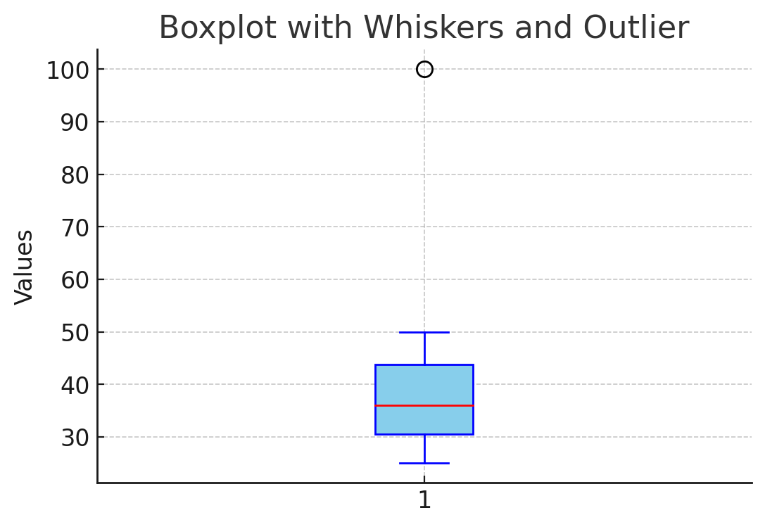
Demo Lab: Handling Outlier (Visualizing Outliers)
!pip install seaborn
import seaborn as sns
import matplotlib.pyplot as plt
# Boxplot for numeric columns (Creates a boxplot for age to visualize its spread and outliers)
sns.boxplot(x=loans["age"])
plt.title("Age Distribution & Outliers")
plt.show()
Boxplot: A graphical way to see the distribution of
numeric data.
Shows: Median (middle line), Quartiles (box edges),
Outliers (points outside the whiskers)

Slide 25
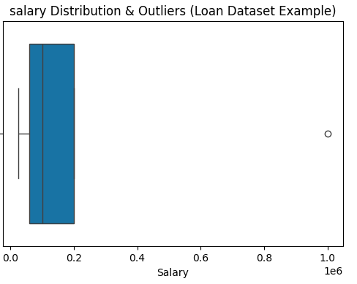
Demo Lab: Handling Outlier (Visualizing Outliers)
sns.boxplot(x=loans["salary"])
plt.title("Salary Distribution & Outliers")
Boxplots make it easy to see the center,
spread, and unusual values in numeric columns.
x=column in sns.boxplot(): Specifies which column of your DataFrame to plot on the x-axis.
Plots the age column along the x-axis.
If you use y=column, it would plot the values vertically instead.
In short: x= tells Seaborn which data to visualize horizontally.

Slide 26
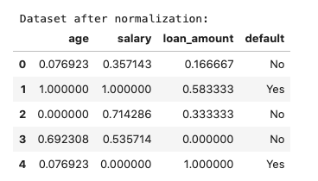
Normalizing Data
from sklearn.preprocessing import MinMaxScaler
scaler = MinMaxScaler()
loans[["age","salary","loan_amount"]] = scaler.fit_transform(loans[["age","salary","loan_amount"]])
print(loans)
MinMaxScaler():
Scales numeric features between 0–1
Essential for ML algorithms (SVM, KNN)

Slide 27
Lab Activity: Data preparation 1
# =========================
# Lecture 2 Demo: Data Preparation I
# =========================
# Approved libraries
import pandas as pd
import numpy as np
import seaborn as sns
import matplotlib.pyplot as plt
from sklearn.preprocessing import MinMaxScaler
from scipy import stats
%matplotlib inline

Slide 28
Lab Activity: Data preparation 1
# -------------------------
# 1. Create loan dataset
# -------------------------
data = {
"age": [25, 40, None, 35, -5],
"salary": [50000, 60000, 55000, None, 45000],
"loan_amount": [20000, 25000, 22000, 18000, 30000],
"default": ["No", "Yes", "No", "No", "Yes"]
}
loans = pd.DataFrame(data)
print("Original Dataset:")
display(loans)

Slide 29
Lab Activity: Data preparation 1
# -------------------------
# 2. Inspecting the dataset
# -------------------------
print("\n--- Info ---") print(loans.info())
print("\n--- Describe ---") print(loans.describe().round(3))
print("\n--- Check for duplicates ---") print(loans.duplicated())
loans = loans.drop_duplicates()
print("After dropping duplicates:")
display(loans)
print("\n--- Check if index is unique ---") print(loans.index.is_unique)

Slide 30
Lab Activity: Data preparation 1
# -------------------------
# 3. Checking missing values
# -------------------------
print("\n--- Missing Values ---")
print(loans.isnull().sum().sort_values())
# Visualize missing data
sns.heatmap(loans.isnull(), cbar=False, cmap="viridis")
plt.title("Missing Values in Loan Dataset")
plt.show()

Slide 31
Lab Activity: Data preparation 1
# -------------------------
# 4. Inspecting extreme values
# -------------------------
print("\n--- Top 2 largest loan amounts ---")
print(loans.sort_values(by='loan_amount', ascending=False)[:2])
print("\n--- Top 2 highest salaries ---")
print(loans.sort_values(by='salary', ascending=False)[:2])

Slide 32
Lab Activity: Data preparation 1
# -------------------------
# 5. Handling missing values
# -------------------------
# Numeric columns
loans["age"].fillna(loans["age"].mean(), inplace=True)
loans["salary"].fillna(loans["salary"].median(), inplace=True)
# Categorical column (if any missing, not in this case)
loans["default"].fillna(loans["default"].mode()[0], inplace=True)
print("\nDataset after filling missing values:")
display(loans)

Slide 33
Lab Activity: Data preparation 1
# -------------------------
# 6. Detecting outliers (Z-score method)
# -------------------------
numeric_cols = ["age", "salary", "loan_amount"]
z_scores = np.abs(stats.zscore(loans[numeric_cols]))
print("\n--- Z-scores ---")
display(pd.DataFrame(z_scores, columns=numeric_cols))

Slide 34
Lab Activity: Data preparation 1
# -------------------------
# 7. Treating outliers
# -------------------------
# Replace negative ages with median
median_age = loans["age"].median()
loans.loc[loans["age"] < 0, "age"] = median_age
# Cap salary outliers (95th percentile)
upper_salary = loans["salary"].quantile(0.95)
loans["salary"] = np.where(loans["salary"] > upper_salary, upper_salary, loans["salary"])
print("\nDataset after treating outliers:")
display(loans)

Slide 35
Lab Activity: Data preparation 1
# -------------------------
# 8. Visualizing cleaned data
# -------------------------
# Boxplots for numeric columns
for col in numeric_cols:
sns.boxplot(x=loans[col])
plt.title(f"{col} Distribution & Outliers")
plt.show()

Slide 36
Lab Activity: Data preparation 1
# Pairplot for relationships
sns.pairplot(loans, hue="default")
plt.show()
# -------------------------
# 9. Normalizing numeric columns
# -------------------------
scaler = MinMaxScaler()
loans[numeric_cols] = scaler.fit_transform(loans[numeric_cols])
print("\nDataset after normalization:")
display(loans)

Slide 37
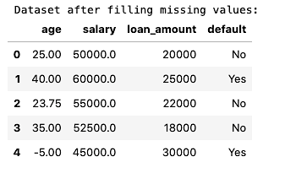
Example of Demo Output
Dataset after filling missing values
Filled missing values with mean (numeric) and mode (categorical).

Slide 38
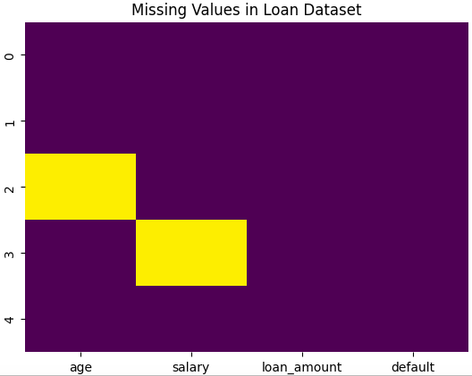
Example of Demo Output
This heatmap provides a visual overview of missing values in the loan dataset, making data cleaning decisions easier.
Helps decide whether to drop or fill missing values.

Slide 39
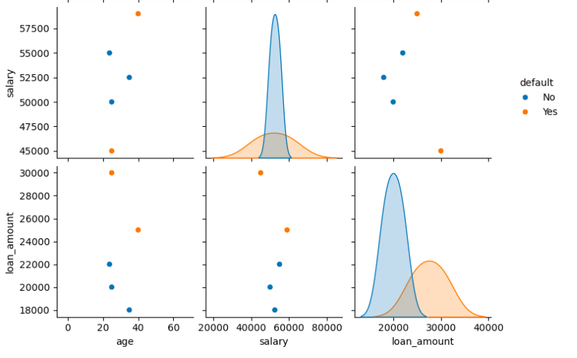
Example of Demo Output
Orange color = people who defaulted.
Blue color = people who did not default.
Look at each scatterplot → do the colors mix together or do they separate?
If they separate → those variables help predict default.
If they mix → no strong relationship.

Slide 40
What this demo does?
Creates a loan dataset with missing and wrong values.
Uses info(), describe(), duplicated(), index.is_unique, isnull().sum().sort_values() for inspection.
Visualizes missing values with a heatmap.
Handles missing numeric and categorical values.
Detects outliers with z-scores.
Treats outliers (negative age → median, salary → capped at 95th percentile).
Visualizes the cleaned dataset with boxplots and pairplots.
Normalizes numeric columns with MinMaxScaler for ML readiness.

Slide 41
Recap: Data Preparation I
Data cleaning ensures accuracy, consistency, and reliability of financial datasets.
We covered how to:
Retrieve data from CSV, JSON, SQL databases, APIs, and cloud sources.
Inspect datasets with info(), describe(), duplicated(), isnull().sum().
Handle missing values using mean, median, mode, and categorical imputation.
Detect and treat outliers (negative values, z-score, capping).
Remove or merge duplicates.
Apply sorting and indexing for better data quality control.
Normalize features with MinMaxScaler for ML readiness.
Cleaned data is the foundation for trustworthy machine learning models in finance.

Slide 42
References
Han, J., Kamber, M., & Pei, J. (2011). Data Mining: Concepts and Techniques. Morgan Kaufmann.
Géron, A. (2019). Hands-On Machine Learning with Scikit-Learn, Keras, and TensorFlow. O’Reilly Media.
Provost, F., & Fawcett, T. (2013). Data Science for Business. O’Reilly Media.
Kuhn, M., & Johnson, K. (2013). Applied Predictive Modeling. Springer.
McKinney, W. (2017). Python for Data Analysis: Data Wrangling with Pandas, NumPy, and IPython. O’Reilly.
VanderPlas, J. (2016). Python Data Science Handbook. O’Reilly.
Articles from IEEE Xplore and Springer on data preprocessing in financial machine learning.

Slide 43
Thank you!
Thank You

