Slide 1


Natural Language
Processing (AI615)
Prepared by Dr. Ashraf Elsayed
Lecture 3

Slide 2



Language Modeling
Lecture 3
Prepared by
Dr. Ashraf Elsayed
www.midocean.ae

Slide 3
The objectives of this lecture is to:
Understand Language Modeling
Define and explain Estimating N-gram Probabilities
Understand Evaluation and Perplexity
Understand Smoothing: Add-one (Laplace) smoothing
www.midocean.ae

Slide 4
Introduction to Language Models
www.midocean.ae

Slide 5
Probabilistic Language Modeling
Goal: compute the probability of a sentence or sequence of words:
  P(W) = P(w₁,w₂,w₃,w₄,w₅…w_{n})
Related task: probability of an upcoming word:
  P(w₅|w₁,w₂,w₃,w₄)
A model that computes either of these:
  P(W) or P(w_{n}|w₁,w₂…w_{n-1})
  is called a language model.
www.midocean.ae

Slide 6
How to compute P(W)
How to compute this joint probability:
  P(its, water, is, so, transparent, that)
Intuition: let’s rely on the Chain Rule of Probability
www.midocean.ae

Slide 7
Reminder: The Chain Rule
Recall the definition of conditional probabilities
  p(B|A) = P(A,B)/P(A) Rewriting: P(A,B) = P(A)P(B|A)
More variables:
  P(A,B,C,D) = P(A)P(B|A)P(C|A,B)P(D|A,B,C)
The Chain Rule in General
P(x₁,x₂,x₃,…,x_{n}) = P(x₁)P(x₂|x₁)P(x₃|x₁,x₂)…P(x_{n}|x₁,…,x_{n-1})
www.midocean.ae

Slide 8
The Chain Rule applied to compute joint probability of words in sentence
P(“its water is so transparent”) =
P(its) × P(water|its) × P(is|its water)
× P(so|its water is) × P(transparent|its water is so)
…
…
www.midocean.ae

Slide 9
How to estimate these probabilities
Could we just count and divide?
No! Too many possible sentences!
We’ll never see enough data for estimating these
www.midocean.ae

Slide 10
Markov Assumption
Simplifying assumption:
Or maybe
www.midocean.ae

Slide 11
Markov Assumption
In other words, we approximate each component in the product
…
…
…
…
www.midocean.ae

Slide 12
Simplest case: Unigram model
…
Some automatically generated sentences from a unigram model
fifth, an, of, futures, the, an, incorporated, a, a, the, inflation, most, dollars, quarter, in, is, mass
thrift, did, eighty, said, hard, 'm, july, bullish
that, or, limited, the
www.midocean.ae

Slide 13
Bigram model
Condition on the previous word:
…
texaco, rose, one, in, this, issue, is, pursuing, growth, in, a, boiler, house, said, mr., gurria, mexico, 's, motion, control, proposal, without, permission, from, five, hundred, fifty, five, yen
outside, new, car, parking, lot, of, the, agreement, reached
this, would, be, a, record, november
www.midocean.ae

Slide 14
N-gram models
We can extend to trigrams, 4-grams, 5-grams
In general this is an insufficient model of language
  because language has long-distance dependencies:
  “The computer which I had just put into the machine room on the fifth floor crashed.”
But we can often get away with N-gram models
www.midocean.ae

Slide 15
Estimating N-gram Probabilities
www.midocean.ae

Slide 16
Estimating bigram probabilities
The Maximum Likelihood Estimate
www.midocean.ae

Slide 17

An example
<s> I am Sam </s>
<s> Sam I am </s>
<s> I do not like green eggs and ham </s>
www.midocean.ae

Slide 18
More examples:
Berkeley Restaurant Project sentences
can you tell me about any good cantonese restaurants close by
mid priced thai food is what i’m looking for
tell me about chez panisse
can you give me a listing of the kinds of food that are available
i’m looking for a good place to eat breakfast
when is caffe venezia open during the day
www.midocean.ae

Slide 19
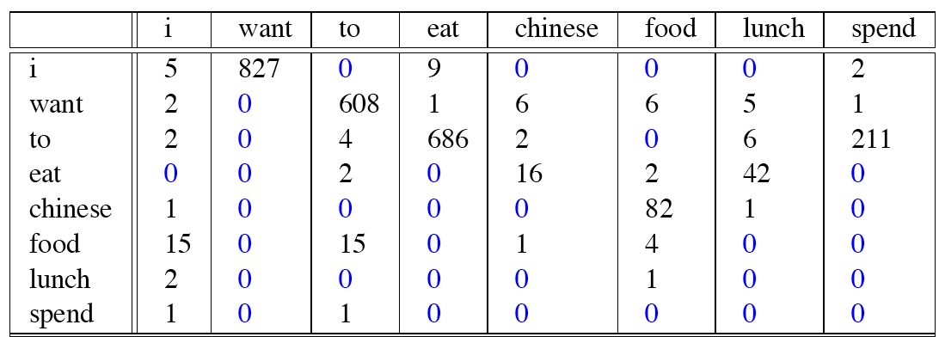
Raw bigram counts
Out of 9222 sentences
www.midocean.ae

Slide 20
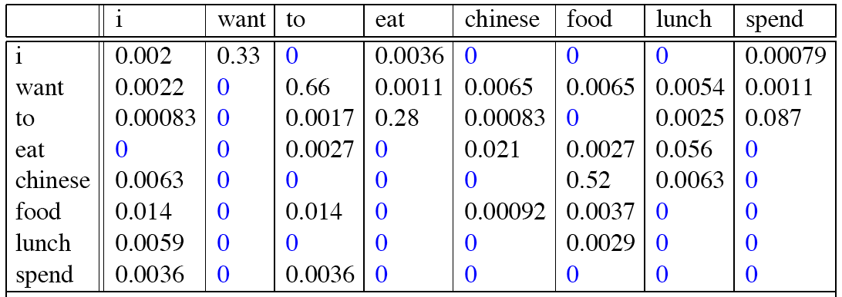
Raw bigram probabilities
Remember
Normalize by unigrams:
Result:
www.midocean.ae

Slide 21
Bigram estimates of sentence probabilities
P(<s> I want english food </s>) =
P(I|<s>)
× P(want|I)
× P(english|want)
× P(food|english)
× P(</s>|food)
= .000031
www.midocean.ae

Slide 22
What kinds of knowledge?
P(english|want) = .0011
P(chinese|want) = .0065
P(to|want) = .66
P(eat | to) = .28
P(food | to) = 0
P(want | spend) = 0
P (i | <s>) = .25
www.midocean.ae

Slide 23
Practical Issues
We do everything in log space
  Avoid underflow
  (also adding is faster than multiplying)
www.midocean.ae

Slide 24
Language Modeling Toolkits
SRILM
  http://www.speech.sri.com/projects/srilm/
www.midocean.ae

Slide 25
Google N-Gram Release, August 2006
…
www.midocean.ae

Slide 26
Google N-Gram Release
serve as the incoming 92
serve as the incubator 99
serve as the independent 794
serve as the index 223
serve as the indication 72
serve as the indicator 120
serve as the indicators 45
serve as the indispensable 111
serve as the indispensible 40
serve as the individual 234
http://googleresearch.blogspot.com/2006/08/all-our-n-gram-are-belong-to-you.html
www.midocean.ae

Slide 27
Language Modeling
Evaluation and Perplexity
www.midocean.ae

Slide 28
Evaluation: How good is our model?
Does our language model prefer good sentences to bad ones?
  Assign higher probability to “real” or “frequently observed” sentences
    Than “ungrammatical” or “rarely observed” sentences?
We train parameters of our model on a training set.
We test the model’s performance on data we haven’t seen.
  A test set is an unseen dataset that is different from our training set, totally unused.
  An evaluation metric tells us how well our model does on the test set.
www.midocean.ae

Slide 29
Extrinsic evaluation of N-gram models
Best evaluation for comparing models A and B
  Put each model in a task
    spelling corrector, speech recognizer, MT system
  Run the task, get an accuracy for A and for B
    How many misspelled words corrected properly
    How many words translated correctly
  Compare accuracy for A and B
www.midocean.ae

Slide 30
Difficulty of extrinsic evaluation of N-gram models
Extrinsic evaluation
  Time-consuming; can take days or weeks
So
  Sometimes use intrinsic evaluation: perplexity
  Bad approximation
    unless the test data looks just like the training data
    So generally only useful in pilot experiments
  But is helpful to think about.
www.midocean.ae

Slide 31
Intuition of Perplexity
The Shannon Game:
  How well can we predict the next word?
  Unigrams are terrible at this game. (Why?)
A better model of a text
  is one which assigns a higher probability to the word that actually occurs
mushrooms 0.1
pepperoni 0.1
anchovies 0.01
….
fried rice 0.0001
….
and 1e-100
I always order pizza with cheese and ____
The 33rd President of the US was ____
I saw a ____
www.midocean.ae

Slide 32
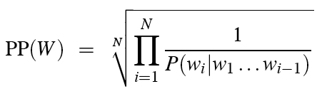
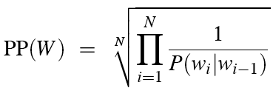
Perplexity
The best language model is one that best predicts an unseen test set
  Gives the highest P(sentence)
Perplexity is the inverse probability of the test set, normalized by the number of words:
Chain rule:
For bigrams:
Minimizing perplexity is the same as maximizing probability
www.midocean.ae

Slide 33
The Shannon Game intuition for perplexity
How hard is the task of recognizing digits ‘0,1,2,3,4,5,6,7,8,9’
  Perplexity 10
How hard is recognizing (30,000) names at Microsoft.
  Perplexity = 30,000
Perplexity is weighted equivalent branching factor
www.midocean.ae

Slide 34
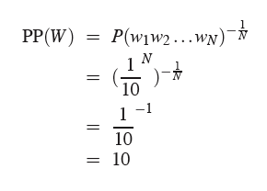
Perplexity as branching factor
Let’s suppose a sentence consisting of random digits
What is the perplexity of this sentence according to a model that assign P=1/10 to each digit?
www.midocean.ae

Slide 35
Lower perplexity = better model
Training 38 million words, test 1.5 million words, WSJ
N-gram Order | Unigram | Bigram | Trigram
Perplexity | 962 | 170 | 109
www.midocean.ae

Slide 36
Language Modeling
Generalization and zeros
www.midocean.ae

Slide 37
The Shannon Visualization Method
Choose a random bigram
(<s>, w) according to its probability
Now choose a random bigram (w, x) according to its probability
And so on until we choose </s>
Then string the words together
<s> I
I want
want to
to eat
eat Chinese
Chinese food
food </s>
I want to eat Chinese food
www.midocean.ae

Slide 38
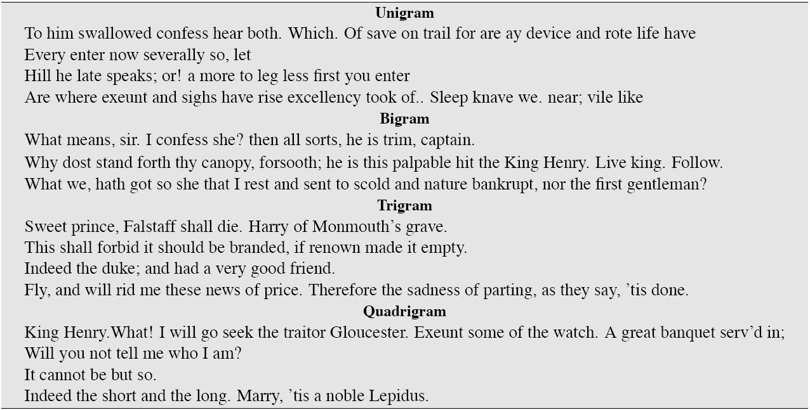
Approximating Shakespeare
www.midocean.ae

Slide 39
Shakespeare as corpus
N=884,647 tokens, V=29,066
Shakespeare produced 300,000 bigram types out of V²= 844 million possible bigrams.
  So 99.96% of the possible bigrams were never seen (have zero entries in the table)
Quadrigrams worse: What's coming out looks like Shakespeare because it is Shakespeare
www.midocean.ae

Slide 40
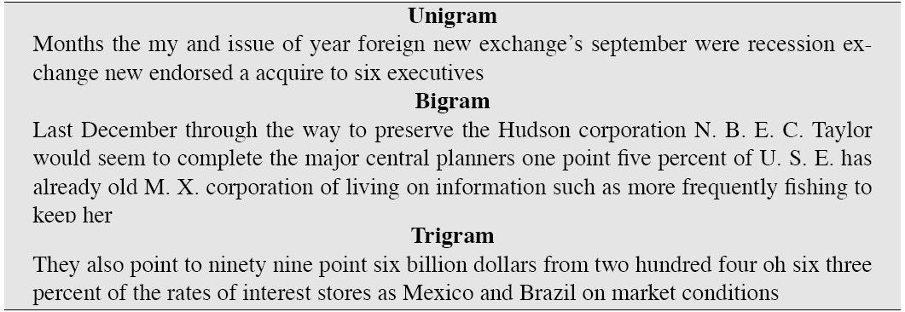
The wall street journal is not shakespeare
www.midocean.ae

Slide 41
Overfitting
N-grams only work well for word prediction if the test corpus looks like the training corpus
  In real life, it often doesn’t
  We need to train robust models that generalize!
  One kind of generalization: Zeros!
    Things that don’t ever occur in the training set
      But occur in the test set
www.midocean.ae

Slide 42
Zeros
Training set:
  … denied the allegations
  … denied the reports
  … denied the claims
  … denied the request
  P(“offer” | denied the) = 0
Test set
  … denied the offer
  … denied the loan
Probability
0
www.midocean.ae

Slide 43
Zero probability bigrams
Bigrams with zero probability
  mean that we will assign 0 probability to the test set!
And hence we cannot compute perplexity (can’t divide by 0)!
www.midocean.ae

Slide 44
Language Modeling
Smoothing: Add-one (Laplace) smoothing
www.midocean.ae

Slide 45
The intuition of smoothing (from Dan Klein)
When we have sparse statistics:
Steal probability mass to generalize better
P(w | denied the)
3 allegations
2 reports
1 claims
1 request
7 total
allegations
attack
man
reports
outcome
…
claims
request
P(w | denied the)
2.5 allegations
1.5 reports
0.5 claims
0.5 request
2 other
7 total
allegations
allegations
attack
man
outcome
reports
…
claims
request
www.midocean.ae

Slide 46
Add-one estimation
Also called Laplace smoothing
Pretend we saw each word one more time than we did
Just add one to all the counts!
MLE estimate:
Add-1 estimate:
www.midocean.ae

Slide 47
Maximum Likelihood Estimates
The maximum likelihood estimate
  of some parameter of a model M from a training set T
  maximizes the likelihood of the training set T given the model M
Suppose the word “bagel” occurs 400 times in a corpus of a million words
What is the probability that a random word from some other text will be “bagel”?
MLE estimate is 400/1,000,000 = .0004
This may be a bad estimate for some other corpus
  But it is the estimate that makes it most likely that “bagel” will occur 400 times in a million word corpus.
www.midocean.ae

Slide 48
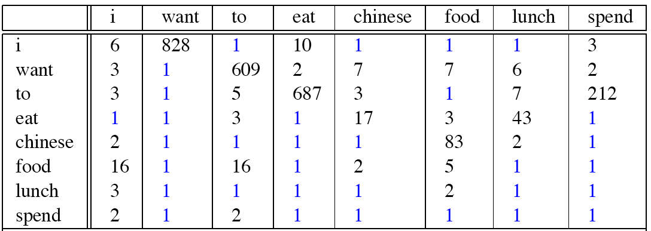
Berkeley Restaurant Corpus: Laplace smoothed bigram counts
www.midocean.ae

Slide 49

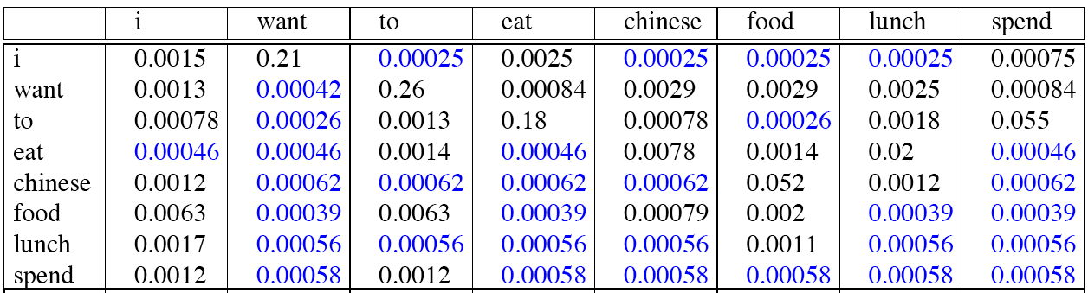
Laplace-smoothed bigrams
www.midocean.ae

Slide 50
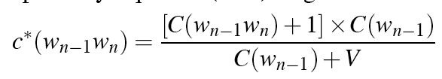
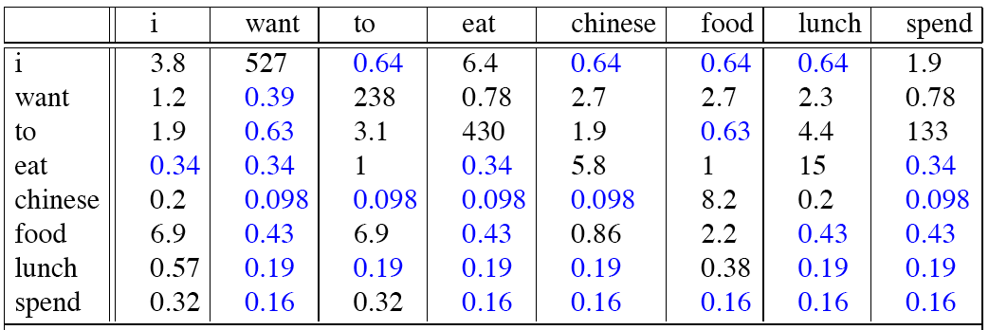
Reconstituted counts
www.midocean.ae

Slide 51
Compare with raw bigram counts
www.midocean.ae
Notes:
C(want to) went from 608 to 238, P(to|want) from .66 to .26!
Discount d= c*/c
d for “chinese food” =.10!!! A 10x reduction

Slide 52
Add-1 estimation is a blunt instrument
So add-1 isn’t used for N-grams:
  We’ll see better methods
But add-1 is used to smooth other NLP models
  For text classification
  In domains where the number of zeros isn’t so huge.
www.midocean.ae

Slide 53

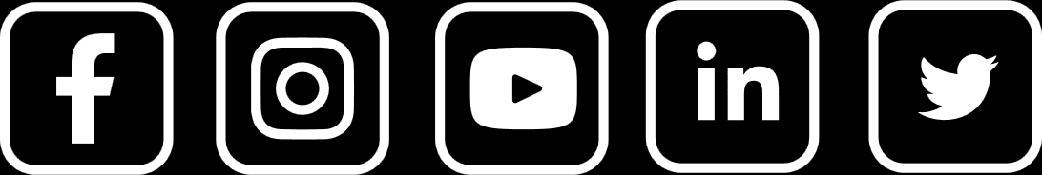
Thank You

