Slide 1



Common Network Devices
Lecture 3
HCIA-Security
Prepared by
Dr. Abdelrhman Ahmed

Slide 2
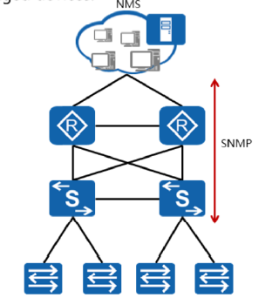
Chapter
03
Introduction to SNMP
• SNMP is used to transmit management information between the network management system (NMS) and managed devices.
• SNMP is a network management protocol widely used in TCP/IP networks. It enables a network management workstation that runs the NMS to manage network devices.
• SNMP supports the following operations:
□ The NMS sends configuration information to network devices through SNMP.
□ The NMS queries and obtains network resource information through SNMP.
□ Network devices proactively report alarm messages to the NMS so that network administrators can quickly respond to network issues.

Slide 3
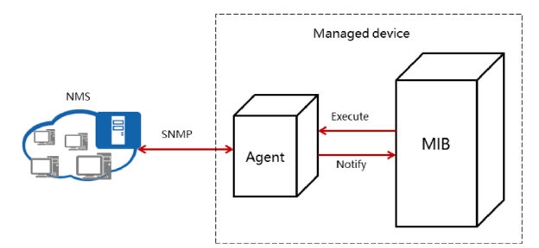
Chapter
03
SNMP Architecture
• SNMP includes the NMS, agent, and MIB.
• An agent is a process performed on the managed devices.
• A MIB is a database that contains variables maintained by managed devices.
• The NMS is network management software running on a workstation. It enables network
administrators to monitor and configure managed network devices.
• An agent is a network management process running on a managed device. After the managed device receives a request sent from the NMS, the agent responds with operations. The agent provides the following functions: collecting device status information, enabling the NMS to remotely operate devices, and sending alarm messages to the NMS.

Slide 4
Chapter
SNMP Architecture
03
• A MIB is a virtual database of device status information maintained on a managed device. An agent searches the MIB to collect device status information.
• Multiple versions of SNMP are available. Typically, these versions are as follows:
□ SNMPvl: Easy to implement but has poor security.
□ SNMPv2c: The security is low. It is not widely used.
□ SNMPv3: Defines a management framework to provide a secure access mechanism for users.
• SNMPvl: The NMS on the workstation and the Agent on the managed device exchange SNMPvl packets to manage the managed devices.
• Compared with SNMPvl, SNMPv2c has greatly improved its performance, security, and confidentiality.
• SNMPv3 has an enhanced security and management mechanism based on SNMPv2. The architecture used in SNMPv3 uses a modular design and enables administrators to flexibly add and modify functions. SNMPv3 is highly adaptable and applicable to multiple operating environments. It can not only manage simple networks and implement basic management functions, but also provide powerful network management functions to meet the management requirements of complex networks.

Slide 5
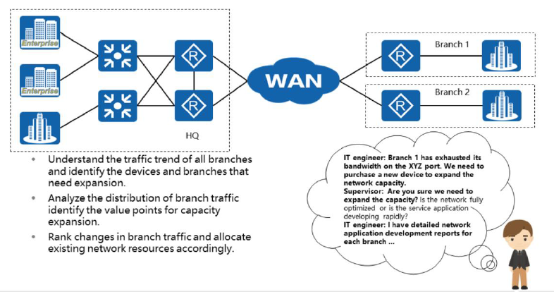
Chapter
03
Enterprise Network O&M

Slide 6
Chapter
03
NTA Concept & Functions
• Basic concept
□ The eSight Network Traffic Analyzer (NTA) is a software-only solution. No hardware probe is required, and no additional investment is needed. The NetFlow, NetStream, and sFlow protocols are used to collect and analyze common IP packets, provide a customer analysis report, and monitor network-wide traffic in real time. This is a powerful tool for enterprise O&M management.
• Functions
□ The eSight NTA provides a convenient way to monitor and analyze networks. By using the IP network traffic information provided by network devices that support NetFlow, NetStream, and sFlow, the eSight NTA analyzes network-wide traffic, provides traffic analysis reports, and displays traffic analysis results in various charts. This helps users learn about network-wide traffic, including the traffic distribution, and detect abnormal network traffic.

Slide 7
Chapter
03
NTA Concepts & Functions
• The eSight NTA provides users with reliable and convenient traffic analysis solutions, monitors network-wide traffic in real time, and provides multi-dimensional traffic analysis reports. This solution helps users detect abnormal traffic in a timely manner and learn about both network bandwidth usage and traffic distribution. In addition, it helps enterprises implement traffic visualization, fault query, and planning.
• Features:
□ Traffic visualization: Monitors IP traffic in real time, displays the network traffic trend, and helps administrators detect and handle exceptions in a timely manner.
□ Exception detectability: Through the NTA, users can analyze and audit the original IP traffic to identify the root cause of abnormal traffic.
□ Proper planning: The traffic trend and customized reports provided by the NTA provide reference for administrators to plan network capacity.

Slide 8
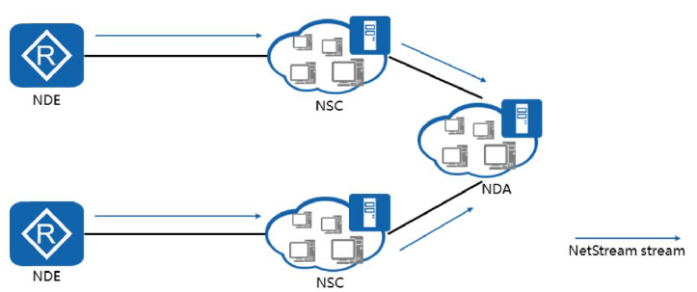
Chapter
03
NetStream Overview
NetStream is a Huawei-patented technology used to collect and distribute statistics about network traffic. The NDE sends the obtained statistics to the NSC for further processing and sends the statistics to the NDA for analysis. The results of the analysis provide a basis for network accounting and planning.

Slide 9
Chapter
NetStream Overview
03
• NetStream provides data that is useful for many purposes, including:
□ Network management and planning
□ Enterprise accounting and departmental charging
□ ISP billing report
□ Data storage
□ Data mining for marketing purposes
• NetStream is implemented using the following devices:
□ NetStream Data Exporter (NDE): Samples the traffic and exports the traffic statistics.
□ NetStream Collector (NSC): Parses packets from the NDE and sends statistics to the database for the NDA to parse.
□ NetStream Data Analyzer (NDA): Analyzes and processes the statistics, generates reports, and provides a foundation for various services, such as traffic charging, network planning, and monitoring.
• The NetStream system works as follows:
□ NDE configured with the NetStream function periodically sends the collected traffic statistics to the NSC.
□ NSC processes the traffic statistics and sends them to the NDA.
□ NDA analyzes the data for applications such as charging and network planning.

Slide 10
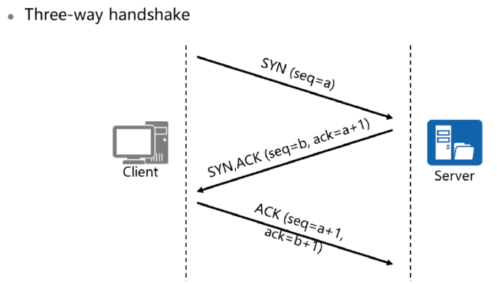
Chapter
03
TCP Connecting
• To establish a connection, TCP uses a three-way handshake process. This process is used to confirm the start sequence number of the communications parties so that subsequent communications can be performed in an orderly manner. The process is as follows:
n When the connection starts, the client sends a SYN to the server. The client sets the SYN's sequence number to a random value a.
□ After receiving the SYN, the server replies with a SYN+ACK. The server sets the ACK's acknowledgment number as the received sequence number plus one (that is, a + 1), and the SYN's sequence number as a random value b.
□ After receiving the SYN+ACK, the client replies with an ACK. The client sets the ACK's acknowledgment number as the received sequence number plus one (that is, b+1).

Slide 11
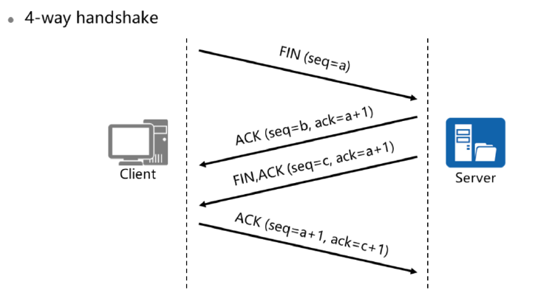
Chapter
03
Disconnecting TCP Connect

Slide 12
Chapter
Disconnecting TCP Connect
03
• To terminate a connection, TCP uses a four-way handshake process. The process is as follows:
□ The client sends a connection release packet (FIN = 1) to the server and stops sending data. The client sets the FIN's sequence number as a (seq=a) and enters the FIN-WAIT-1 state.
□ After receiving the FIN, the server replies with an acknowledgement packet (ACK=1). The server sets the ACK's acknowledgement number as the received sequence number plus one (ack=a + 1), sets the sequence number as b, and enters the CLOSE-WAIT state.
□ After receiving the ACK, the client enters the FIN-WAIT-2 state and waits for the server to send a FIN.
□ After the server finishes sending any remaining data, it sends a connection release packet to the client: FIN = 1; ack=a + 1. Because the connection is in the half-closed state, the server may send more data. Assume that the sequence number is seq=c. The server then enters the LAST-ACK state and waits for acknowledgement from the client.
□ After receiving the connection release packet from the server, the client replies with an acknowledgement packet (ACK=1). The client sets the acknowledgement number to ack=c+1 and sequence number to seq=a + 1. The client then enters the TIME-WAIT state.
□ After receiving the ACK from the client, the server enters the CLOSED state immediately and ends the TCP connection.

Slide 13
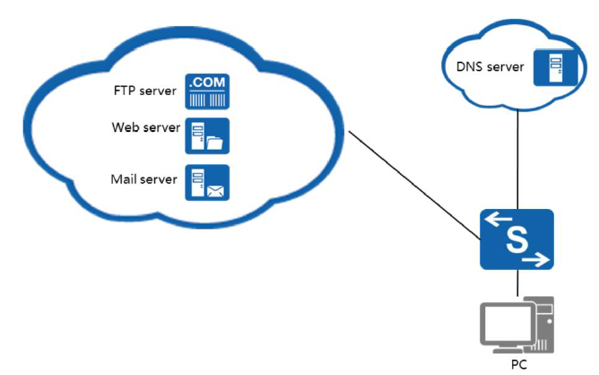
Chapter
03
Common Application Layer Protocols
• HTTP/HTTPS: refers to Hypertext Transfer Protocol, which is a protocol used to browse
web pages.
• FTP protocol: refers to File Transfer Protocol, which is used to upload and download file
resources.
• DNS protocol: refers to Domain Name Resolution Protocol, which is used to resolve
domain names to IP addresses.

Slide 14
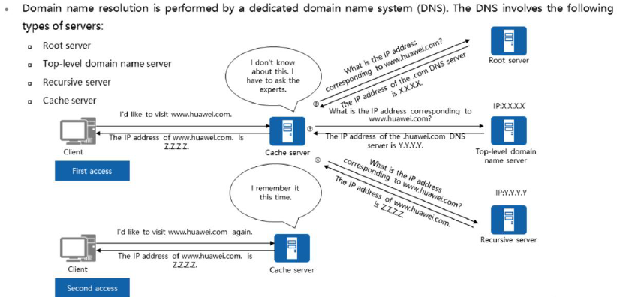
Chapter
03
How DNS Works

Slide 15
Chapter
03
How DNS Works
• A root server is primarily used to manage the main directory of the Internet. The number of root servers are limited to 13 server addresses in the world. Among the 13 nodes, 10 are set in the United States, and the other three are in the UK, Sweden and Japan. Although the network has no borders, servers still have national boundaries. All root servers are managed by the Internet domain name and number allocation agency ICANN, which is authorized by the US government.
• A top-level domain name server is used to store top-level domain names such as .com, .edu, and .cn.
• A recursive server is an authoritative server. It stores definitive domain name records (the resolution relationship between a domain name and an IP address) for the zone in which it servers. If every person accessing the Internet were to send requests to an authoritative server, the server would be overloaded. Therefore, a cache server is necessary.
• A cache server is equivalent to a proxy of the authoritative server and reduces the pressure of the authoritative server. Each time a user accesses the Internet, a request for domain name resolution is sent to the cache server. Upon receiving this request for the first time, the cache server requests the domain name and IP address resolution table from an authoritative server, and then stores the table locally. Subsequently, if a user requests the same domain name, the cache server directly replies to the user. The IP address of a website does not often change. However, entries in the resolution table are valid only for a certain period. When the validity period expires, the entry is automatically aged. The system queries the authoritative server again if a user request is sent. This aging mechanism ensures that the domain name resolution on the cache server is updated periodically.

Slide 16
Chapter
03
How DNS Works
The resolution process of DNS is as follows:
□ The DNS client queries in recursive mode. The cache server first checks whether the local DNS server has the domain name resolution cache.
□ If there is no local cache, the domain name is sent to the root server. After receiving the www.vmall.com request, the root server checks the authorization of the .com and returns the IP address of the top-level domain name server where the .com is located.
□ The cache server continues to send a www.vmall.com resolution request to the top- level domain name server. After receiving the request, the top-level domain name server returns the recursive server IP address of the next-level .vmall.com.
□ The cache server continues to send a www.vmall.com resolution request to the recursive server. After receiving the request, the recursive server returns a resolution address of www.vmall.com.lf there are a large number of domain names, the recursive server also has multiple levels.
□ After obtaining the IP address of www.vmall.com. the cache server sends the IP address to the client and caches the IP address locally.
□ If a client requests the domain name resolution of www.vmall.com again, the cache server directly responds with the IP address.

Slide 17
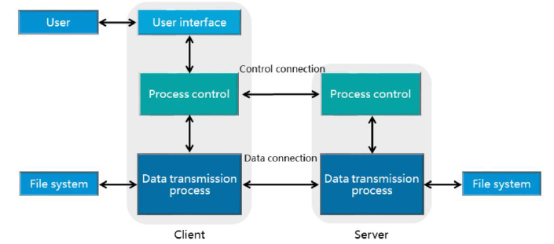
Chapter
03
How FTP Works
• FTP provides an effective way to upload and download files between a server and a client.
• When used to transmit data, FTP establishes a control connection and a data connection between the server and the client..

Slide 18
Chapter
03
How FTP Works
• When FTP is used to transfer files, two TCP connections are used. The first is the control connection between the FTP client and the FTP server. Enable port 21 on the FTP server and wait for the FTP client to send a connection request. The FTP client enables a random port and sends a connection setup request to the FTP server. The control connection is used to transfer control commands between the server and the client.
• The second is the data connection between the FTP client and the FTP server. The server uses TCP port 20 to establish a data connection with the client. Generally, the server actively establishes or interrupts data connections.
• Because the FTP is a multi-channel protocol, a random port is used to establish a data channel. If a firewall exists, the channel may fail to be set up. For details, see the following sections.

Slide 19
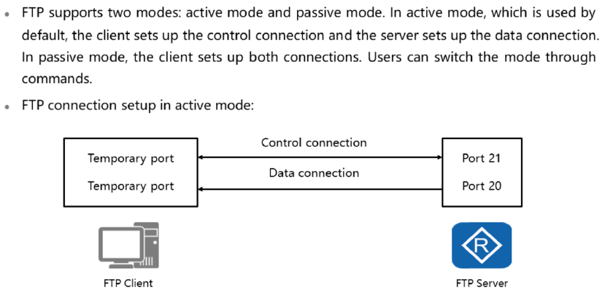
Chapter
03
FTP Transmission Mode (1)

Slide 20
Chapter
03
FTP Transmission Mode (1)
• In active mode, if a firewall is deployed, the data connection may fail to be established because it is initiated by the server. Passive mode solves this issue. The active mode facilitates the management of the FTP server but impairs the management of the client. The opposite is true in the passive mode.
• By default, port 21 of the server is used to transmit control commands, and port 20 is used to transmit data.
• The procedure for setting up an FTP connection in active mode is as follows: n The server enables port 21 to listen for data and waits to set up a control connection with the client . n The client initiates a control connection setup request, and the server responds, n The client sends a PORT command through the control connection to notify the server of the temporary port number used for the client data connection. n The server uses port 20 to establish a data connection with the client.

Slide 21
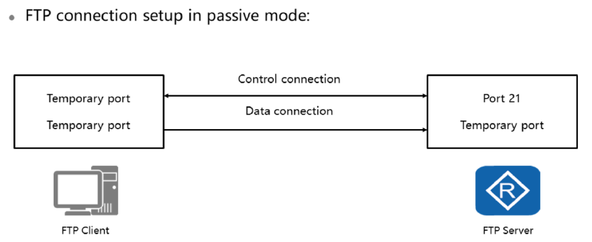
Chapter
03
FTP Transmission Mode (2)

Slide 22
Chapter
03
FTP Transmission Mode (2)
• The procedure for setting up an FTP connection in passive mode is as follows:
□ The server enables port 21 to listen for data and wait to set up a control connection with the client.
□ The client initiates a control connection setup request, and the server responds.
□ The client sends the PASV command through the control connection to notify the server that the client is in passive mode.
□ The server responds and informs the client of the temporary port number used for the data connection.
□ A data connection is set up between the client and the temporary port of the server.

Slide 23
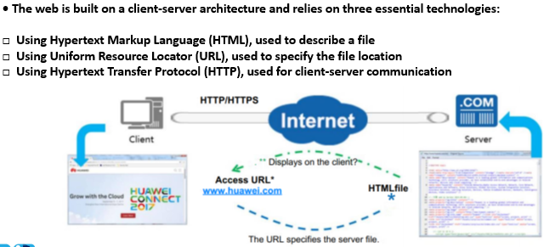
Chapter
03
HTTP/HTTPS: Basic Components of a Web Application

Slide 24
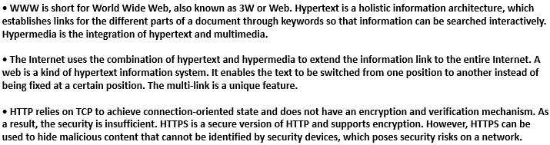
Chapter
03
HTTP/HTTPS: Basic Components of Web Application

Slide 25
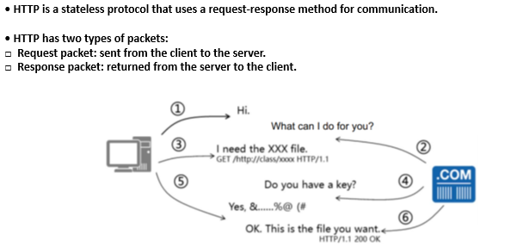
Chapter
03
How HTTP Works

Slide 26
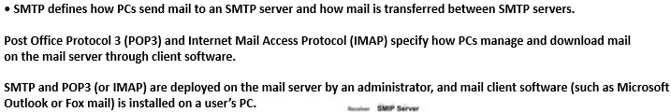
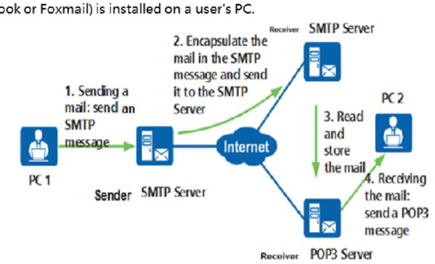
Chapter
03
SMTP,POP3,IMAP: How Mail is Sent & Received

Slide 27
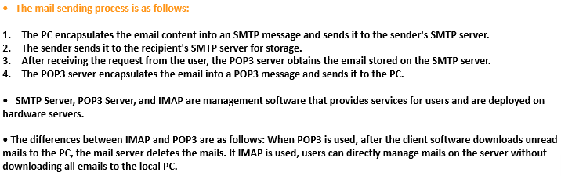
Chapter
03
SMTP,POP3,IMAP: How Mail is Sent & Received

Slide 28



Thank You

