Slide 1



International Business
Management
Prepared by Dr. Noha Adel
Lecture 2

Slide 2



International Business
Management
Lecture 2
Prepared by
Dr. Noha Adel
www.midocean.ae

Slide 3


Chapter
Globalization
01
www.midocean.ae

Slide 4

Chapter
Learning Objectives
01
1-1 Show how international business differs from domestic business.
1-2 Understand what is meant by the term globalization.
1-3 Recognize the main drivers of globalization.
1-4 Describe the changing nature of the global economy.
1-5 Explain the main arguments in the debate over the impact of globalization.
1-6 Understand how the process of globalization is creating opportunities and challenges for management practice.
www.midocean.ae

Slide 5
What Is International Business and
What Is Different about It?
International business
  Business that is carried out across national borders
Foreign business
  The operations of a company outside its home or domestic market
International company (IC)
  A company with operations in multiple nations

Slide 6
What Is International Business and
What Is Different about It?
No domestic firm is entirely free from foreign or international forces due to the potential for competition from foreign imports or foreign competitors setting up operations in the firm’s domestic market.

Slide 7
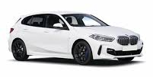

Opening Case: Globalization of BMW, Rolls-Royce, and the MINI
St
Started in 1916
Added motorcycles to its product in 1923
BMW expanded to automobiles in 1929
Globally, BMW is known for streamlined design
incredible luxury and top performance
The company has more than 125000employees
Delivers about 2.4million vehicles annually
Has revenues of about $103 billion in U.S dollars
Bayerische Motoren Werke
www.midocean.ae

Slide 8
Opening Case: Globalization of BMW, Rolls-Royce, and the MINI
Chapter
01
R
Rolls-Royce is considered the most exclusive luxury automobile brand in the world.
This reputation is rooted in the brands long history and rich tradition, effortless power and quality
The entry level carries a price tag around $250000
MINI is a car brand that is owned by BMW that specializes in small cars
The BMW Group’s leader have studied brands outside of the automobiles industry to create the company’s future retail strategy.
Enter the “ product genius”
www.midocean.ae

Slide 9
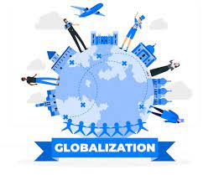
Globalization
Globalization refers to the shift toward a more integrated and interdependent world economy

Slide 10
What Is Globalization? 1
The Globalization of Markets
  Refers to the merging of historically distinct and separate national markets into one huge global marketplace.
    Falling barriers to cross-border trade and investment.
    Global tastes.
    Benefits small and large companies.
    Significant differences between national markets.
    Products that serve universal needs are global: oil.
    Competitors may not change among nations.
Notes:
Globalization refers to the shift toward a more integrated and interdependent world economy
The globalization of markets refers to the merging of historically distinct and separate national markets into one huge global marketplace.

Slide 11
What Is Globalization? 2
The Globalization of Production
  Sourcing goods to take advantage of differences in cost and quality of factors of production.
    Factors of production include labor, energy, land, capital.
  Early outsourcing was confined to manufacturing.
    Modern communications technology has advanced outsourcing today for service activities.
Notes:
The globalization of production refers to the sourcing of goods and services from locations around the globe to take advantage of national differences in the cost and quality of factors of production (such as labor, energy, land, and capital).

Slide 12
What Is Globalization? 3
The Globalization of Production continued
  Robert Reich and “global products.”
  Impediments prevent optimal dispersion of activities:
    Formal and informal barriers to trade.
    Barriers to foreign direct investment.
    Transportation costs.
    Political and economic risk.
    Challenge of coordinating globally dispersed supply chain.

Slide 13
The Emergence of Global Institutions 1
Institutions needed to help manage, regulate, and police global marketplace.
  General Agreement on Tariffs and Trade (GATT).
  World Trade Organization.
  International Monetary Fund.
  The World Bank.
  The United Nations.

Slide 14
The Emergence of Global Institutions 2
The World Trade Organization
  Polices the world trading system.
  Ensures nation-states adhere to the rules.
  Facilitates multinational agreements among members.
  164 nations that account for 98 percent of world trade were members as of 2019.

Slide 15
The Emergence of Global Institutions 3
The International Monetary Fund
  Established to maintain order in the international monetary system.
  Often seen as the lender of last resort.
  In return for loans, requires nation-states to adopt specific economic policies aimed at returning their economies to stability and growth.

Slide 16
The Emergence of Global Institutions 4
The World Bank
  Promotes economic development.
  Focused on making low-interest loans to cash-strapped governments in poor nations that wish to undertake significant infrastructure investments.
  Considered less controversial than the IMF.

Slide 17
The Emergence of Global Institutions 5
The United Nations
  Promotes peace through international cooperation and collective security.
  193 member countries.
  UN Charter – four basic purposes:
    Maintain international peace and security.
    Develop friendly relations among nations.
    Cooperate in solving international problems and in promoting respect for human rights.
    Be a center for harmonizing the actions of nations.

Slide 18
The Emergence of Global Institutions 6
Group of Twenty (G20)
  Finance ministers and central bank governors of the 19 largest economies in the world, plus representatives from the European Union and the European Central Bank.
  Represents 90 percent of global GDP and 80 percent of international global trade.

Slide 19
Drivers of Globalization 1
Declining Trade and Investment Barriers
  1920s to 1930s: Many barriers to international trade and foreign direct investment.
    International trade: when a firm exports goods or services to consumers in another country.
    Foreign direct investment: when a firm invests resources in business activities outside its home country.
  GATT lowered barriers.
    Uruguay Round extended GATT and established WTO.

Slide 20
Drivers of Globalization 2
Declining Trade and Investment Barriers continued
  Between 1960 and 2018 the value of the world economy increased 9.4 times, while the value of international goods increased 22.4 times.
    Trade in goods and services and the value of foreign direct investment have all been growing faster than world output.
      More firms dispersing production process to different locations around the globe.
      Economies of the world’s nation-states are becoming more intertwined.
      World has become significantly wealthier in the past two decades.

Slide 21
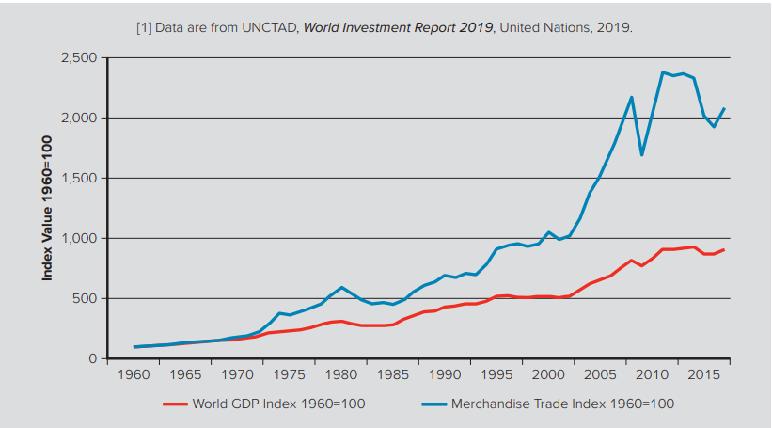
Figure 1.1 Value of world merchandised trade and world production 1960 to 2019
Access the text alternative for slide images
Sources: World Bank, 2019; World Trade Organization, 2019; United Nations, 2019.

Slide 22
Drivers of Globalization 3
Role of Technological Change
  Communications.
    Development of the microprocessor single most important innovation since World War II.
    Moore’s Law predicts that the power of microprocessor technology doubles and its cost of production falls in half every 18 months.
  The Internet.
    More than half of the world’s population uses the Internet.
    Global e-commerce sales over $2.5 trillion.
    The Internet acts as an equalizer.

Slide 23
Drivers of Globalization 4
Role of Technological Change continued
  Transportation Technology.
    Commercial jets, superfreighters, and containerization have all “shrunk the globe.”
  Implications for the Globalization of Production.
    Locating production in geographically separate locations has become more economical.
  Implications for the Globalization of Markets.
    Cultural distance has been reduced and has brought some convergence of consumer tastes and preferences.

Slide 24
The Changing Demographics of the Global Economy 1
The Changing World Output and World Trade Picture
  1960s: U.S. accounted for 38.3 percent of world output.
  2018: U.S. accounted for 24 percent of world output.
  This reflects the faster economic growth of several other economies, particularly China.
    China and BRIC countries growing more rapidly.
    Developing nations may account for more than 60 percent of world economic activity by 2025.

Slide 25
The Changing Demographics of the Global Economy 2
The Changing Foreign Direct Investment Picture
  As barriers to the free flow of goods and services fell, non-U.S. firms increasingly invested across national borders.
    Desire to disperse production activities to optimal locations and to build a direct presence in major foreign markets.
    Outward stock of foreign direct investment: the total cumulative value of foreign investments by firms domiciled in nations outside of that nation’s borders.

Slide 26
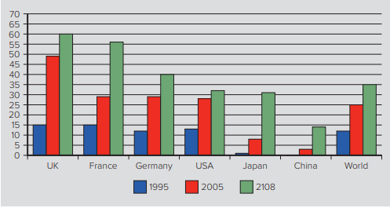
Figure 1.2 FDI outward stock outward as a percentage of GDP
Access the text alternative for slide images
Sources: OECD data 2019, World Development Indicators 2019, UNCTAD data base, 2019

Slide 27
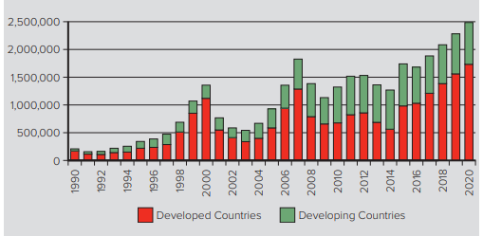
Figure 1.3 FDI inflows (in millions of dollars)
Access the text alternative for slide images
Source: United Nations Conference on Trade and Development, World Investment Report 2019. (Data for 2019–2020 are forecast.)

Slide 28
The Changing Demographics of the
Global Economy 3
The Changing Nature of the Multinational Enterprise
  Multinational enterprise (MNE) is any business that has productive activities in two or more countries.
  Non-U.S. Multinationals.
    In 2003, 38.8 percent of the world’s 2000 largest multinationals were U.S. firms.
    By 2019, 28.8 percent of the top 2000 global firms were U.S. multinationals, a drop of 201 firms.

Slide 29
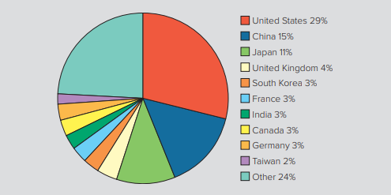
Figure 1.4 National share of the largest 2,000 multinational corporations in 2019
Access the text alternative for slide images
Source: Forbes Global 2000 in 2019

Slide 30
The Changing Demographics of the
Global Economy 4
The Changing Nature of the Multinational Enterprise continued
  The Rise of Mini-Multinationals.
    Growth in the number of medium- and small-sized businesses.
    Internet is lowering barriers that smaller firms faced in international trade.

Slide 31
The Changing Demographics of the
Global Economy 5
The Changing World Order
  Former communist countries present export and investment opportunities.
    Signs of growing unrest and commitment to market-based economic systems cannot be assumed.
    Risks of doing business in these countries are high.
  China moving to industrial superpower.
  In Latin America debt and inflation are down, more private investors, expanding economies.

Slide 32
The Changing Demographics of the
Global Economy 6
Global Economy of the Twenty-First Century
  Barriers to the free flow of goods, services, and capital have been coming down.
  Strengthened by the widespread adoption of liberal economic policies by countries that had opposed them.
  Globalization is not inevitable:
    Countries may pull back.
    Risks are high.

Slide 33
The Globalization Debate 1
Antiglobalization Protests
  Began with 1999 protests at WTO meeting in Seattle.
  Protestors now typically show up at major meetings of global institutions.
  Protestors believe globalization causes detrimental effects on living standards, wage rates, and the environment.
    Theory and evidence suggest these fears may be exaggerated.

Slide 34
The Globalization Debate 2
Globalization, Jobs, and Income
  Critics of globalization argue:
    Falling trade barriers allow firms to move manufacturing activities to countries where wage rates are much lower.
      Destroy manufacturing jobs in wealthy advanced economies.
    Services also being outsourced:
      Contributing to higher unemployment and lower living standards in their home nations.

Slide 35
The Globalization Debate 3
Globalization, Jobs, and Income continued
  Supporters argue:
    Benefits outweigh the costs.
    Free trade will result in countries specializing in the production of goods and services that they can produce most efficiently, while importing goods and services that they cannot produce as efficiently.
      As a result, the whole economy is better off.
      Companies can reduce their cost structure, and consumers benefit.

Slide 36
The Globalization Debate 4
Globalization, Jobs, and Income continued
  Data suggests the share of labor in national income has declined over the past two decades.
    Share of national income by skilled labor has increased.
    Unskilled labor experienced a fall in income, but not necessarily standard of living due to economic growth.
  The weak growth rate in real wage rates for unskilled workers is likely due to a technology-induced shift within advanced economies.
    Technological change has a bigger impact than globalization on declining share of national income enjoyed by labor.

Slide 37
The Globalization Debate 5
Globalization, Labor Policies, and the Environment
  Critics argue:
    Labor and environmental regulations increase manufacturing costs.
    Lack of regulation can lead to abuse.
    Firms move production to nations that do not have regulations.
  Supporters argue:
    Tougher environmental regulations and stricter labor standards go hand in hand with economic progress.
    Free trade leads to less labor exploitation and less pollution.

Slide 38
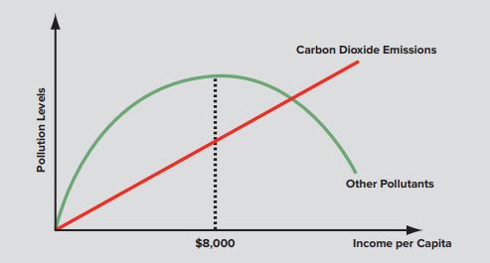
Figure 1.5 Income levels and environmental pollution
Access the text alternative for slide images
Source: C. W. L. Hill and G. T. M. Hult, Global Business Today (New York: McGraw-Hill Education, 2018
Notes:
While the hump-shaped relationship depicted in Figure 1.5 seems to hold across a wide range of pollutants—from sulfur dioxide to lead concentrations and water quality—carbon dioxide emissions are an important exception, rising steadily with higher-income levels.

Slide 39
The Globalization Debate 6
Globalization and National Sovereignty
  Critics argue:
    Shift of power away from national governments toward supranational organizations.
      WTO, EU, United Nations.
  Supporters argue:
    The power of supranational organizations is limited to what nation-states collectively agree to grant.
    These organizations exist to serve the collective interests of member states.
www.midocean.ae

Slide 40
The Globalization Debate 6
Globalization and the World’s Poor
  Critics argue gap between the rich and poor nations has gotten wider.
    Totalitarian governments.
    Poor economic policies.
    Corruption and lack of property rights.
    Expanding populations in developing countries.
    Debt burdens.
  Supporters argue best way to change the situation is to lower barriers to trade and investment and promote free market policies.
www.midocean.ae

Slide 41
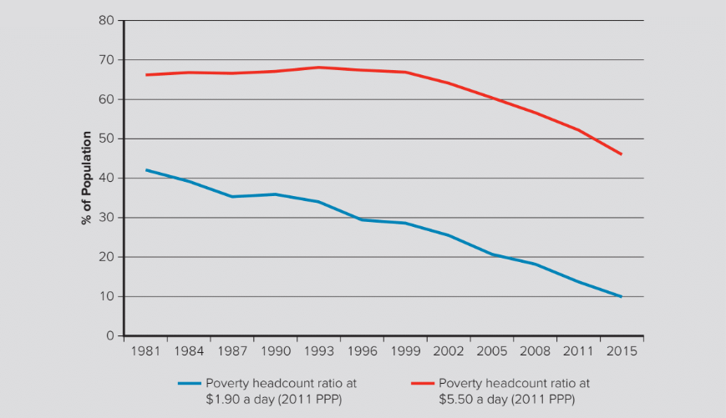
Figure 1.6 Percentage of the world’s population living in poverty during 1981 to 2015
Access the text alternative for slide images
Source: World Bank Data Base on Poverty and Equity, World Development Indicators, 2019

Slide 42
Managing in the Global Marketplace
Managers
  International business is any firm that engages in international trade or investment.
  Managing an international business differs from managing a purely domestic business.
    Countries are different.
    Range of problems is wider and problems more complex.
    Must find ways to work within limits imposed by government.
    Transactions involve converting money into different currencies.

Slide 43
Test Yourself

Slide 44
MCQ Questions
1) Which scenario best demonstrates foreign direct investment?
A) Pure Pearls, a jewelry store in the United States, imports harvested pearls from Indonesia, Philippines, and Australia.
B) Chivalry, a U.S.-based phone manufacturing company, has set up its own assembly plant in Japan to cater to the needs of the Asian market.
C) Delicate Love, a reputable florist company in Holland, exports tulips and roses throughout the globe.
D) Samantha started an Italian restaurant in her home country, the United States, after she took cooking lessons from a well-known chef in Italy.
E) Yin and Yang Inc., a Chinese firm, supplies buttons and zippers to major denim brands in the United Kingdom.

Slide 45
2) Savvy Skin Care, a U.S.-based beauty products manufacturer, has set up a manufacturing plant in Hong Kong. This is an example of
A) foreign direct investment.
B) international trade.
C) exporting.
D) global rivalry.
E) the globalization of markets.

Slide 46
3) Michelle, an Italian fashion designer, sells her merchandise by exporting it to retail stores in the United States, United Kingdom, and Brazil. According to this information, Michelle is participating in
A) foreign direct investment.
B) globalization of production.
C) international trade.
D) multinational enterprise.
E) outsourcing.

Slide 47
4) Why did many nations impose high tariffs on imports of manufactured goods prior to World War II?
A) to protect domestic industries from foreign competition
B) to prevent the occurrence of the Great Depression
C) to safeguard patents, copyrights, and trademarks
D) to promote the trade of services over the trade of manufactured goods
E) to deter any possible attempts to promote communism

Slide 48
5) What is implied by the fact that in today's marketplace, the volume of world trade has been growing faster than world GDP?
A) More companies are relying on domestic firms to obtain parts of their production process.
B) The economies of the world's nation-states are becoming less intertwined.
C) More companies are dispersing parts of their production process to locations around the globe.
D) The world has experienced a loss of overall wealth in the last two decades.
E) More countries are imposing trade barriers to minimize competition.

Slide 49
6) Gerald bought his son, David, a computer two years ago. Recently, he decided to buy his daughter, Julian, a computer of her own. When applying Moore's Law to the two-year gap between the purchase of the computers, it is most likely that
A) Gerald paid a higher price for Julian's computer.
B) David's computer will have a microprocessor with better power than that of Julian's.
C) both David's and Julian's computers would cost Gerald the same price.
D) the microprocessor in Julian's computer will be more advanced in terms of power than that of David's.
E) the power of the microprocessors, in both David and Julian's computers, would be the same.

Slide 50
7) Sharron purchased a computer for $500 in 2018. Compared to the $900 computer that she purchased in 2011, the new one seems better in terms of the price she has paid and the power of the microprocessor technology. This is best explained by
A) product liability.
B) property rights.
C) Moore's law.
D) purchasing power parity.
E) sustainable strategies.

Slide 51
True or False
1) The World Trade Organization, the International Monetary Fund and its sister institution the World Bank, and the United Nations were all created by voluntary agreement between individual nation-states.
2) The WTO polices the world trading system, and without this organization, the globalization of markets might not be where it is today.
3) Foreign direct investment (FDI) occurs when a firm invests resources in business activities outside its home country.

Slide 52
True or False
4) The Uruguay Round extended GATT to cover services as well as manufactured goods.
5) The range of problems that a manager in an international business faces is typically more complex than those faced by a manager in a domestic business
6) As a result of globalization, international businesses can avoid converting of currency exchanges during cross-border transactions.

Slide 53


Thank You

