Slide 1


AWS Cloud Security Foundations
(AWS-CSF)
Lecture 6
AWS Cloud Security
Prepared by
Dr. Ibrahim Gomaa

Slide 2

Lecture
AWS Cloud Security
6
Lecture 6: AWS Cloud Security
Topics
Security in the AWS Cloud
Security design principles
Shared responsibility model
Securing a new AWS account
Securing accounts
Securing data on AWS
Working to ensure compliance
AWS Cloud Security Foundations– AWS-CSF
Lecture 6 – AWS Cloud Security
Dr. Ibrahim Gomaa

Slide 3
Lecture
6
AWS Cloud Security
Security in the AWS Cloud
AWS Cloud Security Foundations– AWS-CSF
Lecture 6 – AWS Cloud Security
Dr. Ibrahim Gomaa

Slide 4



Lecture
6
Security in the AWS Cloud
Security is familiar
Confidentiality
Integrity
Availability
Limit access and disclosure to authorized users
Prevent access by unauthorized people
Maintain data consistency during its lifecycle
Preserve data at rest and data in transit
Have access to information resources when needed
AWS Cloud Security Foundations– AWS-CSF
Lecture 6 – AWS Cloud Security
Dr. Ibrahim Gomaa

Slide 5
Lecture
6
Security in the AWS Cloud
AWS Cloud security: Objectives
Controllability
Auditability
Visibility
Agility
Automation
AWS Cloud Security Foundations– AWS-CSF
Lecture 6 – AWS Cloud Security
Dr. Ibrahim Gomaa

Slide 6

Lecture
6
Security in the AWS Cloud
AWS Cloud security: Controllability
Can I effectively manage users?
How can I provide temporary credentials?
Can I use my own keys?
AWS Identity and Access Management (IAM)
The AWS IAM service helps you securely control access to AWS resources for your users. Use IAM to control who can use your AWS resources (authentication), what resources they can use, and in what ways (authorization).
You can use the AWS Security Token Service (AWS STS) to create and provide trusted users with temporary security credentials that can control access to your AWS resources
With AWS CloudHSM, you can protect your encryption keys within hardware security modules (HSMs) that are designed and validated to government standards for secure key management. You can securely generate, store, and manage the cryptographic keys used for data encryption in a way that ensures that only you have access to the keys
AWS Cloud Security Foundations– AWS-CSF
Lecture 6 – AWS Cloud Security
Dr. Ibrahim Gomaa

Slide 7

Lecture
6
Security in the AWS Cloud
AWS Cloud security: Visibility
What is in my environment?
What impact did a particular action have?
What has changed?
Where is the evidence?
AWS Config
by using AWS Config, you can:
Discover existing AWS resources
Export a complete inventory of your AWS resources with all configuration details
Determine how a resource was configured at any point in time.
AWS Cloud Security Foundations– AWS-CSF
Lecture 6 – AWS Cloud Security
Dr. Ibrahim Gomaa

Slide 8

Lecture
6
Security in the AWS Cloud
AWS Cloud security: Visibility
How do I ensure high availability?
Can I automatically deploy applications with security and compliance-related settings?
How can I apply security checks in a reproducible manner?
AWS CloudFormation
AWS Cloud Security Foundations– AWS-CSF
Lecture 6 – AWS Cloud Security
Dr. Ibrahim Gomaa

Slide 9
Lecture
6
AWS Cloud Security
Security design principles
AWS Cloud Security Foundations– AWS-CSF
Lecture 6 – AWS Cloud Security
Dr. Ibrahim Gomaa

Slide 10

Lecture
6
Security design principles
Apply the principle of least privilege
Grant access as needed
Enforce separation of duties
Avoid long-term credentials
AWS Cloud Security Foundations– AWS-CSF
Lecture 6 – AWS Cloud Security
Dr. Ibrahim Gomaa

Slide 11

Lecture
6
Security design principles
Enable traceability
Monitor actions and changes
Use logs and metrics
Audit your cloud resources
AWS Cloud Security Foundations– AWS-CSF
Lecture 6 – AWS Cloud Security
Dr. Ibrahim Gomaa

Slide 12

Lecture
6
Security design principles
Secure all layers
Use a defense in depth approach
Use different AWS services
AWS Cloud Security Foundations– AWS-CSF
Lecture 6 – AWS Cloud Security
Dr. Ibrahim Gomaa

Slide 13

Lecture
6
Security design principles
Automate security
Automate routine security tasks with APIs
Implement infrastructure as code
AWS Cloud Security Foundations– AWS-CSF
Lecture 6 – AWS Cloud Security
Dr. Ibrahim Gomaa

Slide 14

Lecture
6
Security design principles
Protect data in transit and data at rest
Use encryption and access controls
Classify your data with tags
Use VPN and TLS connections
AWS Cloud Security Foundations– AWS-CSF
Lecture 6 – AWS Cloud Security
Dr. Ibrahim Gomaa

Slide 15


Lecture
6
Security design principles
Prepare for security events
Mitigate the impact of security incidents
Create processes to isolate incidents and restore operations
AWS Cloud Security Foundations– AWS-CSF
Lecture 6 – AWS Cloud Security
Dr. Ibrahim Gomaa

Slide 16


Lecture
6
Security design principles
Minimize the attack surface
Be ready to scale and absorb the attack
Safeguard exposed resources
AWS Cloud Security Foundations– AWS-CSF
Lecture 6 – AWS Cloud Security
Dr. Ibrahim Gomaa

Slide 17
Lecture
6
AWS Cloud Security
Shared responsibility model
AWS Cloud Security Foundations– AWS-CSF
Lecture 6 – AWS Cloud Security
Dr. Ibrahim Gomaa

Slide 18
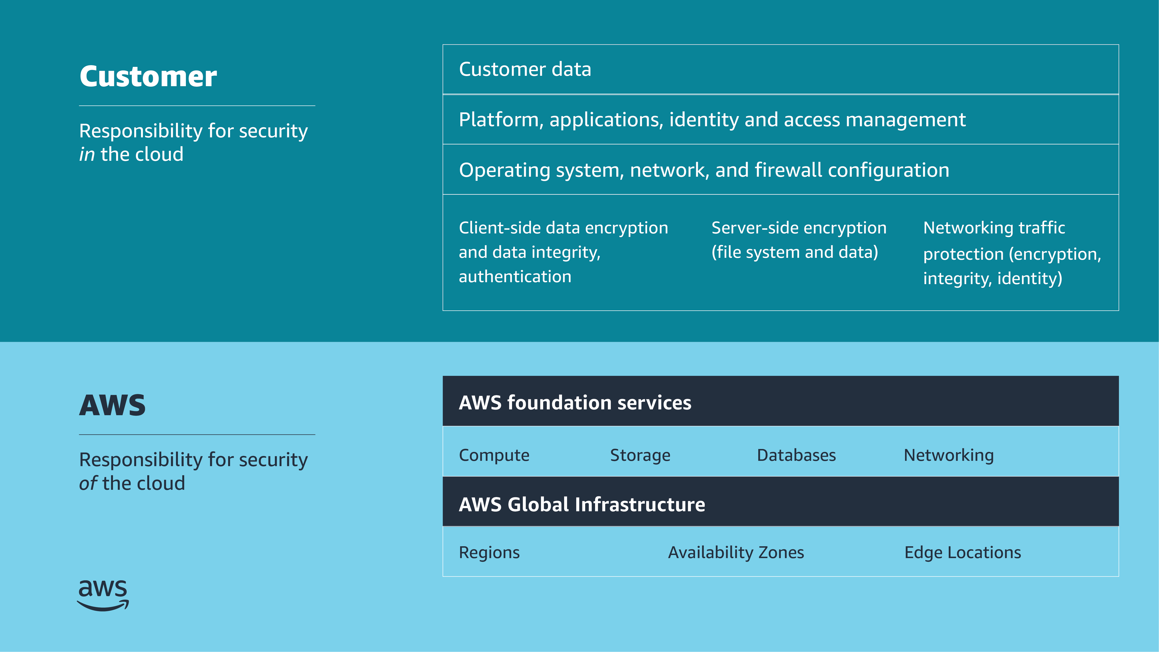
Lecture
6
Shared responsibility model
AWS shared responsibility model
AWS Cloud Security Foundations– AWS-CSF
Lecture 6 – AWS Cloud Security
Dr. Ibrahim Gomaa

Slide 19
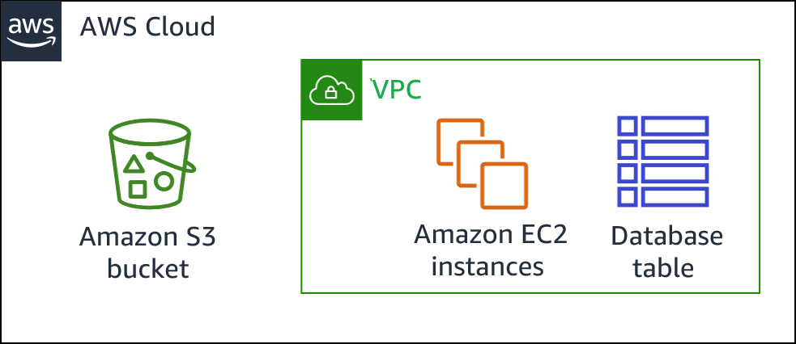
Lecture
6
Shared responsibility model
Shared responsibility example
Accounts and credentials
Customer responsibility examples:
  Guest OS configuration
  Application-level security
  Security group configuration
Customer
AWS
AWS Global Infrastructure
AWS Cloud Security Foundations– AWS-CSF
Lecture 6 – AWS Cloud Security
Dr. Ibrahim Gomaa

Slide 20
Lecture
6
Shared responsibility model
Security in the cloud
Customer data
Platform, applications, identity and access management
Customer
Operating system, network and firewall configuration
Client-side data encryption and data integrity, authentication
Server-side encryption
(file system and/or data)
Network traffic protection
(encryption/integrity/identity)
  Considerations
  What you should store
  Which AWS services you should use
  Which Region to store data in
  What content format and structure to use
  Who has access
AWS Cloud Security Foundations– AWS-CSF
Lecture 6 – AWS Cloud Security
Dr. Ibrahim Gomaa

Slide 21

Lecture
6
Shared responsibility model
Activity: Shared Responsibility Model
AWS Cloud Security Foundations– AWS-CSF
Lecture 6 – AWS Cloud Security
Dr. Ibrahim Gomaa

Slide 22
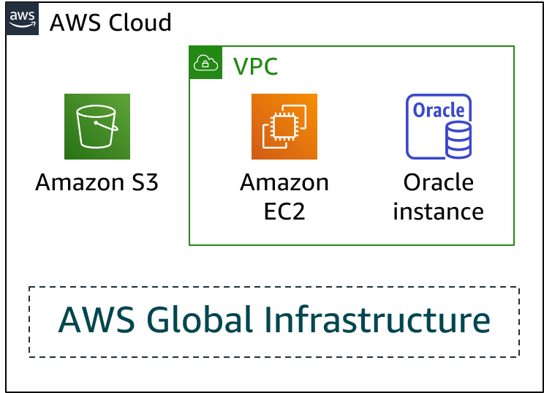
Lecture
6
Shared responsibility model
Activity: Scenario 1
Consider this deployment. Who is responsible: AWS or the customer?
Upgrades and patches to the operating system on the EC2 instance?
Physical security of the data center?
Virtualization infrastructure?
EC2 security group settings?
Configuration of applications that run on the EC2 instance?
Oracle upgrades or patches if the Oracle instance runs as an Amazon RDS instance?
Oracle upgrades or patches if Oracle runs on an EC2 instance?
S3 bucket access configuration?
AWS Cloud Security Foundations– AWS-CSF
Lecture 6 – AWS Cloud Security
Dr. Ibrahim Gomaa

Slide 23
Lecture
6
Shared responsibility model
Activity: Scenario 1
Upgrades and patches to the operating system on the EC2 instance?
Answer: The customer
Physical security of the data center?
Answer: AWS
Virtualization infrastructure?
Answer: AWS
EC2 security group settings?
Answer: The customer
Configuration of applications that run on the EC2 instance?
  Answer: The customer
Oracle upgrades or patches if the Oracle instance runs as an Amazon RDS instance?
Answer: AWS
Oracle upgrades or patches if Oracle runs on an EC2 instance?
Answer: The customer
S3 bucket access configuration?
Answer: The customer
AWS Cloud Security Foundations– AWS-CSF
Lecture 6 – AWS Cloud Security
Dr. Ibrahim Gomaa

Slide 24
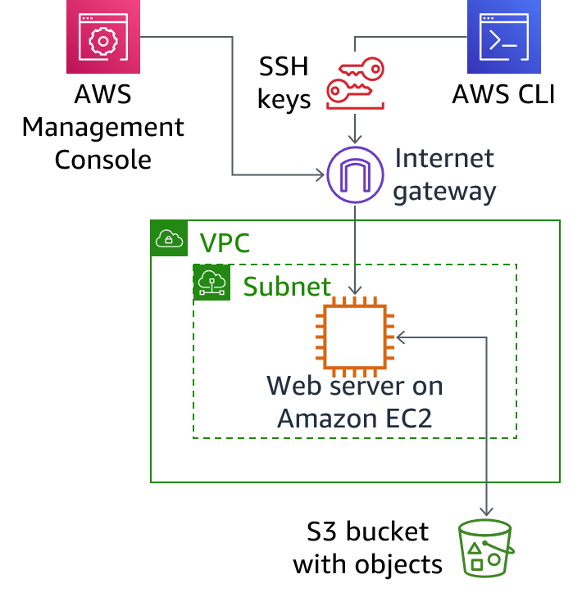
Lecture
6
Shared responsibility model
Activity: Scenario 2
Consider this deployment. Who is responsible: AWS or the customer?
Ensuring that the AWS Management Console is not hacked?
Configuring the subnet?
Configuring the VPC?
Protecting against network outages in AWS Regions?
Securing the SSH keys?
Ensuring network isolation between AWS customers' data?
Ensuring low-latency network connection between the web server and the S3 bucket?
Enforcing multi-factor authentication for all user logins?
AWS Cloud Security Foundations– AWS-CSF
Lecture 6 – AWS Cloud Security
Dr. Ibrahim Gomaa

Slide 25
Lecture
6
Shared responsibility model
Activity: Scenario 2 of 2 answers
1. Ensuring that the AWS Management Console is not hacked?
Answer: AWS
Configuring the subnet?
Answer: The customer
Configuring the VPC?
Answer: The customer
Protecting against network outages in AWS Regions?
Answer: AWS
Securing the SSH keys?
Answer: The customer
Ensuring network isolation between AWS customers' data?
Answer: AWS
Ensuring low-latency network connection between the web server and the S3 bucket?
Answer: AWS
Enforcing multi-factor authentication for all user logins?
Answer: The customer
AWS Cloud Security Foundations– AWS-CSF
Lecture 6 – AWS Cloud Security
Dr. Ibrahim Gomaa

Slide 26


Lecture
6
Shared responsibility model
Managed Services Organization
One approach to implement security and governance is to create a centralized team that is responsible for establishing repeatable processes and templates to deploy applications to AWS.
Such a team could be either internal or external (third-party vendors), and is often referred to as
a provisioning team, center of excellence, or managed services organization (MSO).
External vendors are commonly referred to as managed service providers (MSPs).
“Could you approve my new CloudFormation template?”
“We need five new IAM users.”
“I need a new dev environment.”
MSO
“Which approved AMI is the most recent?”
“We need to create a new AWS account for billing.”
AWS Cloud Security Foundations– AWS-CSF
Lecture 6 – AWS Cloud Security
Dr. Ibrahim Gomaa

Slide 27
Lecture
6
Shared responsibility model
MSO responsibility model
workload owners handle the actual deployment, development, and maintenance of applications. (system administrators, developers, and others who are directly responsible for one or more applications)
MSO ensures that applications are deployed in a secure and compliant fashion through the automated implementation of organizational security requirements.
Workload owners
Customer data
Platform, applications, identity and access management
MSO/MSP
Operating system, network, and firewall configuration
Client-side data encryption and data integrity, authentication
Server-side encryption
(file system and data)
Networking traffic protection
(encryption, integrity, identity)
Software
AWS
Compute
Storage
Databases
Networking
Hardware and AWS Global Infrastructure
Regions
Availability Zones
Edge locations
AWS Cloud Security Foundations– AWS-CSF
Lecture 6 – AWS Cloud Security
Dr. Ibrahim Gomaa

Slide 28
Lecture
6
AWS Cloud Security
Securing a new AWS account
AWS Cloud Security Foundations– AWS-CSF
Lecture 6 – AWS Cloud Security
Dr. Ibrahim Gomaa

Slide 29

Lecture
6
Securing a new AWS account
AWS account root user access versus IAM access
Account root user
IAM
Best practice: Do not use the AWS account root user except when necessary.
  Access to the account root user requires logging in with the email address (and password) that you used to create the account.
Example actions that can only be done with the account root user:
  Update the account root user password
  Change the AWS Support plan
  Restore an IAM user's permissions
  Change account settings (for example, contact information, allowed Regions)
Integrates with other AWS services
Identity federation
Privileges cannot be controlled
Secure access for applications
Full access to all resources
Granular permissions
AWS Cloud Security Foundations– AWS-CSF
Lecture 6 – AWS Cloud Security
Dr. Ibrahim Gomaa

Slide 30
Lecture
6
Securing a new AWS account
Securing a new AWS account: Account root user
Step 1: Stop using the account root user as soon as possible.
  The account root user has unrestricted access to all your resources.
To stop using the account root user:
  While you are logged in as the account root user, create an IAM user for yourself. Save the access keys if needed.
  Create an IAM group, give it full administrator permissions, and add the IAM user to the group.
  Disable and remove your account root user access keys, if they exist.
  Enable a password policy for users.
  Sign in with your new IAM user credentials.
  Store your account root user credentials in a secure place.
AWS Cloud Security Foundations– AWS-CSF
Lecture 6 – AWS Cloud Security
Dr. Ibrahim Gomaa

Slide 31

Lecture
6
Securing a new AWS account
Securing a new AWS account: MFA
Step 2: Enable multi-factor authentication (MFA).
  Require MFA for your account root user and for all IAM users.
  You can also use MFA to control access to AWS service APIs.
Options for retrieving the MFA token –
  Virtual MFA-compliant applications:
    Google Authenticator.
    Authy Authenticator (Windows phone app).
  U2F security key devices:
    For example, YubiKey.
  Hardware MFA options:
    Key fob or display card offered by Gemalto.
MFA token
AWS Cloud Security Foundations– AWS-CSF
Lecture 6 – AWS Cloud Security
Dr. Ibrahim Gomaa

Slide 32
Lecture
6
Securing a new AWS account
Securing a new AWS account: AWS CloudTrail
Step 3: Use AWS CloudTrail.
  CloudTrail tracks user activity on your account.
    Logs all API requests to resources in all supported services your account.
  Basic AWS CloudTrail event history is enabled by default and is free.
    It contains all management event data on latest 90 days of account activity.
To access CloudTrail –
  Log in to the AWS Management Console and choose the CloudTrail service.
  Click Event history to view, filter, and search the last 90 days of events.
To enable logs beyond 90 days and enable specified event alerting, create a trail.
  From the CloudTrail Console trails page, click Create trail.
  Give it a name, apply it to all Regions, and create a new Amazon S3 bucket for log storage.
  Configure access restrictions on the S3 bucket (for example, only admin users should have access).
AWS Cloud Security Foundations– AWS-CSF
Lecture 6 – AWS Cloud Security
Dr. Ibrahim Gomaa

Slide 33
Lecture
6
Securing a new AWS account
Securing a new AWS account: Billing reports
Step 4: Enable a billing report, such as the AWS Cost and Usage Report.
Billing reports provide information about your use of AWS resources and estimated costs for that use.
AWS delivers the reports to an Amazon S3 bucket that you specify.
  Report is updated at least once per day.
The AWS Cost and Usage Report tracks your AWS usage and provides estimated charges associated with your AWS account, either by the hour or by the day.
AWS Cloud Security Foundations– AWS-CSF
Lecture 6 – AWS Cloud Security
Dr. Ibrahim Gomaa

Slide 34
Lecture
6
AWS Cloud Security
Securing accounts
AWS Cloud Security Foundations– AWS-CSF
Lecture 6 – AWS Cloud Security
Dr. Ibrahim Gomaa

Slide 35

Lecture
6
Securing accounts
AWS Organizations
AWS Organizations enables you to consolidate multiple AWS accounts so that you centrally manage them.
Security features of AWS Organizations:
  Group AWS accounts into organizational units (OUs) and attach different access policies to each OU.
  Integration and support for IAM
    Permissions to a user are the intersection of what is allowed by AWS Organizations and what is granted by IAM in that account.
  Use service control policies to establish control over the AWS services and API actions that each AWS account can access
AWS Organizations
AWS Cloud Security Foundations– AWS-CSF
Lecture 6 – AWS Cloud Security
Dr. Ibrahim Gomaa

Slide 36
Lecture
6
Securing accounts
AWS Organizations: Service control policies
Service control policies (SCPs) offer centralized control over accounts.
  Limit permissions that are available in an account that is part of an organization.
Ensures that accounts comply with access control guidelines.
SCPs are similar to IAM permissions policies –
  They use similar syntax.
  However, an SCP never grants permissions.
  Instead, SCPs specify the maximum permissions for an organization.
AWS Cloud Security Foundations– AWS-CSF
Lecture 6 – AWS Cloud Security
Dr. Ibrahim Gomaa

Slide 37

Lecture
6
Securing accounts
AWS Key Management Service (AWS KMS)
AWS Key Management Service (AWS KMS) features:
  Enables you to create and manage encryption keys
  Enables you to control the use of encryption across AWS services and in your applications.
  Integrates with AWS CloudTrail to log all key usage.
  Uses hardware security modules (HSMs) that are validated by Federal Information Processing Standards (FIPS) 140-2 to protect keys
AWS Key Management Service (AWS KMS)
AWS Cloud Security Foundations– AWS-CSF
Lecture 6 – AWS Cloud Security
Dr. Ibrahim Gomaa

Slide 38

Lecture
6
Securing accounts
Amazon Cognito
Amazon Cognito features:
  Adds user sign-up, sign-in, and access control to your web and mobile applications.
  Scales to millions of users.
  Supports sign-in with social identity providers, such as Facebook, Google, and Amazon; and enterprise identity providers, such as Microsoft Active Directory via Security Assertion Markup Language (SAML) 2.0. (SAML is an open standard for exchanging identity and security information with applications and service providers.)
Amazon Cognito
AWS Cloud Security Foundations– AWS-CSF
Lecture 6 – AWS Cloud Security
Dr. Ibrahim Gomaa

Slide 39

Lecture
6
Securing accounts
AWS Shield
AWS Shield features:
  Is a managed distributed denial of service (DDoS) protection service
  Safeguards applications running on AWS
  Provides always-on detection and automatic inline mitigations
  AWS Shield Standard enabled for at no additional cost. AWS Shield Advanced is an optional paid service.
Use it to minimize application downtime and latency.
AWS Shield
AWS Cloud Security Foundations– AWS-CSF
Lecture 6 – AWS Cloud Security
Dr. Ibrahim Gomaa

Slide 40
Lecture
6
AWS Cloud Security
Securing data on AWS
AWS Cloud Security Foundations– AWS-CSF
Lecture 6 – AWS Cloud Security
Dr. Ibrahim Gomaa

Slide 41




Lecture
6
Securing data on AWS
Encryption of data at rest
Encryption encodes data with a secret key, which makes it unreadable
  Only those who have the secret key can decode the data
  AWS KMS can manage your secret keys
AWS supports encryption of data at rest
  Data at rest = Data stored physically (on disk or on tape)
  You can encrypt data stored in any service that is supported by AWS KMS, including:
    Amazon S3
    Amazon EBS
    Amazon Elastic File System (Amazon EFS)
    Amazon RDS managed databases
AWS Cloud Security Foundations– AWS-CSF
Lecture 6 – AWS Cloud Security
Dr. Ibrahim Gomaa

Slide 42








Lecture
6
Securing data on AWS
Encryption of data in transit
Encryption of data in transit (data moving across a network)
  Transport Layer Security (TLS)—formerly SSL—is an open standard protocol
  AWS Certificate Manager provides a way to manage, deploy, and renew TLS or SSL certificates
Secure HTTP (HTTPS) creates a secure tunnel
  Uses TLS or SSL for the bidirectional exchange of data
AWS services support data in transit encryption.
  Two examples:
AWS Cloud
Corporate data center
AWS Cloud
TLS encrypted
data traffic
TLS or SSL
encrypted
Amazon EC2
Amazon EFS
AWS Storage Gateway
Amazon S3
AWS Cloud Security Foundations– AWS-CSF
Lecture 6 – AWS Cloud Security
Dr. Ibrahim Gomaa

Slide 43
Lecture
6
Securing data on AWS
Securing Amazon S3 buckets and objects
Newly created S3 buckets and objects are private and protected by default.
When use cases require sharing data objects on Amazon S3 –
  It is essential to manage and control the data access.
  Follow the permissions that follow the principle of least privilege and consider using Amazon S3 encryption.
Tools and options for controlling access to S3 data include –
  Amazon S3 Block Public Access feature: Simple to use.
  IAM policies: A good option when the user can authenticate using IAM.
  Bucket policies
  Access control lists (ACLs): A legacy access control mechanism.
  AWS Trusted Advisor bucket permission check: A free feature.
AWS Cloud Security Foundations– AWS-CSF
Lecture 6 – AWS Cloud Security
Dr. Ibrahim Gomaa

Slide 44
Lecture
6
AWS Cloud Security
Working to ensure compliance
AWS Cloud Security Foundations– AWS-CSF
Lecture 6 – AWS Cloud Security
Dr. Ibrahim Gomaa

Slide 45



Lecture
6
Working to ensure compliance
AWS compliance programs
Customers are subject to many different security and compliance regulations and requirements.
AWS engages with certifying bodies and independent auditors to provide customers with detailed information about the policies, processes, and controls that are established and operated by AWS.
Compliance programs can be broadly categorized –
  Certifications and attestations
    Assessed by a third-party, independent auditor
    Examples: ISO 27001, 27017, 27018, and ISO/IEC 9001
  Laws, regulations, and privacy
    AWS provides security features and legal agreements to support compliance
    Examples: EU General Data Protection Regulation (GDPR), HIPAA
  Alignments and frameworks
    Industry- or function-specific security or compliance requirements
    Examples: Center for Internet Security (CIS), EU-US Privacy Shield certified
AWS Cloud Security Foundations– AWS-CSF
Lecture 6 – AWS Cloud Security
Dr. Ibrahim Gomaa

Slide 46
Lecture
6
Working to ensure compliance
AWS Config
Assess, audit, and evaluate the configurations of AWS resources.
Use for continuous monitoring of configurations.
Automatically evaluate
recorded configurations versus
desired configurations.
Review configuration changes.
View detailed configuration histories.
Simplify compliance auditing and security analysis.
AWS Config
Example AWS Config Dashboard view
AWS Cloud Security Foundations– AWS-CSF
Lecture 6 – AWS Cloud Security
Dr. Ibrahim Gomaa

Slide 47

Lecture
6
Working to ensure compliance
AWS Artifact
Is a resource for compliance-related information
Provide access to security and compliance reports, and select online agreements
Can access example downloads:
  AWS ISO certifications
  Payment Card Industry (PCI) and Service Organization Control (SOC) reports
Access AWS Artifact directly from the AWS Management Console
  Under Security, Identify & Compliance, click Artifact.
AWS Artifact
AWS Cloud Security Foundations– AWS-CSF
Lecture 6 – AWS Cloud Security
Dr. Ibrahim Gomaa

Slide 48
Lecture
AWS Cloud Security
6
Thanks
AWS Cloud Security Foundations– AWS-CSF
Lecture 6 – AWS Cloud Security
Dr. Ibrahim Gomaa

