Slide 1


IELTS Preparation
Mini-Course
Lecture 1
Prepared by
Ahmed Soliman

Slide 2
Understanding the IELTS Test

Slide 3
37
14
Who am I?
1
2

Slide 4
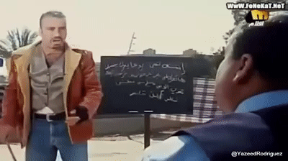
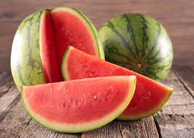


14
1
Years of experience in teaching
The years I taught at KU.
Who am I?
2
37
My 2 favourite foods
My age

Slide 5
🎯 Objectives
By the end of the lesson, students will be able to:
Identify the four IELTS test sections and their timing.
Differentiate between Academic and General Training modules.
Recognize basic question types in each section.
Understand IELTS scoring and band descriptors.

Slide 6
What is IELTS? (International English Language Testing System)
IELTS (General Questions):
What are the four main sections of the IELTS test?
How long does the IELTS test take to complete?
Is the IELTS test paper-based or computer-based?
What is the scoring system in IELTS?
Can you take the Speaking test on a different day than the other sections?
Listening, Reading, Writing, Speaking
About 2 hours 45 minutes
Both paper-based and computer-based options
Scores from 0 to 9 for each section, averaged overall
Yes, Speaking can be on a different day

Slide 7
Academic vs General IELTS – Structure Focused
How is the Reading section structured differently in General and Academic IELTS?
What is the difference in Writing Task 1 between the two versions?
Is Writing Task 2 the same in both versions?
Do the Listening sections have different formats in the two versions?
How does the level of vocabulary and text complexity differ between the two versions?
Academic has 3 long academic texts; General has shorter, everyday texts
Academic: describe a graph/chart; General: write a letter
Yes, same essay structure but different topics
No, Listening is the same in both
Academic uses more advanced vocabulary and complex texts

Slide 8
Test Structure
Section | Time | Number of Questions | Skills Tested
Listening | 30 min + 10 min transfer | 40 | Comprehension, detail, gist
Reading | 60 min | 40 | Skimming, scanning, inference
Writing | 60 min | 2 tasks | Description (T1), Essay (T2)
Speaking | 11–14 min | 3 parts | Fluency, pronunciation, coherence

Slide 9
Listening
How long does the listening module take?
How many questions are there?
How many sections are there?
What happens to the level of difficulty as you progress through the test sections?
How many times do you hear the CD?
What kinds of conversations/ topics do you listen to?
What sort of tasks do you have to do?
Do you use pencil or pen to write your answers on the computer sheet?
While the CD is playing, where do you write your answers?
Does correct spelling matter?

Slide 10
Listening (Answers)
About 30 mins, plus candidate gets 10 mins time after to transfer answers to computerised answer sheet.
40
4
The level of difficulty increases.
Once Only. No possibility of playing it again
Conversation between 2 people regarding an everyday social context, monologue/ talk in an everyday social context, conversation regarding study/ training conversation between 3or 4 people & lecture / talk (academic)
Label/map diagram, multiple choice, matching, complete for chart, table, summary, notes and short answers.
Pencil only and pen now.
On the Question paper
Yes, as a general rule (and grammatical accuracy as well).

Slide 11
Reading
How long does the reading module take?
How long are the reading passages altogether?
How many reading passages are there?
How many questions do you have to answer?
There are different reading papers for Academic IELTS and General Training IELTS. What are the main differences?
Where are the reading tests taken from?
What sort of tasks are commonly set?
How carefully should you read the instructions?

Slide 12
Reading (Answers)
60 minutes
2,150- 2750 words. (around 2,500)
3 in Academic. General uses 2 or 3 short texts in Section 1, 2 short texts in section 2 and one longer text in section 3
40
Academic- topics of general academic interest- written for non-specialist audience- authentic books, journals, magazine newspaper material. General- authentic adverts, brochures newspapers, notices – simpler, more factual than Academic
authentic material see answer 5.
MCQ, sentence completion, matching paragraph headings to paragraphs- testing gist reading- classification, TFNG, short answer, completion: note- flowchart-table-summary etc
Very carefully. Do not exceed number of specified words in the answer.

Slide 13
Writing
How long is the writing test?
How many pieces of writing do you have to do?
What is the minimum number of words you must write for each task?
What does Writing Task One for Academic IELTS consist of?
What does Writing Task One for General Training IELTS consist of?
What kind of writing do you do for Task Two?
How long should you spend on each task?
Are you allowed to write on the question paper?
Which is better to write with- pen or pencil?
What are the marking criteria for Writing?

Slide 14
Writing (Answers)
60 minutes
2 a Task One and a Task 2.
150 for Task One and 250 for Task 2(question words are discounted, so repeating words from the question [ or RUBRIC} doesn’t count towards the word count.
A report on a graph, chart, bar chart, or diagram of a change or a process.
A transactional letter- i.e. a letter that requires a response, or action, on the part of the recipient. Formal, informal or semi-formal.
An essay, look carefully at the TASK.
recommended is 20 mins on first task and 40 on 2nd, because mark on 2nd task carries more weight – mark is calculated by a computer programme.
Yes
pencil- you can rub it out, pen.
Public marking criteria on official Cambridge ESOL website, for Speaking and writing. Writing is: Task Achievement, lexis, grammar- range and accuracy- and Coherence and cohesion

Slide 15
Speaking
How long is the speaking test, approximately?
Is the speaking test recorded?
How many sections are there to the speaking test?
What does each section test?
Is good pronunciation important?
In Section two of the speaking test, you are required to speak on a topic for 1 to 2 minutes. Who chooses the topic, you or the examiner?
What are the marking criteria for Speaking?

Slide 16
Speaking (Answers)
11- 14 mins. (usually nearer 14.)
yes- digital recorder.
3
section 1- responses to everyday topics 2- ability to organize a solo contribution 3- ability to interact with a native speaker- turn-taking, recognizing summarizing, challenges etc. ability to explain, clarify, justify, paraphrase.
yes.
The examiner. You CANNOT ask for another topic.
Public marking criteria on official Cambridge ESOL website, for Speaking and writing. Speaking is: fluency and coherence, lexis, grammar (range and accuracy)- and pron.

Slide 17
✍️ Writing and Speaking Criteria
Both are graded by certified IELTS examiners using specific criteria:
Writing Criteria
Task Achievement (Task 1) / Task Response (Task 2)
Coherence and Cohesion
Lexical Resource (Vocabulary)
Grammatical Range and Accuracy
Speaking Criteria
Fluency and Coherence
Lexical Resource
Grammatical Range and Accuracy
Pronunciation

Slide 18
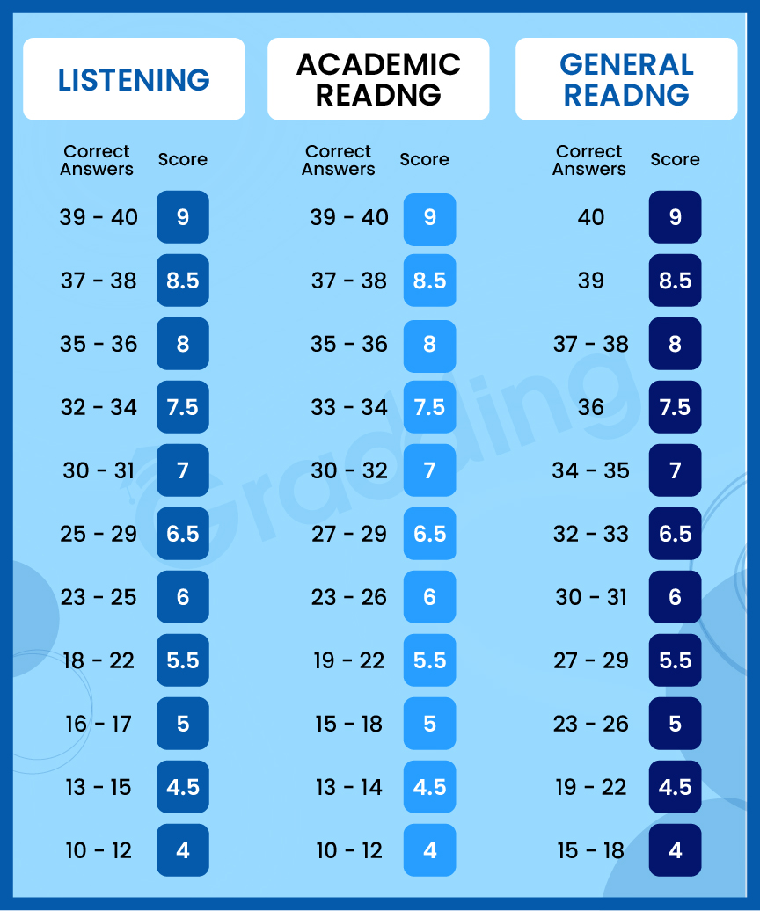
IELTS Listening & Reading Band Score
.,

Slide 19
📈 Example of Overall Band Calculation
Skill | Score
Listening | 7.5
Reading | 7.0
Writing | 6.5
Speaking | 7.0
Average = (7.5 + 7.0 + 6.5 + 7.0) ÷ 4 = 7.0
✅ Overall Band Score = 7.0

Slide 20
🧠 Activity: Mini Quiz (4 Questions)
How many parts are there in the Speaking test?
How long does the Listening test take?
What is the total test duration (approx.)?
What does Task 1 in Academic Writing describe?

Slide 21
IELTS Websites
• https://ieltsonlinetests.com/
• http://mini-ielts.com/
• https://starkcamp.com/
• Recent Topics in IELTS: https://howtodoielts.com/recent-ielts-writing-topics-2022/

Slide 22
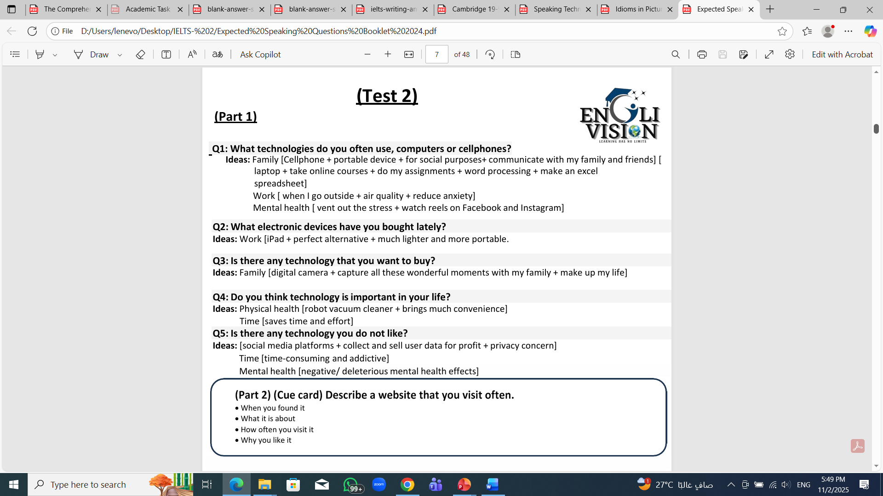
Speaking Questions (Part 1)

Slide 23

Speaking Questions (Part 2)

Slide 24
Assignment
Answer test 1 in Cambridge 19 book.
(Listening – Reading- Writing Task 1)

Slide 25


Thank You

