Slide 1
Compensation
& Benefits

Slide 2
Agenda
01
Employees needs
02
Employer Value Proposition
03
Compensation & benefits Structure
04
Benefits Proposal

Slide 3
Maslow Hierarchy of Needs
SELF FULFILMENT
Accomplishment Mental Growth
ESTEEM
Approval Recognition, Self-confidence
SOCIAL
Friendships, Group Memberships, Social connection
SAFETY
Physical Safety
PHYSIOLOGICAL
Food, Shelter, Clothing

Slide 4
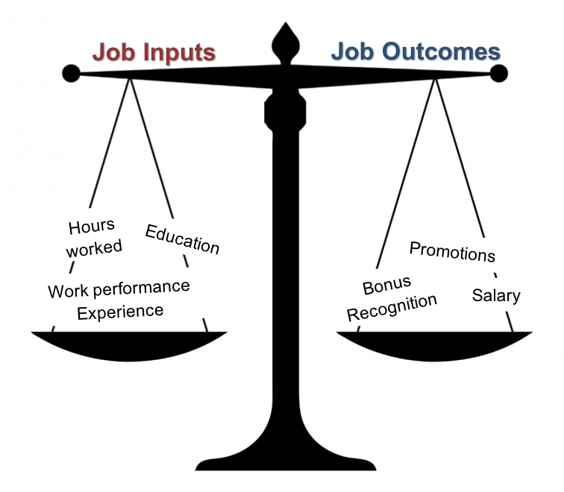
Equity Theory

Slide 5
Employer Value Proposition- Example
Compensation
Competitive Pay
Allowances
Performance Reward
Pay Raise
Career Development
Training & Development
Succession Planning
Mentoring & Coaching
Benefits
Retirement Benefit
Loan
Remote Work during Emergency
Medical Insurance
Value Proposition
Culture
Values, safety culture
& strategy awareness
Reputation
Communication & Org. Dynamics
Work Environment
Family Friendly Environment
Recognition& Awards
Org. Fairness/ Justice
Job Design
Facilities& Layout
Wellness
Health & Safety
Wellness News letter & Training
Wellness activities

Slide 6
Compensation & Benefits Structure
Compensation
Competitive Pay
Allowances
Performance Reward
Pay Raise
Cash payment of basic salary before any allowances, variable bonuses or any cash payment
Ex. 5 years tenure of service: 2 months for every year
< 5 years tenure: 1 month for every year
Post Retirement
Basic Salaries
Ex. Transportation, travel, representation allowances
Allowances
Medical Insurance
Elite medical service to employees & their families
Merit increase or Bonus
Performance Reward
Recognition Awards
Gratuity Reward (every 5 yrs.)
Employee of the year, Wellness Awards

Slide 7
Recognition& Rewards
Employee of the Year Award
Recognizes employees’ exceptional efforts, performance and attitude
.
Wellness Leader
Recognizes leaders who provide encouragement, time, and resources to promote Wellness
Wellness Champion
Celebrates employees who supports and actively participate in wellness program

Slide 8
Employee of the Year Award
0.23
0.20
Knowledge Sharing
0.17
Teamwork
0.16
Professionalism
0.14
Safety Culture
0.11
Customer Focus
Innovation

Slide 9



Wellness Dimensions
Emotional
Spiritual
Managing stress, anxiety, depression, having resilience to cope with life challenges
Having Sense of purpose, meditation, Yoga. Etc.
Social
Intellectual
Building & maintain supportive relationship
Expanding knowledge, skills- based learning
Physical
Occupational
Fitness, nutrition. Exercises, healthy habits
Personal fulfillment, work- life balance

Slide 10

THANK
YOU

