Slide 1

E-Commerce
Prepared by Dr. Adam Yagoub
Lecture 1
MGM212
Introduction to e-business and e-commerce

Slide 2
Course Outline
Lecture 1: Introduction to e-business and e-commerce.
Lecture 2: E-commerce fundamentals.
Lecture 3: E-business infrastructure.
Lecture 4: - E-environment.
Lecture 5: E-business strategy
Lecture 6: E-procurement.
Lecture 7: E-marketing.
Lecture 8: Customer relationship management.
Lecture 9: Analysis and design.
Lecture 10: Implementation and maintenance.

Slide 3
Lecture Outline
1. Introduction.
2. The impact of the electronic communications on traditional businesses.
3. What is the difference between e-commerce and e-business?
- E-commerce defined.
E-business defined.
4. Define electronic commerce (EC) and Electronic business.
5. Traditional Commerce v/s E-Commerce.
6. Benefits of Doing Business Electronically.

Slide 4
Learning Outcomes
After completing this chapter the student should be able to:
1. Define the meaning and scope of e-business and e-commerce and their different elements.
2. Summarize the main reasons for adoption of e-commerce and e-business and barriers that may restrict adoption.
3. Outline the ongoing business challenges of managing e-business and e-commerce in an organization.

Slide 5
Introduction to e-business and e-commerce
1. Introduction:
Organizations have now been applying technologies based on the Internet, World Wide Web and wireless communications to transform their businesses for over 15 years since the creation of the first web site (http://info.cern.ch) by Sir Tim Berners-Lee in 1991. Deploying these technologies has offered many opportunities for innovative e-businesses to be created based on new approaches to business. Table 1.1 highlights some of the best-known examples.

Slide 6
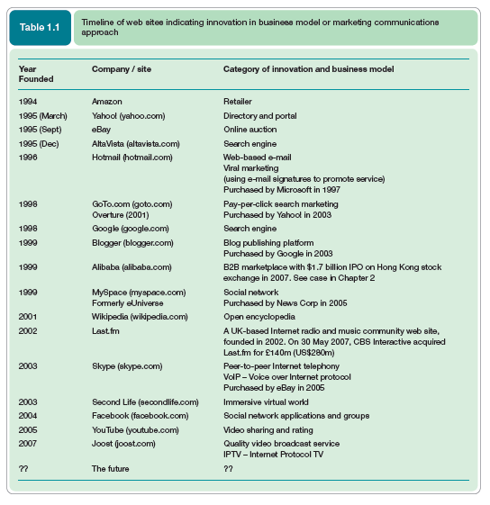
Introduction to e-business and e-commerce

Slide 7
Introduction to e-business and e-commerce
E-business and e-commerce is an exciting area to be involved with, since many new opportunities and challenges arise yearly, monthly and even daily. Innovation is a given, with the continuous introduction of new technologies, new business models and new communications approaches. For example, Google innovates relentlessly. Its service has developed a long way since 1998 (Figure 1.1) with billions of pages now indexed and other services such as web mail, pay per click adverts, analytics and social networks all part of its offering.

Slide 8
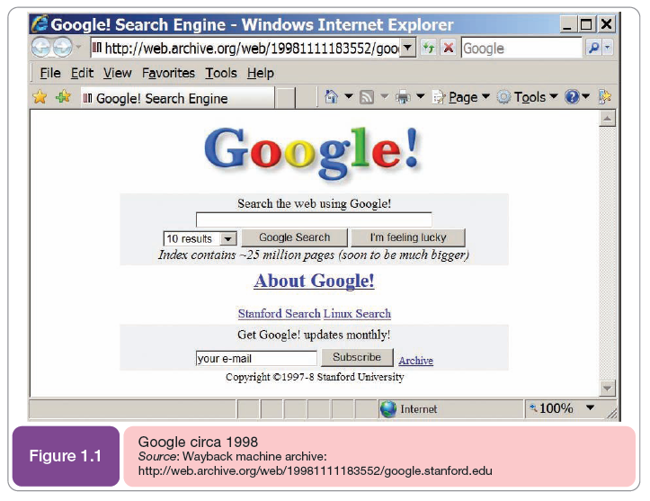
Introduction to e-business and e-commerce

Slide 9
Introduction to e-business and e-commerce
2. The impact of the electronic communications on traditional businesses:
During the same period managers at established businesses have had to determine how to apply new electronic communications technologies to transform their organizations. existing businesses have evolved their approaches to e-business through a series of stages. Innovation in e-business is relentless, with the continuous introduction of new technologies, new business models and new communications approaches.

Slide 10
Introduction to e-business and e-commerce
So all organizations have to review new electronic and Internet-based communications approaches for their potential to make their business more competitive and also manage ongoing risks such as security and performance . For example, current opportunities which many businesses are reviewing the benefits, costs and risks of implementing include:

Slide 11
Introduction to e-business and e-commerce
- the growth in popularity of social networks such as Bebo, Facebook and MySpace, virtual worlds such as Habbo Hotel and Second Life, and blogs created by many individuals and businesses;
- rich media such as online video and interactive applications into their web sites;

Slide 12
Introduction to e-business and e-commerce
- selection of mobile commerce services which exploit the usage of mobile phones and other portable wireless devices such as laptops around the world.
- using location-based tracking of goods and inventory as they are manufactured and transported.

Slide 13
Introduction to e-business and e-commerce
3. What is the difference between e-commerce and e-business?
The rapid advancement of technology and its application to business has been accompanied by a range of new terminology and jargon. The use of the term 'electronic commerce’ has been supplemented by additional terms such as e-business and e-marketing, and more specialist terms such as e-CRM, e-tail and e-procurement.

Slide 14
Introduction to e-business and e-commerce
- E-commerce defined:
Electronic commerce (e-commerce) is often thought simply to refer to buying and selling using the Internet; people immediately think of consumer retail purchases from companies such as Amazon. But e-commerce involves much more than electronically mediated financial transactions between organizations and customers. E-commerce should be considered as all electronically mediated transactions between an organization and any third party it deals with.

Slide 15
Introduction to e-business and e-commerce
By this definition, non-financial transactions such as customer requests for further information would also be considered to be part of e-commerce. Kalakota and Whinston, refer to a range of different perspectives for e-commerce:

Slide 16
Introduction to e-business and e-commerce
1. A communications perspective – the delivery of information, products or services or
payment by electronic means.
2. A business process perspective – the application of technology towards the automation of business transactions and workflows.

Slide 17
Introduction to e-business and e-commerce
3. A service perspective – enabling cost cutting at the same time as increasing the speed and quality of service delivery.
4. An online perspective – the buying and selling of products and information online.

Slide 18
Introduction to e-business and e-commerce
- Electronic commerce (e-commerce)
All electronically mediated information exchanges between an organization and its external stakeholders.
- Electronic commerce (EC)
The process of buying, selling, or exchanging products, services, or information via computer networks.
- E-commerce
The exchange or buying and selling of goods and services by electronic means.

Slide 19
Introduction to e-business and e-commerce
- E-business defined:
Let’s start from the definition by IBM (www.ibm.com/e-business), which was one of the first suppliers to use the term in 1997 to promote its services:
e-business is the transformation of key business processes through the use of Internet technologies.

Slide 20
Introduction to e-business and e-commerce
- E-business
A broader definition of EC that includes not just the buying and selling of goods and services, but also servicing customers, collaborating with business partners, and conducting electronic transactions within an organization
- Electronic business (e-business)
All electronically mediated information exchanges, both within an organization and with external stakeholders supporting the range of
business processes.

Slide 21
Introduction to e-business and e-commerce
An process that an organization conducts over a computer-mediated network
  Production – procurement, ordering, stock replenishment, payment processing, production control, etc.
  Customer-focused – marketing, selling, customer order processing, etc.
  Internal or management-focused – employee service, training, recruiting, information sharing, etc.

Slide 22
Introduction to e-business and e-commerce
- Electronic-Business Infrastructure:
The share of total economic infrastructure used to support e-business processes and conduct e-commerce transactions.
  Hardware
  Software
  Telecommunication networks
  Support services
  Human resources

Slide 23
Introduction to e-business and e-commerce
- importance of electronic commerce:
E- Commerce Can Broaden Your Brand & Expand Your Business
E - Commerce Can Be Done With Fewer Overheads & Fewer Risk
E- Commerce Helps Businesses Go Global

Slide 24
Introduction to e-business and e-commerce
It’s More Convenient
Increase Your Reach
E - Commerce Offers Better Marketing Opportunities
Improve the Image of Your Business
Scalable
Security shows Business reliability

Slide 25
Introduction to e-business and e-commerce
- E-Commerce advantages:
E-Commerce advantages can be broadly classified in three major categories:
- Advantages to Organizations.
- Advantages to Consumers.
- Advantages to Society.

Slide 26

E-commerce –Disadvantages And Problems
Chapter-1
Security
Site crash
No possibility of tried and tested product
Late delivery
Some products are difficult to buy online
Lack of privacy
Tax issues
Legal issues
Huge technological cost
Shipping problems
High labour cost
Credit card fraud

Slide 27
Chapter-1
Traditional Commerce v/s E-Commerce
Sr. No. | Traditional Commerce | E-Commerce
1 | Heavy dependency on information exchange from person to person. | Information sharing is made easy via electronic communication channels making little dependency on person to person information exchange.
2 | Communication/ transaction are done in synchronous way. Manual intervention is required for each communication or transaction. | Communication or transaction can be done in asynchronous way. Electronics system automatically handles when to pass communication to required person or do the transactions.
3 | It is difficult to establish and maintain standard practices in traditional commerce. | A uniform strategy can be easily established and maintain in e-commerce.

Slide 28
Chapter-1
Traditional Commerce v/s E-Commerce
Sr. No. | Traditional Commerce | E-Commerce
4 | Communications of business depends upon individual skills. | In e-Commerce or Electronic Market, there is no human intervention.
5 | Unavailability of a uniform platform as traditional commerce depends heavily on personal communication. | E-Commerce website provides user a platform where al l information is available at one place.
6 | No uniform platform for information sharing as it depends heavily on personal communication. | E-Commerce provides a universal platform to support commercial / business activities across the globe.

Slide 29
Introduction to e-business and e-commerce
- Benefits of Doing Business Electronically:
- Reducing The Cost of Executing Transactions.
- Increasing the Speed of Business.
- Doing Business Any Time Anywhere.
- Improving Workflow.

Slide 30
Introduction to e-business and e-commerce
- Benefits of Doing Business Electronically cont. …:
1. Reducing Errors and Improving Quality
2. Collaborating With Suppliers
  - Joint product design
  - Synchronized production
  - Servicing end customers

Slide 31
Introduction to e-business and e-commerce
- E-Commerce - Business Models and types:
E-commerce business models can generally be categorized into the following categories.
- Business - to - Business (B2B).
- Business - to - Consumer (B2C).
- Consumer - to - Consumer (C2C).
- Consumer - to - Business (C2B).
- Business - to - Government (B2G).
- Government - to - Business (G2B).
- Government - to - Citizen (G2C).

Slide 32
Introduction to e-business and e-commerce
- Examples of E-Commerce:
- Retailing and Marketing.
- Entertainment and Travel.
- Education and Learning.
- Banking and Investment.
- Health-Care.
- Auction.
- Personal and Business Service.

Slide 33
Introduction to e-business and e-commerce
- Key Business Drivers of E-Commerce:
- Internet.
- Information.
- Collaboration.
- Agility.
- Speed.
- Service.

Slide 34
Introduction to e-business and e-commerce
- Competitive Advantages of E-Commerce:
- Offers personalized products/services.
- Enables customer self-service.
- Reduces lead time.
- Reduces overall cost for seller and customers.
- Improves utilization of resources throughout the supply chain.
- Increases customer satisfaction and loyalty.
- Expands to global marketplace.

Slide 35
Introduction to e-business and e-commerce
- B2C E-commerce Implementation Strategies:
- Educate the customer.
- Make the shopping fun.
- Serve customers well.
- Personalize the sales pitch.
- Cross sell and up sell.
- Low price.
- Painless returns.

Slide 36
Introduction to e-business and e-commerce
- Ways to Improve E-Commerce Operations:
- Technology (hardware and software).
- Business Process Reengineering.
- Agile production (mass customization).
- Just-in-time system.
- Supply chain management.
- Business intelligence.
- Customer relationship management.

Slide 37
Introduction to e-business and e-commerce
- 5 factors in E -Commerce success:
The importance of e Commerce for your business can’t be denied, and therefore, check the top 6 factors in e Commerce success:
- High-quality products are important in order to keep your customers loyal to your business, make sure you procure your goods from trusted suppliers.
- The product pricing is important, you don’t want it to be too low for customers to doubt the quality of it or too high that they can’t afford to buy it.

Slide 38
Introduction to e-business and e-commerce
- Make your store accessible on many devices such as mobile devices. You can do things to make your online store viewed better on mobile devices like optimizing your images and using responsive design.
- A first impression lasts forever, so make sure you have a good-looking website and make the best eye-catching designs if possible.

Slide 39
Introduction to e-business and e-commerce
- Lastly, security is a top priority. It is one of the main concerns with e Commerce for consumers and business owners, as their personal and financial information is being handled online.

Slide 40

Introduction to e-business and e-commerce
References:
E-Business and E-Commerce Management : strategy, implementation and practice, fourth edition.
By: dave chaffey.
Chapter 1

