Slide 1

Project Risk &Supply Chain Risk
Prepared by Dr. Dalia Hosni
Lecture 2
PMG 663
Project Risk &Supply Chain Risk

Slide 2


Chapter
02
Project Risk &Supply Chain Risk
What Is a Project?
What Is a Risk?
Types of Project Risk
Supply chain management
Risk in Supply chain
Supply Chain Risk Management (SCRM)

Slide 3
Chapter
02
Project Risk Topics
Plan Risk Management
Identify Risks
Perform Qualitative Risk Analysis
Perform Quantitative Risk Analysis
Plan Risk Responses
Monitor and Control Risks

Slide 4
Chapter
02
What Is a Project?
A Project : A temporary efforts that has a defined goal and definitive start and stop point
      A time-scoped/time-boxed activity
      Has a beginning, middle and an end
      Creates a unique product, service or result
      A ‘progressive elaboration’

Slide 5
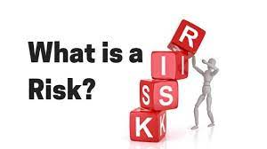
Chapter
02
Risk
Risk
An unplanned or uncertain event that can impact a project

Slide 6
Chapter
02
Risk
Risk
A risk is any uncertain event or condition that might affect your project. Not all risks are negative. Some events (like finding an easier way to do an activity) or conditions (like lower prices for certain materials) can help your project. When this happens, we call it an opportunity; but it’s still handled just like a risk.

Slide 7
Chapter
02
Project Risk Management
التنفيذ
المراقبة والمتابعة
الإغلاق
تخطيط
Initiating
Executing
Monitoring
&
Controlling
Planning
Closing
إعداد
Plan Risk Management
Identify Risks
Perform Qualitative Risk Analysis
Perform Quantitative Risk Analysis
Plan Risk Responses
Monitor and
Control Risks

Slide 8

Chapter
02
Project Risk Management
A key objective of performing project risk management is to increase the probability of project success
by minimizing or eliminating negative risk events and increasing the probability of positive events.
Risk Management includes the processes of planning risk management, identifying risks,
performing qualitative and quantitative analysis of risks, planning responses to risks, and finally
monitoring and controlling risks on the project
Risk is always in the future
Risk involves uncertainty - it may or may not occur
Assess your organization's tolerance for risk: are they risk tolerant or risk averse?
There will be known risks and unknown risks
Risks can be negative or positive and are identified as threats or opportunities
Risk is considered from the moment the project is conceived

Slide 9
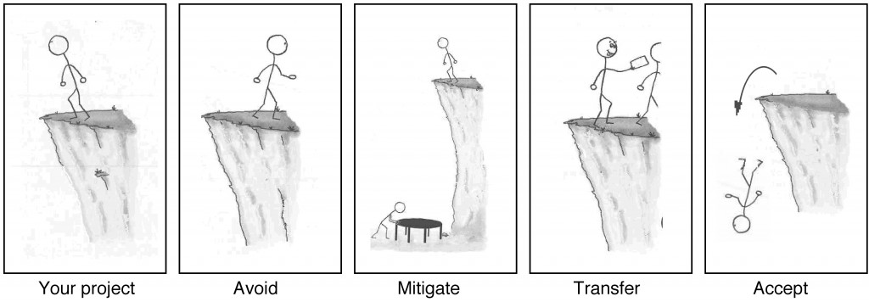
Chapter
02
Risk Management Planning?
        If your project requires that you stand on the edge of a cliff, then there’s a risk that you could fall. If it’s very windy out or if the ground is slippery and uneven, then falling is more likely

Slide 10
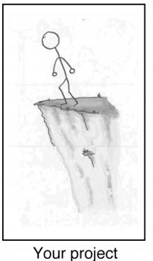
Chapter
02
Risk Management Planning?
When you’re planning your project, risks are still uncertain: they haven’t happened yet. But eventually, some of the risks that you plan for do happen, and that’s when you have to deal with them. There are four basic ways to handle a risk.

Slide 11
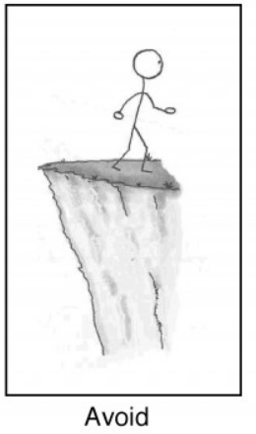
Chapter
02
Risk Management Planning?
Avoid: The best thing you can do with a risk is avoid it. If you can prevent it from happening, it definitely won’t hurt your project.

Slide 12
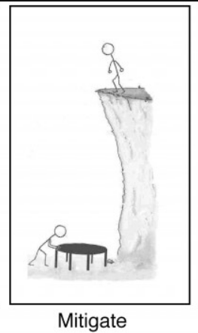
Chapter
02
Risk Management Planning?
Mitigate: If you can’t avoid the risk, you can mitigate it. This means taking some sort of action that will cause it to do as little damage to your project as possible.

Slide 13
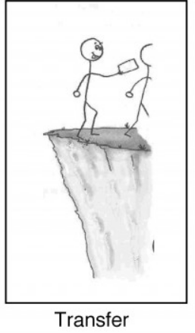
Chapter
02
Risk Management Planning?
3.Transfer: One effective way to deal with a risk is to pay someone else to accept it for you. The most common way to do this is to buy insurance.

Slide 14
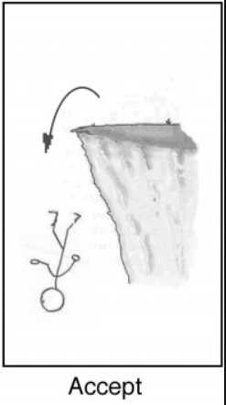
Chapter
02
Risk Management Planning?
Accept: When you can’t avoid, mitigate, or transfer a risk, then you have to accept it. But even when you accept a risk, at least you’ve looked at the alternatives and you know what will happen if it occurs. If you can’t avoid the risk, and there’s nothing you can do to reduce its impact, then accepting it is your only choice.

Slide 15
Chapter
02
Risk Management Planning?
By the time a risk actually occurs on your project, it’s too late to do anything about it. That’s why you need to plan for risks from the beginning and keep coming back to do more planning throughout the project.

Slide 16
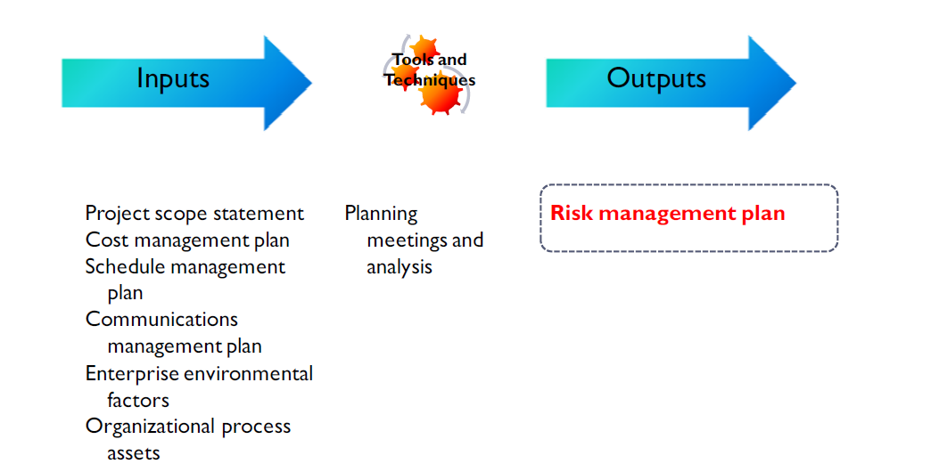
Chapter
02
Plan Risk Management
Notes
This process defines how you will conduct risk management activities for a project. It includes the
process of defining and providing sufficient resources and time to perform risk management activities.
Planning for risk management begins when the project is originally conceived and should be completed early in the Planning process group.

Slide 17
Chapter
02
The Risk Management Plan
Components Include:
Methodology
Roles and responsibilities
Budgeting
Timing
Risk categories
Definitions of probability and impact
Stakeholder tolerances
Reporting formats
Tracking
Which Define:
How you will do risk management
Who will do what
What risk. Will cost
When we do risk.
Example internal, external
Will it happen and how severe the
risk may be
Risk tolerant or risk averse
What goes into the report
Audit of risk process

Slide 18
Chapter
02
The Risk Management Plan
The output of the Plan Risk Management process is the creation and completion of the Risk
Management Plan. The major categories in a risk management plan include:
      Risk management methodology
      roles and responsibilities
      Budgeting
      Timing
      Risk Categories
      Definitions of probability and impact
      Probability and impact matrix
      Revised stakeholder’s tolerances
      Reporting Formats
      Tracking

Slide 19
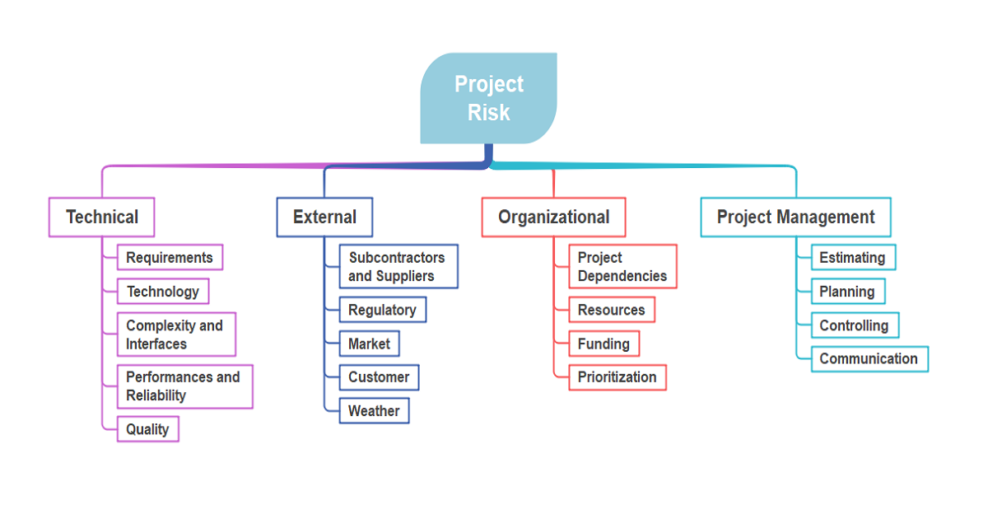
Chapter
02
Risk Breakdown Structure
The risk categories in a project management plan can be graphically represented with a tool that is similar to the work breakdown structure (WBS) called a Risk Breakdown Structure (RBS).
The RBS enables you to see all project risks grouped by basic themes and the specific risk areas occurring in relation to each theme
.

Slide 20
Chapter
02
What is Risk Identification?
Risk identification is the process of identifying and assessing threats to an organization, its operations, and its workforce. For example, risk identification may include assessing IT security threats such as malware and ransomware, accidents, natural disasters, and other potentially harmful events that could disrupt business operations. Companies that develop robust risk management plans are likely to find they’re able to minimize the impact of threats, when and if they should occur.

Slide 21
Chapter
02
Risk Identification Process Steps
There are five core steps within the risk identification and management process. These steps include risk identification, risk analysis, risk evaluation, risk treatment, and risk monitoring.
Risk Identification: The purpose of risk identification is to reveal what, where, when, why, and how something could affect a company’s ability to operate. For example, a business located in central California might include “the possibility of wildfire” as an event that could disrupt business operations.

Slide 22
Chapter
02
Risk Identification Process Steps
Risk Analysis: This step involves establishing the probability that a risk event might occur and the potential outcome of each event. Using the California wildfire example, safety managers might assess how much rainfall has occurred in the past 12 months and the extent of damage the company could face should a fire occur.

Slide 23
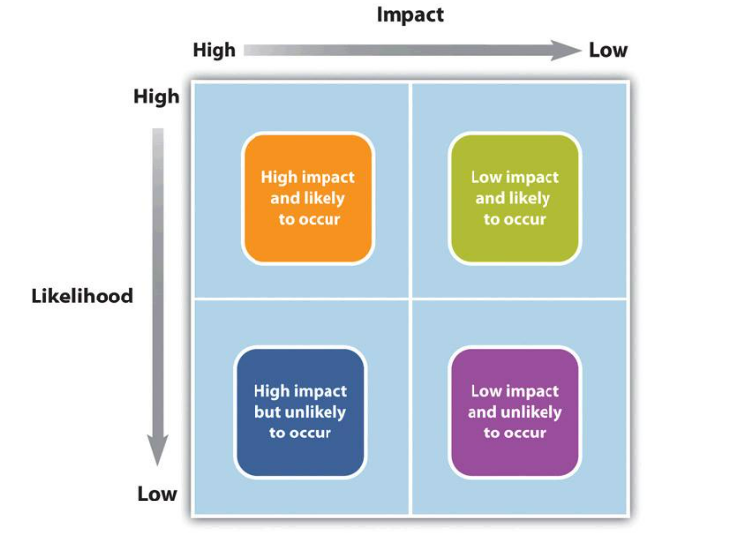
Chapter
02
Risk Identification Process Steps
Risk Evaluation: Risk evaluation compares the magnitude of each risk and ranks them according to prominence and consequence. For example, the effects of a possible wildfire may be weighed against the effects of a possible mudslide. Whichever event is determined to have a higher probability of happening and causing damage, it would rank higher.
تأثير كبير محتمل الحدوث
تأثير منخفض محتمل الحدوث
تأثير كبير ولكن غير محتمل الحدوث
تأثير منخفض ولكن غير محتمل الحدوث

Slide 24
Chapter
02
Risk Identification Process Steps
Risk Treatment: Risk treatment is also referred to as Risk Response Planning. In this step, risk mitigation strategies, preventative care, and contingency plans are created based on the assessed value of each risk. Using the wildfire example, risk managers may choose to house additional network servers offsite, so business operations could still resume if an onsite server is damaged. The risk manager may also develop evacuation plans for employees.
Risk Monitoring: Risk management is a non-stop process that adapts and changes over time. Repeating and continually monitoring the processes can help assure maximum coverage of known and unknown risks.

Slide 25
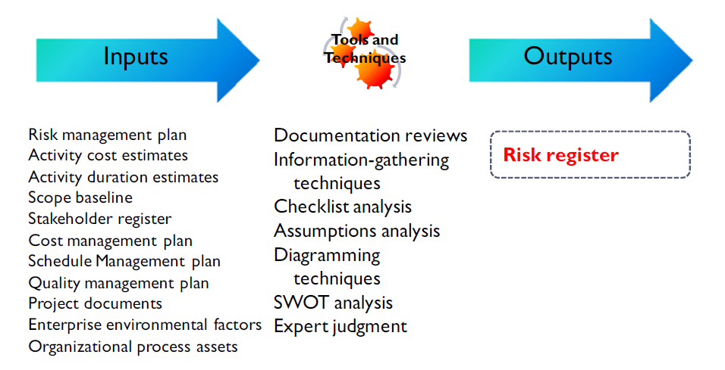
Chapter
02
identify risk

Slide 26
Chapter
02
identify risk
This Process is used to determine which risks may affect the project, and can include the following resources when performing risk identification activities:
      Project Manager
      Project Team
      Risk Team
      Stakeholders
      Customers
      Subject matter experts

Slide 27
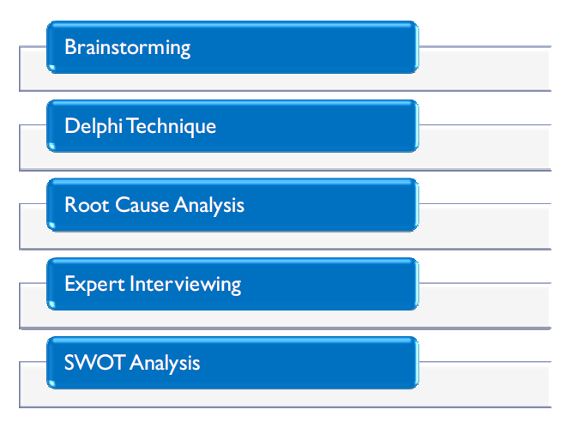
Chapter
02
Risk Information Gathering Techniques
The above-mentioned risk information gathering techniques are well established and have been in use for many years.

Slide 28
Chapter
02
Risk Information Gathering Techniques
Brainstorming and Delphi
Brainstorming is a technique developed by Alex Osborn, The four fundamental steps to brainstorming are as follows:
Focus on quantity: The idea is to facilitate problem solving through the concept, quantity breeds quality. The idea assumes that the greater the number of ideas generated, the greater the chance of producing an effective solution.
Withhold criticism: In brainstorming, criticism of ideas generated is postponed until the team is
ready to analyze the input. Instead, participants focus on extending or adding to ideas. By
suspending judgment, participants will feel free to generate unusual ideas.
Welcome unusual ideas: To get a good and long list of ideas, unusual ideas are welcomed. They can be generated by looking from new perspectives and suspending assumptions. These new ways of thinking may provide better solutions.
Combine and improve ideas: Good ideas may be combined synergistically, to form a single
improved good idea, as suggested by the counterintuitive "1+1=3". It is believed to stimulate
the building of ideas by a process of association.

Slide 29
Chapter
02
Risk Information Gathering Techniques
Delphi Technique
The Delphi Technique was developed by the RAND Corporation (an acronym for Research ANd
Development) in the 1960s and was created as an interactive forecasting method that relies on a panel
of independent experts. Usually, all participants maintain anonymity. Their identity is not revealed even
after the completion of the final report. This stops them from dominating others and using their
authority or personality. This frees participants from their personal biases, minimizing the "bandwagon
effect" or "halo effect", allowing them to freely express their opinions, encouraging open critique and
admitting errors by revising earlier judgments.

Slide 30
Chapter
02
Risk Information Gathering Techniques
Root Cause Analysis (RCA) and Expert Interviewing
The RCA Technique RCA is a reactive method of problem detection and solving, initially. The analysis is performed after an event has occurred. This allows practitioners to identify process ‘triggers’, so that RCA becomes a proactive method. In other words, RCA is able to forecast the possibility of an event before it might occur.
Expert Interviewing is the process of interviewing subject matter experts to obtain critical information
for the project.

Slide 31
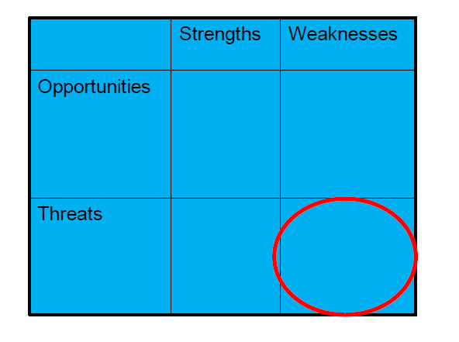
Chapter
02
Risk Information Gathering Techniques
SWOT Analysis
This one analysis is generally set up as a grid with strengths and weaknesses as the two major columns,
and opportunities and threats as the two major rows in the grid.
The idea is to see where the organization's strengths and weaknesses play against opportunities and threats using the four following comparisons:

Slide 32
Chapter
02
Risk Information Gathering Techniques
SWOT Analysis
Strengths-Opportunities - identifies how organizational strengths help the organization to capitalize on opportunities
Weaknesses-Opportunities - identifies organizational weaknesses, from the perspective of making the necessary improvements, to enable the organization to capitalize on opportunities
Strengths-Threats - identifies how our organizational strengths help us deal with competitors or threatening situations
Weaknesses-Threats - identifies how our organizational weaknesses leave us vulnerable to external competition or threats

Slide 33
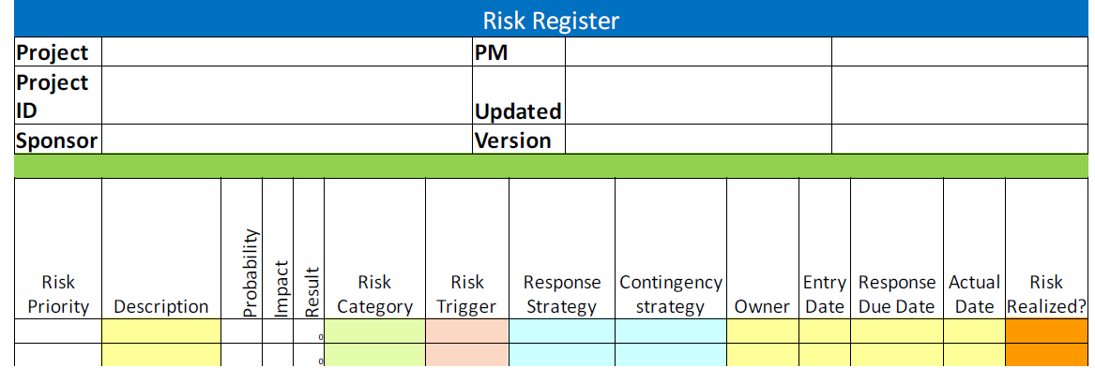
Chapter
02
The Risk Register

Slide 34
Chapter
02
The Risk Register
The risk register becomes a key planning tool for the project. Understand that although a risk identifies only the probability of an event occurring, the possibility of the event is deemed to be real, true and requires assistance in monitoring.
The risk register : contains a description of the risk, it's probability, its impact in dollars, a category of risk, the triggering event that indicates the risk is about to occur, the risk response strategy, the risk owner, the date the risk was identified, a due date for resolution and most importantly, the risk’s priority.
Note
Any risk with a probability percentage of 70% or greater is no longer a risk, it’s an issue!

