Slide 1

MGM 112
Introduction to Economics
Prepared by Dr. Maryem ZORGUI
Lecture 7 The Economies of Scale
And
The Returns to Scale

Slide 2
LEARNING OBJECTIVES
To understand the concepts of Economies of Scale.
To understand the concept of Return to Scale.
To be able to refer to relevant examples in a particular scenario,

Slide 3
Syllabus
I. Economies of Scale
II-The Returns to scale
III- External Economies
And
Trade Policy

Slide 4
I. Economies of Scale
I-1-Definition of Economies of Scale
I-2-How Economies of Scale Work
I-3-Types of Economies of Scale
I-4-Diseconomies of Scale

Slide 5
I. Economies of Scale -1-
I-1-Definition of Economies of Scale
Economies of Scale are cost reductions that occur when companies increase production.
The fixed costs, like administration, are spread over more units of production. Sometimes, a company that enjoys economies of scale can negotiate to lower its variable costs, as well.

Slide 6
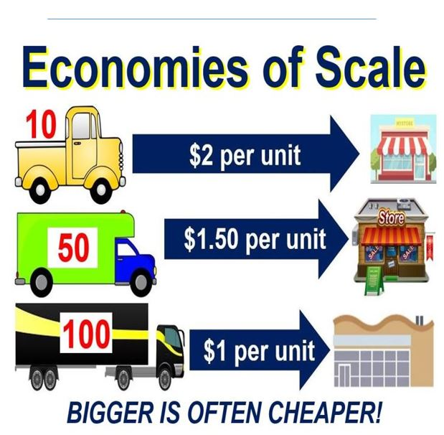

Slide 7
I. Economies of Scale -2-
Any time a company can decrease costs by increasing the volume of goods they produce, that's an example of an Economy of Scale.
There are several reasons why the costs of production would decrease as volume increases.
For example, by keeping a production line focused on one product, companies may save on the costs associated with swapping out raw materials and tools to produce different products.
The most basic examples are managerial and administrative costs—you don't have to hire more managers just because your workers start producing more items per day.

Slide 8
I. Economies of Scale -3-
I-2-How Economies of Scale Work
The specific way an Economy of Scale works depends on the goods or services being produced.
It may be as simple as extending operating hours to get more use out of expensive machinery.
Any way that a company can improve the per-unit cost by producing more units, that is how economies of scale work.
Economies of Scale not only benefit the organization that produces the goods.
Consumers can enjoy lower prices. The economy grows as lower prices stimulate increased demand.

Slide 9
I. Economies of Scale -4-
I-3-Types of Economies of Scale
There are two main types of economies of scale: internal and external. Internal economies are controllable by management because they are internal to the company.
a-External economies: based on changes outside the company
b-Internal economies: caused by factors within the firm,

Slide 10
I. Economies of Scale -5-
I-3-1-Types of Internal Economies of Scale
Internal Economies of Scale are those economies which occurs to the firm itself when it expands its output.
They:
Reduce in the fixed cost.
Cost reduction due to specialization
Less cost for raw material.
.

Slide 11
I. Economies of Scale -6-
We will take a closer look at six different types of internal economies of scale:
1- technical
2- managerial
3- marketing
4-financial Economies of Scale
5- commercial
6- network

Slide 12
I. Economies of Scale -7-
I-3-2-Types of External Economies of Scale
External Economies of Scale are caused by changes outside an individual firm but within the entire industry.
They occure when the whole industry grows larger and the firm benefits from lower long run AC.
External economies:
Outside factor e.g. Taxes.
Reduction in cost due to proper transport
.

Slide 13
I. Economies of Scale -8-
We will take a closer look at the following 4 different types of external Economies of Scale:
1- Infrastructure
2-Specialization
3-Innovation Economies of Scale
4-Lobbying

Slide 14
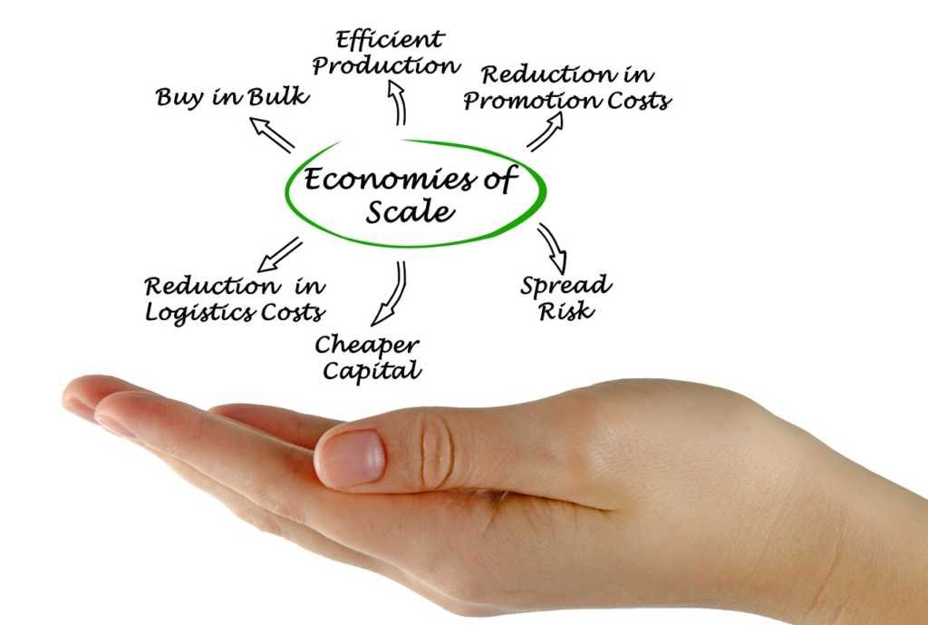
I. Economies of Scale -9-

Slide 15
I. Economies of Scale -10-
I-4-Diseconomies of Scale
Sometimes a company chases economies of scale so much that it becomes too large. This overgrowth is called a diseconomy of scale. There comes a point at which maximum efficiency has been reached. Any units produced after that will increase production costs per unit, rather than decrease them.
Diseconomies of scale aren't always tied to physical production efficiencies. For example, it might take longer to make decisions, making the company less flexible. Miscommunication could occur, especially if the company becomes global. Acquiring new companies could result in a clash of corporate cultures. This clash will slow progress if they don't learn to manage cultural diversity.

Slide 16
I. Economies of Scale -11-
I-5-Economies of Scope
Economies of scope are similar to economies of scale, but they occur when a company branches out into multiple product lines to combine efficiencies and business functions.
For example, most newspapers diversified into similar product lines, such as magazines and online news. In other words, economies of scale focus on one product (volume), while economies of scope involve many products (variety).

Slide 17
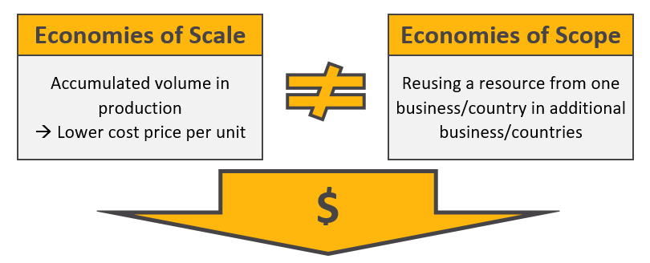

Slide 18
II-The Returns to Scale
II-1- Definition
II-2- Law of returns to scale
II-3- The Returns to scale
A- Increasing returns to scale
B- Decreasing returns to scale
C- Constant returns to scale

Slide 19
II-The Returns to Scale -1-
II-1- Definition of The Returns to scale
Returns to scale
In the long run all factors of production are variable. No factor is fixed. Accordingly, the scale of production can be changed by changing the quantity of all factors of production.
“The term returns to scale refers to the changes in output as all factors change by the same proportion.” Koutsoyiannis
“Returns to scale relates to the behaviour of total output as all inputs are varied and is a long run concept”. Leibhafsky
Returns to scale is the Rate at which output increases as inputs are increased proportionately.

Slide 20
II-The Returns to Scale -2-
II-2- The law of Return to Scale
In the long- run the dichotomy between fixed factor and variable factor ceases. In other words, in the long-run all factors are variable.
The law of returns to scale examines the relationship between output and the scale of inputs in the long-run when all the inputs are increased in the same proportion

Slide 21
II-The Returns to Scale -3-
II-3- The 3 phases of returns to scale
There are three phases of returns in the long-run which may be separately described as :
a- Increasing returns to scale: Situation in which output more than doubles when all inputs are doubled.
b- Constant returns to scale: Situation in which output doubles when all inputs are doubled.
c- Decreasing returns to scale: Situation in which output less than doubles when all inputs are doubled.

Slide 22
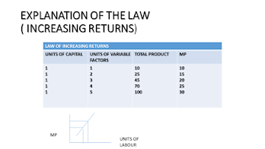
II-The Returns to Scale -4-
A- Increasing returns to scale
Increase in output is more than increase in input.
This is also known as law of diminishing costs.
This is because the cost per unit of output falls as the industry expands.
Causes of increasing returns to scale
Indivisibility of factors of production
Division of labour and specialization
Internal and external economies of scale.

Slide 23
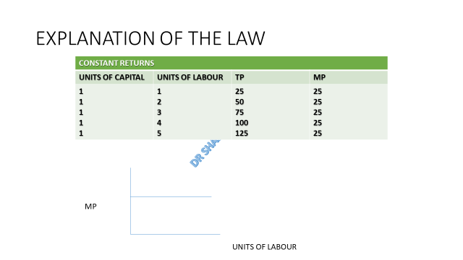
II-The Returns to Scale -5-
B- Constant returns to scale
As more and more units of the variable
factor are applied with the fixed factor,
marginal product tends to remain constant.
Total output increases at constant rate.
increase in the output is equal to increase
in input.
This is called linear homogenous production function

Slide 24
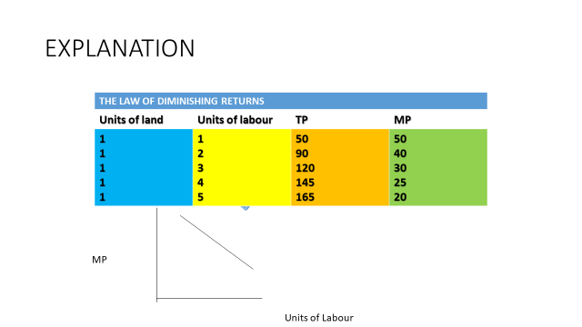
II-The Returns to Scale -6-
C- Decreasing returns to scale
increase in the output is less than the
increase in the input.
Occurs due to difficulties in
management, coordination and control
Assumptions:
  Short Run
  Fixed and variable factors
  Homogeneous
  Change in the factor proportions
  Constant technology

Slide 25
II-The Returns to Scale -8-
Labour | Capital | Total output | Increase in the rate of output | Nature of returns to scale
1 | 1 | 4 | 4 | Increasing returns to scale
2 | 2 | 10 | 6
3 | 3 | 18 | 8
4 | 4 | 28 | 10 | Constant returns to scale
5 | 5 | 38 | 10
6 | 6 | 48 | 10
7 | 7 | 58 | 10
8 | 8 | 65 | 7 | Decreasing returns to scale
9 | 9 | 70 | 5
10 | 10 | 74 | 4
Exp:

Slide 26
II-The Returns to Scale -10-
Explanation:
1- First stage:
  Total product increases at incresing rate.
  MP and AP increase in the begining stage, reach maximum and then start declining.
  When AP is maximum then it equals t MP, stage relates to increasing average returns.
2- Second stage:
  TP increases at decreasing rate and, at the end of stage, it becomes constant.
  AP and MP also decrease.
  MP at the end of the stage becomes zero.
3- Third stage:
  TP starts declining.
  MP becomes negative.
  AP also falls.
Notes:
MP: Marginal Product AP: Average Product TP: Total Product

Slide 27
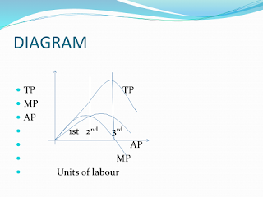
II-The Returns to Scale -11-
Explanation:
During the first stage, the marginal output rises and ultimately begin to fail.
The average product rise and becomes constant in the end of the first stage and becomes equal to Mp.
Second stage, MP becomes zero and AP starts falling.
In the third stage, MP becomes negative and TP starts decreasing. AP also falls.
Third stage is knowing as “Economic Absurdity” or “Economic Nonsense”.
A rational producer will produce up to second stage and it will never produce in third stage.

Slide 28
III- External Economies and Trade Policy

Slide 29
III- External Economies and
Trade Policy -1-
Prior to international trade, equilibrium prices and output for each country would be at the point where the domestic supply curve intersects the domestic demand curve.
Suppose Chinese button prices in the absence of trade would be lower than U.S. button prices.

Slide 30
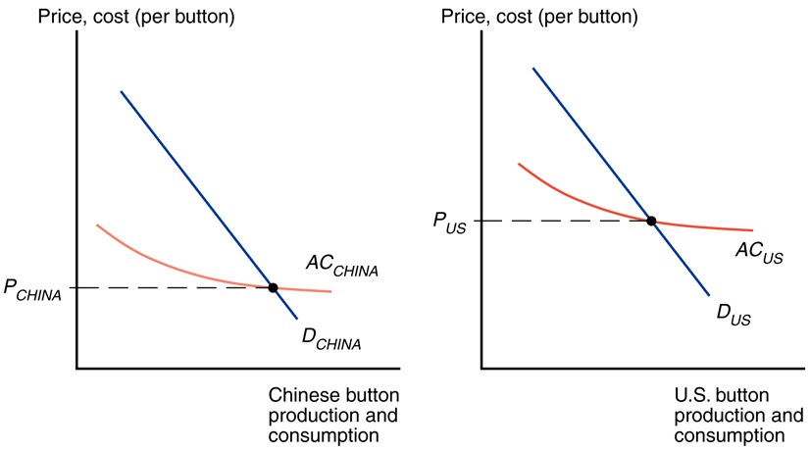

Slide 31
III- External Economies and
Trade Policy -2-
What will happen when the countries open up the potential for trade in buttons?
The Chinese button industry will expand, while the U.S. button industry will contract.
This process feeds on itself: As the Chinese industry’s output rises, its costs will fall further; as the U.S. industry’s output falls, its costs will rise.
In the end, all button production will be in China
Trade leads to prices that are lower than the prices in either country before trade!

Slide 32
III- External Economies and
Trade Policy -3-
What might cause one country to have an initial advantage from having a lower price?
One possibility is comparative advantage due to underlying differences in technology and resources.
If external economies exist, however, the pattern of trade could be due to historical accidents:
  Countries that start as large producers in certain industries tend to remain large producers even if another country could potentially produce more cheaply.
  E.g.: Silicon Valley may owe its existence to two Stanford graduates named Hewlett and Packard who started a business in a garage there.

Slide 33
III- External Economies and
Trade Policy -4-
Dynamic Increasing Returns
So far, we have considered cases where external economies depend on the amount of current output at a point in time.
But external economies may also depend on the amount of cumulative output over time.
Dynamic increasing returns to scale exist if average costs fall as cumulative output over time rises.
  Dynamic increasing returns to scale imply dynamic external economies of scale.

Slide 34
III- External Economies and
Trade Policy -5-
Dynamic increasing returns to scale could arise if the cost of production depends on the accumulation of knowledge and experience, which depend on the production process
over time.
Like external economies of scale at a point in time, dynamic increasing returns to scale can lock in an initial advantage or a head start in an industry.

Slide 35
III- External Economies and
Trade Policy -6-
Can also be used to justify protectionism.
  Temporary protection of industries enables them to gain experience: infant industry argument.
  But temporary is often for a long time, and it is hard to identify when external economies of scale really exist.
Exp: Consider two countries: US and Brazil and the aeronautic industry.

Slide 36
III- External Economies and Trade Policy -7-
Assume that there are dynamic localized external economies (at the country level): external because they depend on the industry size, dynamic because they depend on the accumulated quantity (and not just on today’s quantity) and localized because they do not spill over other countries.
If USA and Brazil had produced the same accumulated quantity (had the same experience), Brazil would be the most efficient producer.
However, Brazil has no experience in the industry.
As before, individual Brazilian producers do not have any incentive to produce.

Slide 37
III- External Economies and
Trade Policy -8-
Brazil does not have an aeronautic industry, not because it is inefficient, but because it has no experience.
Brazil can use protectionist measures (a tariff larger than the cost difference) or subsidies (which cover at least the cost difference) to incentivize the creation of a local aeronautic industry.
Once Brazil has learned enough, it would attain a cost lower than the US. At that point, Brazil is more efficient than the US. It can then open up to trade and become the world producer.
This rationale for temporary protection of a local industry is know as the infant industry argument.

Slide 38
III- External Economies and
Trade Policy -9-
Problems in practice
Hard for governments to identify when external economies of scale really exist.
Hard to identify industries with greatest potential comparative advantage.
Politically difficult to remove “temporary” protection once in place. Local producers will lobby their government to keep protectionist measures indefinitely (rent seeking argument).
    Knowing this, many infant industries never “grow up”→ Protectionism does not incentivize local producers to improve their productivity (competition gives incentives to innovate and become more efficient).

Slide 39
III- External Economies and
Trade Policy -10-
Trade need not to be the result of comparative advantage. Instead, it can result from increasing returns or economies of scale, that is, from a tendency of unit costs to be lower with larger output.
Economies of scale give countries an incentive to specialize and trade even in the absence of differences in resources or technology between countries.

Slide 40
III- External Economies and
Trade Policy -11-
Economies of scale can be internal (depending on the size of the firm) or external (depending on the size of the industry).
Economies of scale can lead to a breakdown of perfect competition, unless they take the form of external economies, which occur at the level of the industry instead of the firm.

Slide 41
III- External Economies and
Trade Policy -12-
External Economies give an important role to history and accident in determining the pattern of international trade.
  When External Economies are important, a country starting with a large advantage may retain that advantage even if another country could potentially produce the same goods more cheaply.
  6. Countries may benefit from temporary protectionism if their industries exhibit external economies of scale either at a point in time or over time.

Slide 42


Slide 43
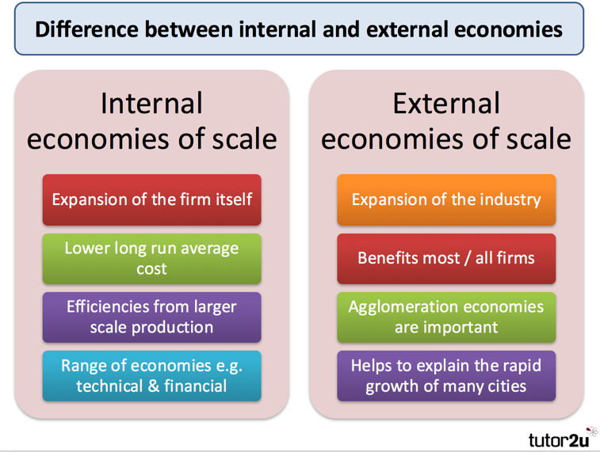

Slide 44
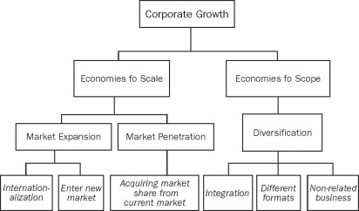

Slide 45


