Slide 1

RHSA (Admin 1) Red Hat Enterprise Linux 8 Essentials
Prepared by Eng. Taghreed Elsayed
Lecture 6
Monitoring and Managing Linux Processes

Slide 2

Chapter
07
Monitoring and Managing Linux Processes
WHAT IS A PROCESS?
A process is a running instance of a launched, executable program.
A process consists of:
• an address space of allocated memory,
• security properties including ownership credentials and privileges,
• one or more execution threads of program code, and the process state.
The environment of a process includes:
• local and global variables,
• a current scheduling context, and allocated system resources, such as file descriptors and network ports.

Slide 3
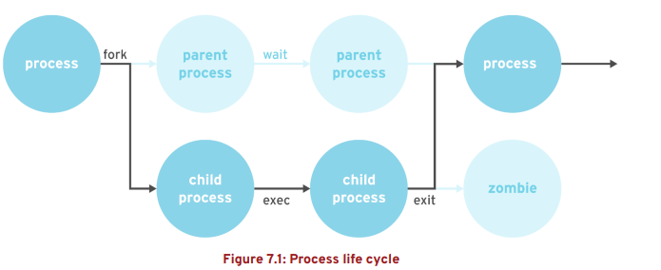
Chapter
07
Monitoring and Managing Linux Processes
An existing (parent) process duplicates its own address space (fork) to create a new (child) process structure.
Every new process is assigned a unique process ID (PID) for tracking and security.
The PID and the parent's process ID (PPID) are elements of the new process environment.
Any process may create a child process. All processes are descendants of the first system process, which is systemd(1) on a Red Hat Enterprise Linux 7 system.

Slide 4
Chapter
07
Monitoring and Managing Linux Processes
PROCESS STATES
In a multitasking operating system, each CPU (or CPU core) can be working on one process at a single point in time.
As a process runs, its immediate requirements for CPU time and resource allocation change.
Processes are assigned a state, which changes as circumstances require.

Slide 5
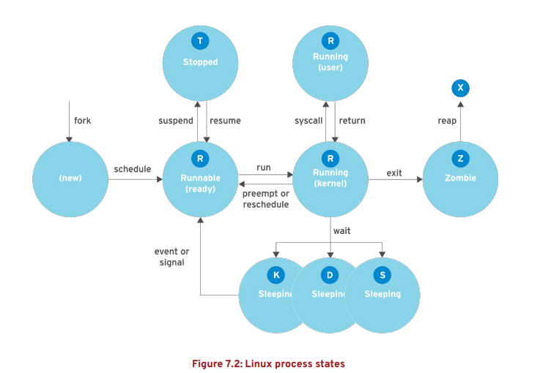
Chapter
07
Monitoring and Managing Linux Processes

Slide 6
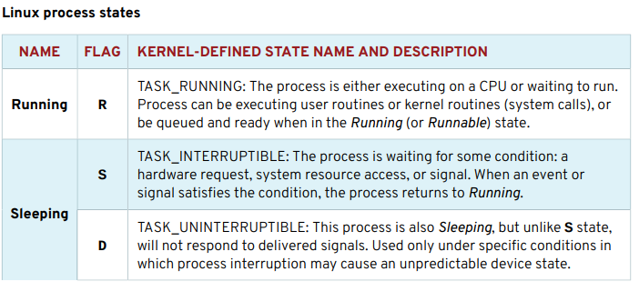
Chapter
07
Monitoring and Managing Linux Processes

Slide 7
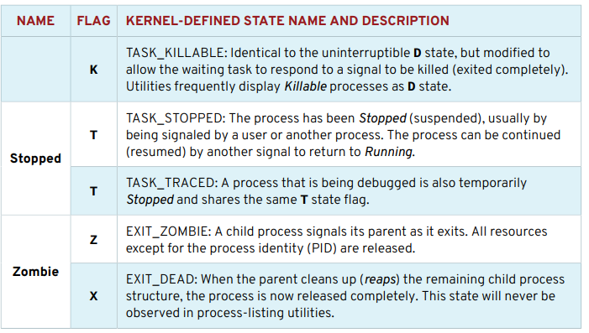
Chapter
07
Monitoring and Managing Linux Processes

Slide 8
Chapter
07
Monitoring and Managing Linux Processes
LISTING PROCESSES
The ps command is used for listing current processes.
The command can provide detailed process information, including:
• the user identification (UID) which determines process privileges,
• the unique process identification (PID).
• the CPU and real time already expended
• how much memory the process has allocated in various locations
• the location of process STDOUT, known as the controlling terminal, and the current process state.

Slide 9

Chapter
07
Monitoring and Managing Linux Processes
A common display listing (options aux) displays all processes, with columns in which users will be interested, and includes processes without a controlling terminal.
A long listing (options lax) provides more technical detail, but may display faster by avoiding the username lookup.
The similar UNIX syntax uses the options -ef to display all processes.

Slide 10
Chapter
07
Monitoring and Managing Linux Processes
CONTROLLING JOBS
JOBS AND SESSIONS Job control is a feature of the shell which allows a single shell instance to run and manage multiple commands. A job is associated with each pipeline entered at a shell prompt.
All processes in that pipeline are part of the job and are members of the same process group. (If only one command is entered at a shell prompt, that can be considered to be a minimal "pipeline" of one command.
That command would be the only member of that job.) Only one job can read input and keyboard-generated signals from a particular terminal window at a time.
Processes that are part of that job are foreground processes of that controlling terminal.

Slide 11
Chapter
07
Monitoring and Managing Linux Processes
The ps command will show the device name of the controlling terminal of a process in the TTY column.
Some processes, such as system daemons, are started by the system and not from a shell prompt.
These processes do not have a controlling terminal, are not members of a job, and can not be brought to the foreground.
The ps command will display a question mark (?) in the TTY column for these processes.
RUNNING JOBS IN THE BACKGROUND
Any command or pipeline can be started in the background by appending an ampersand (&) to the end of the command line.
The bash shell displays a job number (unique to the session) and the PID of the new child process.
The shell does not wait for the child process and redisplays the shell prompt.

Slide 12

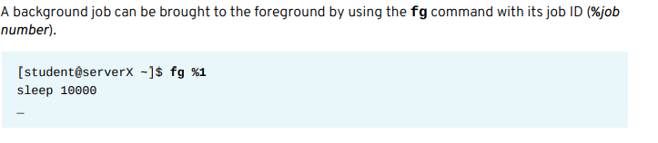
Chapter
07
Monitoring and Managing Linux Processes
The bash shell tracks jobs, per session, in a table displayed with the jobs command.

Slide 13

Chapter
07
Monitoring and Managing Linux Processes
→In the preceding example, the sleep command is now running in the foreground on the controlling terminal.
→The shell itself is again asleep, waiting for this child process to exit. To send a foreground process to the background, first press the keyboard-generated suspend request (Ctrl+z) on the terminal.
The job is immediately placed in the background and is suspended

Slide 14
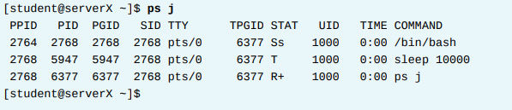
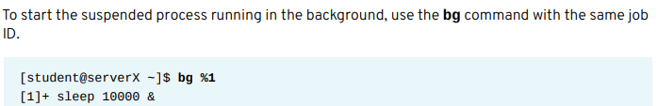
Chapter
07
Monitoring and Managing Linux Processes
The ps j command will display information relating to jobs. The PGID is the PID of the process group leader, normally the first process in the job's pipeline.
The SID is the PID of the session leader, which for a job is normally the interactive shell that is running on its controlling terminal. Since the example sleep command is currently suspended, its process state is T.

Slide 15
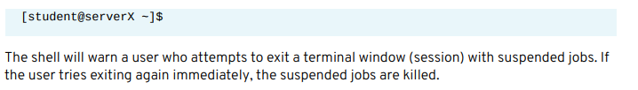
Chapter
07
Monitoring and Managing Linux Processes
KILLING PROCESSES
PROCESS CONTROL USING SIGNALS A signal is a software interrupt delivered to a process.
Signals report events to an executing program. Events that generate a signal can be an error, external event (e.g., I/O request or expired timer), or by explicit request (e.g., use of a signal-sending command or by keyboard sequence).
The following table lists the fundamental signals used by system administrators for routine process management. Refer to signals by either their short (HUP) or proper (SIGHUP) name.

Slide 16
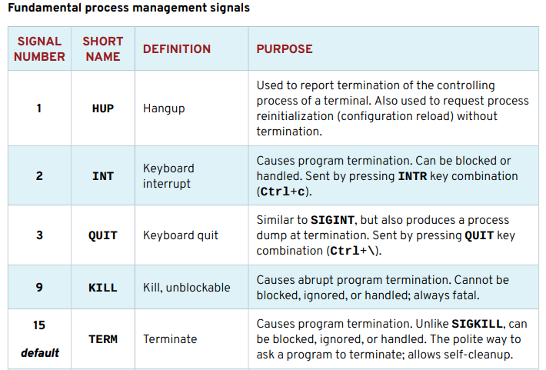
Chapter
07
Monitoring and Managing Linux Processes

Slide 17
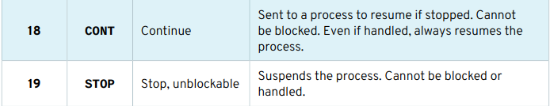

Chapter
07
Monitoring and Managing Linux Processes

Slide 18
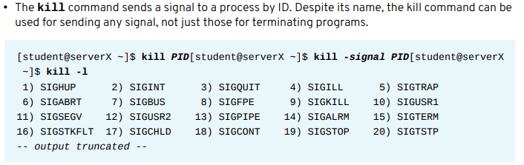
Chapter
07
Monitoring and Managing Linux Processes
Commands for sending signals by explicit request
Users signal their current foreground process by pressing a keyboard control sequence to suspend (Ctrl+z), kill (Ctrl+c), or core dump (Ctrl+\) the process.
To signal a background process or processes in a different session requires a signal-sending command.

Slide 19
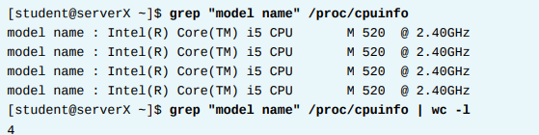
Chapter
07
Monitoring and Managing Linux Processes
MONITORING PROCESS ACTIVITY
• Linux counts not only processes, but threads individually, as separate tasks. CPU request queues for running threads (nr_running) and threads waiting for I/O resources (nr_iowait) reasonably correspond to process states R (Running) and D (Uninterruptable Sleeping). Waiting for I/O includes tasks sleeping for expected disk and network responses.

Slide 20

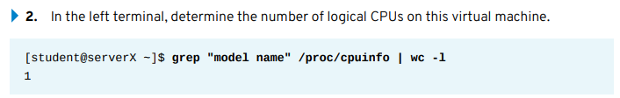
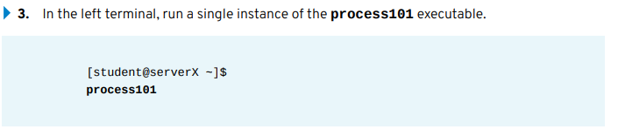
Chapter
07
Monitoring and Managing Linux Processes
→use the top command to dynamically view, sort, and stop processes.

Slide 21
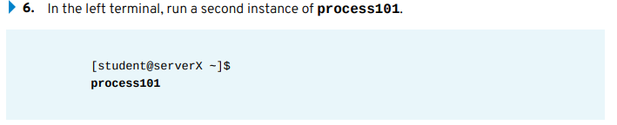
Chapter
07
Monitoring and Managing Linux Processes
4. In the right terminal, observe the top display. Use the single keystrokes l, t, and m to toggle the load, threads, and memory header lines. After observing this behavior, ensure that all headers are displaying.
5. Note the process ID (PID) for process101. View the CPU percentage for the process, which is expected to hover around 25% or 30%. View the load averages. On a single-CPU virtual machine, for example, the one-minute load average is currently less than a value of 1. The value observed may be affected by resource contention from another virtual machine or the virtual host.
7. In top, note the process ID (PID) for the second process101. View the CPU percentage for the process, also expected to hover around 25% or 30%. View the one-minute load average again, which may still be less than 1. Wait up to one minute to allow the calculation to adjust to the new workload.

Slide 22

Chapter
07
Monitoring and Managing Linux Processes
9. In top, note the process ID (PID) for the third process101. View the CPU percentage for the process, again expected to hover around 25% or 30%. View the one-minute load average again, which now is expected to be above 1. Wait up to one minute to allow the calculation to again adjust to the new workload.
10. Optional: If this virtual machine has more than one logical CPU, slowly start additional process101 instances until the one-minute load average equals or exceeds the number of logical CPUs. Divide the load average value by the number of CPUs to determine the estimated load average per CPU.
11. When finished observing the load average values, terminate each of the process101 processes from within top

Slide 23
Chapter
07
Monitoring and Managing Linux Processes
11.1. Press k. Observe the prompt below the headers and above the columns.
11.2. Type the PID for one of the process101 instances. Press Enter.
11.3. Press Enter again to use the default SIGTERM signal 15. Confirm that the selected process is no longer observed in top. If the PID still remains, repeat these terminating steps, substituting SIGKILL signal 9 when prompted.
12. Repeat the previous step for each remaining process101 instance. Confirm that no process101 instances remain in top. 13. In the right window, press q to exit top. Close extra terminal windows.

