Slide 1


Storage Technologies
IT403
Prepared by
Dr. Ahmed El-Douh
Lecture 5

Slide 2



Storage Technologies
Lecture 5
IT403
Storage Network Technologies
Prepared by
Dr. Ahmed El-Douh

Slide 3
Foreword
This module introduces the types of storage network and the comparison of the advantages and disadvantages between different types of storage networks.
This module also introduces the definition of DAS, NAS, and SAN.
This module also describes in detail on the architecture of DAS, NAS and SAN storage network, and its advantages and disadvantages.

Slide 4
Objectives
Upon completion of this module, you will be able to:
  Describe the characteristics of DAS, NAS and SAN storage network technologies.
  Differentiate between the advantages and disadvantages of DAS, NAS, and SAN storage network technologies.

Slide 5
Chapter
Outlines
05
Classification of Network Storages
DAS - Traditional Storage Technology
  Challenges Faced By DAS Storage
SAN - Storage Area Network
  SAN Storage Application
NAS - Network Attached Storage.
  Benefits of NAS
Comparison of DAS, NAS and SAN

Slide 6


Chapter
05
Classification of Network Storages

Slide 7
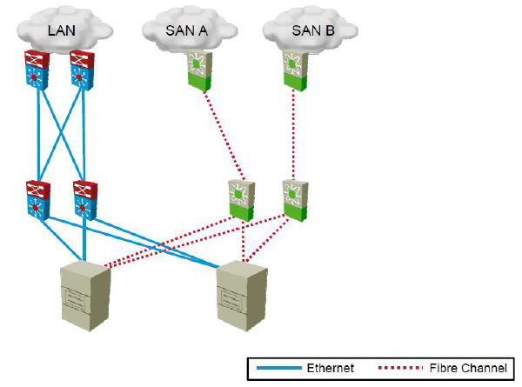
Data Center Storage Network

Slide 8
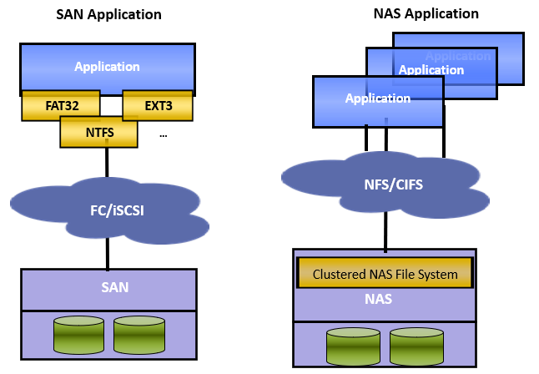
SAN VS NAS

Slide 9
Chapter
05
DAS - Traditional Storage Technology

Slide 10

Definition of DAS
Definition of DAS: DAS refers to 1 or more storage devices that are directly connected to the servers which provides block storage services to the servers.
Classification of DAS: Based on the location of those storage devices relative to the servers, DAS is divided into Internal DAS and External DAS.
Host
Storage Device

Slide 11
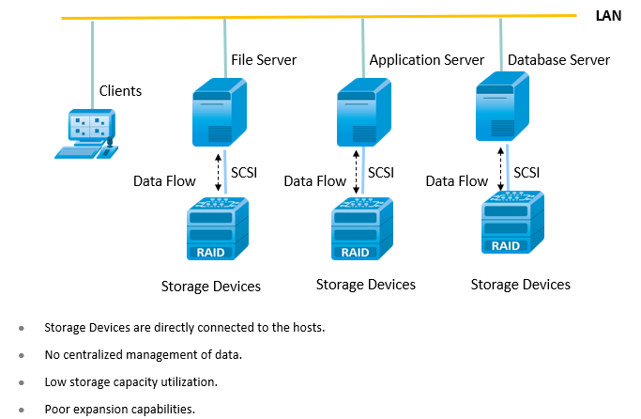
DAS (Direct Attached Storage)

Slide 12
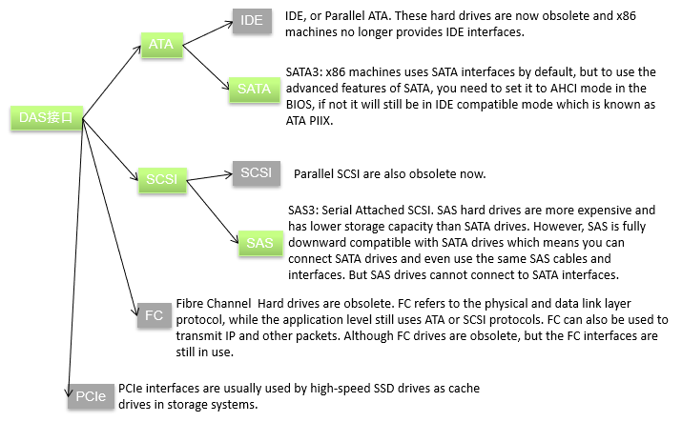
Block Storage Based Physical Local Hard Disk DAS System

Slide 13
Chapter
05
Challenges Faced By DAS Storage

Slide 14
Challenges Faced By DAS Storage
Poor Scalability and Expansion Capabilities
  Limited number of ports connecting to the host.
  Limited number of disks.
  Distance limitations.
System needs to be offline during the maintenance of Internal DAS.
Poor Resource Sharing Capabilities
  Hard to share the front service ports and storage space of storage arrays.
  Causes isolated resource islands or silos: For example, DAS system that is low in space cannot use the unutilized storage space of other DAS storage devices.

Slide 15
Chapter
05
SAN - Storage Area Network

Slide 16
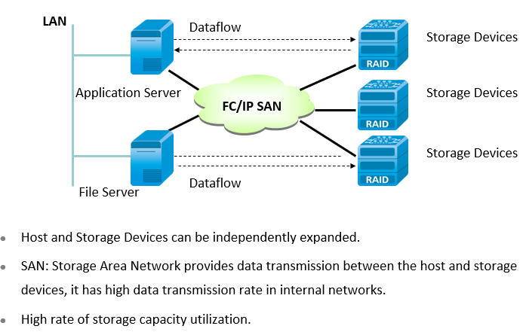
SAN (Storage Area Network)

Slide 17
Block Storage based Virtualized Network Disk SAN System
SAN
APP
OS API
LUN(logical unit number) Management
Internal File System
SCSI target
Host Bus Adapter (HBA)
ATA/SCSI
Block Storage Interface
SCSI Initiator
Host Bus Adapter (HBA)
SCSI Initiator
HBA
FC Switch
FC Switch to SAN 2

Slide 18
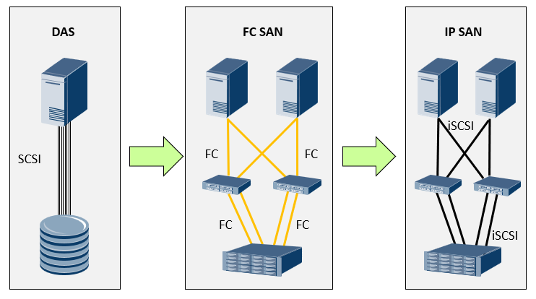
FC SAN and IP SAN

Slide 19
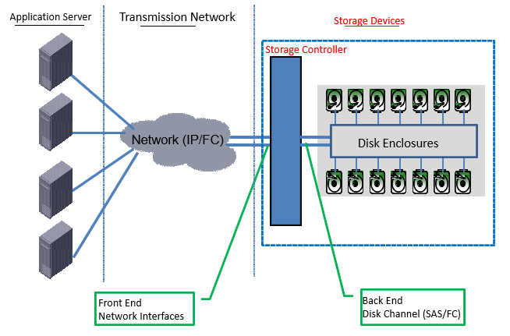
Components of a SAN System

Slide 20
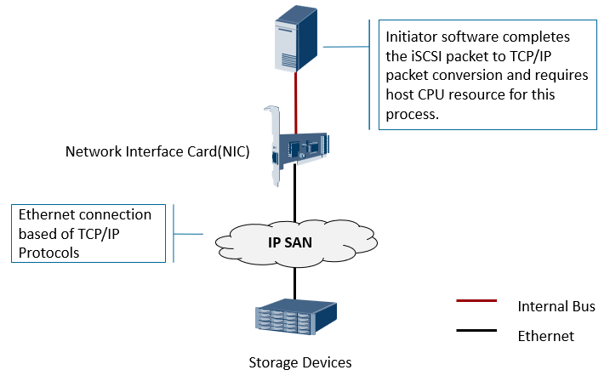
NIC + Initiator Software

Slide 21
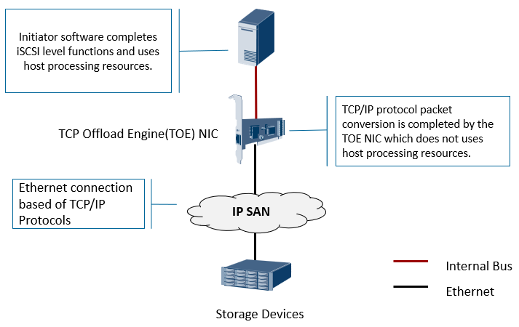
TOE NIC + Initiator Software

Slide 22
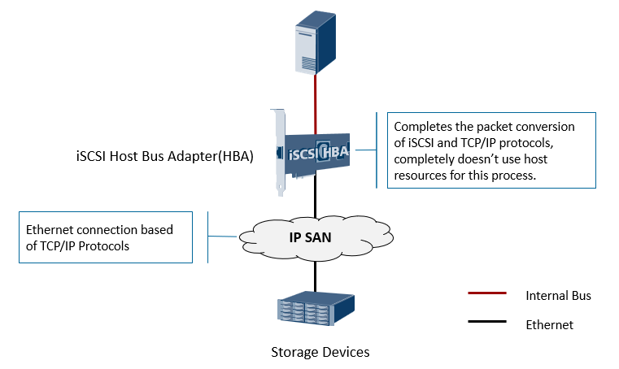
iSCSI HBA Card

Slide 23
Comparison between FC SAN and IP SAN
Description | FC SAN | IP SAN
Network Speed | 4Gb、8Gb、16Gb | 1Gb、10Gb、40Gb
Network Architecture | Custom built optical network and HBA cards. | Uses existing IP networks.
Transmission Distance | Limited by optical transmission distance. | Theoretically no distance limitation.
Management & Maintenance | Complex management and technologies. | Easy operation like normal IP devices.
Compatibility | Poor compatibility. | Compatible with all IP network devices.
Performance | Very high transmission and read/write performance. | Mainstream of 1Gb/s, and 10 Gb/s speed is still growing.
Cost | Purchase ( FC Switches, HBA cards, FC Disk Arrays),and Maintenance (Train Personnel, System Configuration and Monitoring) costs are high. | Compared to FC SAN, the purchase and maintenance cost are lower with higher ROI.
Disaster Recovery | Disaster recovery hardware and software cost are high. | Can achieve local and remote disaster recovery with lower cost.
Security | Higher security. | Lower security.

Slide 24
Chapter
05
SAN Storage Application

Slide 25
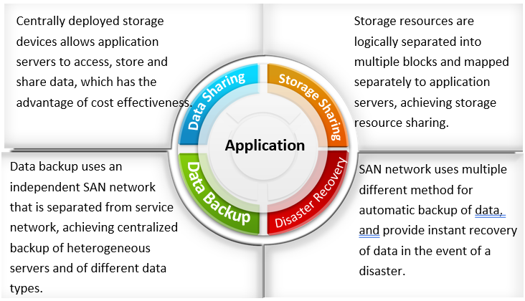
SAN Storage Application

Slide 26
Chapter
05
File Sharing

Slide 27
File Sharing Environment
File system is used for storing and organizing data in a structured form.
File Sharing:
  Access data through network storage.
  File system needs to be mounted before it can be used.
In the traditional Client/Server model, remote file sharing can be achieved through file sharing protocols such as:
  FTP (File Transfer Protocol)
  DFS (Distributed File System)

Slide 28
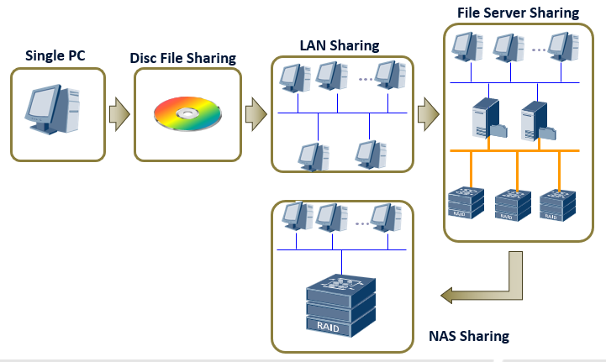
Evolution of File Sharing Technologies

Slide 29
Chapter
05
NAS - Network Attached Storage

Slide 30
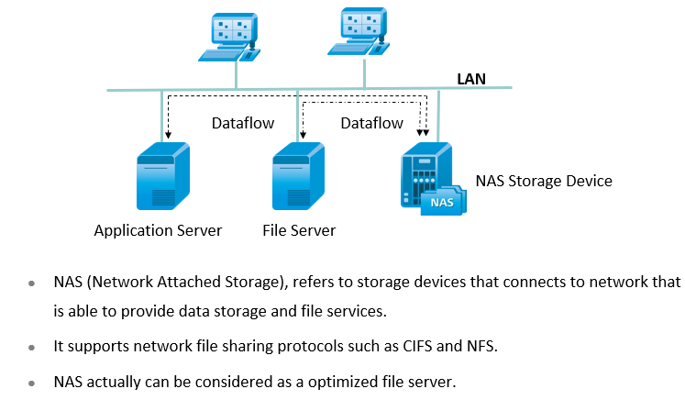
NAS (Network Attached Storage)

Slide 31
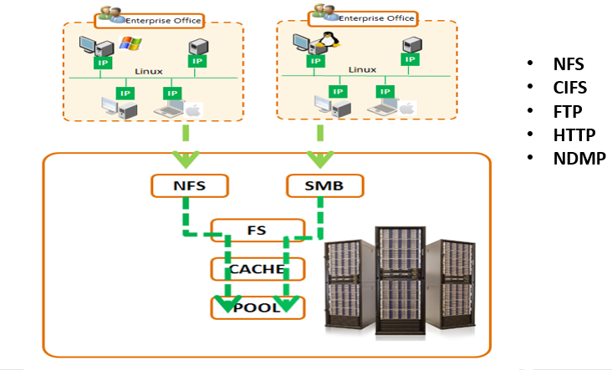
Common NAS Protocols

Slide 32
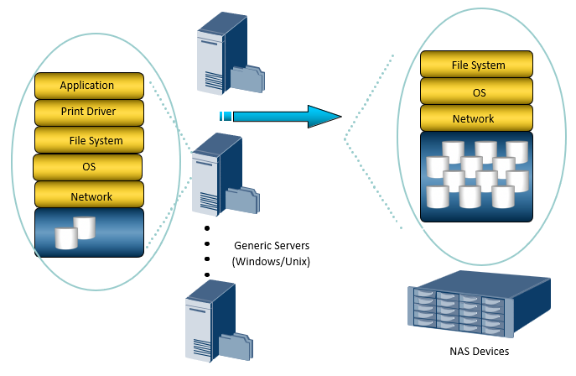
Generic Server and NAS Devices

Slide 33
Chapter
05
Benefits of NAS

Slide 34
Benefits of NAS
Supports comprehensive and global access to information.
Increases efficiency.
Increases flexibility.
Centralized storage.
Simplifies management.

Slide 35
Benefits of NAS
Scalability and Expansion.
High availability through local clustering.
Provides safe integrated environment for storage (user authentication and role management)

Slide 36
Chapter
05
Comparison of DAS, NAS and SAN

Slide 37
Comparison of DAS, NAS and SAN (1)
Storage System Architecture | DAS | NAS | SAN
Data Transmission Protocol | SCSI/FC/ATA | TCP/IP | FC
Data Transfer Object | Block | File | Block
Uses Standard File Sharing Protocols | No | Yes（NFS/CIFS...） | No
Centralized Management | Not Exactly | Yes | Requires Management Tools
Increases Server Efficiency | No | Yes | Yes
Disaster Tolerance | Low | High | High, Dedicated Solutions

Slide 38
Comparison of DAS, NAS and SAN (2)
Storage System Architecture | DAS | NAS | SAN
Suitable Clients | SME Servers, JBOD | SME, Monitoring, Broadcasting | Large Enterprises, Data Centers
Application Environment | Local Area Network(LAN). Low file sharing level, independent operating platform, and less server management | Local Area Network(LAN). High file sharing level, high demand in heterogeneous storage format. | Fibre Channel Storage Network. Complex network environment, high file sharing level, heterogeneous OS platform, high number of servers.
Capacity Expansion Capabilities | Low | Medium | High

Slide 39
Summary
  Data Center Storage Network.
  Network Architecture of DAS, SAN and NFS.
  Advantages and Disadvantages of DAS, SAN and NFS Network Technologies.

Slide 40



Thank You

