Slide 1



Risk Management
MGM 510
Lecture 1
Prepared by
Dr. Hamed Almahadin
www.midocean.ae

Slide 2
Chapter#1
Approaches to defining risk
Lecture 1
Prepared by
Dr. Hamed Almahadin
www.midocean.ae

Slide 3
Intended Learning outcomes (ILOs)
Upon completion of this chapter each student will be able to:
Produce a range of established definitions of risk and risk management and describe the usefulness of the various definitions;
List the range of characteristics of a risk that need to be identified in order to provide a full risk description and justify the inclusion of each item;
Summarize the options for the attachment of risks to various attributes of an organization and describe the advantages of each approach;
Identify the features of the four types of risk that enable them to be identified as compliance, hazard, control and opportunity risks.

Slide 4
Topics to be covered in this chapter
Definitions of risk.
Types of risks
Risk description
Risk triggers.
Inherent level of risk
Risk classification systems
Risk management
Benefits of Risk Management

Slide 5
Definition of “ RISK “
Risk is a chance or possibility of danger, loss, injury or other adverse consequences
Risk is exposed to danger
Risk is related to uncertainty of outcome
Risk is the combination of the probability of an event and its consequence
Risk is effect of uncertainty on objectives
Risk is often described by an event, a change in circumstances, a consequence, or a combination of these and how they may affect the achievement of objectives.

Slide 6
Definition of “ RISK “
Risk is the uncertainty of an event occurring that could have an impact on the achievement of objectives
Risk is a combination of likelihood and magnitude
Risk is anything that can impact the fulfilment of corporate objectives
Risk is an unplanned event with unexpected consequences
Risk is an event with the ability to impact (inhibit, enhance or cause doubt about) the effectiveness and efficiency of the core processes of an organization

Slide 7
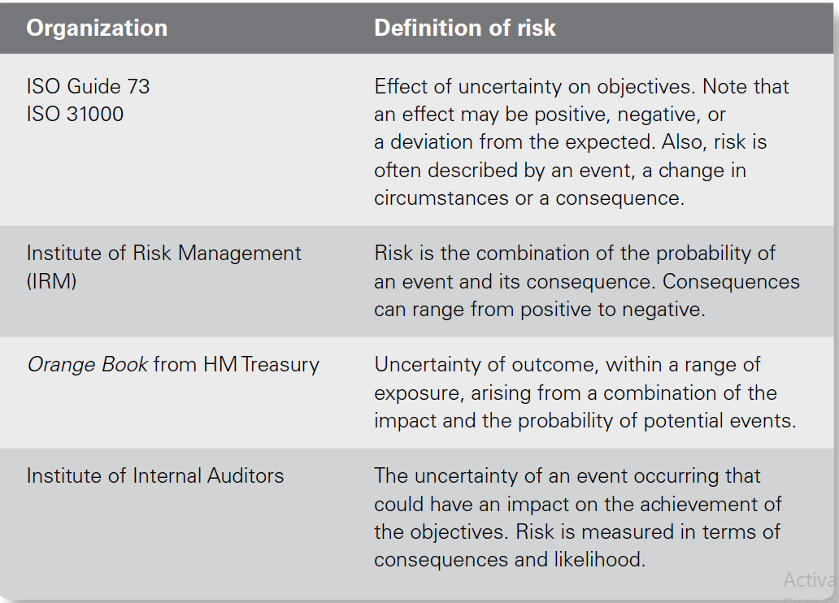
Definition of “ RISK “

Slide 8

Definition of “ RISK “
Any possible/potential event could have either:
  Positive consequence (opportunity)
  Negative consequence (threats)
  Typically, we get more concerned about threats than opportunities.

Slide 9

Definition of “ RISK “
Risks aren’t problems/Issues.
Problems/Issues are negative events that are in the process of occurring right now.
Risks are potential/possible event that can materialize and then become problems.

Slide 10
Definitions of ‘Risk’
‘Effect of uncertainty on objectives’ -
ISO 3100:2009 Risk Management – Principles and Guidelines
NOTE 1 – An effect is a deviation from the expected – positive and/or negative
NOTE 2 – Objectives can have different aspects (such as financial, health and safety, and environmental goals) and can apply at different levels (such as strategic, organization-wide, project, product and process).

Slide 11
Definitions of ‘Risk’
‘Effect of uncertainty on objectives’ -
ISO 3100:2009 Risk Management – Principles and Guidelines
‘Effect of uncertainty on objectives’ -
NOTE 3 – Risk is often characterized by reference to potential events and consequences, or a combination of these.
NOTE 4 – Risk is often expressed in terms of a combination of the consequences of an event (including change in circumstances) and the associated likelihood of occurrence.
NOTE 5 – Uncertainty is the state, even partial, of deficiency of information related to, understanding or knowledge of, an event, its consequence or likelihood.

Slide 12
Definitions of ‘Risk’
‘A hazard is the potential for harm arising from an intrinsic property or disposition of something to cause detriment.’
‘Risk is the chance, high or low, that somebody or something could be harmed by these and other hazards, together with an indication of how serious the harm could be.’

Slide 13
Types of risks
Risk may have positive or negative outcomes or may simply result in uncertainty.
Therefore, risks may be considered to be related to an opportunity or a loss or the presence of uncertainty for an organization.
Every risk has its own characteristics that require particular management or analysis.
Risks are divided into four categories:
  Compliance (or mandatory) risks;
  Hazard (or pure) risks;
  Control (or uncertainty) risks;
  Opportunity (or speculative) risks.

Slide 14
Types of risks
In general terms, organizations will seek to minimize compliance risks, mitigate hazard risks, manage control risks and embrace opportunity risks.
It is, perhaps, more common to find risks described as two types, pure or speculative
The most important issue is that an organization adopts the risk classification system that is most suitable for its own circumstances.

Slide 15
Types of risks-Hazard (or pure) risks
There are certain risk events that can only result in negative outcomes.
These risks are hazard risks or pure risks, and these may be thought of as operational or insurable risks.

Slide 16
Types of risks-Hazard (or pure) risks
In general, organizations will have a tolerance of hazard risks, and these need to be managed within the levels that the organization can tolerate.
A good example of a hazard risk faced by many organizations is “Theft Risk”.

Slide 17
Types of risks-Hazard (or pure) risks
Hazard risks are associated with a source of potential harm or a situation with the potential to undermine objectives in a negative way.
Hazard risk management is concerned with mitigating the potential impact.
Hazard risks are the most common risks associated with operational risk management, including occupational health and safety programs.

Slide 18
Types of risks- Control (or uncertainty) risks
There are other risks that give rise to uncertainty about the outcome of a situation.
These can be described as control risks and are frequently associated with project management.
In general, organizations will have an aversion to control risks.

Slide 19
Types of risks- Control (or uncertainty) risks
Uncertainties can be associated with the benefits that the project produces, as well as uncertainty about the delivery of the project on time, within budget and to specification.
The management of control risks will often be undertaken in order to ensure that the outcome from the business activities falls within the desired range.
The purpose is to reduce the variance between anticipated outcomes and actual results.

Slide 20
Types of risks- Control (or uncertainty) risks
Control risks are associated with unknown and unexpected events.
They are sometimes referred to as uncertainty risks and they can be extremely difficult to quantify.
Control risks are often associated with project management and the implementation of tactics.

Slide 21
Types of risks- Control (or uncertainty) risks
In these circumstances, it is known that the events will occur, but the precise consequences of those events are difficult to predict and control.
Therefore, the approach is based on managing the uncertainty about the potential impacts and consequences of these events

Slide 22
Types of risks- opportunity (or speculative) risks
Organizations deliberately take risks, especially marketplace or commercial risks, in order to achieve a positive return.
These can be considered as opportunity or speculative risks, and an organization will have a specific appetite for investment in such risks.
Opportunity risks relate to the relationship between risk and return.

Slide 23
Types of risks- Opportunity (or speculative) risks
The purpose is to take action that involves risk to achieve positive gains.
The focus of opportunity risks will be towards investment.

Slide 24
Types of risks- Opportunity (or speculative) risks
There are two main aspects associated with opportunity risks:
There are risks/dangers associated with taking an opportunity, but there are also risks associated with not taking the opportunity.
Opportunity risks may not be visible or physically apparent, and they are often financial in nature.

Slide 25
Types of risks- Opportunity (or speculative) risks
Although opportunity risks are taken with the intention of obtaining a positive outcome, this is not guaranteed.
Nevertheless, the overall approach is to embrace the opportunity and the associated opportunity risks.
Opportunity risks for small businesses include moving a business to a new location, acquiring new property, expanding a business and diversifying into new products.

Slide 26
Risk description
In order to fully understand a risk, a detailed description is necessary so that a common understanding of the risk can be identified, and ownership/responsibilities may be clearly understood.
Risk description Table lists the range of information that must be recorded to fully understand a risk.
The list of information set out in Risk description Table is most applicable to hazard risks and the list will need to be modified to provide a full description of control or opportunity risks.

Slide 27
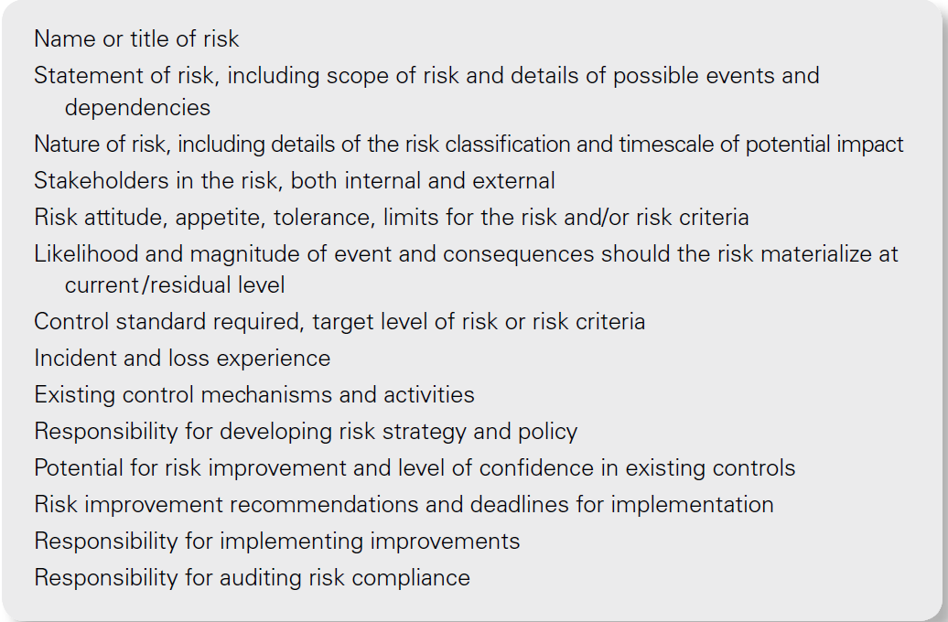
Risk description table

Slide 28
Risk Triggers
Risk triggers are “signs” that a risk event is about to occur.
A risk trigger signals that something more relevant to the project is on the horizon.

Slide 29
Inherent level of risk
Terminology varies and the inherent level of risk is sometimes referred to as the absolute risk or gross risk.
Also, the current level of risk is often referred to as the residual level, net level or the managed level of risk.

Slide 30
Risk classification systems
Risks can be classified according to the nature of the attributes of the risk, such as timescale for impact, and the nature of the impact and/or likely magnitude of the risk.
The source of the risk can also be used as the basis of classification. In this case, a risk may be classified according to its origin, such as counterparty or credit risk.

Slide 31
Risk classification systems
Risks may also be classified according to the component or feature of the organization that will be impacted.
Individual organizations will decide on the risk classification system that suits them best, depending on the nature of the organization and its activities.

Slide 32
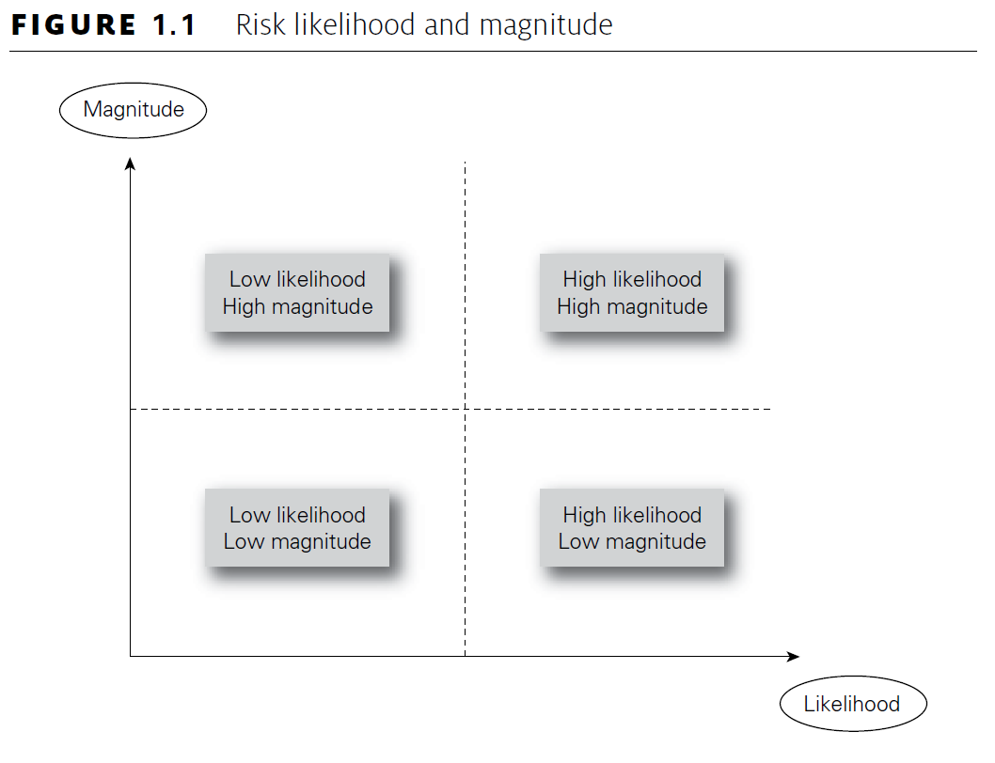
Risk classification systems

Slide 33

Open thinking
What risks did you face today as you traveled to the workshop?
What was the risk?
How did you manage the risk?

Slide 34

Example
Boss!!!
There is a strange sound coming from the excavation…??!!

Slide 35
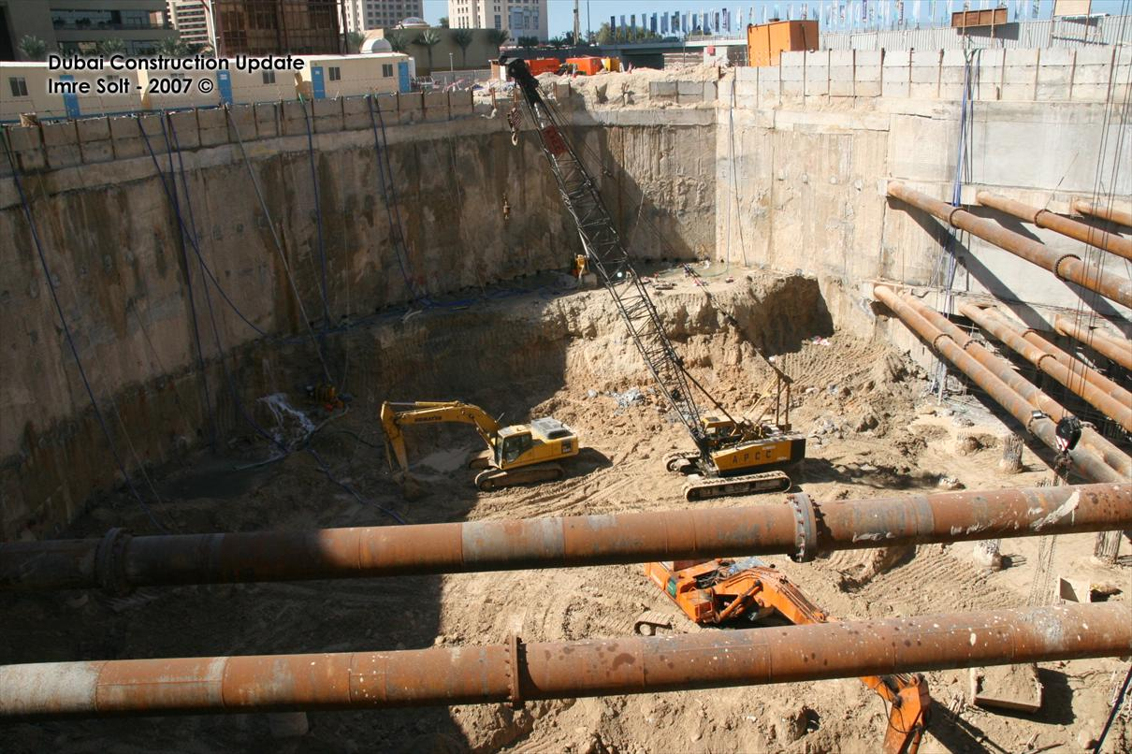
Example
Strange Sound

Slide 36
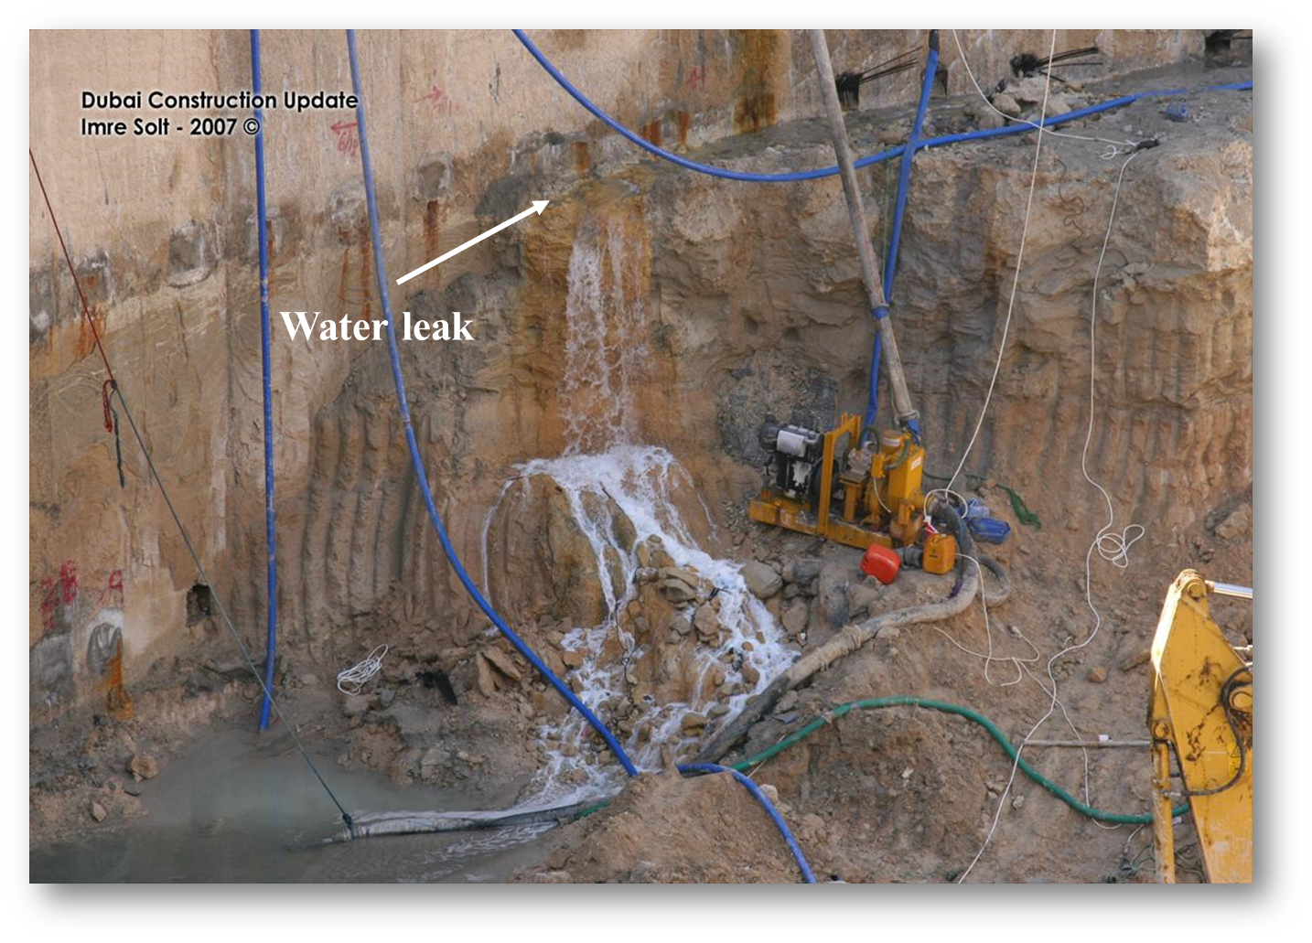
Example
What Happen??

Slide 37

Operational Risk

Slide 38

Without Risk Management!!
You will be surprised by the Threats surrounding you and will miss opportunities, as well!

Slide 39
Why does Risk Management
Good risk management can save time, improve quality, and reduce the costs of achieving an agreed outcome.
Effective risk management can be a significant contributor to project success.

Slide 40
Benefits of Risk Management
‘HARD’ (tangible)
Enables better informed and more believable plans, schedules and budgets
Increases the likelihood of a project adhering to its schedules and budgets
Leads to the use of the most suitable type of contract
Allows a more meaningful assessment of contingencies
Contributes to the build-up of statistical information to assist in better management of future projects
Enables a more objective comparison of alternatives
Identifies, and allocates responsibility to, the best risk owner

Slide 41
Benefits of Risk Management
‘SOFT’ (intangible)
Improves corporate experience and general; communication
Leads to a common understanding and improved team spirit
Helps distinguish between good luck / good management and bad luck / bad management
Helps develop the ability of staff to assess risks
Focuses project management attention on the real and most important issues.

Slide 42
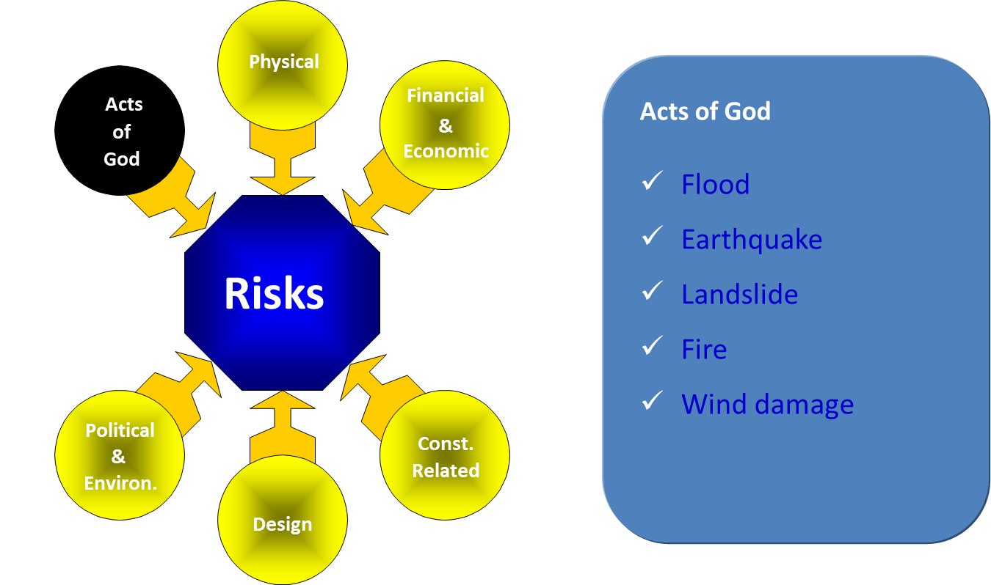
Risk Examples

Slide 43
Thank you
MGM 510 - Risk Management

