Slide 1


Slide 2


Slide 3
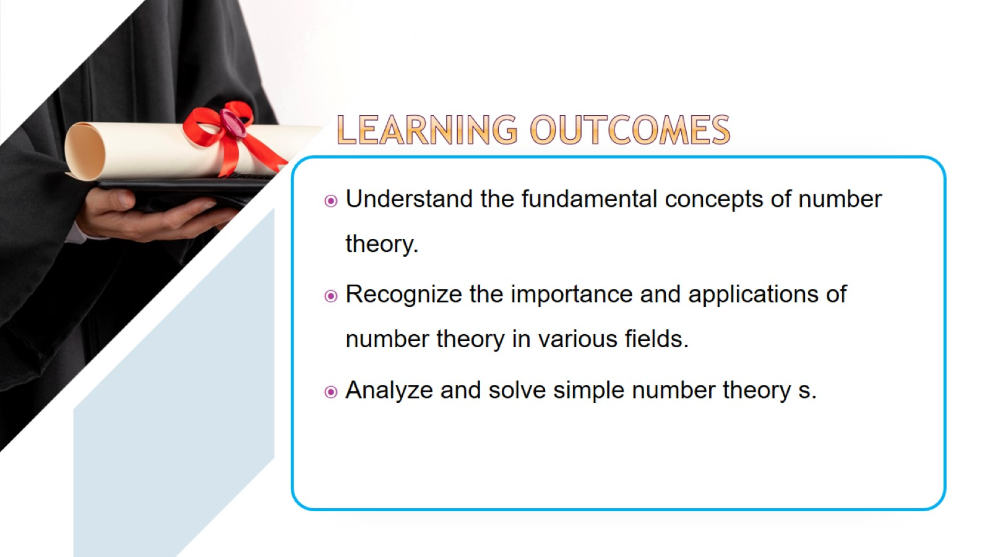

Slide 4
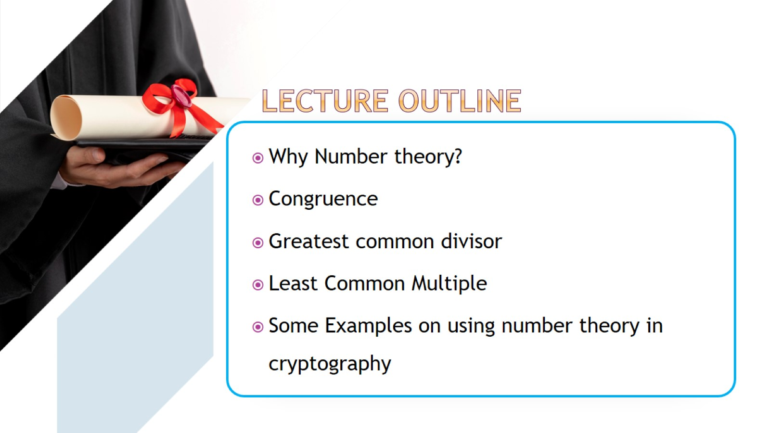

Slide 5
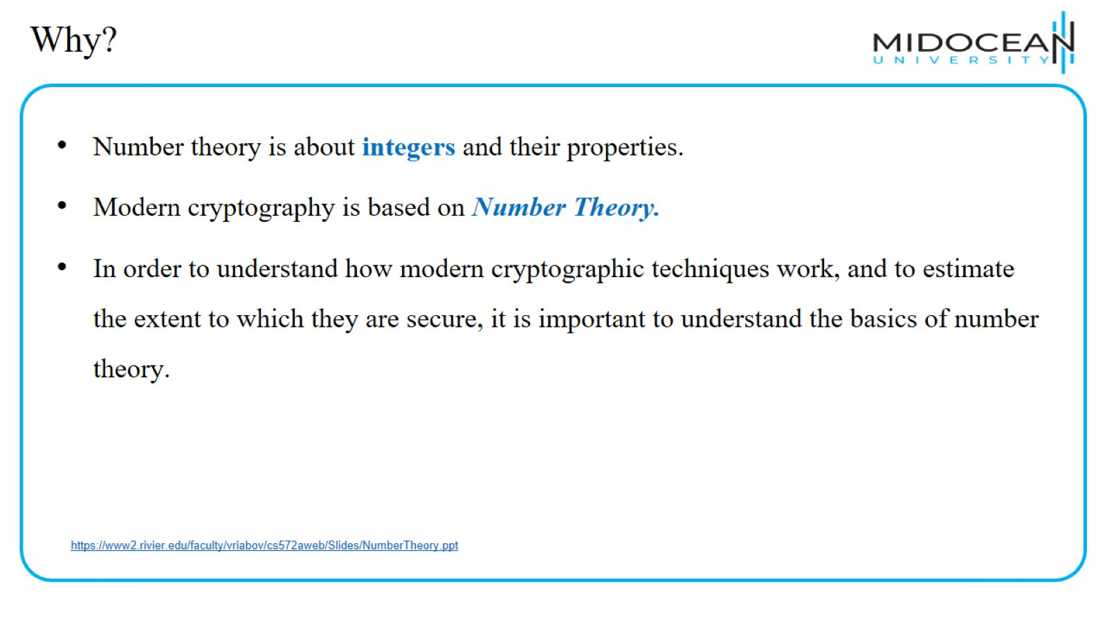
Why?

Slide 6
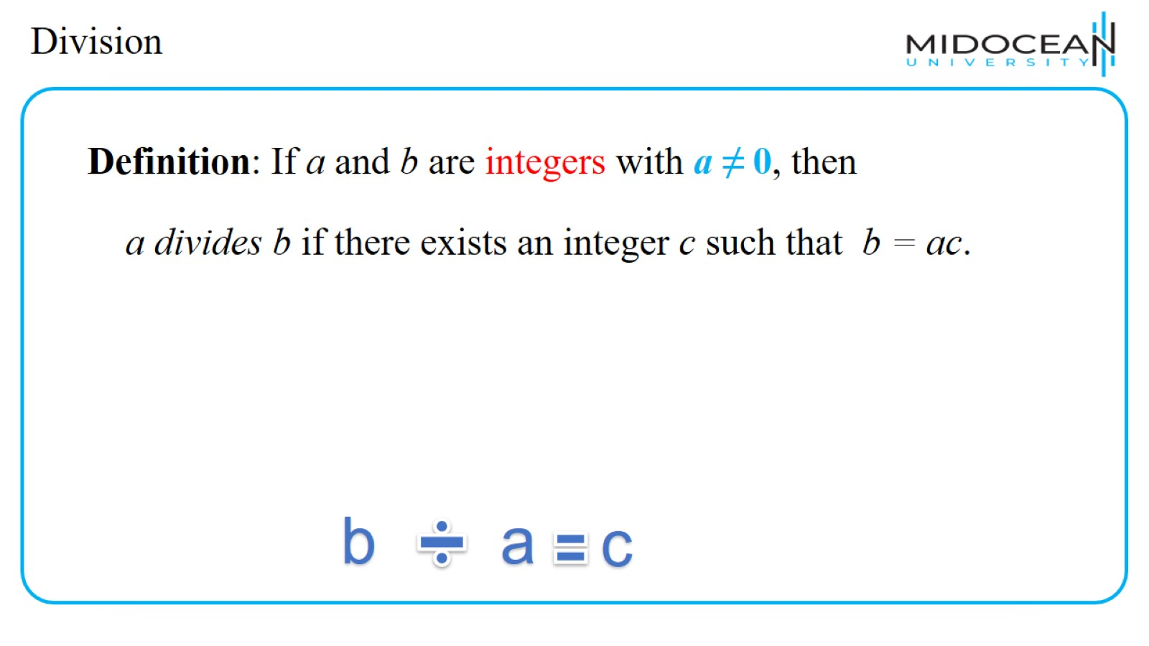
Division

Slide 7
Division

Slide 8
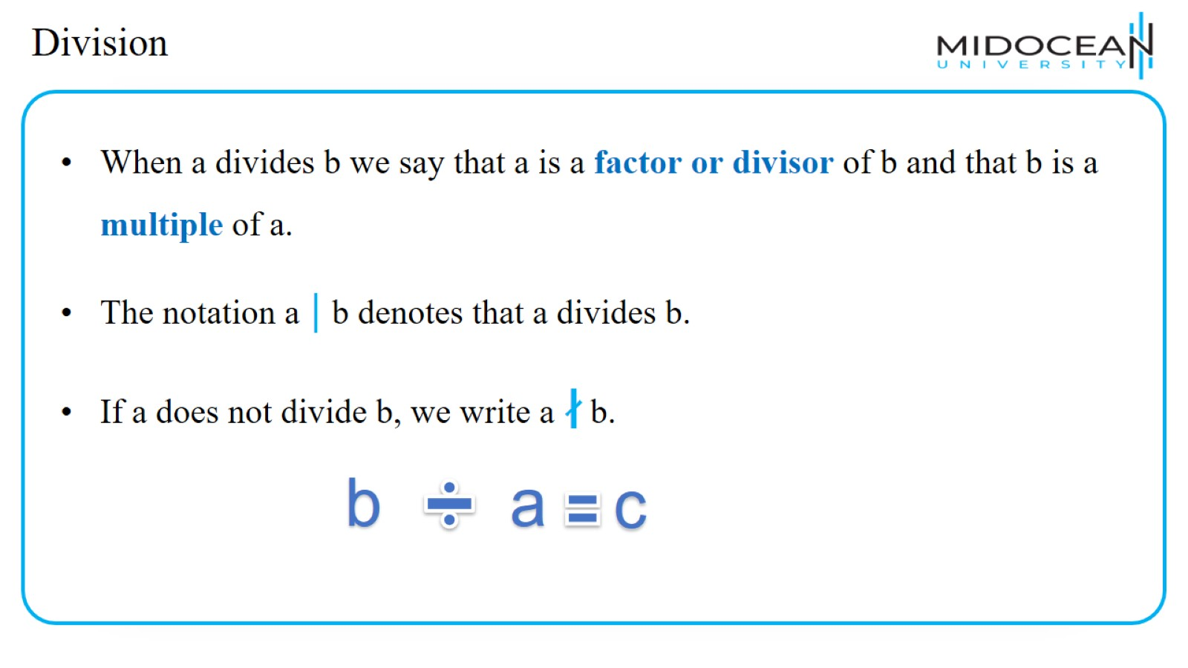
Division

Slide 9
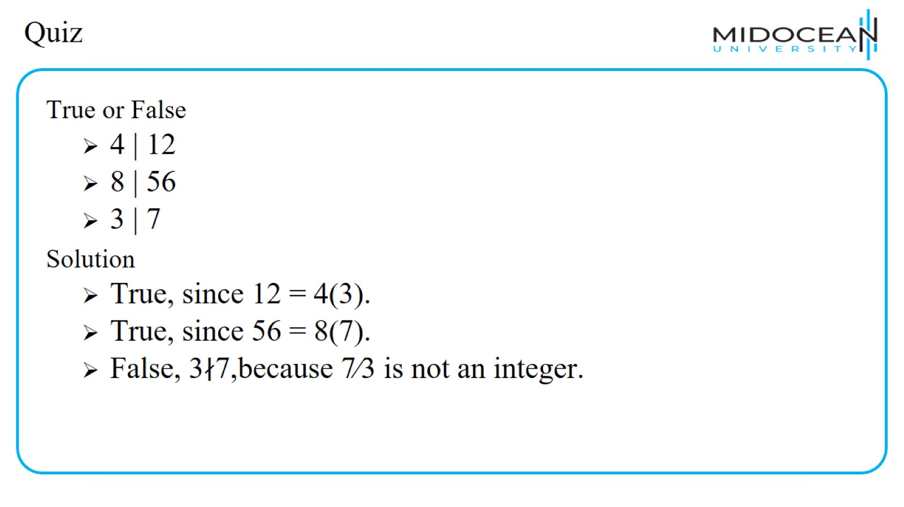
Quiz

Slide 10
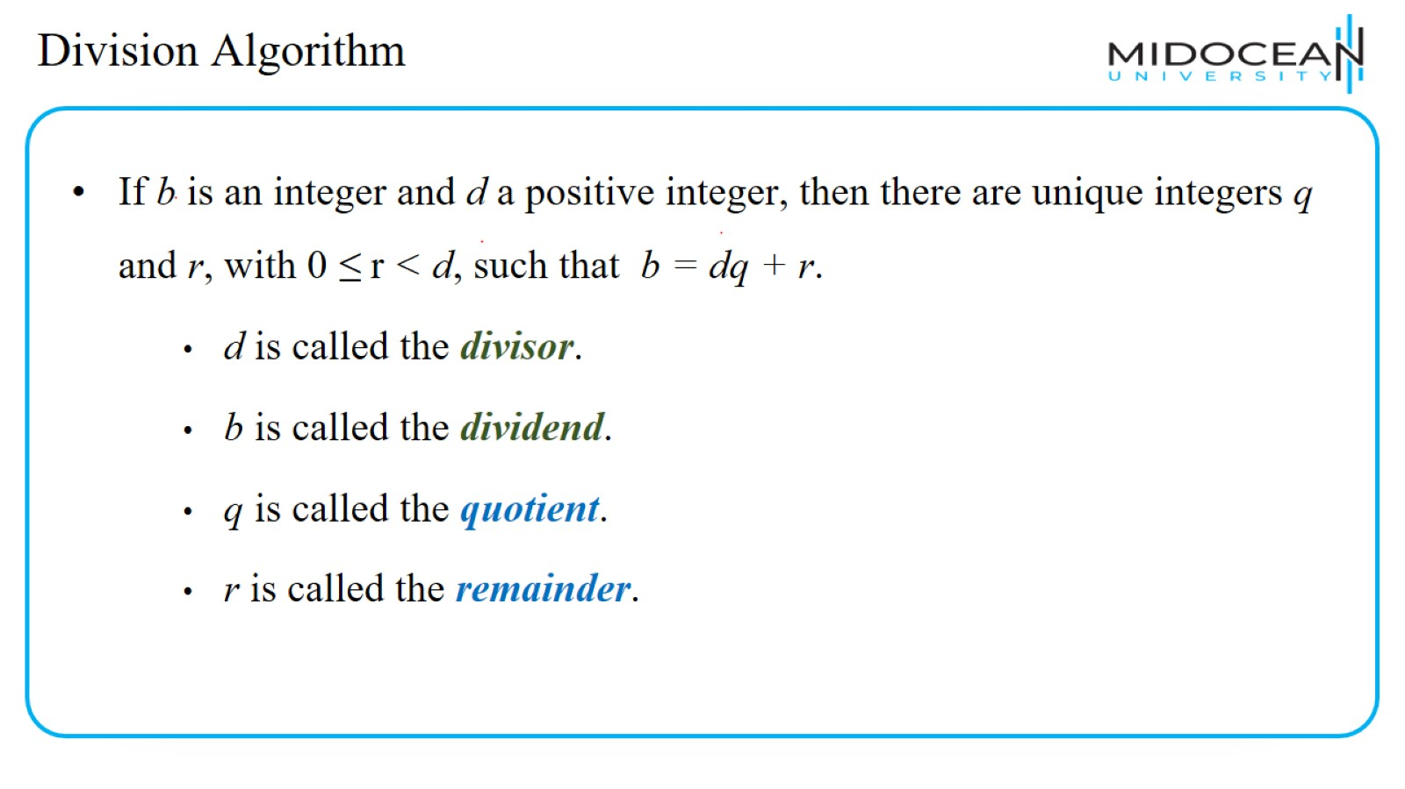
Division Algorithm

Slide 11
Division Algorithm

Slide 12
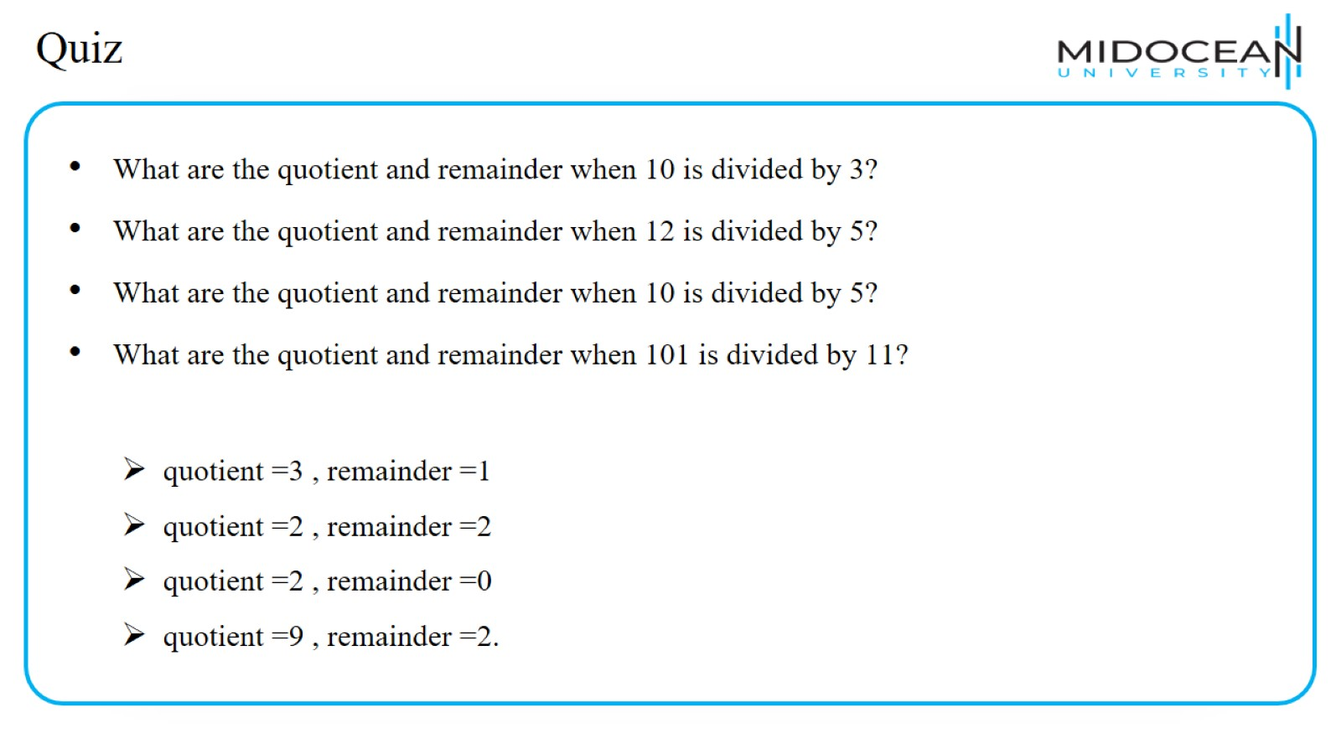
Quiz

Slide 13
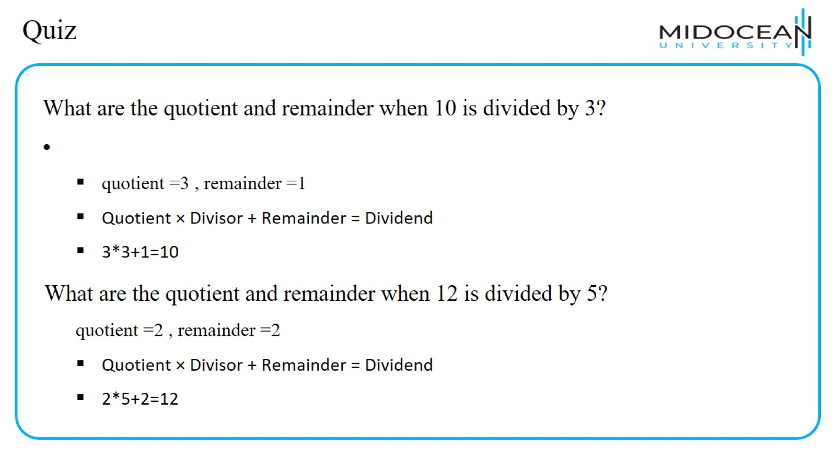
Quiz

Slide 14
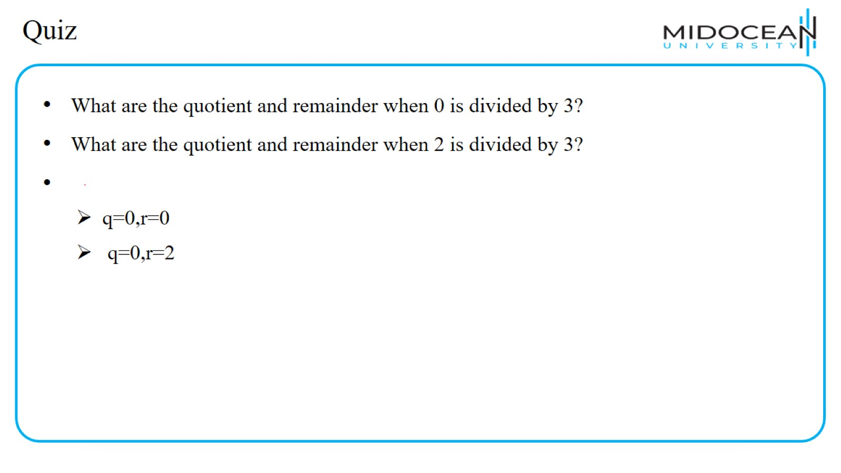
Quiz

Slide 15
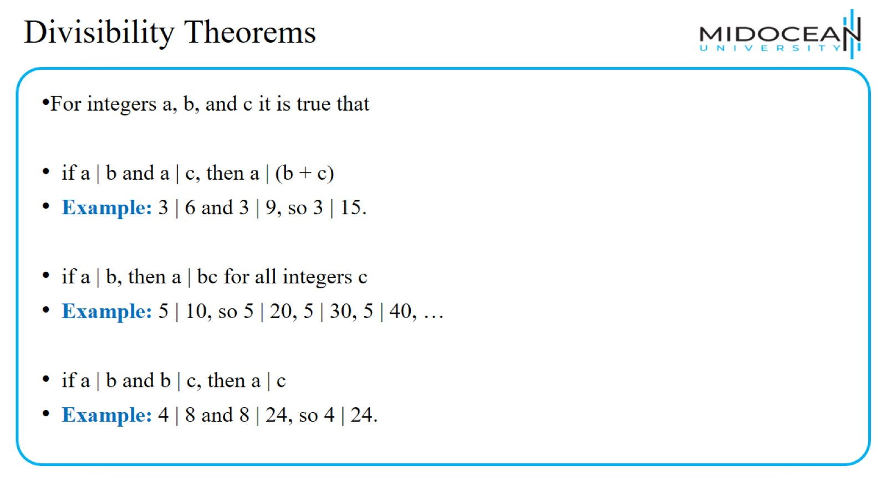
Divisibility Theorems

Slide 16
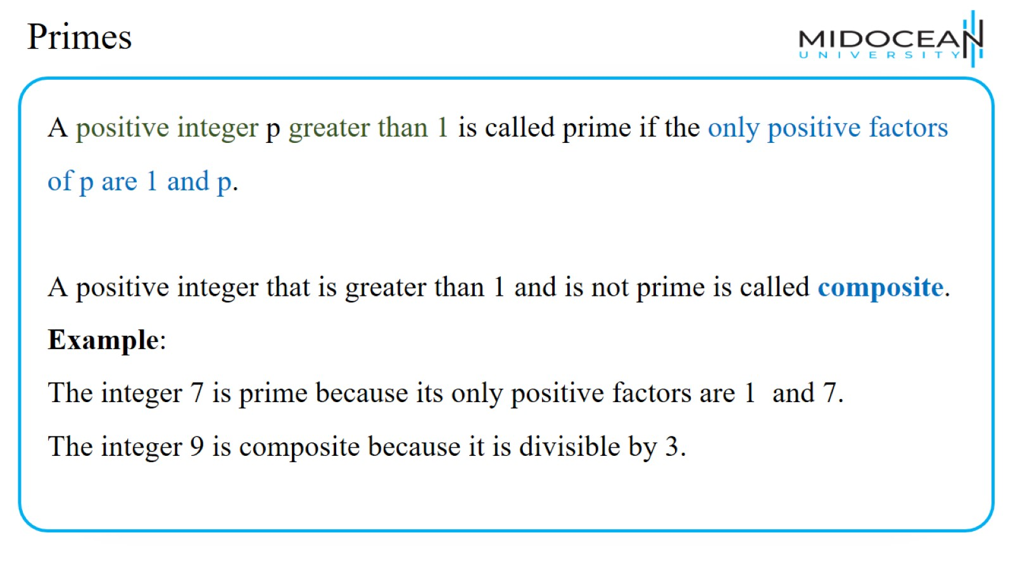
Primes

Slide 17
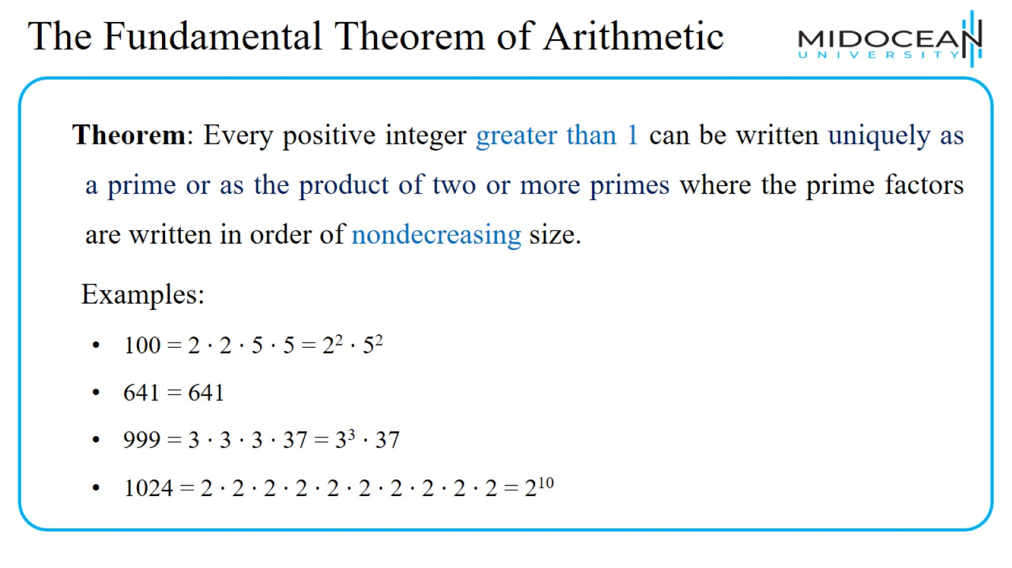
The Fundamental Theorem of Arithmetic

Slide 18
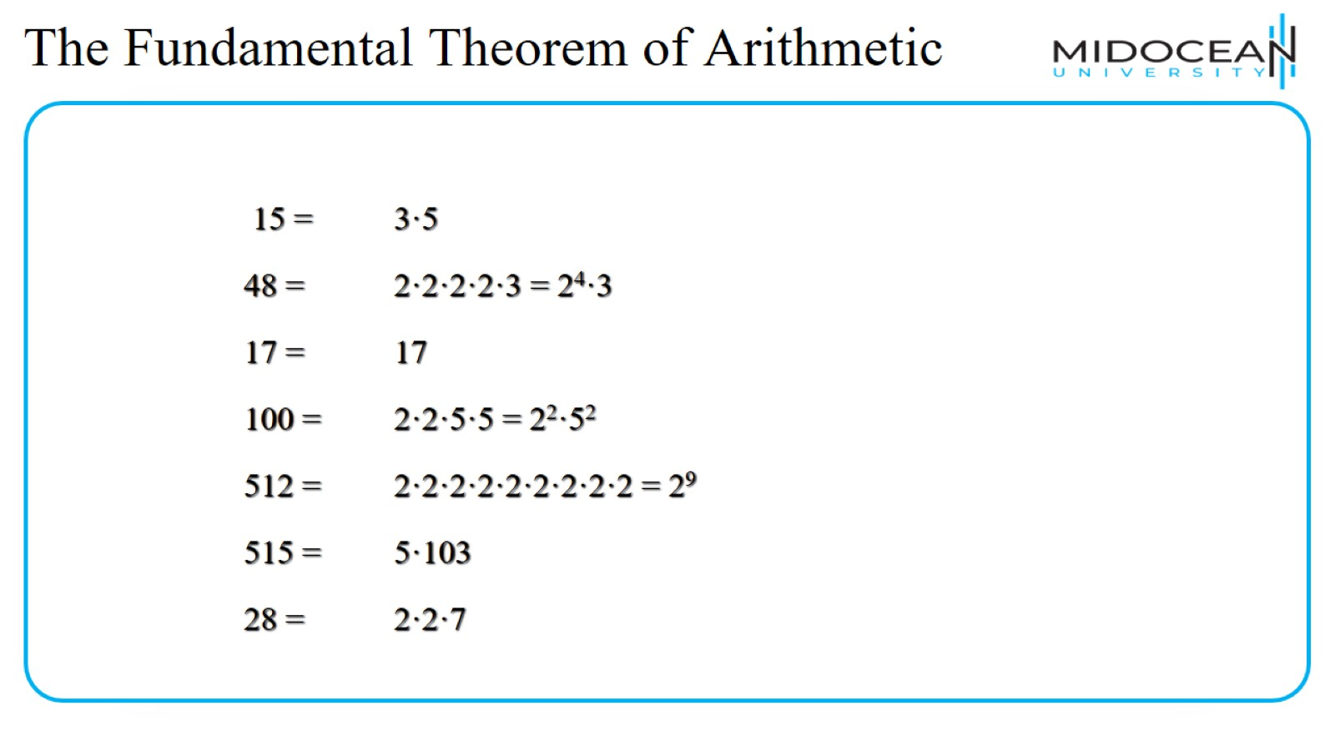

Slide 19
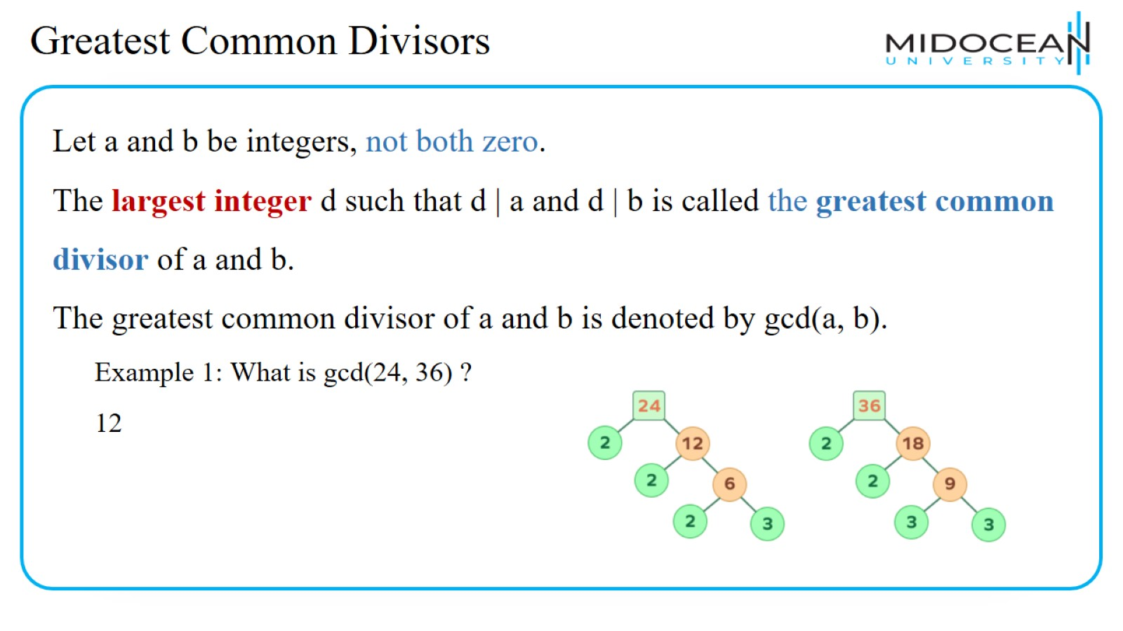
Greatest Common Divisors

Slide 20
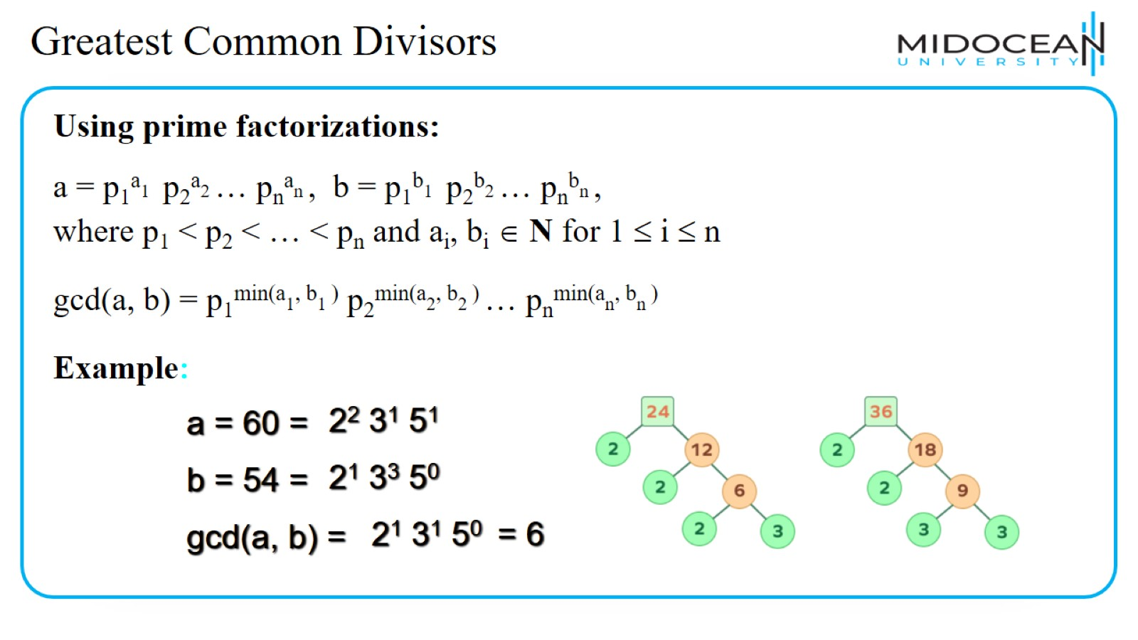
Greatest Common Divisors

Slide 21
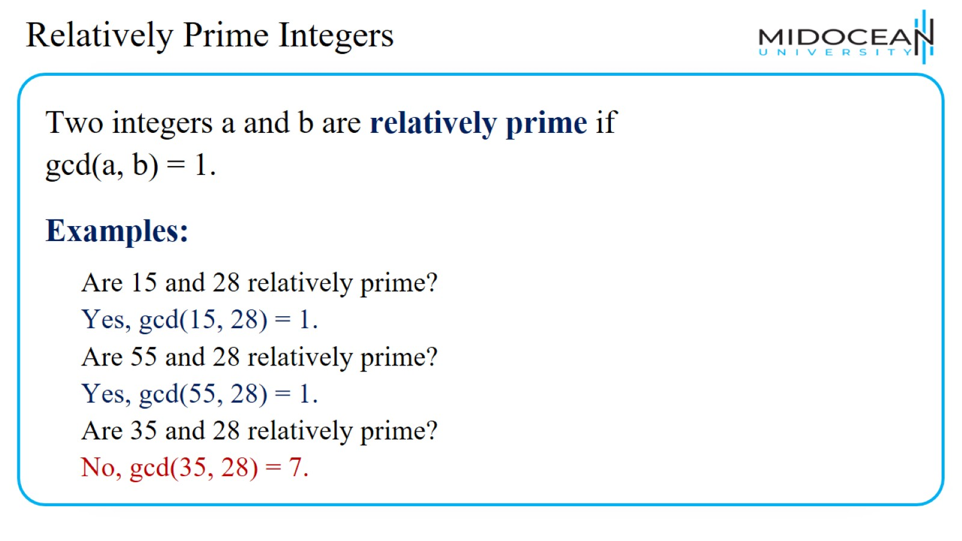
Relatively Prime Integers

Slide 22
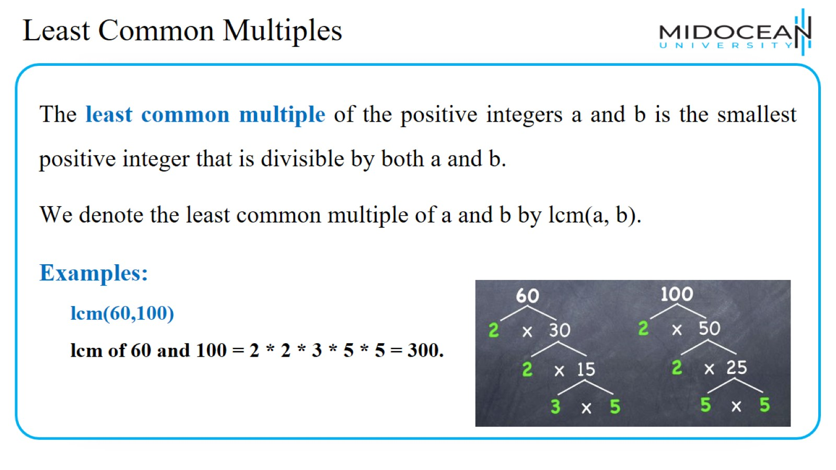
Least Common Multiples

Slide 23
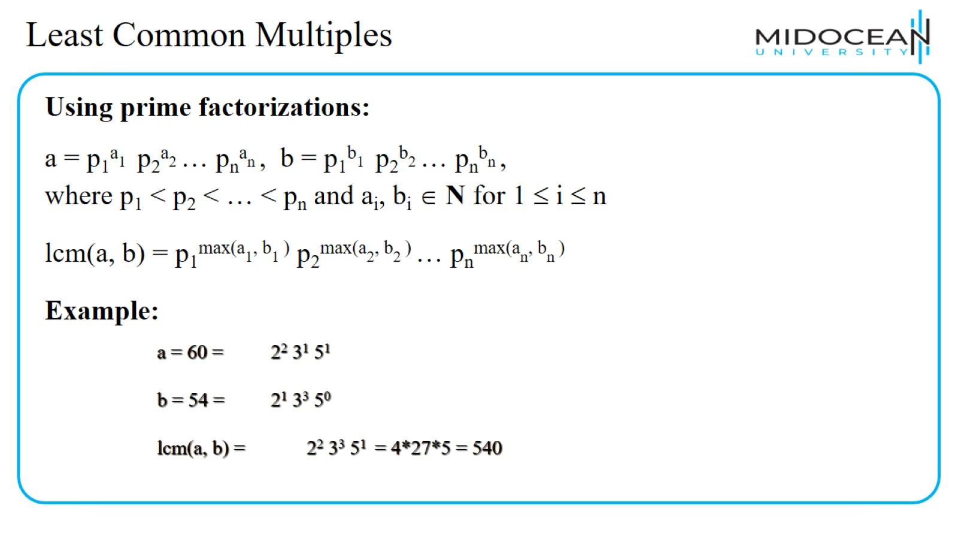
Least Common Multiples

Slide 24
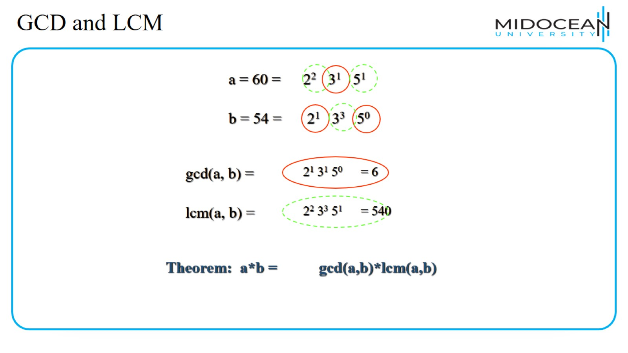
GCD and LCM

Slide 25
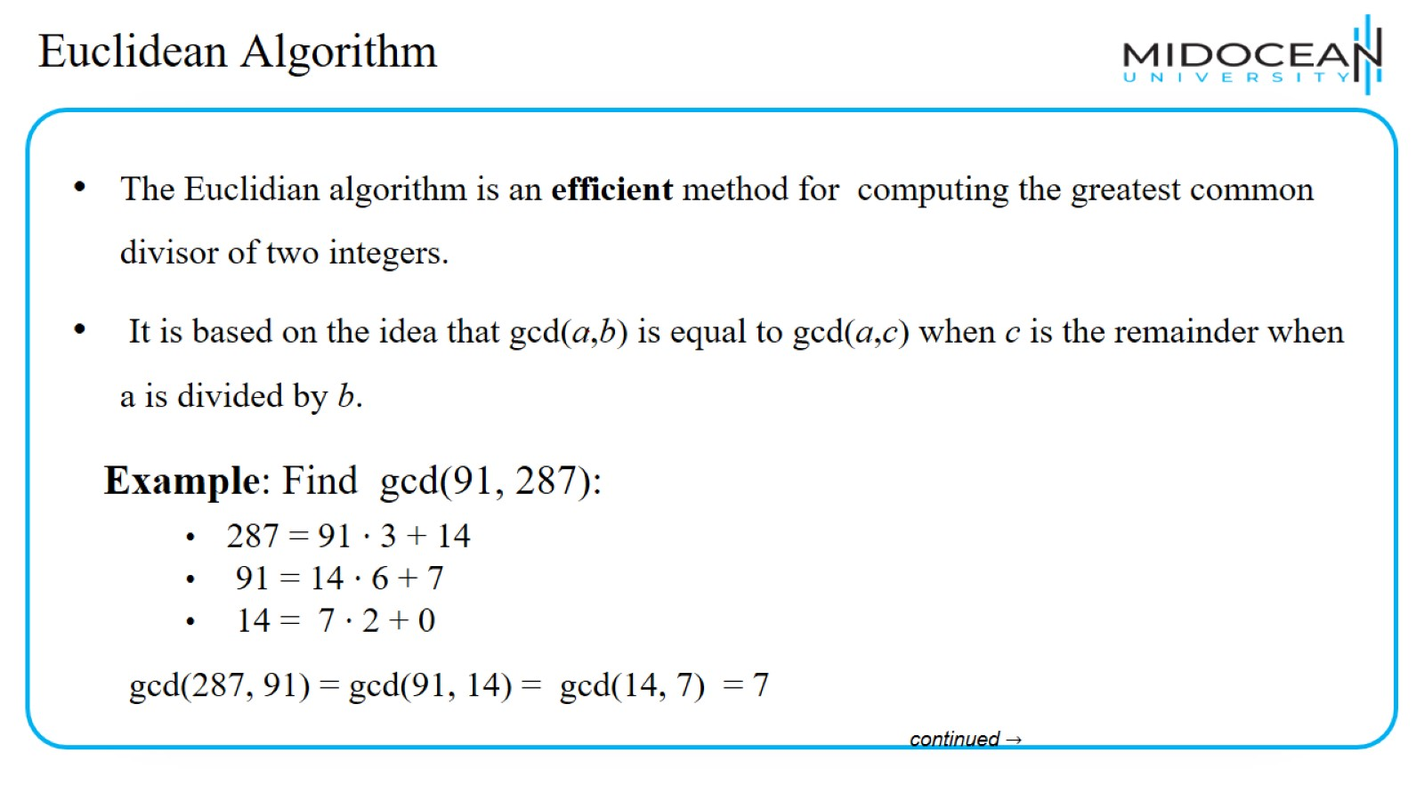
Euclidean Algorithm

Slide 26
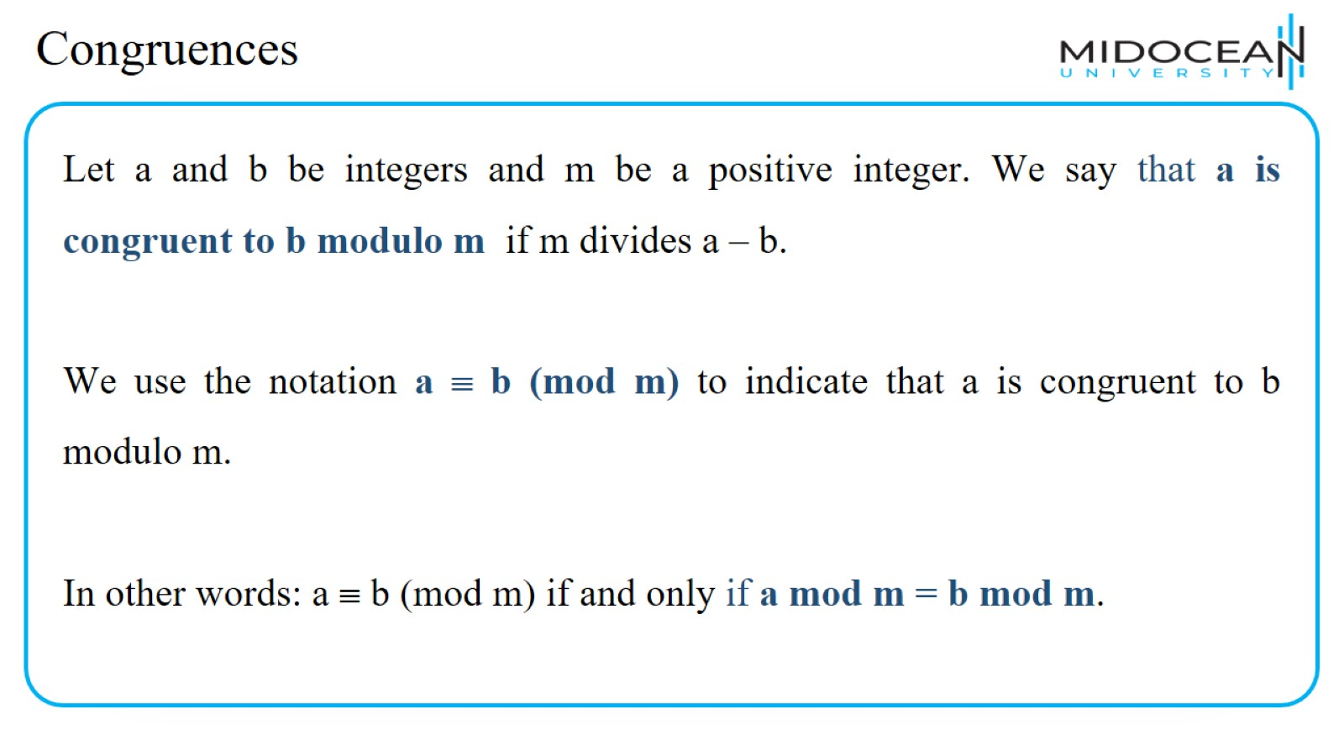
Congruences

Slide 27
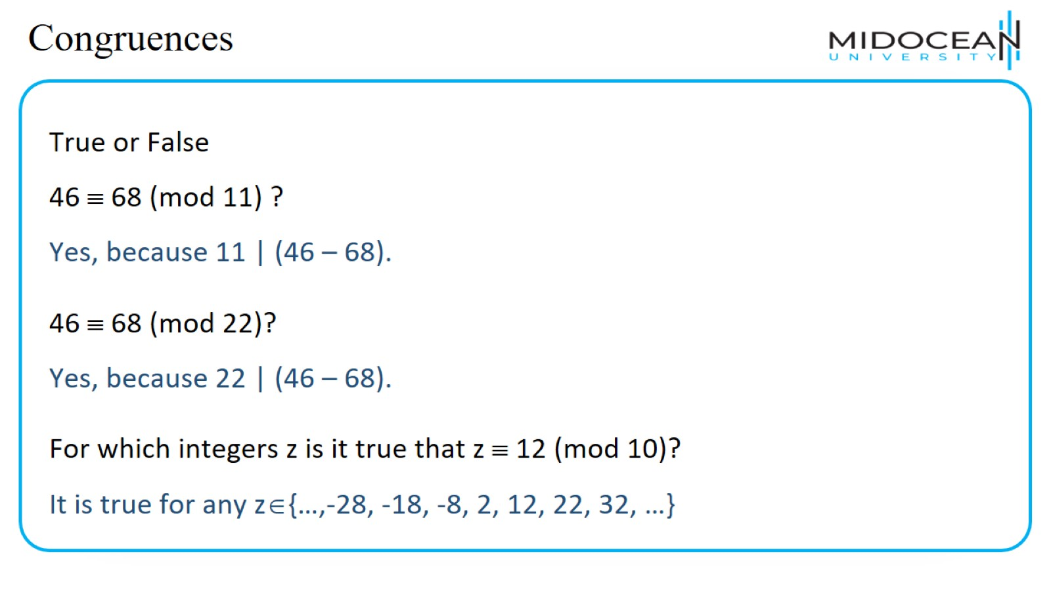
Congruences

Slide 28
Congruences

Slide 29
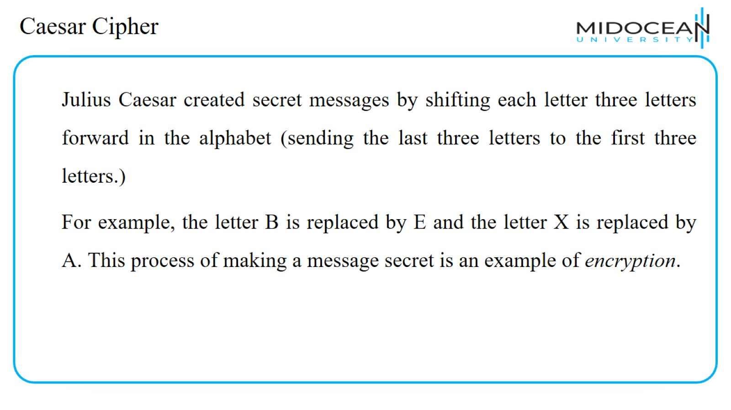
Caesar Cipher

Slide 30
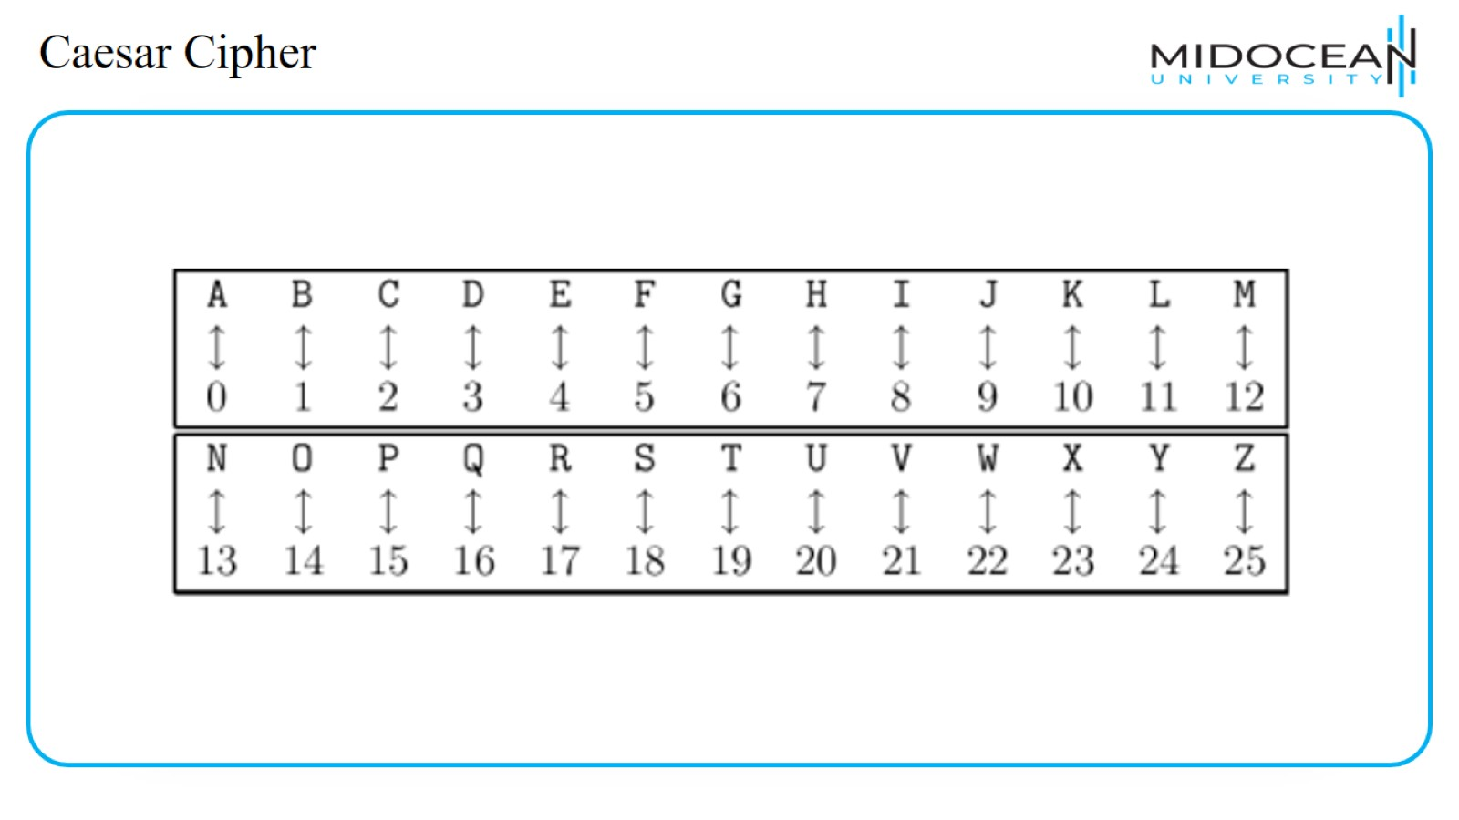
Caesar Cipher

Slide 31
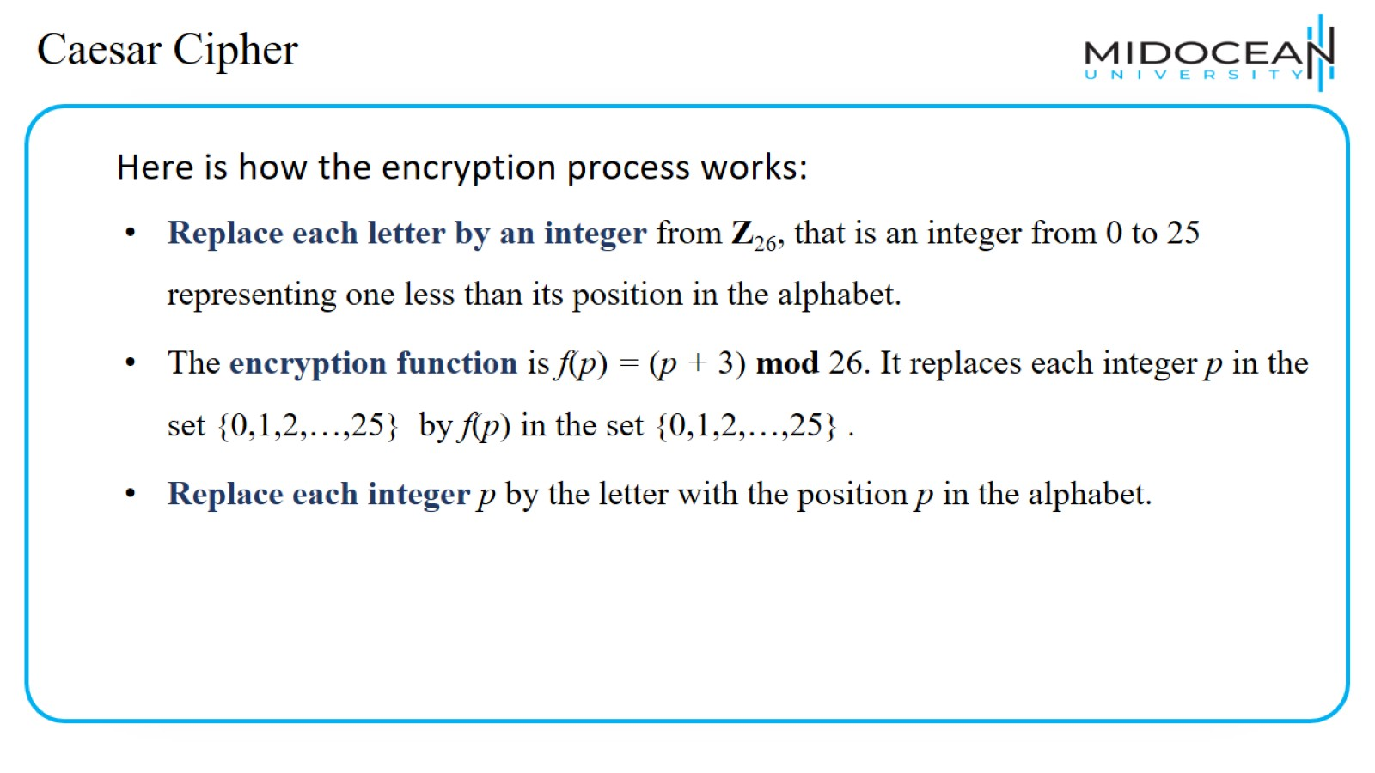
Caesar Cipher

Slide 32
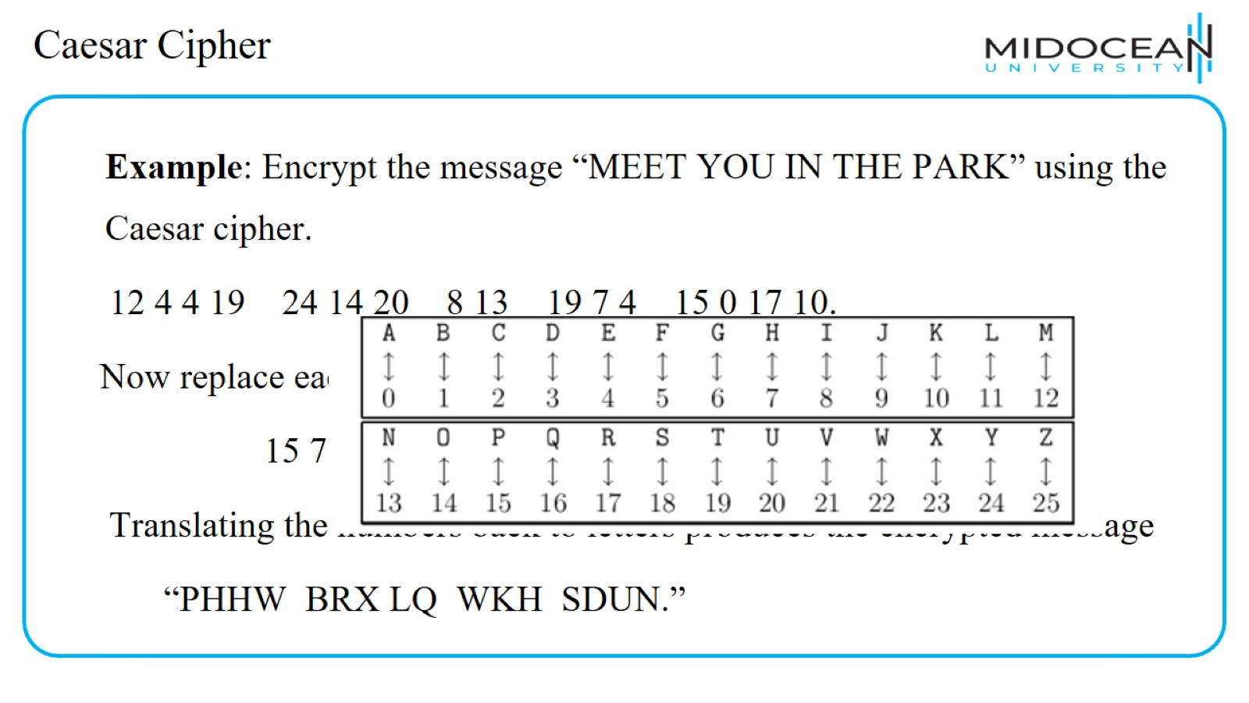
Caesar Cipher

Slide 33
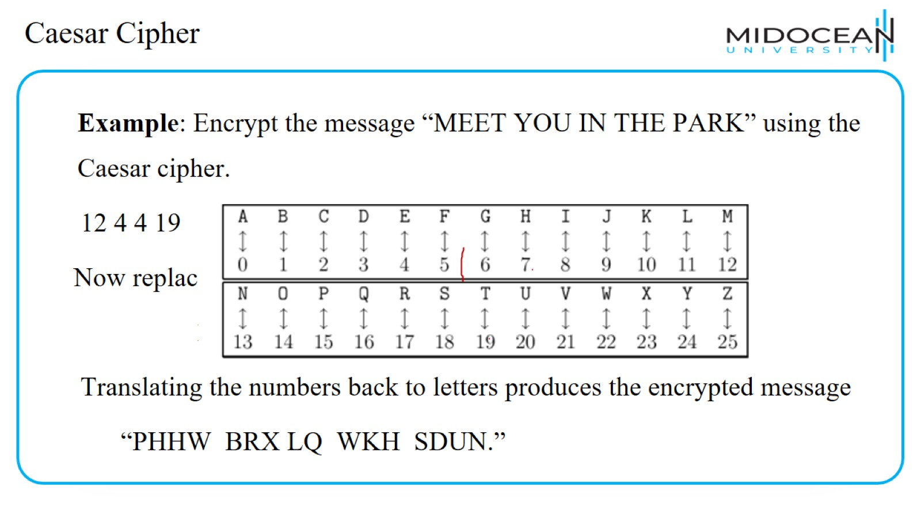
Caesar Cipher

Slide 34
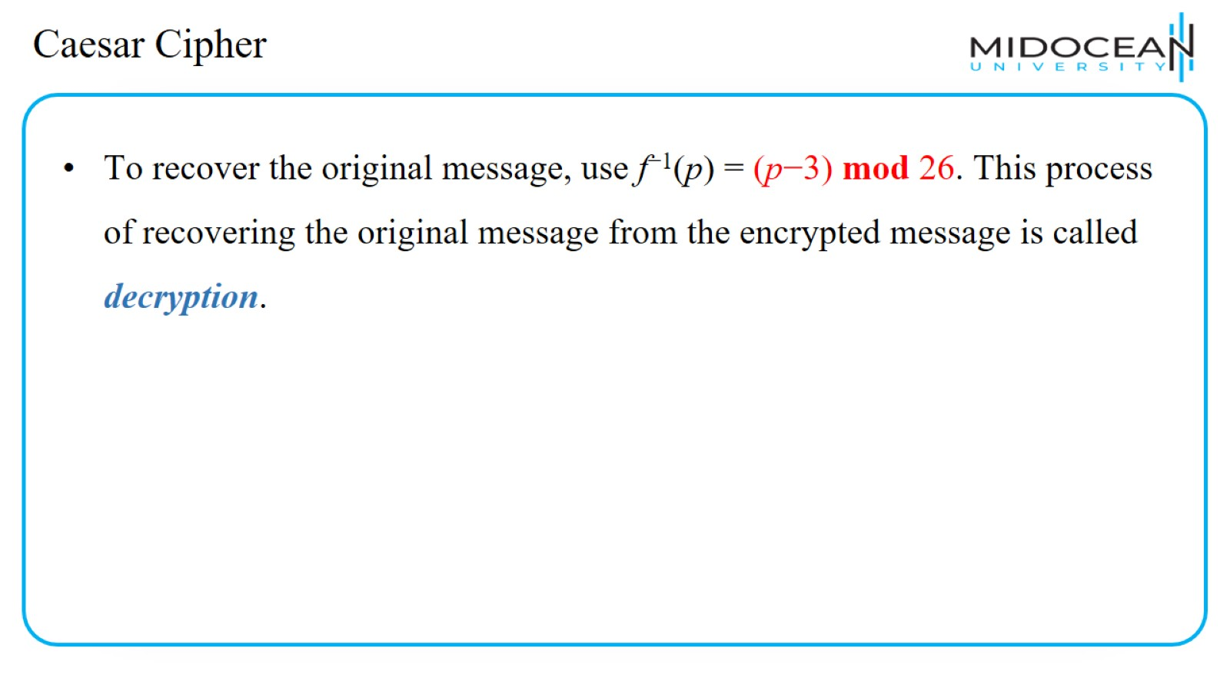
Caesar Cipher

Slide 35
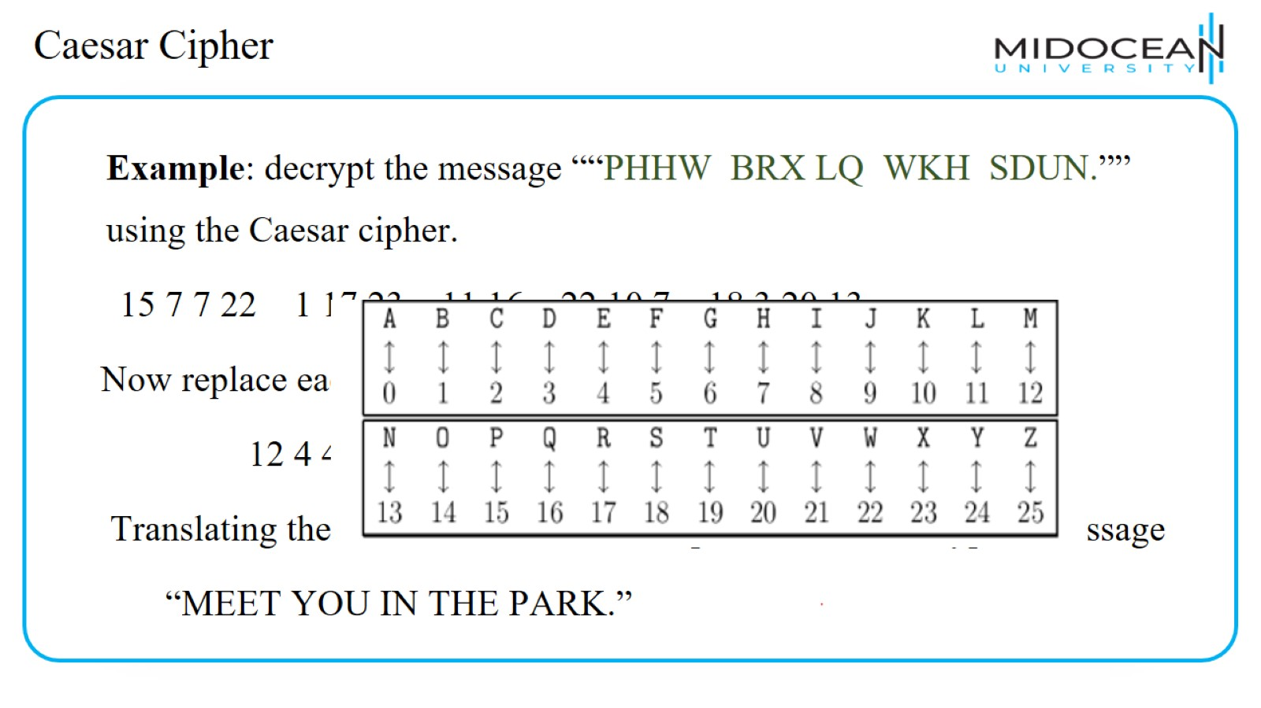
Caesar Cipher

Slide 36
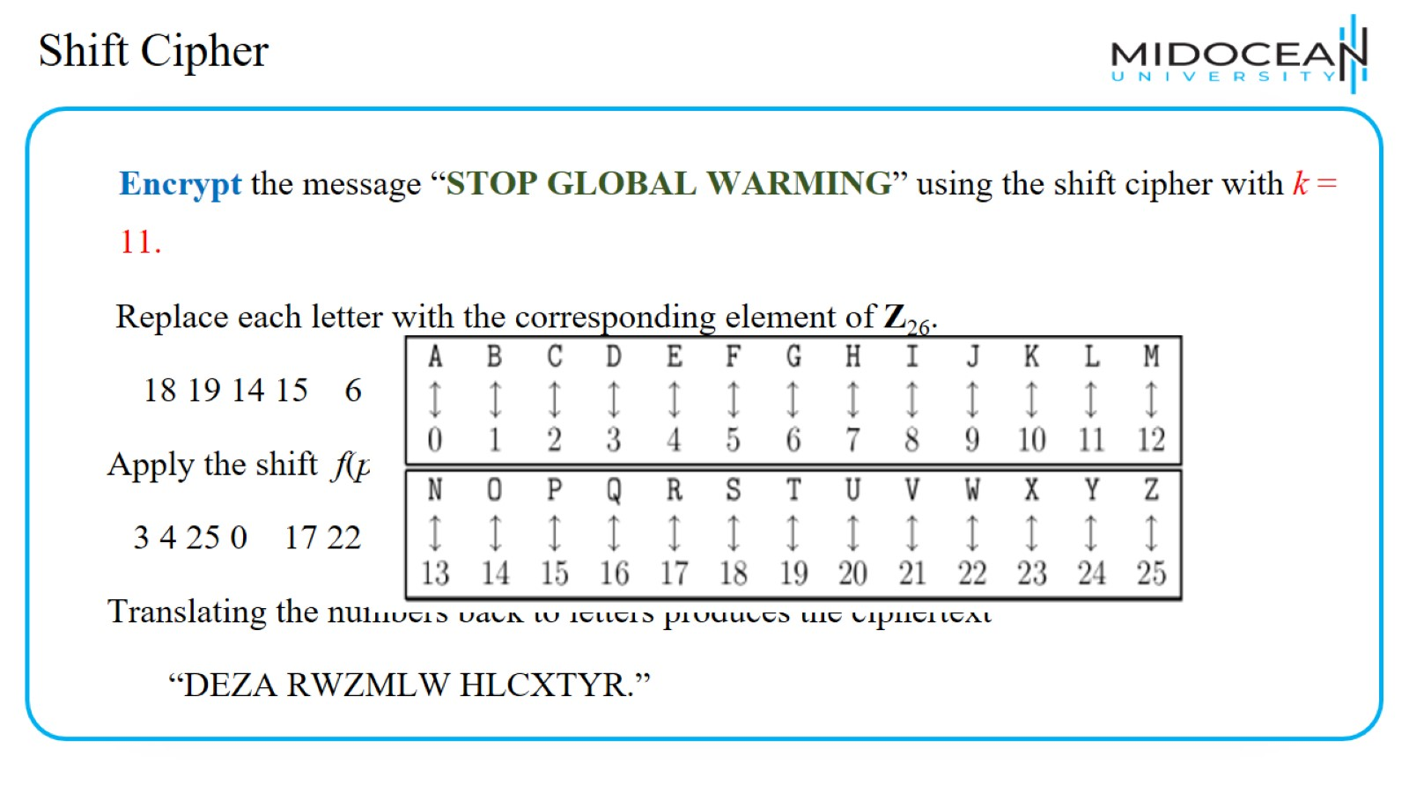
Shift Cipher

Slide 37
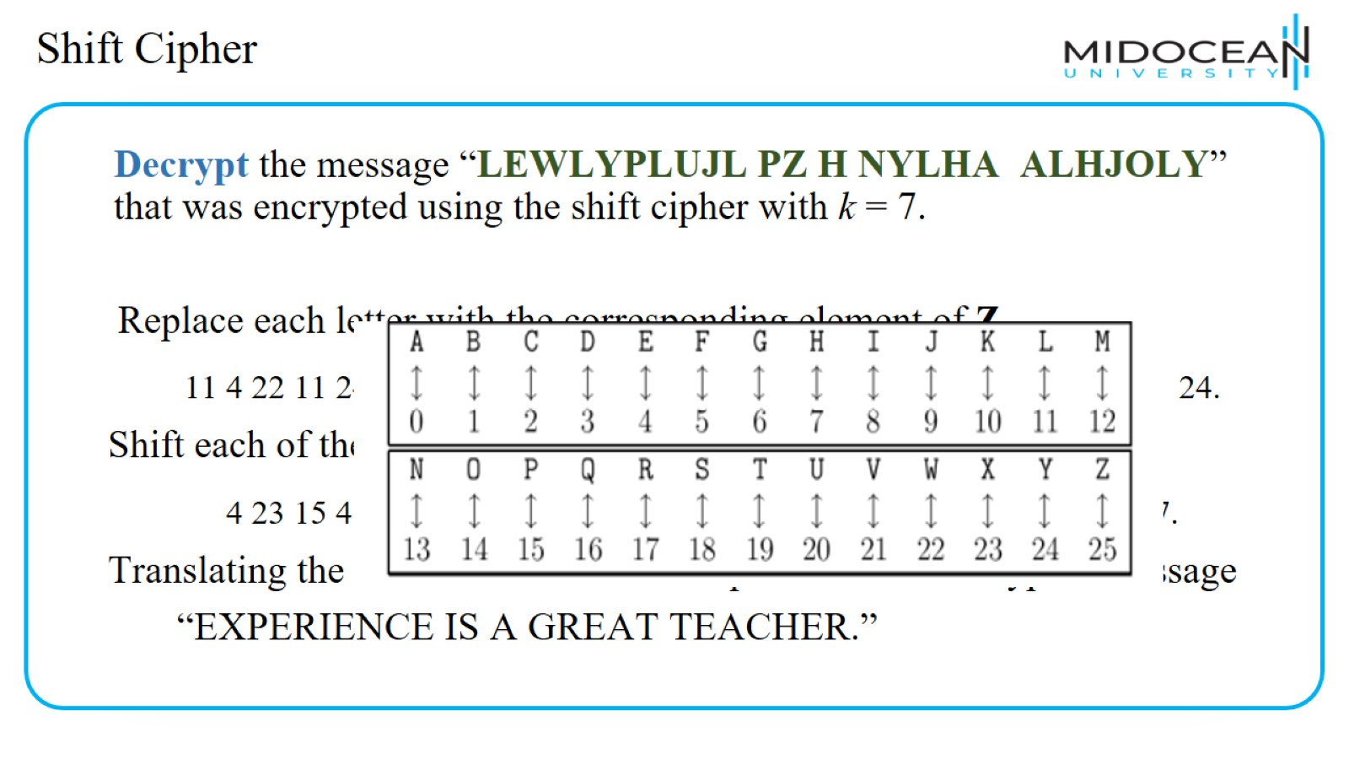
Shift Cipher

Slide 38
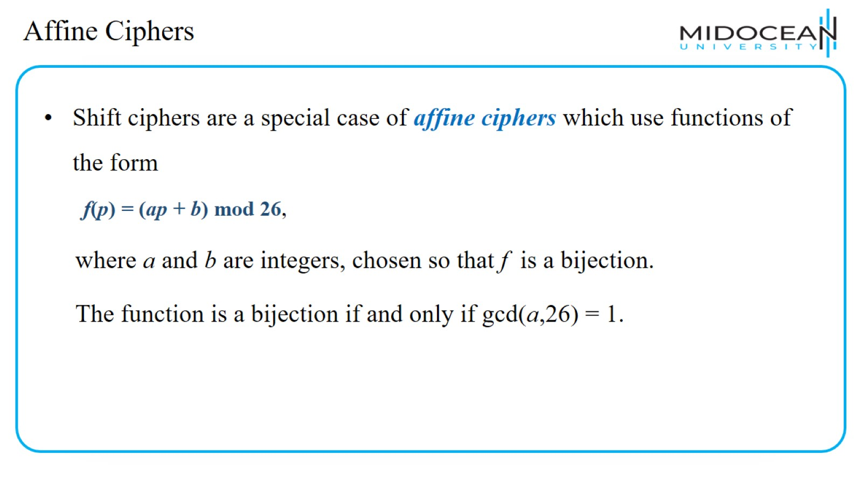
Affine Ciphers

Slide 39
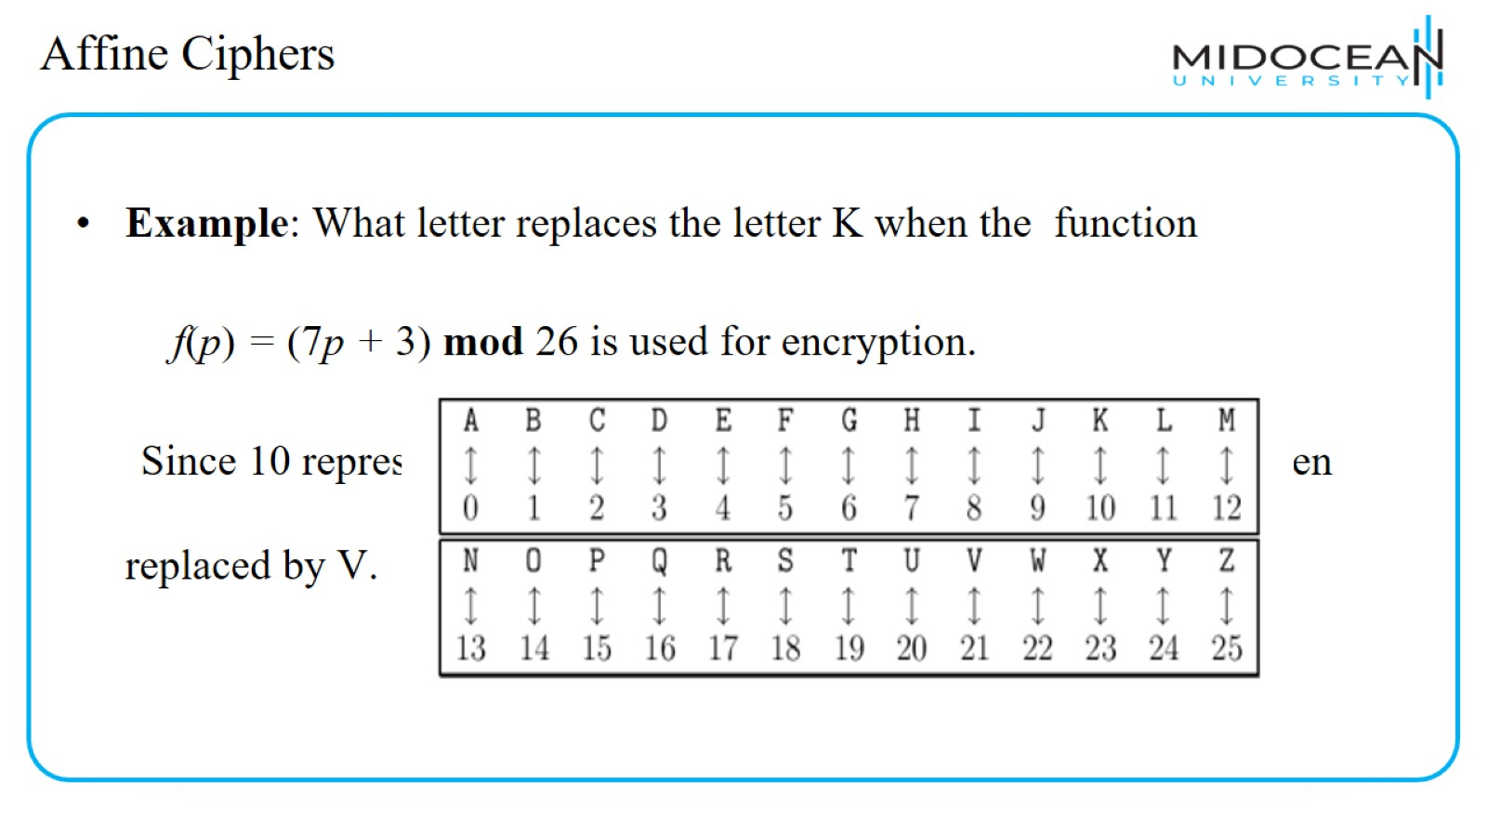
Affine Ciphers

Slide 40
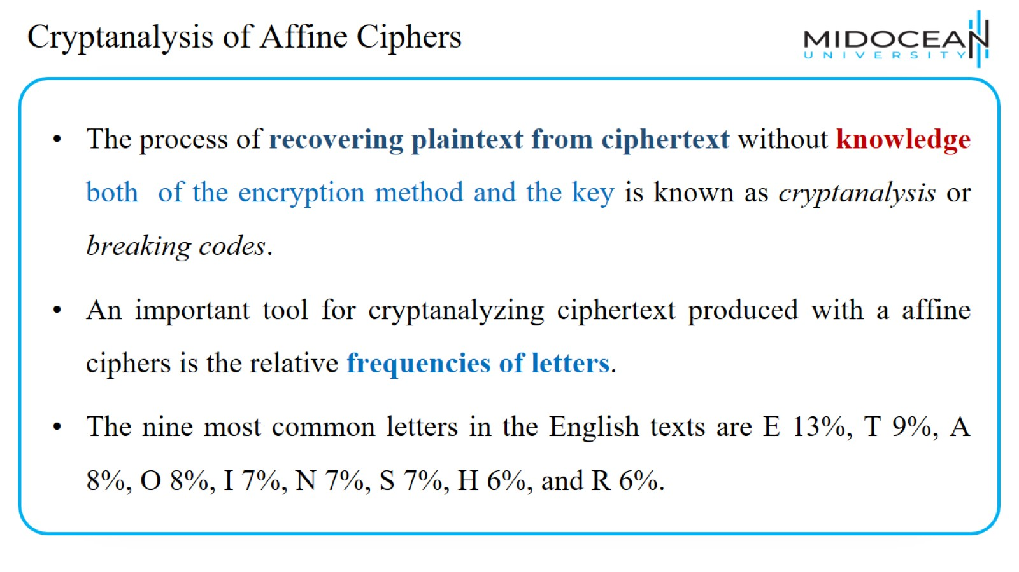
Cryptanalysis of Affine Ciphers

Slide 41
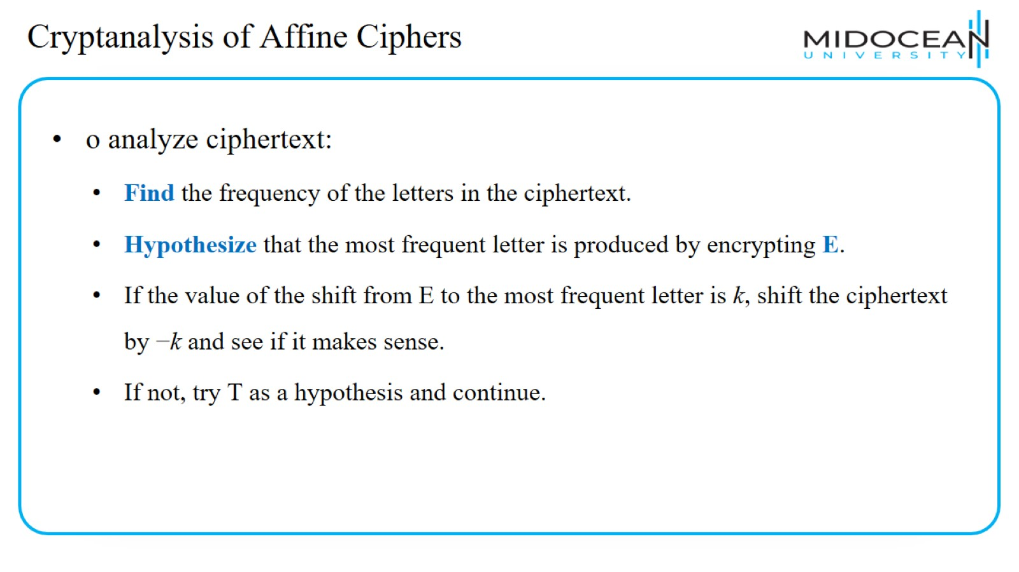
Cryptanalysis of Affine Ciphers

Slide 42
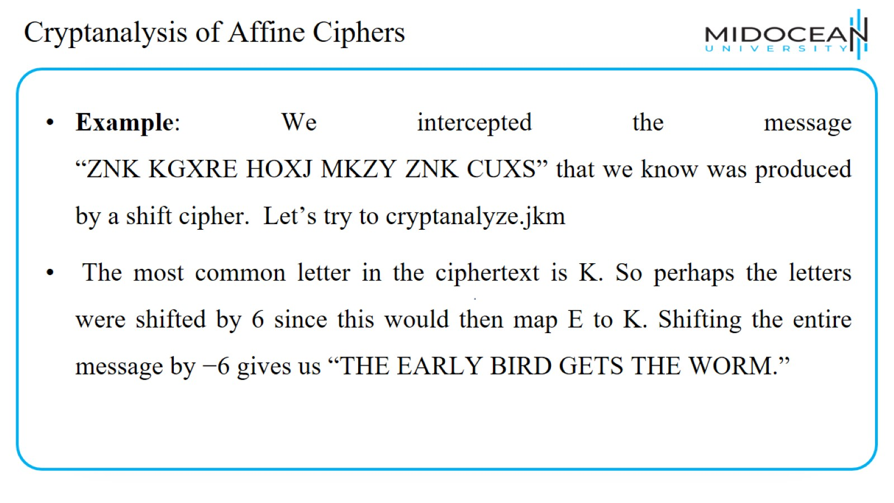
Cryptanalysis of Affine Ciphers

Slide 43
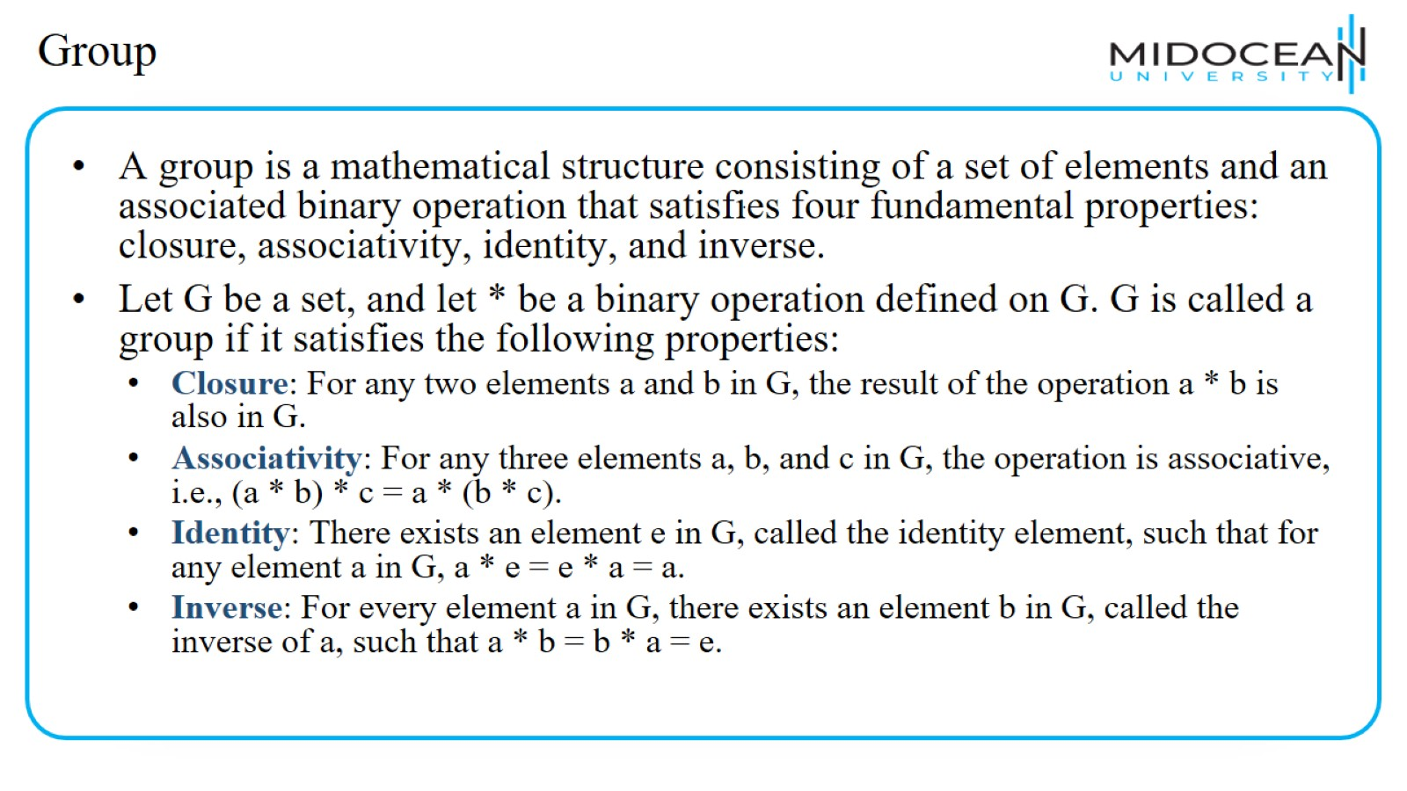
Group

Slide 44
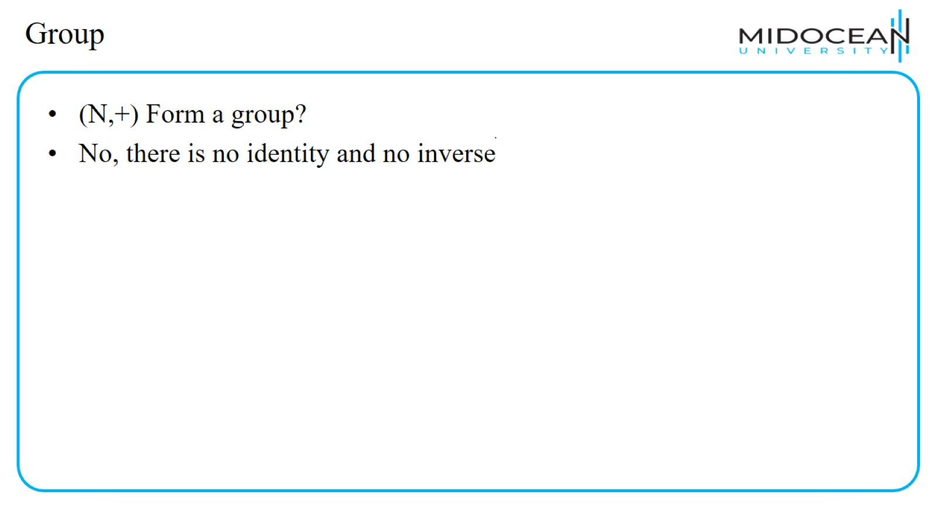
Group

Slide 45
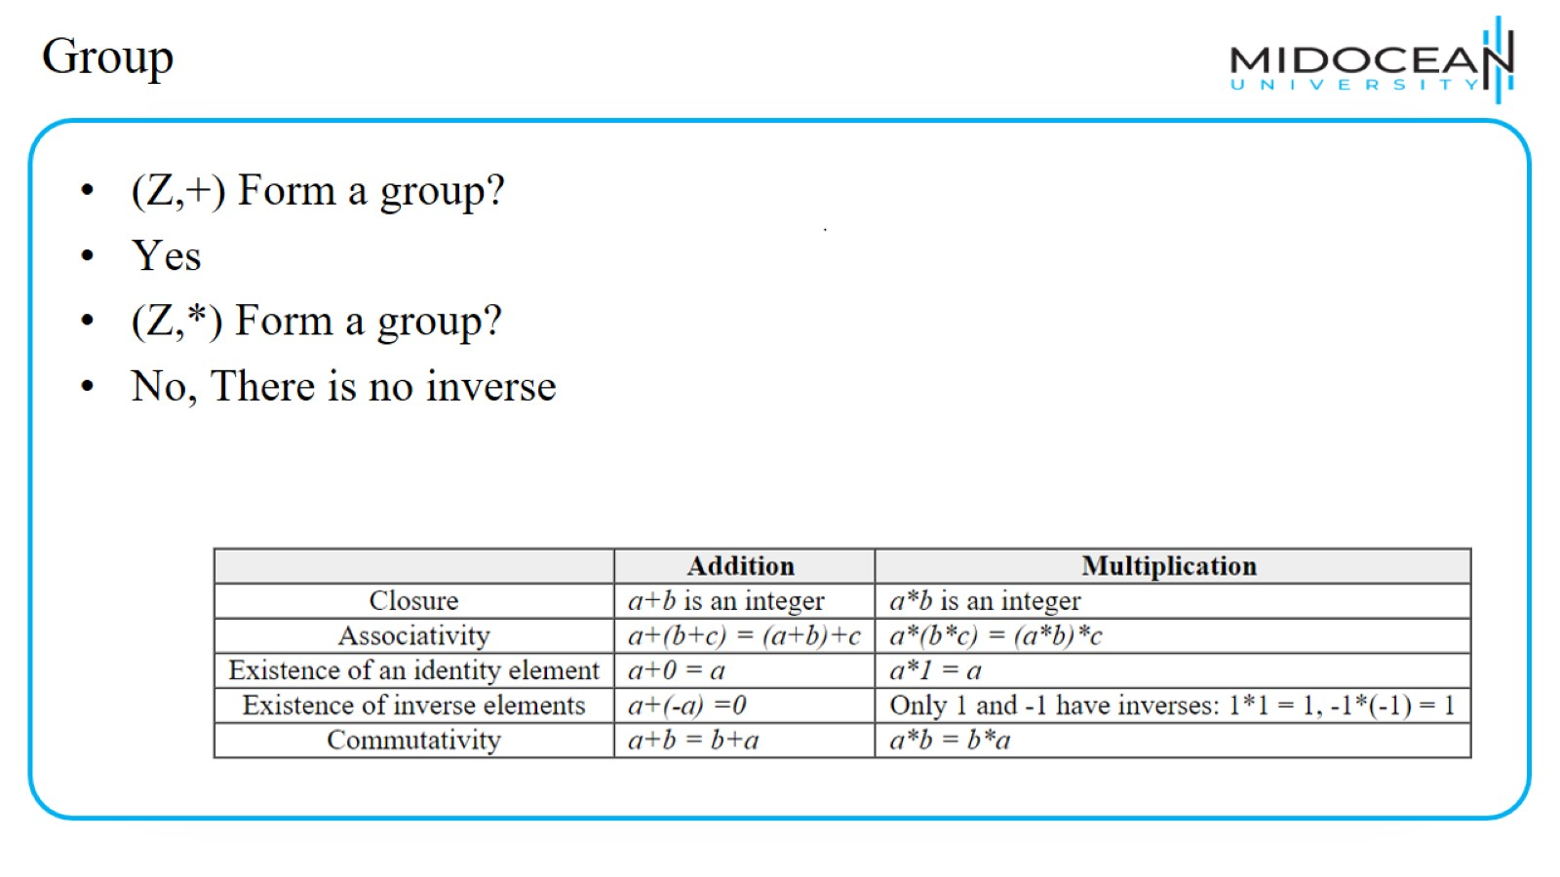
Group

Slide 46
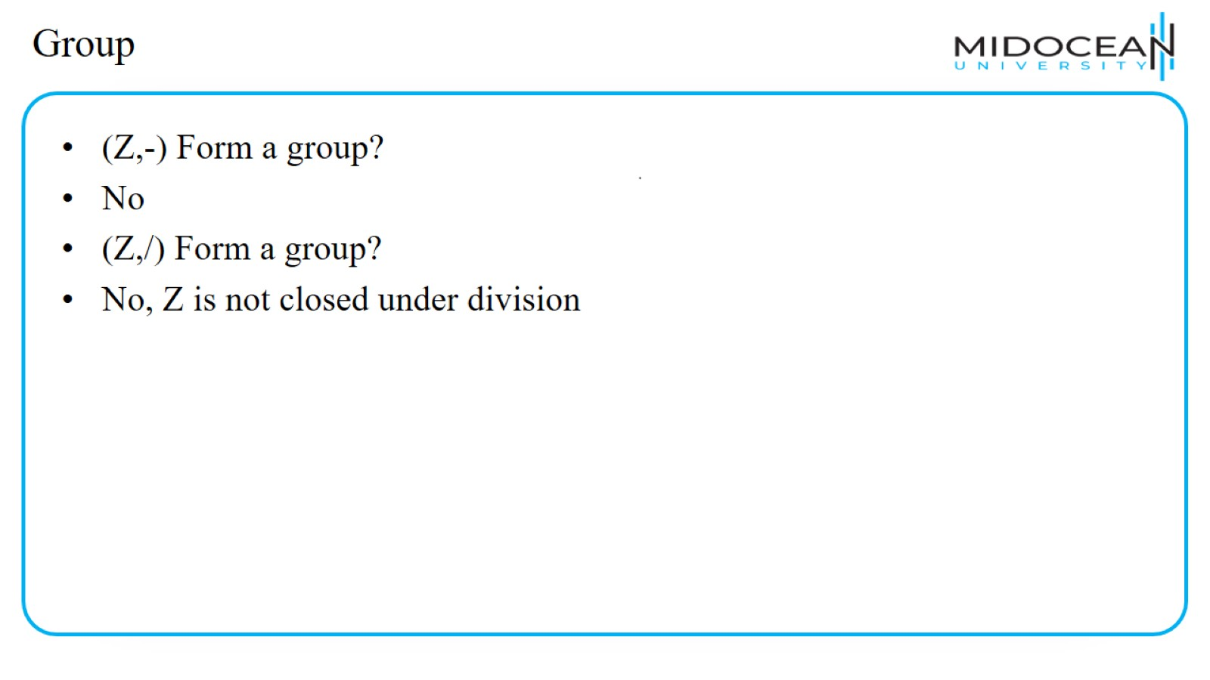
Group

Slide 47
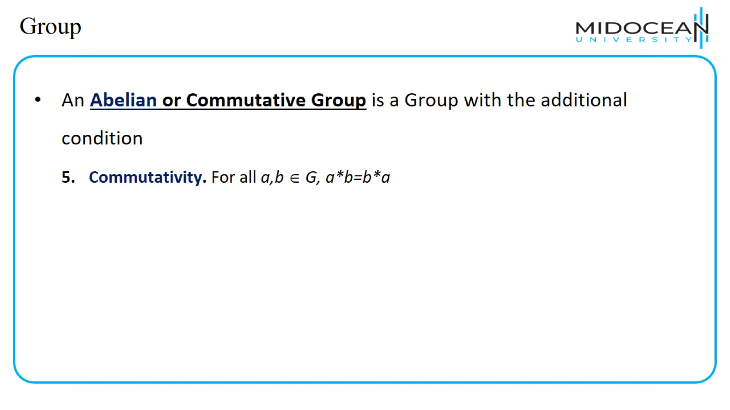
Group

Slide 48
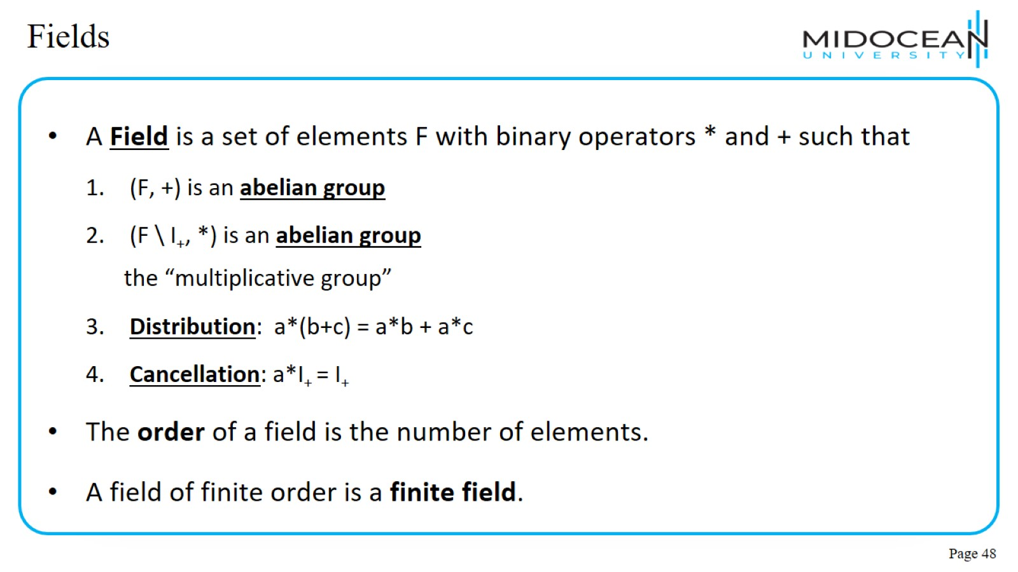
Fields

Slide 49
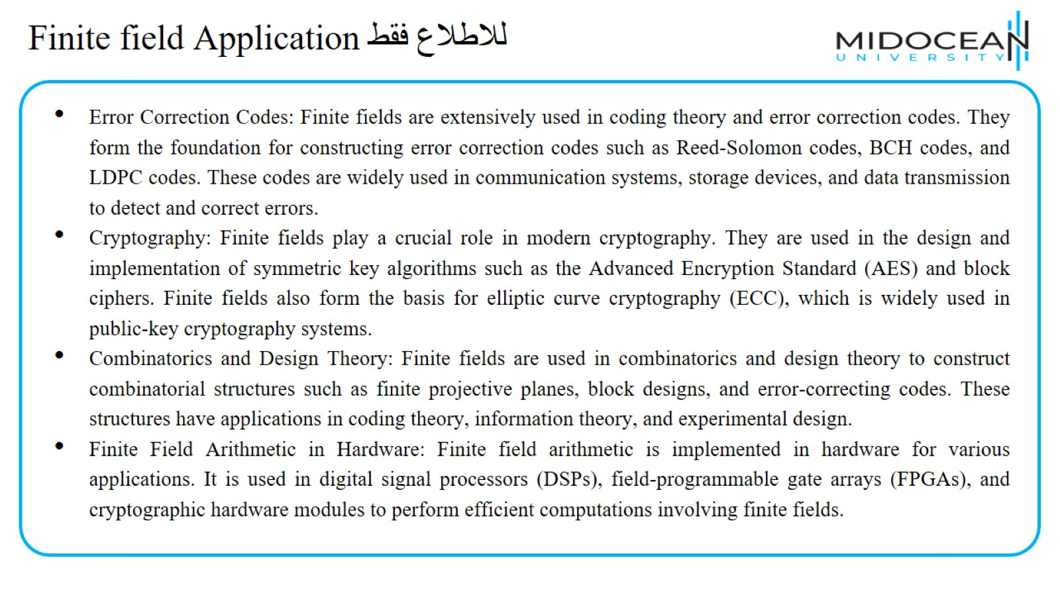
Finite field Application للاطلاع فقط

Slide 50
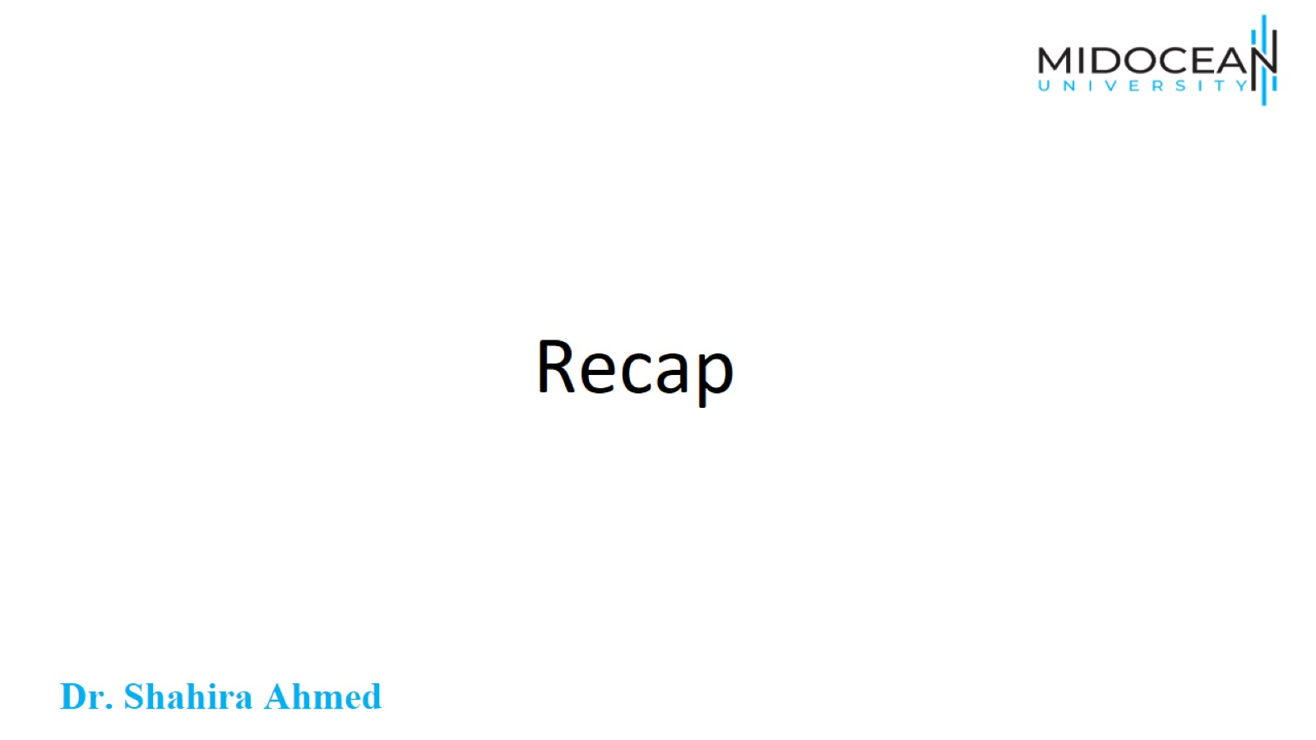
Recap

Slide 51
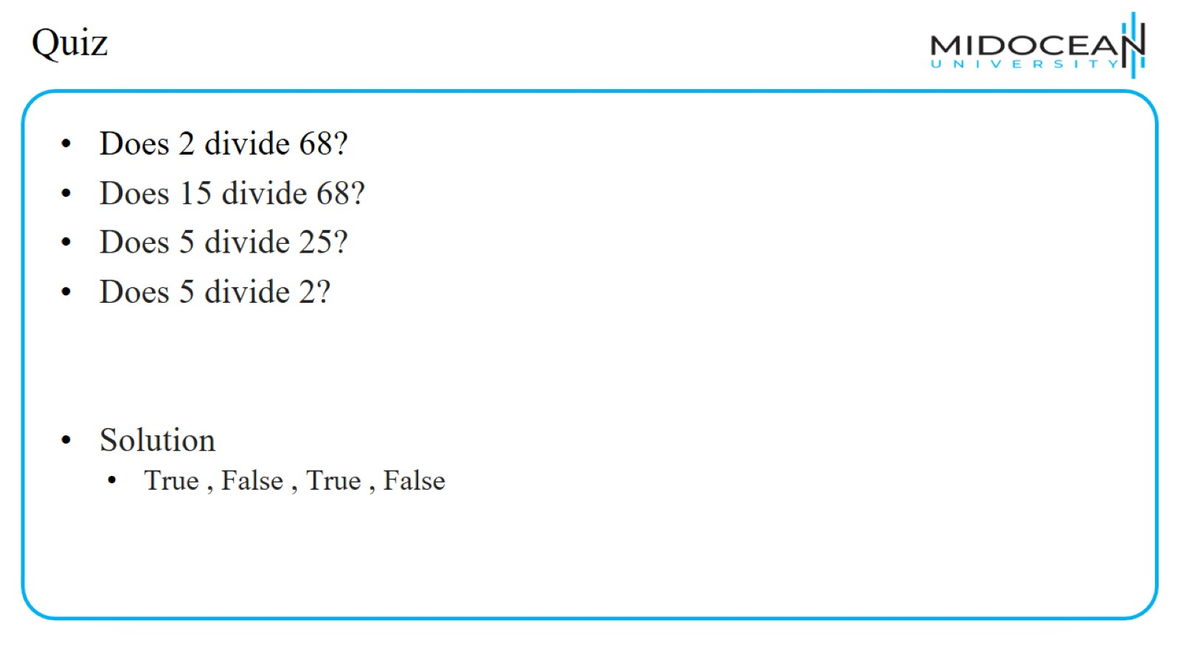
Quiz

Slide 52
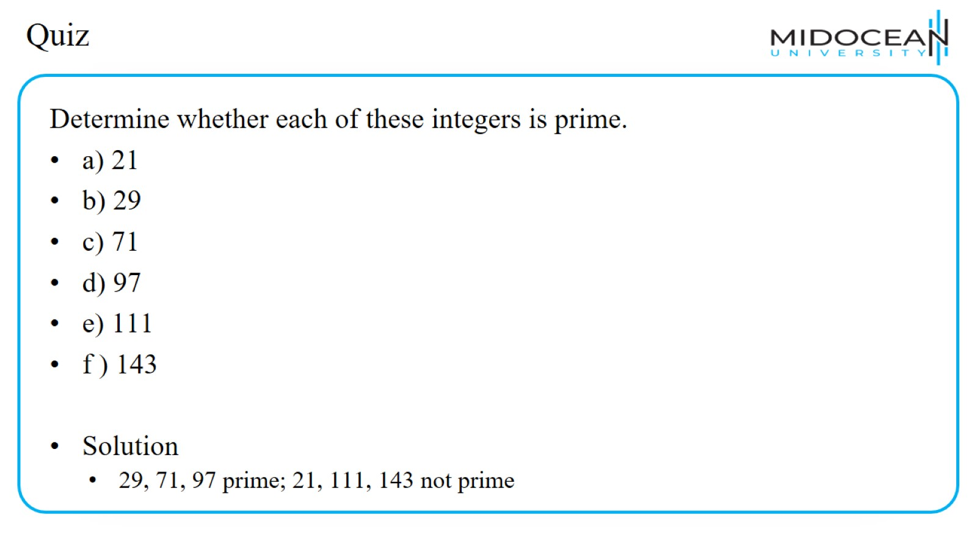
Quiz

Slide 53
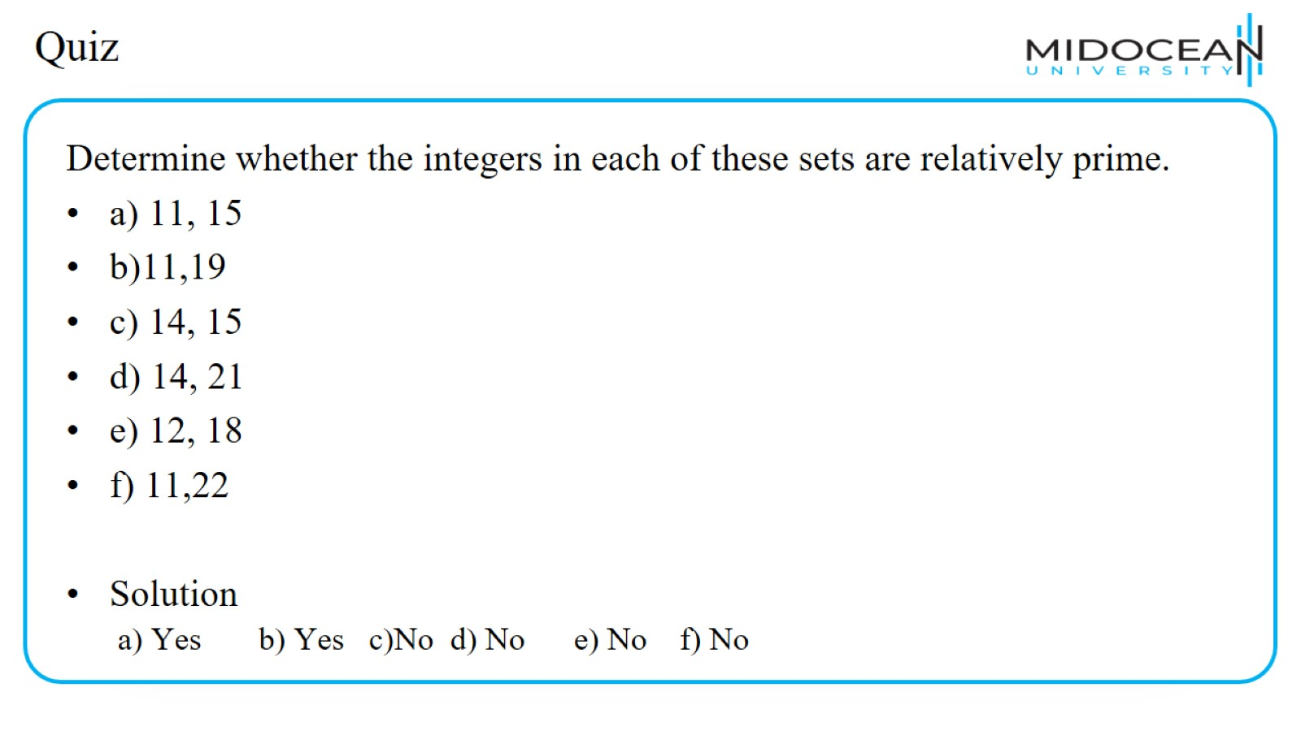
Quiz

Slide 54
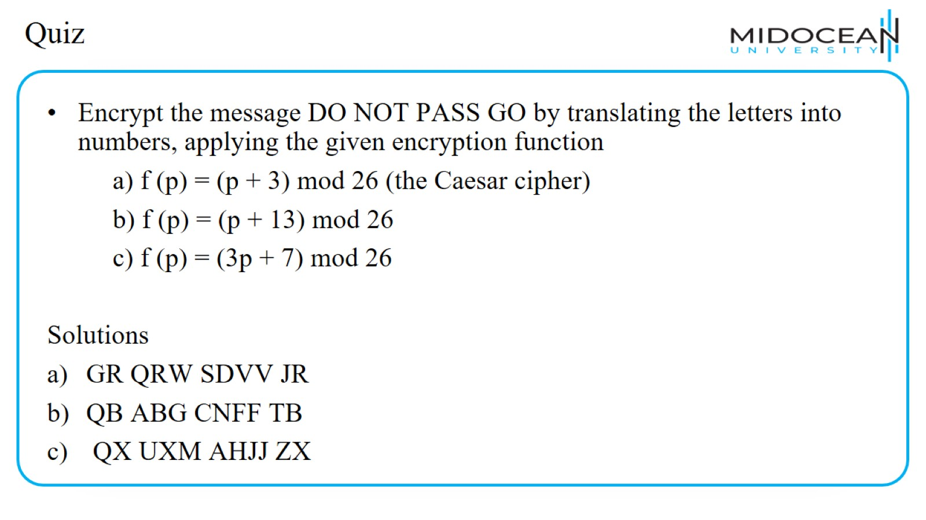
Quiz

Slide 55
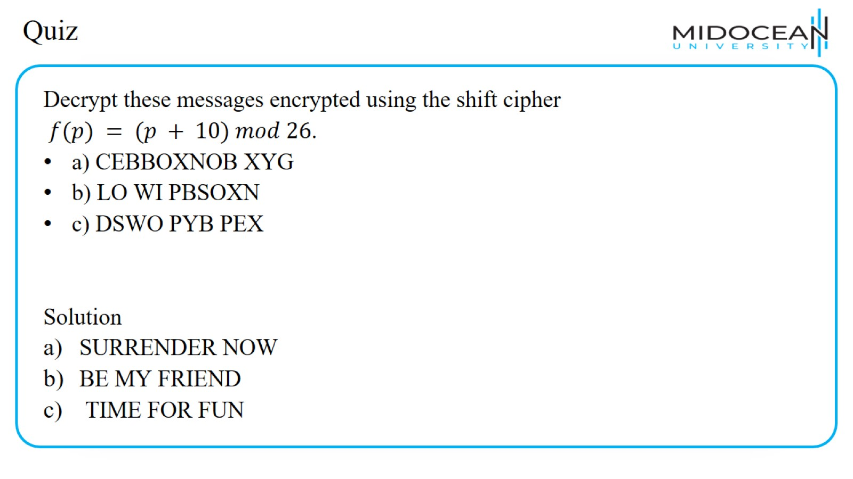
Quiz

Slide 56

Quiz

Slide 57

Quiz

Slide 58


Slide 59


