Slide 1

Financial Management
Prepared by
Dr. Mohamed Hussein
Assistant Professor of Accounting
MGM 424
Lecture 2

Slide 2



Financial Management
Lecture 2
MGM424 Basic Financial Statements
Prepared by
Dr. Mohamed Hussein

Slide 3

Chapter
02
Basic Financial Statements

Slide 4

Chapter
Basic Financial Statements
2
The Four Basic Financial Statements
Identify the income statement (Profit & loss)
Explain the statement of changes in owner’s Equity.
Describe the classified balance sheet(Statement of financial position).
Identify Accrual Basis & Cash Basis and Cash flow statement.

Slide 5
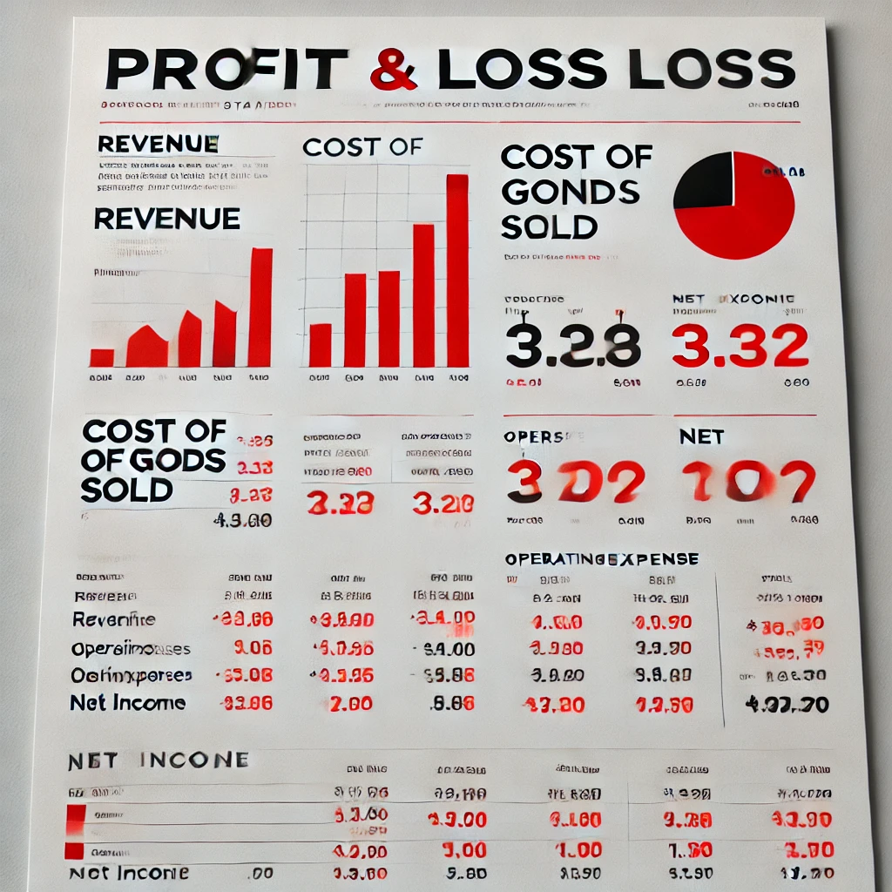
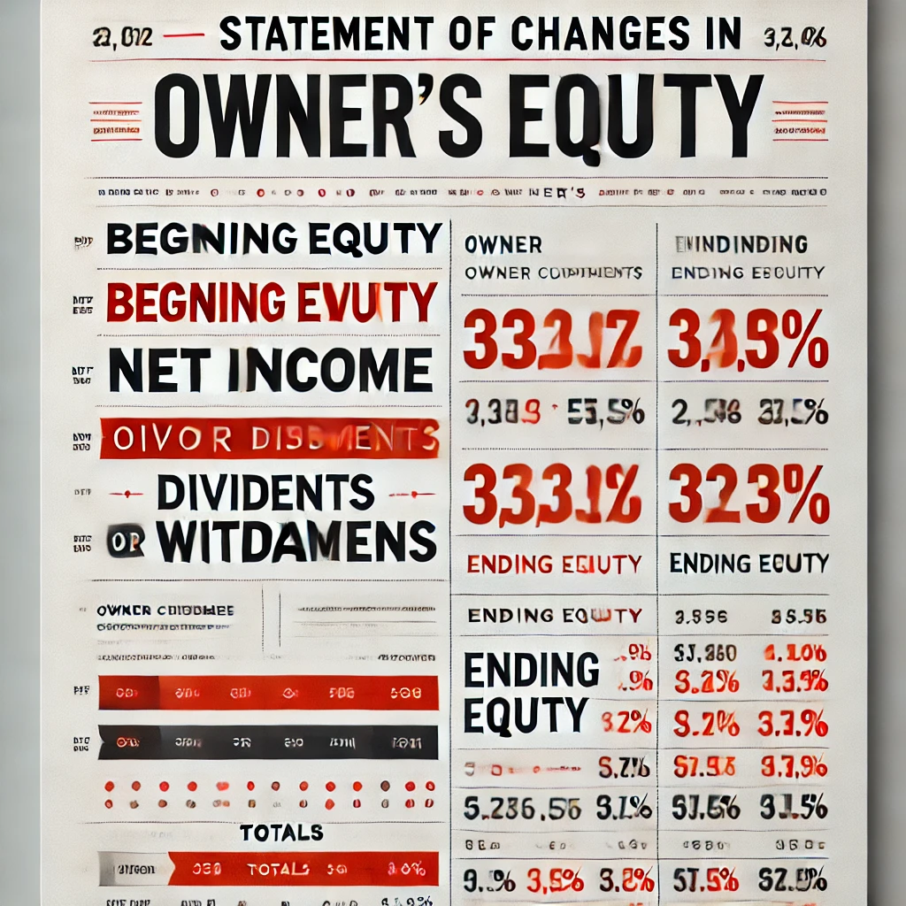
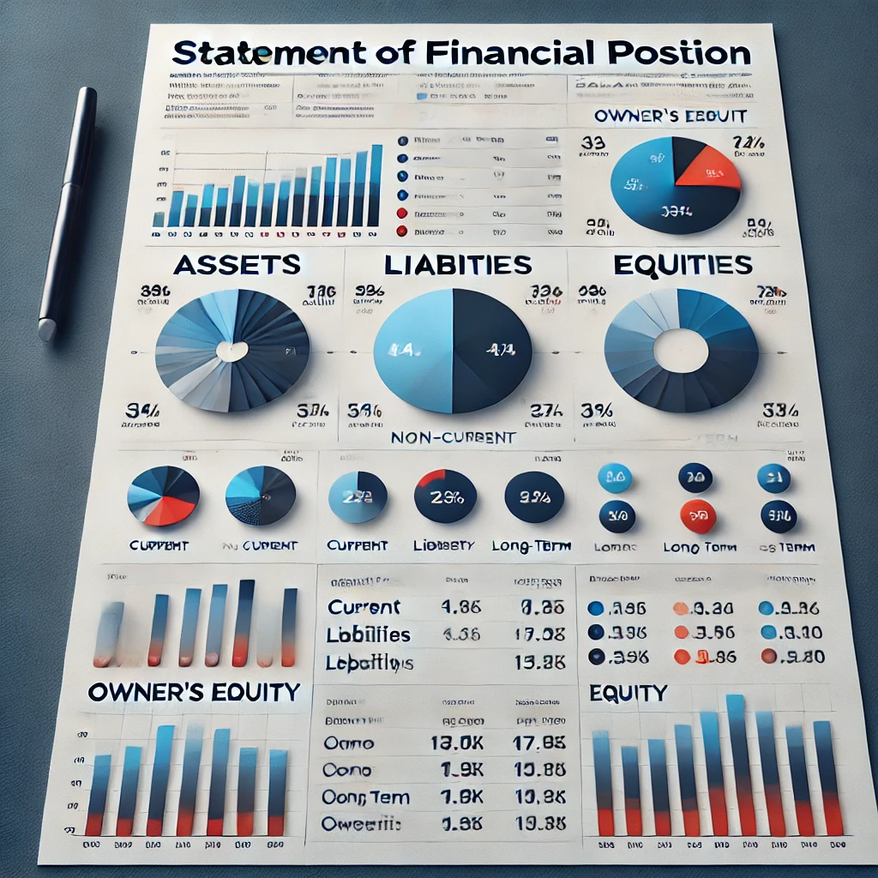

The Four Basic Financial Statements
Financial Statements are prepared directly from the Trial Balance.
Companies prepare four financial statements:
Income Statement (Profit & loss statement) |  | Changes in owner’s Equity Statement |  | Statement of Financial Position (Balance Sheet) |  | Statement of Cash Flows
Period of time
Period of time
Point in time
Period of time

Slide 6
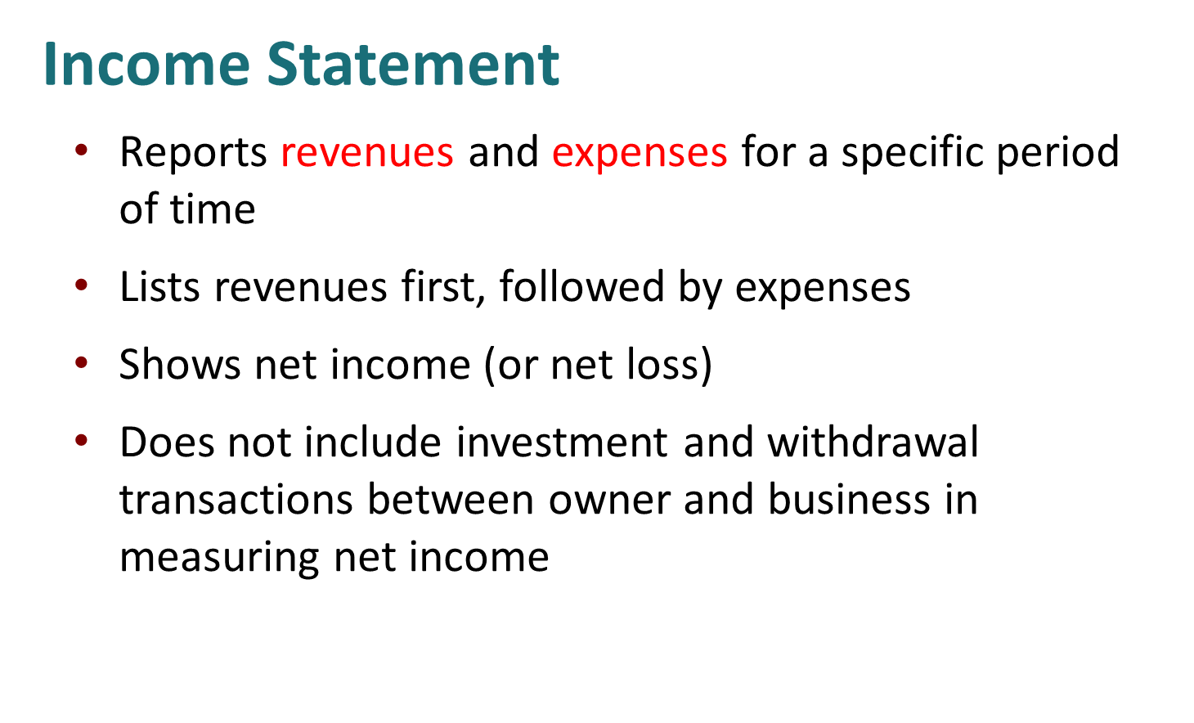


Slide 7
Business Name…. Single-Step income statement for the year ended Dec. 31, 2024
Revenues :
Sales Revenue | ×
Service Revenue | ×
Fees Earned | ×
Commission Revenue | ×
Consulting revenue | ×
Dividends Revenue | ×
Rental revenue | ×
Total Revenues | ××
Expenses:
Salary expenses | (×)
Wages expenses | (×)
Rent expenses | (×)
Utility expense | (×)
Repair expense
Insurance expense | (×)
Interest expense | (×)
Depreciation expense | (×)
Advertising expense | (×)
Supplies expense | (×)
Total expenses | (××)
Net income | ××

Slide 8
Revenues and expenses determine if a net income or net loss occurs as follows:
Revenues > Expenses: Net Income(Profit).
Revenues < Expenses: Net Income (loss).

Slide 9

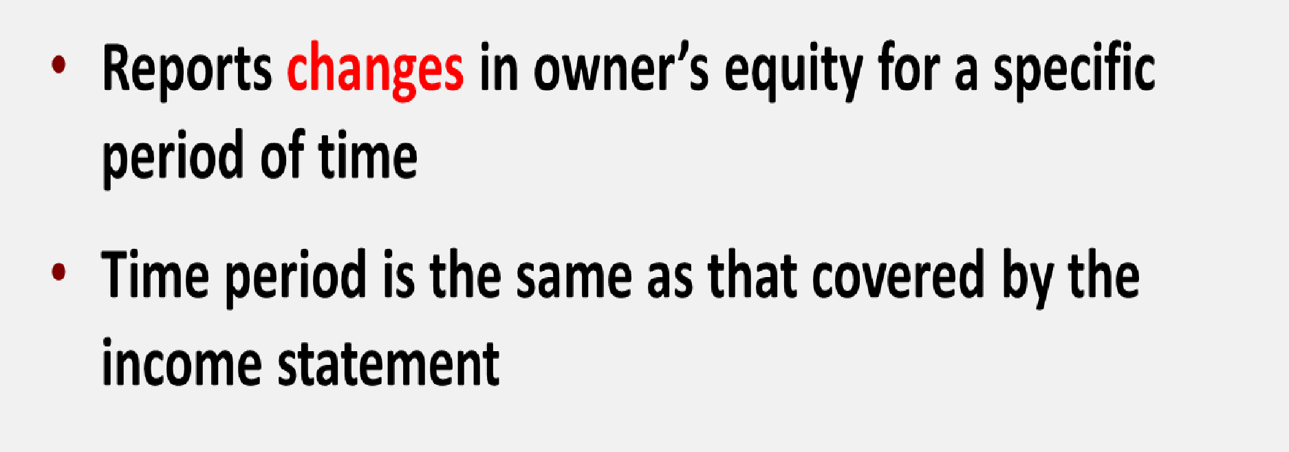
Changes in Owner’s Equity Statement

Slide 10
Business Name…. Changes in Owner’s equity statement For the year ended Dec 31.2024
Beginning Capital | ×
Add (+) | +
Additional Investment | ×
Net income (Profit) ….from the income statement | ×
Less (-) | (×)
Drawings (Withdrawals)
Net income (Loss) …. from the income statement
Ending Capital | ××

Slide 11
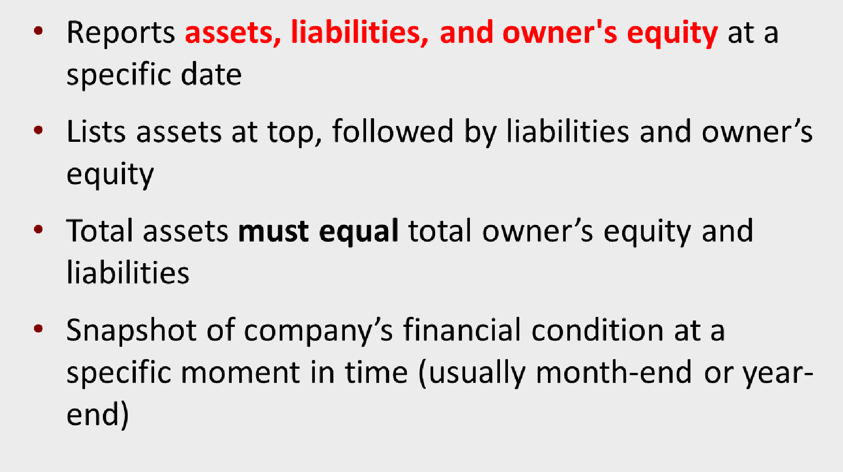

Statement of Financial Position (Balance sheet)

Slide 12

At the year ended Dec 31.2024
Assets | xx xx xx xx xx xx
Current assets Cash Short-term investment Account receivable Notes receivable Inventories Prepaid expenses Total current assets |  | xx
Property, plant, and equipment (Fixed Assets) |  | xx
Land Building ( - ) Accumulated Depreciation Equipment ( - ) Accumulated Depreciation Machinery ( - ) Accumulated Depreciation Furniture ( - ) Accumulated Depreciation | xx xx xx xx xx
Total property, plant, and equipment |  | xx
Intangible assets | xx
Goodwill | xx
Copyright | xx
Trademark | Xx
Total intangible assets |  | xx
Total assets | xx
Liabilities & owner's equity
Liabilities | xx xx Xx | xx
Current liabilities |  | xx
Notes payable Account payable Unearned revenue Total current liabilities |  | xx
 | xx xx
Long term liabilities Mortgage payable Bank loan payable Total long-term liabilities |  | xx
Total liabilities |  | xx
Owner's equity Capital …..From the changes in owner’s equity statement |  | xx
Total liabilities & owner's equity |  | xx
www.midocean.ae

Slide 13
Example (1)
Mohamed Hussein has the following Activities during the year:
Service revenue $52800- Rent expense $4800 - wages expense $33080 - advertising expense $5400- utilities expense $3600 - Mohamed withdrawals
$2800- Cash $6200- Accounts receivable $3000-supplies $400- Accounts payable $1800 - Mohamed beginning capital $8680
Required
Prepare the income statement.
Prepare the statement of owner's equity.
Prepare the balance sheet for Mohamed Hussein proprietorship.
land 4000-

Slide 14




Mohamed Hussein
Balance Sheet
At the year ended Dec 31.2024
Mohamed Hussein Single-Step income statement for the year ended Dec. 31, 2024
Revenues :
Service Revenue | 52800
Expenses:
Rent expenses | (4800)
Wages expenses | (33080)
Advertising expense | (5400)
Utility expense | (3600)
Total expenses | (46880)
Net income | 5920
Assets
6200
3000
400
Current assets:
Cash Accounts receivable Supplies
9600
4000
Fixed Assets
Land
Total Assets
Liabilities and owner's’s equity
Short term liabilities
Accounts Payable
Long term liabilities
Loans (If found)
Owner's equity
Capital
4000
13600
Mohamed Hussein
Owner’s equity statement
For the year ended Dec 31.2024
1800
Beginning Capital
Add (+)
Additional Investment Net income (Profit) Less (-)
Drawings (Withdrawals)
8680
+
0
5920
11800
(2800)
Total liabilities and Owner's equity
13600
Ending Capital
11800

Slide 15
Example(2)
Given the following trial balance:
FastForward Trial Balance
December 31, 2011
 | Debits | Credits
Cash | $ 4,350
Accounts receivable |  | -
Supplies | 9,720
Prepaid Insurance | 2,400
Equipment | 26,000
Accounts payable |  | $ 6,200
Unearned consulting revenue |  | 3,000
C. Taylor, Capital |  | 30,000
Owner's Withdrawals Consulting revenue | 200 | 5,800
Rental revenue |  | 300
Salaries expense | 1,400
Rent expense | 1,000
Utilities expense 230
Instructions
Prepare the income statement.
Prepare the statement of owner's equity.
Prepare the statement of
financial position.
Total
$ 45,300 $ 45,300

Slide 16
FASTFORWARD Income Statement For the Month Ended December 31, 2011
Revenues:
Consulting revenue | $ 5,800
Rental revenue | 300
Total revenues |  | $ 6,100
Expenses:
Rent expense | 1,000
Salaries expense | 1,400
Utilities expense | 230
Total expenses |  | 2,630
Net income |  | $ 3,470

Slide 17


STATEMENT OF OWNER'S EQUITY
FASTFORWARD Statement of Owner's Equity For the Month Ended December 31, 2011
C. Taylor, Capital 12/1/11 | $ -
Net income for December | 3,470
Plus: Investments by Owner | 30,000
 | 33,470
Less: Owner Withdrawals | 200
C. Taylor, Capital, 12/31/11 | $ 33,270
Connections
FASTFORWARD Income Statement For the Month Ended December 31, 2011
Revenues:
Consulting revenue | $ 5,800
Rental revenue | 300
Total revenues |  | $ 6,100
Expenses:
Rent expense | 1,000
Salaries expense | 1,400
Utilities expense | 230
Total expenses |  | 2,630
Net income |  | $ 3,470

Slide 18

BALANCE SHEET
FASTFORWARD
Statement of Owner's Equity
FASTFORWARD
Balance Sheet
For the Month Ended December 31, 2011
C. Taylor, Capital 12/1/11 | $ | -
Net income for December | 3,470
Plus: Investments by Owner | 30,000
 | 33,470
Less: Owner Withdrawals | 200
C. Taylor, Capital, 12/31/11 | $ | 33,270
December 31, 2011 Assets
Cash Supplies
Prepaid insurance Equipment
Total assets
Liabilities Accounts payable Unearned revenue Total liabilities
Equity
$
4,350
9,720
2,400
26,000
$
42,470
$
6,200
3,000
Connections
9,200
C. Taylor, Capital Total equity
Total liabilities and equity
$ 33,270
33,270
$ 42,470

Slide 19
Example(3)
Given the following trial balance:
Account title | Dr | Cr
Cash | 100,000
Accounts receivable | 30,000
Building | 90,000
Accumulated Depreciation -Building |  | 20,000
Equipment | 350,000
Accumulated Depreciation -Equipment |  | 50,000
Notes payable |  | 60,000
Accounts Payable |  | 90,000
Zaher ,Capital |  | 280,000
Zaher , Withdrawals | 30,000
Service revenue |  | 140,000
Salaries expense | 20,000
Insurance expense | 8,000
Advertising expense | 9,000
Rent expense | 3,000
Total | 640,000 | 640,000
Instructions
Prepare the income statement.
Prepare the statement of owner's equity.
Prepare the statement of
financial position.

Slide 20
income statement
for the year ended Dec. 31, 2024
Balance Sheet At the year ended Dec 31.2024
Assets
Fixed assets (Non-Current Assets) :
Building | 90,000
(-) Accumulated Depreciation | ( 20,000) | 70,000
Equipment | 350,000
(-) Accumulated Depreciation | (50,000)
Current Assets |  | 300,000
Cash |  | 100,000
Accounts receivable |  | 30,000
Total Assets |  | 500,000
Liabilities and stockholder’s equity
Short term liabilities
Accounts payable |  | 90,000
Notes payable |  | 60,000
Long term liabilities
Loans (If found)
Owner's equity
Capital |  | 350,000
Total liabilities and Owner's equity |  | 500,000
Revenues :
Service Revenue Expenses: Salaries Expense
Insurance expenses
Advertising Expense Rent expense
140000
(20000)
(8000)
(9000)
(3000)
Total expenses
(40000)
Net income (Profit)
100,000
Owner’s equity statement For the year ended Dec 31.2024
Beginning Capital | 280,000
Add (+) | +
Additional Investment | Zero
Net income (Profit) | 100,000
Less (-)
Drawings (Withdrawals) | (30,000)
Ending Capital | 350,000

Slide 21
DO IT! Financial Statement Items
Presented below is selected information related to Li Fashions at December 31, 2024. Li reports financial information monthly.
Equipment | HK$10,000 | Utilities Expense | HK$4,000
Cash | 8,000 | Accounts Receivable | 9,000
Service Revenue | 36,000 | Salaries and Wages Expense | 7,000
Rent Expense | 11,000 | Notes Payable | 16,500
Accounts Payable | 2,000 | Owner’s Drawings | 5,000
a. Determine the total assets at December 31, 2020.
b. Determine the net income reported for December 2020.
c. Determine the owner’s equity at December 31, 2020.

Slide 22
Multiple Choice Questions

Slide 23
1. The following items are taken from the financial statements of the Postal Service for the year ending December 31, 2014:
Accounts payable | $ 18,000
Accounts receivable | 11,000
Accumulated depreciation – equipment | 28,000
Advertising expense | 21,000
Cash | 15,000
Owner’s capital (1/1/14) | 102,000
Owner’s drawings | 14,000
Depreciation expense | 12,000
Insurance expense | 3,000
Note payable, due 6/30/15 | 70,000
Prepaid insurance (12-month policy) | 6,000
Rent expense | 17,000
Salaries and wages expense | 32,000
Service revenue | 133,000
Supplies | 4,000
Supplies expense | 6,000
Equipment | 210,000
What is the company’s net income for the year ending December 31, 2014?
a. $12,000
b. $28,000
c. $42,000
d. $133,000

Slide 24
income statement for the year ended Dec. 31, 2014
Revenues :
Service Revenue | 133000
Expenses:
Advertising Expense | (21000)
Depreciation expenses | (12000)
Insurance Expense | (3000)
Rent expense | (17000)
Salaries & wages expense | (32000)
Supplies expense | (6000)
Total Expenses | (91000)
Net income (Profit) | 42000
The correct Answer is
c

Slide 25
2. Misra Company compiled the following financial information as of December 31, 2023:
Revenues $340,000
Owner’s Capital (1/1/23)140,000
Equipment | 80,000
Expenses | 250,000
Cash | 90,000
Owner’s Drawings | 20,000
Supplies | 10,000
Accounts payable | 40,000
Accounts receivable | 70,000
Misra’s owner’s equity on December 31, 2023 is
a. $90,000.
b. $140,000.
c. $210,000.
d. $250,000.

Slide 26
income statement for the year ended Dec. 31, 2023
Revenues : | 340,000
Less (-) | (-)
Expenses | 250000
Net income (Profit) | 90,000
Owner’s equity statement For the year ended Dec 31.2023
Beginning Owner’s Capital | 140,000
Add (+) | +
Additional Investment | Zero
Net income (Profit) | 90,000
Less (-)
Drawings (Withdrawals) | (20,000)
Ending Owner’s Capital | 210,000
The correct Answer is
c

Slide 27
3.The following items are taken from the financial statements of the Postal
Service for the year ending December 31, 2014:
Accounts payable | $ 18,000
Accounts receivable | 11,000
Accumulated depreciation – equipment | 28,000
Advertising expense | 21,000
Cash | 15,000
Owner’s capital (1/1/14) | 102,000
Owner’s drawings | 14,000
Depreciation expense | 12,000
Insurance expense | 3,000
Note payable, due 6/30/15 | 70,000
Prepaid insurance (12-month policy) | 6,000
Rent expense | 17,000
Salaries and wages expense | 32,000
Service revenue | 133,000
Supplies | 4,000
Supplies expense | 6,000
Equipment | 210,000
Total current assets = Accounts receivable 11,000+ Cash 15,000+
Prepaid insurance 6000+ Supplies 4000
= $36000
The correct Answer is
B
What are total current assets at December 31, 2014?
a. $26,000
b. $36,000
c. $32,000
d. $42,000

Slide 28
5 .The income statement for the year 2023 of Nour Emad Co. contains the following information:
Revenues $70,000
Expenses:
Salaries and Wages Expense $45,000
Rent Expense Advertising Expense Supplies Expense Utilities Expense Insurance Expense
Total expenses
Net income (loss)
12,000
10,000
6,000
2,500
2,000
77,500
$ (7,500)
At January 1, 2023, Nour reported owner’s equity of $50,000. Owner drawings for the year totalled $10,000. At December 31, 2023, the company will report owner’s equity of
a. $17,500.
b. $32,500.
c. $40,000.
d. $42,500.

Slide 29
Owner’s equity statement For the year ended Dec 31.2023
Beginning Owner’s Capital | 50,000
Add (+) | +
Additional Investment Less (-) | Zero
Net income (loss) | (7500)
Drawings (Withdrawals) | (10,000)
Ending Owner’s Capital | 32,500
The correct Answer is
b

Slide 30
7.Misra Company compiled the following financial information as of December 31, 2014:
Revenues $340,000 Owner’s Capital (1/1/14)140,000
Total Assets= Equipment 80,000+ Cash 90,000+Supplies 10,000+ Accounts
receivable 70,000
= $250,000
Equipment | 80,000
Expenses | 250,000
Cash | 90,000
Owner’s Drawings | 20,000
Supplies | 10,000
Accounts payable | 40,000
Accounts receivable | 70,000
Misra’s assets on December 31, 2014 are
a. $180,000.
b. $250,000.
c. $360,000. d $490,000.
The correct Answer is
b

Slide 31
8.As of December 31, 2014, Calexico Company has assets of $42,000 and owner's equity of
$20,000. What are the liabilities for Calexico Company as of December 31, 2014?
a. $22,000.
b. $20,000.
c. $42,000.
d. $62,000.
Net income results when
  Assets > Liabilities.
  Revenues = Expenses.
  Revenues > Expenses.
  Revenues < Expenses.
The correct Answer is a
The correct Answer is c
Owner's capital at the end of the period is equal to
  owner's capital at the beginning of the period plus net income minus liabilities.
  owner's capital at the beginning of the period plus net income minus drawings.
c. net income.
d. assets plus liabilities.
The correct Answer is b

Slide 32
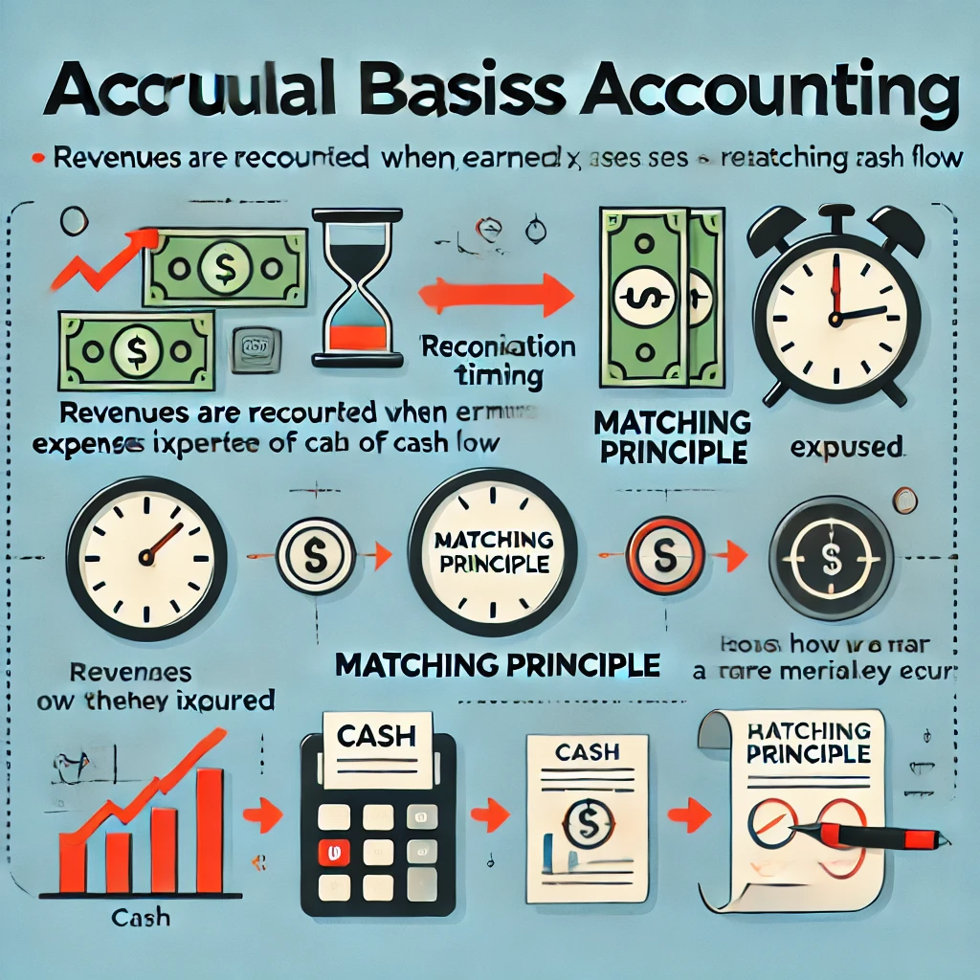
Accrual Basis & Cash Basis
1. Accrual Basis Accounting:
Recognition Timing:
  Revenues are recorded when earned, regardless of when the cash is received.
  Expenses are recorded when incurred, even if the cash hasn’t been paid yet.
Matching Principle:
  Revenues and expenses are matched to the period in which they occur, giving a more accurate picture of a company’s financial performance.
  .

Slide 33
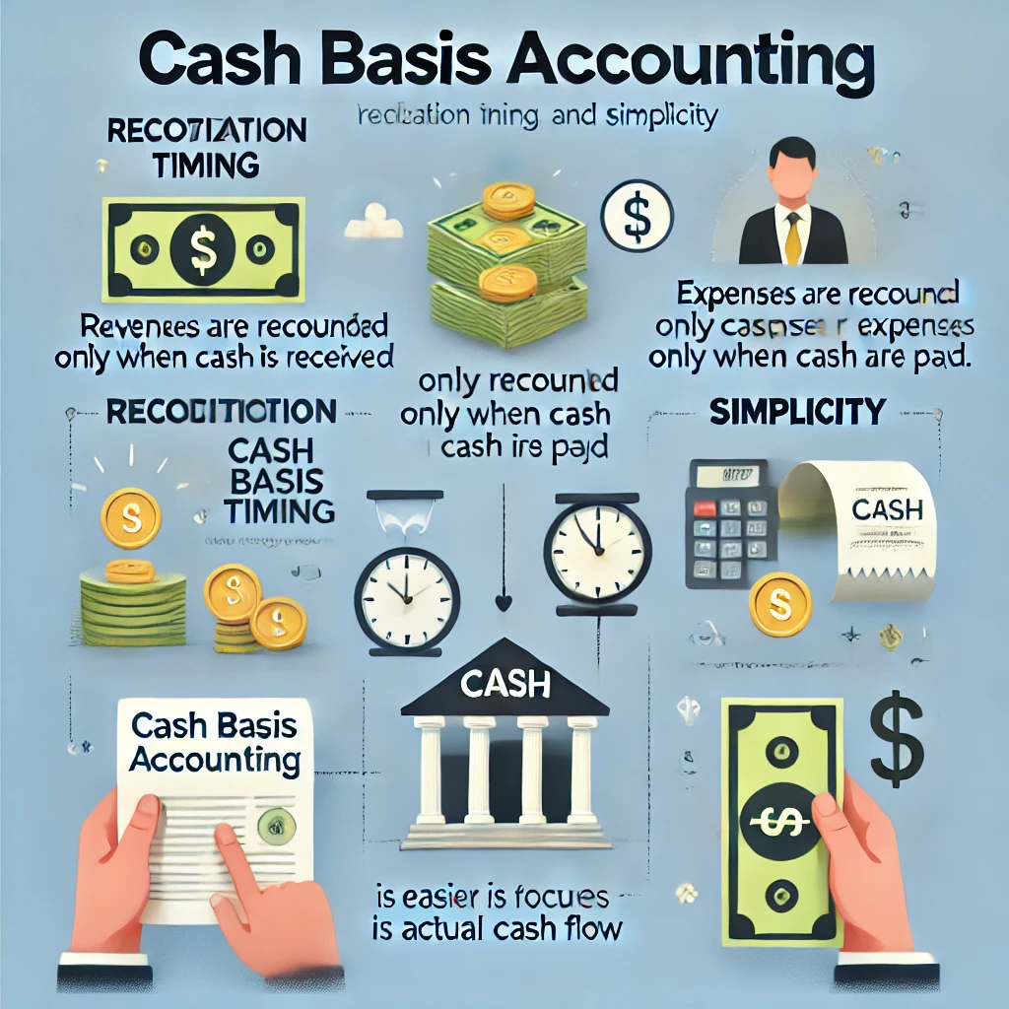
Accrual Basis & Cash Basis
Cash Basis Accounting:
Recognition Timing:
  Revenues are recorded only when cash is received.
  Expenses are recorded only when cash is paid.
Simpler:
  This method is straightforward and easier to manage since it focuses only on actual cash flow.

Slide 34
Accrual Basis & Cash Basis
Aspect | Accrual Basis | Cash Basis
Timing of Revenue | Recognized when earned (before cash is received) | Recognized when cash is received
Timing of Expenses | Recognized when incurred (before cash is paid) | Recognized when cash is paid
Complexity | More complex, follows matching principle | Simple, focuses on cash inflows and outflows
Used By | Larger businesses, those following GAAP | Small businesses, freelancers, or cash-dependent

Slide 35
Question:
Company "Success" provided services in June worth $10,000. Half of the amount ($5,000) was received in cash in June, and the remaining amount will be received in July. The company also incurred expenses of $3,000 in June, which will be paid in July.
Based on accrual accounting, what is the net income for the company in June?
A) $2,000
B) $7,000
C) $5,000
D) $10,000
The correct Answer is b

Slide 36
Question:
Company "Bright" provided services worth $8,000 in May. The customer paid $5,000 in May and will pay the remaining $3,000 in June. In May, the company also received a bill for $2,000 in expenses, which will be paid in June.
Based on Cash Basis Accounting, what is the net income for May?
A) $3,000
B) $6,000
C) $5,000
D) $8,000
The correct Answer is c

Slide 37
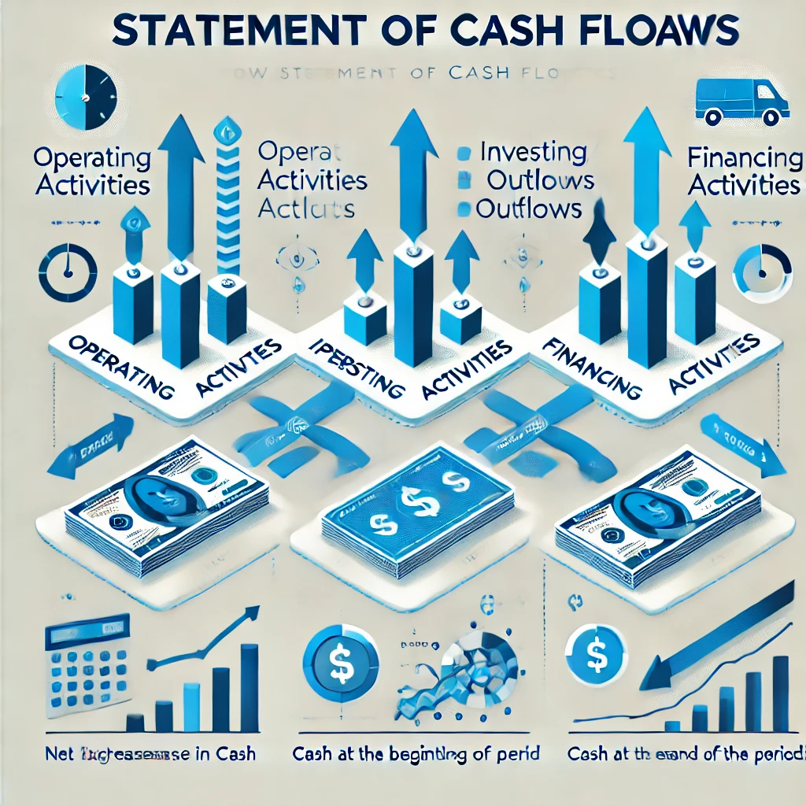
STATEMENT OF CASH FLOWS
In a Statement of Cash Flows, cash flows are categorized as either cash inflows (money coming into the business) or cash outflows (money going out of the business). Here's a breakdown for each activity:
Operating Activities
Investing Activities
Financing Activities

Slide 38
STATEMENT OF CASH FLOWS
Income statement
Cash flow statement
Net income
Net cash flow
80,000,000
30,000,000
Accrual Basis
Cash Basis

Slide 39
Problem 1: Accrual Basis (Income Statement)
A company reports $80,000,000 in Net Income on its Income Statement, which is prepared using the Accrual Basis. This includes:
$50,000,000 in revenue earned but not yet received in cash.
$10,000,000 in expenses incurred but not yet paid.
Question:
How much of the company's net income is based on actual cash received?
A) $70,000,000
B) $40,000,000
C) $80,000,000
D) $50,000,000
The correct Answer is b

Slide 40
Problem 2: Cash Flow Statement (Cash Basis)
A company’s Cash Flow Statement shows $30,000,000 in Net Cash Flow. This includes:
$40,000,000 cash received from customers.
$10,000,000 paid to suppliers.
$5,000,000 paid as taxes.
$5,000,000 paid in dividends.
Question:
What is the company's net cash flow from operations?
A) $30,000,000
B) $20,000,000
C) $25,000,000
D) $15,000,000
The correct Answer is c

Slide 41




Thank You

