Slide 1

Department of Cybersecurity
Orientation Lecture

Slide 2


Slide 3


Who Am I?
Name
Hamada Ibrahim AbdulWakel
B.Sc. degree
Faculty of Computers & Information, Minia University, Minia, Egypt.
M.Sc. & Ph.D. degrees
In Computer Science from Faculty of Computers and Artificial Intelligence, Cairo University.
Semantic web & Social networking
Internet of Things

Slide 4
Who Am I?
Jobs
Lecturer at Faculty of Computers & Information, Minia University, Minia, Egypt.
Lecturer at Elsadat Academy.

Slide 5



Who Am I?
Google Scholar
Publons
ORCID

Slide 6

Your Turn

Slide 7
Level 1 – Term 1: Course Details
Course Code
CYB615
Course Name
Network Programming
Coordinating Unit
Cybersecurity department, Everyone's Smart University.

Slide 8
Course Contact
ESU email:
  hamada@esu.ac.ae
  (Subject name: "Foundations of Python Network
  Programming Course: Question")

Slide 9


Course Materials
The main contents:
"Foundations of Python Network Programming",
by Brandon Rhodes and John Goerzen
Recorded lectures available on course moodle page.

Slide 10

Course Learning Objectives
What you'll learn?
Network and programming.
Using "Python" to program network applications.
TCP/UDP/IP networks and interfaces.
Using sockets programming.

Slide 11

Topics Covered in this Course
The main contents:
Introduction to network.
Introduction to network basic programming in python.
TCP and UDP applications programming.
Sockets and DNS programming.
Network error handling.

Slide 12
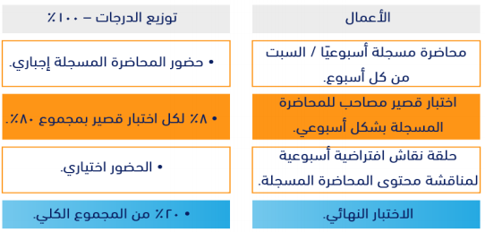
Course Assessment

Slide 13

Academic Calendar

Slide 14
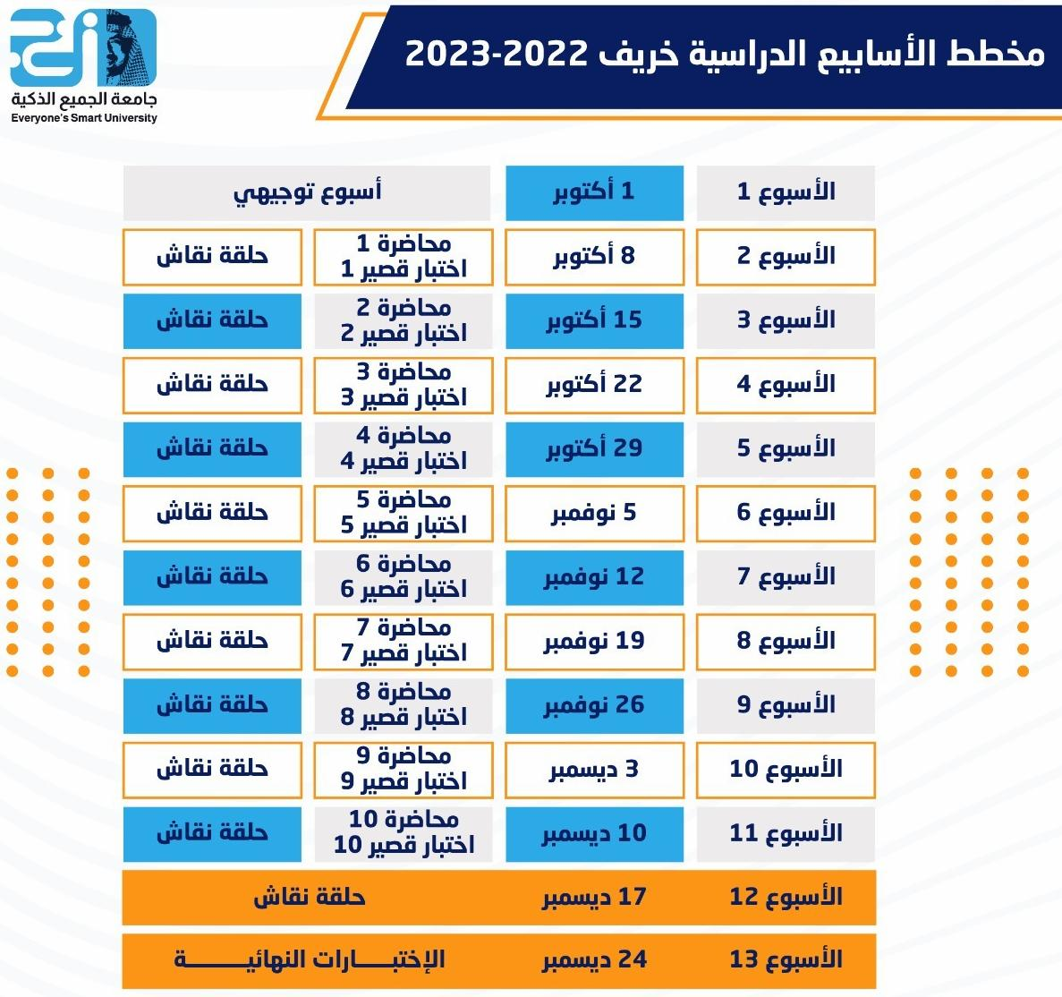
Academic Calendar

Slide 15
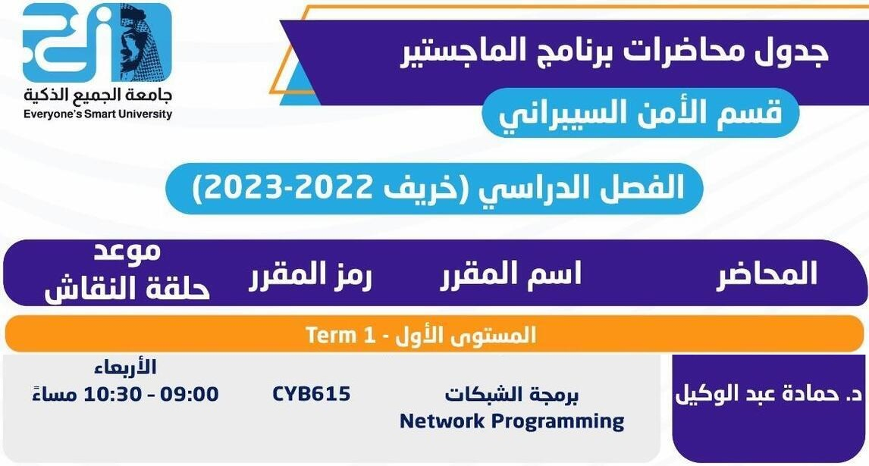
Academic Calendar

Slide 16


Course Exams
Exam rules:
Exam password: agree.
Eight must answer questions/exam.
One-Try exam.
24 min/exam.
You must be sure of your selected answer before pass to the next question.

Slide 17
Course Exams
Exam rules:
Exam begins on Saturday 10:00 PM
to next Saturday 9:00 PM.
Exam question types are Multiple-choice
and T/F questions.

Slide 18


Slide 19


