Slide 1

CCNA (200-301) Cisco Certified Network Associate
Prepared by Eng. Taghreed Elsayed
Lecture 3
LAN Switching

Slide 2
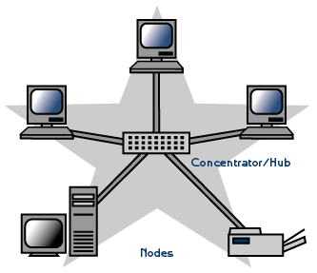
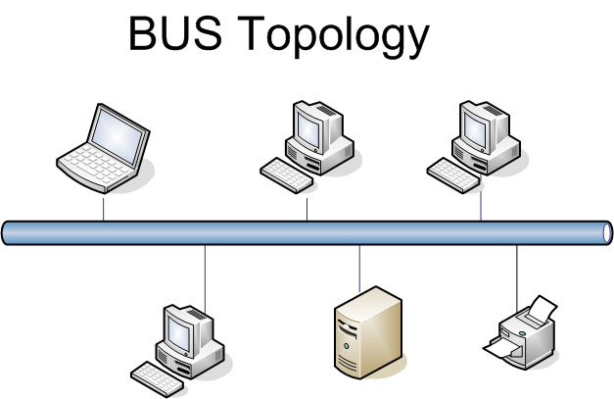

Chapter
02
Lan Switching
Problems before Lan switching(IEEE 802.3)
Before going further, let us recall that a hub is a multiple-port repeater.
Similarly, a switch is a multiple-port bridge so that you can understand why repeaters and bridges are not typically used in production networks(because of less number of ports).
Now, narrowing it down to Hubs, Switches and Routers, let us discuss them

Slide 3
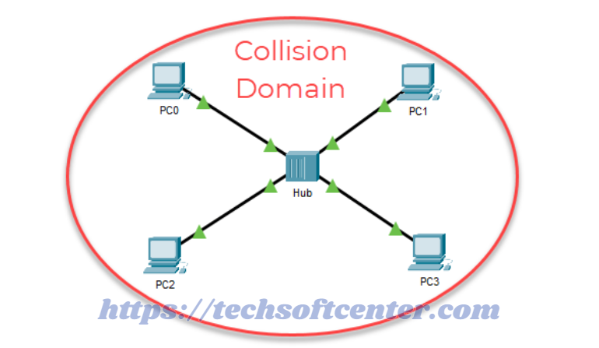
Chapter
02
Lan Switching
Problems before Lan switching(IEEE 802.3)
Collision Domain :
A Collision Domain is a problem in which when a device sends out a message to the network, all other devices which are included in its collision domain have to pay attention to it, no matter if it was destined for them or not. This causes a problem because, in a situation where two devices send out their messages simultaneously, a collision will occur leading them to wait and re-transmit their respective messages, one at a time. Remember, it happens only in the case of a half-duplex mode.
single collision domain

Slide 4
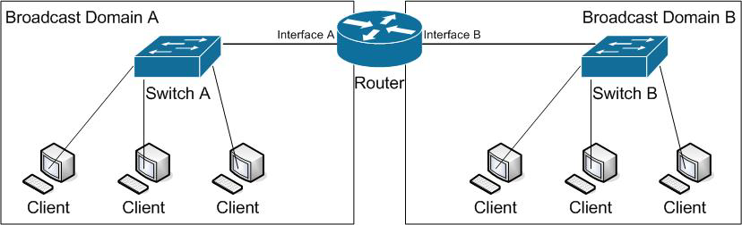
Chapter
02
Lan Switching
Problems before Lan switching(IEEE 802.3)
2. Broadcast Domain :
A Broadcast Domain is a problem in which when a device sends out a broadcast message, all the devices present in its broadcast domain have to pay attention to it. This creates a lot of congestion in the network, commonly called LAN congestion, which affects the bandwidth of
the users present in that network.
From this, we can realize that the more the
number of collision domains and the more
the number of broadcast domains, the more
efficient is the network providing better
bandwidth to all its users.

Slide 5
Chapter
02
Lan Switching
What is an Ethernet Switch?
Ethernet switching connects wired devices such as computers, laptops, routers, servers, and printers to a local area network (LAN). Multiple Ethernet switch ports allow for faster connectivity and smoother access across many devices at once.
An Ethernet switch creates networks and uses multiple ports to communicate between devices in the LAN. Ethernet switches differ from routers, which connect networks and use only a single LAN and WAN port. A full wired and wireless corporate infrastructure provides wired connectivity and Wi-Fi for wireless connectivity.
Hubs are similar to Ethernet switches in that connected devices on the LAN will be wired to them, using multiple ports. The big difference is that hubs share bandwidth equally among ports, while Ethernet switches can devote more bandwidth to certain ports without degrading network performance. When many devices are active on a network, Ethernet switching provides more robust performance.

Slide 6
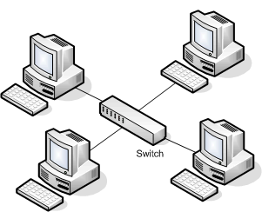
Chapter
02
Lan Switching
Switch and bridge are layer 2 (data link ) devices ,as they forwarding packets according destination address.
Bridge and switch both provide the same functionality but the switch does it with greater efficiency. A bridge connects smaller network segments to form a large network, and it also relays frame from one LAN to another LAN. On the other hand, the switch connects more network segments as compared to the bridges.
MAC address table (CAM: content addressable memory)
MAC | port
MAC 1 | 1
MAC 2 | 2
MAC 3 | 3

Slide 7
Chapter
02
Lan Switching
Building MAC address table (learning)
Switch learn MAC address table by examining the source mac address on the received packet and store it belong the incoming port.
Aging time
For any entry on CAM is aging time.
During this time the switch store learned MAC address belongs to the incoming port.
The default value for aging time is 300 sec(5 min).
The switch counts down by reducing this time , if aging timer reaches 0 , an entry will remove from the CAM and will learn again when the device sends a packet.

Slide 8
Chapter
02
Lan Switching
Switch actions
Flooding
Forwarding
Filtering

Slide 9

Chapter
02
Lan Switching
Flooding
Flooding means that the switch sends the incoming frame to all occupied and active ports (except for the one from which it was received). In essence, flooding is when a switch pretends to be a hub. There are two basic reasons why a switch will flood a frame.
When the switch receives a broadcast, it has no choice but to continue the broadcast. Protocols like ARP and DHCP (among others) rely on these broadcasts for their basic function. The following diagram is an example of what an Ethernet frame header might look like as a broadcast.

Slide 10
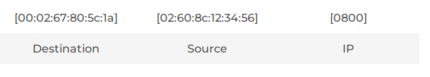
Chapter
02
Lan Switching
When the switch receives a frame dedicated for a particular destination but that destination does not have an entry in the MAC Address Table, the switch has no choice but to flood the frame. The goal of this flood is that the device using the MAC address in the destination of the frame will receive the flood and respond to the message. If that device responds, then the switch can learn their MAC address and map it to the port into which the message arrives. The following diagram is an example of what an Ethernet frame header might look like. Notice that the destination MAC address does not match the MAC Address Table above.

Slide 11
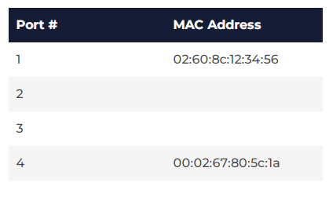
Chapter
02
Lan Switching
The following diagram shows the new MAC Address Table now that the response to the flood has been received.

Slide 12
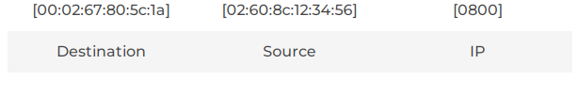
Chapter
02
Lan Switching
Forwarding
Now that Workstation A and Workstation D are both identified by their port numbers, the switch can do what switches do. Workstation A can now continue its conversation with Workstation D. But this time, when the switch receives the frame , it first looks up the destination address in the MAC Address Table. It then forwards the frame to that specific port. In our scenario, Workstation A is connected to Port 1 and Workstation D is connected to Port 4. When the switch receives the frame, it immediately forwards that frame to Port 4.

Slide 13
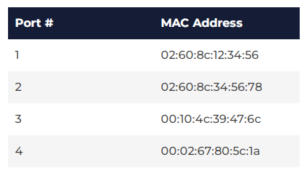
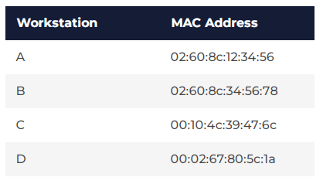
Chapter
02
Lan Switching
Filtering
So what about Workstations B and C? Well, due to filtering, Workstations B and C are none the wiser. Let’s fill in the rest of our MAC table.
The switch intentionally filters out ports 2 and 3,
only forwarding the data to the destination MAC address identified in the frame header.
These four default functions are just the beginning. Managed switches can include performance optimization, security, monitoring, diagnostics and more. But that’s for another discussion.

Slide 14
Chapter
02
Lan Switching
Effects on collision domain
switch stores packets and forwards it when port is idle
No of collision domain = no of switch ports
No CSMA/CD is required
Hosts works in Full duplex

Slide 15
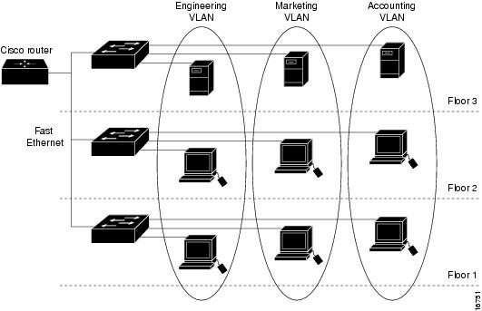
Chapter
02
Lan Switching
Effects on Broadcast domain
when switch flood packets , all ports or all devices are in the same /single broadcast domain.
This will be solved by implementing VLANS

