Slide 1

Entrepreneurship & Innovation
Prepared by Dr. Amany Ramadan
ENT 611
Entrepreneurship & Innovation
Lecture 3

Slide 2


Designing a Competitive Business Model and
Building a Solid Strategic Plan
Chapter
2
www.midocean.ae

Slide 3
Entrepreneurship
Lecture 3: Designing a Competitive Business Model and
Building a Solid Strategic Plan
www.midocean.ae

Slide 4
Learning Objectives
1. Understand the importance of strategic management to a small business.
2. Explain why and how a small business must create a competitive advantage in the market.
3. Develop a strategic plan for a business using the nine steps in the strategic planning process.
4. Discuss the characteristics of three basic strategies: low cost, differentiation, and focus and know when to employ them.
5. Understand the importance of controls such as the balanced scorecard in the planning process.
www.midocean.ae

Slide 5

Chapter
Idea Generation
2
www.midocean.ae

Slide 6
Ideas?
Coming up with an innovative idea on which to base a business start-up or project is not easy
Most ideas come to us through experience – often negative experiences
Problem solving and idea generation often go hand in hand
Change is a catalyst in much the same way – change creates new ‘problems’ requiring new ‘solutions’
www.midocean.ae

Slide 7
The Business Idea: Ideation
Opportunity identification
Creativity - idea generation
Idea development
Continual refinement
www.midocean.ae

Slide 8
Examples: Change
What were the main business opportunities associated with the drink-driving laws?
What were the main opportunities associated with the smoking ban?
www.midocean.ae

Slide 9
Innovation in the wider sense
Just as opportunities can be created by changes in the environment, the environment can be changed by ideas that have been developed into opportunities.
Low cost airlines
Internet
www.midocean.ae

Slide 10
New Industries:
Low Cost Airlines
The Airlines
Entrepreneurial idea – revolutionised the industry. E.g.,
Use of remote airports – reduces cost
On board catering sales – income
Seat allocation sales – income
Other opportunities created by this change, e.g.,
Bus services from remote airports
Retail expansion at formerly low-use airports
Accommodation
LOOK FOR CHANGE TO GAIN IDEAS
www.midocean.ae

Slide 11
Developing Creativity
Brainstorming – alone or in a group
E-brainstorming
Templates – A problem,
Templates - An interest
www.midocean.ae

Slide 12
Brainstorming
Brainstorming – non judgemental
All ideas count
Do not try and evaluate as you go on
www.midocean.ae

Slide 13

A Major Shift . . .
From financial capital to intellectual capital
Human
Structural
Customer
www.midocean.ae

Slide 14
Intellectual capital
Intellectual capital is considered an asset and a key source of a company's competitive advantage.
It can be defined as the collection of all informational resources a company has at its disposal that can be used to drive profits, gain new customers, create new products or otherwise improve the business.
Intellectual capital is comprised of three components: Human capital, Structural capital, and Customer capital.
www.midocean.ae

Slide 15
1.Human capital
The talents, creativity, skills, and abilities of a company's workforce.
The value that the employees of a business provide through the application of skills, know-how and expertise.
www.midocean.ae

Slide 16
2. Structural capital
Is the accumulated knowledge and experience that a company possesses.
It can take many forms including processes, techniques, information systems, software, and databases, patents, copyrights, as well as the organization’s image, experience of the people in a company.
www.midocean.ae

Slide 17
3. Customer capital
Includes the established customer base, positive reputation, ongoing relationships, and goodwill a company builds up over time with its customers.
www.midocean.ae

Slide 18

3. Strategic Management
Is crucial to building a successful business.
Involves developing a game plan to guide a company as it strives to accomplish its mission, goals, and objectives, and to keep
it on its desired course.
www.midocean.ae

Slide 19
Strategic Management and Competitive Advantage
Developing a strategic plan is crucial to creating a sustainable competitive advantage, the aggregation of factors that sets a company apart from its competitors and gives it a unique position in the market that is superior to its competition.
www.midocean.ae

Slide 20
Key: Core Competencies
Unique set of capabilities a company develops in key areas, such as superior quality, customer service, innovation, team-building, flexibility, responsiveness, and others that allow it to vault past competitors (outperform its competitors).
They are what a company does best.
www.midocean.ae

Slide 21
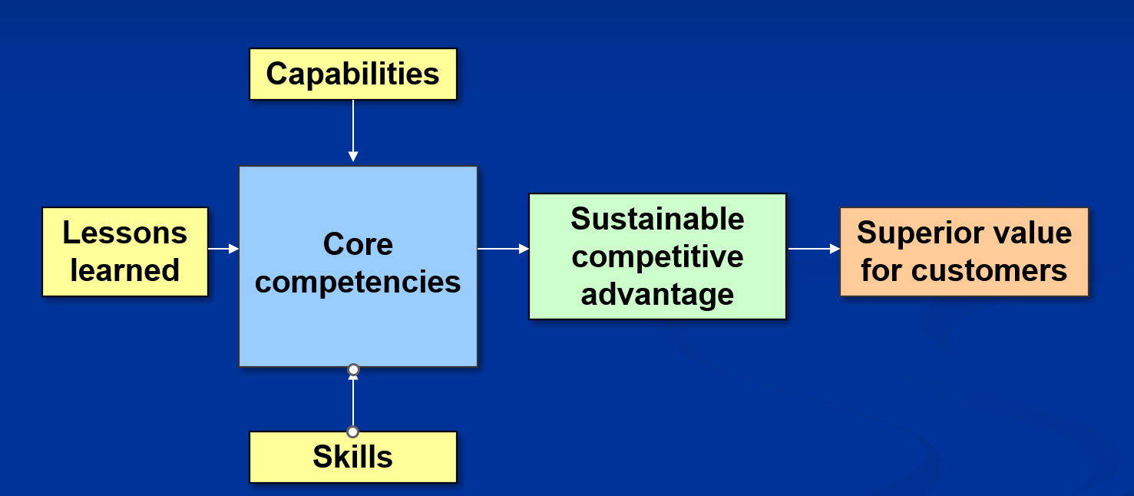
Building a Sustainable Competitive Advantage
www.midocean.ae

Slide 22
Strategic Management Process
Step 1 Develop a vision and translate it into a mission statement
Step 2 Assess strengths and weaknesses
Step 3 Scan environment for opportunities and threats
Step 4 Identify key success factors
www.midocean.ae

Slide 23
Strategic Management Process
Step 5 Analyze competition
Step 6 Create goals & objectives
Step 7 Formulate strategies
Step 8 Translate plans into actions
Step 9 Establish accurate controls
www.midocean.ae

Slide 24
Step 1: Develop a Vision and Create a Mission Statement
Vision – the result of an entrepreneur’s dream of something that does not exist yet and the ability to paint a compelling picture of that dream for everyone to see.
A clearly defined vision:
Provides direction
Determines decisions
Motivates people
Allows for perseverance in the face of adversity
www.midocean.ae

Slide 25
Step 1: Develop a Vision and Create a Mission Statement
Addresses question: “What business are we in?”
The mission is a written expression of how the company will reflect an entrepreneur’s values, beliefs,
and vision – more than just
“making money.”
Serves as a “strategic compass.”
www.midocean.ae

Slide 26
Step 1: Develop a Vision and Create a Mission Statement
Elements of a mission statement:
Purpose of the company: What are we in business to accomplish?
Business we are in: How are we going to accomplish that purpose?
Values of the company: What principles and beliefs form the foundation of the way we do business?
www.midocean.ae

Slide 27
Step 2: Assess Company Strengths and Weaknesses
Strengths
Positive internal factors a company can draw on to accomplish its mission, goals, and objectives.
Weaknesses
Negative internal factors that inhibit a company’s ability to accomplish its mission, goals, and objectives.
www.midocean.ae

Slide 28
Step 3: Scan for Opportunities and Threats
Opportunities
Positive external factors the company can exploit to accomplish its mission, goals, and objectives.
Threats
Negative external factors that inhibit the firm's ability to accomplish its mission, goals, and objectives.
www.midocean.ae

Slide 29
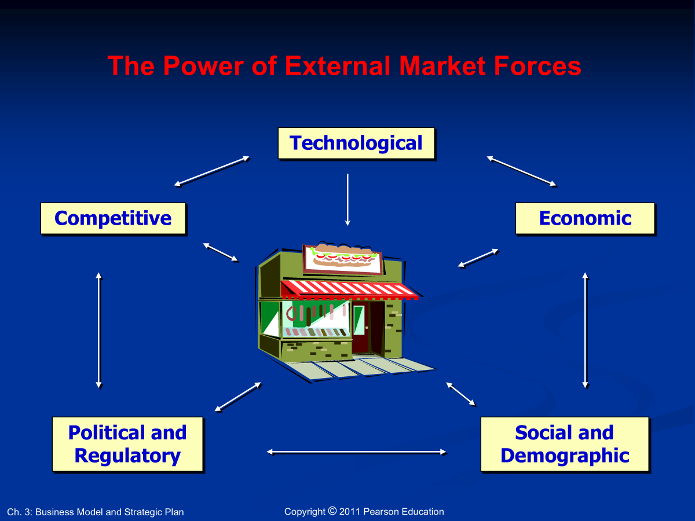
www.midocean.ae

Slide 30

Step 4: Identify Key Success Factors
Key success factors (KSFs): factors that determine the relative success of market participants.
The keys to unlocking the secrets of competing successfully in a
particular market segment.
www.midocean.ae

Slide 31
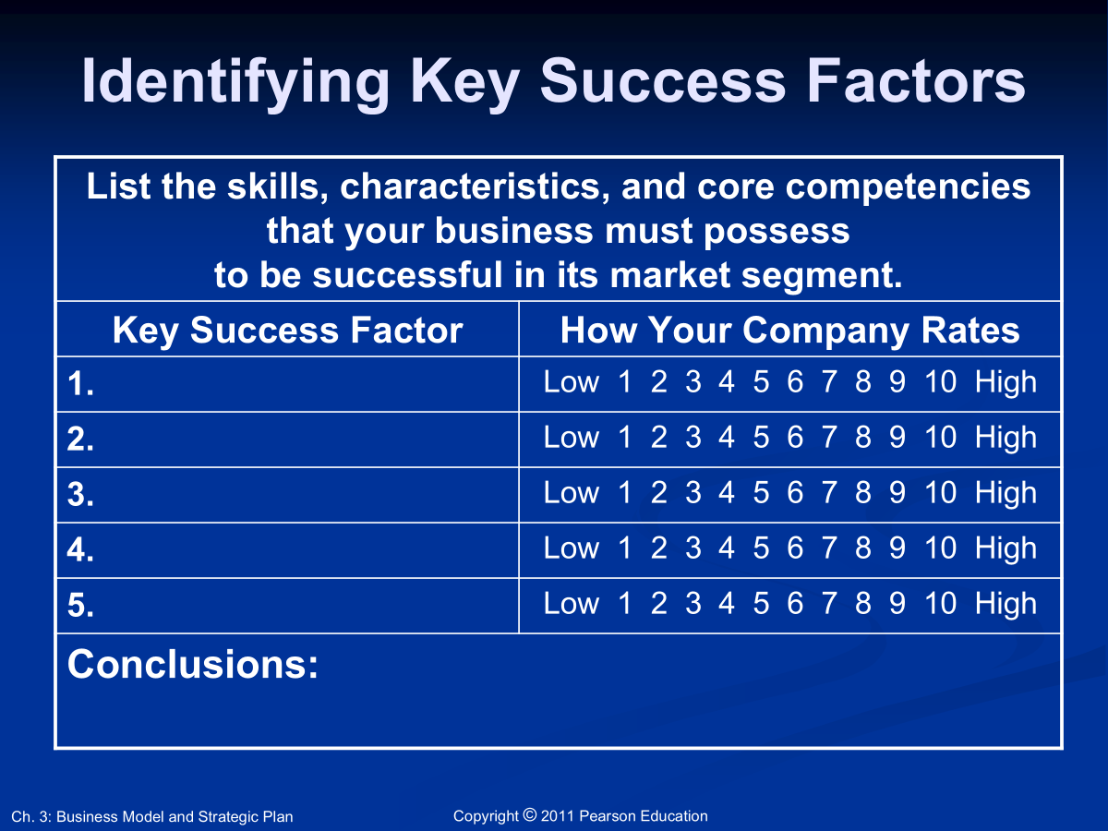
www.midocean.ae

Slide 32
Step 5: Analyze Competitors
Analyzing key competitors allows an entrepreneur to:
Avoid surprises from existing competitors’ new strategies and tactics.
Identify potential new competitors and the threats they pose.
Improve reaction time to competitors’ actions.
Anticipate rivals’ next strategic moves.
www.midocean.ae

Slide 33
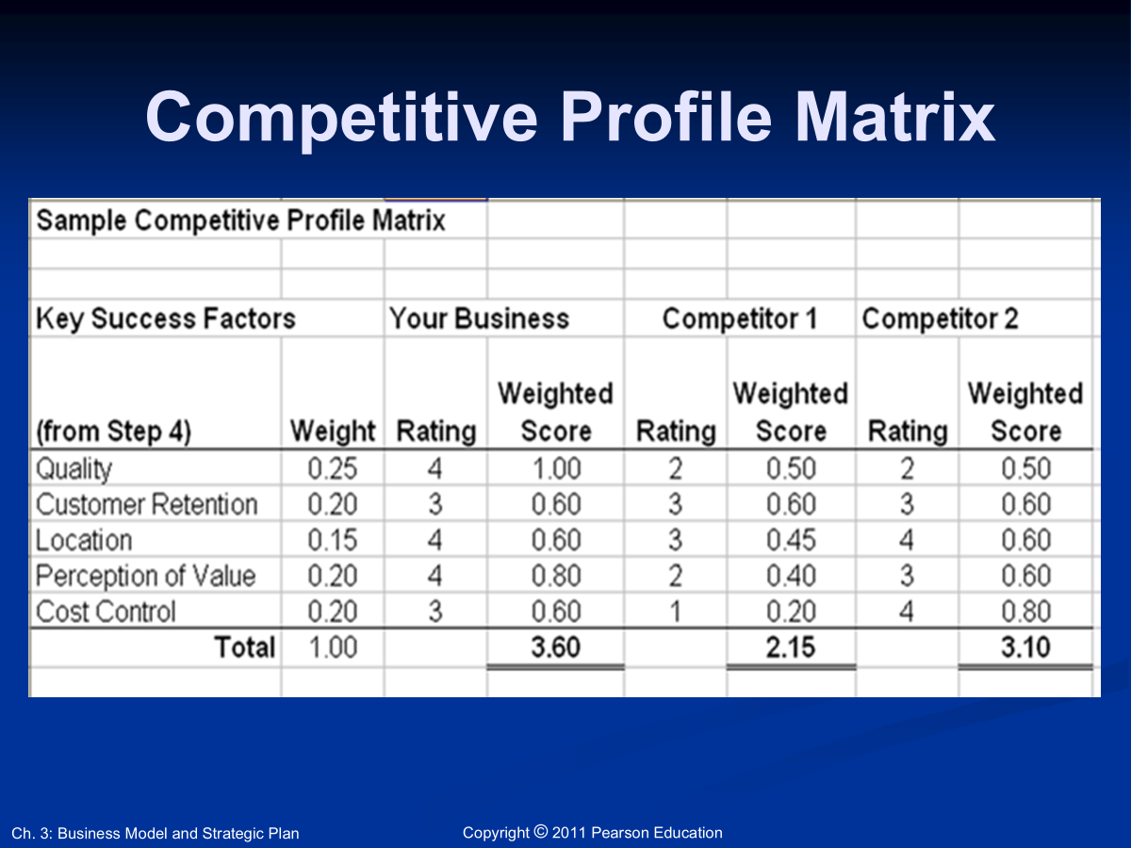
www.midocean.ae

Slide 34
Step 6: Create Company Goals and Objectives
Goals: Broad, long-range attributes to be accomplished. “BHAGs”
Objectives: More detailed, specific targets of performance that are S.M.A.R.T.
Specific
Measurable
Assignable
Realistic (yet challenging)
Timely
www.midocean.ae

Slide 35

Step 7: Formulate Strategies
Strategy - a road map of the actions an entrepreneur draws up to achieve a company’s mission, goals, and objectives.
It is the company’s game plan for gaining a competitive advantage.
www.midocean.ae

Slide 36
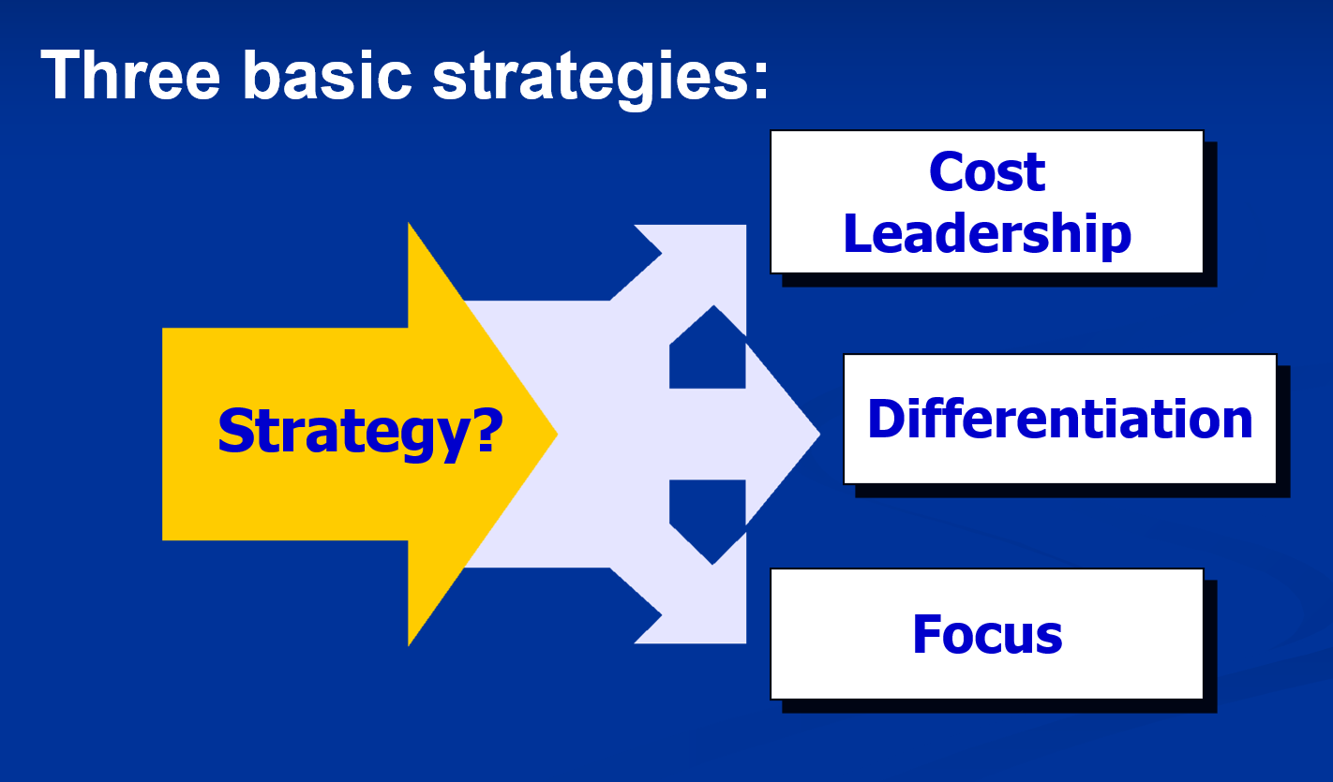
www.midocean.ae

Slide 37
Cost Leadership
Goal: to be the low-cost producer in the industry (or market segment).
Low-cost leaders have advantages:
Reaching buyers who buy on the basis of price
The power to set the industry’s price floor.
www.midocean.ae

Slide 38
Differentiation
Company seeks to build customer loyalty by positioning its goods or services in a unique or different fashion.
Idea is to be special at something customers value.
Key: Build basis for differentiation on a distinctive competence, something that the small company is uniquely good at doing in comparison to its competitors.
www.midocean.ae

Slide 39
Focus
Company selects one or more customer segments in a market, identifies customers’ special needs, wants, or interests, and then targets them with a product or service designed specifically for them.
Strategy builds on the differences among market segments.
Rather than try to serve the total market, the company focuses on serving a niche (or several niches) within that market.
www.midocean.ae

Slide 40
Step 8: Translate Strategies into Action Plans
Survey of senior executives: Companies achieved only 63% of the results in their strategic plans.
Create projects by defining:
Purpose
Scope
Contribution
Resource requirements
Timing
www.midocean.ae

Slide 41
Step 9: Establish Accurate Controls
Plan establishes the standards against which actual performance is measured.
Entrepreneur must:
Identify and track key performance indicators.
Take corrective action.
www.midocean.ae

Slide 42
Balanced Scorecards
A set of measurements unique to a company that includes both financial and operational measures
Gives managers a quick,
yet comprehensive,
picture of a company’s
overall performance.
www.midocean.ae

Slide 43
Balanced Scorecards
Five Perspectives:
Customer: How do customers see us?
Internal Business: At what must we excel?
Innovation and Learning: Can we continue to improve and create value?
Financial: How do we look to shareholders?
Corporate Citizenship: Do we meet our responsibility to society as a whole, the environment, the community, and other external stakeholders?
www.midocean.ae

Slide 44
Step 9: Establish Accurate Controls
Plan establishes the standards against which actual performance is measured.
Entrepreneur must:
Identify and track key performance indicators.
Take corrective action.
www.midocean.ae

Slide 45
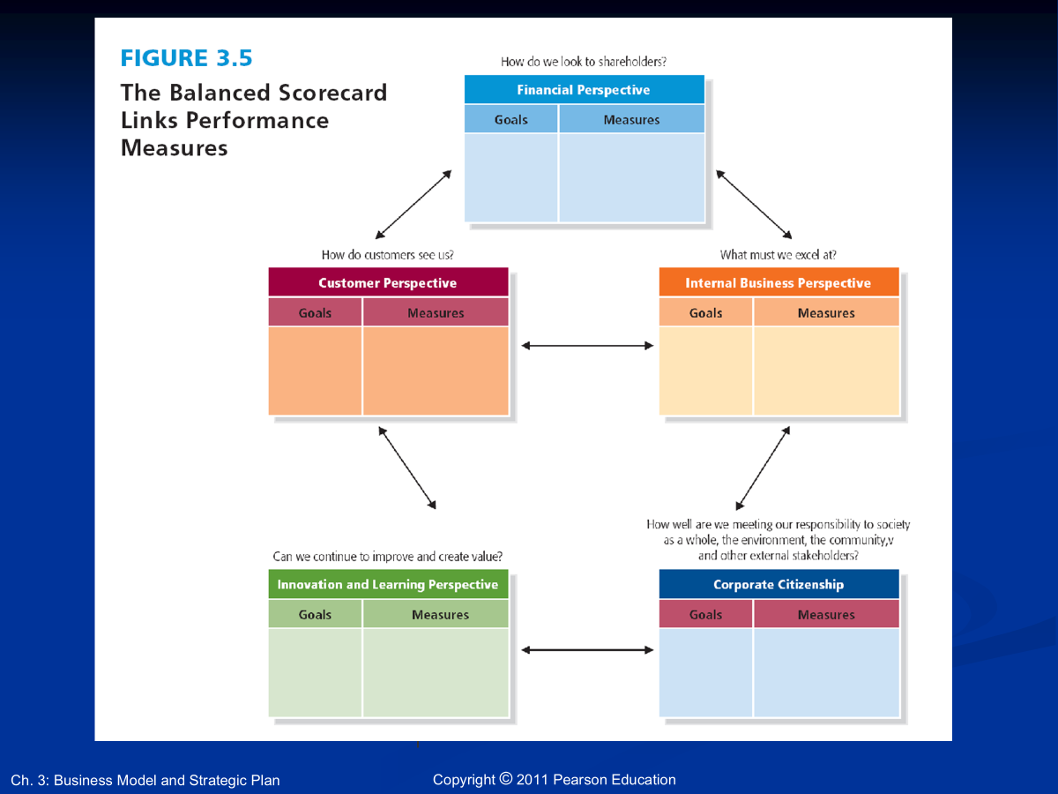
www.midocean.ae

Slide 46

www.midocean.ae
The strategic planning process:
Begins with the nine steps.
Teaches entrepreneurial
discipline for a higher
chance of survival.
Chapter
01
Conclusion

Slide 47




Thank You

