Slide 1

Lecture 5:
Resources Management
PMG 605
Project Resources and Time Management
Dr. Eng.
Abdullah Jameel Halawany

Slide 2
Session Outline
Resources Management
Introduction
Overview of the Resource Scheduling Problem
Classification of a Scheduling Problem
Multiproject Scheduling Problems
Splitting
Time Constrained Project
Resource Constrained Project
Computer Software for Scheduling Resources
Benefits of Scheduling Resources

Slide 3

Introduction to
Resources Management

Slide 4

5–4

Slide 5
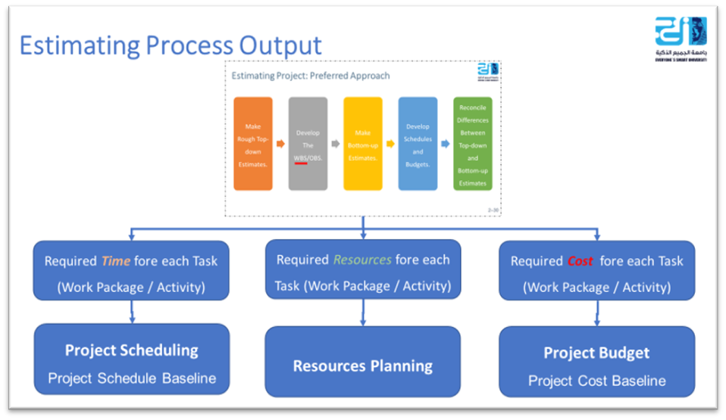
Resource Management
We have consistently stressed that up-front planning results in big payoffs
However, there is still a need to plan for resources to execute the work in the short term
5–5

Slide 6
Why Resource Management?
Shortages and mismanagement of resources are frequent causes of substantial delays
Most project managers have watched worker standing idly by due to
  lack of materials, or
  experienced delays due to the wrong piece of equipment used in performing a task
Proper management of resources—materials, labor, and equipment—can minimize or even eliminate these types of inefficiencies
5–6

Slide 7
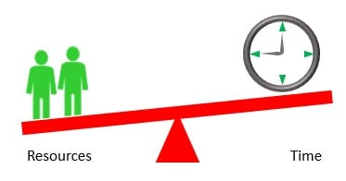
Resource Allocation
Scheduling and coordinating resources so that they arrive on‐site as needed and are removed when not needed is called resource allocation or resource loading
When performed properly, it is the effective and efficient utilization of all resources
Shortages of material or scheduling the wrong piece of equipment will inevitably lead to a delay in performing the task and may delay the project itself
5–7

Slide 8
Resource Allocation
Allocating too many people to the crew will leave some underutilized and increase the cost per unit of work
Inversely, too small a crew will result in less being produced per unit of time
Neither condition is desirable
It is the goal of resource allocation to maintain sufficient resources to allow the work to proceed in a smooth or even flow
5–8

Slide 9
Resource Management
The estimate tells us how much labor and type of equipment are needed for a task but does not tell us when it is needed
For that we need to refer to the Schedule Plan
The Schedule Plan is also silent about conflicting demands for labor or equipment resources
For example, a single piece of equipment and its crew may be required for two tasks at the same time
5–9

Slide 10
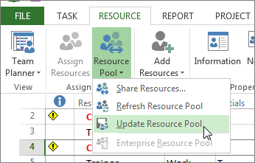
Resource Management
Resource Pool is a set of resources available for assignment to project tasks
A resource pool can be assigned exclusively to a project or task or shared by several projects
5–10

Slide 11
Resource Management
After staff and other resources were assigned to the project, a project manager listed the following questions that still needed to be addressed:
  Will the assigned labor and/or equipment be adequate and available to deal with my project?
  Will outside contractors have to be used?
  Do unexpected resource dependencies exist? Is there a new critical path?
  How much flexibility do we have in using resources?
  Is the original deadline realistic?
Any project scheduling system should facilitate finding quick, easy answers to these questions
5–11

Slide 12
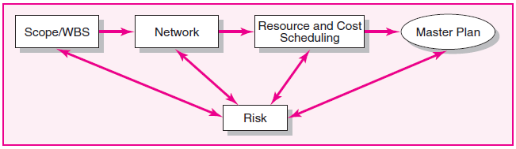
Resource Management Goals
To ensure that the correct resource is available at the correct time and in sufficient quantity, and
To ensure that the resource is used efficiently
That by Developing Resource and Cost Scheduling Plans
5–12

Slide 13
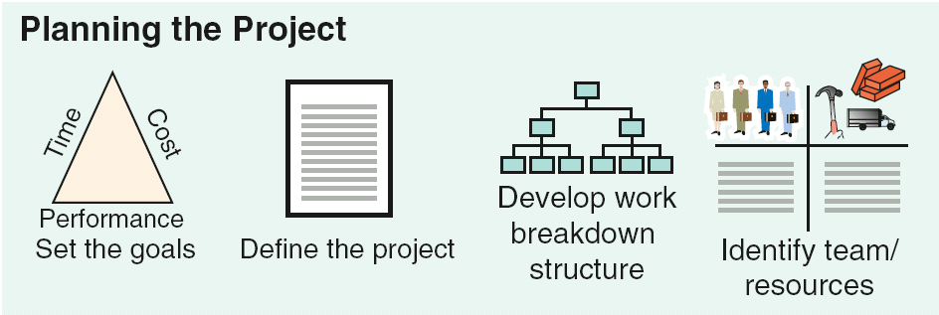
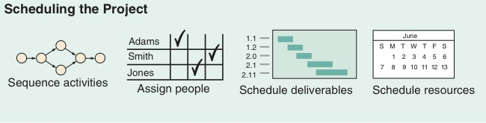
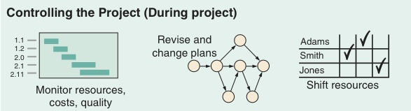
Project Planning, Scheduling, and Controlling
Time/cost estimates
Budgets
Engineering diagrams
Cash flow charts
Material availability details
Budgets
Delayed activities report
Slack activities report
CPM/PERT
Gantt charts
Milestone charts
Cash flow schedules
5–13

Slide 14

Overview of the Resource Scheduling Problem

Slide 15
Overview of the Resource Scheduling Problem
The planned network and activity project duration times found in previous chapters fail to deal with resource usage and availability
The time estimates for the work packages and network times were made independently with the assumption that resources would be available
This may or may not be the case.
5–15

Slide 16
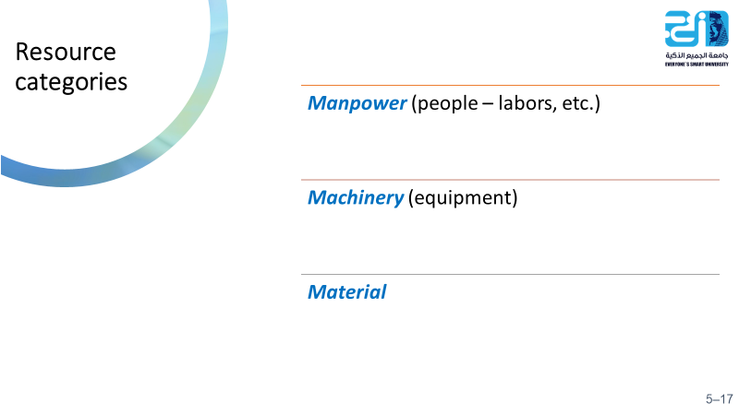
Types of Resource
Resources are people, equipment, and material that can be drawn on to accomplish something
In projects, the availability or unavailability of resources will often influence the way projects are managed
5–16

Slide 17

Types of Resource - People
The most obvious and important project resource
Human resources are usually classified by the skills they bring to the project—for example, programmer, mechanical engineer, welder, inspector, marketing director, supervisor
The many differing skills of human resources add to the complexity of scheduling projects.
5–17

Slide 18

Types of Resource - Materials
Project materials cover a large spectrum: for example, chemicals for a scientific project, concrete for a road project, survey data for a marketing project
Material availability and shortages have been blamed for the delay of many projects
When it is known that a lack of availability of materials is important and probable, materials should be included in the project network plan and schedule
For example, delivery and placement of an oil rig tower in a Siberian oil field has a very small-time window during one summer month
5–18

Slide 19
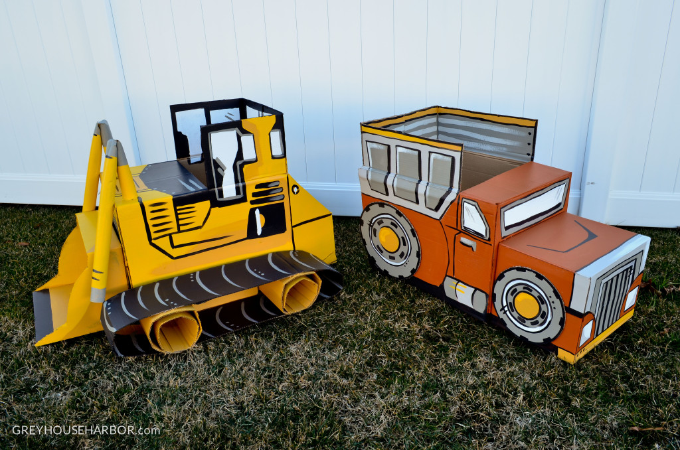
Types of Resource - Equipment
Usually presented by type, size, and quantity.
In some cases, equipment can be interchanged to improve schedules, but this is not typical
Equipment is often overlooked as a constraint
The most common oversight is to assume the resource pool is more than adequate for the project
For example, if a project needs one earthmoving tractor six months from now and the organization owns four, it is common to assume the resource will not delay the pending project
5–19

Slide 20


Classification of a Scheduling Problem

Slide 21
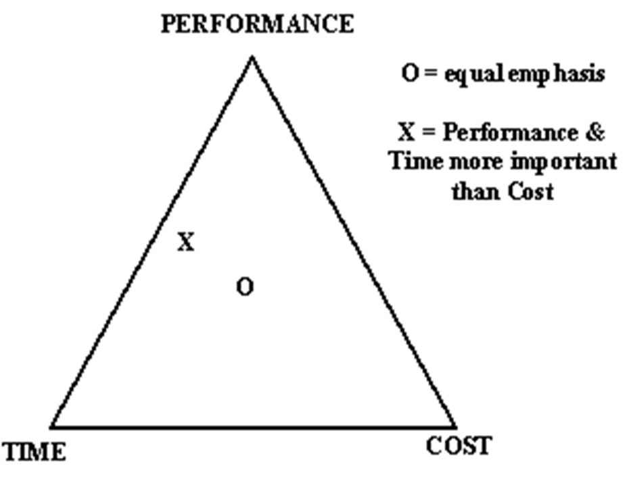
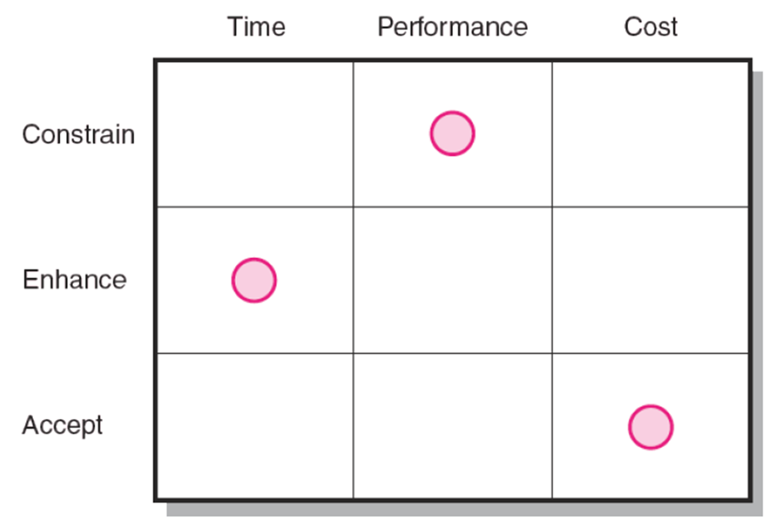
Classification of a Scheduling Problem
The scheduling methods available today require the project manager to classify the project as either
Time constrained or
Resource constrained
Project managers need to consult their priority matrix to determine which case fits their project
5–21

Slide 22
Classification of a Scheduling Problem
Time constrained
Resource constrained
project has a defined delivery date that is mandated by contract
If required, resources can be added to meet the delivery date
the resources available to do the project are limited or cannot be exceeded or over allocated
If production falls behind, the delivery date is extended
5–22

Slide 23
Classification of a Scheduling Problem
In scheduling terms,
Time Constrained means time (project duration) is fixed, and resources are flexible
Resource Constrained means resources are fixed, and time is flexible
One simple test: “If the critical path is delayed, will resources be added to get back on schedule?”
  If the answer is yes, assume the project is time constrained
  if the answer no, assume the project is resource constrained
Logical relationship (also called technical constraints) must be respected during Recourse Scheduling Process
5–23

Slide 24
Time Constrained Project

Slide 25
Time Constrained Project
Time Constrained means time (project duration) is fixed, and resources are flexible
Scheduling time-constrained projects focuses on resource utilization
Although time is the critical factor, resource usage should be no more than is necessary and sufficient
Practitioners have attacked the utilization problem using resource leveling techniques that balance demand for a resource
5–25

Slide 26
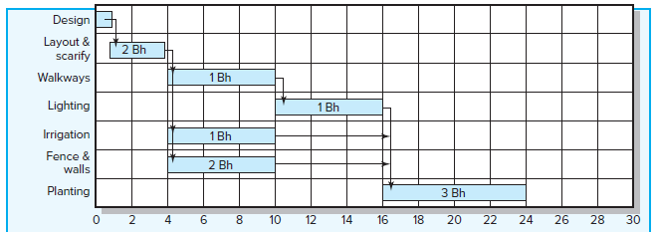
Smoothing Resource Demand
Also called Leveling Techniques delay noncritical activities by using positive slack to reduce peak demand and fill in the valleys for the resources
5–26

Slide 27
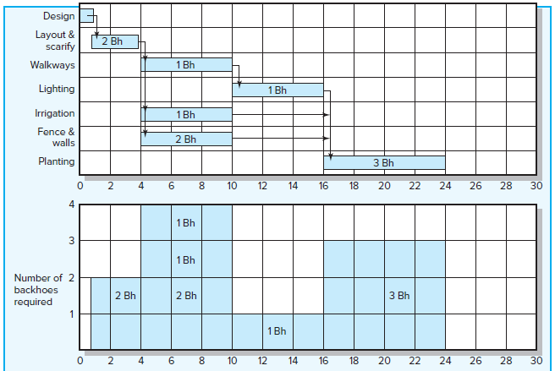
Leveling Techniques - Example
5–27

Slide 28
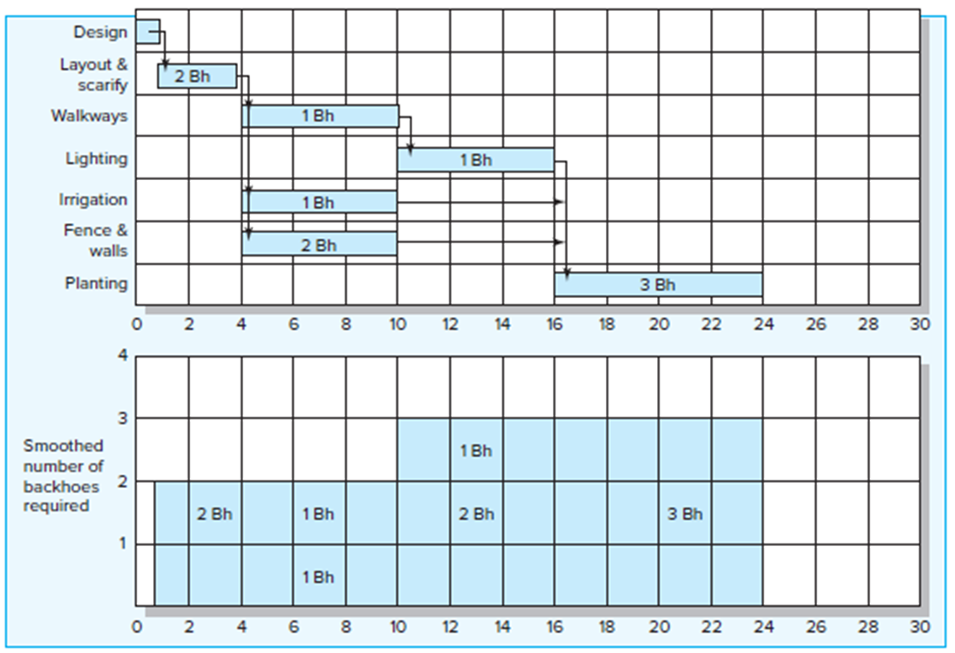
Leveling Techniques - Example
5–28

Slide 29
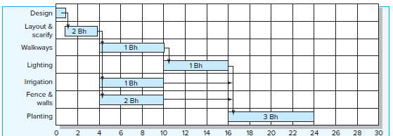
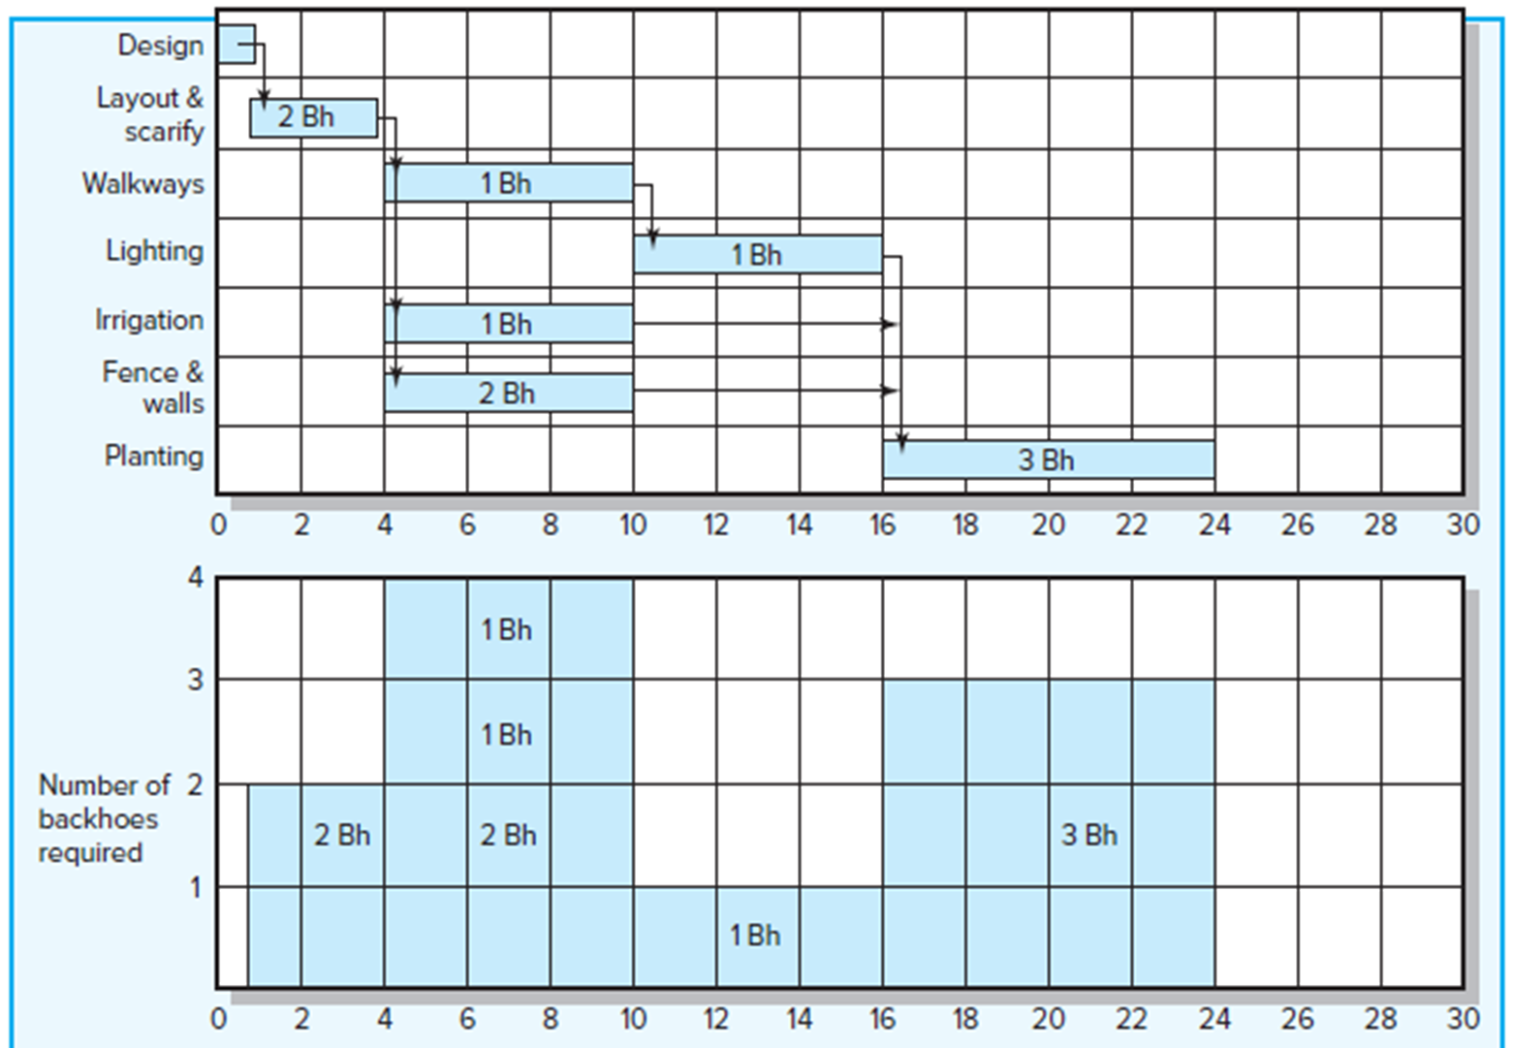
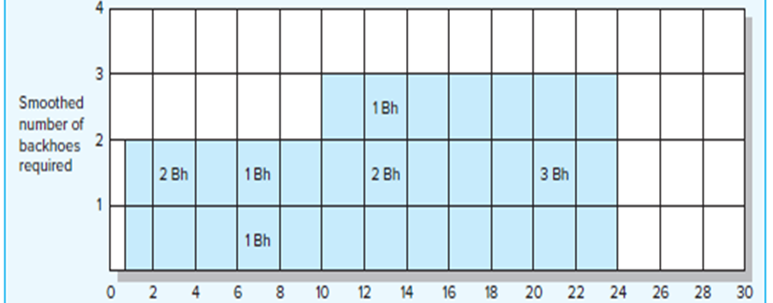
Leveling Techniques - Example
Before Leveling
After Leveling
5–29

Slide 30
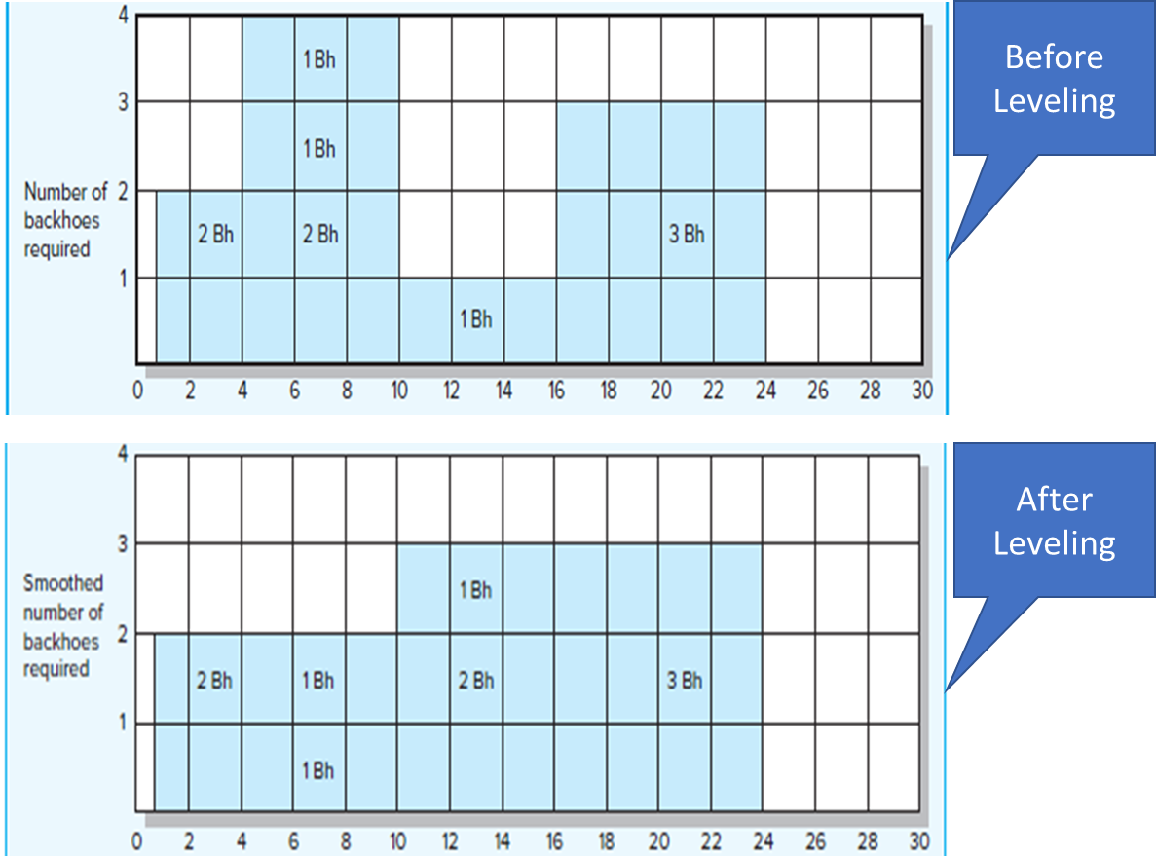
Leveling Techniques (also called Smoothing)
Advantages
  The peak of demand for the resource was reduced
  Resources over the life of the project have been reduced
  The fluctuations in resource demand were minimized
Disadvantages
  Loss of flexibility that occurs from reducing slack.
  Increases in the criticality of all activities.
5–30

Slide 31

Resource Constrained Project

Slide 32
Resource Constrained Project
Resource Constrained means resources are fixed, and time is flexible
One research study of more than 50 projects found that planned project network durations were increased 38 percent when resources were scheduled
The traditional critical path concept of sequential activities from the start to the end of the project is no longer meaningful
The resource constraints can break the sequence and leave the network with a set of disjointed critical activities
Conversely, parallel activities can become sequential. Activities with slack on a time-constrained network can change from critical to noncritical
5–32

Slide 33
Resource Constrained Project
Activities are scheduled using heuristics (rules-of-thumb) that focus on:
Minimum slack
Smallest (least) duration
Lowest activity identification number
The Parallel Method is used to apply heuristics
  An iterative process starting at the first time period of the project and scheduling period-by-period the start of any activities using the three priority rules
5–33

Slide 34
Heuristics (Rules-of-Thumb)
In any period when two or more activities require the same resource, the priority rules are applied (with respect to logical relationship and resource availability)
Minimum slack: the first activity placed in the schedule would be the activity with the least slack (rule 1)
Smallest (least) duration: if all activities have the same slack, the activity with the smallest duration would be placed in the schedule first (rule 2)
Lowest activity identification number: the tie is broken by the lowest activity identification number (rule 3)
5–34

Slide 35
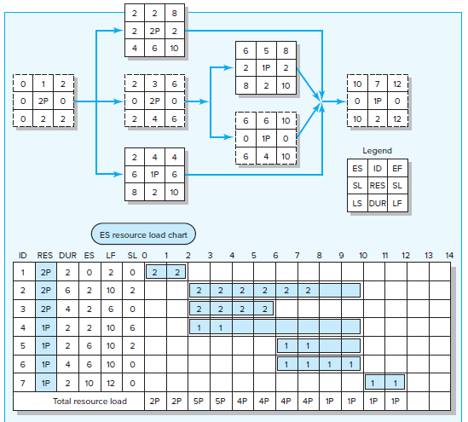
Parallel Method - Example
Resource available =
3 programmers (3P)
Rules-of-Thumb
Minimum slack
Smallest duration
Lowest activity ID#
5–35

Slide 36
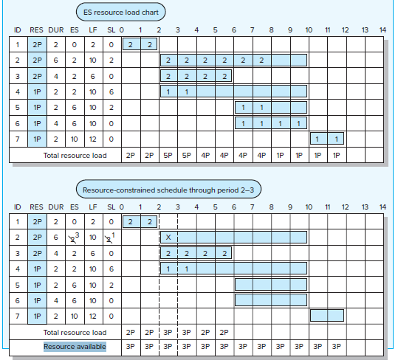
Parallel Method - Example
Resource available =
3 programmers (3P)
Rules-of-Thumb
Minimum slack
Smallest duration
Lowest activity ID#
5–36

Slide 37
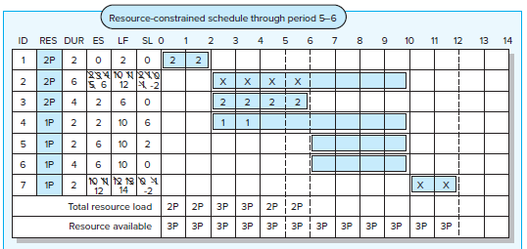
Parallel Method - Example
Resource available =
3 programmers (3P)
Rules-of-Thumb
Minimum slack
Smallest duration
Lowest activity ID#
5–37

Slide 38
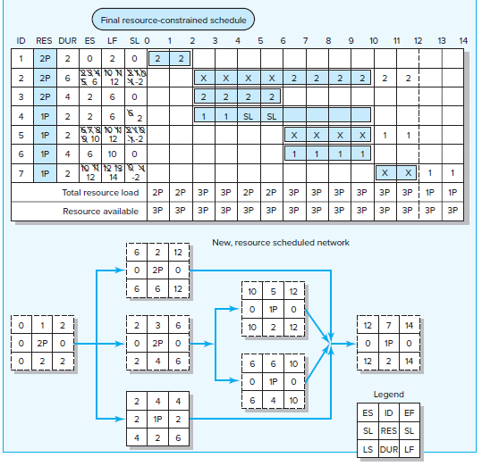
Parallel Method - Example
Lag 4
Resource available =
3 programmers (3P)
Lag 4
Rules-of-Thumb
Minimum slack
Smallest duration
Lowest activity ID#
5–38

Slide 39
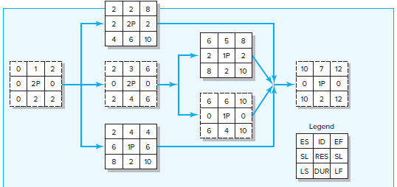
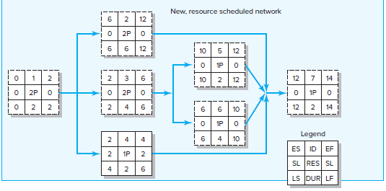
Parallel Method - Example
Before
After
Lag 4
Resource available =
3 programmers (3P)
Lag 4
Rules-of-Thumb
Minimum slack
Smallest duration
Lowest activity ID#
5–39

Slide 40
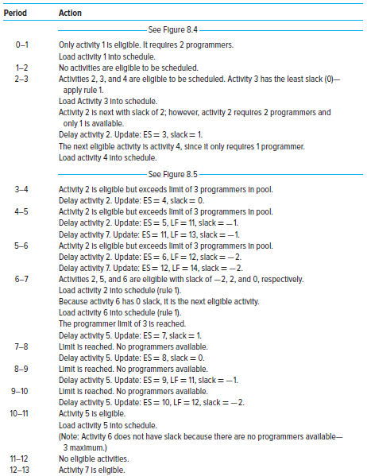
Parallel Method - Example
Resource available =
3 programmers (3P)
Rules-of-Thumb
Minimum slack
Smallest duration
Lowest activity ID#
5–40

Slide 41
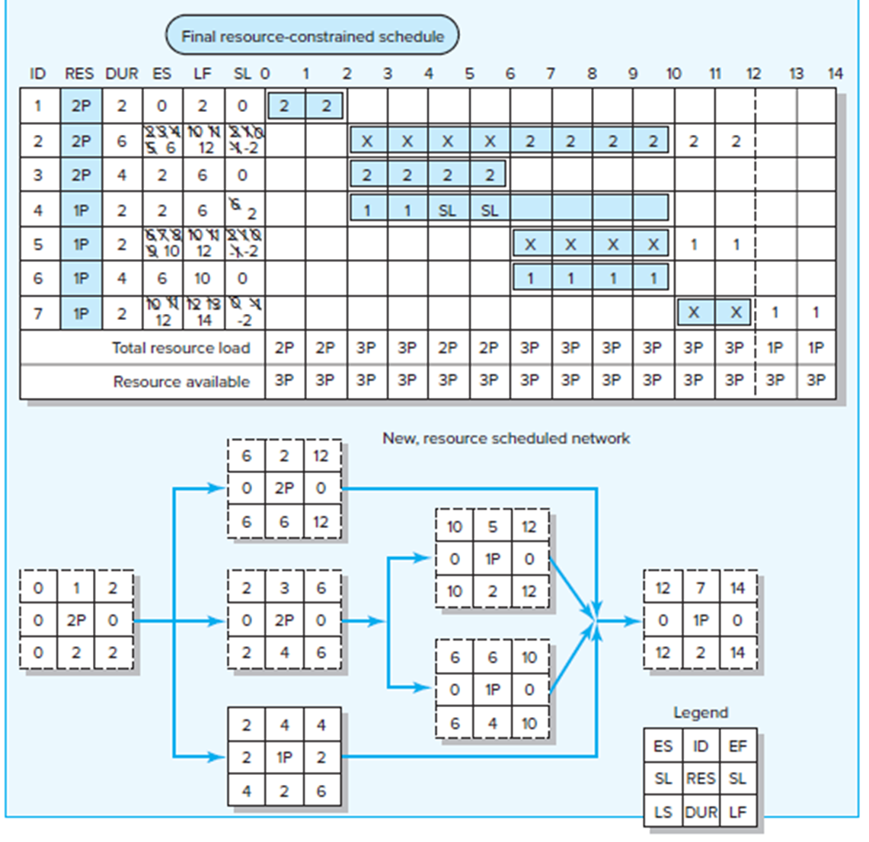
The Impacts of Resource-Constrained Scheduling
Reduces delay but reduces flexibility
Increases criticality of events
Increases scheduling complexity
May make the traditional critical path no longer meaningful
Can break sequence of events
May cause parallel activities to become sequential
Activities with slack can change from noncritical to critical
5–41

Slide 42

Splitting

Slide 43
Splitting
A scheduling technique use to get a better project schedule and/or increase resource utilization
Involves interrupting work on an activity to employ the resource on another activity, then returning the resource to finish the interrupted work
Is feasible when startup and shutdown costs are low
Is considered the major reason why projects fail to meet schedule
Planners should avoid the use of splitting as much as possible, except in situations where splitting costs are known to be small or when there is no alternative for resolving the resource problem
5–43

Slide 44
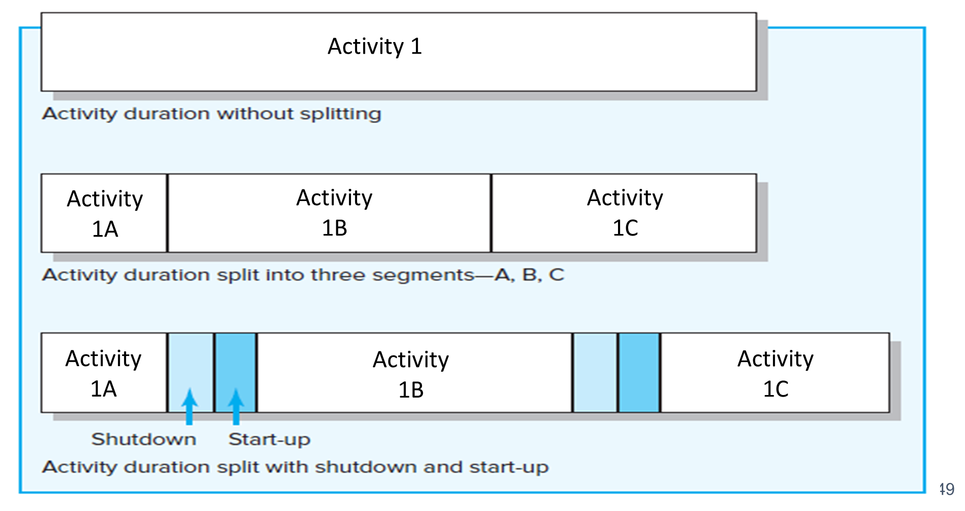
Splitting

Slide 45

Computer Software for Scheduling Resources

Slide 46
Computer Software for Scheduling Resources
Fortunately, project management software is capable of assessing and resolving complicated resource-constrained schedules using heuristics like what was described
It is important to note that the software is not “managing” the project
The software is simply a tool the project manager uses to view the project from different perspectives and conditions
5–46

Slide 47
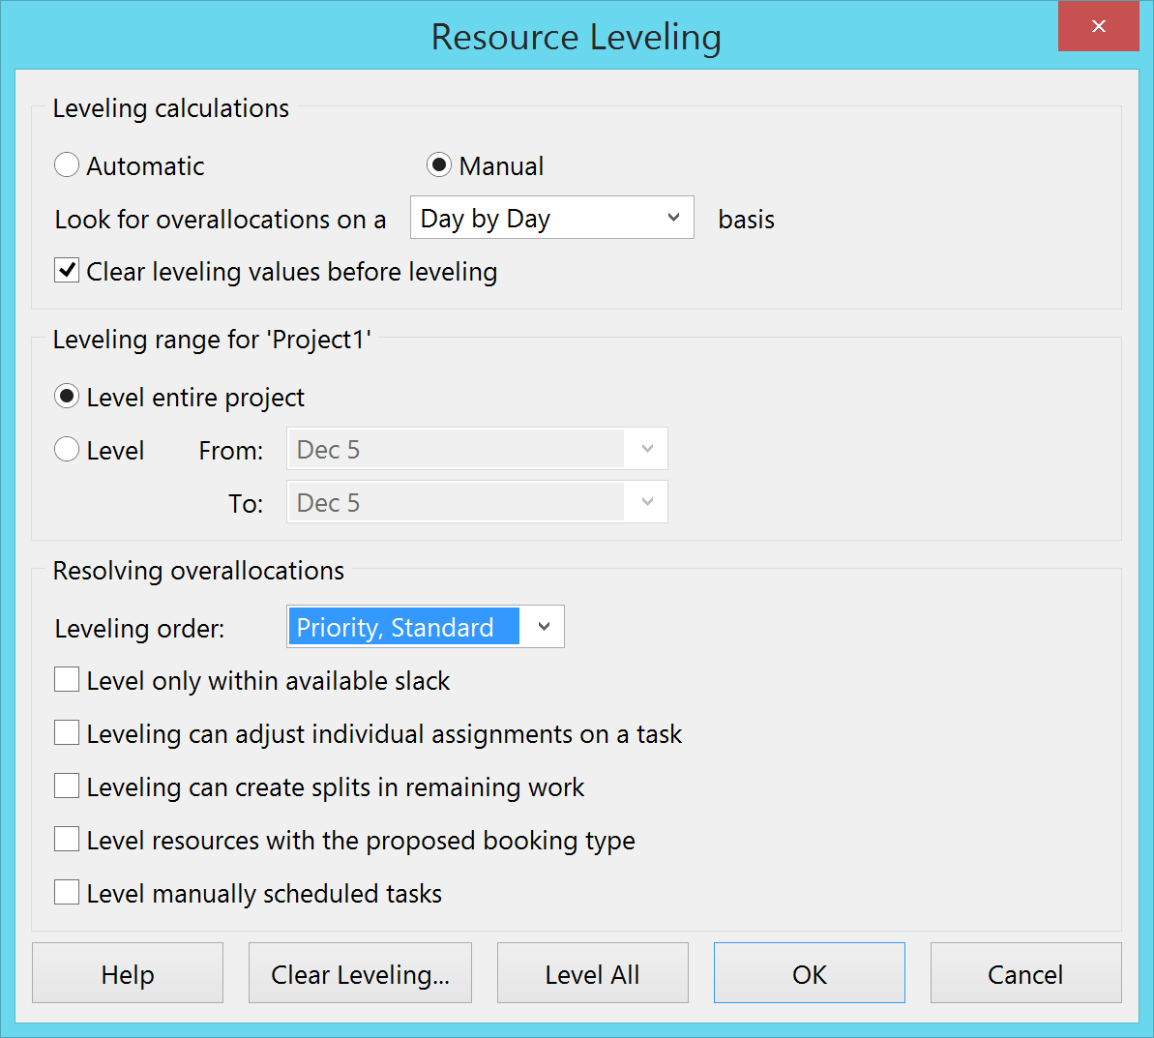
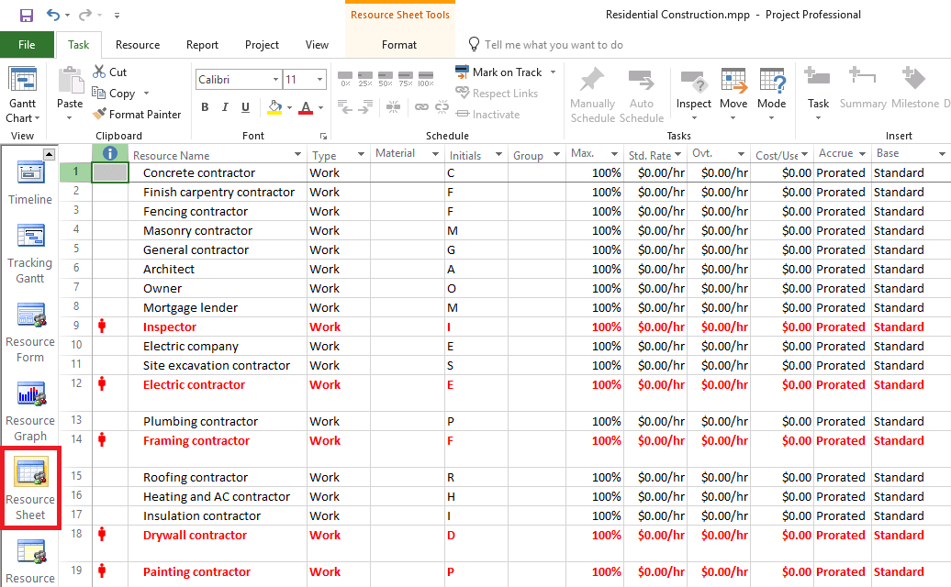
Computer Software for Scheduling Resources
5–47

Slide 48
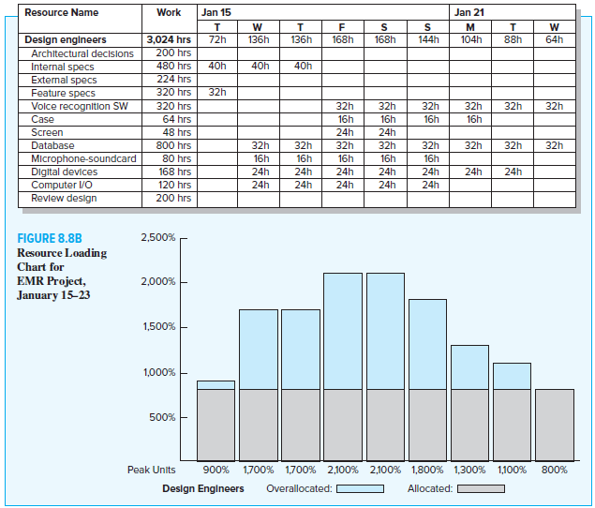

Computer Software for Scheduling Resources
5–48

Slide 49
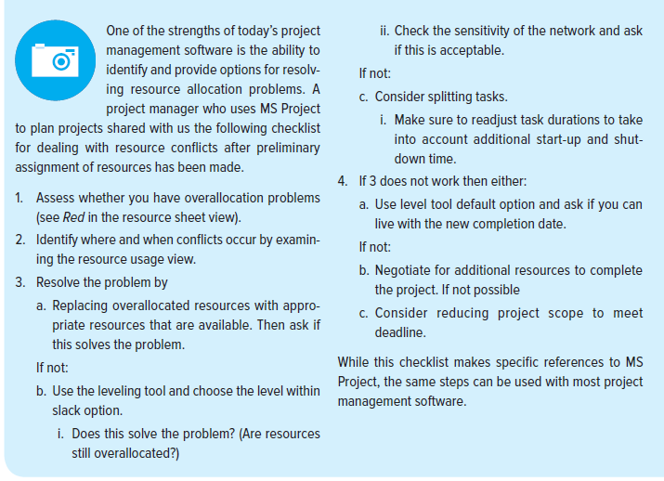
Snapshot from Practice - Assessing Resource Allocation
5–49

Slide 50
Benefits of Scheduling Resources

Slide 51
Benefits of Scheduling Resources
If resources are truly limited and activity time estimates are accurate, the resource-constrained schedule will materialize as the project is implemented—not the time-constrained schedule!
Failure to schedule limited resources can lead to serious problems for a project manager
The benefit of creating this schedule before the project begins leaves time for considering reasonable alternatives
If the scheduled delay is unacceptable or the risk of being delayed too high, the assumption of being resource constrained can be reassessed
5–51

Slide 52
Benefits of Scheduling Resources
Resource schedules provide the information needed to prepare time-phased work package budgets with dates
Once established, they provide a quick means for a project manager to gauge the impact of unexpected events such as equipment breakdowns, or transfer of project personnel
Resource schedules also allow project managers to assess how much flexibility they have over certain resources
5–52

Slide 53
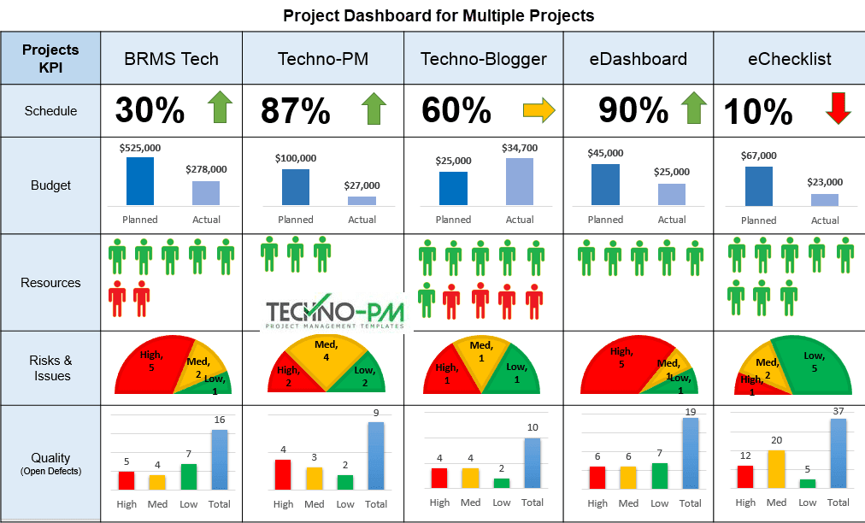
Multiproject Scheduling Problems

Slide 54
Multiproject Scheduling Problems
Overall schedule slippage. Because projects often share resources, delays in one project can have a ripple effect and delay other projects
  work on one software development project can grind to a halt because the coders scheduled for the next critical task are late in completing their work on another development project
Inefficient resource utilization. Because projects have different schedules and requirements, there are peaks and valleys in overall resource demands
  a firm may have a staff of 10 electricians to meet peak demands when, under normal conditions, only 5 electricians are required
Resource bottlenecks. Delays and schedules are extended as a result of shortages of critical resources that are required by multiple projects
5–54

Slide 55
Summary of Today Session

Slide 56
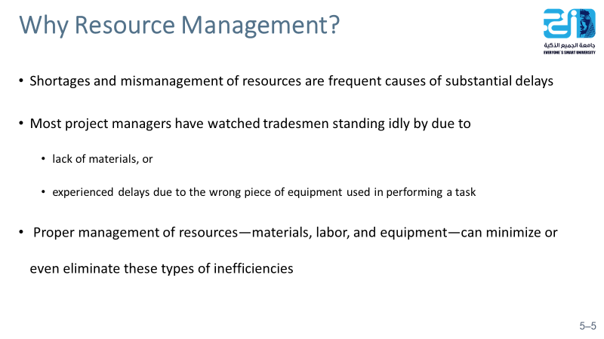
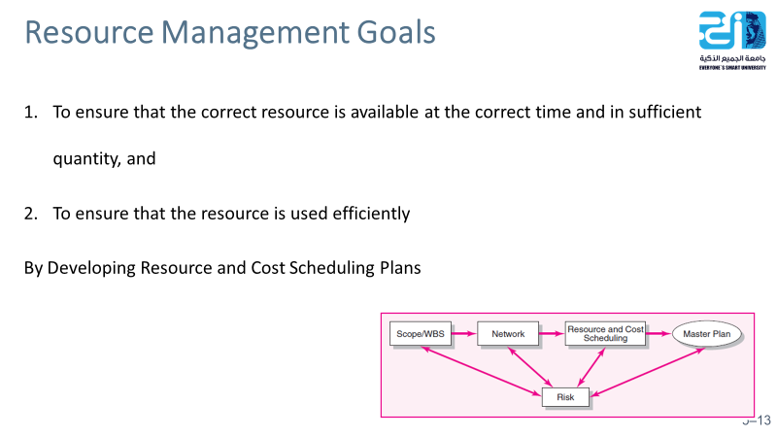
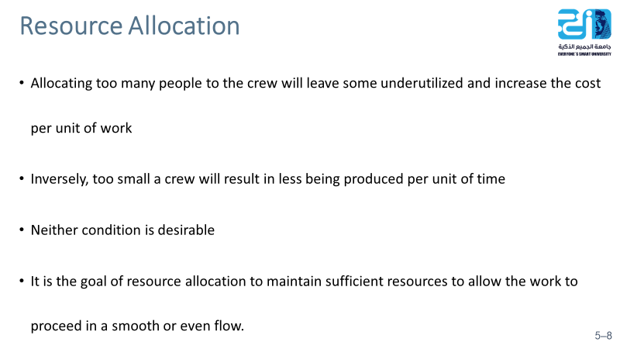
5–56

Slide 57
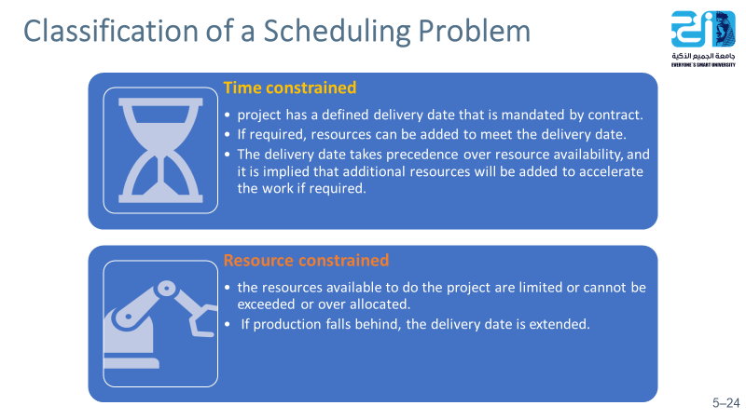
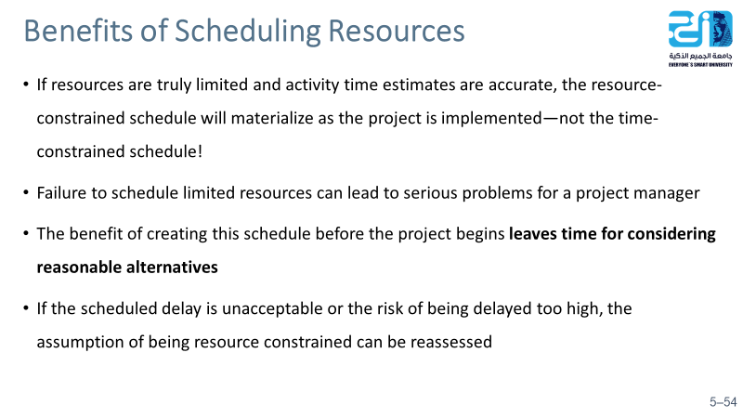
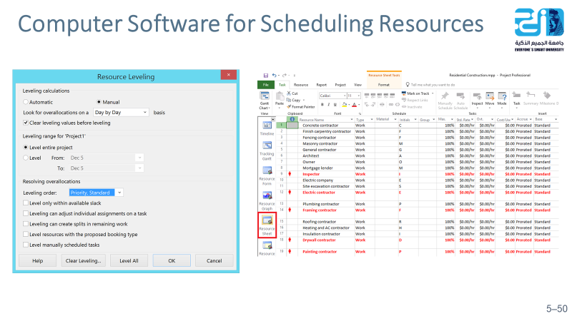
5–57

Slide 58
Resources
Project Management
The Managerial Process
Fifth Edition
By: Erik W. Larson
Oregon State University
Clifford F. Gray
Oregon State University
5–58

