Slide 1


Prepared by Dr. Karim Ahmed
MKT631
Digital Analytics

Slide 2



MKT631
Digital Analytics
Lecture 7
Prepared by
Dr. Karim Ahmed

Slide 3
Lecture 7
The Art of
Analytics
Part 1

Slide 4
Lecture 7
Objectives:
Introduce students to the fundamental stages of the Marketing Analytics Process (MAP).
Highlight the strategic importance of asking the right questions in analytics.
Equip students with a structured approach to planning their analytics journey and managing uncertainty throughout the process.
Distinguish between clear marketing objectives and broader business results.
Explore two critical marketing objectives: stimulating demand and building awareness.
www.midocean.ae

Slide 5
Lecture 7
Lecture Content:
Introduction
The Four Steps of the Marketing Analytics Process ( MAP)
‘The Ask Behind the Ask’
Planning for Your Analytics Expedition
www.midocean.ae

Slide 6

Chapter
Introduction
07
Analysts desperately want the big idea. They want to uncover the insight that expresses something no one else sees, gives their organizations a competitive advantage, and earns them accolades.
The impossible way for the analyst to reach the insight they seek is to sit alone in a room and think on the problem until they come up with the solution. Indeed, analytics is not an individual sport.
www.midocean.ae

Slide 7
Chapter
07
The Four Steps of the Marketing Analytics Process ( MAP)
The marketing analytics process (MAP) that guides us along our analytics journey consists of four steps: plan, collect, analyze and report. The four steps are a circular process and each time through informs the next journey. Analysts find data they’re comfortable working with. They hone analysis techniques through experience. And as analysts prepare to report their findings, they learn what audiences value and what they don’t like. The knowledge analysts build through this process is important. The next time they start a planning phase, they’ll have understanding, data, and insights to apply moving forward.
www.midocean.ae

Slide 8
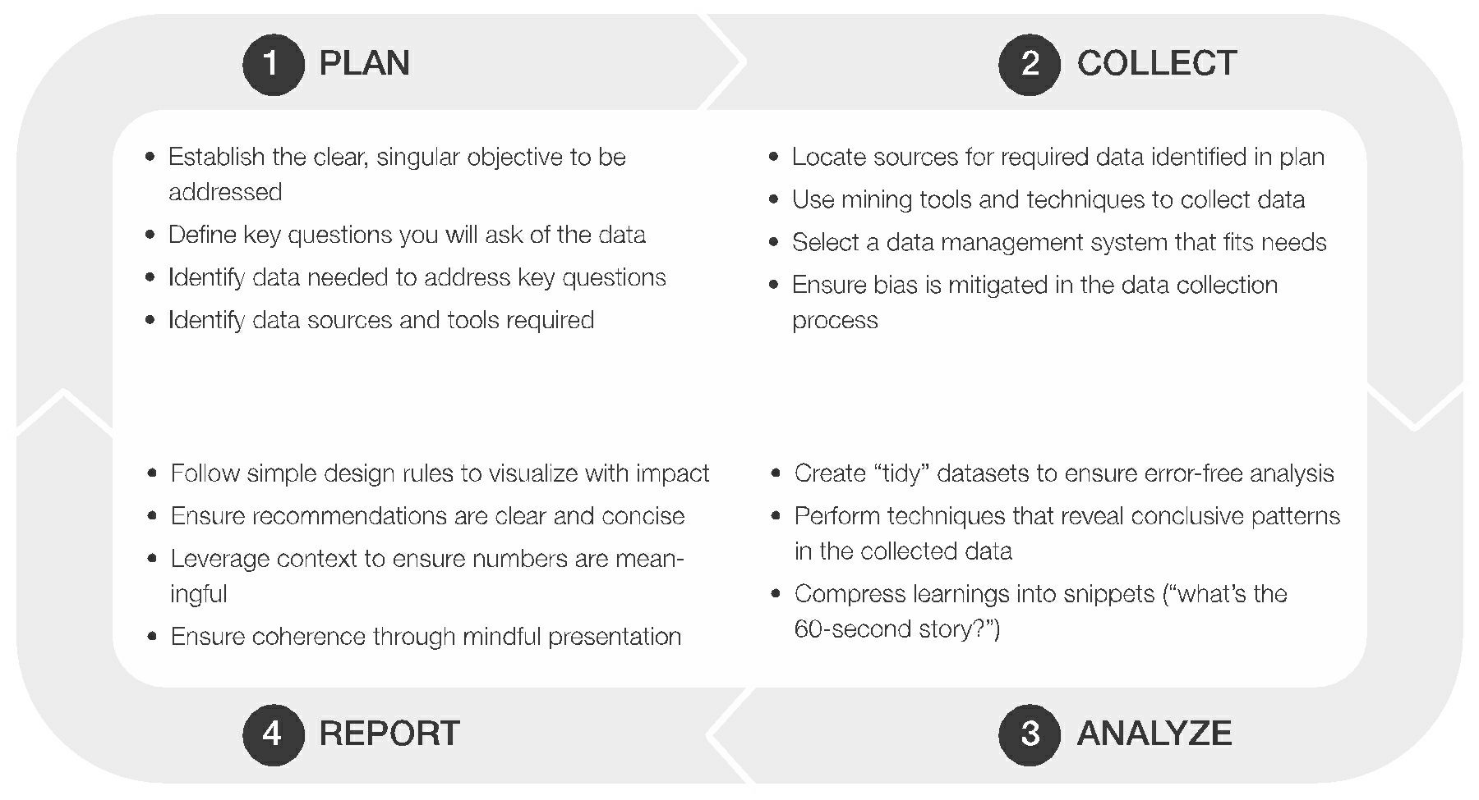
Chapter
07
The Four Steps of the Marketing Analytics Process ( MAP)
www.midocean.ae

Slide 9
Chapter
07
The Four Steps of the Marketing Analytics Process ( MAP)
First Step: Plan
The first item in the plan step is to establish a clear, singular objective for the analysis. Singular is a key word here. The analyst can’t tackle multiple objectives with their analysis. It’s imperative that the analyst fight for this upfront by getting executive sponsors and stakeholders to align on a singular objective and commit to its pursuit. Taking on too many objectives (i.e., more than one) will scatter resources, analysis, and focus. Being singular in the objective allows the analyst to bring the full weight of their analysis to a specific, identified goal.
www.midocean.ae

Slide 10
Chapter
07
The Four Steps of the Marketing Analytics Process ( MAP)
First Step: Plan
The second phase in the plan step is defining the key questions analysts will ask of the data. Approach this by thinking of the three (or more) questions to answer to achieve the objective. For example, if the objective of my analysis is to determine how my company/client can improve awareness for a new product, I might ask questions such as:
What’s the current level of awareness for products in this category?
Why have some channels been successful while others haven’t?
How can I use media most efficiently to build awareness among my target consumers?
www.midocean.ae

Slide 11
Chapter
07
The Four Steps of the Marketing Analytics Process ( MAP)
First Step: Plan
The final thing the analyst will do in this plan step is to pull it all together in a planning document (a literal plan) that will help guide them through the rest of the analysis. The key elements of this planning document make clear the (1) objective, (2) key questions, and (3) data and sources used to find those answers. This document helps keep the analysis centered as the project works its way through the remaining complex (and distraction-filled) phases of the MAP.
www.midocean.ae

Slide 12
Chapter
07
The Four Steps of the Marketing Analytics Process ( MAP)
Second Step: Collect
In the collect step, the analyst seeks data to answer key questions. The first step is to find and engage the sources of required data. Frequently, data sources in the plan step don’t work out. Data owners could deny access to those sources, access could be too expensive, or the data could no longer exist. This is one of the primary reasons we need to be flexible in our analysis journey. When data proves to be inaccessible, we must refresh our plan with a new dataset that can provide the answers we seek. This is where the experience gained from previous journeys will come in handy, as quickly replacing an inaccessible data source with one the analyst used in the past will preserve the analysis timeline.
www.midocean.ae

Slide 13
Chapter
07
The Four Steps of the Marketing Analytics Process ( MAP)
Second Step: Collect
Once the analyst identifies and engages sources, the second phase to the collect step is to use data mining techniques and other tactics to pull that data out and get it into a usable form. There are primarily three techniques: (1) accessing facilitated downloads, (2) tapping application programming interfaces (APIs), and (3) scraping webpages.
www.midocean.ae

Slide 14
Chapter
07
The Four Steps of the Marketing Analytics Process ( MAP)
Second Step: Collect
The final phase in the collect step is selecting a data management system to house the collected data. Many systems are available, but the key consideration is balancing analysis power with simplicity of use. Usually, those are negatively correlated
www.midocean.ae

Slide 15
Chapter
07
The Four Steps of the Marketing Analytics Process ( MAP)
Third Step: Analyze
The first phase of the analyze step is producing an analysis-ready, tidy dataset. Beginning with clean, well-organized data will make that process much more efficient and effective.
The next phase of the analyze step is to perform analysis. Each analysis has a varying level of depth and, therefore, produces varying levels of insight. Sometimes, a simple analysis with a simple insight is all analysts need. Other times, it’s important to go
deeper. We’ll discuss how those analysis techniques produce that depth of insight.
www.midocean.ae

Slide 16
Chapter
07
The Four Steps of the Marketing Analytics Process ( MAP)
Step Four: Report
The fourth and last step in the MAP is to report the analysis results. In this step, analysts should feel tension as they compress the story into a tight, digestible packet. Compressing this story means no extraneous information obscures insights that matter, the logical flow of the story is solid, and the story’s aperture can be opened wide enough to provide details to low-level stakeholders and focused enough to provide a high-level narrative to a C-level audience.
www.midocean.ae

Slide 17
Chapter
07
The Four Steps of the Marketing Analytics Process ( MAP)
Step Four: Report
The first phase in the report step is to design a visual story that reaches audiences effectively and efficiently. The analyst will do this by leveraging pre-attentive attributes in visual perception.
The second phase is to ensure recommendations are clear and concise. Concepts, ideas, and recommendations included in the analyst’s report must be easy to understand. We’ll discuss some simple rules to help ensure our message, and all of its elements, is precise.
The last phase in the report step is to ensure the presentation is distraction free by focusing on detail and sophisticated execution elements.
www.midocean.ae

Slide 18
Chapter
07
‘The Ask Behind the Ask’
Open and frequent communication between analysts and stakeholders is a hallmark of any successful analytics journey that arrives at a Big Idea. While communication throughout the process is important, it’s never more critical than at its beginning. This is when clear expectations must be set and understood.
One of the greatest complications for the analyst is the discussion of needs and requirements for an analytics project with non-analyst stakeholders. The analyst is a strategist who applies a specialized set of tools and skills on data to solve problems and find new opportunities. Analysts cannot (and should not) expect their non-analyst stakeholders to know the solutions that would solve stakeholders’ challenges.
www.midocean.ae

Slide 19
Chapter
07
‘The Ask Behind the Ask’
Put simply, the analyst is not an order taker. The analyst is not employed to simply produce on-demand analytics products that stakeholders request from a neat, well-defined menu. The sophistication of business today and the complexity of data analytics projects dramatically reduces the shelf life of unmalleable analytics projects. What may make sense for the business today will almost certainly be out of date within a few quarters (if not weeks). More importantly, the carefully prescribed analytics menu constrains analysts and stifles their creativity. This, in turn, leads to suboptimal outcomes for the business as well as the analyst’s career.
www.midocean.ae

Slide 20
Chapter
07
‘The Ask Behind the Ask’
It’s important for analysts to get to what we call “the ask behind the ask” from their stakeholders. In other words, rather than taking a non-analyst stakeholder’s request at face value, the successful analyst will seek to uncover what the stakeholder is attempting to solve. The non-analyst’s requested solution is “the ask,” but the real underlying challenge that has motivated the request (the ask behind the ask) is what the analyst must understand. By doing so, the analyst can use their expertise to assess the challenge and craft an appropriate solution.
www.midocean.ae

Slide 21
Chapter
07
‘The Ask Behind the Ask’
We can assume this scenario involves a well-intentioned sales leader approaching an analyst with a lengthy data request. The sales leader had just received a call from a client during which the client shared plans for a new campaign to take advantage of an unexpected spike in consumer demand.
“The client needs help with their approach to consumer targeting,” the sales leader stated, “so there’s some data I’d like you to pull.” Without any hesitation, the sales leader launched into a review of the long list of data they had hastily scribbled on a notepad. At that point, the analyst interjected with one simple question: “What are we trying to solve?”.
www.midocean.ae

Slide 22
Chapter
07
‘The Ask Behind the Ask’
Those six simple words stopped the sales leader in their tracks. What followed was a thoughtful and thorough discussion of the client’s market position, the difficulties they faced, and the opportunities before them. This led the sales leader and the analyst to a concise articulation of the challenge facing the planned campaign. In a few minutes, the analyst successfully guided the sales leader to an entirely different analysis path using a different collection of data that would produce a different set of outcomes. These outcomes would provide a clearer and actionable solution to the client’s true challenge. When the analyst finished describing their proposed approach, the sales leader stood in amazement. “I didn’t know we could do that,” the sales leader said gleefully.
www.midocean.ae

Slide 23
Chapter
07
‘The Ask Behind the Ask’
By getting to the ask behind the ask, this analyst applied their expertise in data analytics to the client’s challenge rather than pursuing the request of a non-analyst stakeholder. More importantly, the analyst saved the team several rounds of back-and-forth with clients and countless hours of pointless (and, most likely, ultimately rejected) analysis.
www.midocean.ae

Slide 24
Chapter
07
Planning for Your Analytics Expedition
www.midocean.ae

Slide 25
Chapter
07
The uncertainty that analysts face when starting their journeys means that flexibility is crucial. All too frequently, data deemed necessary is unavailable, errors render data unreliable, or patterns revealed in data contradict the stories analysts believed. Analysts must modify their plans quickly to keep analyses on track in these situations. The dynamic and shifting nature of the analysis journey means that analysts’ carefully laid plans can appear worthless.
www.midocean.ae

Slide 26
Chapter
07
The planning process yields insight into an organization’s needs, the stakeholders invested (or not invested) in the analysis, and other elements that affect projects and can be taken as important truths. Analysts can use these as “North Stars” to anchor their analyses and guide projects through inevitable twists and turns. One such truth is the objective that acts as a fixed point in the distance for analysts and their analysis journeys. The rigor needed to identify that objective successfully can keep analysts centered, regardless of how thoroughly they’re forced to abandon elements of their plans.
www.midocean.ae

Slide 27
Chapter
07
When Objective-Setting Goes Awry
One of the most damaging errors analysts make happens at one of the earliest stages: establishing an objective improperly. Should that objective be off in some way, the effect on the work it guides will ripple through every step. We may define three common errors that occur during the critical stage of objective setting that an analyst must fight to avoid:
1. Making the objective too broad
2. Confusing an objective with a result
3. Making the objective too complex
Let’s take a deeper look at each of these errors and how to correct them through proper objective setting.
www.midocean.ae

Slide 28
Chapter
07
When Objective-Setting Goes Awry
Breadth
Focus when setting objectives is critical for success. A well-defined, narrow objective is more attainable than one spanning multiple outcomes. Work hard upfront to ensure the objective is singular. One easy way to make sure this happens is by forbidding the use of the word “and” in the documented objective. For example, the broad objective “build awareness for our new product AND influence consumers to choose our new product” becomes two separate, singular objectives (i.e., “(1) Build awareness for our new product,” and “(2) Influence consumers to choose our new product”) that must be tackled by two separate analysis paths.
www.midocean.ae

Slide 29
Chapter
07
When Objective-Setting Goes Awry
Objectives Versus Results
Too often, analysts incorrectly identify objectives as results. No marketing analysis can yield an insight for an advertiser to “drive sales.” Sales are not an objective, but rather the result an advertiser realizes when achieving a different objective. For example, an advertiser whose sales suffer from a lack of awareness must focus on increasing exposure. Therefore, “building awareness” is the appropriate objective that will ultimately “drive sales.” In the next section of this lesson, we’ll see that the objectives marketing analysis should seek to improve are what we’ll call “Marketing Objectives” while sales, volume, and profit are “Business Objectives” that should be viewed as results.
www.midocean.ae

Slide 30
Chapter
07
When Objective-Setting Goes Awry
Complexity
When attempting to rally an organization behind an objective, message clarity and conciseness are critical. Likewise, straightforward messages are important when centering stakeholders on the objective of an analysis. To do this, analysts must simplify their approaches to objective setting. Analysts can feel confident in the soundness of their objectives when selecting from one of six well-known and tested Marketing Objectives.
www.midocean.ae

Slide 31
Chapter
07
The Six Marketing Objectives
We may submit six Marketing Objectives that can serve as the focus for analysis and the objective of any campaign. Those six objectives are: stimulate demand, build awareness, influence consideration, improve the sales processes, reposition the brand, and increase loyalty.
The six Marketing Objectives simplify the underlying complex systems of consumer/brand connections. They’re true objectives that marketing can influence (i.e., they aren’t results but are marketing levers that will end in results), and – most importantly – they’re mutually exclusive from one another. Marketing Objectives, and their relative position to other categories of important objectives, are presented here in the following figure:
www.midocean.ae

Slide 32
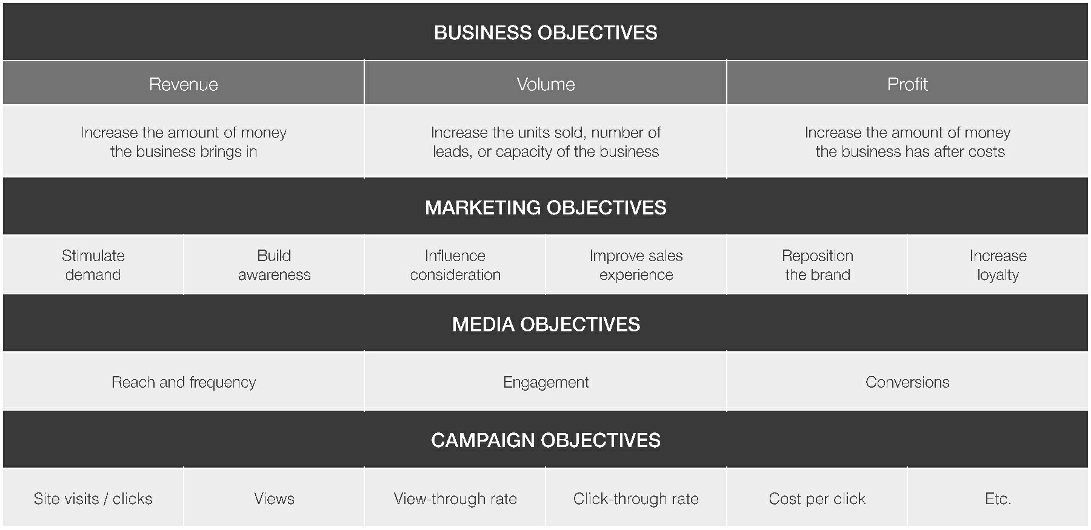
Chapter
07
The Six Marketing Objectives
www.midocean.ae

Slide 33
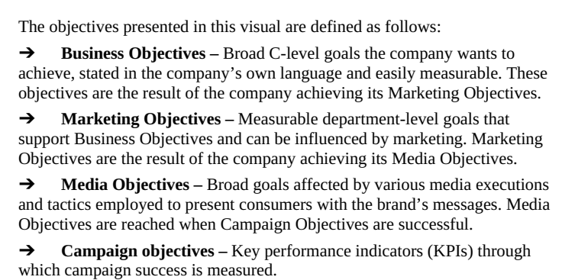
Chapter
07
The Six Marketing Objectives
www.midocean.ae

Slide 34
Chapter
07
The Six Marketing Objectives
The most important layer of objectives for marketing analysts to understand is the line of Marketing Objectives. These objectives will result in revenue, volume, or profit growth that’s critical to business performance. In addition, these are the highest level of objectives that marketing performance can influence. As such, the analyst can most affect the organization by conducting analysis to solve challenges to Marketing Objectives.
www.midocean.ae

Slide 35
Chapter
07
The Six Marketing Objectives
1- Stimulating Demand
Stimulating demand is a curious Marketing Objective. At its root is the idea of convincing consumers they need an advertiser’s product. Of course, this idea is not unfamiliar to advertisers. Every brand in the world recognizes the need for consumer demand. The challenging thing about pursuing this objective lies in the need for one critical element: authenticity.
www.midocean.ae

Slide 36
Chapter
07
The Six Marketing Objectives
1- Stimulating Demand
Consumers – and especially consumers of today, with their limitless access to information – can sense inauthentic brand messages from miles away. A brand that simply calls, “Please! Buy my product!” to the market will undoubtedly face consumer apathy or, even worse, distrust. After all, as we’ve seen in today’s consumer/brand relationship, it’s the brand that must fit in the consumer’s life – not the other way around. Consumers have too many choices for an inauthentic message to drive demand. Brands can use marketing, however, to effectively stimulate demand for their products in a few limited ways.
www.midocean.ae

Slide 37
Chapter
07
The Six Marketing Objectives
1- Stimulating Demand
One way a brand can achieve this Marketing Objective is by providing clarity around how the product is used or the need it fulfills. If consumers are confused about the function or purpose of a product, demand for that product will be hard to earn. By clearing up this confusion – typically through demonstration – the advertiser can reveal the ability of the product to satisfy a need when, often, the consumer didn’t know they had that need. When you think of brands that must stimulate demand by offering more clarity around use, myriad products in infomercials come to mind.
www.midocean.ae

Slide 38
Chapter
07
The Six Marketing Objectives
1- Stimulating Demand
A second way brands can stimulate demand is through a high-risk and (sometimes) high-reward approach: creating scarcity. By announcing a dwindling supply of products, brands can try to stimulate demand by effectively manipulating market forces. This approach can have disastrous results for a brand when the message is viewed as a spurious attempt to “trick” consumers. In contrast, creating scarcity can be effective with consumers who are aware of the products and demonstrated affinity for them previously.
www.midocean.ae

Slide 39
Chapter
07
The Six Marketing Objectives
2- Building Awareness
Awareness is the percentage of consumers who are familiar with an advertiser’s brand or product. Awareness can be measured by the percent of the total consumer population that claims familiarity with the item being measured or against a more specific target population. General awareness is nice to have, but awareness among key consumer groups is always more important (e.g., awareness among demographic groups like “women 35+” or psychographic groups like “frequent gamers”).
www.midocean.ae

Slide 40
Chapter
07
The Six Marketing Objectives
2- Building Awareness
There can also be degrees of awareness. “Aided awareness” means the percentage of consumers who recognize an advertiser’s brand or product when they see or hear either name. “Unaided awareness” means consumers voluntarily mention the brand or product when prompted by a generic question such as, “What brands of automobile have you heard of?” Unaided awareness clearly reveals a deeper consumer/brand connection than aided awareness.
www.midocean.ae

Slide 41
Chapter
07
The Six Marketing Objectives
2- Building Awareness
Consumer surveys are typically the best way to gauge awareness. Survey measurement is particularly helpful for brands that launch new brands, sub-brands, products, or features. Tracking awareness can help advertisers optimize their approaches to targeting mid-campaign toward consumer groups (e.g., demographics) with the highest awareness lifts.
www.midocean.ae

Slide 42
In this lecture, we discussed:
Introduction
The Four Steps of the Marketing Analytics Process ( MAP)
‘The Ask Behind the Ask’
Planning for Your Analytics Expedition
When Objective-Setting Goes Awry
The Six Marketing Objectives (Stimulating Demand - Building Awareness)
www.midocean.ae

Slide 43


Thank You

