Slide 1


Communication skills
CMM201
Prepared by Dr. Merna Emad
Team Work
Lecture 7

Slide 2

Section 2
Conflict in Team Meetings
Lecture
Handling Conflict
Section 1
Groups vs teams
Conducting meetings
Shared Leadership

Slide 3
Section One

Slide 4
Groups vs teams

Slide 5
Groups vs teams
Is there a difference between groups and teams? Although executives and managers often use these terms interchangeably, their definitions do differ. For those seeking professional excellence, understanding this difference is essential.
Definition of group
Definition of a team
Two or more persons who are interacting with one another in such a manner that each person influences and is influenced by each other person.
A team is defined as a group in which members share leadership responsibility for creating a team identity, achieving mutually defined goals, and fostering innovative thinking.

Slide 6
Groups vs teams
This definition highlights four key differences between groups and teams.
First, unlike group members, team members share leadership responsibilities. There may be one team member who has a leadership title such as manager, vice president, or coach, but all team members demonstrate leadership when it comes to defining goals, making decisions, and implementing ideas.
Second, team members share an identity. They refer to their team as “us” and “we,” as opposed to “the group” or “them.”
Third, group members work toward common goals, while team members not only work toward common goals but also help define what those goals will be.
Finally, teams strive for innovation.

Slide 7
Conducting Meetings

Slide 8
Conducting Meetings
According to an old adage, groups outperform individuals, and teams outperform groups.
If you wish to achieve professional excellence in the workplace, you must learn to transform your groups into teams. Effective communication is essential for this transformation.
What makes meeting effective?
For meetings to run effectively, a few basics must always be considered. These basics include
The meeting environment
The meeting participants
The meeting topics

Slide 9
Conducting Meetings
Meeting Environment
What is a meeting environment?
The meeting environment is as much a part of the communication that occurs as the words that are said. Unfortunately, despite the importance of the meeting environment, most people spend little time thinking about it when they plan their meetings.
It includes both
The time of the meeting
The location of the meeting

Slide 10
Conducting Meetings
The time of the Meeting
If you wish to create an effective meeting environment, what factors should be considered?
First, you must consider the time. Time of day, Time of week, And time of year can all influence communication.
When selecting meeting times, be aware of differences in team members’ schedules. If team members work different shifts with different days off, meeting times should be varied.
For example
if half the team works from 7:00 a.m. to 3:00 p.m. and the other half from 3:00 p.m. to 11:00 p.m., holding every meeting at 9:00 a.m. would repeatedly inconvenience the same half of the team. When team members work varied schedules, there is no ideal time to meet. Yet alternating the meetings between shifts shows that all team members are valued and respected, which positively impacts communication interactions.

Slide 11
Conducting Meetings
The Location of the Meeting
Location is also an important component in creating a positive meeting environment. In fact, you should consider the convenience, aesthetics, and comfort of the location.
When selecting a meeting location, you should also consider aesthetics and comfort. Many leaders get in the habit of holding all their meetings in the same room.
For example
there is only one conference room in our building, so a lot of meetings are held there. The problem is that the conference room has an extremely long and narrow table. When sitting at the table, team members can’t see one another, making it very difficult to hold discussions or brainstorming sessions. Further, the room is very dull and uninspired, with no windows and poor lighting. Fortunately, there is another room two floors down that has movable tables, excellent lighting, and a great view outside the window.

Slide 12
Conducting Meetings
Meeting Topics (Agenda)
What is a meeting Agenda?
An agenda is a guide or an overview of the topics that will be covered during the meeting. An agenda can be simple or complex.
Why should Agendas be distributed several days in advance of the meeting?
This will allow team members to comment on the agenda items and give the leader time to revise the agenda if necessary.
It will also give team members time to think about issues in advance of the meeting. If you’d like the participants to brainstorm ideas or share information, the agenda is a valuable preparation tool for team members.
Noting the allotted time for each topic also helps the leader determine which topics and how many can be covered in any given meeting. Leaders with professional excellence prioritize agenda items.

Slide 13
Conducting Meetings
Meeting Topics (Agenda)
Meeting Agenda content
Heading: Should include date, time, and location. May include a list of participants.
I. Welcome/opening
The leader should always orient the team and focus the meeting during the opening.
II. Approve minutes from the previous meeting
Minutes are a written record of the meeting.
III. Specific points to be discussed
The majority of the agenda will be a list of the specific items that will be covered during the meeting. Beside each item, state who will lead the discussion and/or report on this item. It is also wise to include the estimated time it should take to cover each item.

Slide 14
Conducting Meetings
Meeting Topics (Agenda)
Meeting Agenda content
IV. Old business
Allow time for the team to discuss items from previous meetings that may still be unresolved.
V. New business
Minutes are Allow time for the team to discuss any new items that may have come up after the agenda was finalized or during the meeting itself.
written record of the meeting.
VI. Arrangement of the next meeting
Summarize any assignments that must be completed by the next meeting. Also make certain to discuss the time and location of the next meeting.
VII. Closing
Always provide some sort of closing statement.

Slide 15
Conducting Meetings
Meeting Participants
When it comes to planning meetings, you should ask yourself two important questions.
First, who should be at this meeting? Determining the participants in a meeting should not be based on office politics. Leaders with professional excellence avoid the trap of inviting a representative of each department in order to be politically correct. Invite people who can contribute to the purpose of the meeting. Take time to assess the meeting’s purpose, and then determine who can best serve that purpose.
Second, can all key members attend this meeting at this time? If key team members can’t be present, the meeting should be rescheduled.

Slide 16
Shared Leadership

Slide 17
Shared Leadership
There are many designated leadership titles (e.g., director, manager, supervisor, vice president, president, queen). Regardless of your title, if you’re the designated leader, think of yourself as a coach. A coach has a very distinct role in meetings. Remember, a coach does not play the game. The coach must remain on the sidelines.
The coach doesn’t have to be an expert on everything, have all the answers, or do all the talking. However, the coach does need to call the meetings, set the agenda, and then facilitate the discussion. A coach facilitates the discussion by supporting positive team roles and norms while eliminating self-centered roles and unproductive norms.

Slide 18
Shared Leadership
Team Norms
What’s a norm? A norm is an unwritten rule of behavior. Although norms are unwritten, they are as powerful as (if not more powerful than) the written rules. Think about the organizations for which you have worked

Slide 19
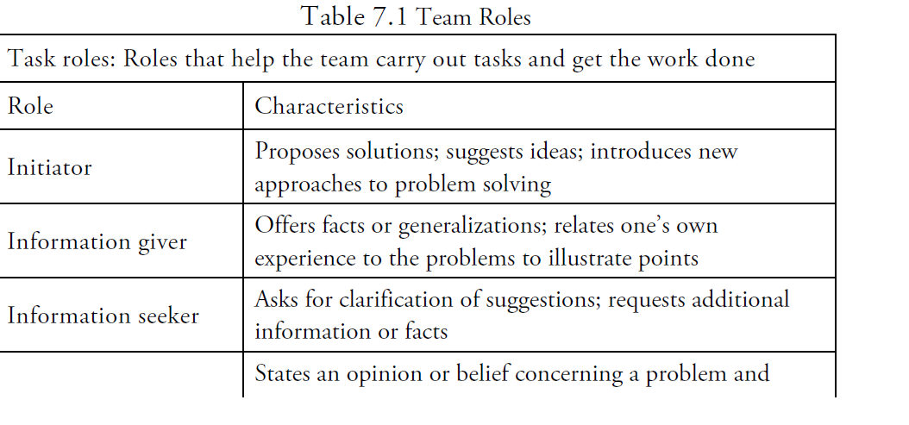

Slide 20
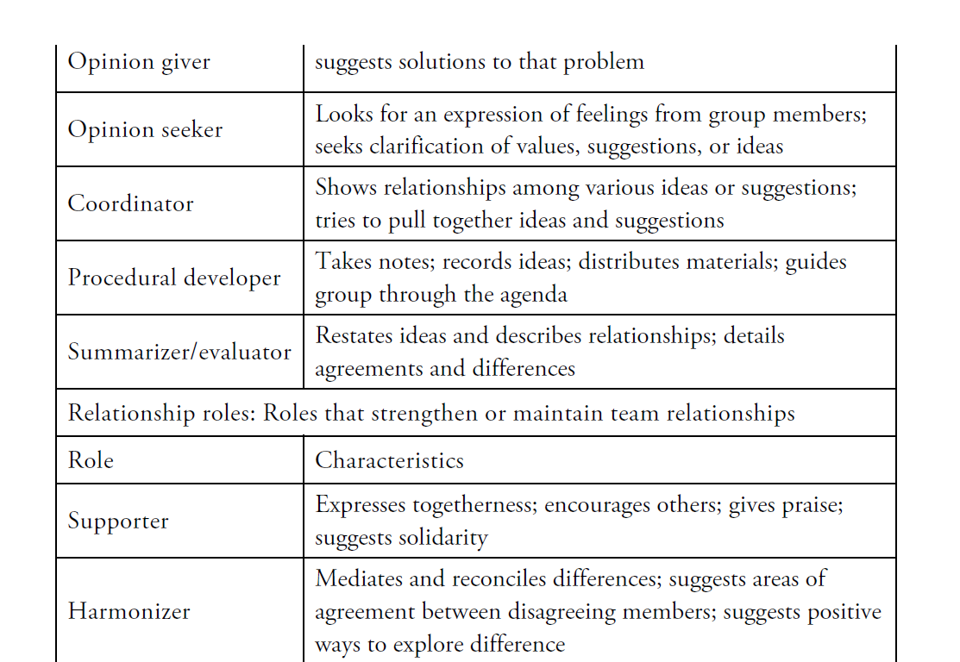

Slide 21
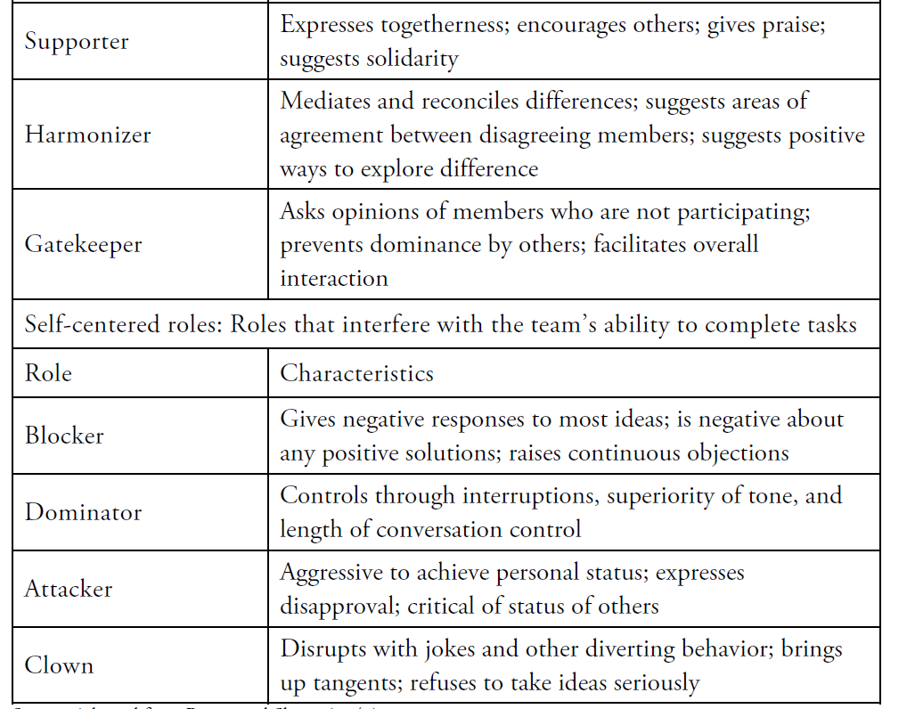

Slide 22
Shared Leadership
Decision making
Problem solving and decision making are not interchangeable terms. Decision making is actually a step in the problem-solving process. A leading scholar in group communication, decision making is “the act of choosing among a set of alternatives under conditions that necessitate choice”.
Problem solving involves not only making a choice but also coming up with quality alternatives from which to select and then working to implement the choice your team selects.

Slide 23
Shared Leadership
Decision making
How can you ensure that your team generates innovative alternatives and/or successfully implements its choice?
five steps make up problem solving:
  1. Describing and analyzing the problem
  2. Generating possible solutions
  3. Evaluating all solutions
  4. Deciding on the solution
  5. Planning how to implement the solution

Slide 24
Shared Leadership
Decision by the Leader
When the decision by the leader approach is used, members are not truly functioning as a team. The role of the members is to recommend or advise the leader. The leader then makes the ultimate decision. As a result, the goal is not mutually defined. In some instances, this approach may be the best way to make a decision.
For example, if an emergency room team needs to make a quick decision about an unfamiliar medical situation, the physician in charge may ask the advice of colleagues and/or medical staff. Yet, due to the need for a quick decision, the physician will ultimately determine the course of action. Although this approach has benefits in pressure situations, it’s not the preferred approach for building teams.

Slide 25
Shared Leadership
Decision by the Leader
Voting
The concept of voting is another way to reach a decision. With this approach, team members cast a vote for the solution they find most meritorious. The solution that receives the most votes is implemented. There are some obvious advantages to voting.
First, all team members have equal input in the decision. Next, it is an easy process that often requires little more than raised hands or slips of paper for casting votes.
Finally, it requires little time in comparison with the compromise or consensus approaches.

Slide 26
Shared Leadership
Decision by the Leader
Downsides of voting
Because it is quick and easy, voting is often used to speed up the decision-making process and avoid any lengthy discussions or conflict. Conflict is a valuable, needed resource in innovative problem solving and team building.
Limiting this process can resultin quick decisions that lack innovation and cause division. Voting is a win-lose approach to decision making. Unfortunately, not everyone makes a good loser—or a good winner, for that matter—so voting can divide the group and stop it from becoming a team.

Slide 27
Shared Leadership
Decision by the Leader
Compromise
Team members approaching decision making with a “let’s compromise” positive attitude. Although it is a commonly held belief that compromise is a good thing, compromise can limit innovation. With compromise, all parties are willing to give up something in order to gain something they want; so the goal becomes narrowing options, not developing innovative ideas.

Slide 28
Shared Leadership
Decision by the Leader
Consensus
The final approach to decision making is consensus. Consensus occurs when a solution or agreement that all team members can support is reached. This does not mean that the final solution is one that all team members prefer; rather, it means that the solution has the support of all team members. In an ideal world, team members might be able to come up with an idea that everyone loves and thinks is the best way to go, but most times that doesn’t occur. Thus, finding a solution that everyone supports has many positive benefits.

Slide 29
Shared Leadership
Decision by the Leader
Downsides of consensus
Because consensus is time-consuming. Many leaders and/or groups do not see the value in spending time working through the consensus process. Although consensus is more time-consuming as a decision-making approach, decisions reached using consensus can often be implemented quickly because they have the support of all members. As a result, consensus may be less time-consuming than voting or compromise, especially when the process is looked at from beginning to end.

Slide 30
Section two

Slide 31
Conflict in Team Meetings

Slide 32
Conflict in Team Meetings
When was the last time you thought to yourself, “I have a meeting today.
I hope it’s full of conflict”?
Chances are you’ve never had those thoughts. In fact, you may have thought the exact opposite on occasion: “I hope my meeting today has no conflict.”
Believe it or not, lack of conflict isn’t a good thing.

Slide 33
Conflict in Team Meetings
Lack of conflict is a strong sign that your group has some serious problems, such as:
Not develop innovative ideas, and never reach “team” status.
The whole purpose for having meetings is to get different people together to share a variety of ideas and develop innovative solutions to problems. If this is to occur, then conflict must occur, too.
If you replace the word conflict with something such as discussion or sharing of ideas, then the phrase sounds more appealing:
“I hope my meeting today is full of discussion and sharing of ideas.” To better understand the need for conflict in meetings and strategies for facilitating productive conflict, let’s explore each area in more detail.

Slide 34
Conflict in Team Meetings
Need for Conflict
As groups develop into teams, some naïve leaders think that a positive byproduct of this transformation will be a lack of conflict. Nothing could be further from the truth. If you’re part of a group that is not experiencing conflict, chances are you’re part of either a groupthink or a meeting think situation.
Groupthink
Groupthink is the tendency of highly cohesive groups to suspend critical thinking and make faulty decisions.
Causes of Groupthink.
For groupthink to occur, several conditions must exist. First, the group must be highly cohesive.

Slide 35
Conflict in Team Meetings
For example
Causes of Groupthink.
groupthink is more likely to occur if the group functions in isolation, is very homogeneous, lacks norms for critically analyzing information, and/or is dealing with high stress threats. In addition, these groups are often headed by a charismatic, directive leader.
Because of the strong desire to maintain the cohesiveness with leader and group, group members begin to self-censor.
No one in the group wants to be the voice of dissent, so members remain silent even though they have doubts or concerns.
If a group member does voice disagreement, “mind guards” jump in and silence the dissent until the dissenting member begins self-censoring. (Just as bodyguards protect the group from physical harm, mind guards protect the group from conflict and dissention.)
Since these groups often function in isolation, they do not receive feedback from the outside. In the end, it appears as if everyone agrees, assumptions go unchallenged, and faulty decisions are made.

Slide 36
Conflict in Team Meetings
Avoid Groupthink.
The way to avoid groupthink is to introduce conflict systematically. Norms should be developed for seeking additional information, testing assumptions. Having the larger group divide into subgroups when brainstorming and/or having the leader withhold his or her thoughts are additional strategies used to reduce groupthink.
False Empowerment.
False empowerment occurs when a leader acts as if he or she plans to involve the group in the decision-making process when, in reality, the leader is going to make the decision regardless of the input received from the group. At first, group members believe they are empowered to make a decision, but in the end this proves to be false. Over time, group members learn that their opinions, ideas, and thoughts are not valued, so they remain silent during meetings. As a result, critical thinking is suspended.

Slide 37
Conflict in Team Meetings
Avoid Groupthink.
Overload
Overload occurs when group members have so much on their plates that they cannot truly concentrate on and engage in the meeting at hand.
While the meeting is occurring, group members are thinking about the 10 other items they have to do that day at work, as well as the list of things they must take care of when they leave work. Being overloaded may also cause members to come to meetings without preparing.

Slide 38
Conflict in Team Meetings
Avoid Groupthink.
Poorly Run Meetings
Poorly run meetings are a third contributor to the meetingthink problem. Poorly run meetings can be the result of some or all of the factors we discussed earlier:
The meeting may be disorganized due to a lack of an agenda. It may be too long and/or include too many topics.
Overtalkers may be dominating the meeting.
The leader may be doing all the talking and failing to do any facilitating.
Regardless of the reason, poorly run meetings result in group members disengaging, which results in poor decision making.

Slide 39
Conflict in Team Meetings
Productive Conflict
By now, you may be convinced that conflict is a necessary part of teams, but you still may not be excited about the idea of engaging in conflict, especially if you’ve experienced negative, counterproductive conflict in the past. Achieving professional excellence in teams involves the utilization of positive, productive conflict as a valuable resource.
Stages of Team Development
Conflict is present in three of the five stages that make up team development.
Forming
Storming
Norming
Performing
Adjourning

Slide 40
Conflict in Team Meetings
Productive Conflict
Stages of Team Development
Conflict is present in three of the five stages that make up team development.
Forming
Storming
Norming
Performing
Adjourning
During the forming stage, group members tend to be polite and impersonal as they test the waters.
Conflict appears in the second stage, storming. During the storming stage, members engage in infighting and often clash with the leader.
In the norming stage, the group develops procedures for organizing, giving feedback, and confronting issues.
In the performing stage, the members carry out the duties of the group.
In the final stage, adjourning, the group completes its work, resolves issues, and comes to a close.

Slide 41
Conflict in Team Meetings
Productive Conflict
Stages of Team Development
Conflict is present in three of the five stages that make up team development.
Forming
Storming
Norming
Performing
Adjourning
This is not a linear process. Group members don’t march neatly from stage to stage. It’s normal for groups to revisit stages and circle through the process repeatedly. The point here is that groups encounter conflict in the storming, norming, and performing stages of development.
If a group is going to become a team, it will encounter conflict in the storming stage, develop productive ways to handle conflict in the norming stage, and utilize the kind of innovative thinking in the performing stage that can come only through productive discussion or conflict.

Slide 42
Conflict in Team Meetings
Handling Conflict
To achieve professional excellence, you must determine the best way to handle conflict so that it’s both positive and productive. Every time you are faced with a conflict, you must select one of three modes of conflict resolution:
Flight
Fight
Unite
Flight occurs when you choose not to engage or deal with a conflict. There are times when this is the appropriate strategy. Some issues are not worth the time or the energy. However, if there is a problem that must be solved or a behavior that must be changed, flight is not the appropriate response and avoidance only makes the problem worse.
Fight is another alternative for handling conflict. Using the fight approach will require you to engage in some type of confrontation. This approach is also known as a win-lose approach to problem solving.

Slide 43
Conflict in Team Meetings
Handling Conflict
To achieve professional excellence, you must determine the best way to handle conflict so that it’s both positive and productive. Every time you are faced with a conflict, you must select one of three modes of conflict resolution:
Fight
Unite
Both parties face off as opponents, and one party will come out the winner, while the other party will come out the loser. Clearly, this approach can have some negative consequences. In fact, the losing party often holds a grudge, which can damage relationships in the long run. However, there are times when an issue is important enough to warrant the fight approach. If handled properly, even conflicts that are solved using the fight approach can be positive.

Slide 44
Conflict in Team Meetings
Handling Conflict
To achieve professional excellence, you must determine the best way to handle conflict so that it’s both positive and productive. Every time you are faced with a conflict, you must select one of three modes of conflict resolution:
Unite
The third mode for conflict resolution is the unite approach, which requires team members to move away from stating positions to exploring interests. The unite approach defines team members as joint problem solvers rather than as adversaries. Instead of approaching the conflict as team member against team member, it becomes the team united against the problem. A position is a demand that includes each person’s solution to the problem. Under the unite approach, team members look beneath the surface of each position to see all the interests. Interests are the needs and concerns underlying each position.

Slide 45
Conflict in Team Meetings
Invite Cooperation
Once the problem is stated, invite cooperation.
For example, you might say, “How can we solve this problem together?” By listening, you and the other team members will gain a better understanding of everyone’s perceptions of the issue.
If your team is not familiar with this approach, you may need to guide team members through the process.
Prior to addressing any issues, talk to the team about the benefits of using the unite approach. Have the team imagine themselves on one side of the table, united against whatever issue or problem arises. Emphasize that the unite approach requires effective listening and participation from all team members.
To develop listening and participating as a norm, incorporate the round robin technique.

Slide 46
Conflict in Team Meetings
Invite Cooperation
Once the problem is stated, invite cooperation.
After you’ve raised the issue and invited cooperation, go around the circle and allow everyone to share his or her perceptions of the issue.
The round robin technique requires members to listen and not interrupt while other team members are speaking. Team members may ask one another clarification questions to improve understanding, but they can’t argue for or against positions.
As the team discusses their perceptions of the issue, the underlying interests will become clearer. Only then can the team begin generating options and select the best solution(s).

Slide 47
Thank you

