Slide 1




Social Media and Crises
Lecture 6
DGM 730
The Social Media Crisis Plan
(Issues & Risks)
Prepared by
Dr. Doaa Rady

Slide 2

Lecture
06
Lecture outline
The Social Media Crisis Plan (Issues & Risks)
The Seven Functional Blocks of Social Media
How to appear transparent, visible and accessible
Managing accessibility
Managing a 24/7 information streamتدفق المعلومات
Best practices in risk and crisis communication
Assessing and Managing Social Media Issues and Risks
Preventing Social Media Risk
خطة أزمة وسائل التواصل الاجتماعي (القضايا والمخاطر)
إدارة إمكانية الوصول
كيف تظهر بشكل شفاف ومرئي ويمكن الوصول إليه

Slide 3


Case Study

Slide 4
Lecture
06
Starbucks Case Study
Starbucks - Using a crisis as an opportunity for improving business practices
In April 2018, two black men who were waiting for a friend in a Philadelphia Starbucks were arrested after a store manager called the police on them, causing an uproar and garnering national attention. Naturally, the incident also went viral on social media.
ستاربكس - استخدام الأزمة كفرصة لتحسين الممارسات التجارية في أبريل 2018، ألقي القبض على رجلين أسودين كانا ينتظران صديقًا في مقهى ستاربكس بفيلادلفيا بعد أن اتصل مدير المتجر بالشرطة بشأنهما، مما أثار ضجة وحظي باهتمام وطني. وبطبيعة الحال، انتشرت الحادثة أيضًا على وسائل التواصل الاجتماعي.

Slide 5
Lecture
06
Starbucks Case Study
In response, Starbucks CEO Kevin Johnson apologized and acknowledged that the arrest “should not have happened”. Starbucks also announced that the manager involved in the incident was no longer working at the store, and that all 8,000 company-owned stores across the United States would close for one afternoon to provide a racial bias training to employees the following month.
ورداً على ذلك، اعتذر كيفن جونسون، الرئيس التنفيذي لشركة ستاربكس، واعترف بأن الاعتقال "لم يكن من المفترض أن يحدث". أعلنت شركة ستاربكس أيضًا أن المدير المتورط في الحادث لم يعد يعمل في المتجر، وأن جميع المتاجر المملوكة للشركة البالغ عددها 8000 متجرًا في جميع أنحاء الولايات المتحدة ستغلق أبوابها بعد ظهر أحد الأيام لتوفير تدريب على التحيز العنصري للموظفين في الشهر التالي.

Slide 6
Lecture
06
Starbucks Case Study
The company's quick response to the situation allowed them to reclaim and take control of the narrative. People ended up talking about Starbucks’ response in a largely positive way, instead of focusing on the unfortunate incident. The company also made a smart move by issuing an immediate response from their CEO, but having a “cooling down” period of a month before making news again with their attempt to right the wrong.
سمحت لهم استجابة الشركة السريعة للموقف باستعادة السرد والسيطرة عليه. وانتهى الأمر بالناس إلى الحديث عن رد فعل ستاربكس بطريقة إيجابية إلى حد كبير، بدلا من التركيز على الحادث المؤسف. اتخذت الشركة أيضًا خطوة ذكية من خلال إصدار رد فوري من رئيسها التنفيذي، ولكن مع فترة "تهدئة" مدتها شهر قبل إصدار الأخبار مرة أخرى بمحاولتها تصحيح الخطأ.

Slide 7
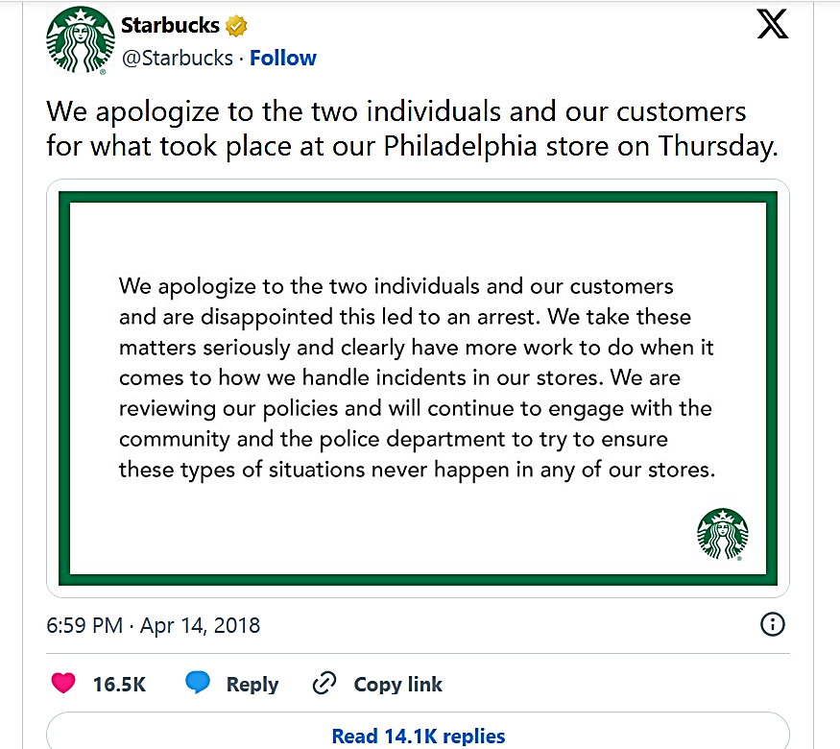
Lecture
06
Starbucks Case Study

Slide 8
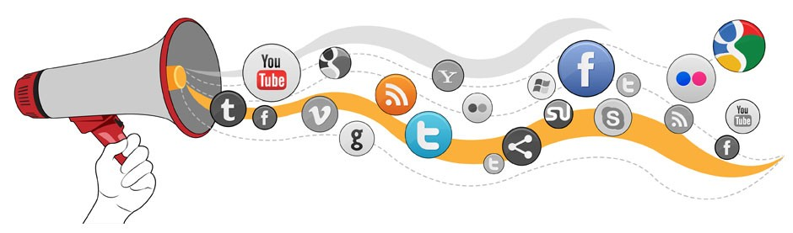
The Seven Functional Blocks
of Social Media

Slide 9
Lecture
06
The Seven Functional Blocks of Social Media
There are seven functional blocks of social media that apply to all users across any given platform:
1) Identity, (Identity deals with how users reveal themselves in a social media setting. Most of the information disclosed in this block is personal characteristics of the users such as age, name, gender, profession, and other information that represents them. This identity that is formed, generally happens through expression of what a person likes, dislikes, feels and thinks whether it is done consciously or unconsciously.)
2) Conversations, (This refers to the way in which users' communication in a social media setting, either as a group user or an individual. People communicate daily, using social media for a variety of purposes, often to, obtain information on important topics or to stay in touch with friends and family.)

Slide 10
Lecture
06
The Seven Functional Blocks of Social Media
3) sharing, (The dissemination of information by the users and groups based on what each think is relevant. Sharing is one of the key facets of social media, but each medium has a different intention. For example, Facebook is based on status updates of users and groups whereas Twitter is for short bits of information and links to information or video. YouTube on the other hand, presents video representation of information.)
4) presence, (Social media allows for constant connectivity even when individuals are nowhere near each other. This gives ease of access to users to know when others are accessible and when they are not. In Facebook, users know if someone is online if a green dot appears next to their name stating “available”. Constant connectivity allows for constant communication on the go, thus users can access and converse about information at anytime during the day with each other or as a group community.)
5) relationships, (The relationship means “two or more users have some form of association that leads them to converse, share objects of sociality, encounter, or simply just list each other as a friend or fan. E.G.: Twitter and YouTube do not value relationships as much as other sites do.)
Content Format

Slide 11
Lecture
06
The Seven Functional Blocks of Social Media
6) reputation, (Organizations need to always keep the public aware of what channels are official, so that information is not misconstrued. If an unofficial page is perceived to be official by the public and disseminates false or skewed information, this could aid in the damage of an organization’s image.)
7) groups, (This function allows for users to come together as a community for a common goal or purpose. Facebook and Flickr for example have the ability to create two different kinds of groups that people can be a part of.)
The following figure shows the functions of social media along with the implicationالنتيجة of each function. With the growth and expansion of social media in society in particular fields such as public relations, it is necessary for the academic community to analyze them for patterns that could emerge to help predict future of certain channels of social media in the professional world.
ويوضح الشكل التالي وظائف وسائل التواصل الاجتماعي مع النتيجة الضمنية لكل وظيفة. مع نمو وتوسع وسائل التواصل الاجتماعي في المجتمع في مجالات معينة مثل العلاقات العامة، من الضروري أن يقوم المجتمع الأكاديمي بتحليلها بحثًا عن الأنماط التي يمكن أن تظهر للمساعدة في التنبؤ بمستقبل قنوات معينة لوسائل التواصل الاجتماعي في العالم المهني.

Slide 12
Lecture
06
The Seven Functional Blocks of Social Media
سرعة

Slide 13
Lecture
06
The Seven Functional Blocks of Social Media
Social media creates a media of the masses.
Social media have been classified into these categories: Internet forums, weblogs, social blogs, wikis, podcasts, pictures and video.
From a public relations perspective, blogs and other forms of social networking are excellent ways to segment the public as groups of individuals who read the same blog or visit the same social networking site as those who share common interests.
This interaction has resulted in a participatory culture الثقافة التشاركية where ordinary citizens can have their voices be heard by the general public and large organizations, if they are listening.
Because of these reasons it is time organizations and public relations practitioners to pay attention to the online conversations taking part without them and learn ways to get involved with their online publics.

Slide 14

How to appear transparent,
visible and accessible

Slide 15
Lecture
06
How to appear transparent,
visible and accessible
كيفية استخدام الرؤى الاجتماعية لإرشاد عملية صنع القرار
How to use social insights to inform decision-making
Social media is a powerful source of inspiration and data that can inform the best approach for your business during a crisis—both in terms of new ideas to serve customers and strategic discussionsمن حيث الأفكار الجديدة لخدمة العملاء أو المناقشات الإستراتيجية to have within your organization. While social can certainly fuel a crisis, it can also be used to manage one. في حين أن وسائل التواصل الاجتماعي يمكن أن تؤجج الأزمات بالتأكيد، إلا أنها يمكن استخدامها أيضًا لإدارة الأزمة.
What challenges are top of mind for your brand right now? Use social to look at:ما هي التحديات التي تتصدر اهتمامات علامتك التجارية الآن؟ استخدم وسائل التواصل الاجتماعي للنظر إلى:
What your target audience has to say about related topics
How competitors are responding
What the local community is searching for

Slide 16
Lecture
06
How to appear transparent,
visible and accessible
How to use social insights to inform decision-making (Cont’d)
You can use social listening tools to evaluate a wide spectrum of global social media messages, or you can simply search for keywords or hashtags to find examples to inspire your next steps.
Listening can help you mitigate a crisis by catching it early. When a popular Twitter account unearthed insensitive Tweets written by a tenured Indiana University professor, IU used Sprout’s Listening tools to monitor the topic. Within almost 24 hours of the conversation escalating, IU was able to present their listening data, quickly put out a statement from the provost condemning the professor’s Tweets and get ahead of a potential PR nightmare.
أدوات الاستماع الاجتماعي
عندما اكتشف أحد حسابات تويتر الشهيرة تغريدات غير حساسة كتبها أستاذ دائم في جامعة إنديانا، استخدمت IU أدوات الاستماع الخاصة بـ Sprout لمراقبة الموضوع. في غضون 24 ساعة تقريبًا من تصاعد المحادثة، تمكنت IU من تقديم بيانات الاستماع الخاصة بها، وسرعان ما أصدرت بيانًا من العميد يدين تغريدات الأستاذ، وتجاوز كابوس العلاقات العامة المحتمل.

Slide 17
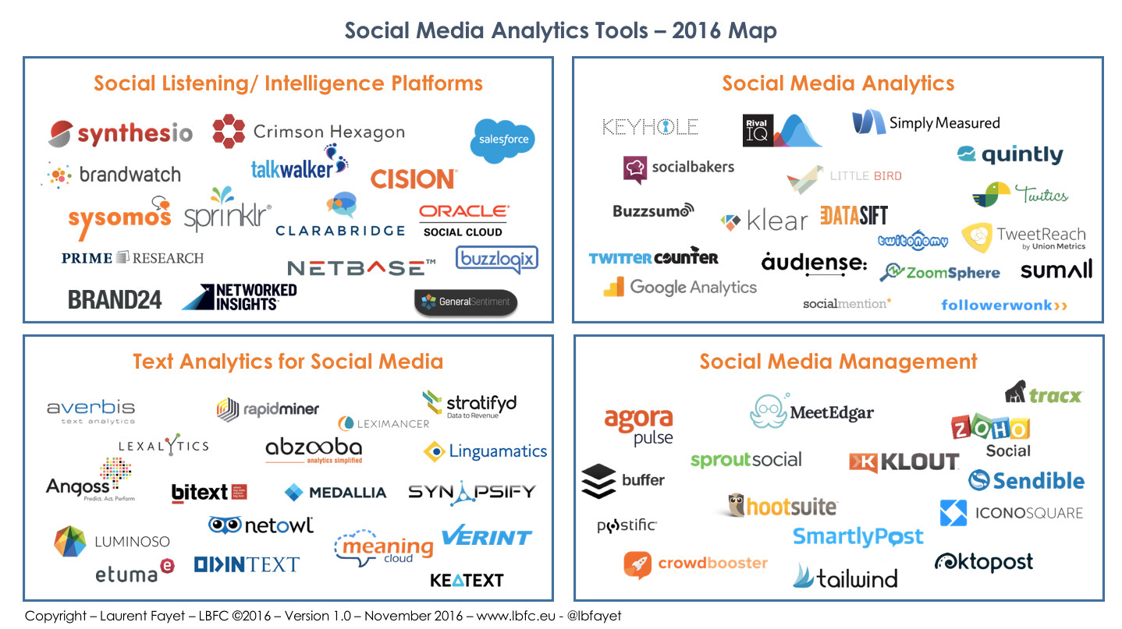
Live
Lecture
06
How to appear transparent,
visible and accessible

Slide 18
Lecture
06
How to appear transparent,
visible and accessible
How to use social insights to inform decision-making (Cont’d)
Package these insights into a report that you can share with the rest of your team. Include high-level takeaways about the social conversation as well as examples of messages so your team members who aren’t on the social front lines can hear from people in their own words. Make sure to share this report along with your own recommendations.

Slide 19

Managing accessibility

Slide 20
Lecture
06
Managing accessibility
What is social media accessibility? ما هي إمكانية الوصول إلى وسائل التواصل الاجتماعي؟
Social media accessibility is the practice of designing and developing social media content and posts that provide a smooth, inclusive experience for everyone—including for you, the marketer.
Non-accessible content can cause all sorts of annoying, disruptive experiences—like videos with a lot of background noise that don’t use captions. Creating more accessible social content is truly a win-win for everyone involved—from you, to your audience.

Slide 21
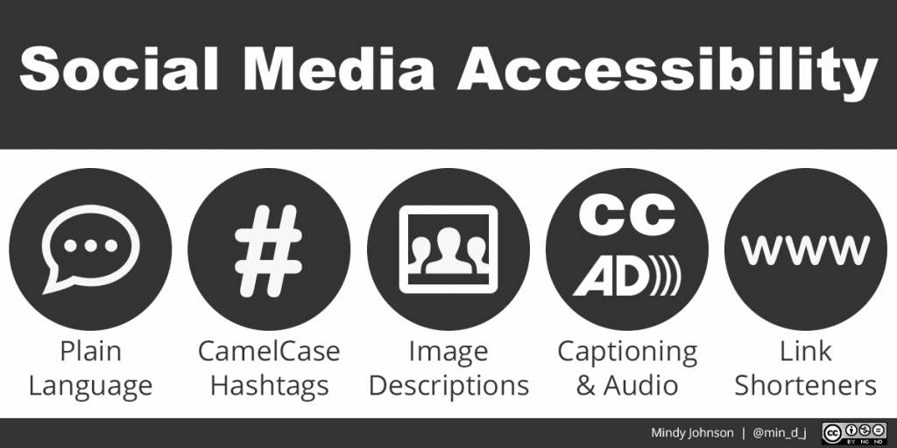
Lecture
06
Managing accessibility
Here are 8 social media accessibility best practices and tips you can start implementing today:
Add alt text to images (Short Image description)
Make your text accessible
Be mindful of emojis
Add closed captions and subtitles to videos
Make your visual content accessible
Use inclusive language
Prioritize inclusivity in your images
إعطاء الأولوية للشمولية في الصور الخاصة بك (الخدمات والأشخاص)
Make accessibility and inclusion part of your routine
تستفيد جميع الجماهير من التصميم الشامل

Slide 22

Managing a 24/7 information stream

Slide 23
Lecture
06
Managing a 24/7
information stream
Social media for business is important—particularly when your brand is managing a crisis. When an emergency strikes, your social feeds should help mitigate the problem, serve as a way to stay in touch with customers, and help create a feeling of consistency. But it takes some finesse. After all, we’ve all seen how badly a mismanaged crisis can play out on social media.
Monitor Social Media 24/7
One of the best ways to ensure a quick response? Have employees monitor your social media feeds at all times. You need dedicated resources for 24/7 monitoring of crises, customer questions and complaints, and opportunities—because you never know when your organization might actually benefit from an unexpected incident.

Slide 24
Lecture
06
Managing a 24/7
information stream
What is social media monitoring (and analytics)?
Social media monitoring is keyword monitoring on social media platforms to search for mentions of predefined keywords. What keywords are worth tracking? In business, they could be connected to:
  Brand
  Product
  Service
  Industry
  CEO
  Competitors
  Marketing campaigns
  Hashtags
  Anything business-related

Slide 25
Lecture
06
Managing a 24/7
information stream
Furthermore, social media monitoring tools have plenty of analytical features that get you heaps of data and insights about monitored keywords.
Some of them include:
Metrics of volume
Metrics of engagement
Metrics of sentiment
Metrics of influence
Metrics of reach and online presence
مقاييس الحجم
مقاييس المشاركة
مقاييس المشاعر
مقاييس التأثير
مقاييس الوصول والتواجد عبر الإنترنت

Slide 26
Lecture
06
Managing a 24/7
information stream
There are three main aspects to social listening:
Setting-up. First of all, it starts with setting up a project. You need to provide the keywords you want to track across social media. There’s often an advanced set-up with required and excluded keywords that can be used to make your query even more specific.
Collecting. Secondly, the tool collects mentions into a dashboard. There’s usually plenty of filters you can use to clean up, group, mark, delete collected mentions. Apart from the dashboard, you can receive mentions directly to your inbox in various shapes and quantities: daily, weekly, or real-time reports.
Analyzing. Thirdly, there’s the analytics. It depends on a tool, as different tools analyze different data. Some tools analyze metrics of volume, engagement, reach, sentiment, and influence of social media mentions.
إعداد

Slide 27
Lecture
06
Managing a 24/7
information stream
What can you do with your monitoring data?
Here are a few things you can do by monitoring different terms:
Monitoring your brand or company name – Find out where your audience is talking about you and distribute more content and ads there. Learn more about the type of audience that you have. See what your audience is saying about you and manage your reputation.
Monitoring your product – Measure what the public thinks about your product. See how it’s being used. This will help you find the right angle to promote your product or reposition it on the market if necessary.
Tracking hashtags – A social media marketing campaign is incomplete without a #hashtag. Monitor your #hashtag to see how often it’s being used and what the conversations are about.

Slide 28
Lecture
06
Managing a 24/7
information stream
Investigate similar products – See what people are saying about products similar to yours. Are they better? Are they worse? These are key insights that your R&D team needs to see.
Find key influencers – There are people who set trends and people who follow them. If you’re not a trendsetter (yet), at least stay up to date by following important industry influencers.
Analyze competitors – See where they fall short, and this may be something that you can cover with your own company.
Key execs at your company – It’s likely that your CEO or Public Relations specialist talks about your company… a lot. Monitor what they’re saying and see how people are reacting.
Manage a social media crisis – You can detect crises early thanks to sentiment analysis, storm alerts, and daily mentions monitoring.
المديرين التنفيذيين الرئيسيين

Slide 29

Best practices in risk
and crisis communication

Slide 30
Lecture
06
Best practices in risk and crisis communication
التكتيكات التقليدية التي يستخدمها ممارسون العلاقات العامة،
Tying into traditional tactics used by PR practitioners, Veil, Buehner, & Palenchar (2011) review ten of the best practices used in risk and crisis communication:
establish risk and crisis management policies and process approaches;
plan pre-event logistics; الخدمات اللوجستية/ السوقية
partner with the public;
listen to the public’s concerns and understand the audience;
communicate with honesty, candor الصراحة, and openness;
collaborate and coordinate with credible sources;
meet the needs of the media and remain accessible;
communicate with compassion عطف, concerns, and empathy تعاطف;
accept uncertainty and ambiguity;
provide messages of self-efficacy. الكفاءة الذاتية
عشرة من أفضل الممارسات المستخدمة في التواصل بشأن المخاطر والأزمات
وضع سياسات إدارة المخاطر والأزمات ونهج العمليات

Slide 31
Lecture
06
Best practices in risk and crisis communication
Best practices for crisis communication through social media
أفضل الممارسات للتواصل في الأزمات عبر وسائل التواصل الاجتماعي
1. Fully integrate social media into decision making and policy
Development
2. Actively engage in dialogue online
3. Use media affordances الإمكانيات الإعلامية to provide credible sources of information
4. Be cautious about message update speed
5. Own the hashtag
6. Cooperate with the public and similar organizations
7. Monitor misinformation

Slide 32
Lecture
06
Best practices in risk and crisis communication
Affordances for internalizing allow organizations to access resources – primarily information and knowledge – shared by non organizational users (e.g., community members, volunteers, media representatives, and responders from other organizations or organizational sub-units).
The following tables are an overview of these affordances, with definitions and selected references.
In particular, social media enable users to observe digital content that non-organizational users have contributed to social media presences, such as their digital profiles or community or collaborative spaces (monitoring the information stream). They can, for instance, keep track of digital content that features event-related markers, such as hashtags, watch updates contributed to wikis, forums, and collaborative maps, follow contributions to digital profiles or other presences, join relevant groups, and establish relational ties to relevant users to receive automatic notifications of recent activities.

Slide 33
Lecture
06
Best practices in risk and crisis communication
تسمح إمكانيات الاستيعاب للمؤسسات بالوصول إلى الموارد - في المقام الأول المعلومات والمعرفة - التي يتقاسمها المستخدمون غير التنظيميين (على سبيل المثال، أعضاء المجتمع والمتطوعين وممثلي وسائل الإعلام والمستجيبين من المنظمات الأخرى أو الوحدات الفرعية التنظيمية).وتمثل الجداول التالية نظرة عامة على هذه الإمكانيات، مع تعريفاتها ومراجعها المختارة.
على وجه الخصوص، تتيح وسائل التواصل الاجتماعي للمستخدمين مراقبة المحتوى الرقمي الذي ساهم به المستخدمون غير التنظيميين في تواجدهم على وسائل التواصل الاجتماعي، مثل ملفاتهم الشخصية الرقمية أو مجتمعاتهم أو مساحاتهم التعاونية (مراقبة تدفق المعلومات).
يمكنهم، على سبيل المثال، تتبع المحتوى الرقمي الذي يتضمن علامات ذات صلة بالحدث، مثل علامات التصنيف، ومشاهدة التحديثات التي يتم المساهمة بها في مواقع الويكي والمنتديات والخرائط التعاونية، ومتابعة المساهمات في الملفات الشخصية الرقمية أو حالات الحضور الأخرى، والانضمام إلى المجموعات ذات الصلة، وإنشاء علاقات علائقية. العلاقات مع المستخدمين المعنيين لتلقي الإخطارات التلقائية للأنشطة الأخيرة.

Slide 34
Lecture
06
Best practices in risk and crisis communication
Review findings on organizational learning affordances provided by social media
Based on the systematic literature review, we identified affordances of social media – five each pertaining to internalizing, externalizing, and collaborating processes.
واستنادًا إلى المراجعة المنهجية للأدبيات، حددنا إمكانيات وسائل التواصل الاجتماعي - خمس منها تتعلق بعمليات الاستيعاب الداخلي والخارجي والتعاون.

Slide 35
Lecture
06
Best practices in risk and crisis communication
Affordances |  | Definitions
(1) | Monitoring the information stream | Observing crisis-related digital content contributed to social media
(2) | Automatically processing big (social media) data | Utilizing technological artifacts for collecting, analyzing, and displaying crisis-related digital content contributed to social media
(3) | Tapping collective intelligence | Harnessing the outcomes of users’ joint efforts to make sense of crises
(4) | Accessing information providers | Identifying and consulting knowledgeable users
(5) | Evaluating crisis response | Analyzing experiences gained from prior uses of social media in response to crises
تسخير نتائج الجهود المشتركة للمستخدمين لفهم الأزمات
Overview of social media affordances for internalizing.
نظرة عامة على إمكانيات وسائل التواصل الاجتماعي لاستيعابها.

Slide 36
Lecture
06
Best practices in risk and crisis communication
Affordances |  | Definitions
(6) | Contributing information | Making crisis-related digital content available to users through social media
(7) | Forwarding information | Sharing previously contributed crisis-related digital content with users beyond its original audience through social media
(8) | Framing narratives | Contributing or forwarding digital content that conveys a particular interpretation of a crisis
(9) | Establishing digital presences | Setting up and promoting outlets for contributing and forwarding crisis-related digital content through social media
(10) | Communicating a reputation | Signaling the status and legitimacy of users contributing or forwarding crisis-related digital content through social media
Overview of social media affordances for externalizing.
نظرة عامة على إمكانيات وسائل التواصل الاجتماعي للخارج.

Slide 37
Lecture
06
Best practices in risk and crisis communication
Affordances |  | Definitions
(11) | Negotiating consensus | Aligning perceptions and developing a shared interpretation of a crisis
(12) | Integrating contributions | Registering, monitoring, and deploying resources provided by users in response to a crisis in a coordinated way
(13) | Crowdsourcing contributions | Calling for and incorporating resources to be provided by users in response to a crisis
(14) | Developing community | Advancing connections, sense of community, and collective action among users in response to a crisis
(15) | Establishing norms | Developing and enforcing principles for using social media to respond to a crisis collaboratively
Overview of social media affordances for collaborating.
نظرة عامة على إمكانيات وسائل التواصل الاجتماعي للتعاون.

Slide 38

Assessing and Managing Social Media Issues and Risks

Slide 39
Lecture
06
Assessing and Managing Social Media Issues and Risks
What is social media risk management?
Social media risk management is the process of identifying, assessing, and mitigating risks that stem from social media.
Your brand, customers, and employees are all active on social media.
This means your social channels are a common ground where conversations — both good and bad — and crises can start.
إدارة مخاطر وسائل التواصل الاجتماعي

Slide 40
Lecture
06
Assessing and Managing Social Media Issues and Risks
What are the risks of social media for businesses?
Damage to reputation (Negative comments, inappropriate posts, or bad reviews can all damage your brand’s reputation.)
Security breaches (If your social account passwords get into the wrong hands, then a security breach is a major risk.)
Compliance violations انتهاكات الامتثال(Social media compliance refers to following rules and regulations set by regulatory bodies, social platforms, and your own company. )
Legal issues (You should also have a policy that covers your employees’ social activity and conduct if you want to avoid legal issues.)
Financial consequences (Any negative situation, like a PR crisis, impact your company’s bottom line.)

Slide 41
Lecture
06
Assessing and Managing Social Media Issues and Risks
5 steps to managing risk on social media
1. Define your social media policy
The policy should clearly state what everyone’s roles are in crisis scenarios — from the legal team to PR to customer service.
2. Train your employees
Your employees are some of your company’s best brand advocates. But without clear guidelines or regular training, employees can put your business at risk.
3. Monitor your social media accounts
Brands must keep a close eye on their mentions so they can quickly step in if needed.

Slide 42
Lecture
06
Assessing and Managing Social Media Issues and Risks
5 steps to managing risk on social media
4. Respond promptly to negative feedback
A negative comment or review can gain traction within minutes or even seconds. It’s critical to have a response plan ready to go so you can address feedback the instant it comes up.
5. Review and revise your policy on a regular basis
Your organization’s social media policy isn’t set in stone — it should be revised as often as social media changes.

Slide 43

Preventing Social Media Risk

Slide 44
Lecture
06
Preventing Social Media Risk
1) Guidelines
As general best practice, a high-level overall policy should be rolled out to guide the use of social media by all employees of the organization and any third party acting on behalf of the organization. The guidelines should highlight key components including:
Scope—Defining the overall scope of the policy guidelines that is set forth by the enterprise for its employees
Purpose—Definition of the purpose of the guidelines for the organization, specifically, how social media activity on behalf of the organization will take place and what sort of information is relevant to share via that activity.

Slide 45
Lecture
06
Preventing Social Media Risk
Goals—Clear definition of the overall outcome that is to be achieved from the social media presence for the organization and how the social media platform will get the organization there
Ownership guidelines—General guidelines for the creation and maintenance of all social media sites for the organization
Contributor guidelines—General guidelines and principles directing contributors to the social media sites
Approved social media platforms—Expectation for departments assessing social media solutions outside of the company to demonstrate how the social media presence will contribute to achievement of the overall goal and, more importantly, the platform’s degree of utilization and security

Slide 46
Lecture
06
Preventing Social Media Risk
2) Training and awareness
It is key for the organization to embody the proper use of social media etiquette as part of the onboarding training of all employees, especially in roles such as marketing, HR and IT—departments that will most likely be representing the organization as part of their ongoing job functions. Embedding the behaviors and instilling the right concepts of social media norms that align with the organizational policies and processes will help in the long run as more and more employees participate on social media and represent their organization and its products and interests.

Slide 47
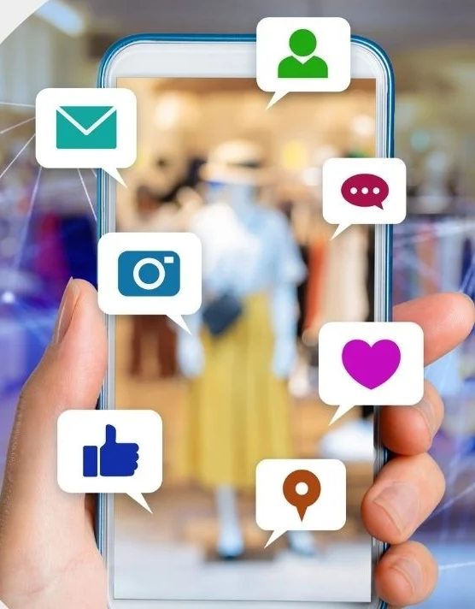
Lecture
06
Preventing Social Media Risk
3) Social media crisis and communication plan
A robust قوية social media crisis and communication plan must be developed in the event that a crisis occurs. There has to be a single point of contact, usually the communications team, for all communication with the media and stakeholders. Key department personnel have to be involved, especially if there is a matter that applies to that specific department.

Slide 48
Lecture
06
Conclusion
The Social Media Crisis Plan (Issues & Risks)
The Seven Functional Blocks of Social Media
How to appear transparent, visible and accessible
Managing accessibility
Managing a 24/7 information stream
Best practices in risk and crisis communication
Assessing and Managing Social Media Issues and Risks
Preventing Social Media Risk

Slide 49
Lecture
06
Recommended Reference
Wedlock, B. C. (2012, May). (dissertation). The diffusion of social media in public relations: Use of social media in crisis response strategies. ProQuest. Retrieved May 2023, from https://www.researchgate.net/publication/295547824_The_Diffusion_of_Social_Media_in_Public_Relations_Use_of_Social_Media_In_Crisis_Response_Strategies.
Eismann, K., Posegga, O., & Fischbach, K. (2021). Opening organizational learning in crisis management: On the affordances of Social Media. The Journal of Strategic Information Systems, 30(4), 101692. https://doi.org/10.1016/j.jsis.2021.101692
Social Media Rewards and Risk. ISACA. (n.d.). https://www.isaca.org/resources/isaca-journal/issues/2017/volume-4/social-media-rewards-and-risk
Chia. (2023, January 7). Social Media Monitoring - best tools &amp; proven tactics: Brand24. Brand24 Blog. https://brand24.com/blog/social-media-monitoring/
Lauron, S. (2023, July 5). 5 expert tips for effective social media risk management. Social Media Marketing &amp; Management Dashboard. https://blog.hootsuite.com/social-media-risk-management/

Slide 50


Thank You

